Slide 1
Home
Describing the specific details and textures implicit in real-world hydro-climatic data sets is paramount for the proper description and simulation of variables such as precipitation, streamflow, and temperature time series. To this aim, a couple of decades ago, a deterministic geometric approach, the so-called fractal-multifractal (FM) method was introduced. Such is a holistic approach capable of faithfully encoding (describing), simulating, and downscaling hydrologic records in time, as the outcome of a fractal function illuminated by a multifractal measure. This study employs the FM method to generate ensembles of daily precipitation and temperature sets obtained from global circulation models (GCMs). Specifically, this study uses data obtained via ten GCM models, two sets of daily records, as implied from the past, over a year, and three sets projected for the future, as downscaled via localized constructed analogs (LOCA) for a couple of sites in California. The study demonstrates that faithful representations of all sets may be achieved via the FM approach, using encodings relying on 10 and 8 geometric (FM) parameters for rainfall and temperature, respectively. They result in close approximations of the data's histogram, entropy, and autocorrelation functions. By presenting a sensitivity study of FM parameters' for historical and projected data, this work concludes that the FM representations are useful for tracking and foreseeing the records' complexity in the past and the future and other applications in hydrology such as bias correction.
Press to explore

Slide 2
Content
Introduction
The Fractal-Multifractal method
Methodology
Temperature Encoding
Precipitation Encoding
Comparative Assessment
Concluding Remarks

Slide 3
Introduction
Introduction
Introduction
Promising applications of the geometric approach in hydrology such as encoding, downscaling, prediction and classifications
Hypothesis: Could the geometric approach be useful in representing evolution of climate variables from GCMs used in climate studies?
Primary goal of this work is to describe (encode) the climate variables (temperature and precipitation) via the deterministic geometric approach
The Fractal-Multifractal Method
Methodology
Temperature Encoding
Precipitation Encoding
Comparative Assessment
Concluding Remarks

Slide 4
The Fractal-Multifractal Method
The Fractal-Multifractal Method
Introduction
A geometric deterministic notion introduced by Puente (1996)
It produces a vast class of interesting patterns by transforming multifractal measures into derived measures through fractal functions
The calculations are done iterating simple maps and require a small number of parameters
The method aims at preserving actual shapes and hence, if successful, it also captures statistical and multifractal properties as found in natural data sets
The Fractal-Multifractal Method
Methodology
Temperature Encoding
Precipitation Encoding
Comparative Assessment
Concluding Remarks

Slide 5
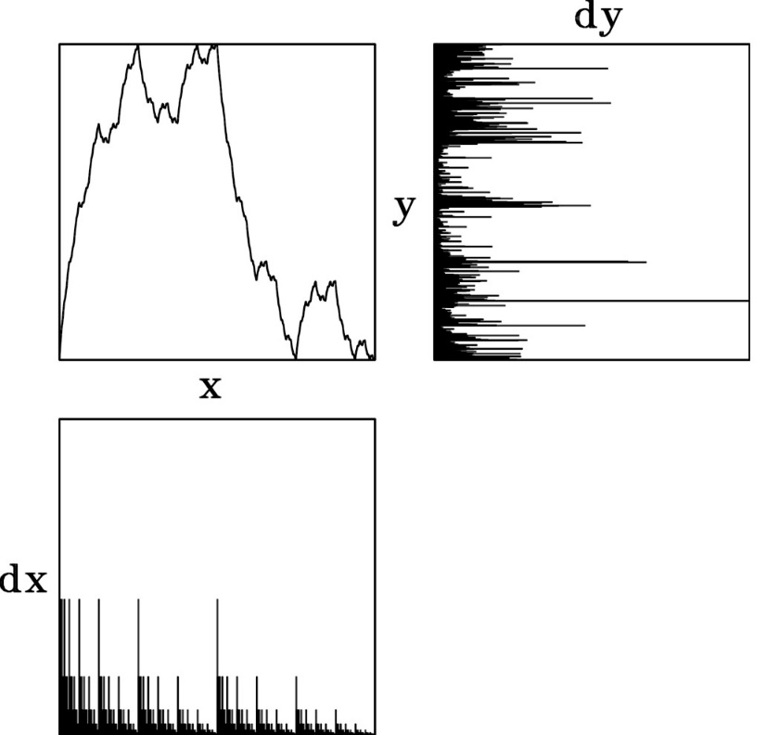
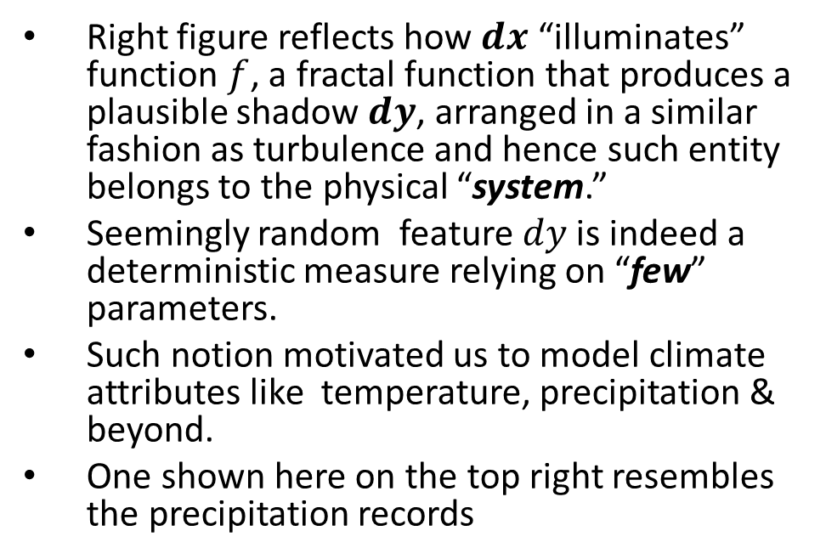
The Fractal-Multifractal Method
The Fractal-Multifractal Method
Introduction
Right figure reflects how $dx$ “illuminates” function $f$, a fractal function that produces a plausible shadow $dy$, arranged in a similar fashion as turbulence and hence such entity belongs to the physical “system.”
Seemingly random feature $dy$ is indeed a deterministic measure relying on “few” parameters.
Such notion motivated us to model climate attributes like temperature, precipitation & beyond.
One shown here on the top right resembles the precipitation records
The Fractal-Multifractal Method
Methodology
Temperature Encoding
Precipitation Encoding
Comparative Assessment
Concluding Remarks

Slide 6
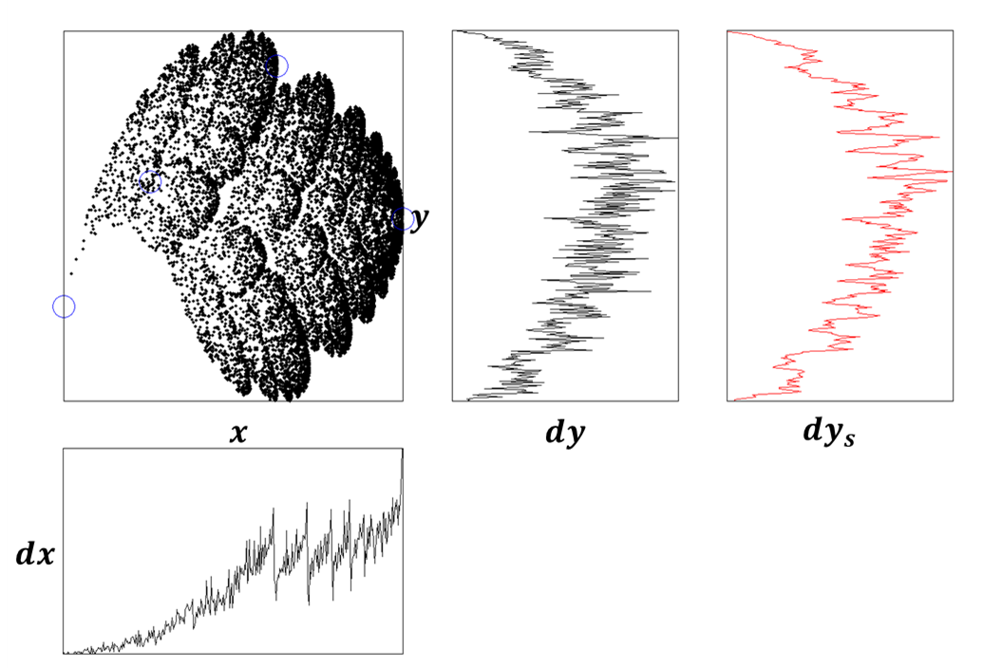
The Fractal-Multifractal Method
The Fractal-Multifractal Method
Introduction
There exist a variant of the FM notion that produces a leafy (cloud like) attractor, instead of a function, defined by end points.
And yet produces interesting pattern like temperature and others.
The smoother version (red) resembles air temperature set either recorded or modeled.
The Fractal-Multifractal Method
Methodology
Temperature Encoding
Precipitation Encoding
Comparative Assessment
Concluding Remarks

Slide 7
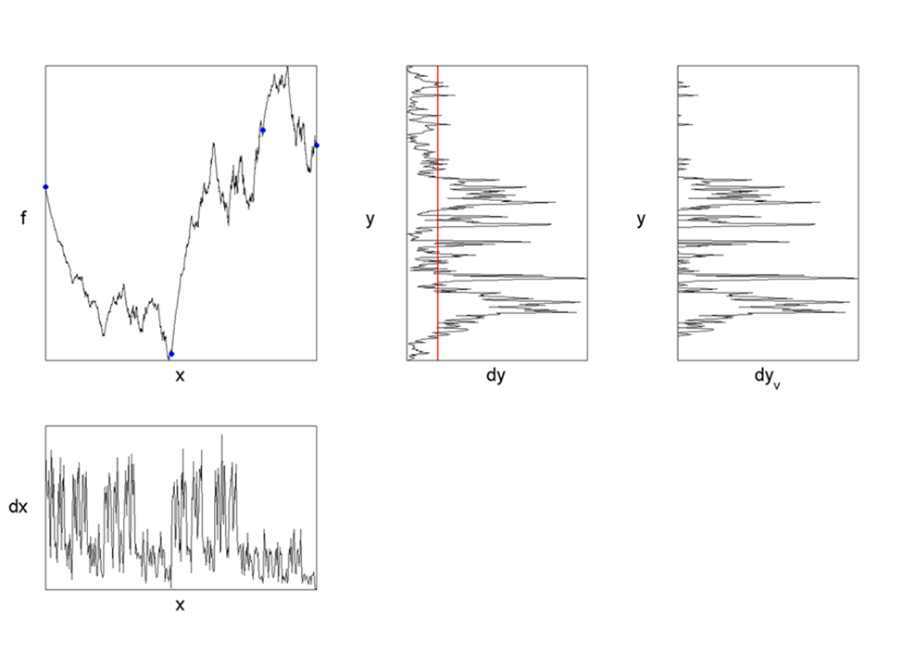
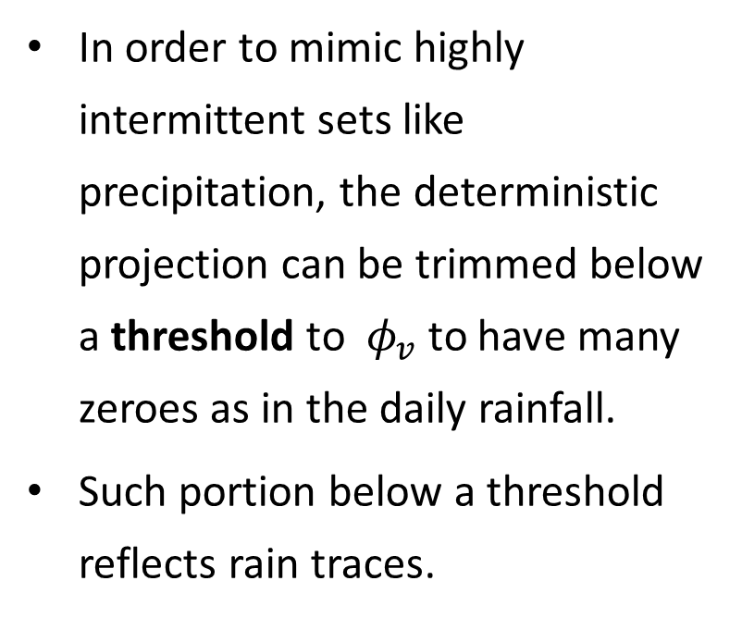
Methodology
Methodology
Introduction
In order to mimic highly intermittent sets like precipitation, the deterministic projection can be trimmed below a threshold to $φ_{v}$to have many zeroes as in the daily rainfall.
Such portion below a threshold reflects rain traces.
The Fractal-Multifractal Method
Methodology
Temperature Encoding
Precipitation Encoding
Comparative Assessment
Concluding Remarks

Slide 8
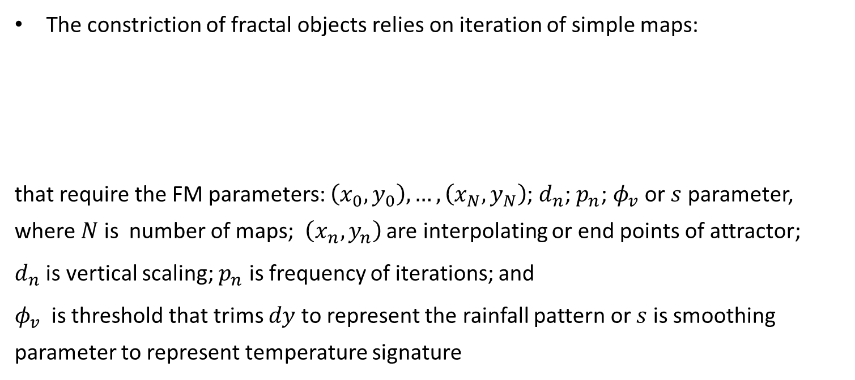

Methodology
Methodology
Introduction
The constriction of fractal objects relies on iteration of simple maps:
that require the FM parameters: $\left(x_{0},y_{0}\right),…,\left(x_{N},y_{N}\right)$; $d_{n}$; $p_{n}$; $φ_{v}$or $s$ parameter, where $N$ is number of maps; $\left(x_{n},y_{n}\right)$ are interpolating or end points of attractor;
$d_{n}$ is vertical scaling; $p_{n}$ is frequency of iterations; and
$φ_{v}$ is threshold that trims $dy$ to represent the rainfall pattern or $s$ is smoothing parameter to represent temperature signature
The Fractal-Multifractal Method
      $w_{n}\left(\begin{matrix}x \\ y\end{matrix}\right)=\left(\begin{matrix}a_{n} & 0 \\ c_{n} & d_{n}\end{matrix}\right)\left(\begin{matrix}x \\ y\end{matrix}\right)+\left(\begin{matrix}e_{n} \\ f_{n}\end{matrix}\right)$
      subject to
  $w_{n}\left(\begin{matrix}x_{0} \\ y_{0}\end{matrix}\right)=\left(\begin{matrix}x_{n−1} \\ y_{n−1}\end{matrix}\right)$; $w_{n}\left(\begin{matrix}x_{N} \\ y_{N}\end{matrix}\right)=\left(\begin{matrix}x_{n} \\ y_{n}\end{matrix}\right)$
Methodology
Temperature Encoding
Precipitation Encoding
Comparative Assessment
Concluding Remarks

Slide 9
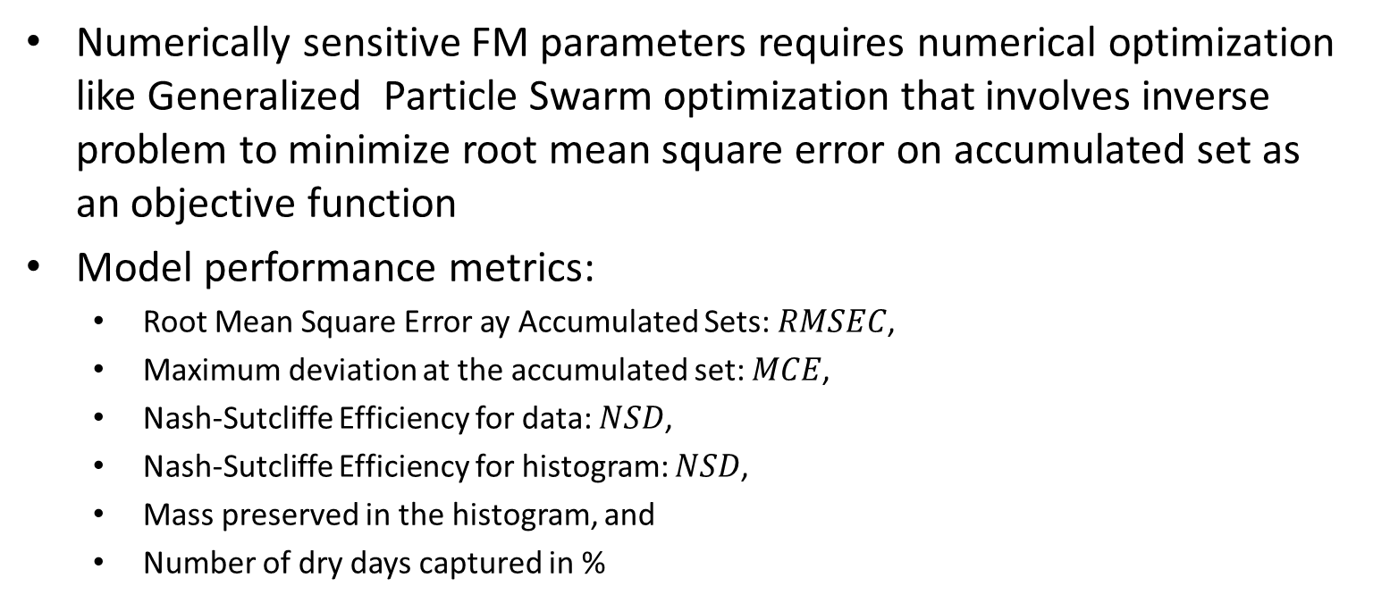
Methodology
Methodology
Introduction
Numerically sensitive FM parameters requires numerical optimization like Generalized Particle Swarm optimization that involves inverse problem to minimize root mean square error on accumulated set as an objective function
Model performance metrics:
  Root Mean Square Error ay Accumulated Sets: $RMSEC$,
  Maximum deviation at the accumulated set: $MCE$,
  Nash-Sutcliffe Efficiency for data: $NSD$,
  Nash-Sutcliffe Efficiency for histogram: $NSD$,
  Mass preserved in the histogram, and
  Number of dry days captured in %
The Fractal-Multifractal Method
Methodology
Temperature Encoding
Precipitation Encoding
Comparative Assessment
Concluding Remarks

Slide 10
Methodology
Methodology
Introduction
Three locations within the Central Valley of California: Shasta Dam, Sacramento and Merced
Two years of historical data sets 1975 and 2005, and three projected sets: years 2035, 2065 and 2099
10 GCM models to determine both historical and future sets, as suggested by the California Department of Water Resources
Optimization of the FM parameters for a given GCM followed by the FM parameters of other GCMs based on common simplex
Data comes from localized downscaling under two carbon emission scenarios RCP4.5 and RCP8.5 that correspond to non attenuated and partially attenuated conditions
The Fractal-Multifractal Method
Methodology
Temperature Encoding
Precipitation Encoding
Comparative Assessment
Concluding Remarks

Slide 11
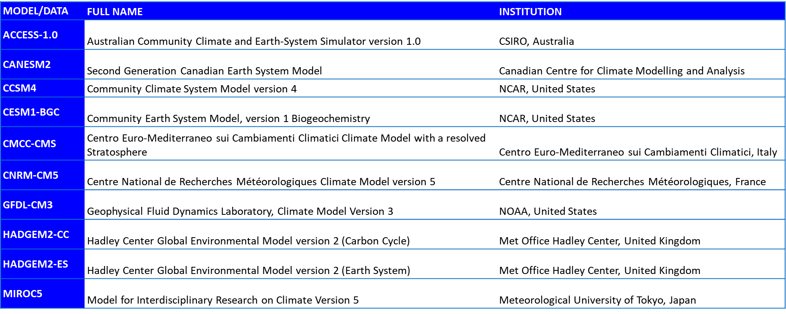
Methodology
Methodology
Introduction
Ten Global Circulation Models (GCMs)
The Fractal-Multifractal Method
Methodology
Temperature Encoding
Precipitation Encoding
Comparative Assessment
Concluding Remarks

Slide 12
Temperature
Temperature Encoding
Introduction
Shasta Dam
Sacramento
The Fractal-Multifractal Method
Methodology
Temperature Encoding
Merced
Precipitation Encoding
Comparative Assessment
Concluding Remarks
Sensitivity Analysis

Slide 13
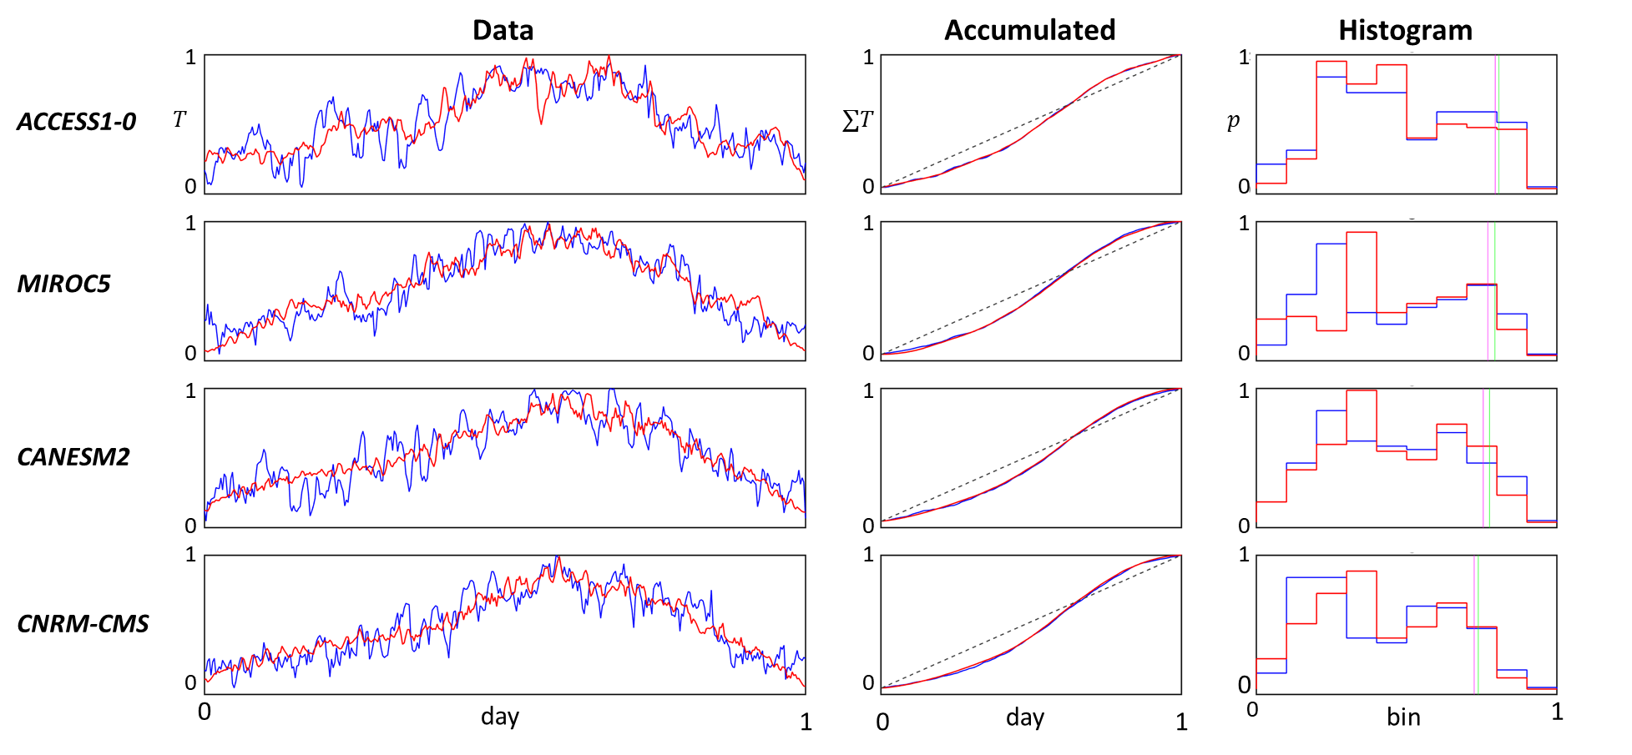
Temperature Shasta (Historical)
Temperature Shasta Dam (Historical set: 1975)
Shasta Dam
Annual maximum temperature in degrees Celsius is given in parenthesis.
(32)
Sacramento
(31)
GCM Output
RCP4.5
Metric
RMSEC <0.8%
MCE <1.7%
NSD > 67%
NSH > 80%
Merced
(33)
Sensitivity Analysis
(34)
More than 89% of mass preserved in histogram!!

Slide 14
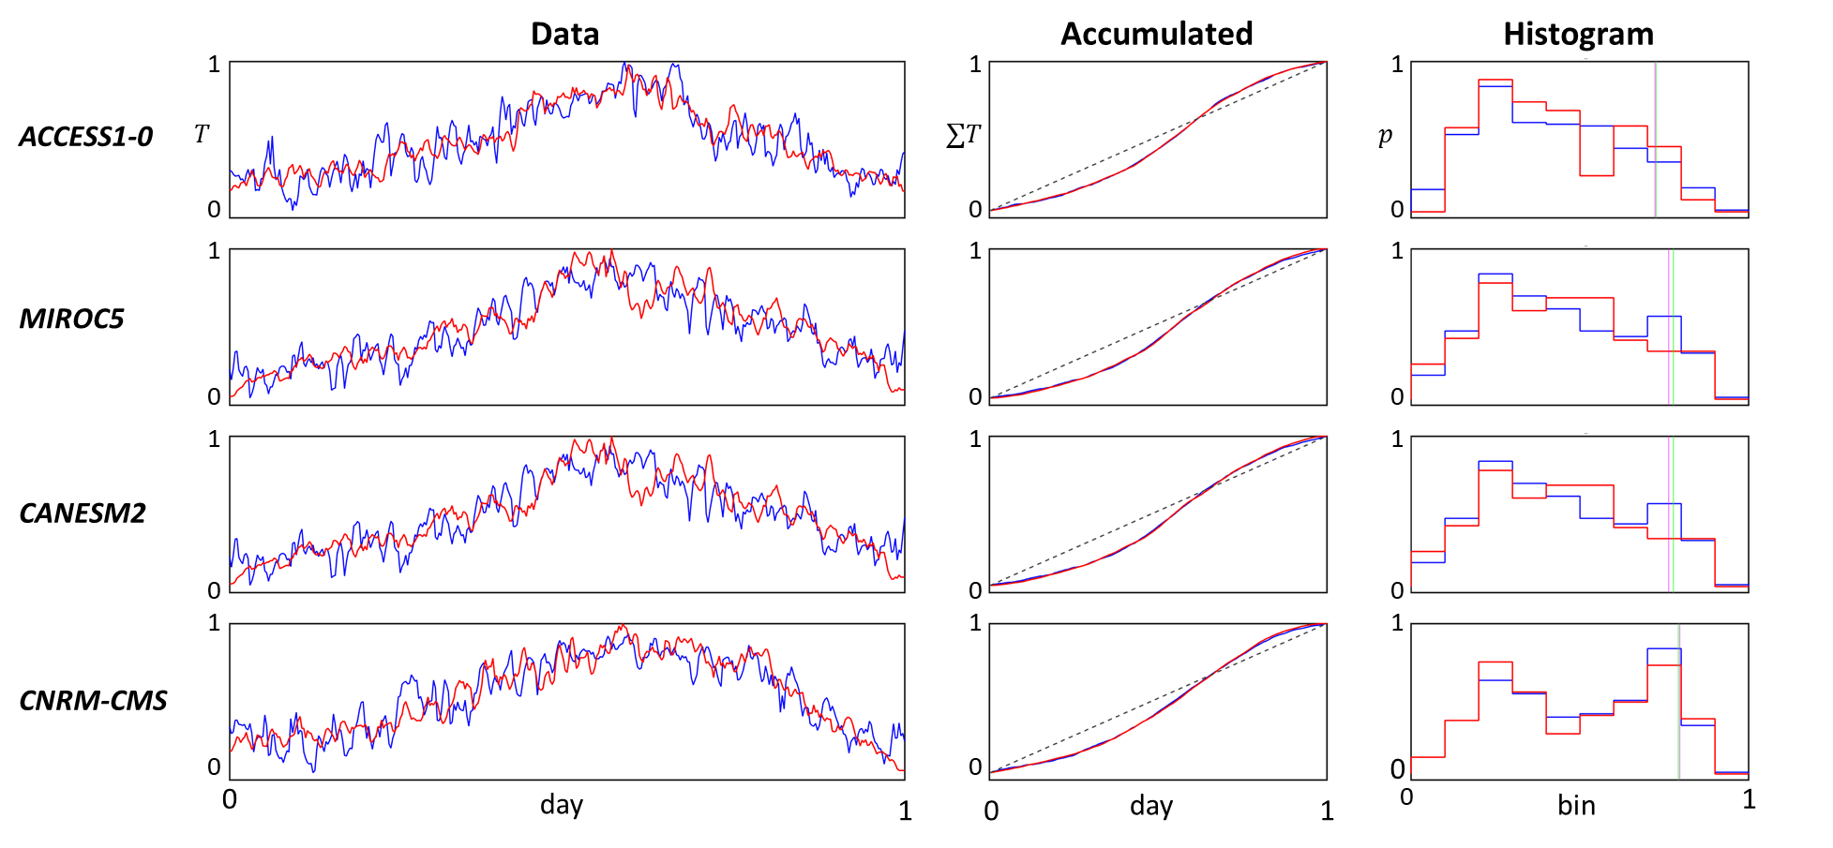
Temperature Shasta (Future)
Temperature Shasta Dam (Future set: 2065)
Shasta Dam
Annual maximum temperature in degrees Celsius is given in parenthesis.
(39)
Sacramento
(35)
GCM Output
RCP8.5
Metric
RMSEC <1.0%
MCE <2.1%
NSD > 74%
NSH ~NA
Merced
(36)
Sensitivity Analysis
(35)
More than 89% of mass preserved in histogram!!

Slide 15
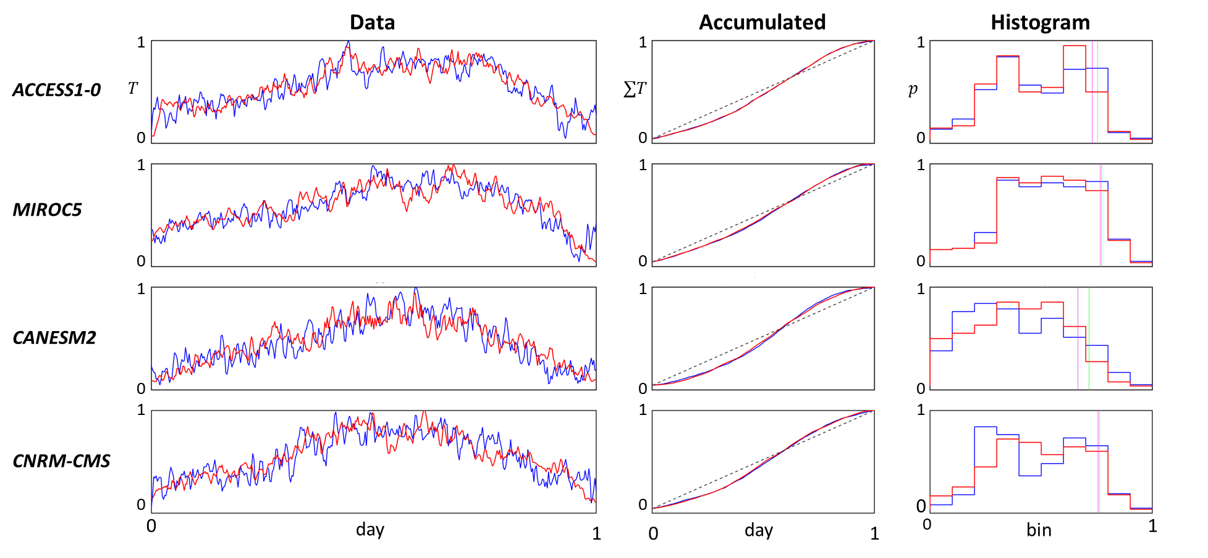
Temperature Sacramento (Historical)
Temperature Sacramento (Historical set: 2005)
Shasta Dam
Annual maximum temperature in degrees Celsius is given in parenthesis.
(32)
Sacramento
(30)
GCM Output
RCP4.5
Metric
RMSEC <1.3%
MCE <2.5%
NSD > 67%
NSH > 63%
Merced
(33)
Sensitivity Analysis
(31)
More than 91% of mass preserved in histogram!!

Slide 16
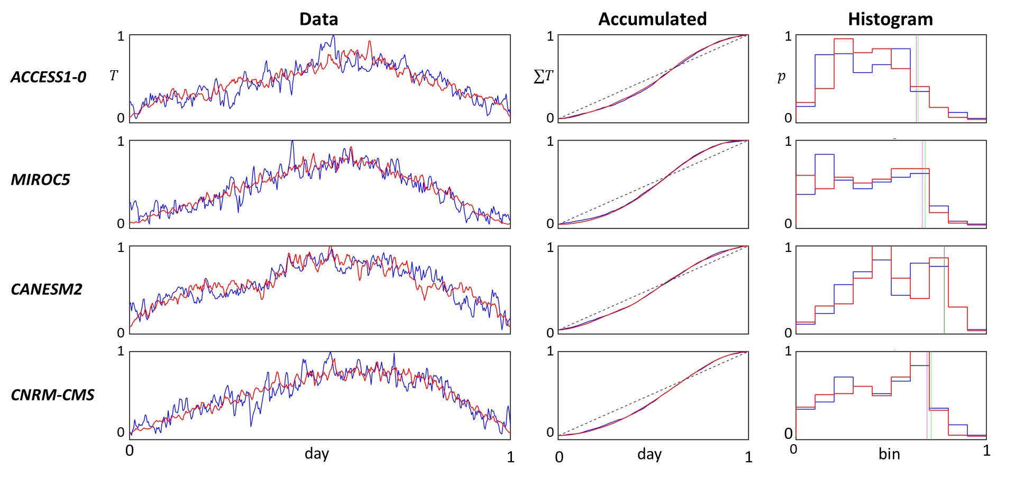
Temperature Sacramento (Future)
Temperature Sacramento (Future set: 2099)
Shasta Dam
Annual maximum temperature in degrees Celsius is given in parenthesis.
(42)
Sacramento
(38)
GCM Output
RCP8.5
Metric
RMSEC <0.7%
MCE <1.5%
NSD > 66%
NSH > 67%
Merced
(40)
Sensitivity Analysis
(37)
More than 90% of mass preserved in histogram!!

Slide 17
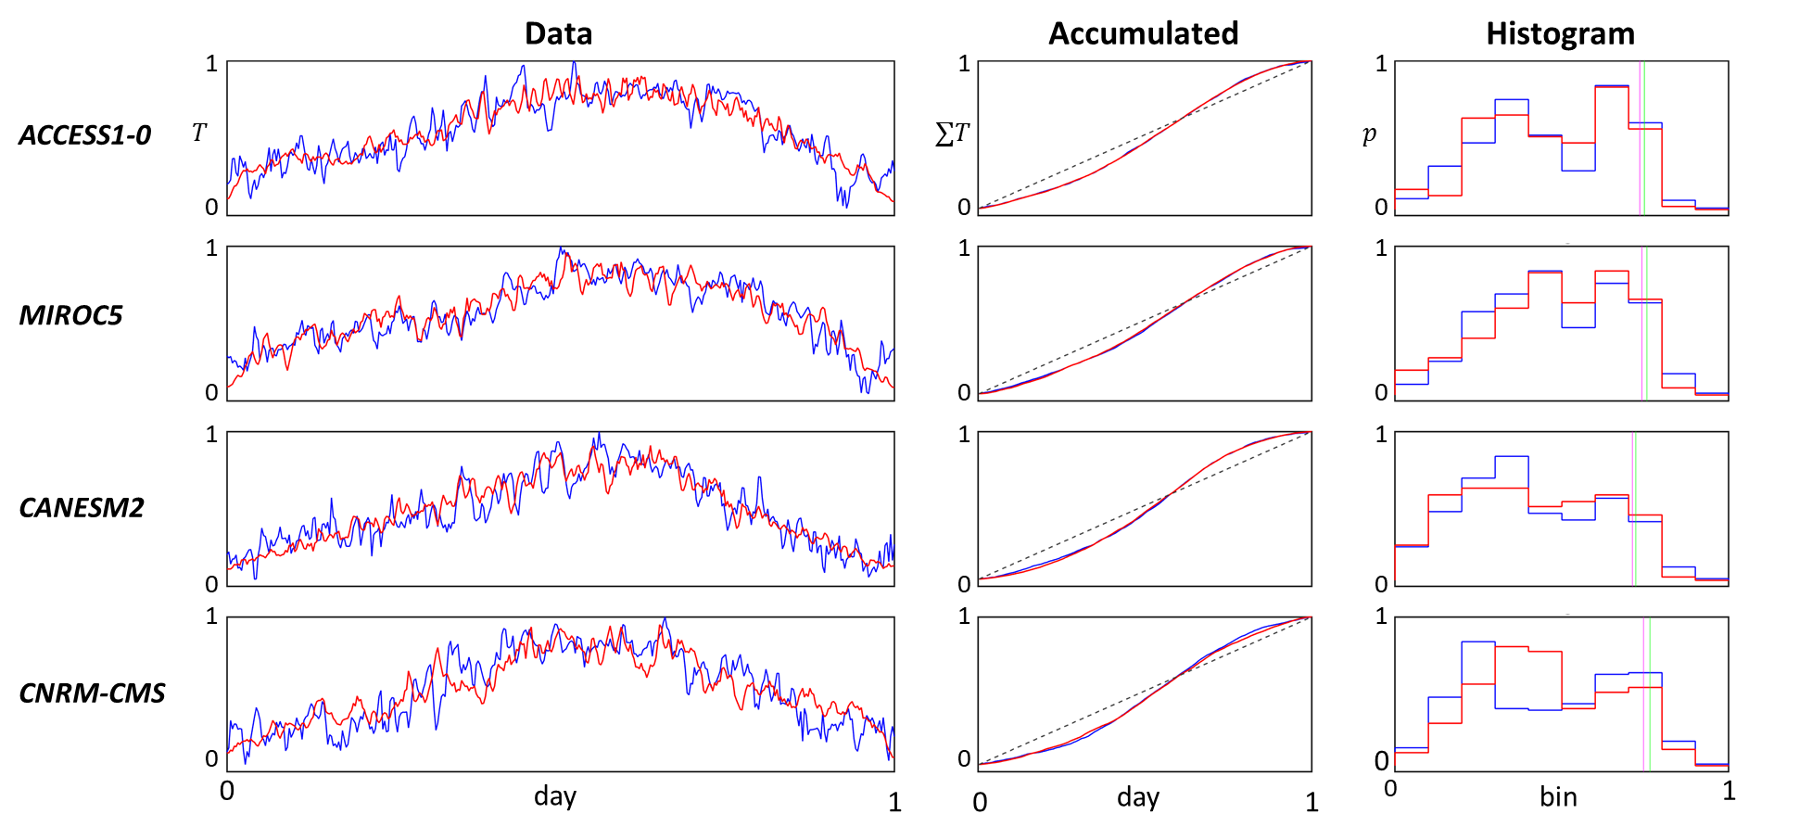
Temperature Merced (Historical)
Temperature Merced (Historical Set: 2005)
Shasta Dam
Annual maximum temperature in degrees Celsius is given in parenthesis.
(32)
Sacramento
(32)
GCM Output
RCP4.5
Metric
RMSEC <1.2%
MCE <2.6%
NSD > 71%
NSH > NA
Merced
(34)
Sensitivity Analysis
(31)
More than 90% of mass preserved in histogram!!

Slide 18
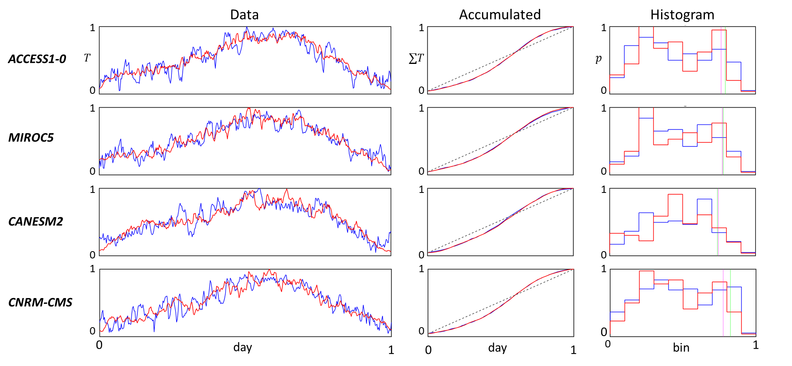
Temperature Merced (Future)
Temperature Merced (Future Set: 2035)
Shasta Dam
Annual maximum temperature in degrees Celsius is given in parenthesis.
(33)
Sacramento
(31)
GCM Output
RCP4.5
Metric
RMSEC <0.6%
MCE <1.2%
NSD > 72%
NSH > NA
Merced
(35)
Sensitivity Analysis
(32)
More than 90% of mass preserved in histogram!!

Slide 19
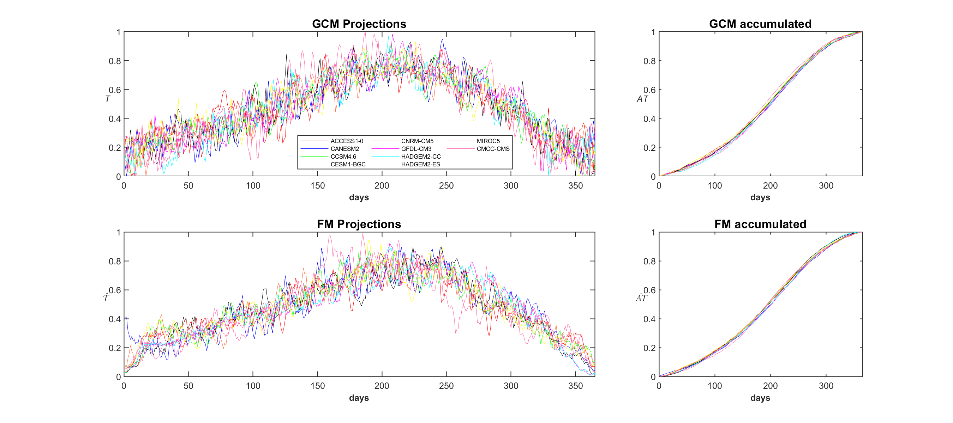
Sensitivity Analysis (Temperature)
Temperature Sensitivity Analysis (Merced: 1975, RCP4.5)
Shasta Dam
Ensemble of normalized temperatures are more variable than parameter variability even though they are themselves intricate
Sacramento
Merced
Sensitivity Analysis

Slide 20
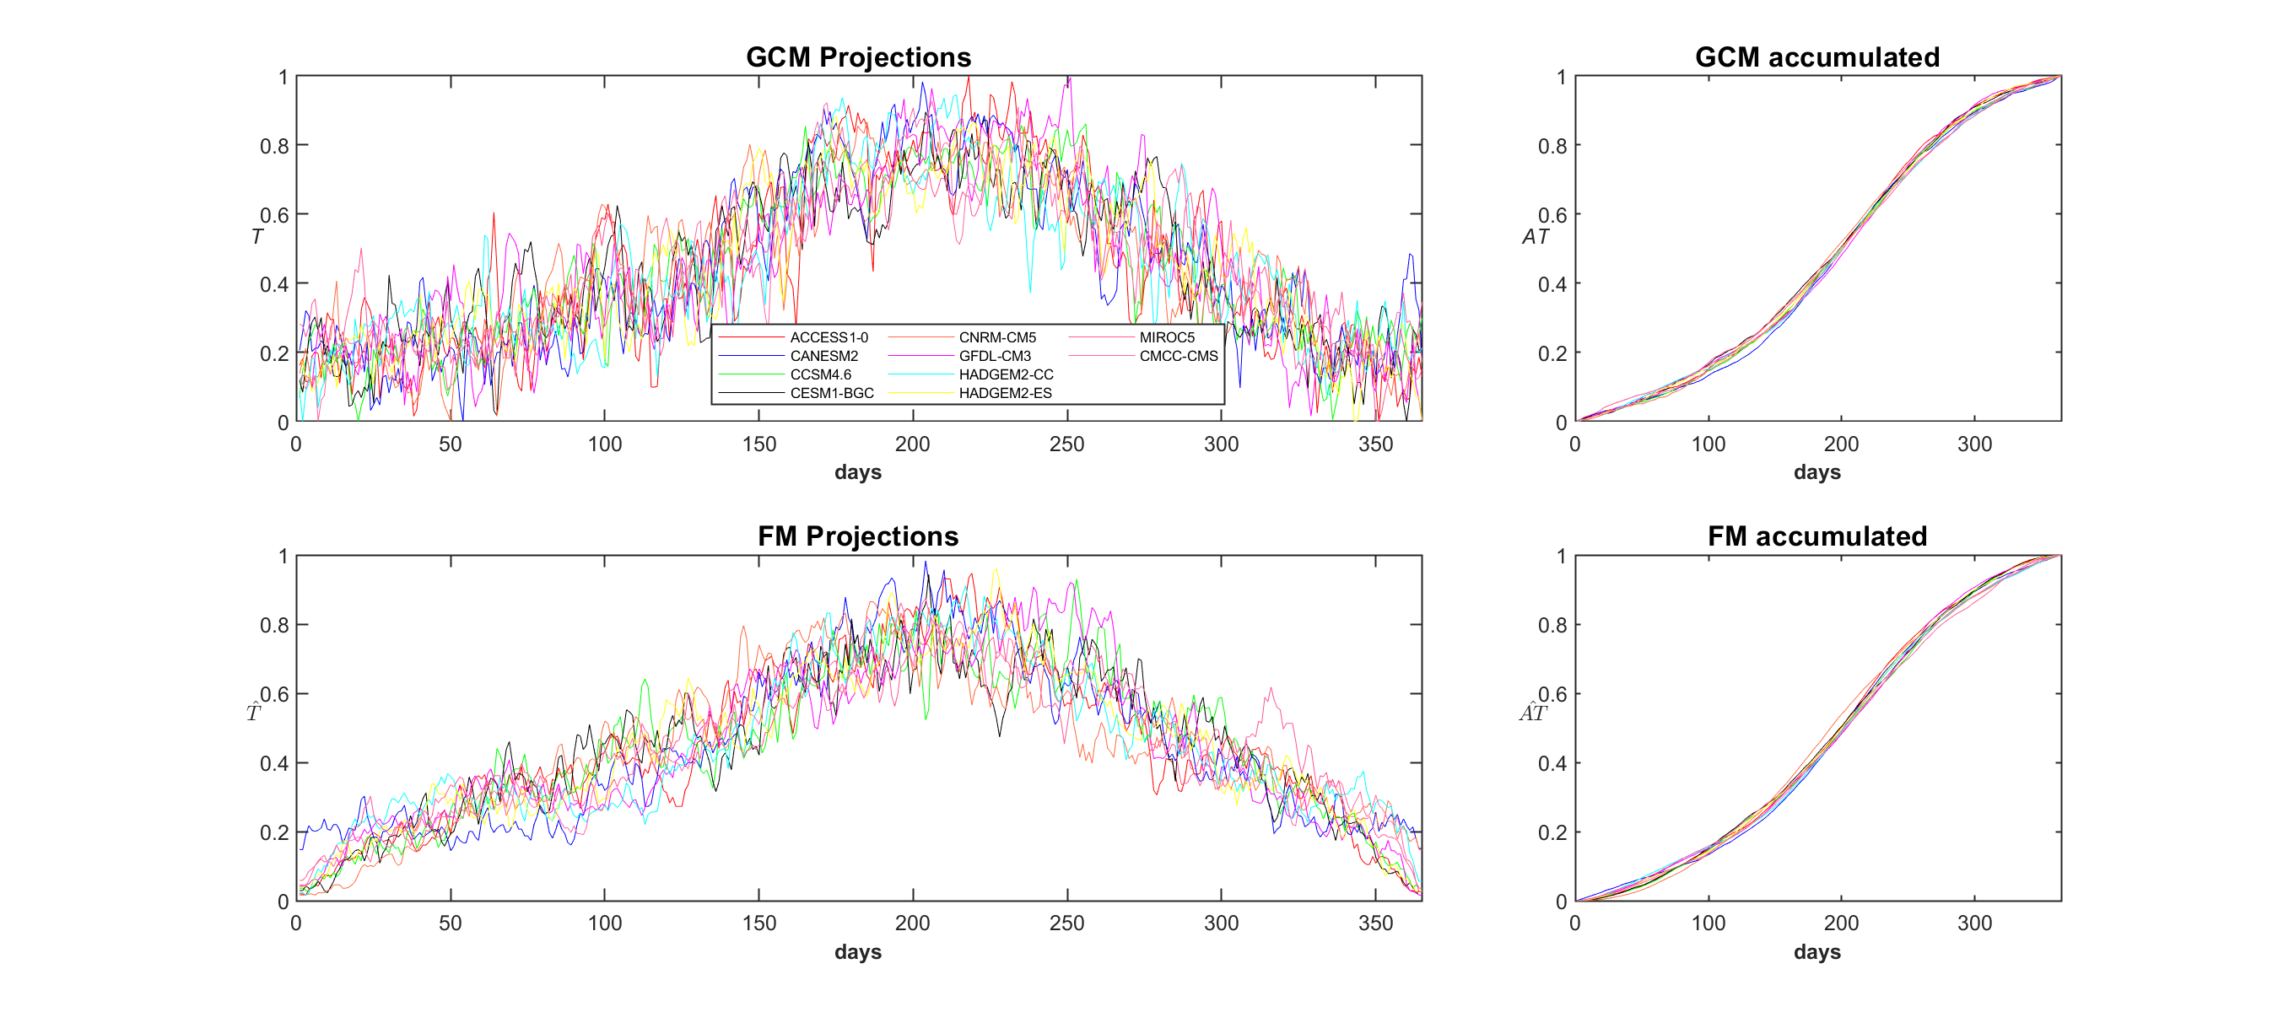
Sensitivity Analysis (Temperature)
Temperature Sensitivity Analysis (Shasta: 2035, RCP8.5)
Shasta Dam
Ensemble of normalized temperatures are more variable than parameter variability even though they are themselves intricate
Sacramento
Merced
Sensitivity Analysis

Slide 21
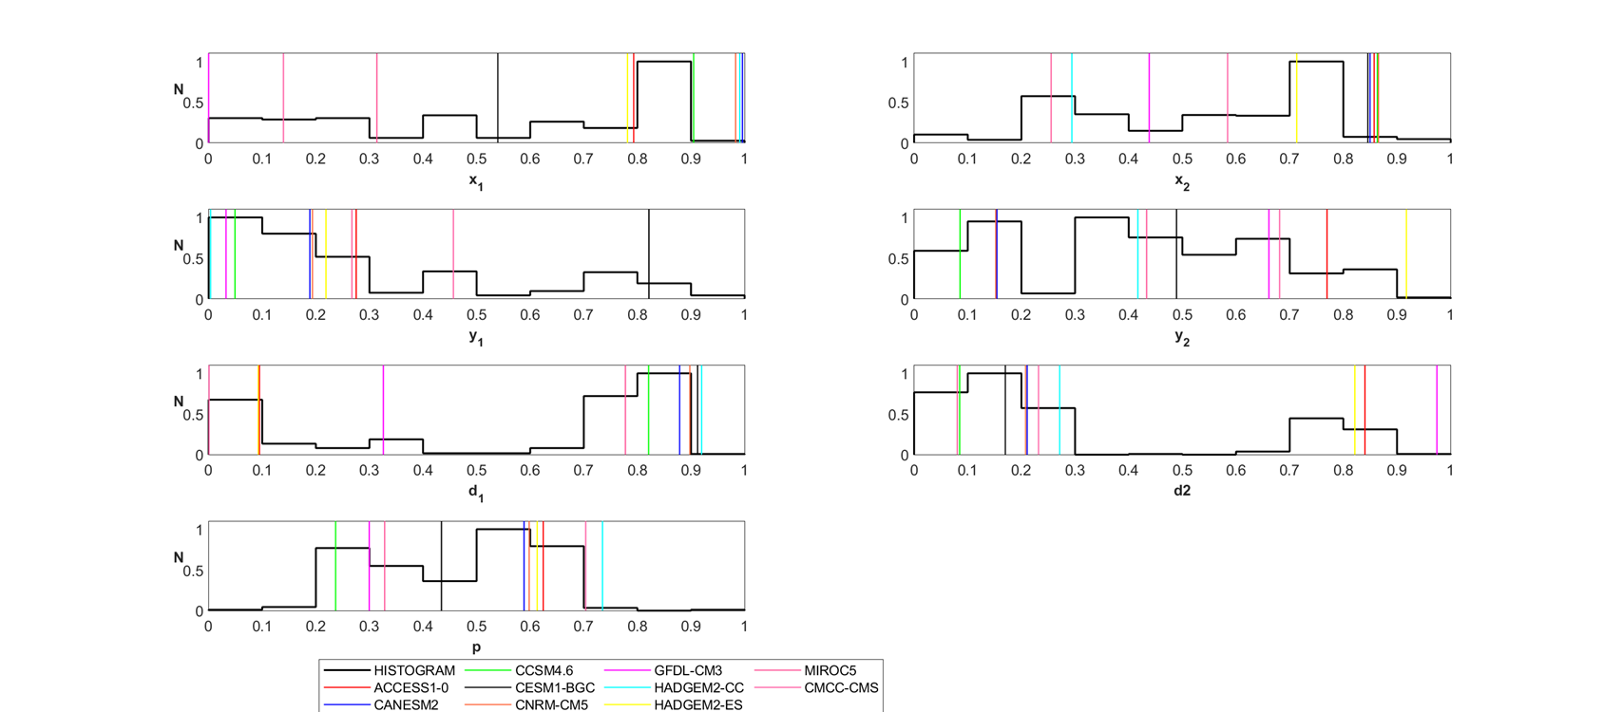
Sensitivity Analysis (Temperature)
Temperature Sensitivity Analysis (Merced: 2005, RCP4.5)
Shasta Dam
Vertical bars correspond to best FM parameters for each GCM. Despite smoothness of records, the parameter space is highly variable.
Sacramento
Merced
Sensitivity Analysis

Slide 22
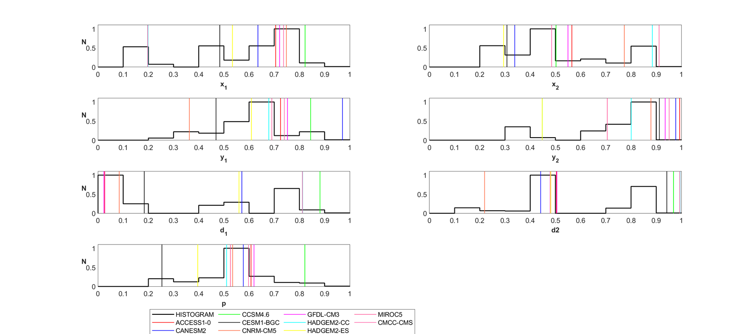
Sensitivity Analysis (Temperature)
Temperature Sensitivity Analysis (Shasta: 2065, RCP8.5)
Shasta Dam
Vertical bars correspond to best FM parameters for each GCM. Despite smoothness of records, the parameter space is highly variable.
Sacramento
Merced
Sensitivity Analysis

Slide 23
Precipitation
Precipitation Encoding
Introduction
Shasta Dam
Sacramento
The Fractal-Multifractal Method
Methodology
Temperature Encoding
Merced
Precipitation Encoding
Comparative Assessment
Concluding Remarks
Sensitivity Analysis

Slide 24
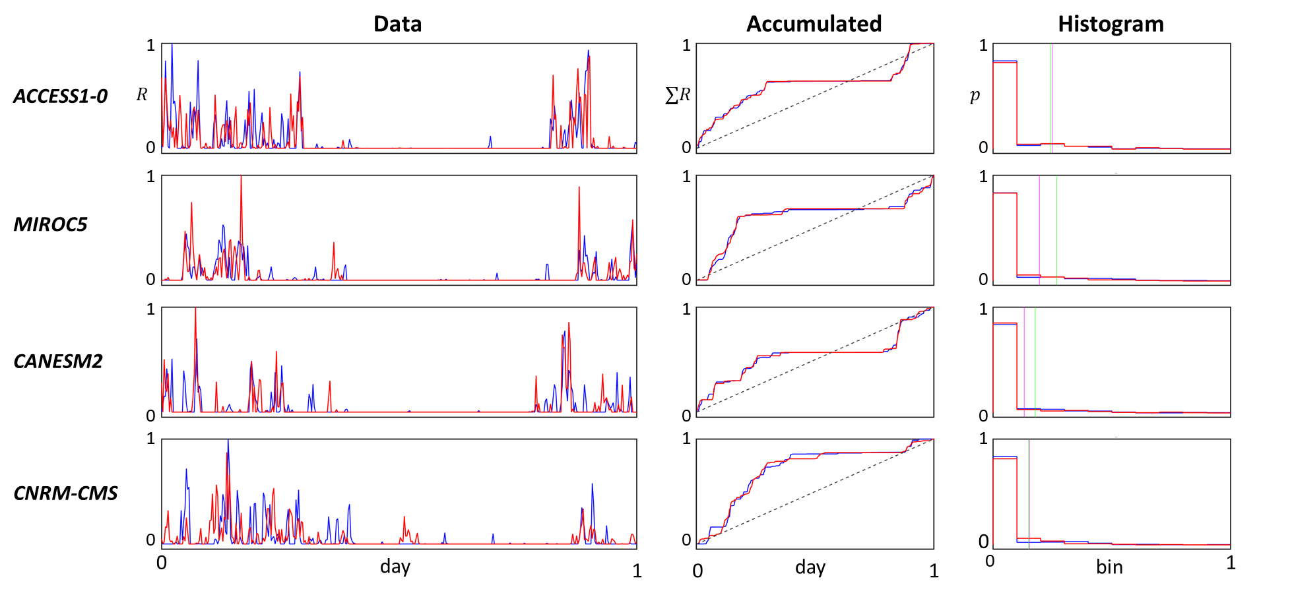
Precipitation Shasta (Future)
Precipitation Shasta Dam (Historical Set: 2005)
Shasta Dam
Annual total rainfall in millimeters is given in parenthesis.
(1480)
Sacramento
(1088)
GCM Output
RCP8.5
Metric
RMSEC <2.1%
MCE <6.5%
NSH > 99%
Merced
(2180)
Sensitivity Analysis
(1394)
Overall geometry of sets is preserved, more than 87% of dry days are accurate.

Slide 25
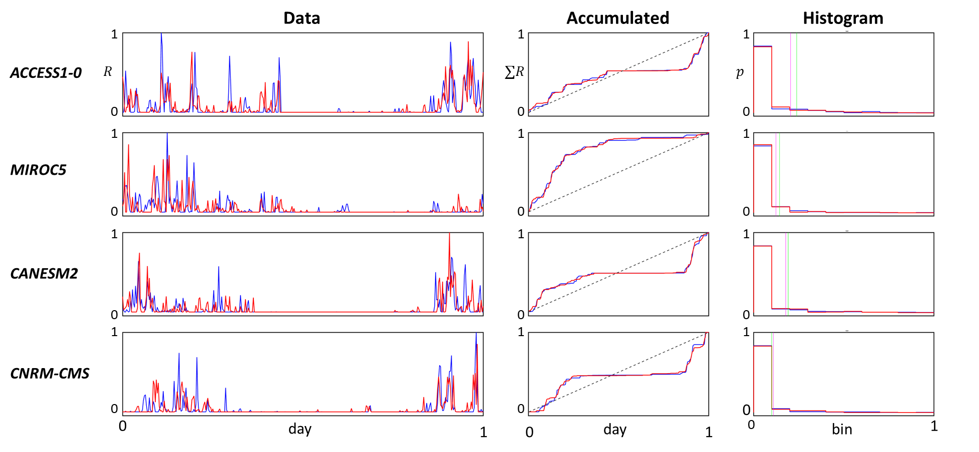
Precipitation Shasta (Future)
Precipitation Shasta Dam (Future Set: 2065)
Shasta Dam
Annual total rainfall in millimeters is given in parenthesis.
(1897)
Sacramento
(1741)
GCM Output
RCP8.5
Metric
RMSEC <2.8%
MCE <8.1%
NSH > 98.4%
Merced
(2151)
Sensitivity Analysis
(1471)
More than 70% of dry days are preserved!!

Slide 26
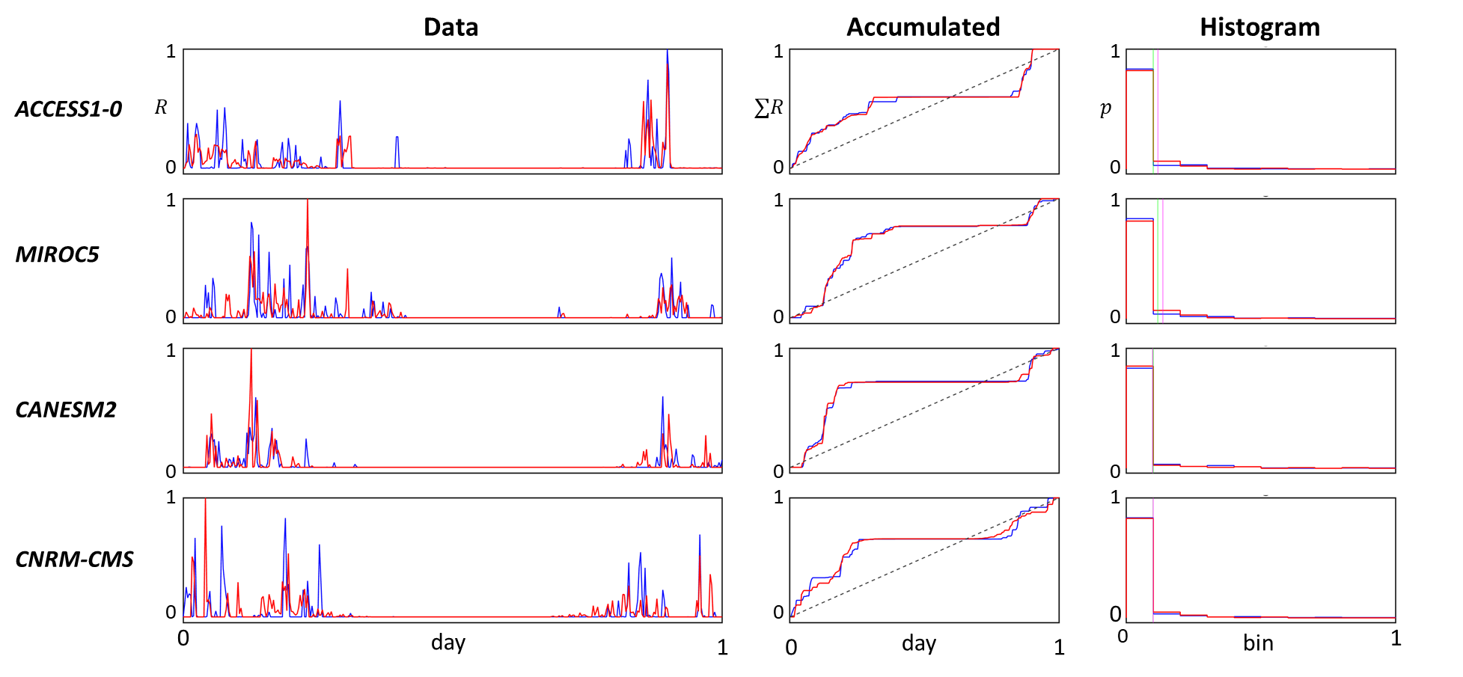
Precipitation Sacramento (historical)
Precipitation Sacramento (Historical Set: 2005)
Shasta Dam
Annual total rainfall in millimeters is given in parenthesis.
(639)
Sacramento
(298)
GCM Output
RCP8.5
Metric
RMSEC <1.9%
MCE <8.0%
NSH > 99%
Merced
(697)
Sensitivity Analysis
(465)
More than 72% of dry days are preserved!!

Slide 27
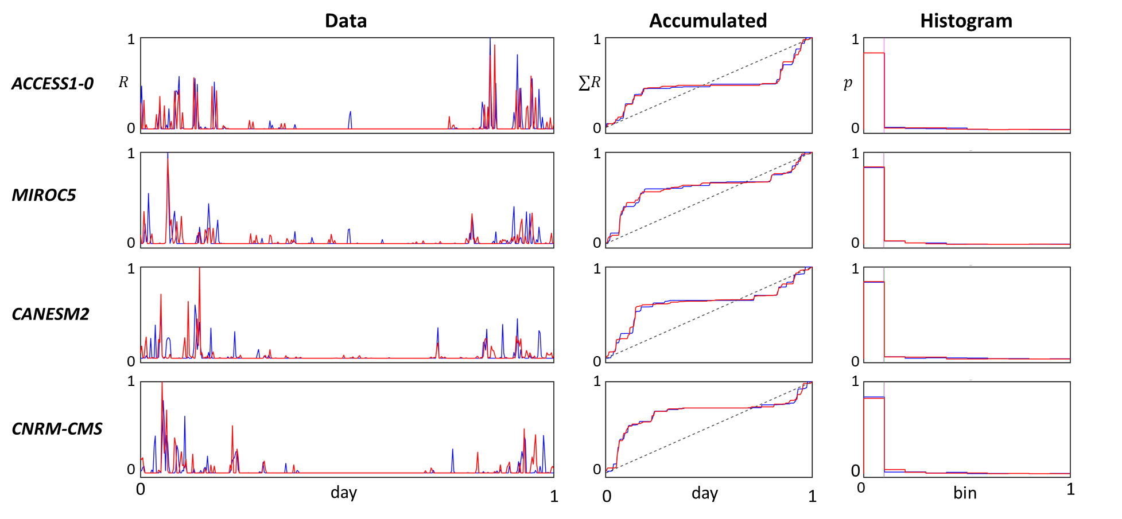
Precipitation Sacramento (Future)
Precipitation Sacramento (Future Set: 2035)
Shasta Dam
Annual total rainfall in millimeters is given in parenthesis.
(291)
Sacramento
(506)
GCM Output
RCP8.5
Metric
RMSEC <2.6%
MCE <7.8%
NSH > 99%
Merced
(230)
Sensitivity Analysis
(577)
More than 84% of dry days are preserved!!

Slide 28
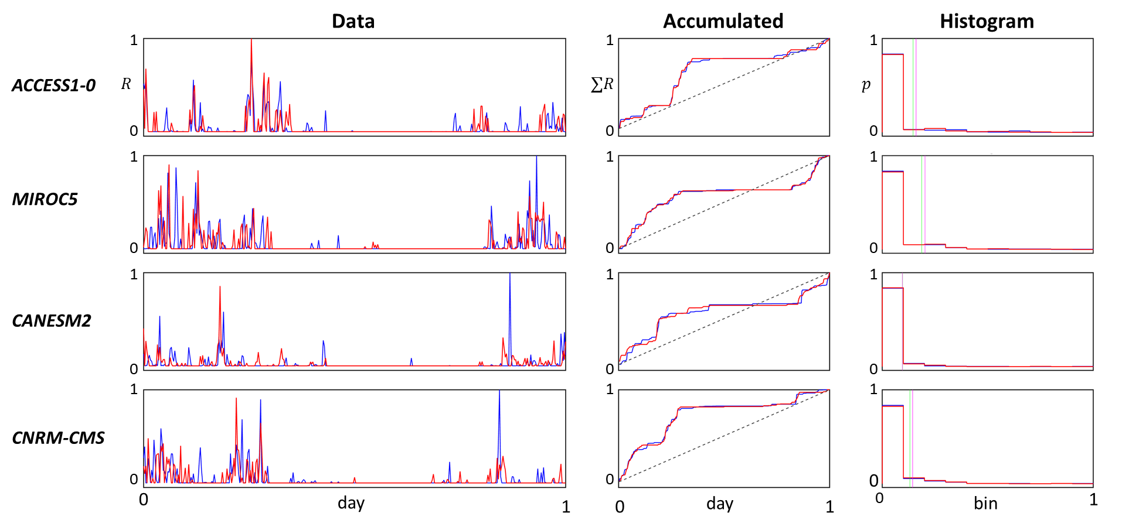
Precipitation Merced (Historical)
Precipitation Merced (Historical Set: 1975)
Shasta Dam
Annual total rainfall in millimeters is given in parenthesis.
(295)
Sacramento
(420)
GCM Output
RCP4.5
Metric
RMSEC <3%
MCE <8.9%
NSH > 97%
Merced
(206)
Sensitivity Analysis
(405)
More than 90% of dry days are preserved!!

Slide 29
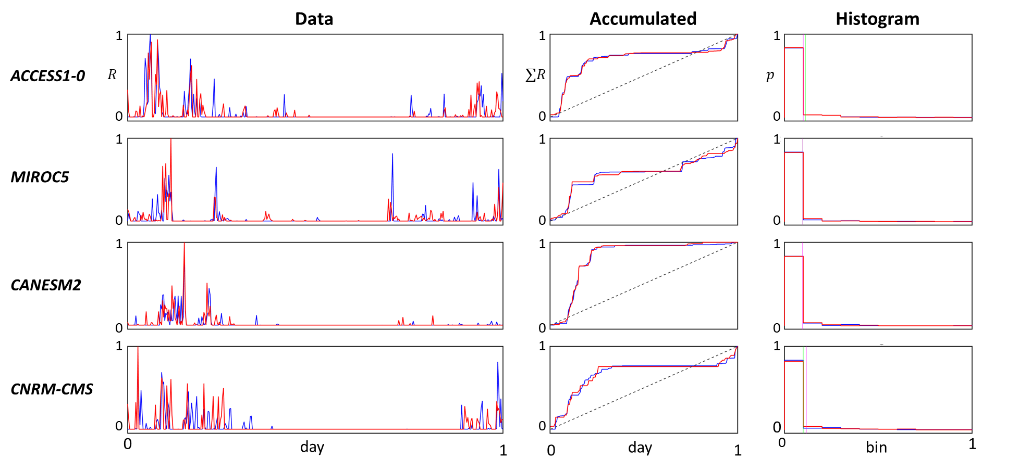
Precipitation Merced (Future)
Precipitation Merced (Future Set: 2099)
Shasta Dam
Annual total rainfall in millimeters is given in parenthesis.
(313)
Sacramento
(341)
GCM Output
RCP4.5
Metric
RMSEC <2.8%
MCE <9.1%
NSH > 99%
Merced
(248)
Sensitivity Analysis
(218)
More than 87% of dry days are preserved!!

Slide 30
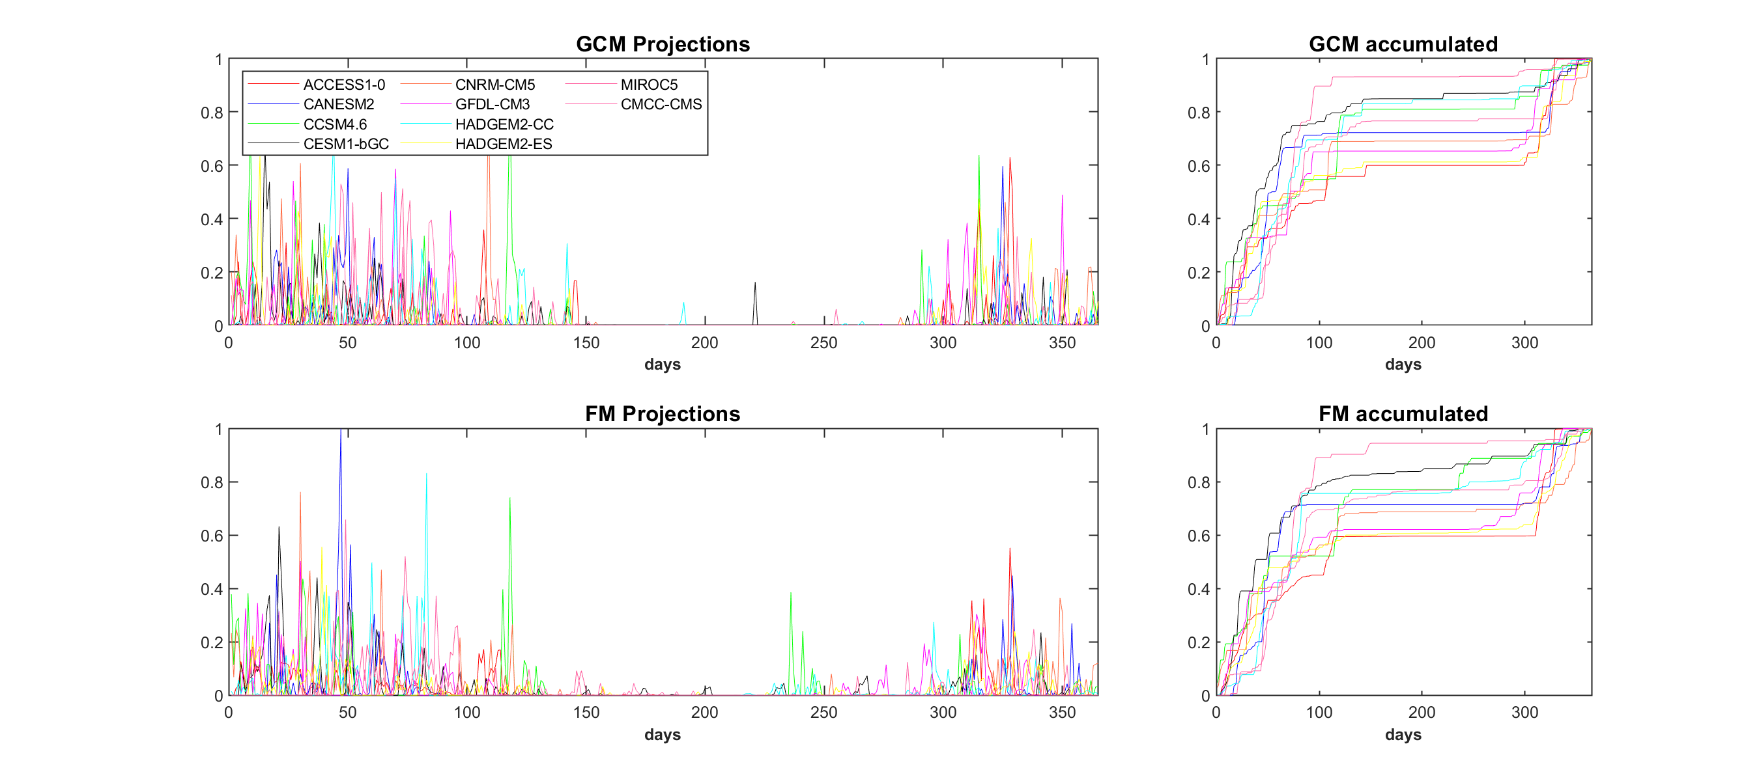
Sensitivity analysis
Precipitation Sensitivity Analysis (Sacramento: 2005, RCP8.5)
Shasta Dam
Ensembles of normalized rainfall are highly variable as their FM parameters.
Similar results under RCP4.5
Sacramento
Merced
Sensitivity Analysis

Slide 31
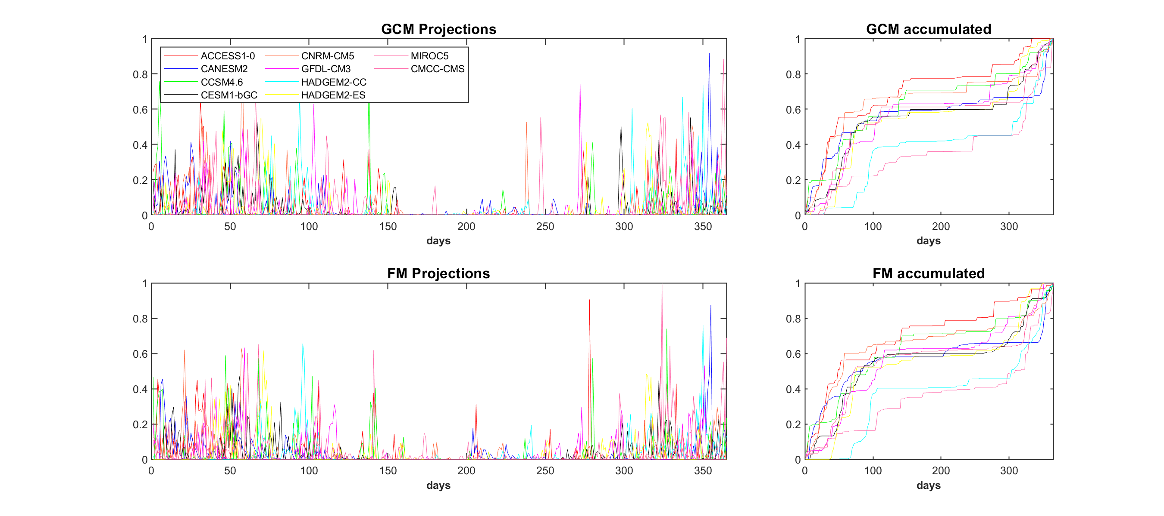
Sensitivity analysis
Precipitation Sensitivity Analysis (Shasta: 2065, RCP8.5)
Shasta Dam
Ensembles of normalized rainfall are highly variable as their FM parameters.
Similar results under RCP4.5
Sacramento
Merced
Sensitivity Analysis

Slide 32
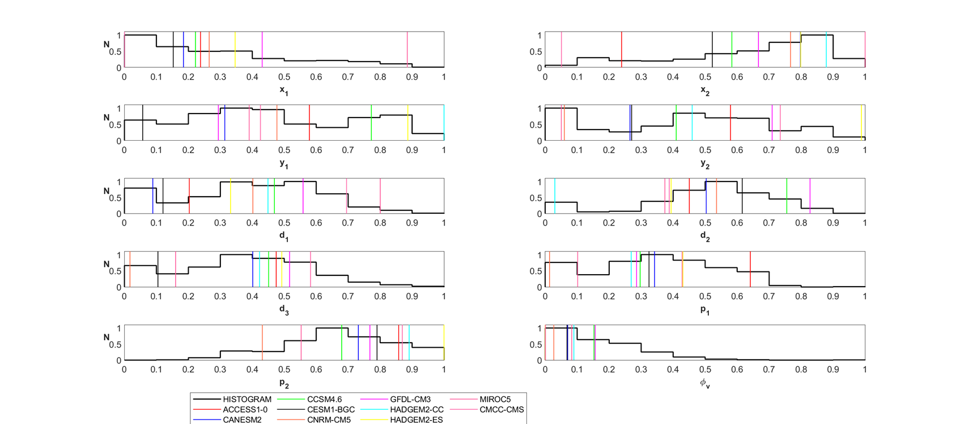
Sensitivity analysis
Sensitivity Analysis (Merced: 2099, RCP8.5)
Shasta Dam
Vertical bars correspond to best FM parameters for each GCM. There is more variability in rainfall compared to temperature. Similar results for RCP4.5
Sacramento
Merced
Sensitivity Analysis

Slide 33
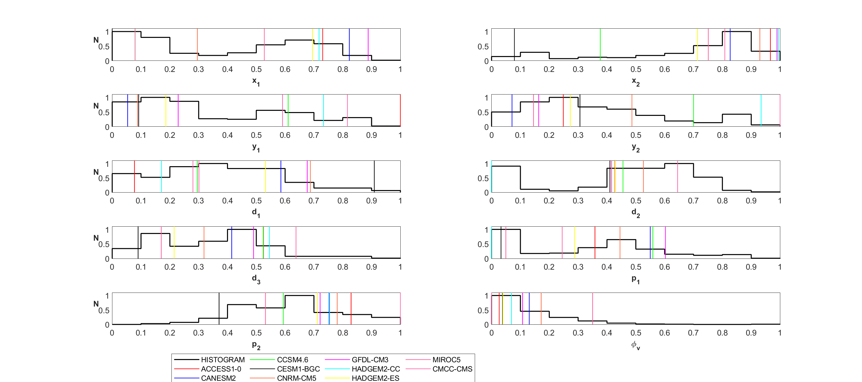
Sensitivity Analysis
Precipitation Sensitivity Analysis (Shasta: 2005, RCP8.5)
Shasta Dam
Vertical bars correspond to best FM parameters for each GCM. There is more variability in rainfall compared to temperature. Similar results for RCP4.5
Sacramento
Merced
Sensitivity Analysis

Slide 34
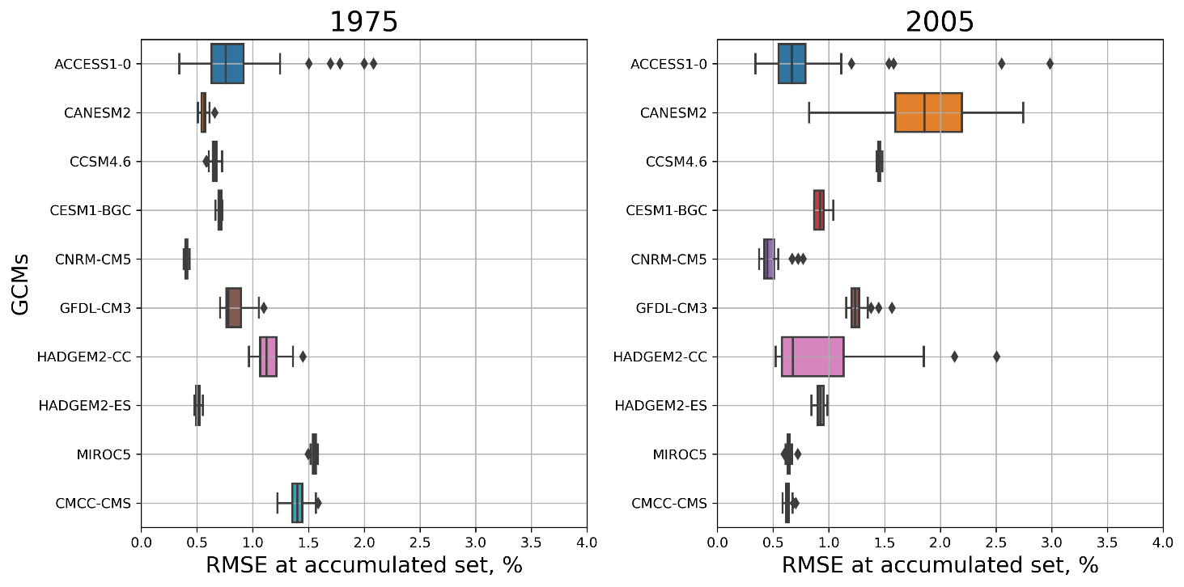
Comparative Assessment
Temperature Comparative Assessment: Merced, Historical
Introduction
FM performance based on 100 encodings under RCP 4.5
The Fractal-Multifractal Method
RMSEC merely less than 3% in all GCMs.
Variability reflects the intrinsic geometrical complexity.
Methodology
Temperature Encoding
Precipitation Encoding
Comparative Assessment
Concluding Remarks

Slide 35
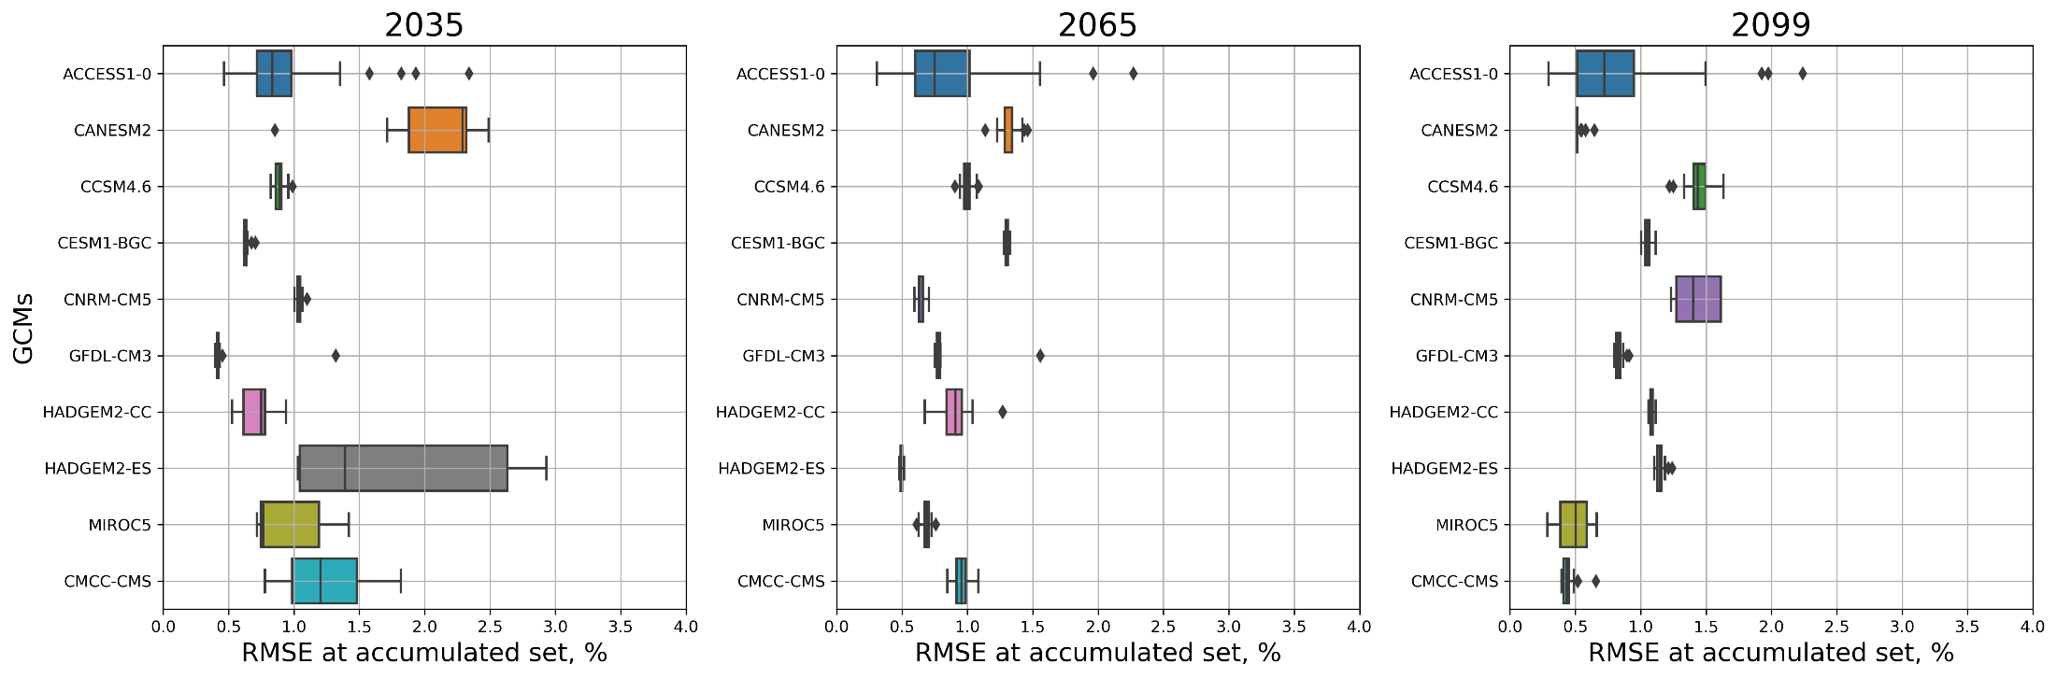
Comparative Assessment
Temperature Comparative Assessment: Merced, Future
Introduction
FM performance based on 100 encodings under RCP 4.5
The Fractal-Multifractal Method
Methodology
Temperature Encoding
Precipitation Encoding
Comparative Assessment
Concluding Remarks
RMSEC merely less than 3% in all GCMs but wider variability than in the past.

Slide 36
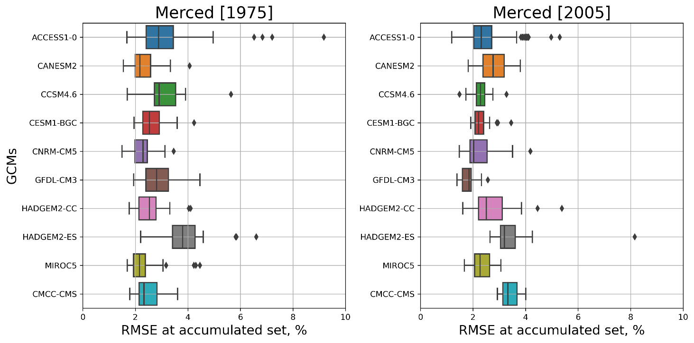
Comparative Assessments
Precipitation Comparative Assessment: Shasta, Historical
Introduction
FM performance based on 100 encodings under RCP 8.5
The Fractal-Multifractal Method
RMSEC merely less than 8% in all GCMs.
Higher error compared to temperature sets means rainfall is more complex to describe
Methodology
Temperature Encoding
Precipitation Encoding
Comparative Assessment
Concluding Remarks

Slide 37
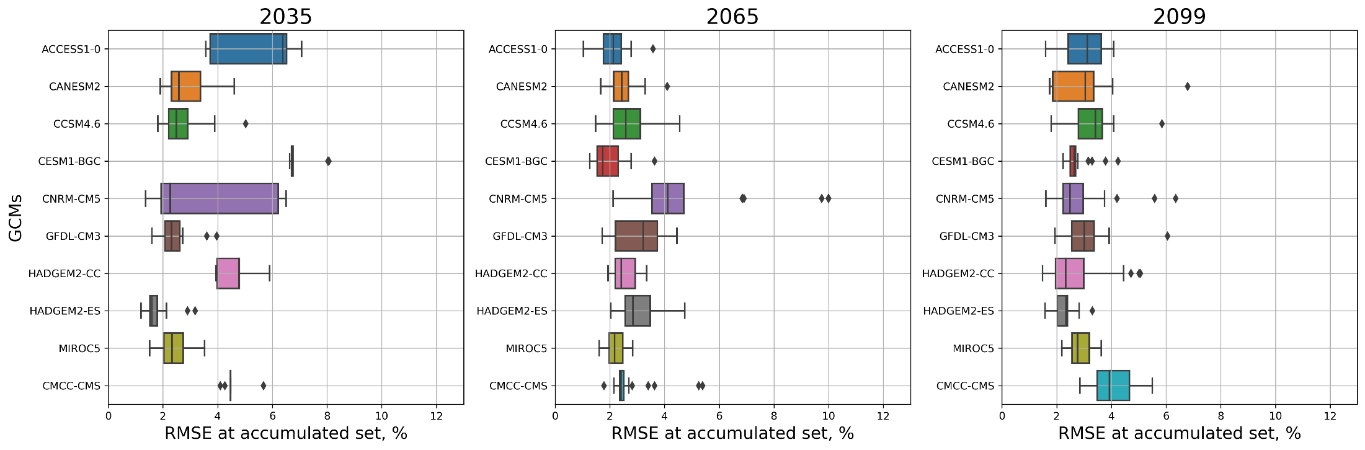
Comparative Assessments
Precipitation Comparative Assessment: Shasta, Future
Introduction
FM performance based on 100 encodings under RCP 8.5
The Fractal-Multifractal Method
Methodology
Temperature Encoding
Precipitation Encoding
Comparative Assessment
Concluding Remarks
RMSEC merely less than 8% in all GCMs but wider variability than in the past.

Slide 38
Conclusions
Conclusions
Introduction
Climate variables from GCM output can be faithfully encoded via the FM method using 7 and 10 parameters for temperature and rainfall, respectively.
Encoding all the GCM outputs is not needed but one can encode one GCM and transfer the parameter set via a common simplex.
Encoding rainfall from GCM is as difficult as encoding it observed in the ground.
Temperature can be encoded with low RMSE at accumulated set as high as 5% while rainfall has a higher value up to 13%.
The performance of the FM models are comparable between RCP4.5 and RCP8.5.
Variability in the performance metrics reflect the intrinsic complexity hidden inside the, geometry of climate variables from different GCMs.
The FM method can be used in climate studies in various applications including sensitivity analysis of meteorological data, streamflow etc. and beyond
This method opens more research avenue in understanding the natural phenomena in time and space those are concerned for broader community.
The Fractal-Multifractal Method
Methodology
Temperature Encoding
Precipitation Encoding
Comparative Assessment
Concluding Remarks

Slide 39
The End
Thank you for viewing

