Slide 1

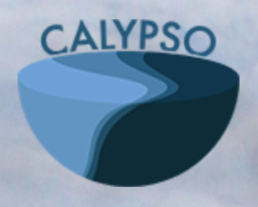


Observing and Quantifying Ocean Flow Properties Using Drifters with Drogues at Different Depths
Irina I. Rypina, Larry Pratt,
Tim Getscher, and Baptiste Mourre
April, 2021

Slide 2
Introduction
In 2018, we deployed 24 drifters with drogues at different depths in the Mediterranean Sea as part of the ONR CALYPSO project. 6 drifters were deployed at 1, 10, 30 and 50 m.
We used drifter data to quantify divergence, vorticity, vertical velocity, terms in the vorticity balance, and FTLEs
We also used a high-resolution (400 m) numerical model (SOCIB WMOP ROMS) to investigate how reliable are the drifter-based estimates and what are the sources of errors

Slide 3
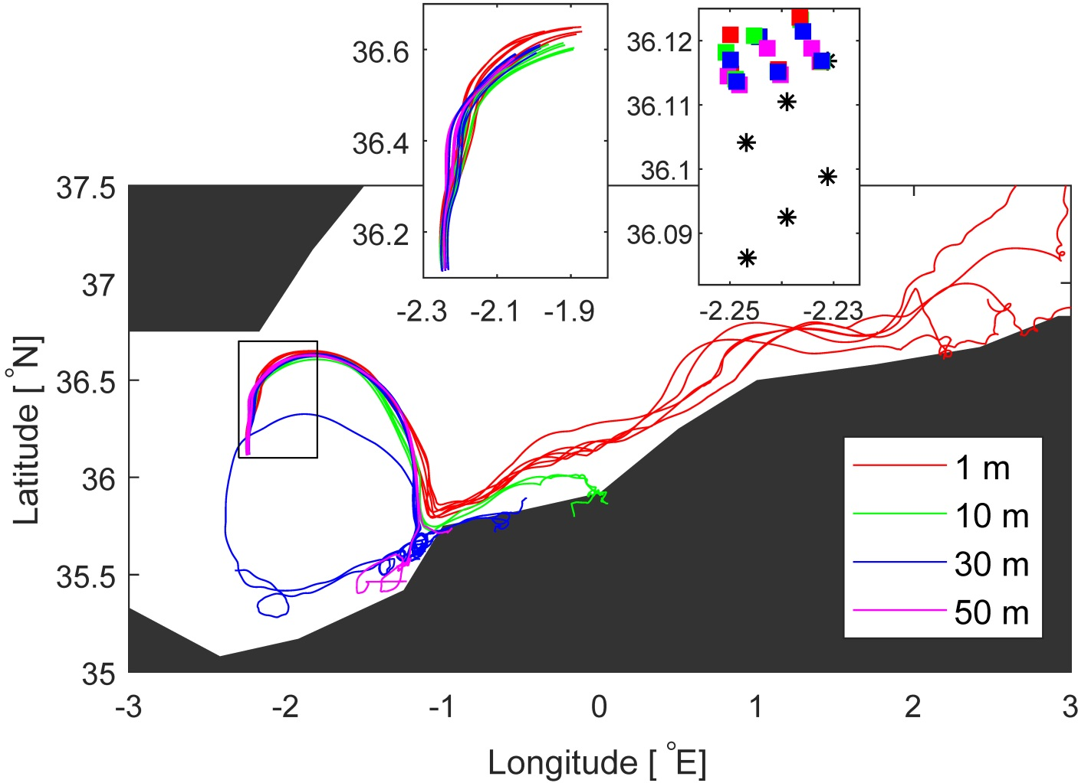
Real drifters
deployment locations
24-hour segments

Slide 4
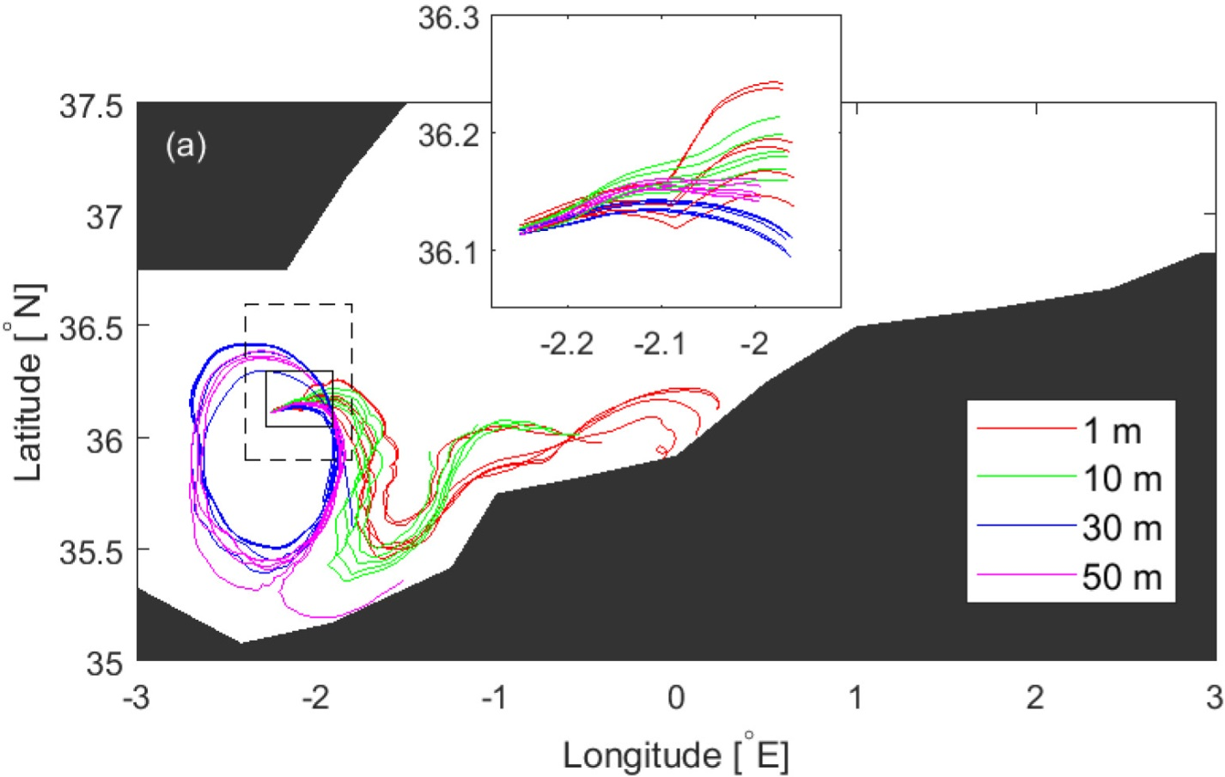
Simulated drifters
24-hour segments

Slide 5
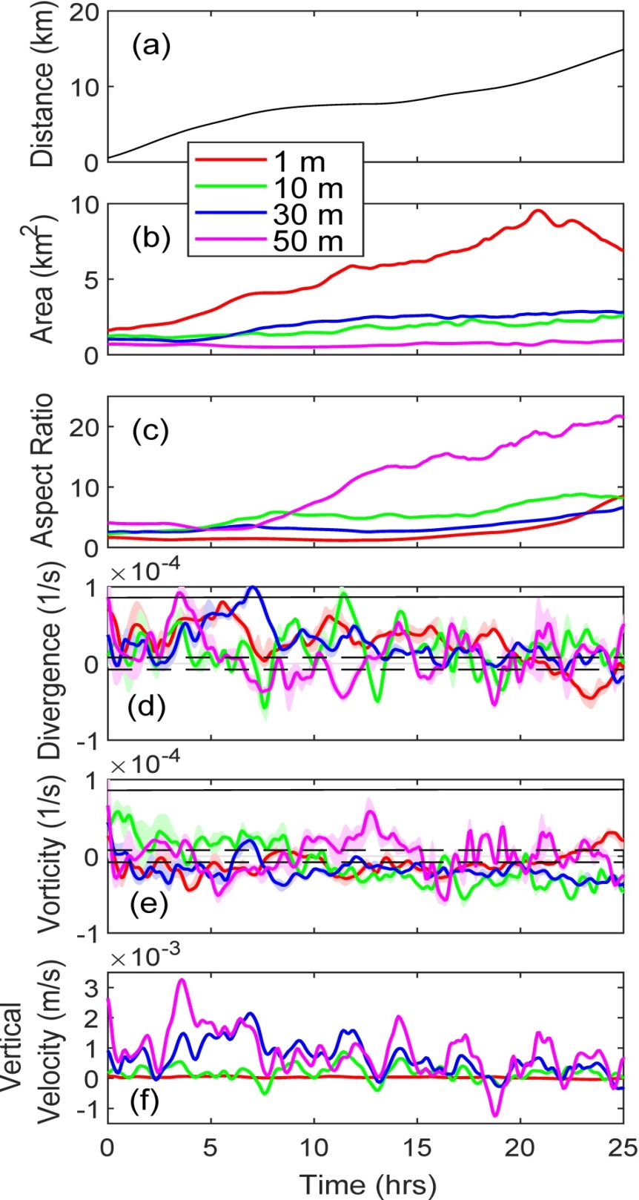
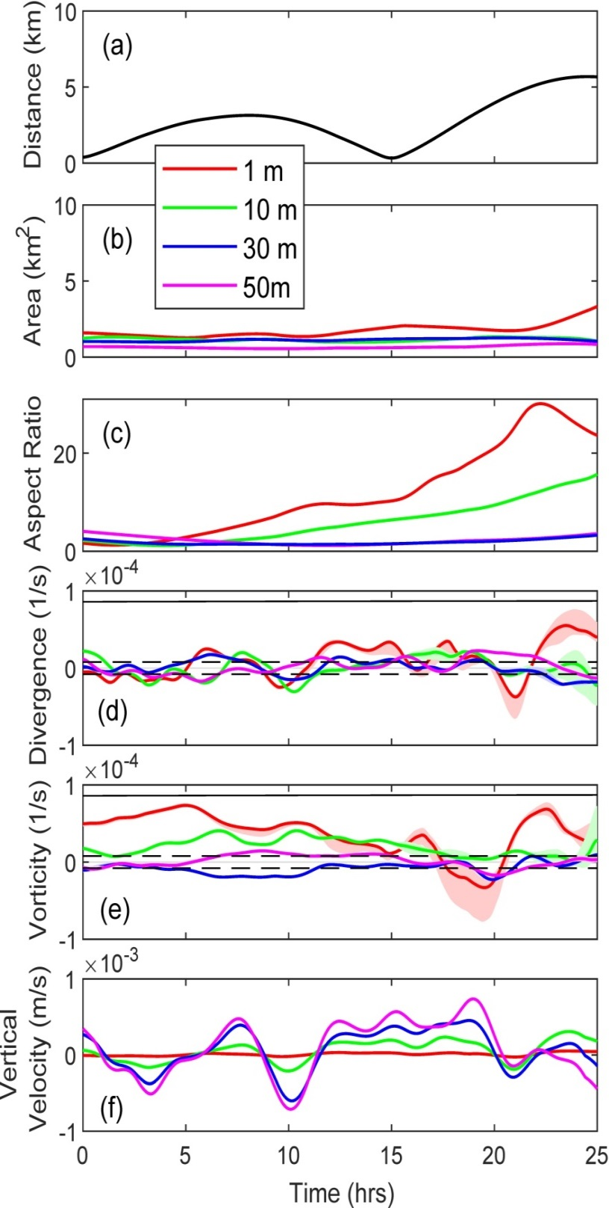
real
simulated

Slide 6
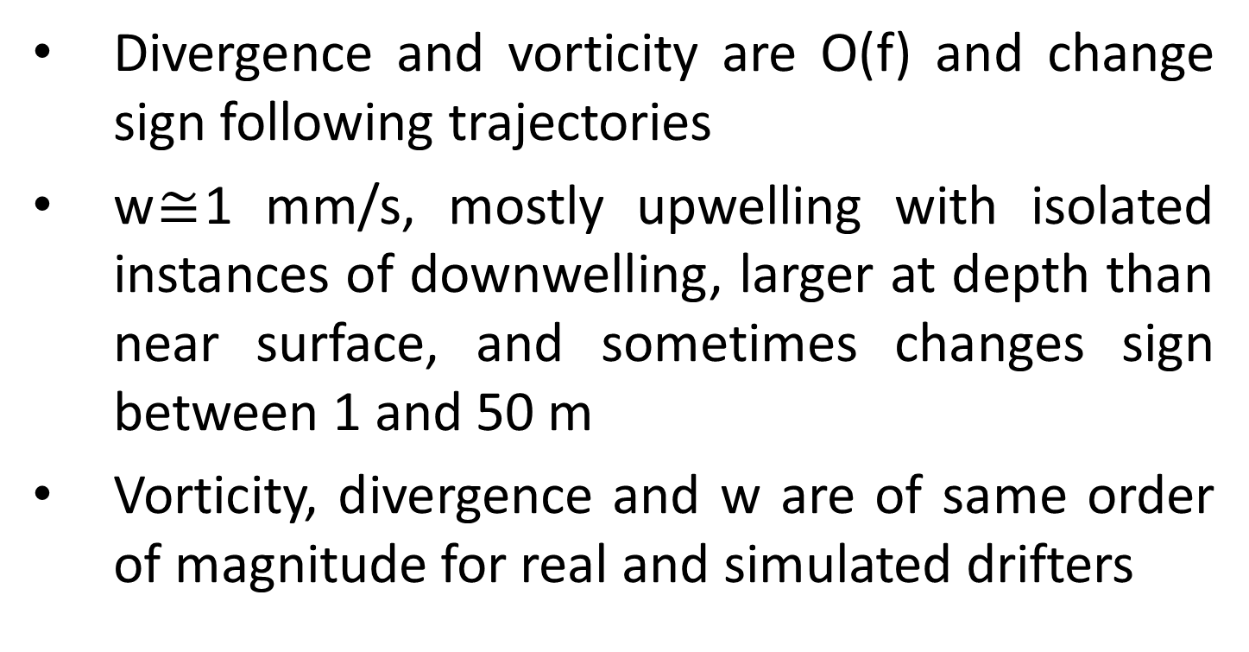
Results:
Divergence and vorticity are O(f) and change sign following trajectories
w$≅$1 mm/s, mostly upwelling with isolated instances of downwelling, larger at depth than near surface, and sometimes changes sign between 1 and 50 m
Vorticity, divergence and w are of same order of magnitude for real and simulated drifters

Slide 7
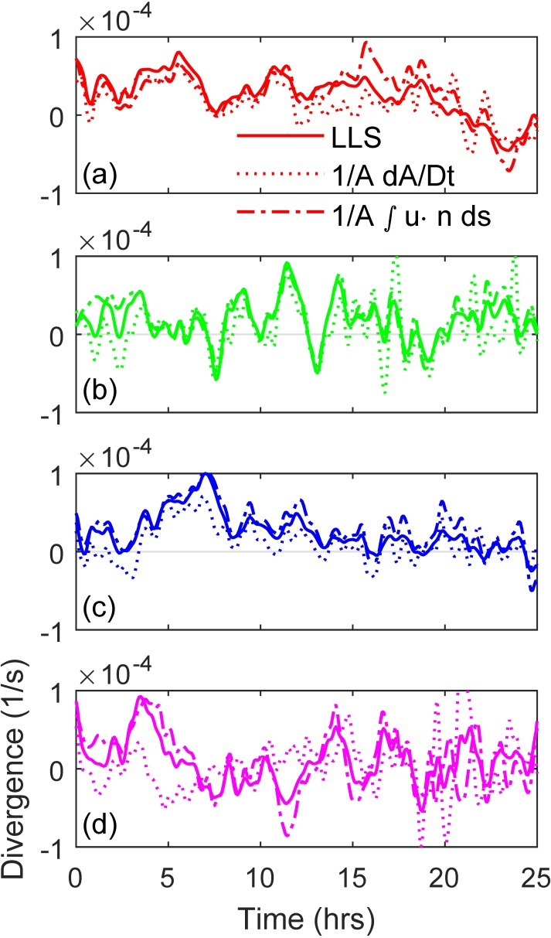
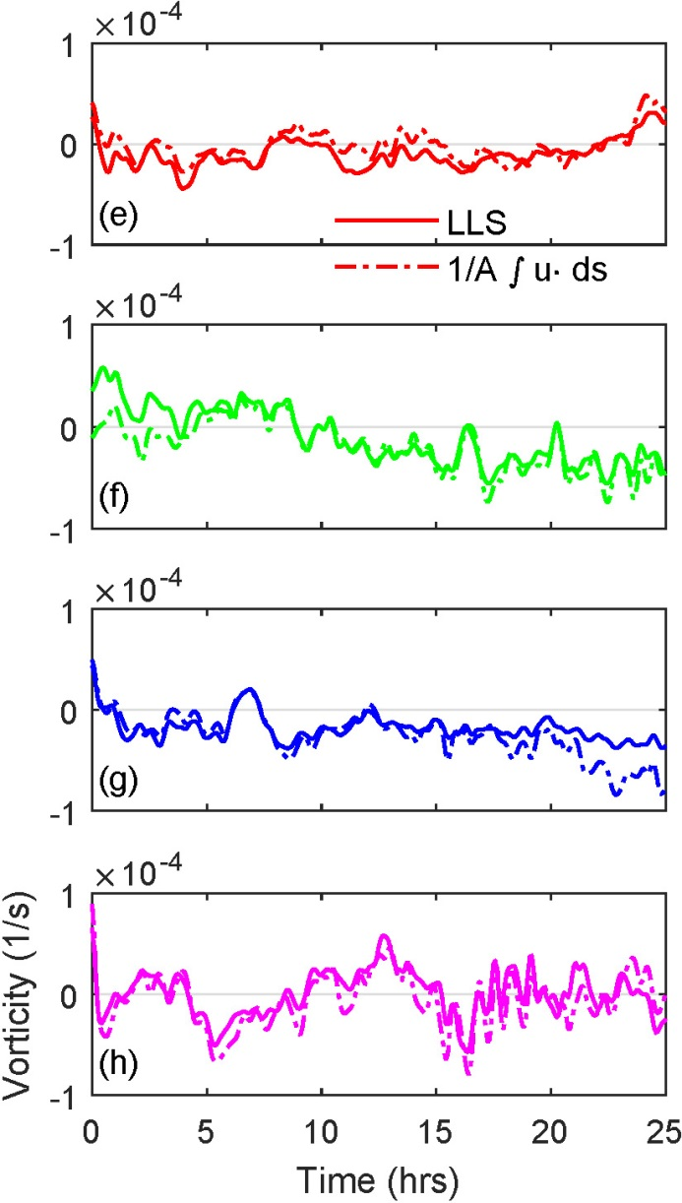

Different methods of estimating divergence and vorticity – Linear Least Squares (LLC), Green’s theorem, and area change – are in agreement

Slide 8
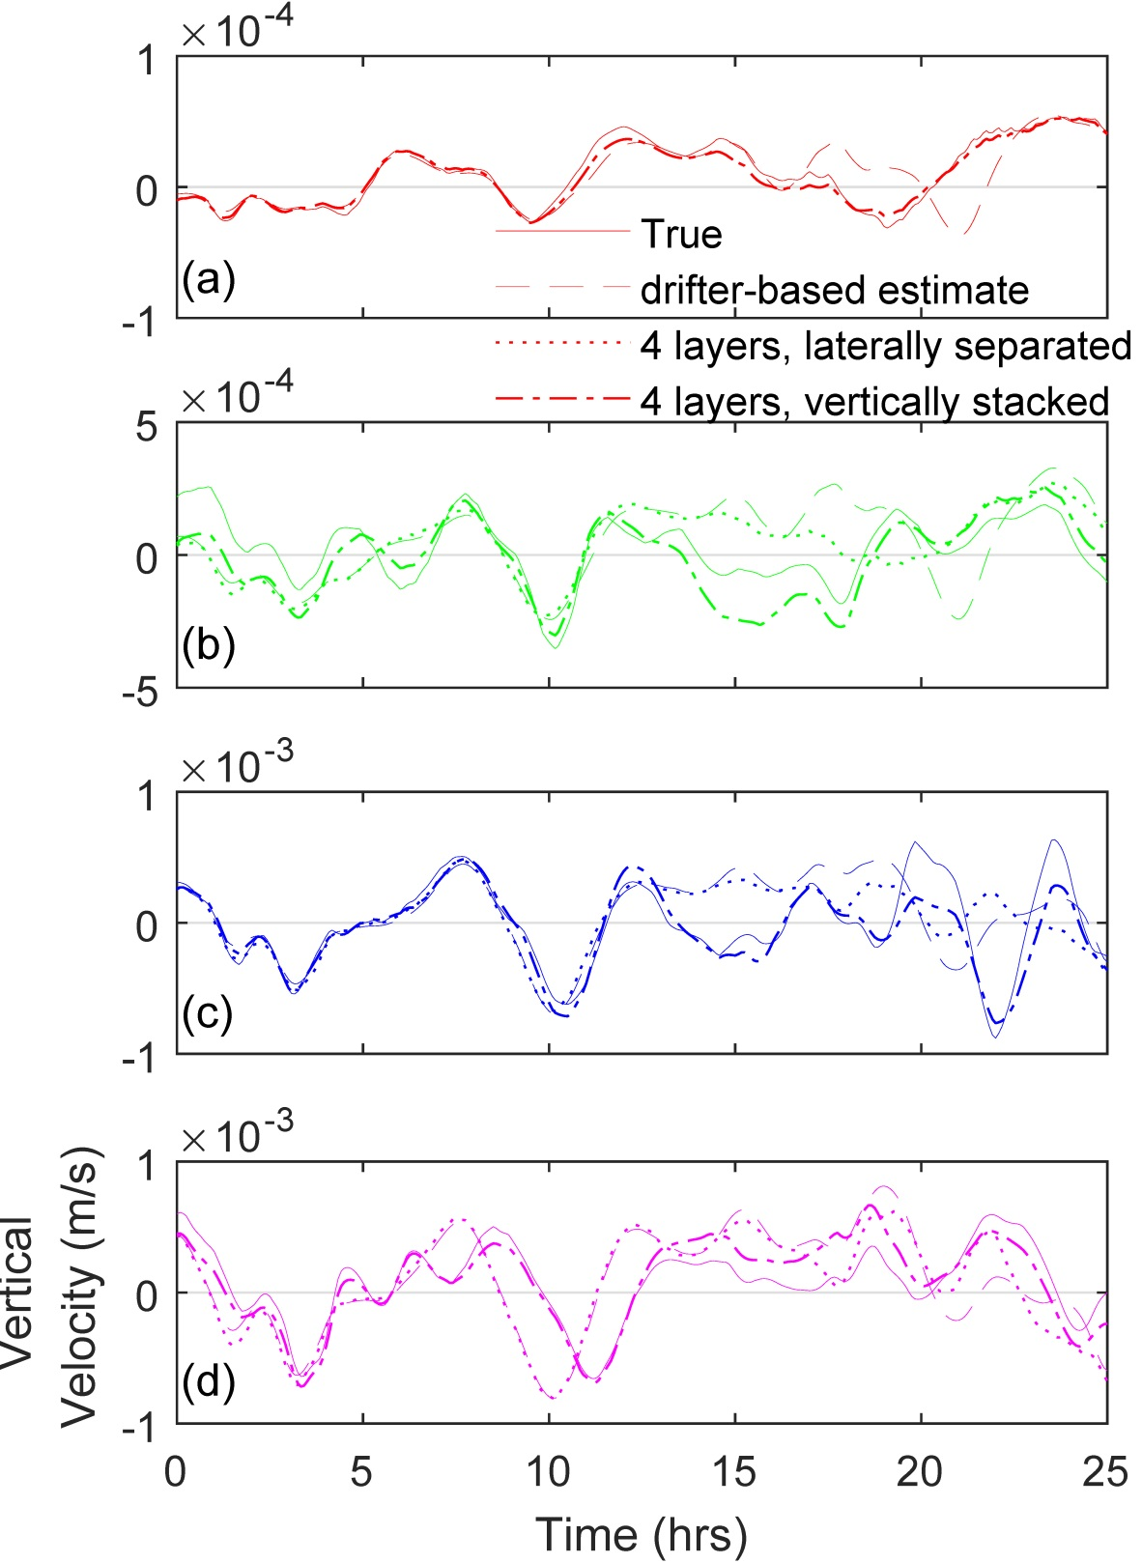
Comparing drifter-based Lagrangian and Eulerian estimates in the model suggests:
Divergence and vorticity at all levels can be reliably estimated using 6 drifters
Vertical velocity agrees reasonably well, and the main source of error comes from lateral separation between drifters in upper and lower levels

Slide 9
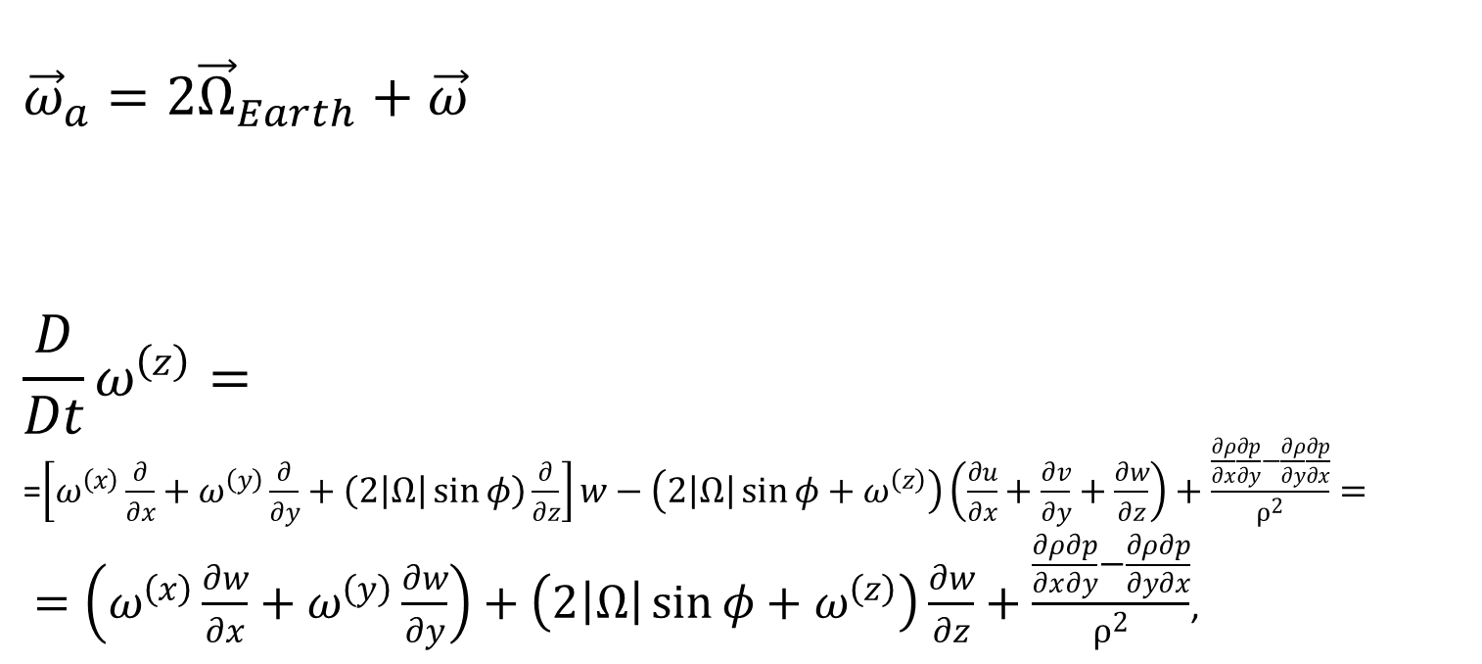
Estimating terms in vorticity balance
${\vec{ω}}_{a}=2{\vec{Ω}}_{Earth}+\vec{ω}$
$$\frac{D}{Dt}ω^{\left(z\right)}=$$
=$\left[ω^{\left(x\right)}\frac{∂}{∂x}+ω^{\left(y\right)}\frac{∂}{∂y}+\left(2\left|Ω\right|\sin{φ}\right)\frac{∂}{∂z}\right]w−\left(2\left|Ω\right|\sin{φ}+ω^{\left(z\right)}\right)\left(\frac{∂u}{∂x}+\frac{∂v}{∂y}+\frac{∂w}{∂z}\right)+\frac{\frac{∂ρ}{∂x}\frac{∂p}{∂y}−\frac{∂ρ}{∂y}\frac{∂p}{∂x}}{ρ^{2}}=$
$=\left(ω^{\left(x\right)}\frac{∂w}{∂x}+ω^{\left(y\right)}\frac{∂w}{∂y}\right)+\left(2\left|Ω\right|\sin{φ}+ω^{\left(z\right)}\right)\frac{∂w}{∂z}+\frac{\frac{∂ρ}{∂x}\frac{∂p}{∂y}−\frac{∂ρ}{∂y}\frac{∂p}{∂x}}{ρ^{2}}$,
These terms can be estimated from drifter data alone
Time change of vorticity
following a water parcel
Vortex tilting
Vortex stretching
Baroclinic
production

Slide 10
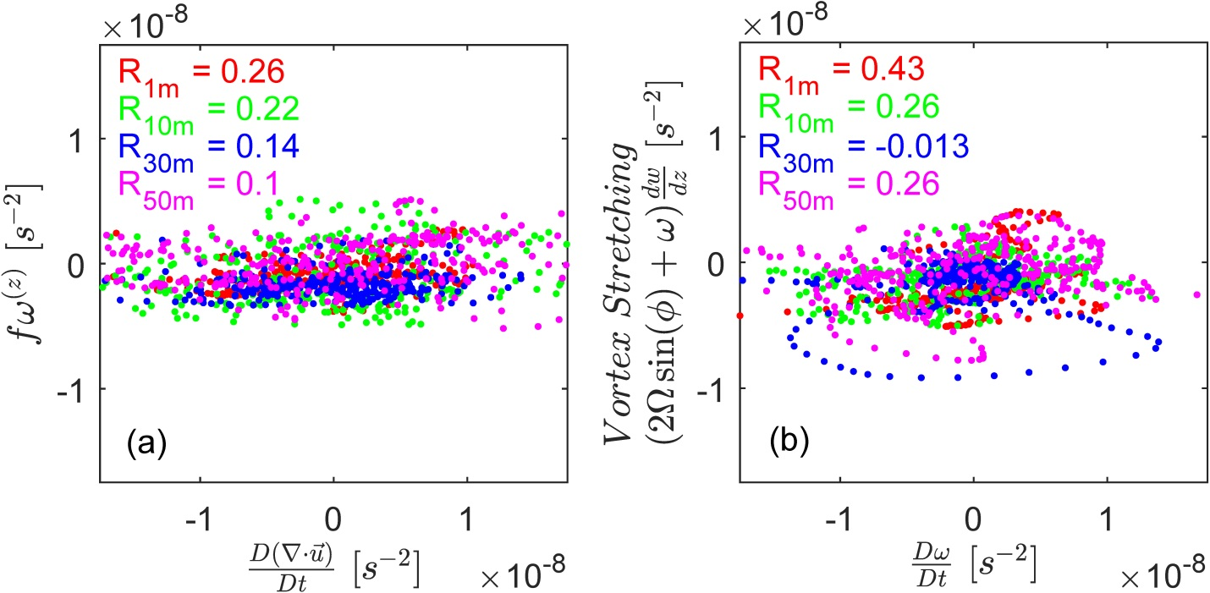
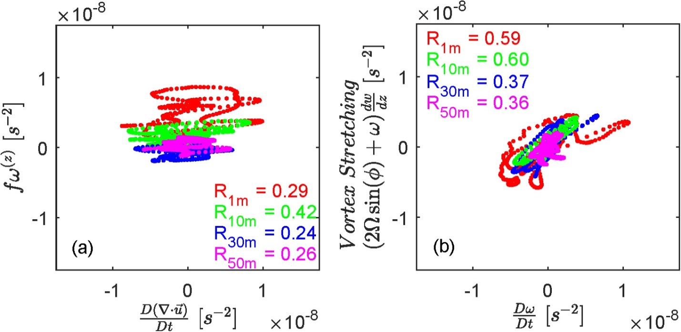
Vorticity and divergence balance
Vortex stretching is important but not dominant
real
Balance looks a bit different in the model
simulated

Slide 11
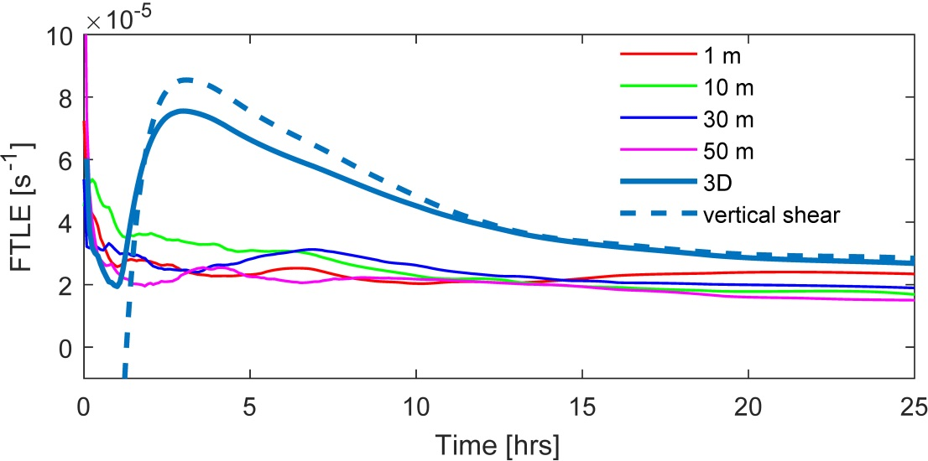
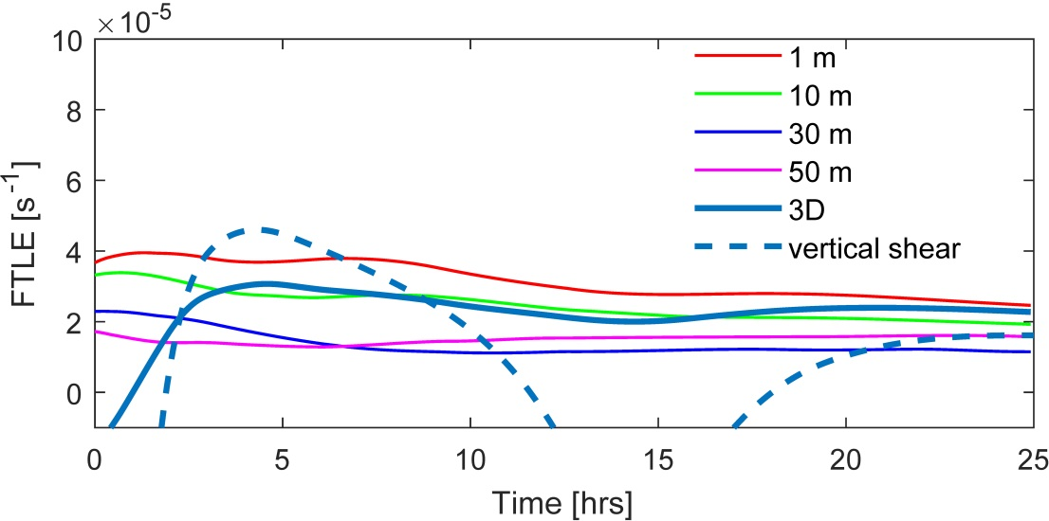
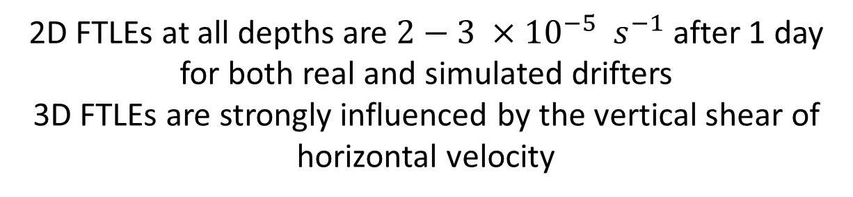
2D FTLEs at all depths are $2−3 ×{10}^{−5} s^{−1}$ after 1 day for both real and simulated drifters
3D FTLEs are strongly influenced by the vertical shear of horizontal velocity
real
simulated

Slide 12
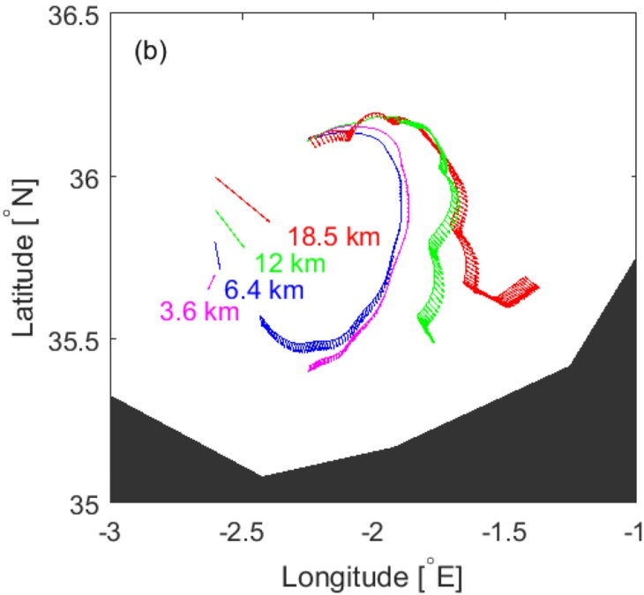
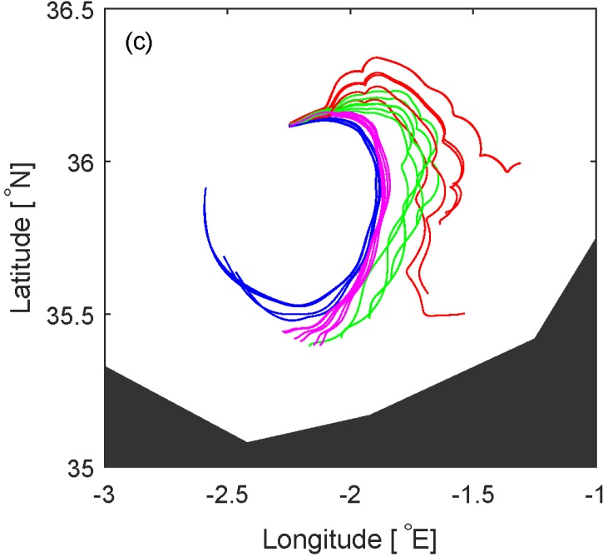
The role of Ekman currents
1- and 10-m trajectories go eastward past Oran, while 30- and 50-m trajectories recirculate
Ekman pushes upper 2 levels eastward
Trajectories without Ekman
10-m trajectories (green) start to recirculate within the gyre when Ekman currents are removed

Slide 13
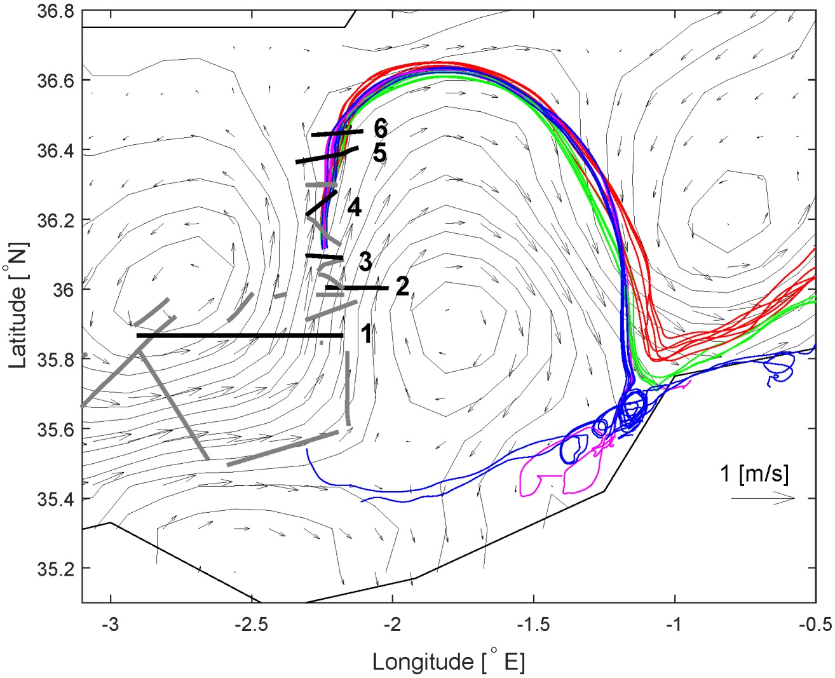
Comparing with SSH, u-CTD and ADCP data
We will look at 6 sections: #1 through #6
northward
jet

Slide 14
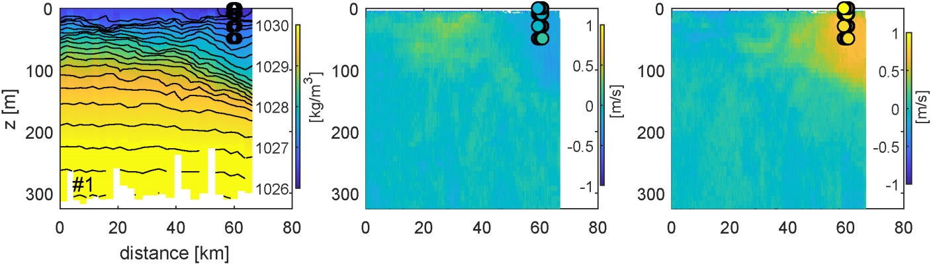

Front with sloping isopycnals in the upper 150 m, with width O(20 km)
Surface mixed layer of about 20 m
drifters
$$ρ$$
u
v
Density below/within mixed layer is dominated by salinity/temperature
There is a northward jet (that we saw in ssh) which coincides with the front
Drifters were deployed in the jet, close to the centerline, and a little to the west from it
Drifter-based u- and v-velocities (colored circles) are consistent with adcp

Slide 15
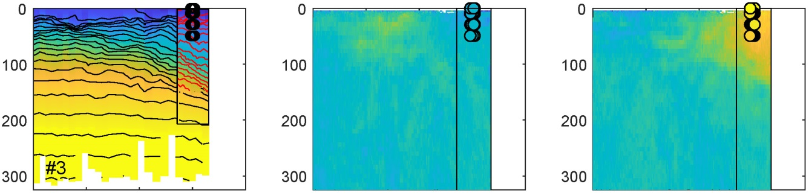
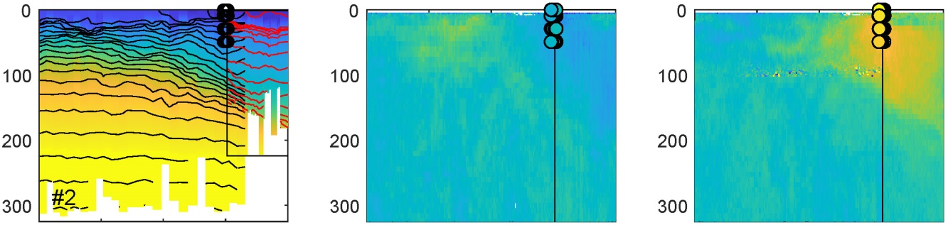


$$ρ$$
u
v
$$ρ$$
u
v
$$ρ$$
u
v

Slide 16
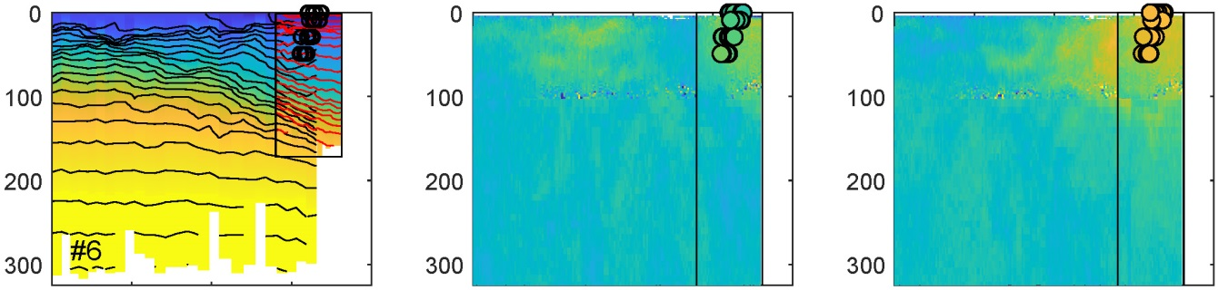
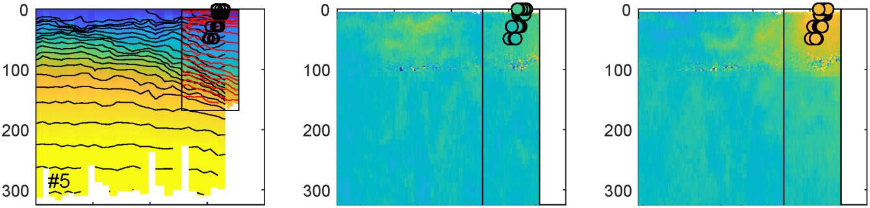
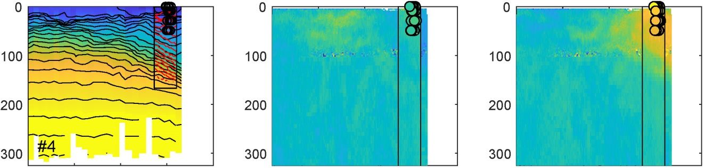
$$ρ$$
u
v
$$ρ$$
u
v
$$ρ$$
u
v

Slide 17
All 6 sections look qualitatively similar (jet structure hasn’t changes much)
Upper levels of drifters seem to move toward, and then cross, the jet center.
  this is consistent with the downwelling on the heavier side and the presence of cross-jet secondary circulation
  vorticity at all levels is initially positive but then becomes negative for the upper layers

Slide 18
Overall, our study demonstrates how drifters, heretofore restricted to 2D near-surface observations, can be used to learn about 3D flow properties throughout the upper layer of the water column
Reference: Rypina et al., 2021: Observing and quantifying ocean flow properties using drifters with drogues at different depths, JPO, in review

