Slide 1
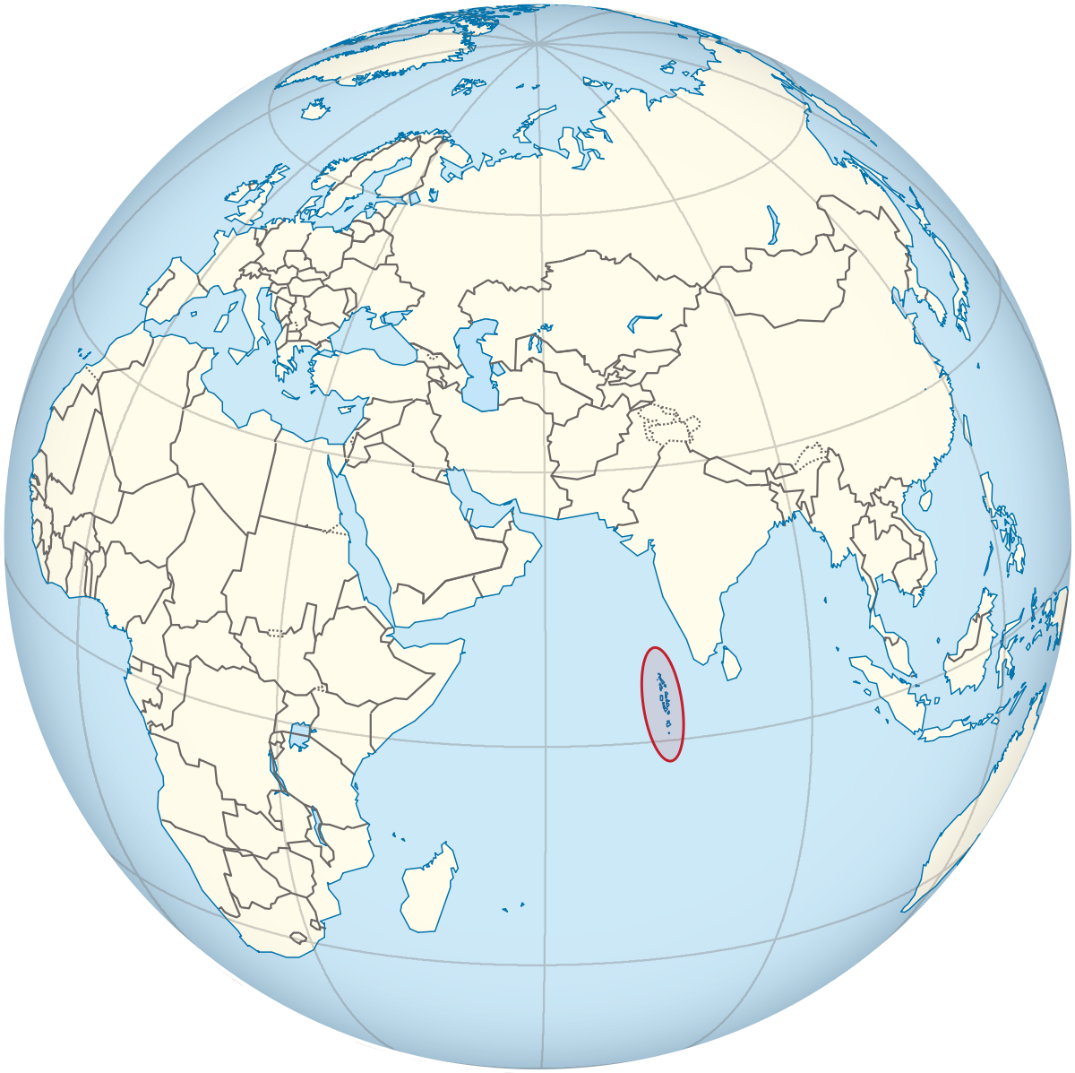
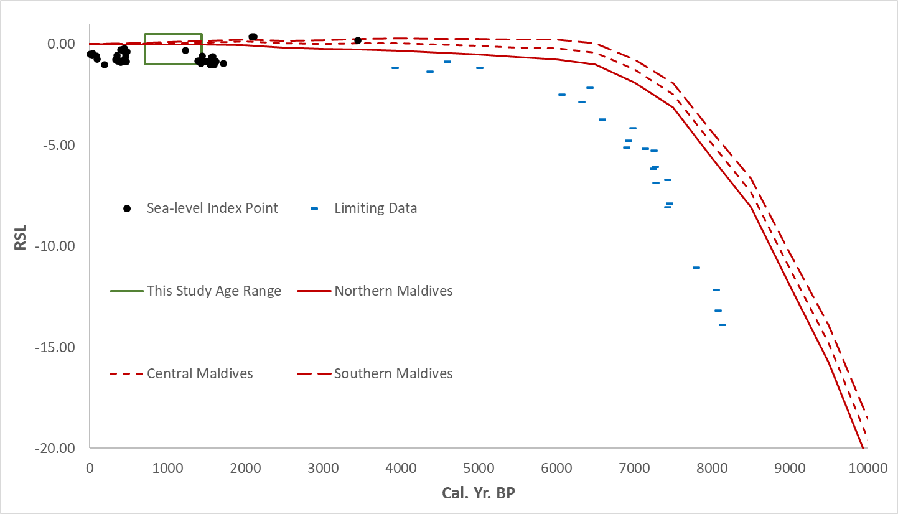
A new Holocene record from a far-field site in the Indian Ocean to constrain Holocene sea level.
Geoff Richards, Jedrzej Majewski, Christabel Tan, Fangyi Tan, Tanghua Li, Timothy Shaw, Benjamin Horton.
Maldives
630 ± 65
1030 ± 23
1184 ± 98
1262 ± 75
1340 ± 44
1355 ± 50
Kelaa

