Slide 1


Assessing groundwater management sustainability of coastal cities by utilizing the City Blueprint Approach
April 27th, 2021
Khawon Lee¹⁾, Sun Woo Chang²⁾, and Jeryang Park¹⁾
Department of Civil and Environmental Engineering, Hongik university ¹⁾,
Department of Land, Water and Environmental Research, Korea Institute of Civil Engineering and Building Technology ²⁾

Slide 2
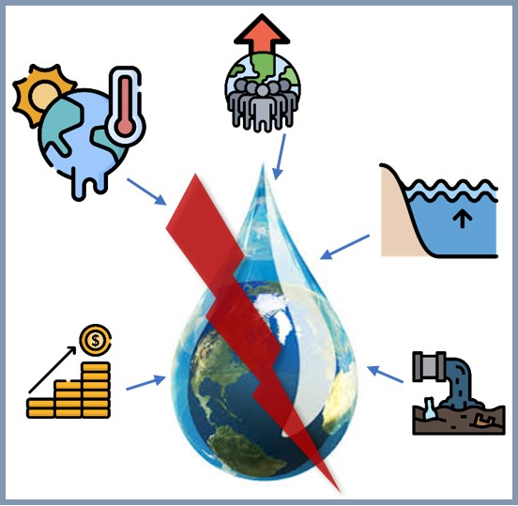
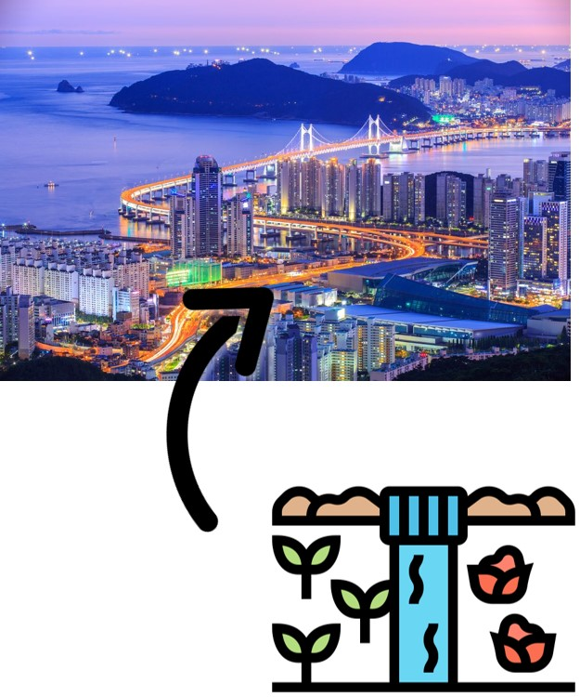
1. Introduction
1.1 Background
Variety factors (seawater intrusion, climate change, economic growth, etc.) threaten water security
Groundwater is primary water resource at coastal cities
Supply 40% of water in California, USA
Sustainable coastal groundwater management is essential
Primary
water resource
Source: genevaactions, flaticon, travel lens
Department of Civil and Environmental Engineering
Hongik University

Slide 3
1. Introduction
1.2 Objectives
Assess sustainable water management of Busan and Incheon, South Korea by using City Blueprint Approach
Develop an influence factor network of coastal groundwater based on City Blueprint Approach
Analyze main influence factors of coastal groundwater

Slide 4
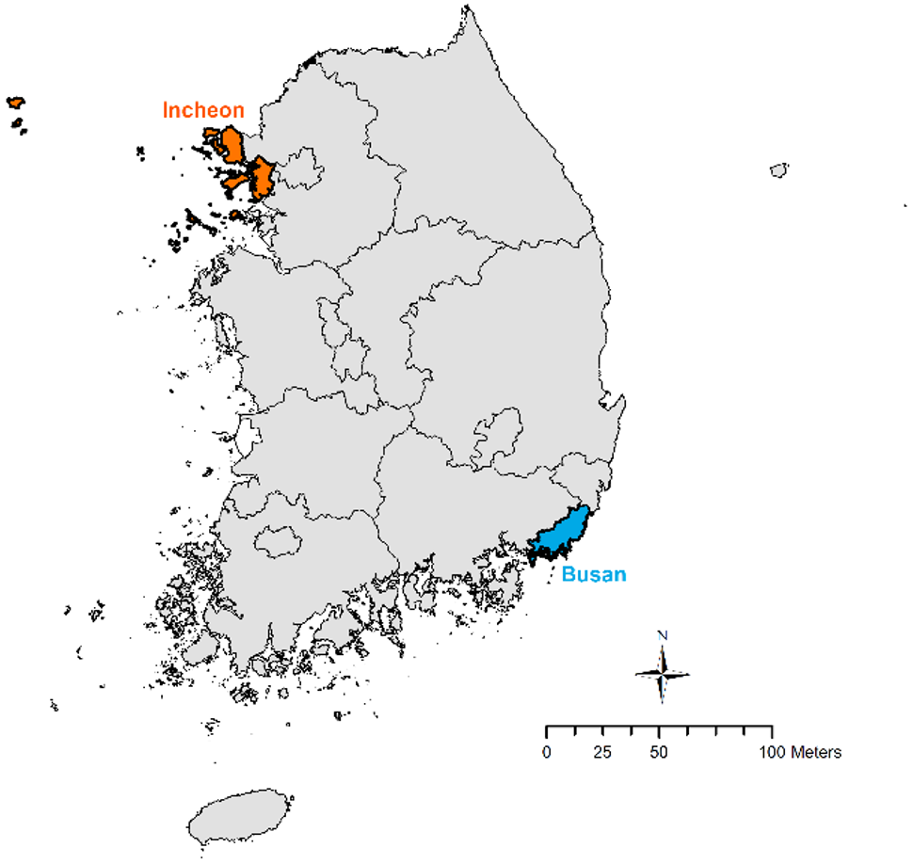
2. Methods
2.1 Study area
Incheon and Busan, South Korea
Busan: The largest coastal city in South Korea
- Groundwater usage ratio: 5.7%
Incheon: The second largest coastal city
- Groundwater usage ratio: 7.0%
→ over 3 times higher than Seoul (1.8%)
Fig 1. Study area (Incheon: orange, Busan: blue)

Slide 5
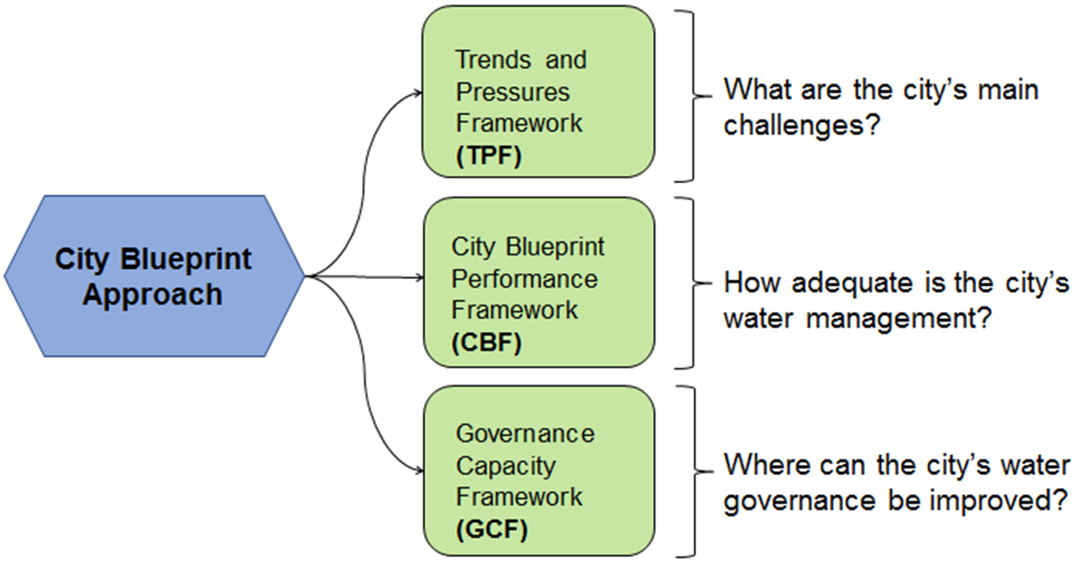
2. Methods
2.1 City Blueprint Approach
Source: watershare
Fig 2. City Blueprint Approach
City Blueprint Approach: Assess sustainable water management of cities
Data: National scale & Regional scale
City Blueprint Score
TPF: 0 (No concern) – 10 (Great concern)
CBF: 0 (Bad) – 10 (Good)
Fig 3. Indicators of TPF (left) and CBF (right)

Slide 6
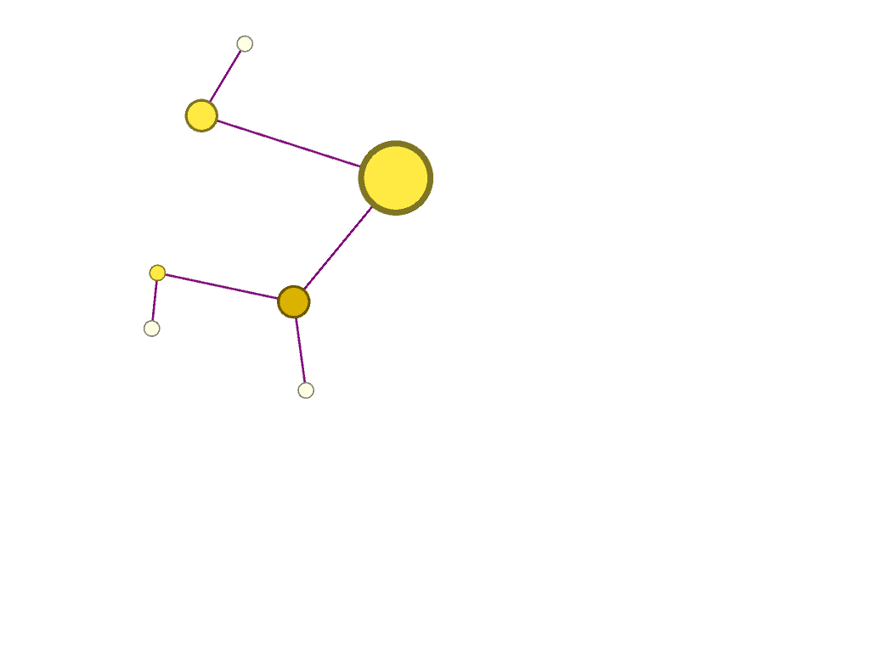
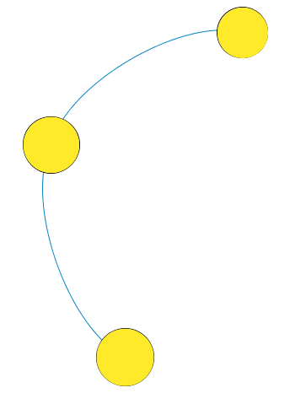
2. Methods
2.2 Network Construction
Nodes : 48 indicators
Weighted Edges
Node number | City Blueprint Indicator | Node number | City Blueprint Indicator
1 | TPF 1 Urbanization rate | 25 | CBF 1 Access to drinking water
2 | TPF 2 Burden of disease | 26 | CBF 2 Access to sanitation
3 | TPF 3 Education rate | 27 | CBF 3 Drinking water quality
4 | TPF 4 Female participation | 28 | CBF 4 Secondary WWT
5 | TPF 5 Urban drainage flood | 29 | CBF 5 Tertiary WWT
6 | TPF 6 River peak discharges | 30 | CBF 6 Groundwater quality
7 | TPF 7 Sea level rise | 31 | CBF 7 Nutrient recovery
8 | TPF 8 Land subsidence | 32 | CBF 8 Energy recovery
9 | TPF 9 Freshwater scarcity | 33 | CBF 9 Sewage sludge recycling
10 | TPF 10 Groundwater scarcity | 34 | CBF 10 WWT energy efficiency
11 | TPF 11 Sea water intrusion | 35 | CBF 11 Stormwater separation
12 | TPF 12 Biodiversity | 36 | CBF 12 Average age sewer
13 | TPF 13 Heat risk | 37 | CBF 13 Water system leakages
14 | TPF 14 Air quality | 38 | CBF 14 Operation cost recovery
15 | TPF 15 Economic pressure | 39 | CBF 15 Solid waste collected
16 | TPF 16 Unemployment rate | 40 | CBF 16 Solid waste recycled
17 | TPF 17 Poverty rate | 41 | CBF 17 solid waste energy recovered
18 | TPF 18 Investment freedom | 42 | CBF 18 Green space
19 | TPF 19 Voice and accountability | 43 | CBF 19 Climate adaptation
20 | TPF 20 Political stability | 44 | CBF 20 Climate-robust buildings
21 | TPF 21 Government effectiveness | 45 | CBF 21 Management and action plans
22 | TPF 22 Regulatory quality | 46 | CBF 22 Water efficiency measures
23 | TPF 23 Rule of law | 47 | CBF 23 Drinking water consumption
24 | TPF 24 Control of corruption | 48 | CBF 24 Attractiveness
The association between nodes
Forming the edges: based on correlation coefficient
Spearman correlation coefficient (r ≥ 0.5)
r < 0.5 → no edge
r ≥ 0.5 → each coefficient is given as weight
Network is constructed until 2nd - level connection from groundwater indicators
Ex)
2nd –level indicator
1st – level indicator
Groundwater quality

Slide 7

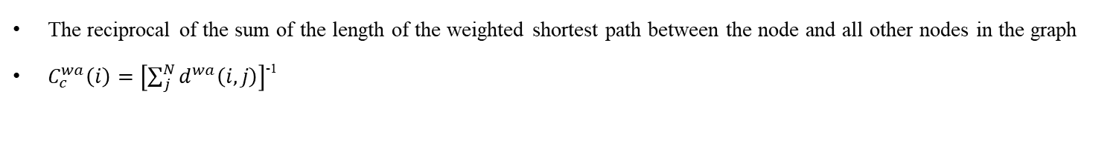
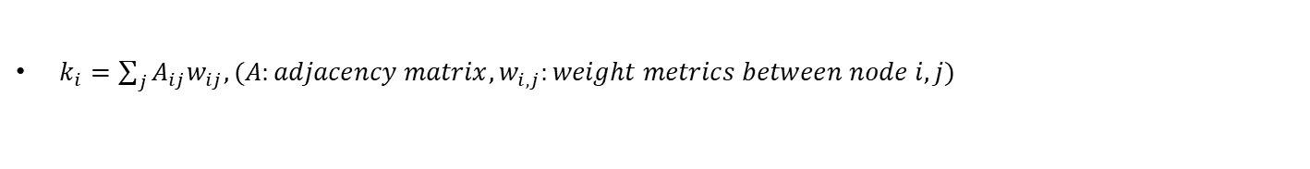
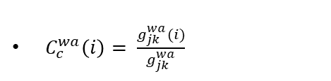
2. Methods
2.2 Complex network analysis: Topological Metrics
Topological Metrics | Definition
Node strength
Closeness centrality
Betweenness centrality
The sum of edge weights connected to node i ($k_{i})$
$k_{i}=\sum_{j}{A_{ij}w_{ij}, (A:adjacency matrix, w_{i,j}:weight metrics between node i,j)}$
The reciprocal of the sum of the length of the weighted shortest path between the node and all other nodes in the graph
$C_{c}^{wa}\left(i\right)=\left[\sum_{j}^{N}{d^{wa}\left(i,j\right)}\right]$⁻¹
$$d^{wa}\left(i,j\right)=\min{(\frac{1}{\left(w_{ih}\right)a}+…+\frac{1}{\left(whj\right)a})}$$
d^{wa}(i,j): the length of the weighted shortest path between two nodes(i,j)
a: a positive tuning parameter
The sum of percentages of weighted shortest paths between any two other nodes that goes through the node under consideration
$C_{c}^{wa}\left(i\right)= \frac{g_{jk}^{wa}(i)}{g_{jk}^{wa}}$
g_{jk}: the number of binary shortest paths between two nodes
g_{jk}(i): the number of those paths that go through node i.

Slide 8
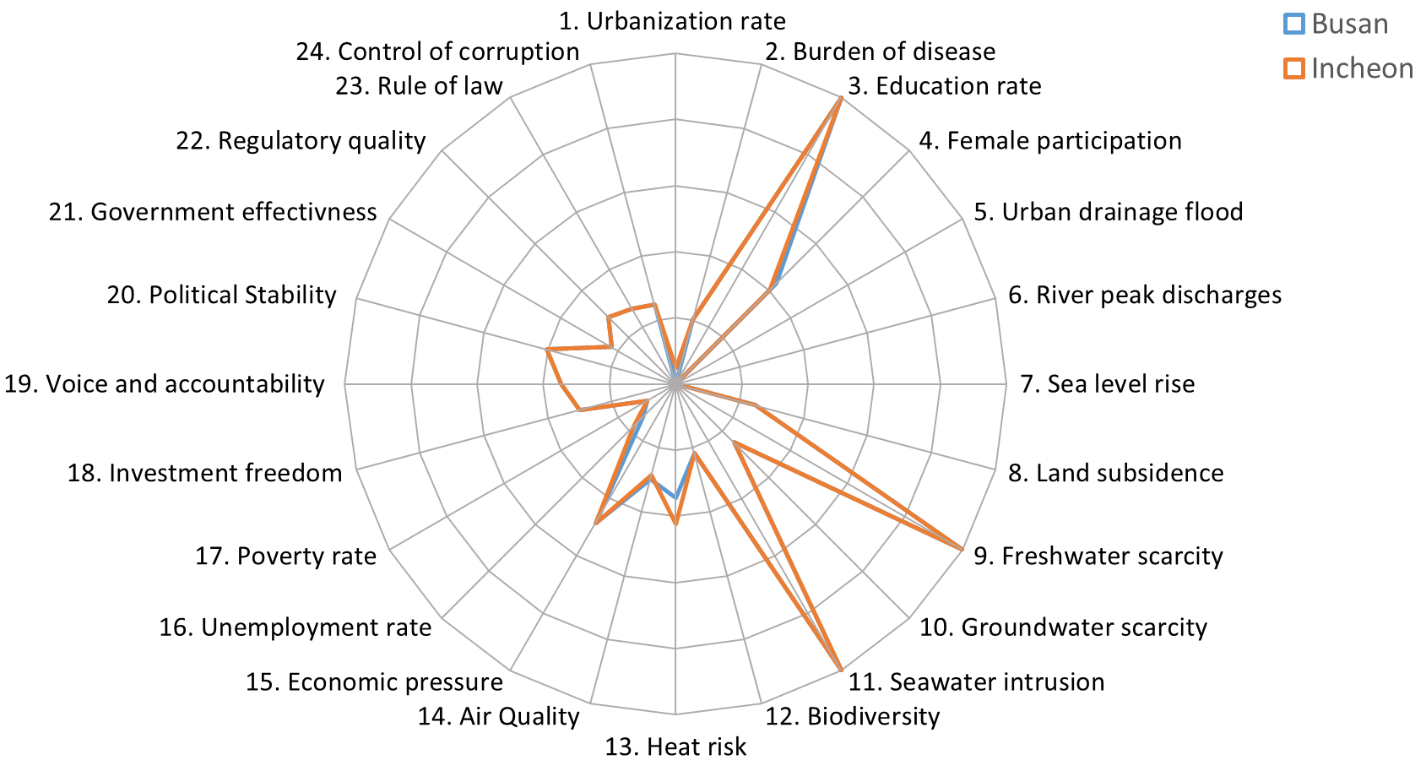
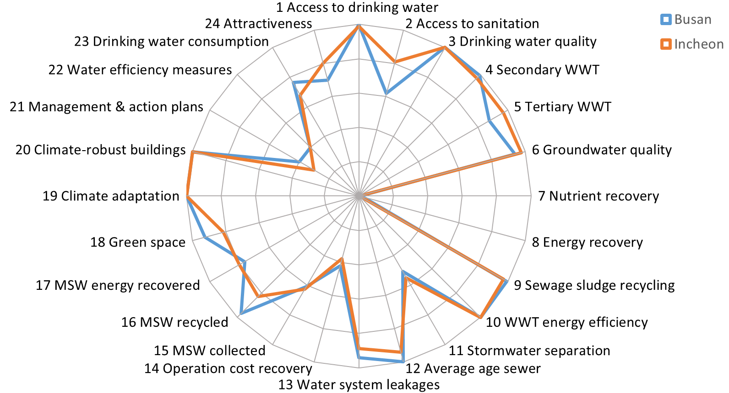
3. Results
3.1 City Blueprint
Fig 4. TPF (Incheon: orange, Busan: blue)
Fig 5. CBF (Incheon: orange, Busan: blue)
Incheon
TPF: ‘little concern’ (Groundwater scarcity, Heat risk), ‘very concern’ (Freshwater scarcity, Seawater intrusion)
CBF: 9.78 (Groundwater quality), 8.15 (Green space)
Busan
TPF: ‘little concern’ (Groundwater scarcity, Heat risk), ‘very concern’ (Freshwater scarcity, Seawater intrusion)
CBF: 9.39 (Groundwater quality), 9.24 (Green space)

Slide 9
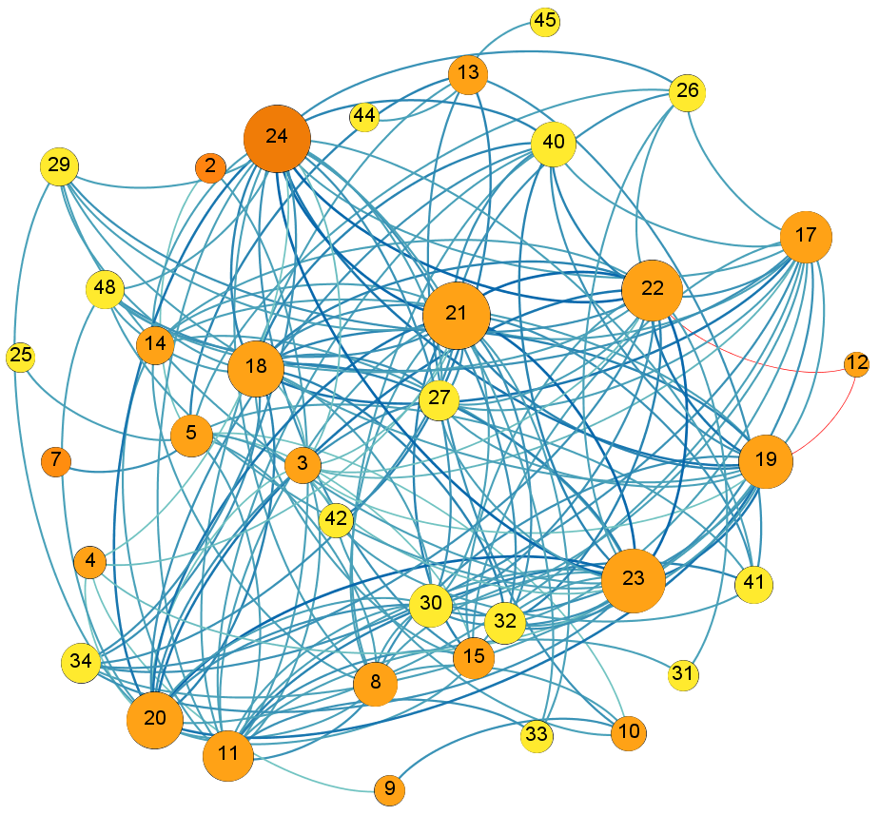
3. Results
3.2 Coastal groundwater network
36 nodes & 160 edges
Node 10: Groundwater scarcity(quantity)
Node 30: Groundwater quality
Orange: TPF indicators , Yellow: CBF indicators
Node → small size: small centrality node
Edge → Blue: positive association, red: negative association
→ Light color: small weight
Groundwater quality
Groundwater scarcity
Fig 7. Node Strength

Slide 10
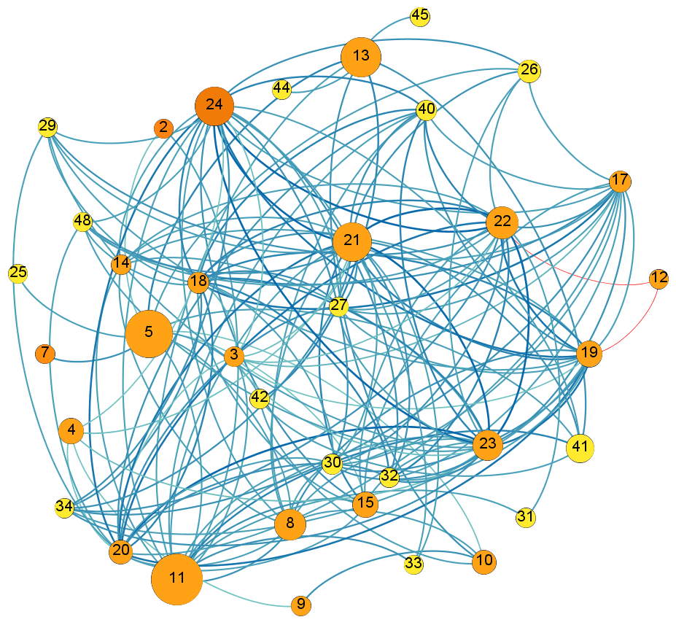
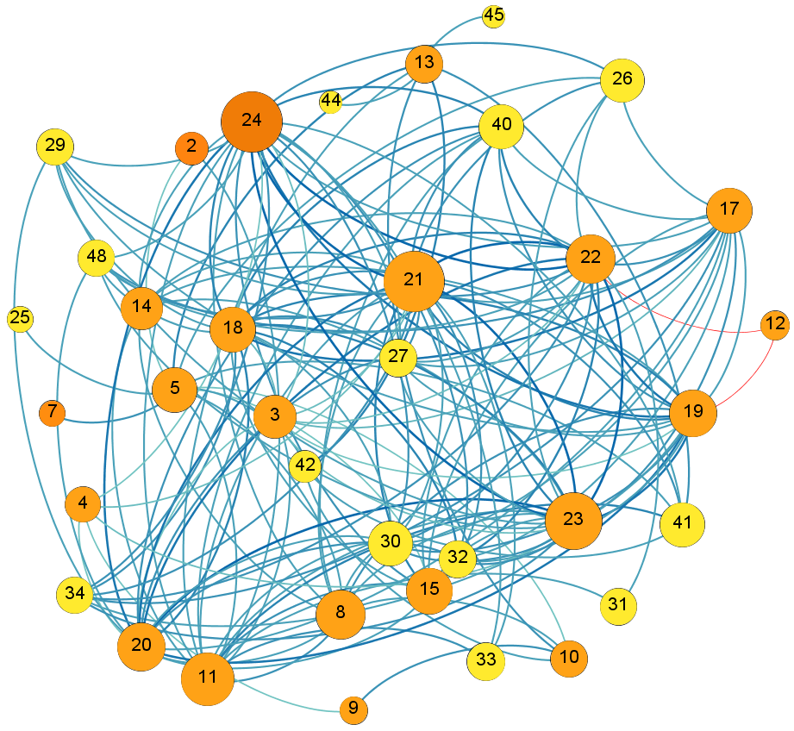
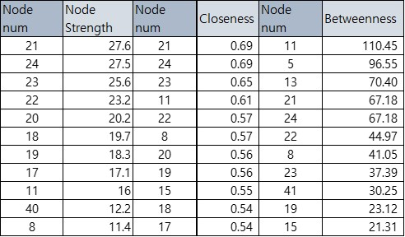
3. Results
3.2 Coastal groundwater network
Table 1. Result of top 11 nodes
Fig 8. Betweenness centrality
Fig 9. Closeness centrality
Governance related nodes (18~24) show high strength. Also betweenness and closeness of those nodes are generally high (19~24)
17 (Poverty rate), 11(Seawater intrusion), 8 (Land subsidence) nodes have high node strength
Node 11 shows the highest betweenness, followed by node 5 (Urban drain flood) and node 13 (Heat risk)
Excluding governance related nodes, node 11 shows also high closeness, followed by node 8, 15 (Economic pressure), 17

Slide 11
4. Conclusion
Major influence factors of coastal groundwater
Implication for sustainable coastal groundwater management
Influence factor network is constructed by giving edge weights based on correlation analysis.
Governance related indicators (18~24) are revealed as major factors influencing groundwater
Seawater intrusion, poverty rate, and land subsidence have many associations with other factors. Especially seawater intrusion is one of the main influence factors for groundwater.
The current groundwater conditions of Busan and Incheon are stable (groundwater scarcity showed ‘little concern’ and the indicator score of groundwater quality is around 9).
However, several influence factors are at the level of ‘concern’ (seawater intrusion, land subsidence, heat risk); around 8 nodes of top 12.
Without avoiding the influence of those factors, the groundwater of Busan and Incheon will likely deteriorate in the future.

Slide 12
Thank You
Acknowledgement
This research was supported by the Development program of Minimizing of Climate Change Impact Technology through the National Research Foundation of Korea (NRF), funded by the Korean government (Ministry of Science and ICT)
(NRF-2020M3H5A1080775).

