Slide 1






Fractal analysis of rain gauges’ inhomogeneous distribution and the associated hydrological impacts: the case study of Muriaé River
Priscila Celebrini de O. Campos¹, Igor Paz¹, Maria Esther Soares Marques¹,
Ioulia Tchiguirinskaia², and Daniel Schertzer²
¹ Instituto Militar de Engenharia, Rio de Janeiro, 22290-270, Brazil
² HM&Co, École des Ponts ParisTech, Université Paris-Est, Champs-sur-Marne, 77455, France

Slide 2
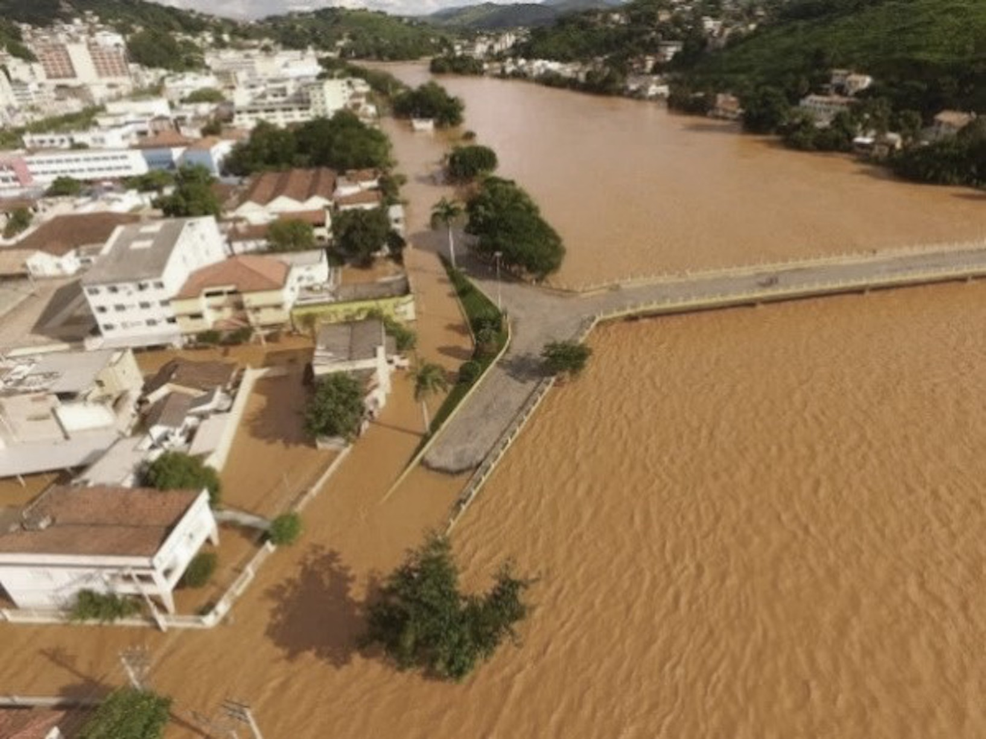
Introduction
The increasing urbanization, associated with the disordered occupation of the riverbanks and the suppression of the vegetation, leads to the soil sealing of the urban basins and, consequently, increases susceptibility to flooding of these basins (Suria and Mudgal, 2012).
In Brazil, the problems currently faced are even more significant in medium-sized cities (between 100,000 and one million inhabitants), that present an average annual growth of over 1% per year (IBGE, 2019).
Currently, flooding in urban centers corresponds to one of the main dilemmas of cities, causing numerous losses concerning environmental, social, economic, and public health risks.
Therefore, it is necessary to evaluate the several impacts of these floods in which the process of the mapping of areas affected through graphical visualization tools is presented as a fundamental instrument to control and prevention.
This work presents a spatial diagnosis of rain gauges’ distribution and the associated hydrological impacts on the municipality of Itaperuna, Rio de Janeiro, Brazil.
Itaperuna

Slide 3
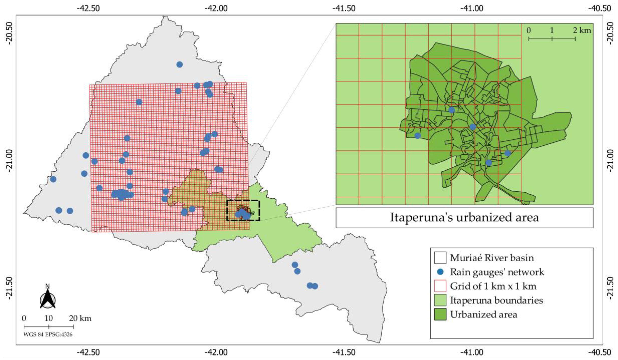
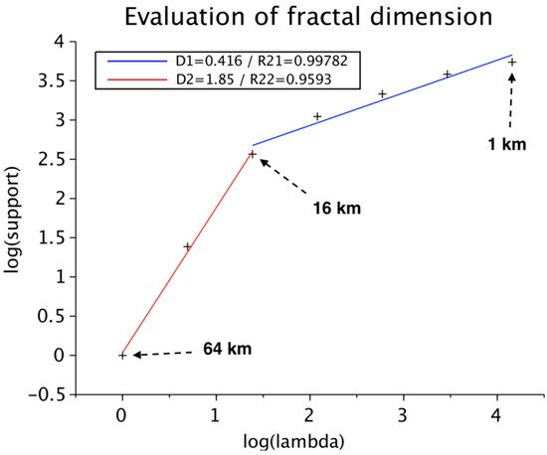
Fractal Analysis of Instrumentation
Method
Fractal analysis of rain gauge network’s distribution of the Muriaé River basin using the box-counting method (Lovejoy et al, 1987) in an area of 64 km x 64 km through the equation below:
Furthermore, a grid size of 1 km × 1 km was used to associate the spatial distribution of the rain gauges with the resolution of S-band Doppler polarimetric weather radar.
Previous Results
A scaling break at the spatial scale of 16 km: the rain gauges’ distribution presents two different scaling behaviors at the large (16 km–64 km) and small (1 km–16 km) scales:
- High fractal dimension of 1.85 at the large-scale range;
- Low fractal dimension of 0.416 at the small-scale range.
The density and distribution of the rain gauges are enough only for large scales.
For the small-scale approaches the actual instrumentation is insufficient to capture the spatial variability of rainfall fields and then to perform accurate modeling and enable better forecasts (Paz et al, 2020; Peleg et al. 2013).

Slide 4
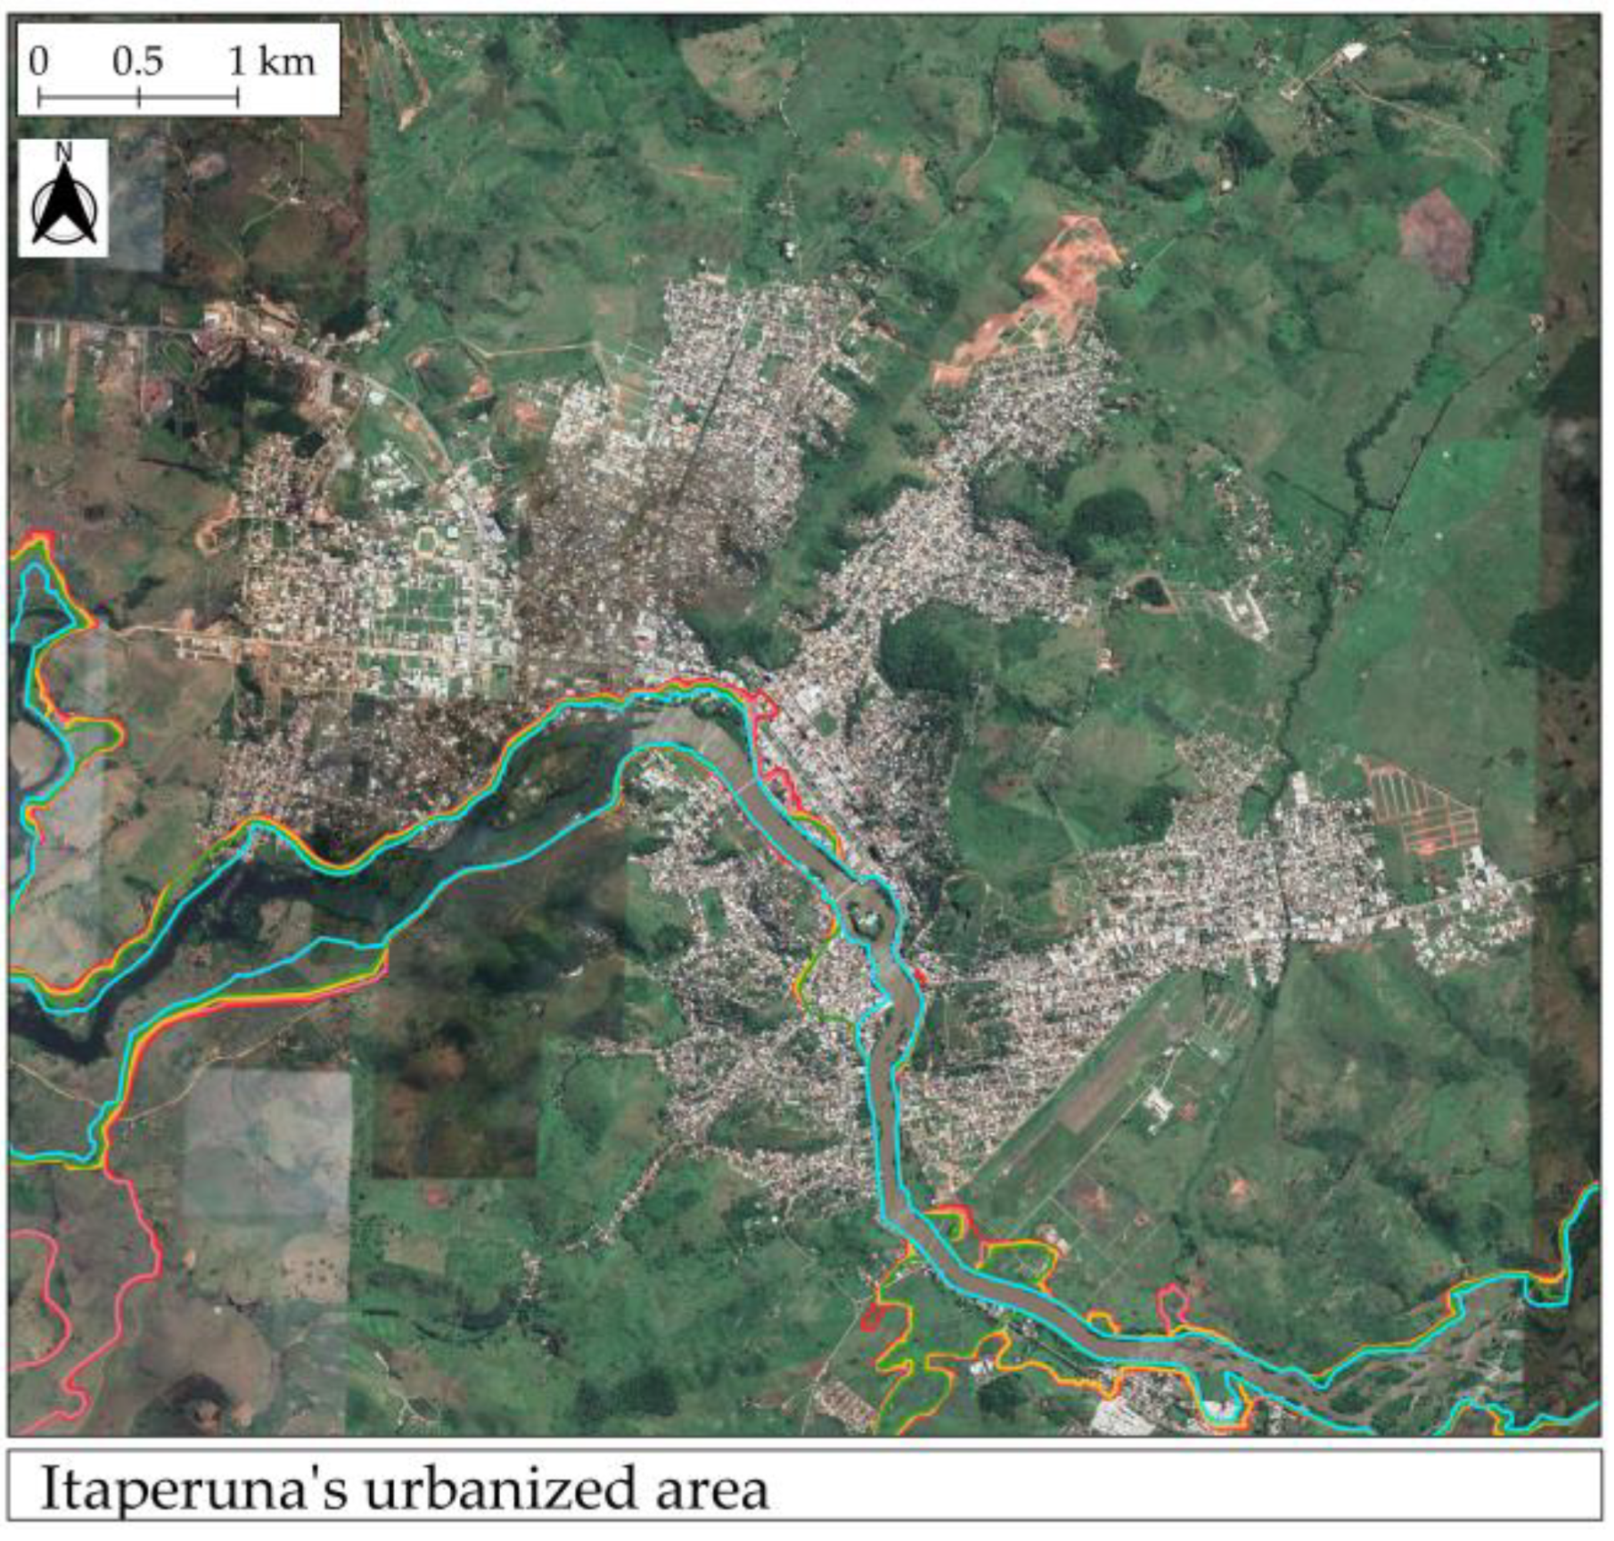
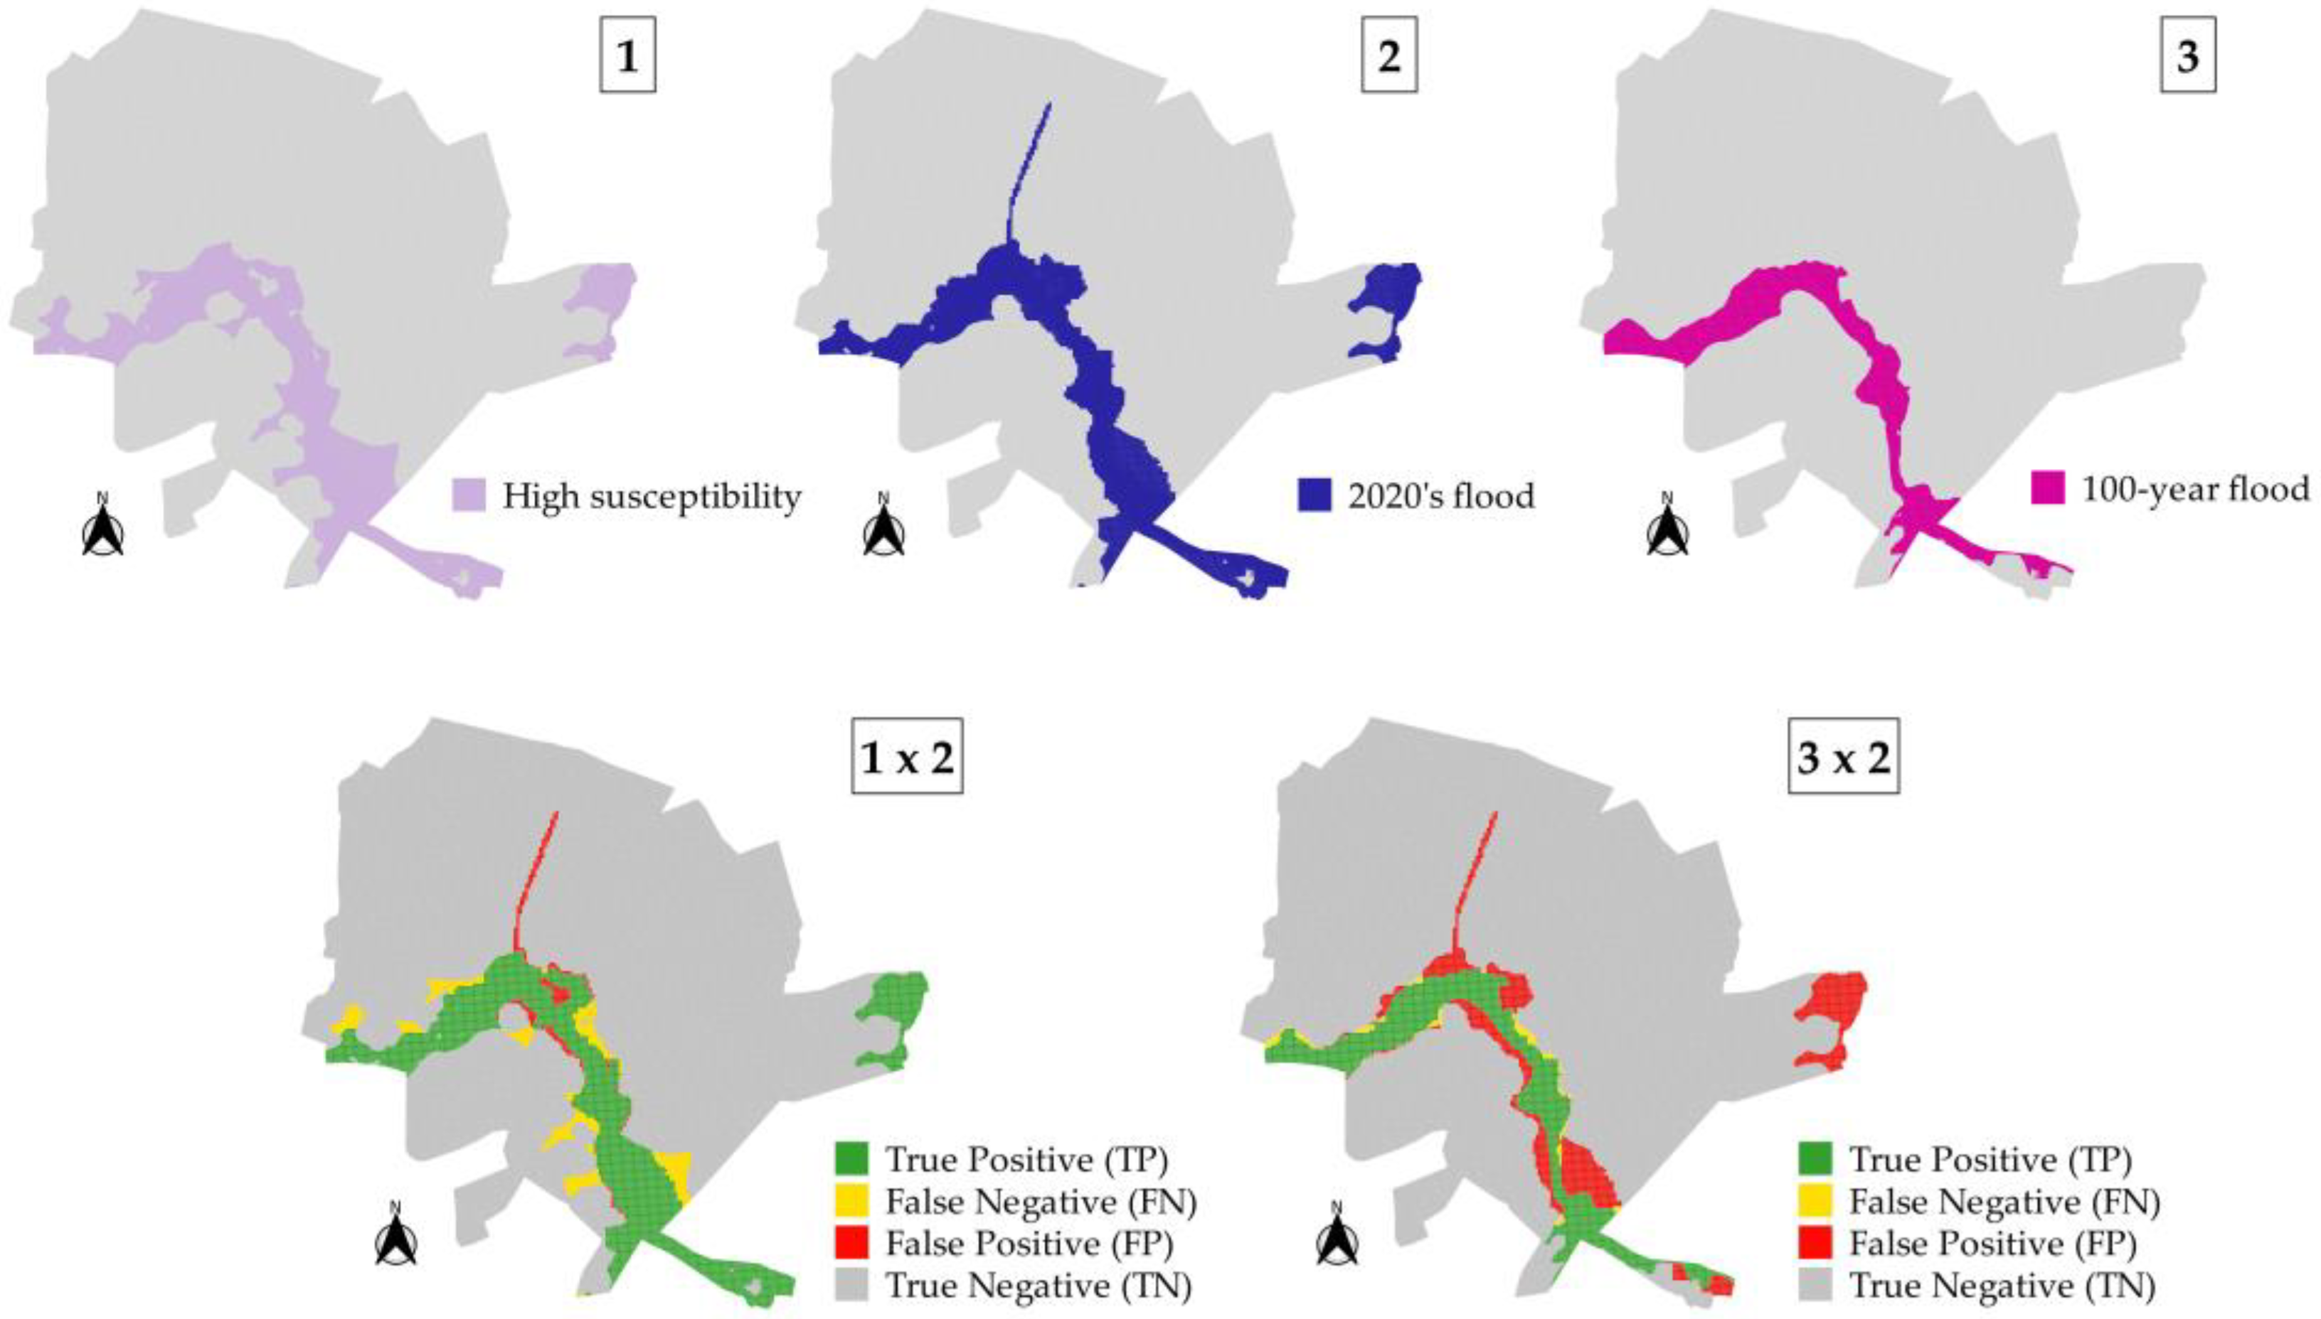
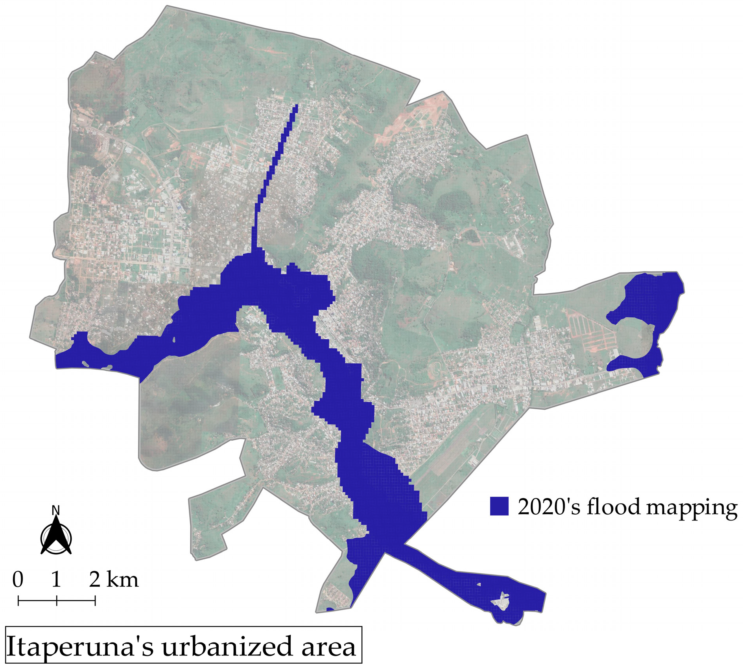
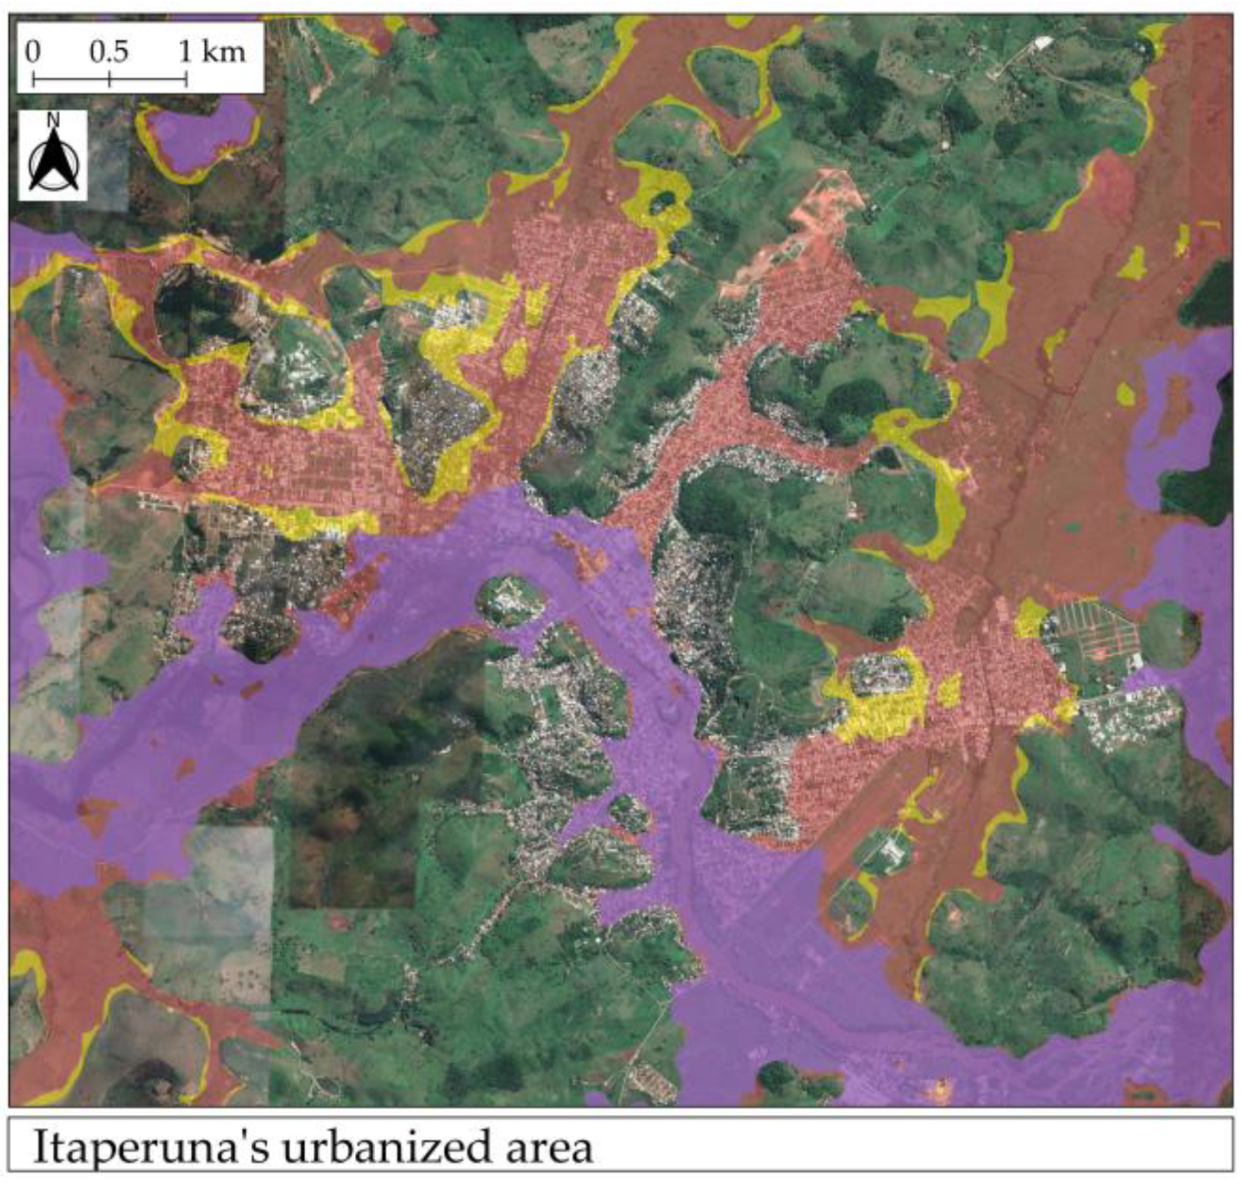
Evaluation of Flood Susceptibility Maps
Predicted Maps
Real Flooding Map
Cross-Tabulation Method
1) Transitory Factors Map
1) Transitory Factors Map
55,2%
Probability of Detection
44,8%
Miss
Rate
2) Permanent Factors Map
94,4%
Probability of Detection
5,6%
Miss
Rate
2) Permanent Factors Map
Transitory Factor:
The recurrence of floods in the municipality of Itaperuna requires special attention due to its essential role in the North/Northwest region of the State of Rio de Janeiro.
In December 2014, the Critical Events Alert System (SACE) was implemented in the Muriaé River Basin to perform basin monitoring, hydrological forecasts and measurements control to mitigate impacts on the population.

Slide 5
Final Considerations
Spatial analysis of the rain gauges: sparse distribution (low fractal dimension);
Impacts on the choice and construction of flood susceptibility maps (based on transitory or permanent factors).
References
Campos, P.C.d.O.; Paz, I. Spatial Diagnosis of Rain Gauges’ Distribution and Flood Impacts: Case Study in Itaperuna, Rio de Janeiro—Brazil. Water 2020, 12, 1120.
IBGE—Instituto Brasileiro de Geografia e Estatística. Agência IBGE Notícias. Available online: https://agenciadenoticias.ibge.gov.br/agencia-sala-de-imprensa/2013-agencia-de-noticias/releases/25278-ibge-divulga-as-estimativas-da-populacao-dos-municipios-para-2019 (accessed on 2 November 2019).
INEA Instituto Estadual de Ambiente. Monitoramento Hidrometeorológico. Available online: http://www.inea.rj.gov.br/ar-agua-e-solo/monitoramento-hidrometeorologico/ (accessed on 21 February 2020).
Lovejoy, S.; Schertzer, D.; Tsonis, A.A. Functional box-counting and multiple elliptical dimensions in rain. Science 1987, 235, 1036–1038.
Suria, S.; Mudgal, B.V. Impact of urbanization on flooding: The Thirusoolam sub watershed A case study. J. Hydrol. 2012, 412–413, 210–219.
Paz, I.; Willinger, B.; Gires, A.; Ichiba, A.; Monier, L.; Zobrist, C.; Tisserand, B.; Tchiguirinskaia, I.; Schertzer, D. Multifractal Comparison of Reflectivity and Polarimetric Rainfall Data from C-and X-Band Radars and Respective Hydrological Responses of a Complex Catchment Model. Water 2018, 10, 269.
Paz, I.; Tchiguirinskaia, I.; Schertzer, D. Rain gauge networks’ limitations and the implications to hydrological modelling highlighted with a X-band radar. J. Hydrol. 2020, 583, 124615.
Peleg, N.; Ben-Asher, M.; Morin, E. Radar subpixel-scale rainfall variability and uncertainty: Lesson learned from observations of a dense rain-gauge network. Hydrol. Earth Syst. Sci. 2013, 17, 2195–2208.

