Slide 1
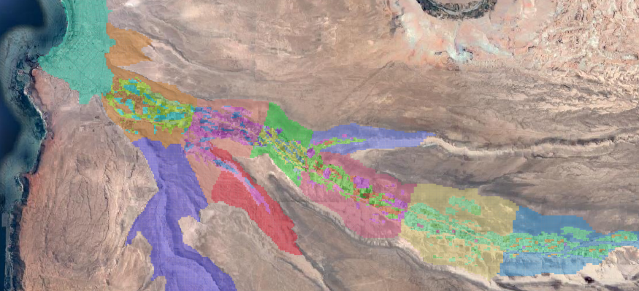
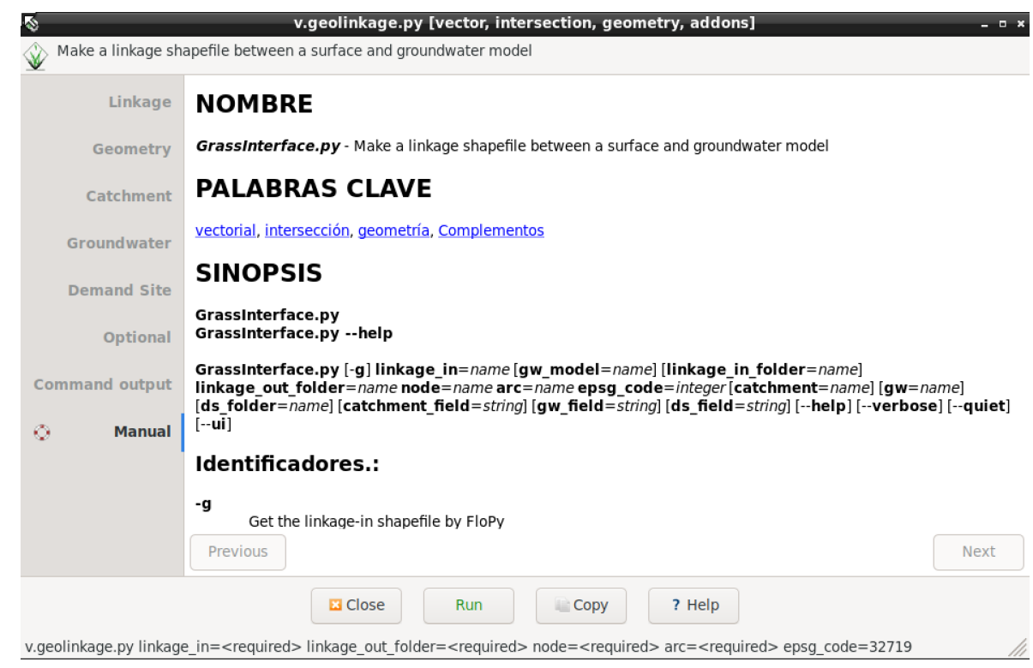
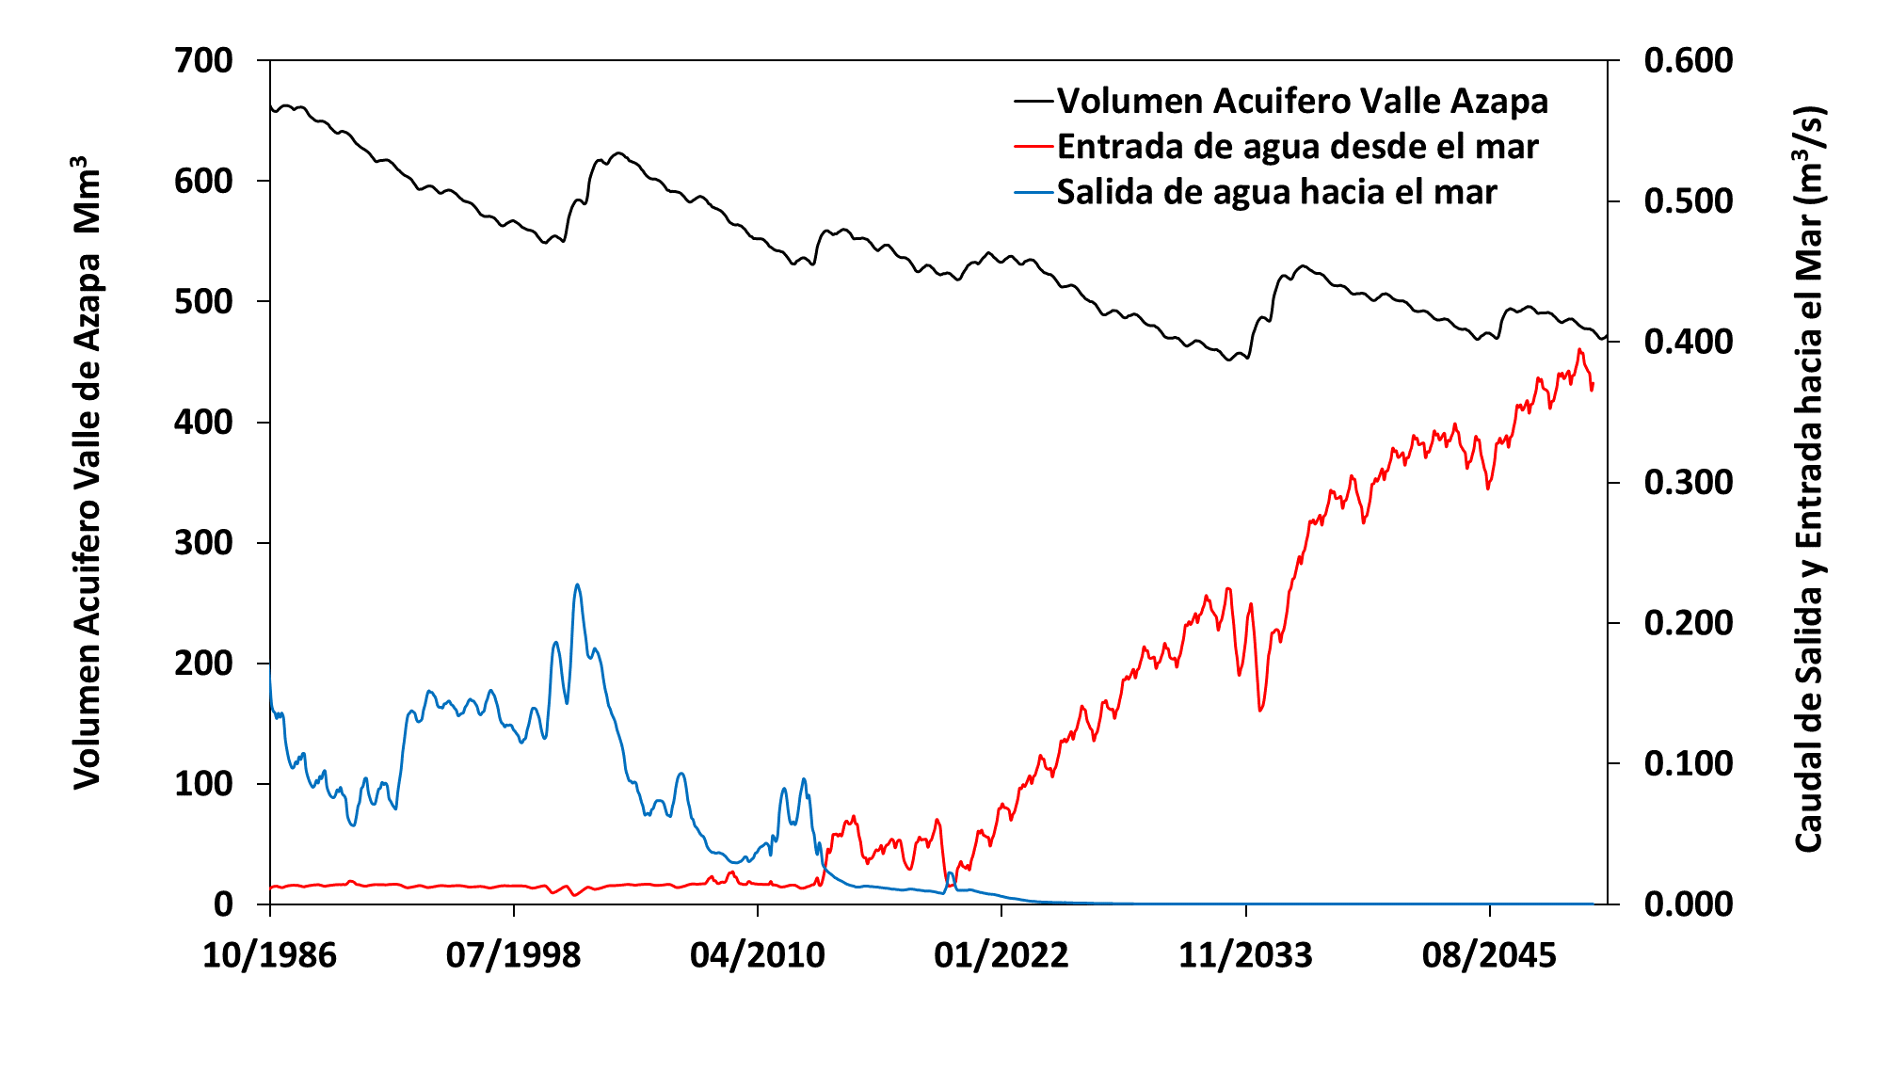
GeoLinkage: A GRASS-GIS plugin to integrate surface waters and groundwater
in WEAP-MODFLOW models
F. Troncoso, N. Hitschfeld, P. Sanzana, F. Suárez, J-F Muñoz Hydro-informatics Session
Pre-Procesing
Hyper-Arid Desert
Azapa Valley
WEAP-Modflow (SEI; USG)
-Past and Future Scenarios
Layers
Polygon or Points:
1.-Catchments
2.- Demand Sites
2.1.- Irrigation
2.2.- Industry
2.3.- Minning
2.4.- Wetlands
GeoLinkage.py
Arica
City
GeoLinkage Mesh
Azapa Valley
Final Linkage MESH
Urban and Agricultural
over-pumping aquifer
Graphical User Interface
Post-procesing
Volume Aquifer
GW Out to Sea
GW Inlet from Sea
Past Future
Chile
felipe.troncoso.uc@gmail - ppsanzana@uc.cl

