Slide 1




Water storage of tropical alpine catchments at the top of the Andes
How well do standard laboratory methods reflect the water retention curve of Andosols?
Giovanny Mosquera
Postdoctoral Researcher USFQ
  vEGU2021
  28-Apr-2021

Slide 2
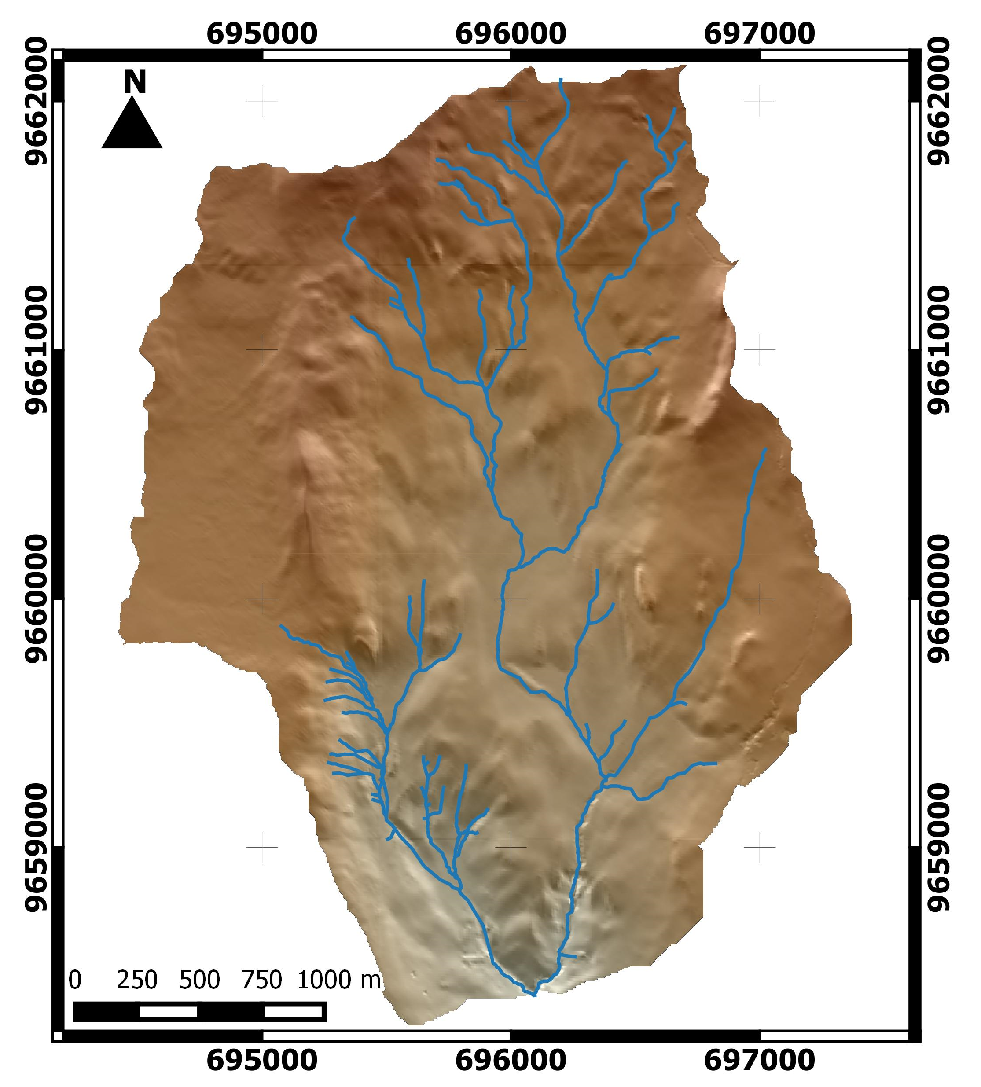
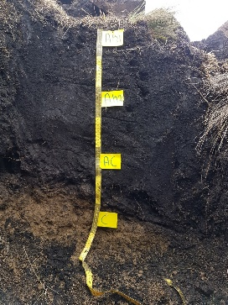
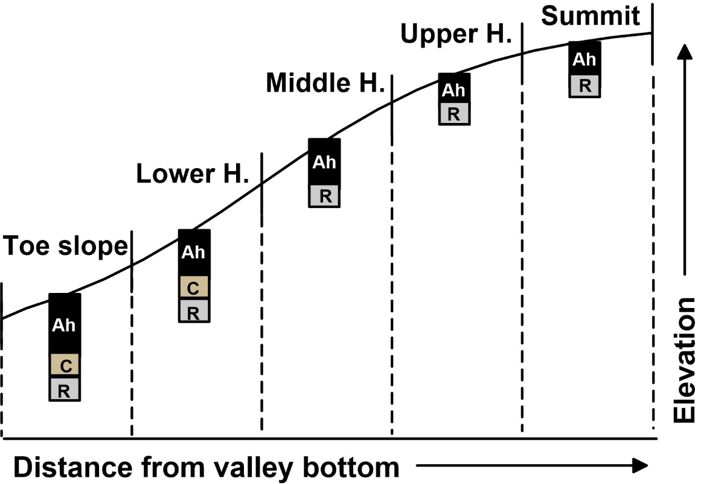
Study site
Zhurucay Ecohydrological Observatory
Andosols (Ah)
72% study area
Hillslopes
Ah
Drainage area:
7.5 km²

Slide 3
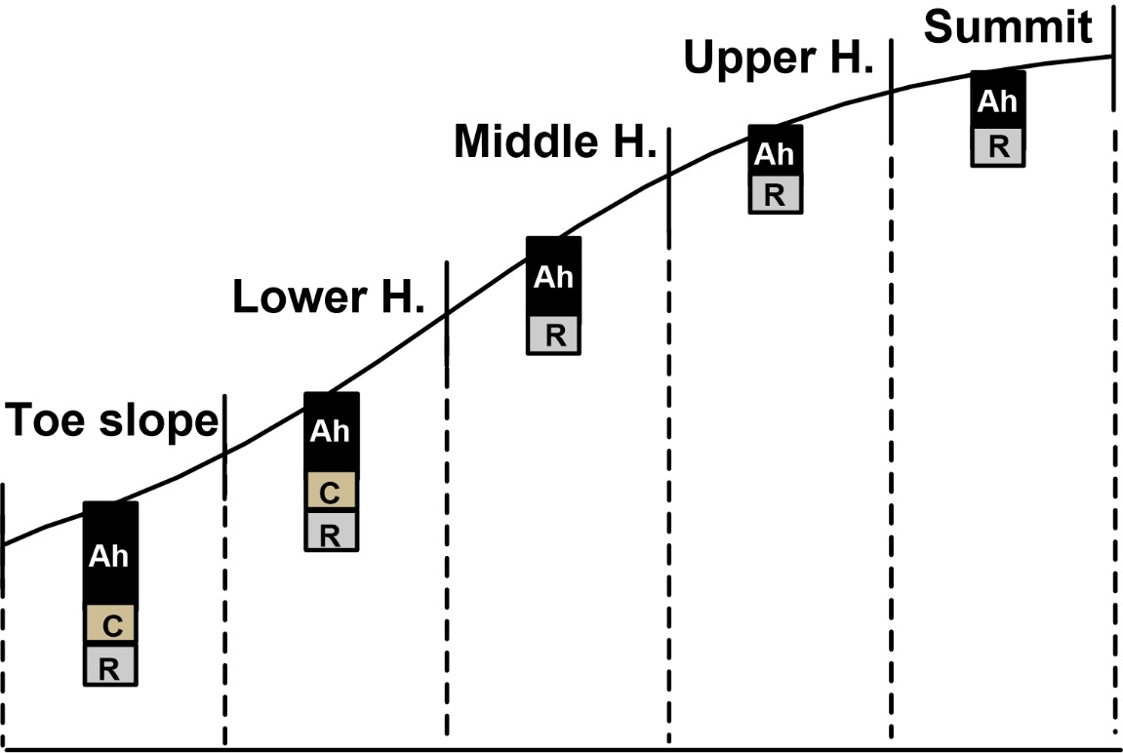
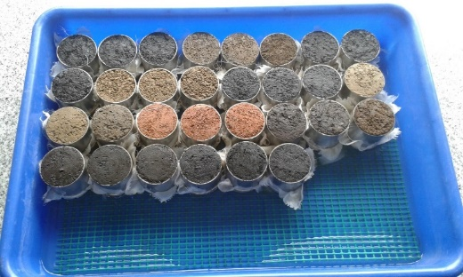
Materials and methods
Laboratory (standard) WRC
Forty one sampling locations
Three transects
100 cm³ volume samples
Hydrostatic equilibrium
(Sand box &Pressure plate)

Slide 4
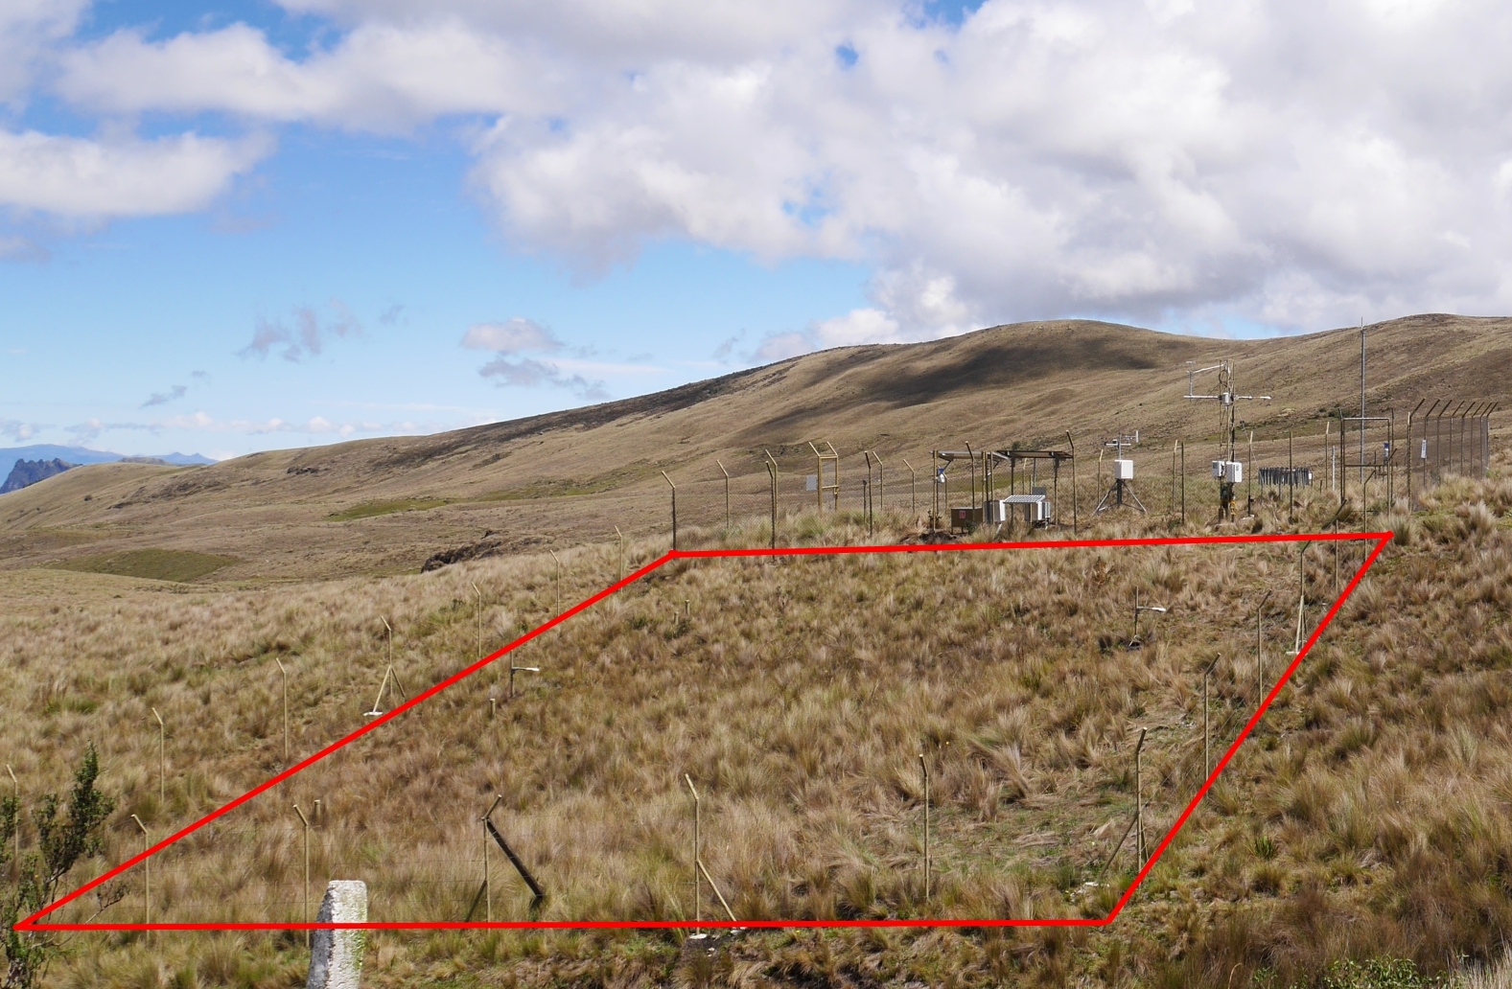
Materials and methods
Field (correct) WRC
Soil moisture content
Matric potential (pF ~2.9)
Environmental conditions
Monitoring period 2011-2018

Slide 5
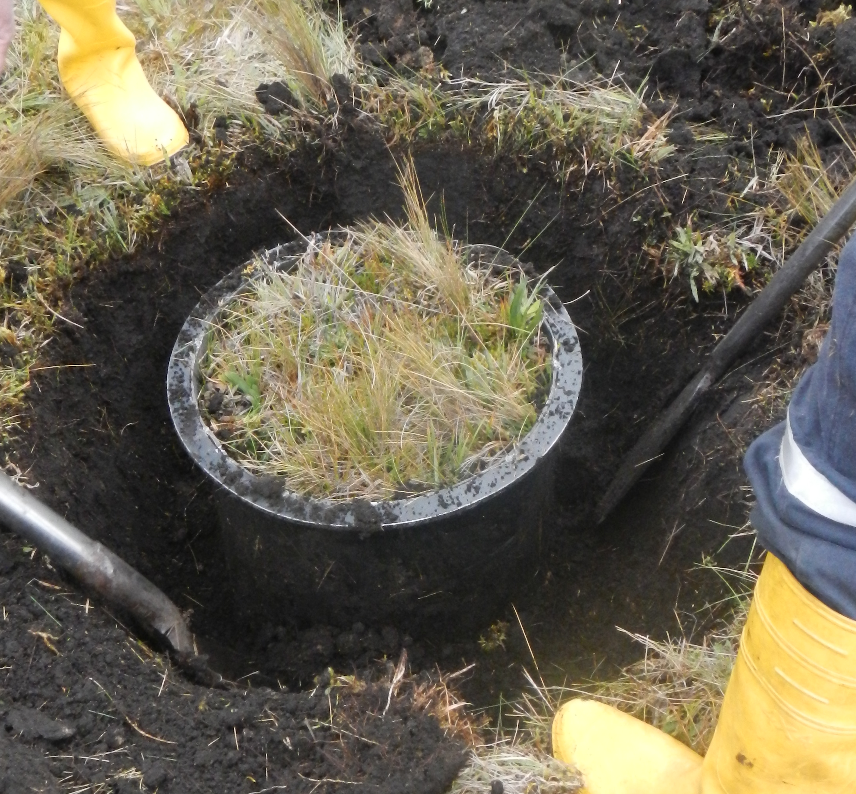
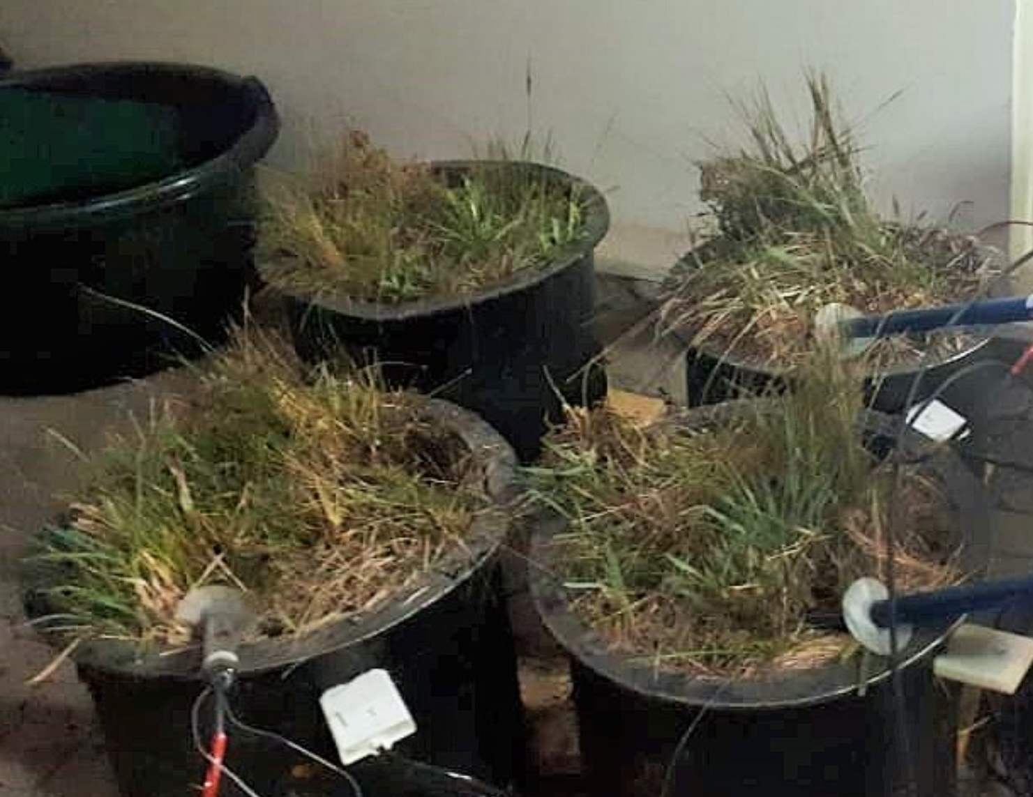
Materials and methods
Experimental WRC
Three soil cores (40,000 cm³)
Soil moisture content
Matric potential
Desiccation experiment

Slide 6

Materials and methods
www.thesisscientist.com
Compiled WRC data (Literature review)
16 articles → 71 WRC similar conditions
Standard laboratory methods (Hydrostatic equilibrium)
Small soil samples (<300 cm³ volume)

Slide 7
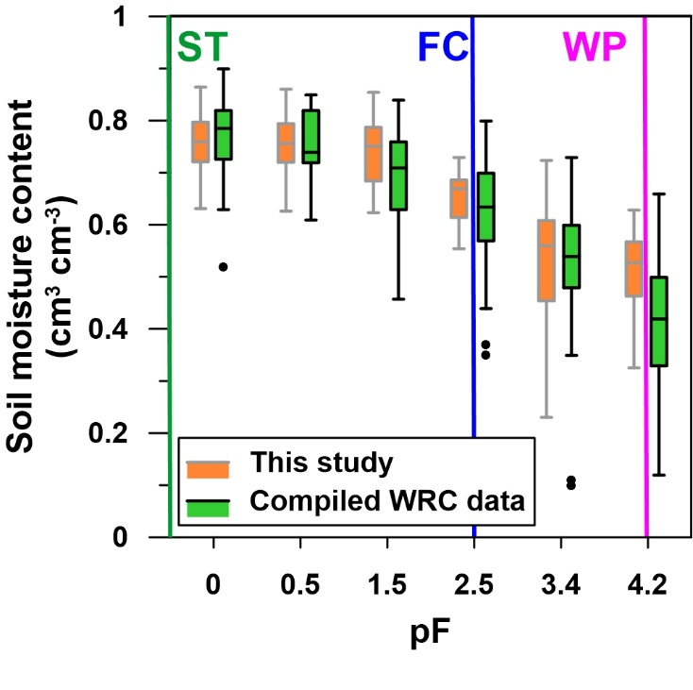
Water retention curves of Andosols
Notes:
Buytaert: Multistep outflow, porous membrane (pF 3.4 and 4.2) and air-dry moisture (pF 5.9): Soroche & Huagrauma
Iñiguez: pressure chambers and multi-step. Calluancay

Slide 8
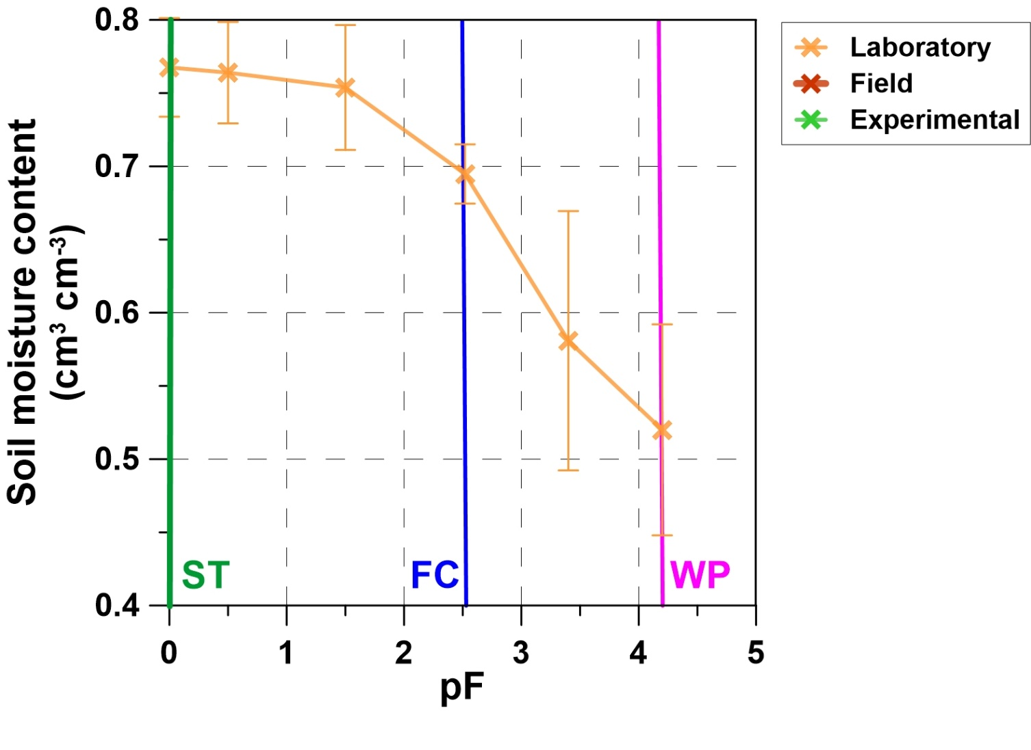
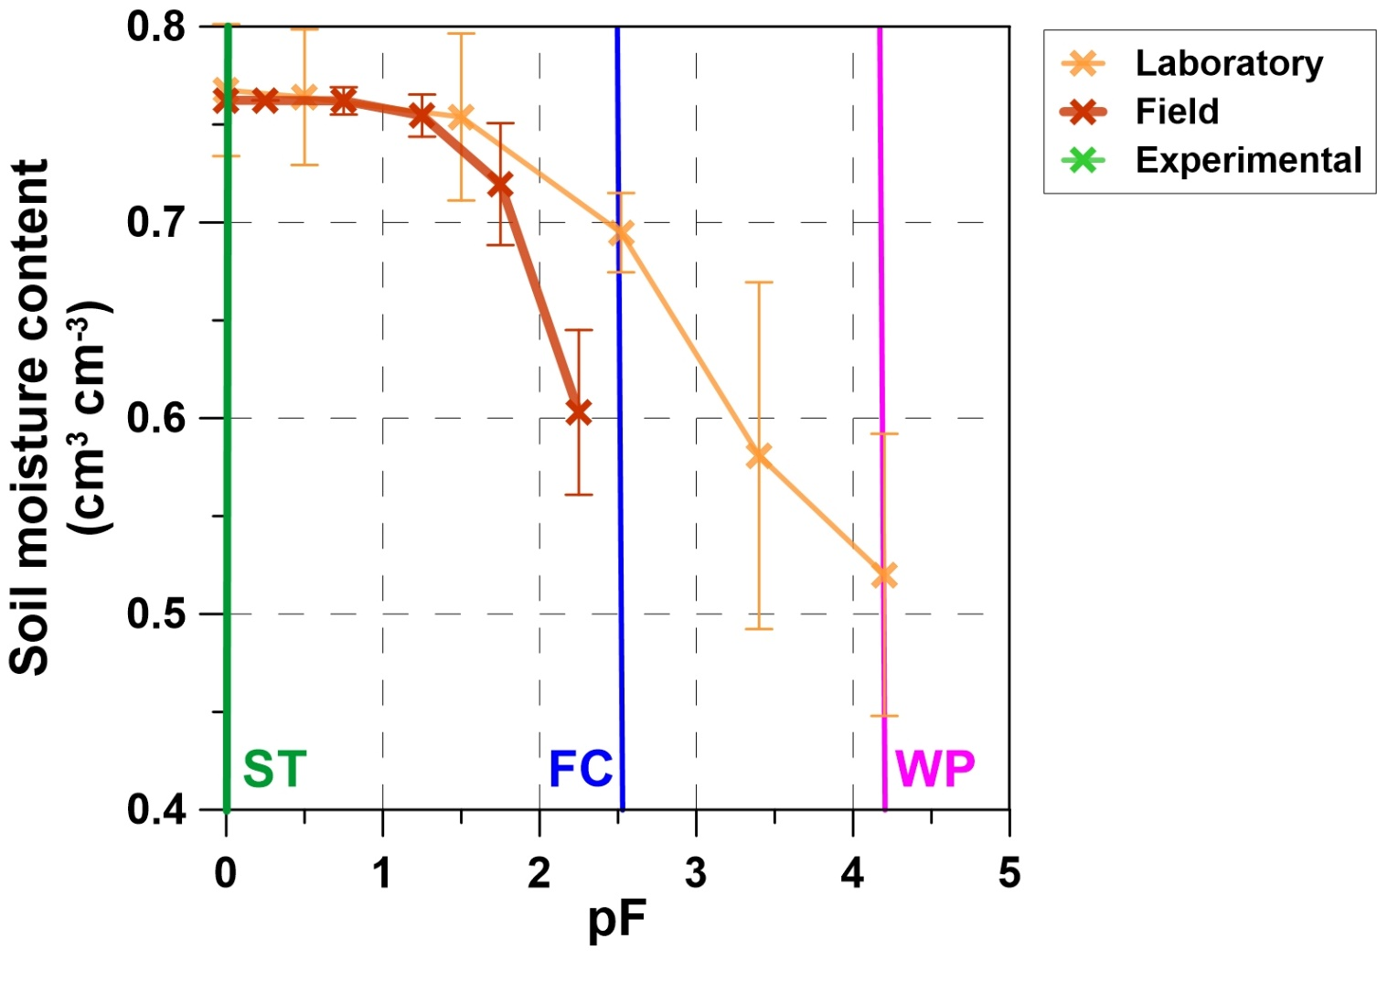
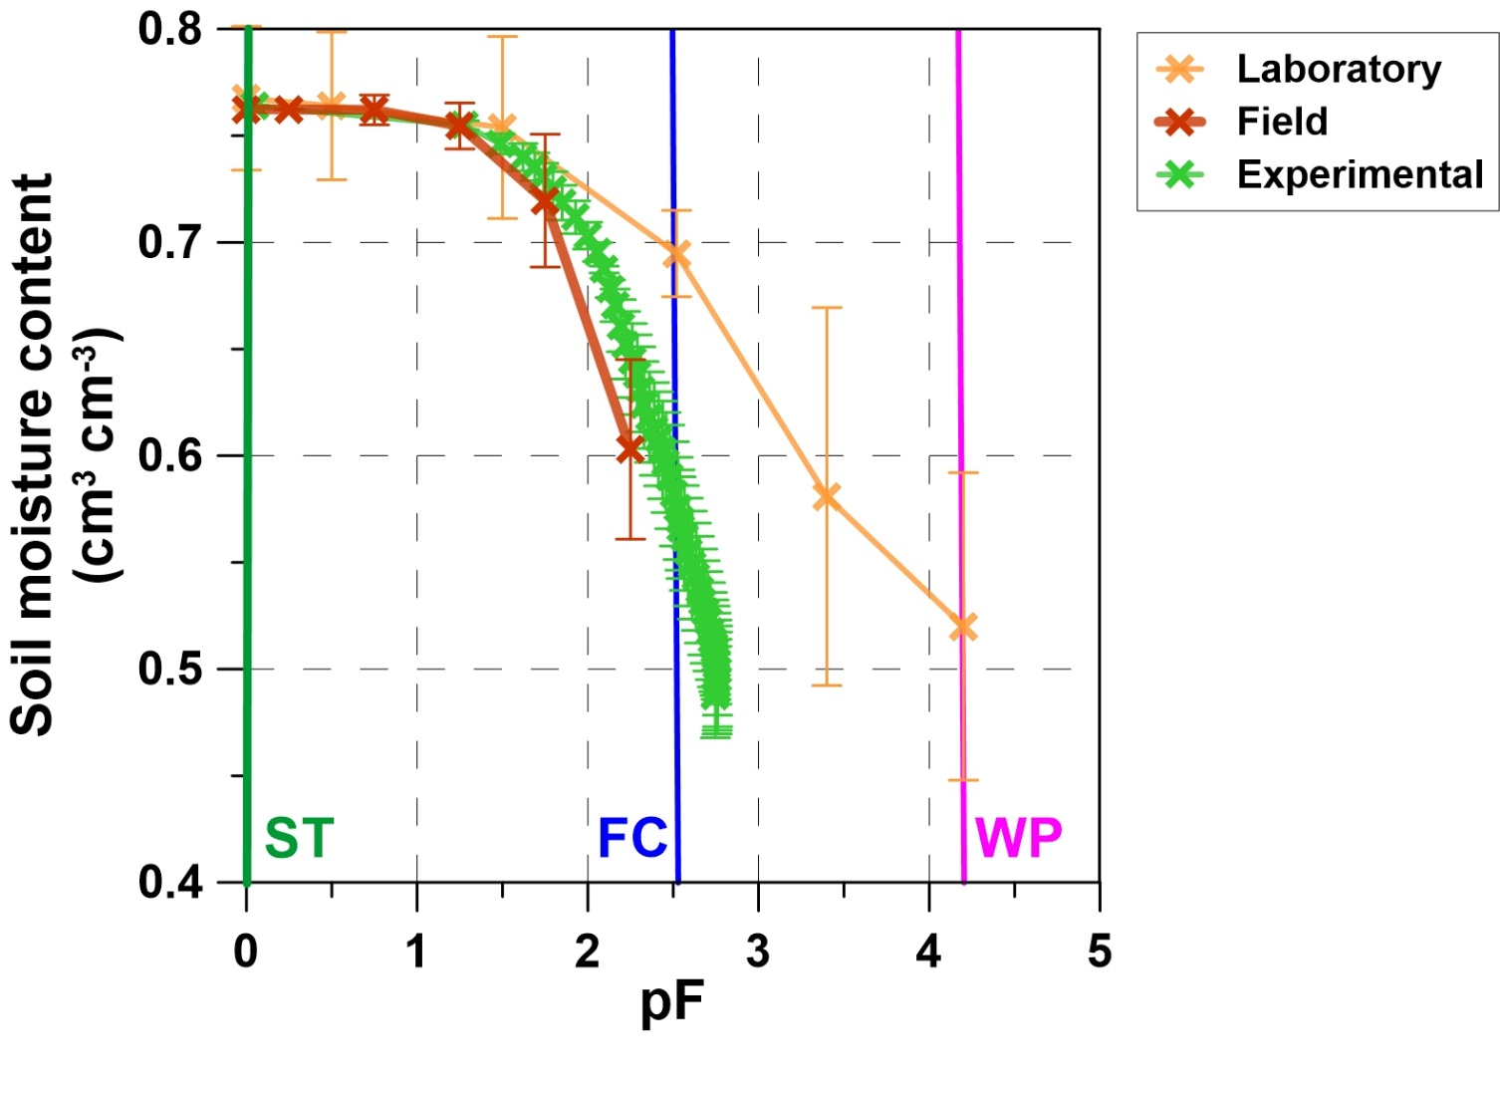

How well do standard laboratory methods
reflect field conditions?
- Standard laboratory methods resemble well
WRC up to pF 1.5
- Overestimate water content for higher pFs

