Slide 1

Tropospheric Dispersive Phase Anomalies during Heavy Rain Detected by L-band InSAR and Their Interpretation
ESSI2.10, EGU21-13944
Naufal Setiawan and Masato Furuya

Slide 2
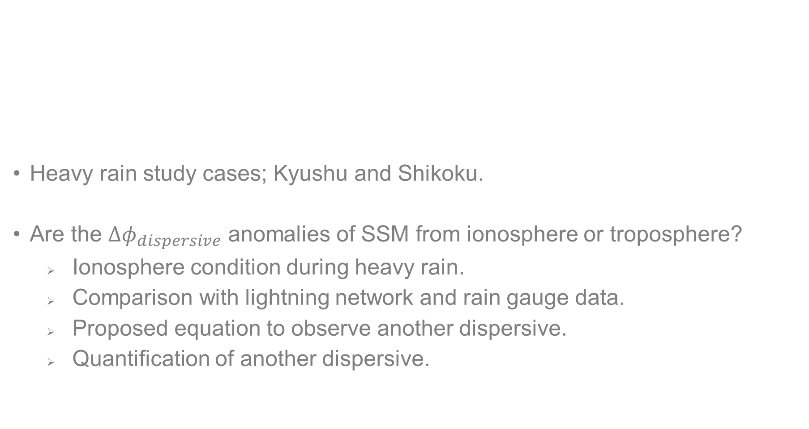
Contents.
Introduction.
Split-spectrum method.
Previous study.
Study objective.
Heavy rain study cases; Kyushu and Shikoku.
Are the ${∆φ}_{dispersive}$ anomalies of SSM from ionosphere or troposphere?
Ionosphere condition during heavy rain.
Comparison with lightning network and rain gauge data.
Proposed equation to observe another dispersive.
Quantification of another dispersive.

Slide 3





Split-spectrum method → Dual freq. observation
Bw₀ (original)
Bw_{L}
Bw_{H}
InSAR has been based on a single frequency observation, but SSM allows us to perform dual frequency obs. like GNSS to “correct for” the ionospheric dispersive phase. High/Low InSAR phases consist of ${∆φ}_{dispersive}$ and ${∆φ}_{non−dispersive}$ with distinct factors, depending on the frequencies.
f_{L}
f₀
f_{H}
$${∆φ}_{non−dispersive}= \frac{f_{0}}{\left(f_{H}^{2}−f_{L}^{2}\right)} \left({∆φ}_{H}{ f}_{H}− {∆φ}_{L}{ f}_{L}\right)$$
$${∆φ}_{H}={∆φ}_{non−disper. }\frac{f_{H}}{f_{0}}+{∆φ}_{dispersive}\frac{f_{0}}{f_{H}}$$
$${∆φ}_{L}={∆φ}_{non−disper. }\frac{f_{L}}{f_{0}}+{∆φ}_{dispersive}\frac{f_{0}}{f_{L}}$$
$${∆φ}_{dispersive}= \frac{f_{H}{ f}_{L}}{f_{0} \left(f_{H}^{2}−f_{L}^{2}\right)} \left({∆φ}_{L}{ f}_{H}− {∆φ}_{H}{ f}_{L}\right)$$
Water Vapor
(+ Deformation)
Ionospheric TEC (1st order)

Slide 4
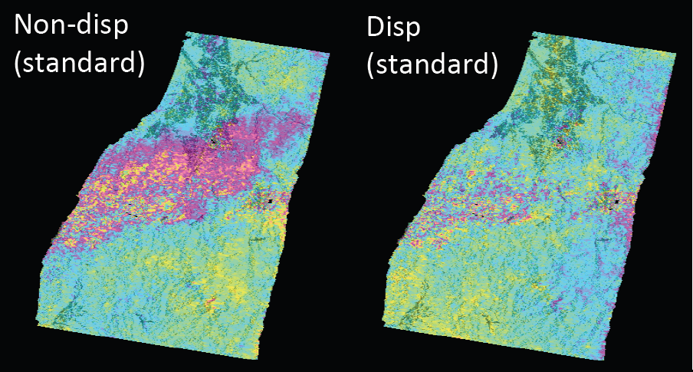
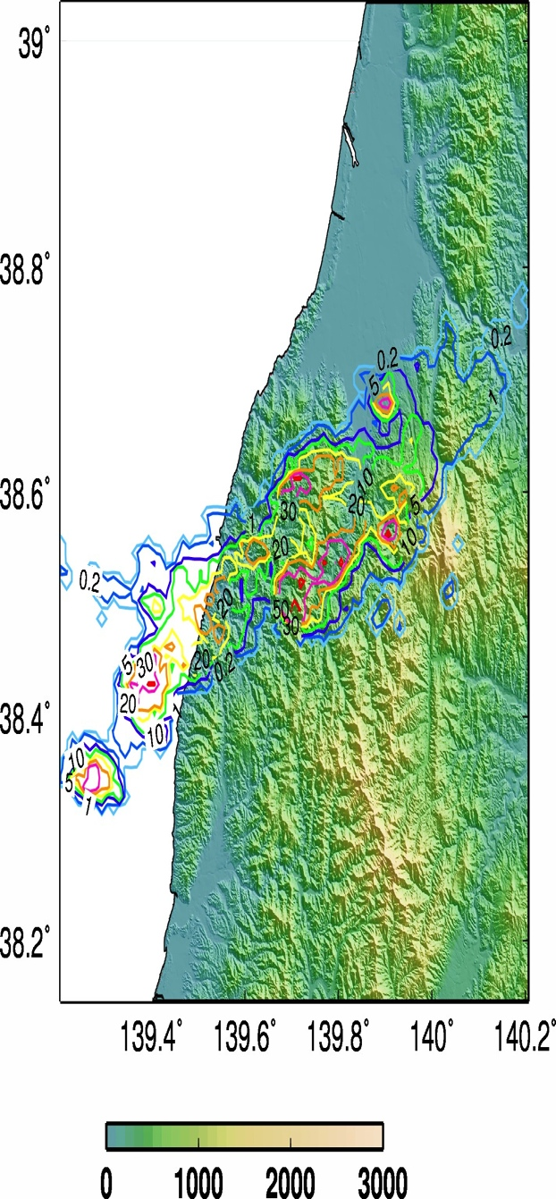
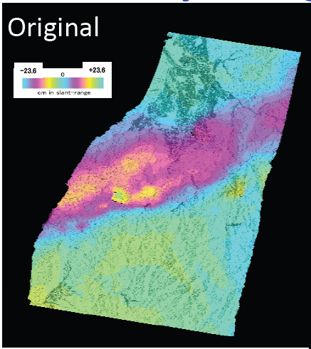

Previous study.
Rain radar by JMA
ALOS1 InSAR
Water vapor
Niigata-Yamagata study case. 20100525_20100825.
Furuya and Kinoshita, AGU, 2017.
Ionosphere?!

Slide 5
Interpretation 1; Relativistic Runaway Electron Avalanche.
Gamma ray emission is common phenomena near the top of thunderstorms. With similar process (RREA) to the terrestrial gamma ray flash (Kelley et al., 2015).
Thundercloud and lightning produce energetic runaway electrons, accompanying with x-ray and gamma ray emissions (e.g., Dwyer et al., 2012; Enoto et al., 2017).
Bremsstrahlung gamma ray
+ + + +
+ + + +
- - -- - -
Thundercloud = Electric field
e⁻
e⁻
- - -- - -
- - - -- -
e⁻
e⁻
- - -
Accelerated electron
e⁻
- - -
- - -
- - -
High-energy electron
+ + + +
Accelerated electrons → dispersive InSAR phase???

Slide 6
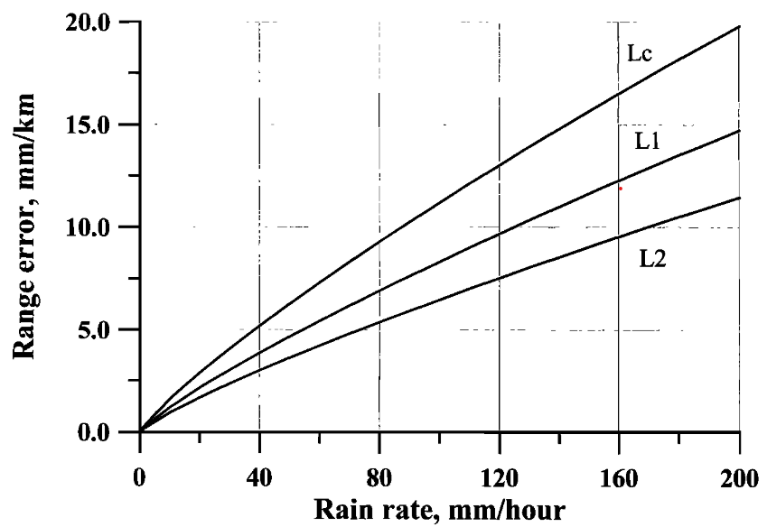
Interpretation 2; Rain Dispersive Effect.
Microwave propagation through rain undergoes an interaction with rain droplet, causing a complex refractivity (Van de Hulst.,1957; Crane, 1966).
Solheim et al. (1999) showed the dispersive effect of heavy rain on GPS, based on the scattering theory by Oguchi (1983).
Different errors as a function of frequency→
No previous studies demonstrated the effect of rain drop on real GNSS data, to our knowledge.
Solheim et al., JGR 1999.

Slide 7
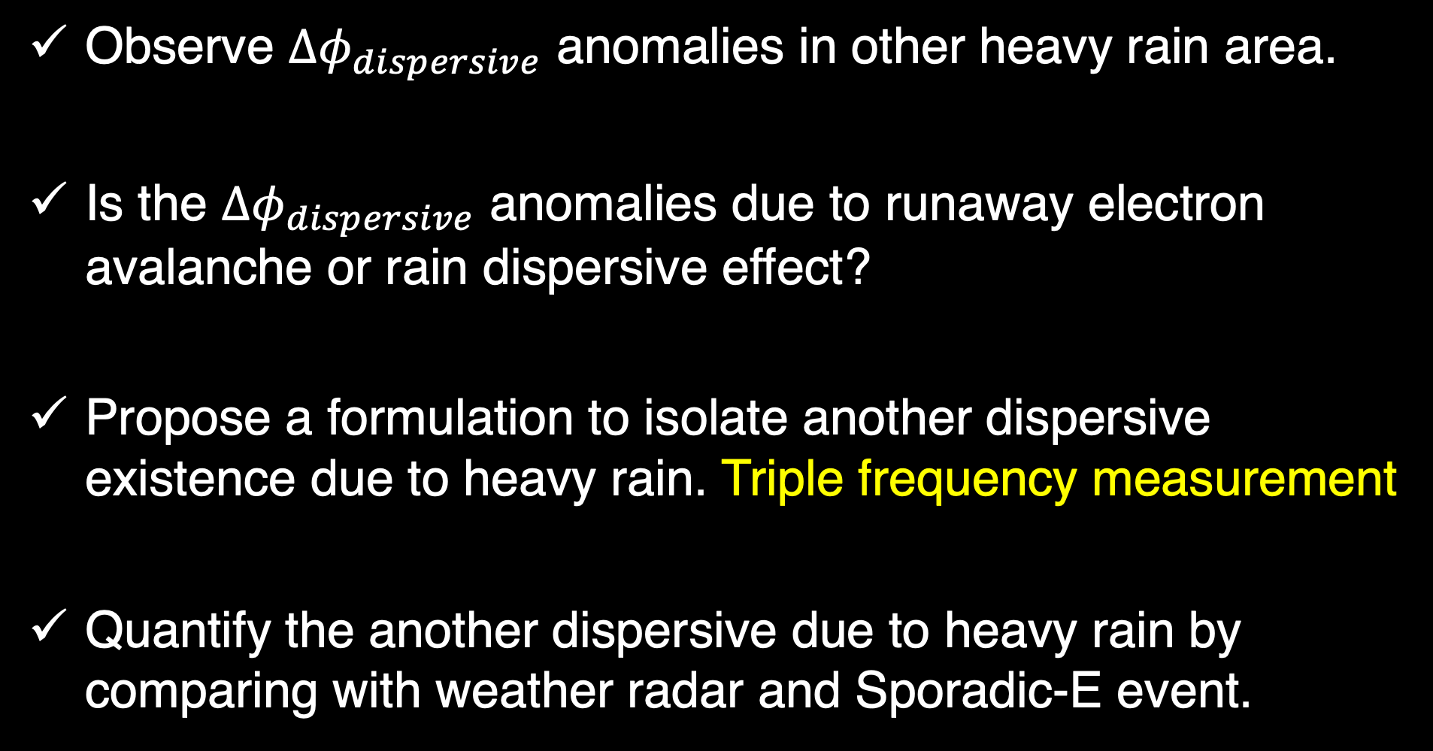
Study objective.
Observe ${∆φ}_{dispersive}$ anomalies in other heavy rain area.
Is the ${∆φ}_{dispersive}$ anomalies due to runaway electron avalanche or rain dispersive effect?
Propose a formulation to isolate another dispersive existence due to heavy rain. Triple frequency measurement
Quantify the another dispersive due to heavy rain by comparing with weather radar and Sporadic-E event.

Slide 8
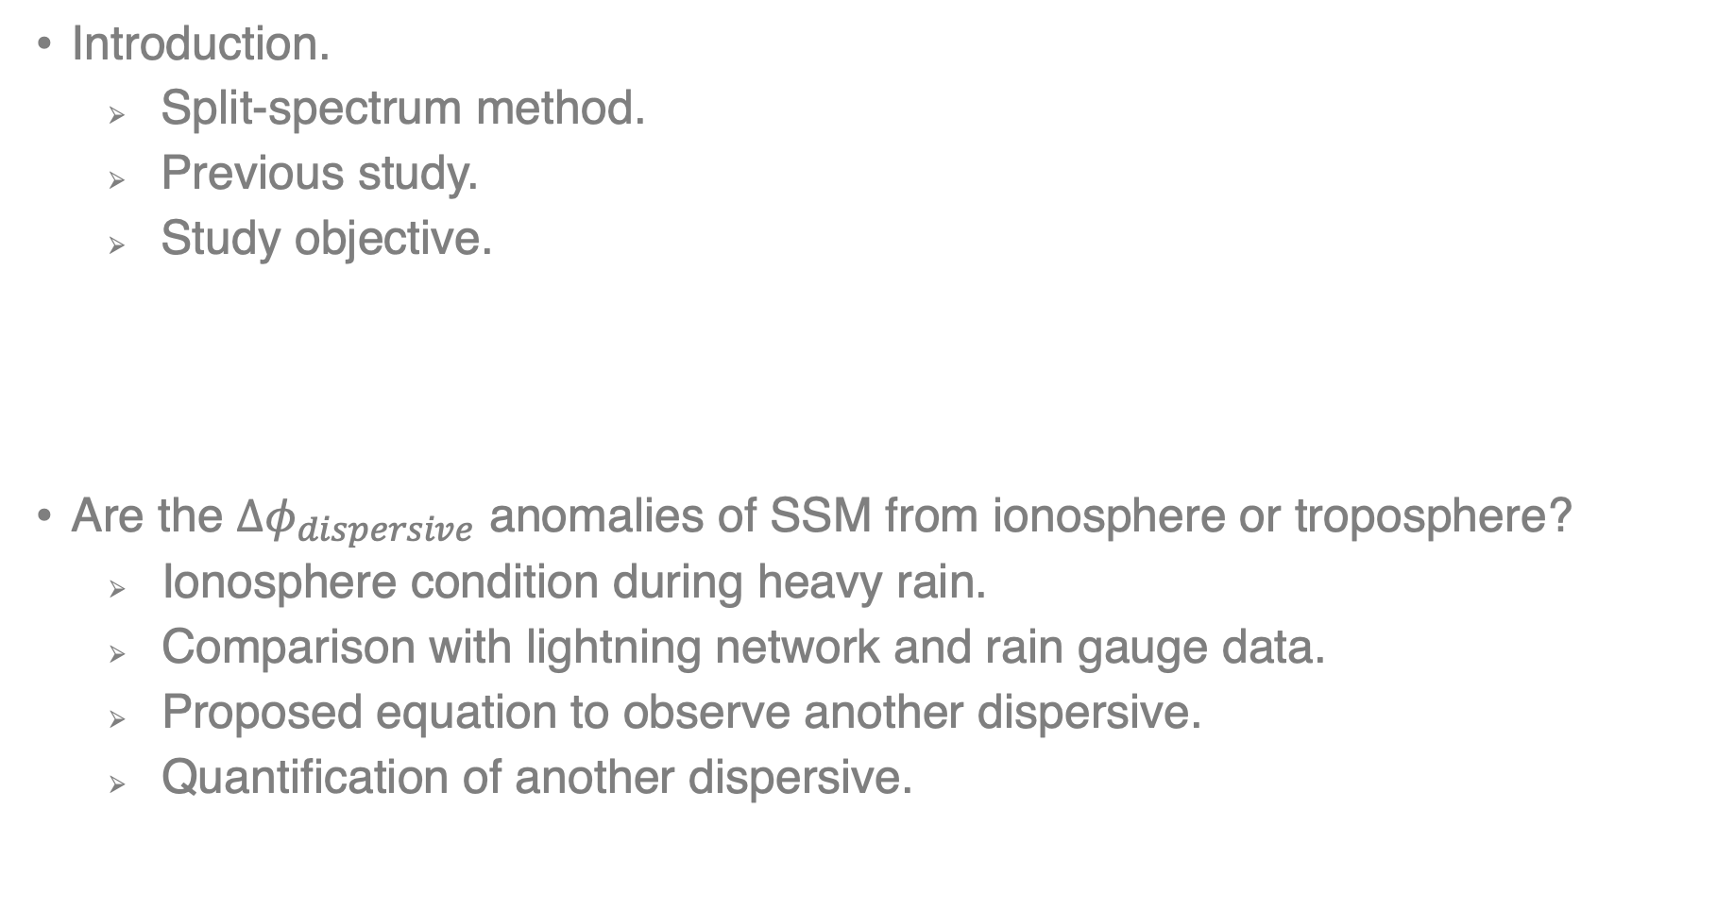
Contents.
Introduction.
Split-spectrum method.
Previous study.
Study objective.
Heavy rain study cases; Kyushu and Shikoku.
Are the ${∆φ}_{dispersive}$ anomalies of SSM from ionosphere or troposphere?
Ionosphere condition during heavy rain.
Comparison with lightning network and rain gauge data.
Proposed equation to observe another dispersive.
Quantification of another dispersive.

Slide 9
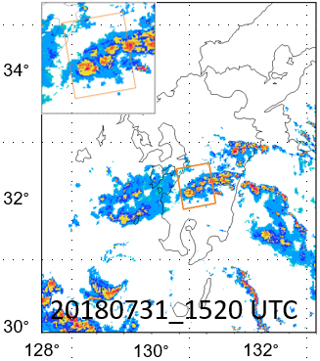
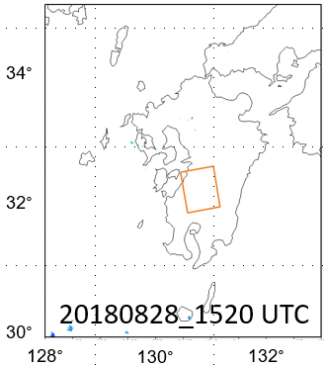
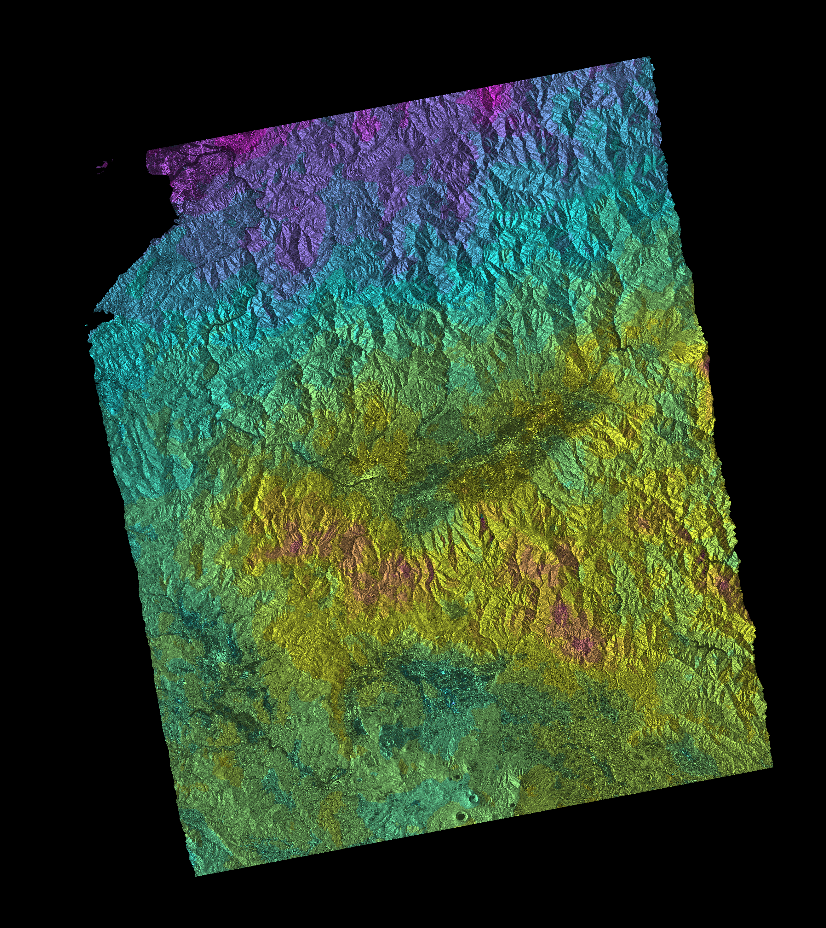
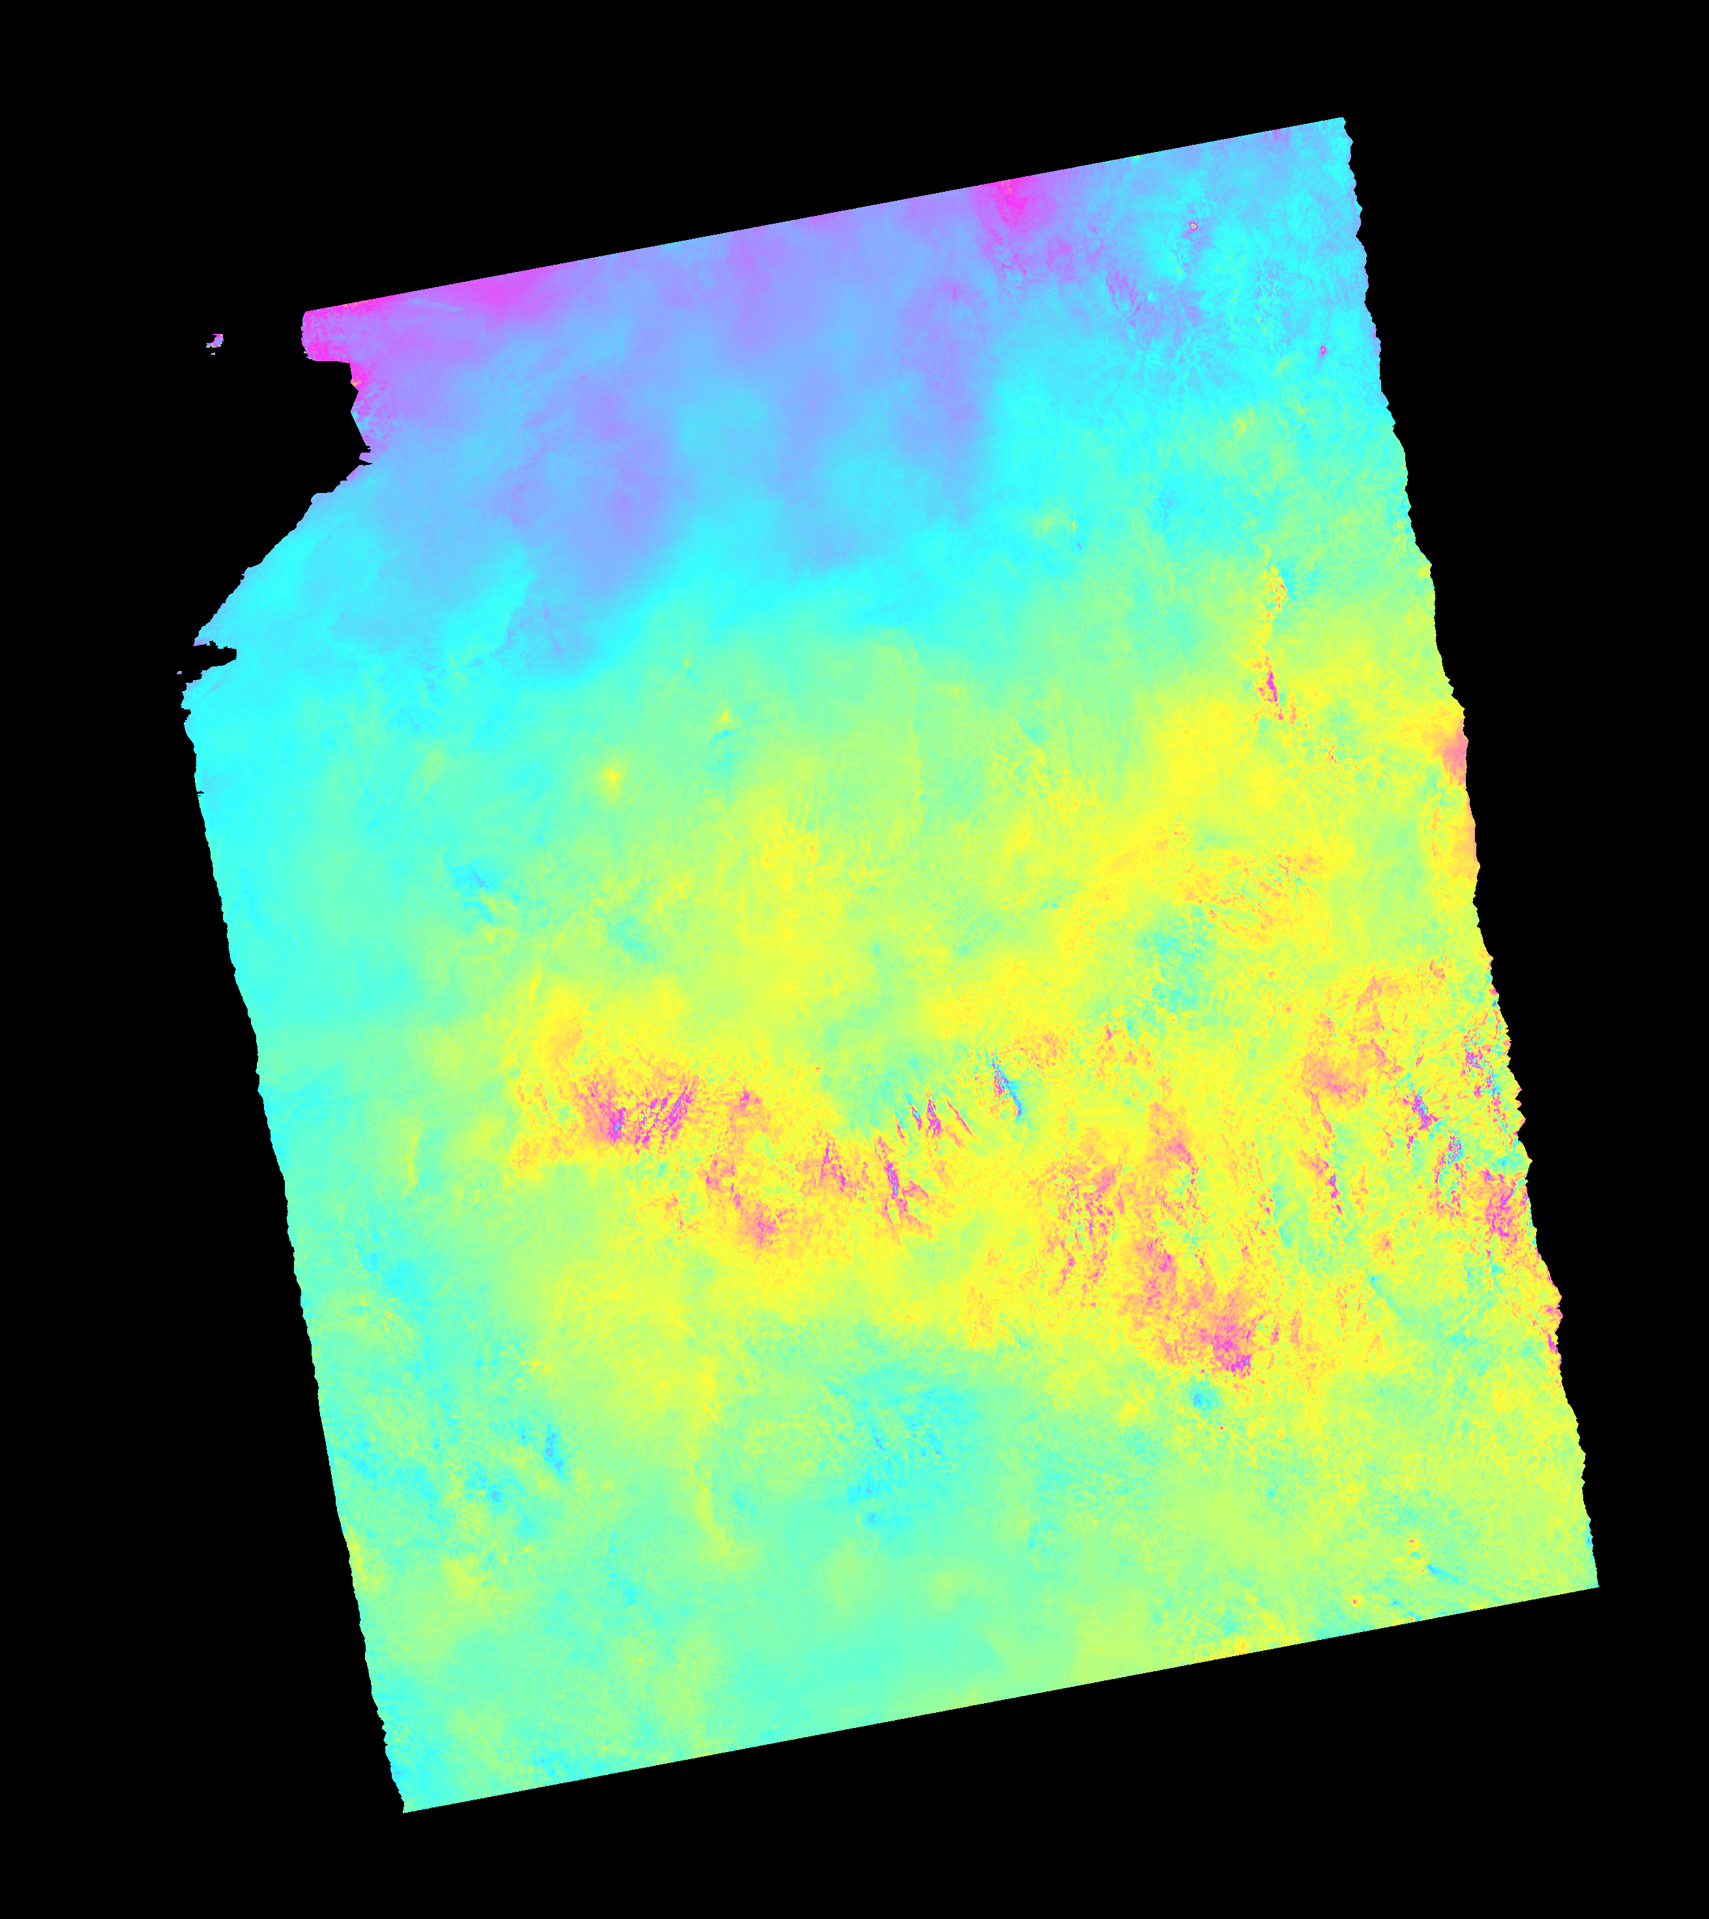
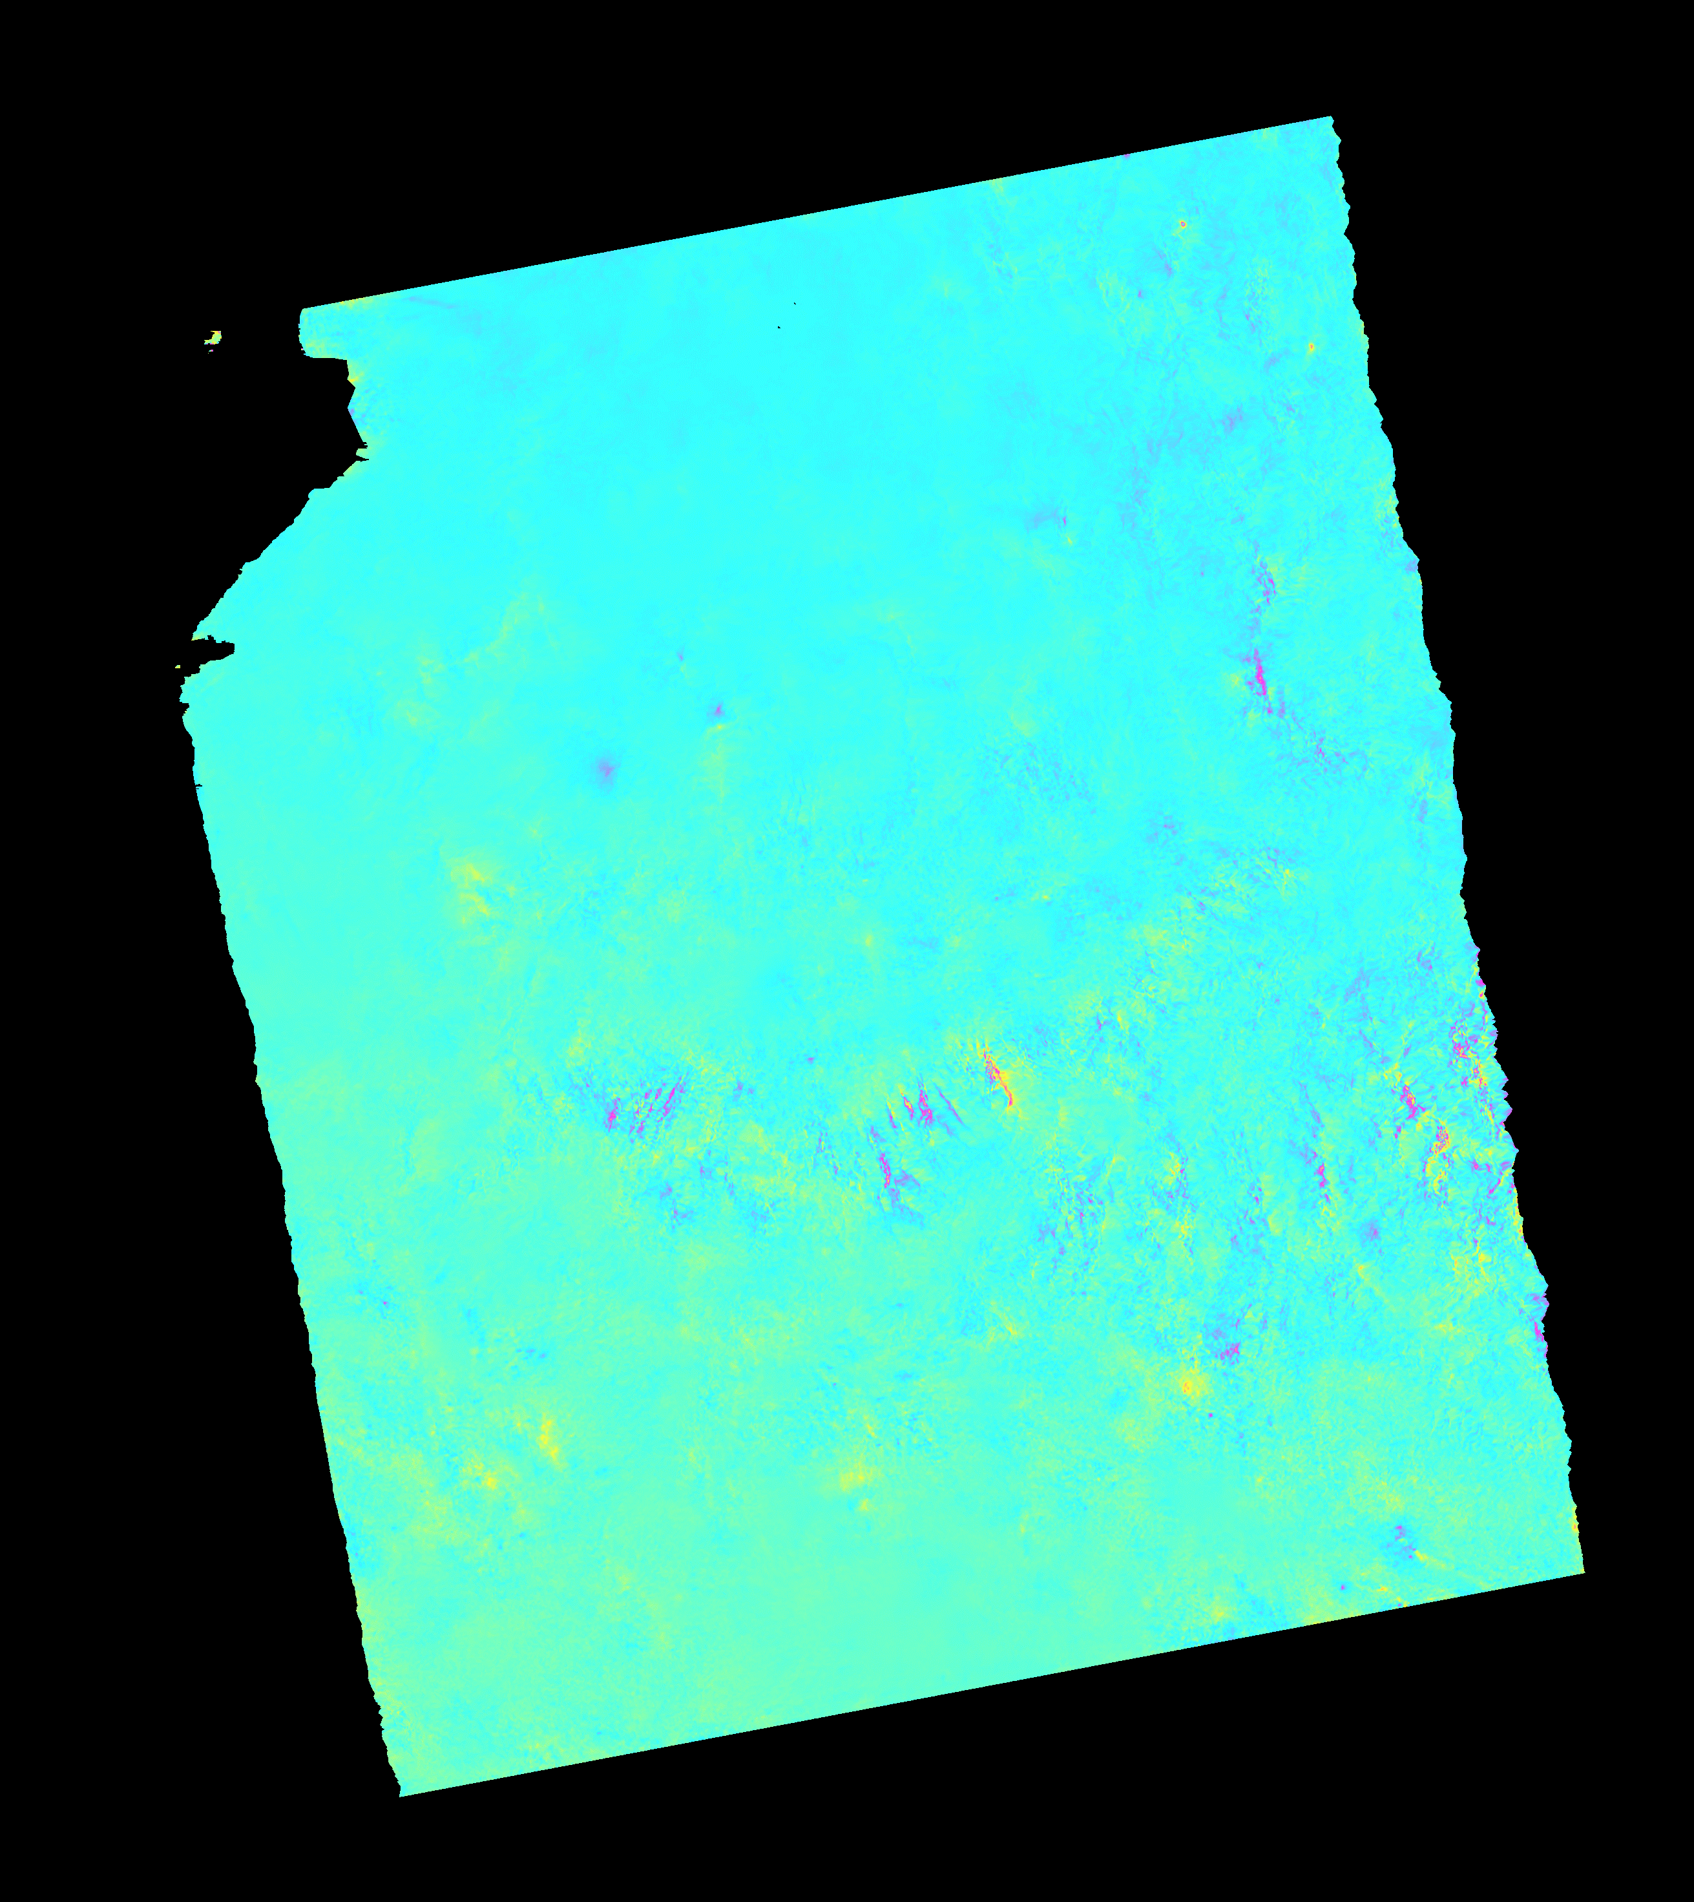


InSAR and SSM result. Kyushu.
Bpara: 8.0437 m
Bperp: 41.1592 m
Non-dispersive
Dispersive
Flight
LOS
20180731_20180828

Slide 10
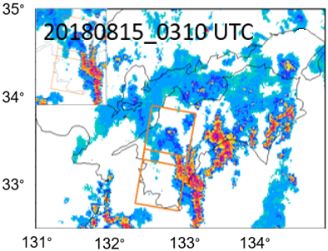
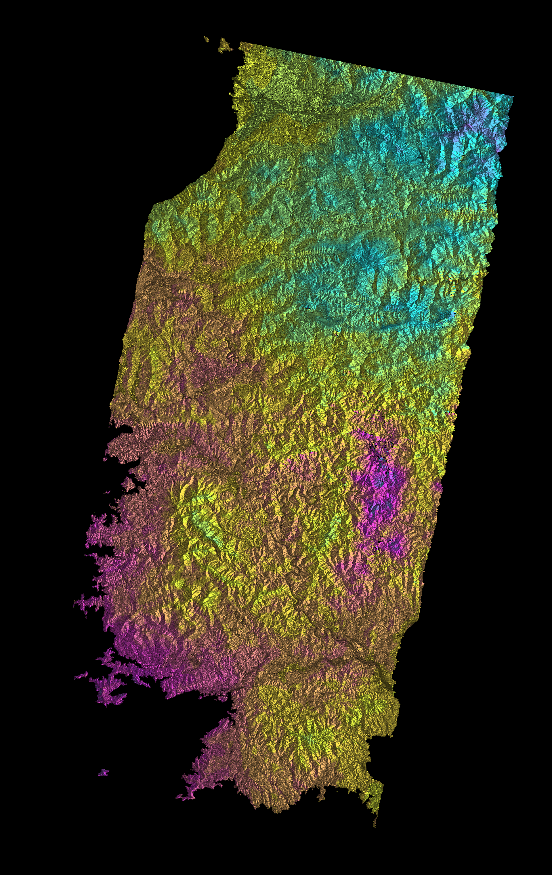
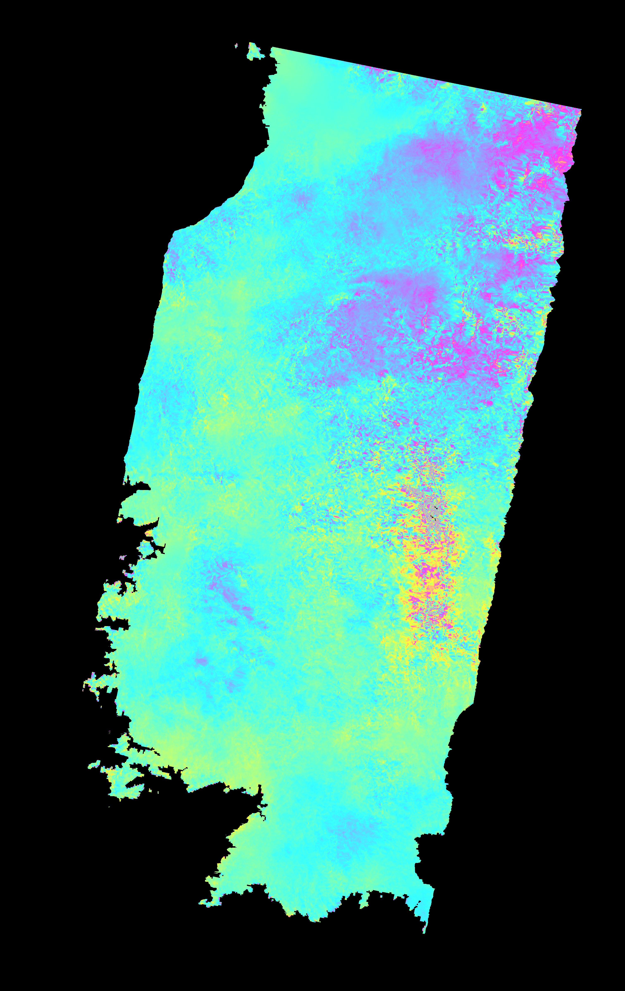
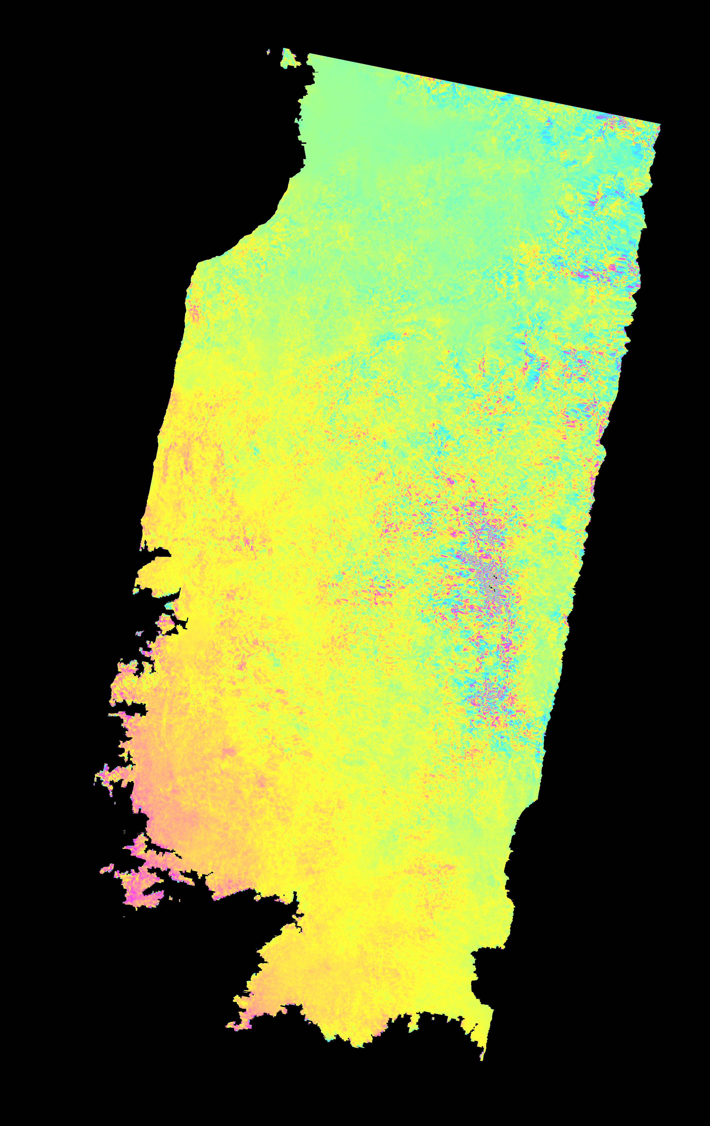
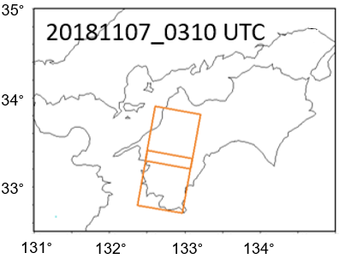
InSAR and SSM result. Shikoku.
Bpara: -213.0470 m
Bperp: -274.9842 m
LOS
Flight
Original
20180815_20181107
Non-dispersive
20180815_20181107
Dispersive
20180815_20181107

Slide 11
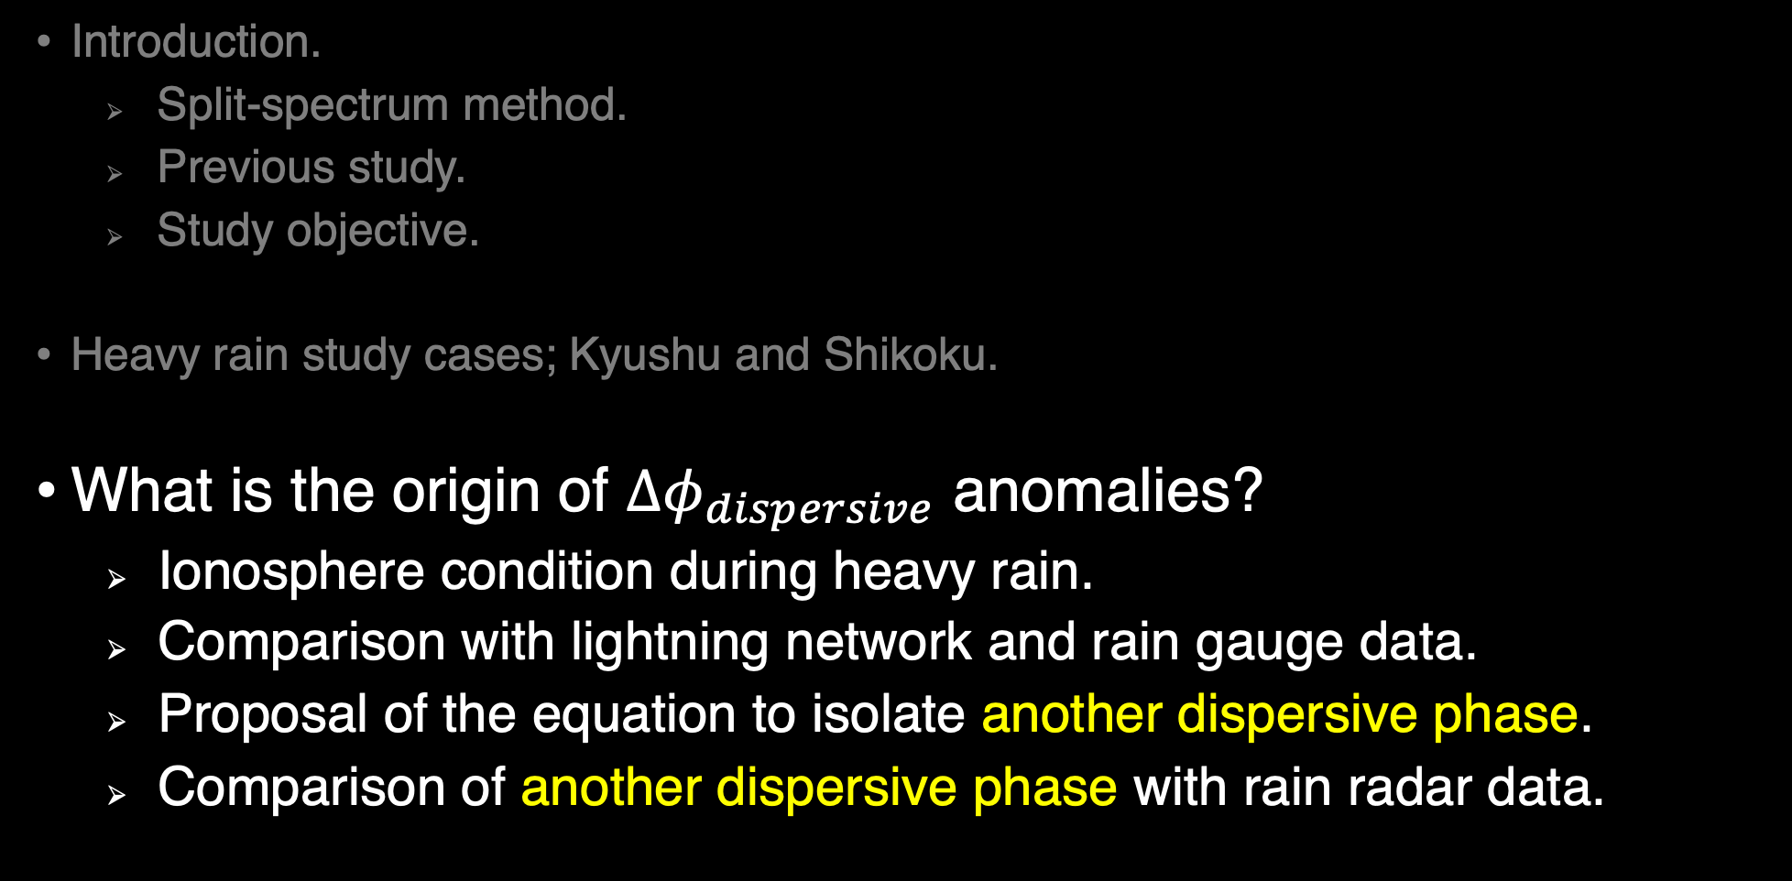
Contents.
Introduction.
Split-spectrum method.
Previous study.
Study objective.
Heavy rain study cases; Kyushu and Shikoku.
What is the origin of ${∆φ}_{dispersive}$ anomalies?
Ionosphere condition during heavy rain.
Comparison with lightning network and rain gauge data.
Proposal of the equation to isolate another dispersive phase.
Comparison of another dispersive phase with rain radar data.

Slide 12
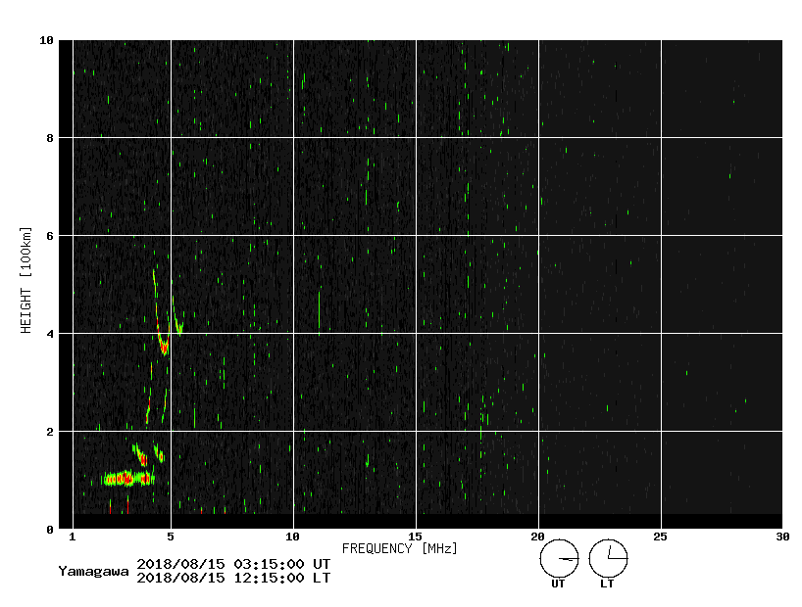
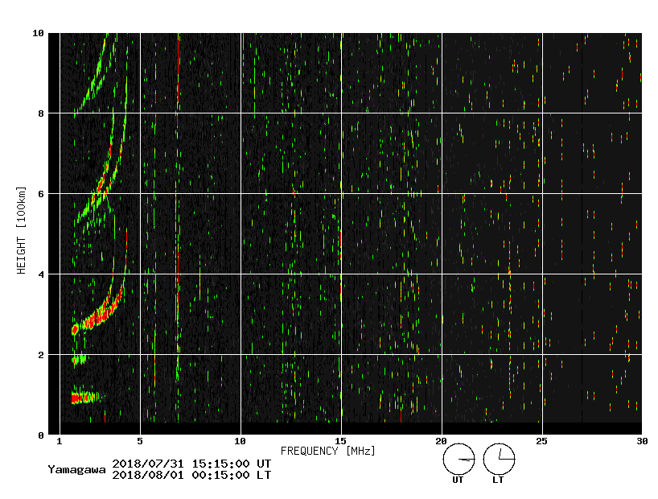
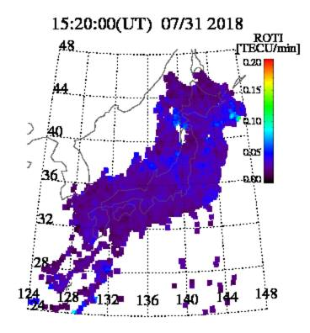
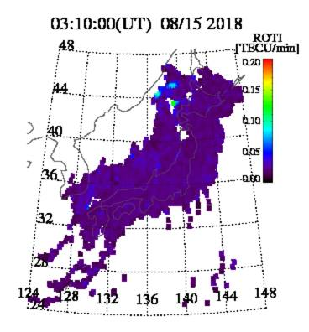
Ionosphere condition during heavy rain.
Shikoku heavy rain 2018/08/15
Kyushu heavy rain 2018/07/31
Calm ionosphere layer from the ionosonde and GNSS ROTI map.
Images from the NICT website.

Slide 13
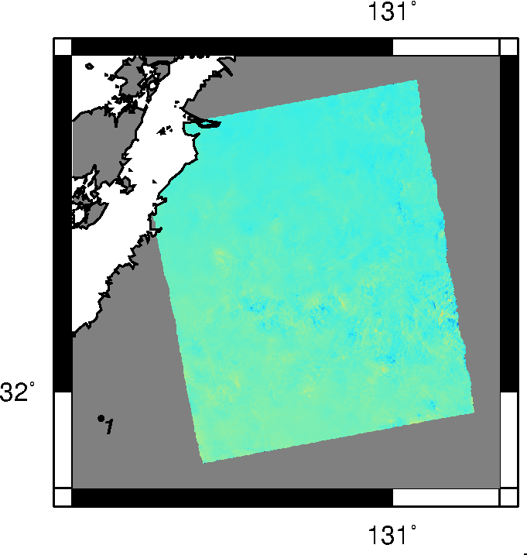
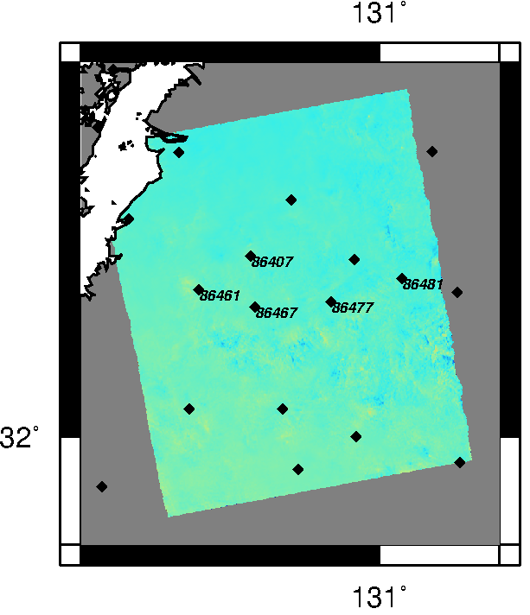
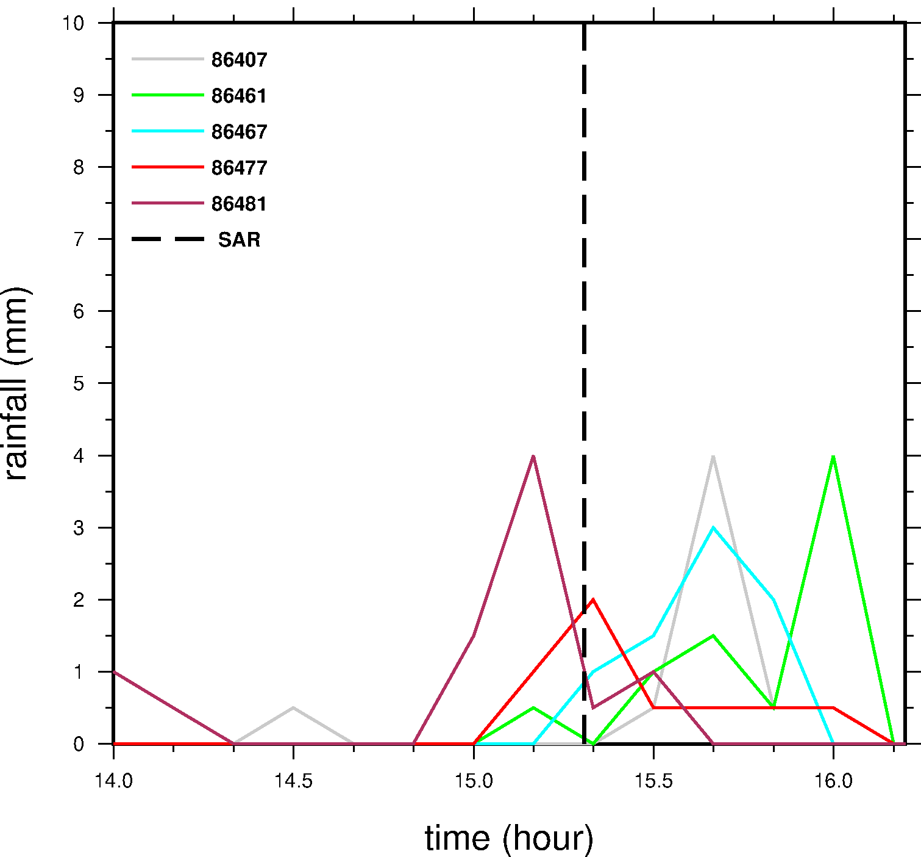
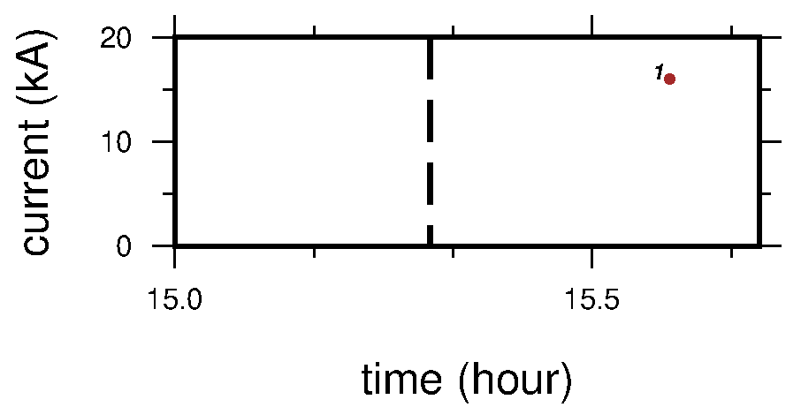

Lightning data
Rain gauge data
~17 minutes
Kyushu.

Slide 14
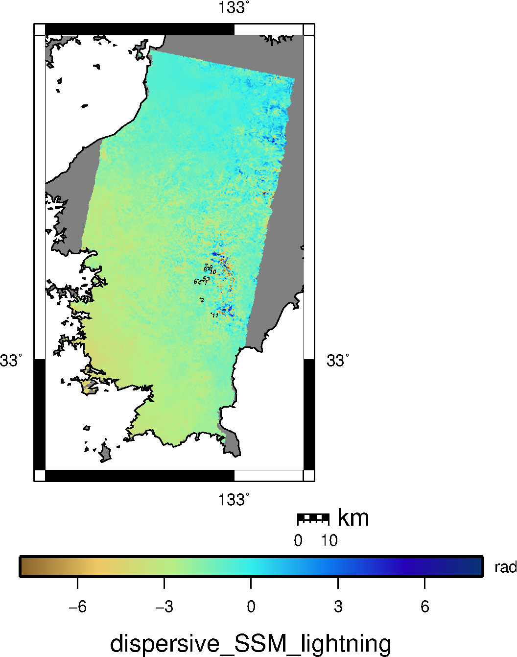
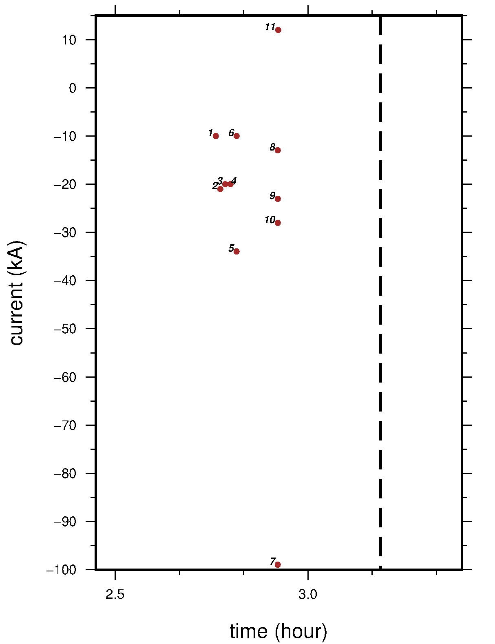
Lightning data
~15 minutes
Lightning did NOT correlate spatiotemporally with the dispersive phase.
We thus rule out the possible effect of RREA.
a
Shikoku.
b

Slide 15
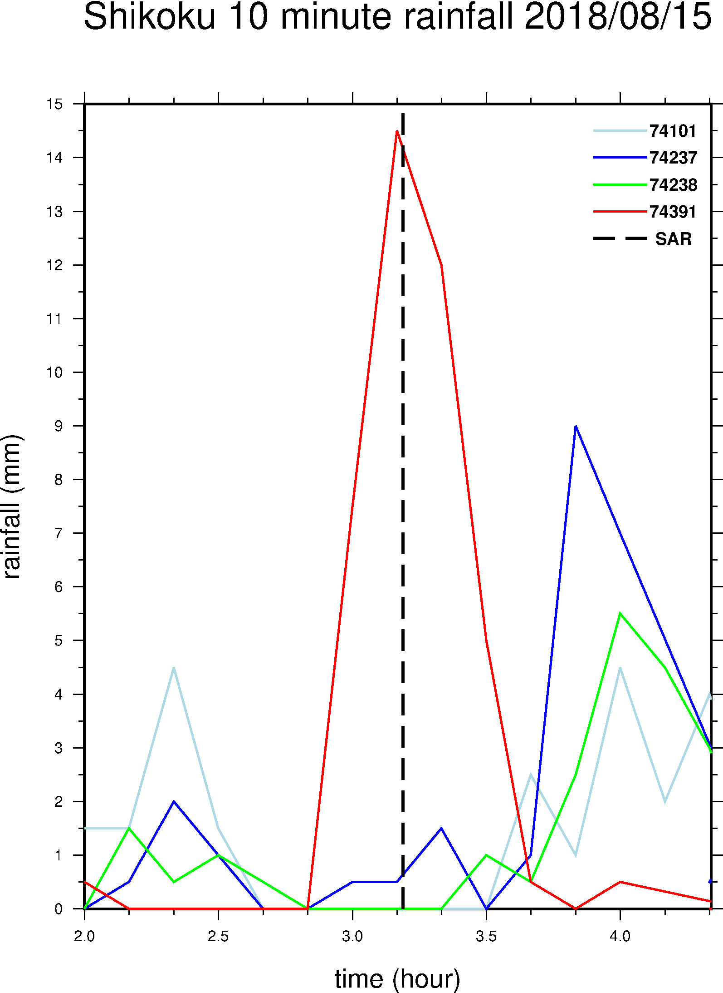

Rain gauge data
Rain gauge data from AMeDAS shows good correlation.
b
Shikoku.

Slide 16

Proposal of the equation to isolate another dispersive phase.
We need to add another dispersive phase term for heavy rain like the higher-order ionosphere (eg: Kedar et al., 2003, Furuya et al., 2017.)
$${∆φ}_{H}={∆φ}_{non−dispersive}\frac{f_{H}}{f_{0}}+{∆φ}_{dispersive}\frac{f_{0}}{f_{H}}+{∆φ}_{another_disp} X_{(fH)}$$
$${∆φ}_{L}={∆φ}_{non−dispersive}\frac{f_{L}}{f_{0}}+{∆φ}_{dispersive}\frac{f_{0}}{f_{L}}+{∆φ}_{another_disp} X_{(fL)}$$
$${∆φ}_{H′}={∆φ}_{non−dispersive}\frac{f_{H′}}{f_{0}}+{∆φ}_{dispersive}\frac{f_{0}}{f_{H′}}+{∆φ}_{another_disp} X_{(fH′)}$$
Need 3rd frequency
$$\frac{{∆φ}_{H}}{f_{H} }−\frac{{∆φ}_{L}}{f_{L} }={∆φ}_{dispersive}(\frac{f_{0}}{f_{H}^{2}}−\frac{f_{0}}{f_{L}^{2}})+{∆φ}_{another_disp}[X_{\left(fH\right)}−X_{\left(fL\right)}]$$
$$\frac{{∆φ}_{H}′}{f_{H}\text{′} }−\frac{{∆φ}_{L}}{f_{L} }={∆φ}_{dispersive}(\frac{f_{0}}{f_{H^{′}}^{2}}−\frac{f_{0}}{f_{L}^{2}})+{∆φ}_{another_disp}[X_{\left(fH^{′}\right)}−X_{\left(fL\right)}]$$

Slide 17


Proposal of the equation to isolate another dispersive (cont.)
$$\frac{\frac{{∆φ}_{H}}{f_{H} }−\frac{{∆φ}_{L}}{f_{L} }}{(\frac{1}{f_{H}^{2}} − \frac{1}{f_{L}^{2}})}={∆φ}_{dispersive} f_{0}+\frac{{∆φ}_{another_disp}[X_{\left(fH\right)}−X_{\left(fL\right)}]}{(\frac{1}{f_{H′}^{2}} − \frac{1}{f_{L}^{2}})}≡Γ(∆f)$$
$$\frac{\frac{{∆φ}_{H}′}{f_{H}\text{′} }−\frac{{∆φ}_{L}}{f_{L} }}{(\frac{1}{f_{H′}^{2}} − \frac{1}{f_{L}^{2}})}={∆φ}_{dispersive} f_{0}+\frac{{ ∆φ}_{another_disp}[X_{\left(fH′\right)}−X_{\left(fL\right)}]}{(\frac{1}{f_{H′}^{2}} − \frac{1}{f_{L}^{2}})}≡Γ(∆f)′$$
$$Γ(∆f)′− Γ(∆f)={∆φ}_{another_disp}\left[Y_{\left(fH^{′}\right)}−Y_{\left(fL\right)}\right]− {∆φ}_{another_disp}[Y_{\left(fH\right)}−Y_{\left(fL\right)}]$$
$${∆φ}_{another_disp}=\left[Γ(∆f)′− Γ(∆f)\right]/\left[Y_{\left(fH^{′}\right)}−Y_{\left(fL\right)}−Y_{\left(fH\right)}+Y_{\left(fL\right)}\right]$$

Slide 18
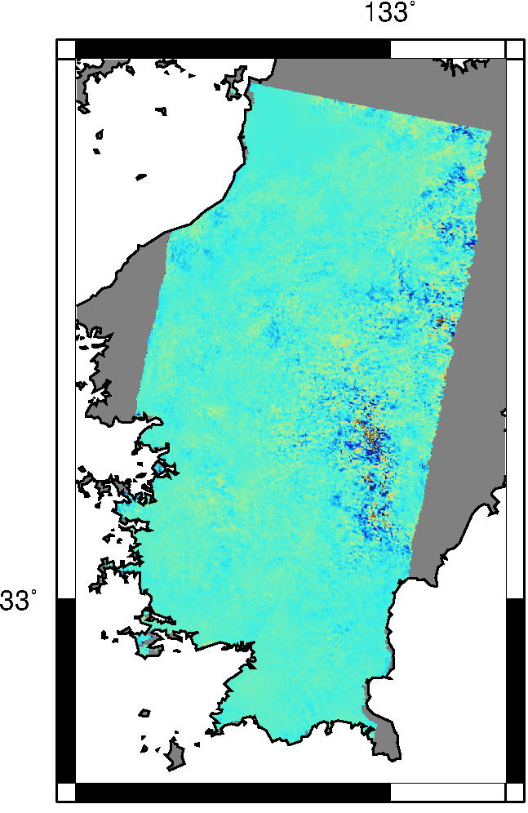
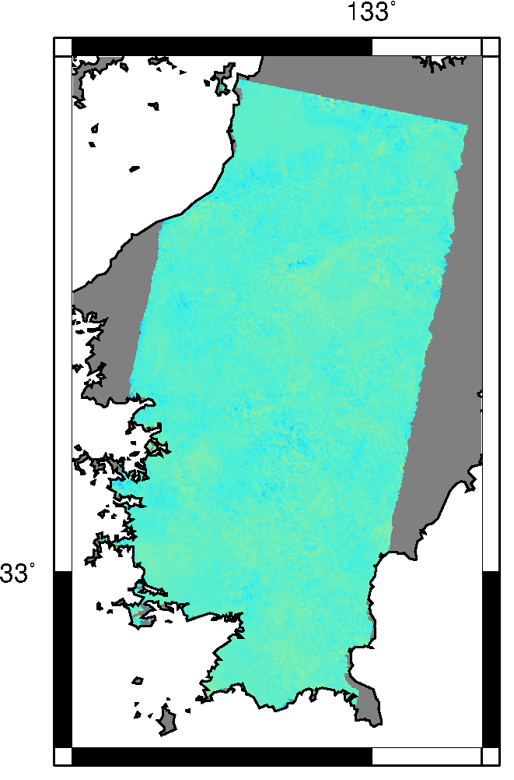
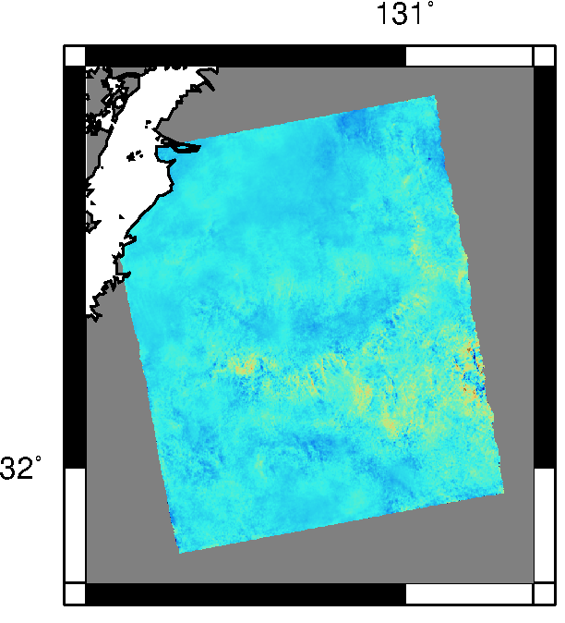
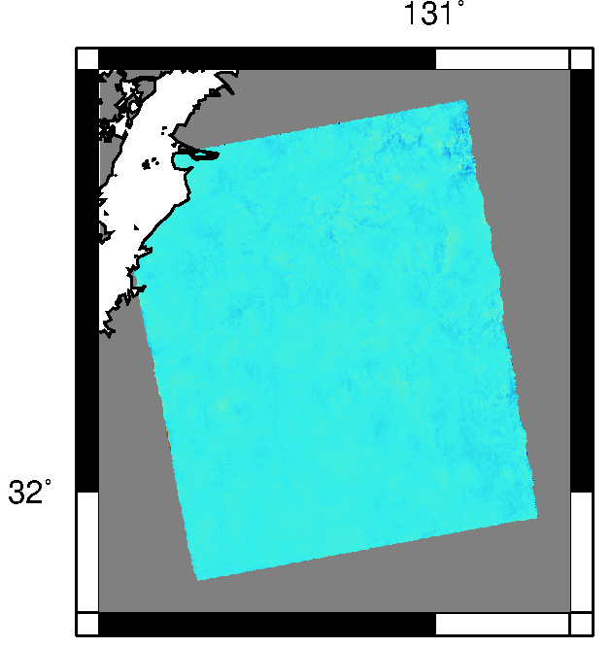


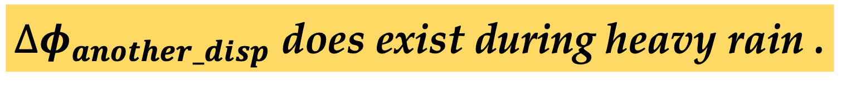
Result of proposed equation: ${∆φ}_{another_disp}$
Heavy rain
Fair weather
Heavy rain
Fair weather
${∆φ}_{another_disp}$ does exist during heavy rain .
20180731_20180828
20180410_20180828
Kyushu.
20180815_20181107
20180228_20181107
Shikoku.
$${∆φ}_{another_disp}$$

Slide 19
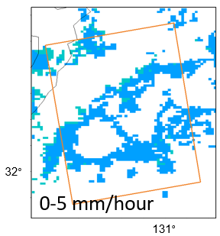
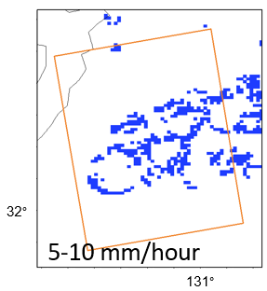
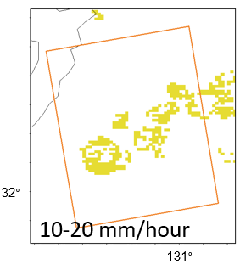
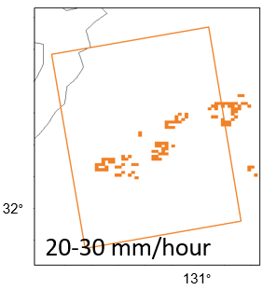
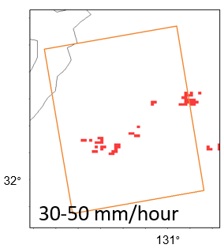
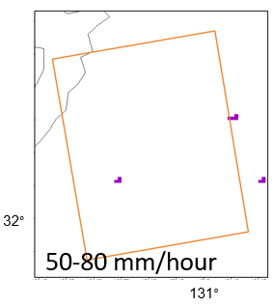
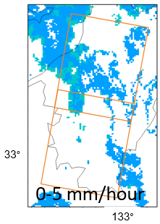
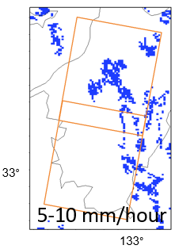
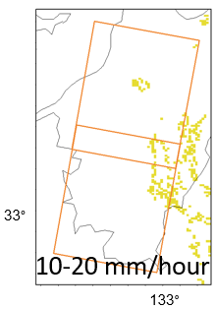
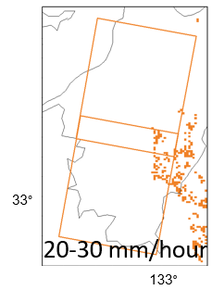
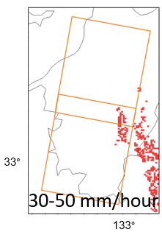
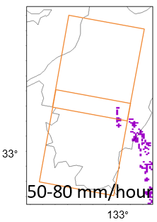
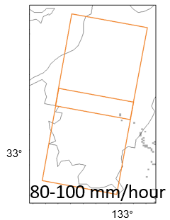
Quantification of ${∆φ}_{another_disp}$ and weather radar
I categorized each pixel location into 6-7 classes of rain rate in JMA radar.
JMA weather radar on Kyushu. 20180731_1520 UTC.
JMA weather radar on Shikoku. 20180815_0310 UTC.

Slide 20
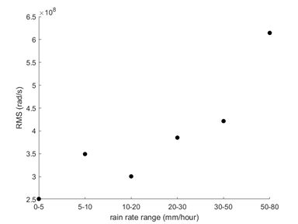
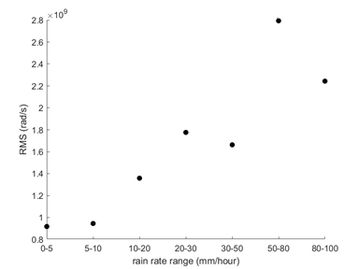
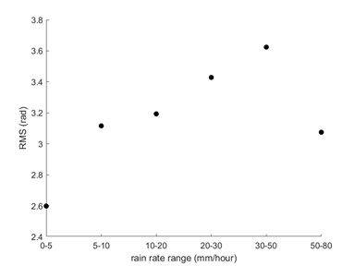




Comparison of ${∆φ}_{another_disp}$, ${∆φ}_{non−disper.}$and weather radar
Kyushu.
Shikoku.
$${RMS of ∆φ}_{another_disp}$$
(Rain droplet)
Positive correlation between RMS ${of ∆φ}_{another_disp}$ , ${∆φ}_{non−dispersive} and rain rate.$
$${RMS of ∆φ}_{\begin{aligned}non−dispersive \\ \end{aligned}}$$
(Water vapor)
$$X_{RMS}= \sqrt{\frac{x_{1}^{2}+ x_{2 }^{2}+ x_{3}^{2}+ . . . + x_{n}^{2}}{n}}$$
Root mean square or quadratic mean.
Rain rate (mm/hr)
Rain rate (mm/hr)

Slide 21




Confirmation the presence of ionosphereic higher-order term during Sporadic-E, using the proposed equation.
Naufal: You should include a part of Furuya et al (2017) that suggested Ionospheric higher-order term. Your result does not assume any explicit functional form and performed “triple frequency measurement”.
$${∆φ}_{another_disp}$$

Slide 22

Summary
In both Kyushu and Shikoku heavy rain pairs, the significant signals in the ${∆φ}_{non−dispersive}$ clearly correspond to the large water vapor amount, whereas there are spotty anomalies in the ${∆φ}_{dispersive}$ in the rainy area.
Comparison between in the ${∆φ}_{dispersive}$ anomalies with ground-based lightning detection network, and rain gauge data, shows rain dispersive effect is spatiotemporally favorable than runaway electron avalanche.
Our formulation demonstrates that ${∆φ}_{another_disp}$ does exist during heavy rain. The RMS of ${∆φ}_{another_disp}$, ${∆φ}_{non−dispersive}$ and rain rate show positive correlation.
A comparison with Sporadic-E events and heavy rain shows that ${∆φ}_{another_disp}$ effect due to rain dispersive effect and higher-order ionospheric effect are likely to be on the same order of magnitude.

