Slide 1
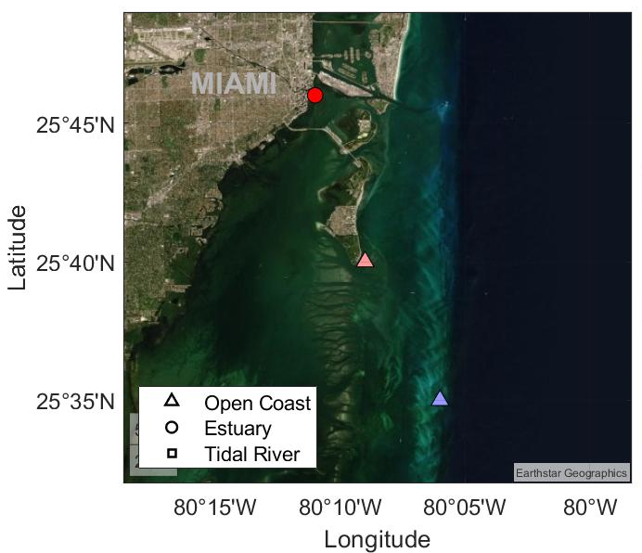
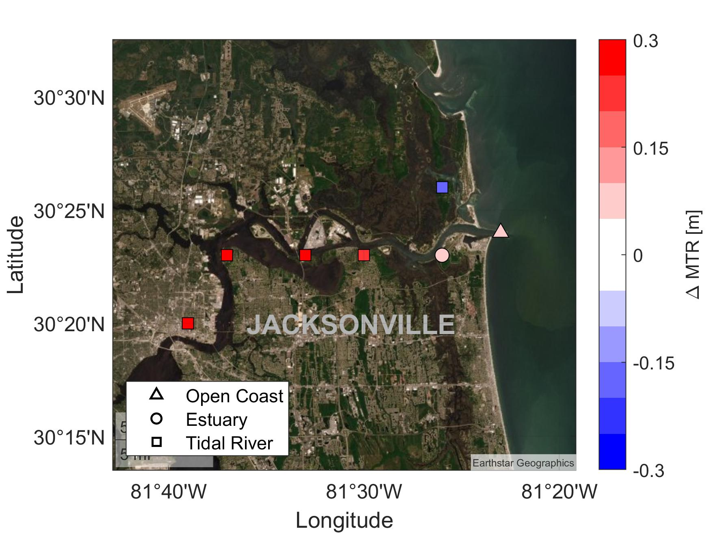
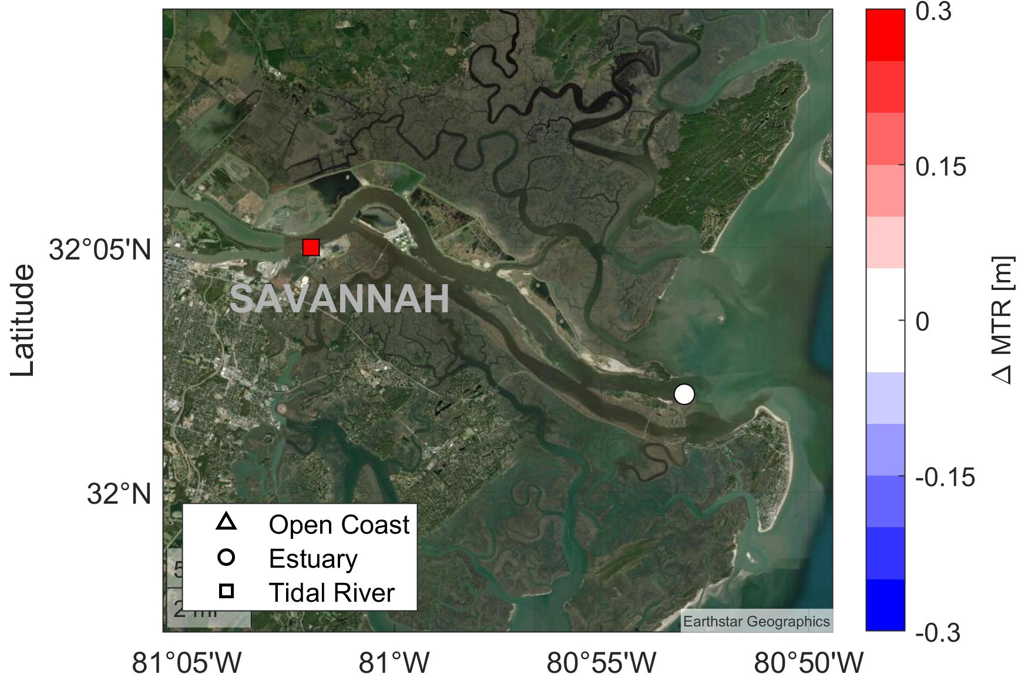
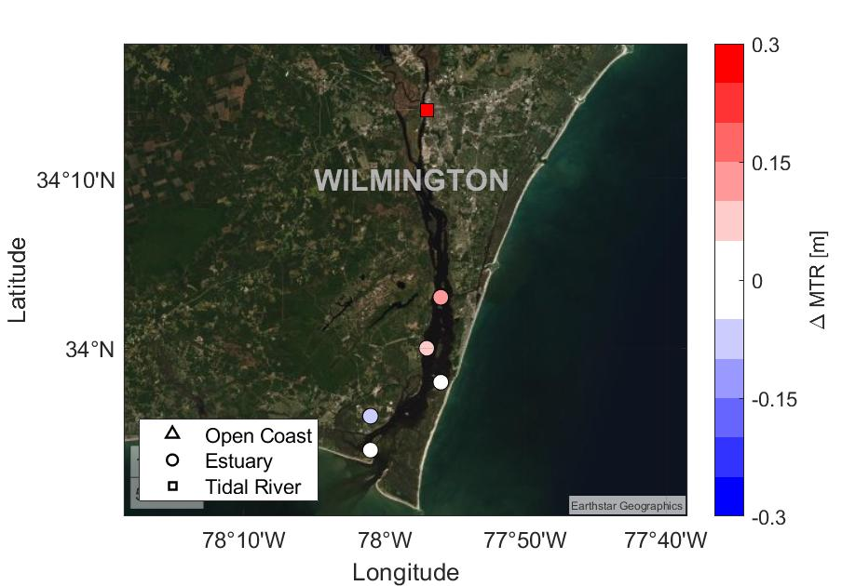
Secular variation in mean tidal range (MTR) at four locations along the East Coast. From the upper left panel in clockwise order: Miami (FL), Jacksonville (FL), Savannah (GA), Wilmington (NC)

Slide 2
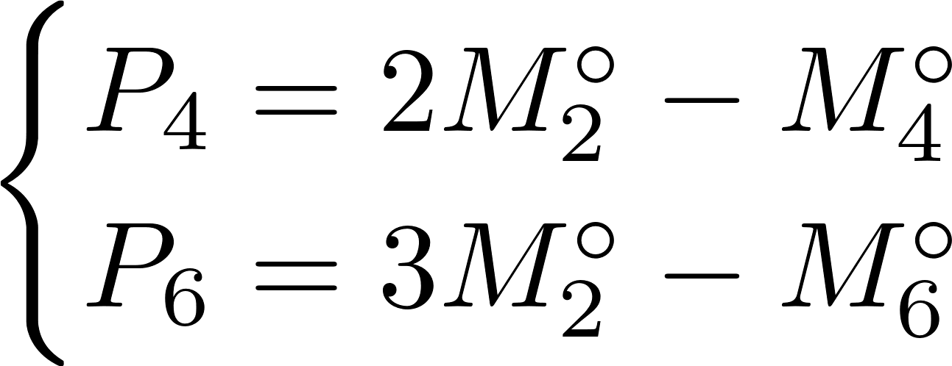
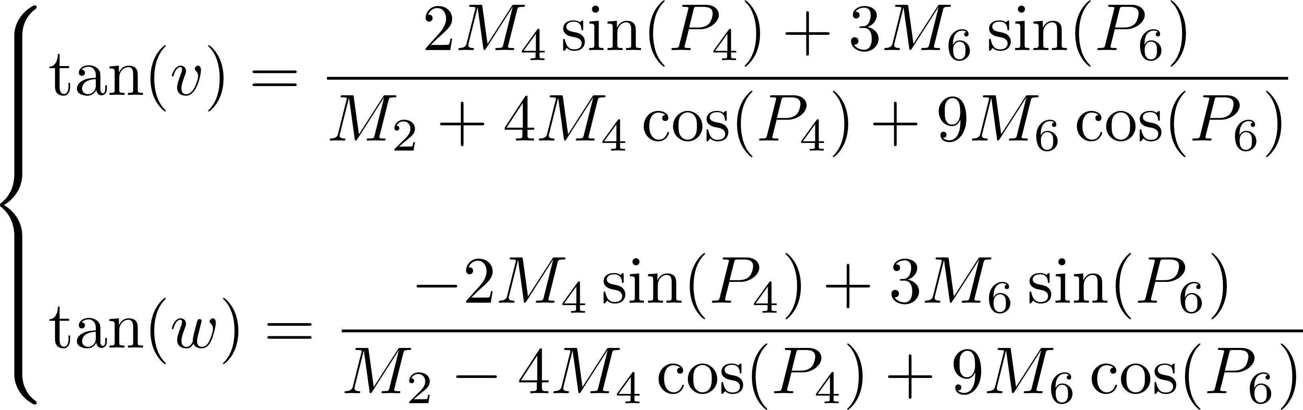
M₂ PREDICTION FROM MEAN TIDAL RANGE
Coast, U. S. "Geodetic Survey." Manual of Harmonic Constant Reductions (1952).
parameters assumed
parameter unknown
parameter given

Slide 3
ASSESSING HOW TRENDS IN M₂ ARE AFFECTING THE OCCURRENCE OF NF
The residual over a modern epoch is computed as the difference between the total water level and the predicted tides,
For each year of the historical epoch considered, the minimum and maximum values of inferred M2 are computed,
Modern M2 are replaced with the inferred historical M2 amplitudes and new tides are predicted over the modern epoch,
Step 3 is repeated replacing all the modern tidal constituents with their historical counterparts according to Li et. al., (2021),
Modern residuals are added on top of both the surrogated tides,
Yearly number of NF days are computed on i) the observed data, ii) the data driven by historical tides + modern residuals, and iii) the data driven by historical M2 estimates + modern residuals (two time series for each year of the historical epoch)
The differences between the number of NF days observed and computed from the surrogate series are computed over the modern period.

Slide 4
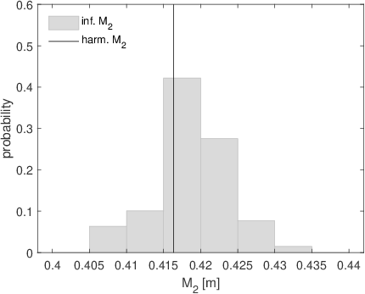
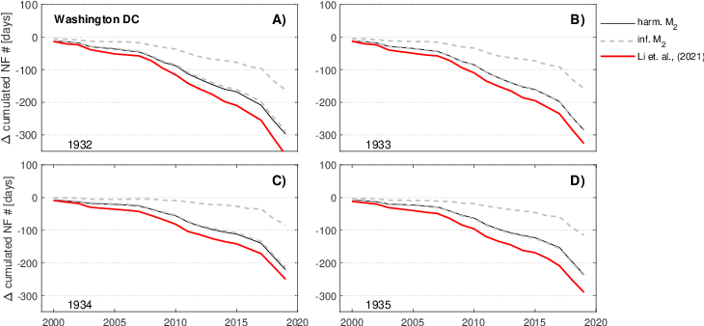
AN EXAMPLE OF THE METHOD - RESULTS AT WASHINGTON DC (NEGATIVE TREND)
Distribution of the inferred M₂ amplitudes for 1936 compared to the predicted value (benchmark data)
cumulated differences between the observed and inferred number of NF days over the 2000-2020 period for different reference years.

