Slide 1
Data assimilation, sensitivity analysis and uncertainty quantification in semi-arid terminal catchments
Eduardo de sousa
Matthew Hipsey
Ryan vogwill

Slide 2
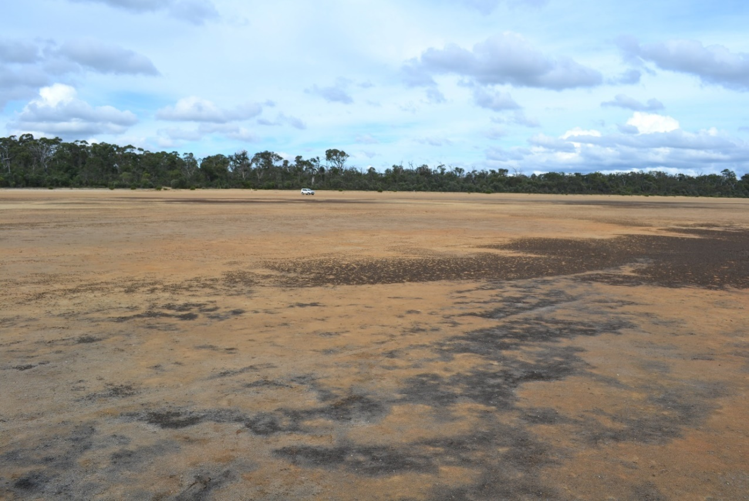
Terminal catchments
Terminal catchments are characterised by the absence of surface and groundwater outflows
Also known as endorheic basins or basins of internal drainage
Widely distributed around the globe, many of which are biodiversity hotspots
These areas are often subject to climate change and/or human activities

Slide 3
Data sparsity
Environment impact assessment and research efforts are constrained by highly incomplete datasets
Majority of studies based on indirect measurements and/or remote sensing data
There is a need to “make the most” of available data, and the extract the maximum amount of information
Use of data assimilation (DA), uncertainty quantification (UQ) and sensitivity analysis (SA) in hydrology studies are emerging fields
These techniques have the potential to help with the research in the endorheic basisn

Slide 4
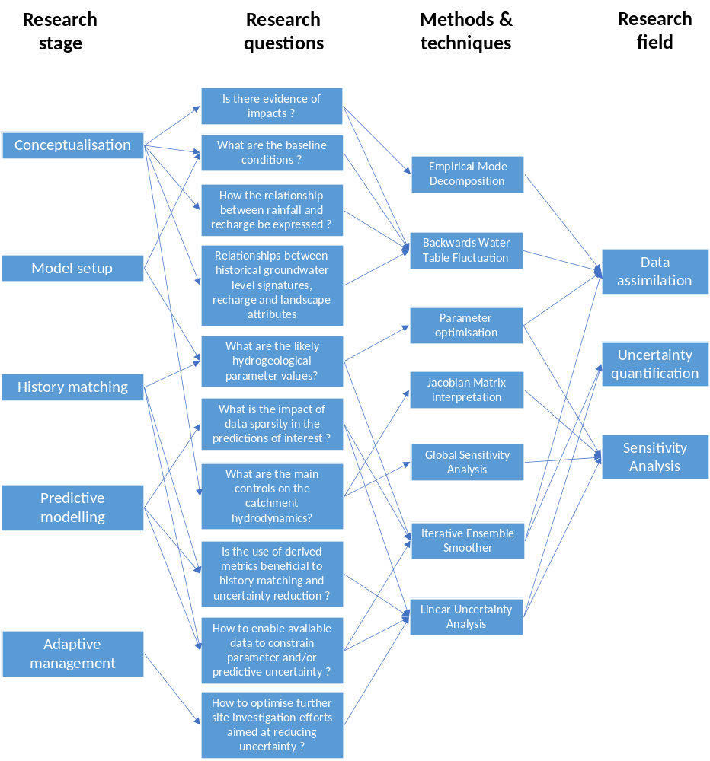
Objectives
Explore the potential different techniques in DA, UQ and SA to facilitate research in endorheic basins
Facilitate the different research stages and address research questions often arisen in these studies

Slide 5
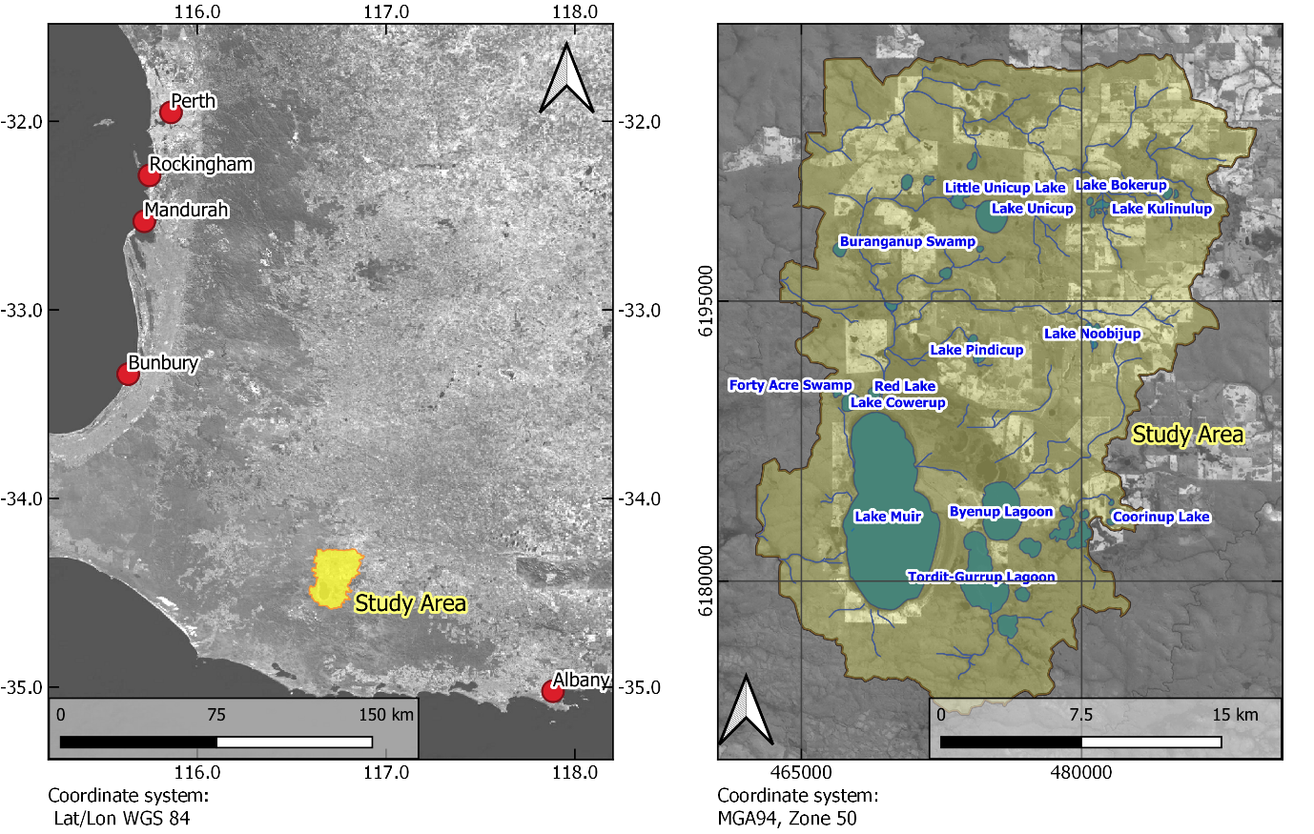
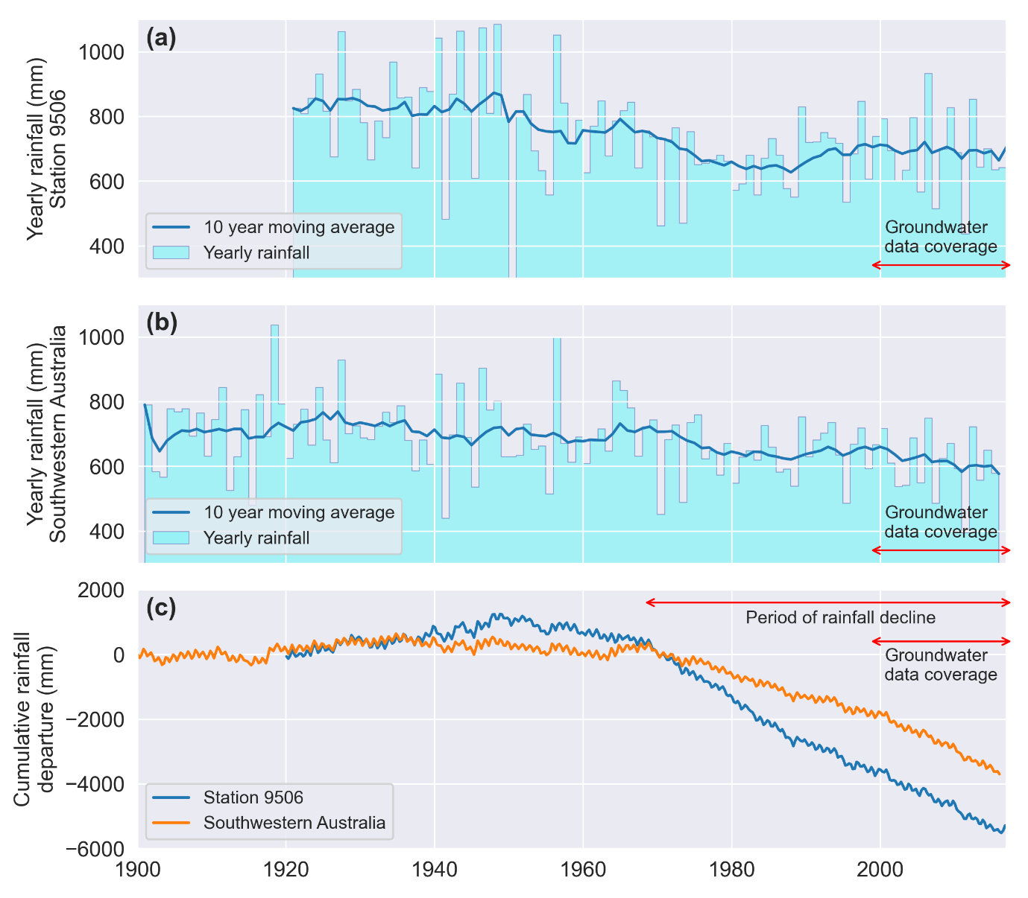
Study site
Lake Muir-Unicup Natural Diversity Recovery Catchment (MUNDRC)
Small scale terminal catchment in southwestern Australia
Dominant catchment outflow occurs through Lake Muir
Subject to rainfall decline since 1970

Slide 6
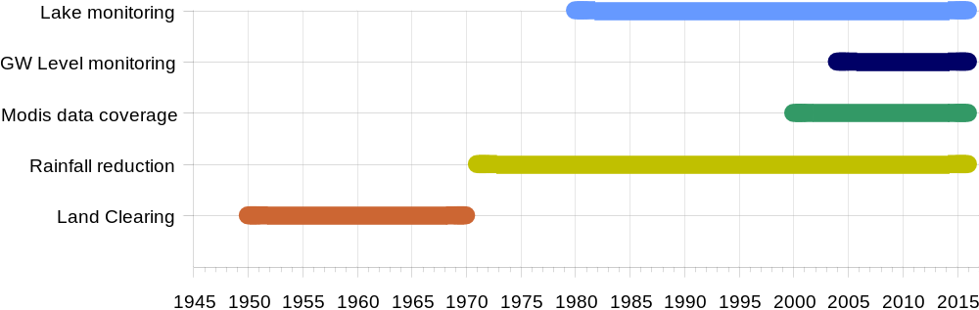
Data gaps
Rainfall decline since 1970
First groundwater records from early 2000’s
First lake records from 1980’s
No baseline data

Slide 7
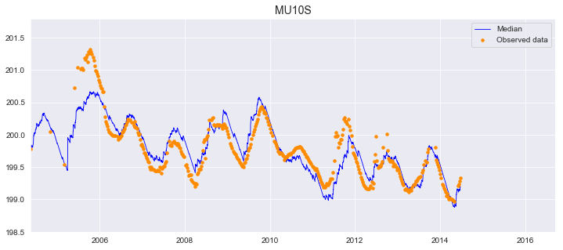
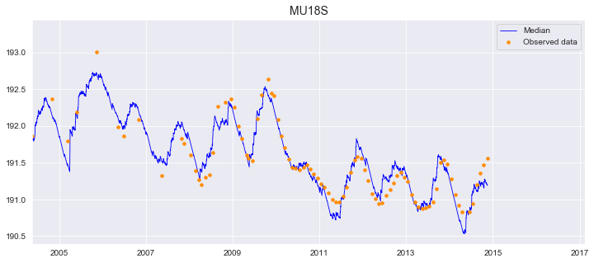
DA - Reconstruction of groundwater levels
Backward water table fluctuation method
Data-driven model
Capable of running backwards in time
Calibrated against existing data
Provided hindcasts for 1970 groundwater levels

Slide 8
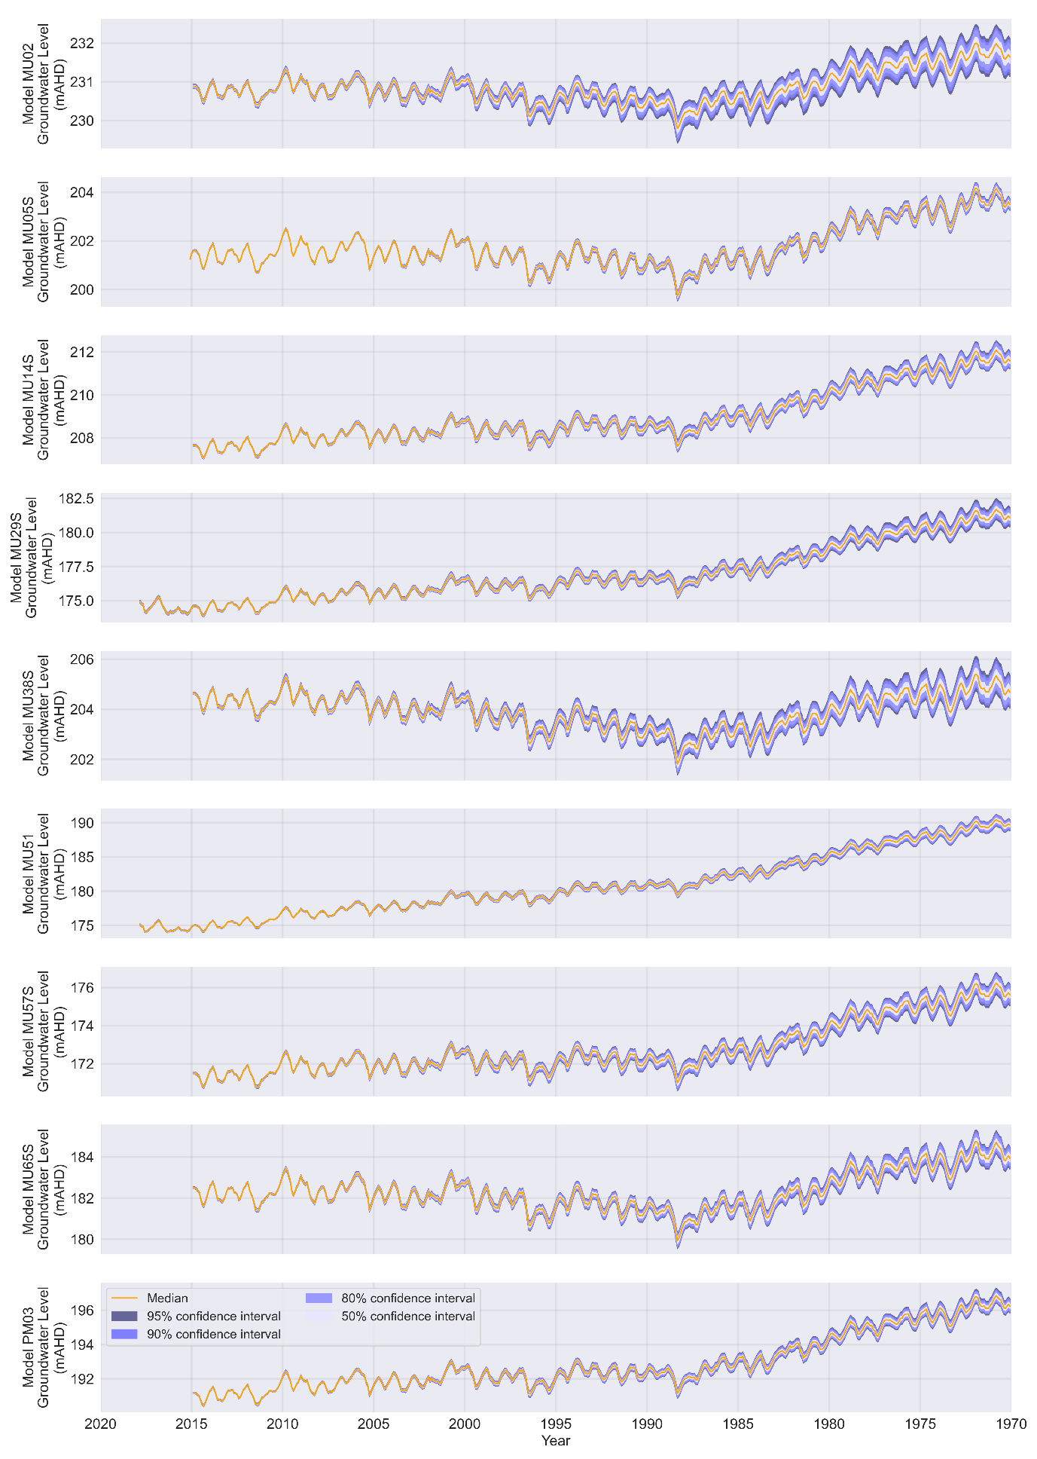
DA - Reconstruction of groundwater levels
Backward water table fluctuation method
Data-driven model
Capable of running backwards in time
Calibrated against existing data
Provided hindcasts for 1970 groundwater levels

Slide 9
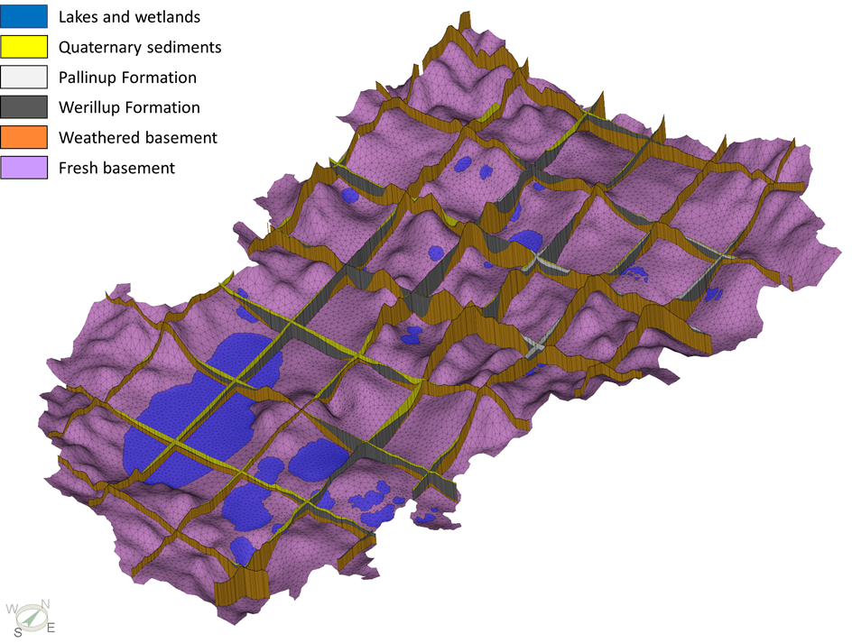
DA/UQ – Reducing uncertainty through history matching
An integrated lake-groundwater model was developed
Parameter and predictive uncertainty assessed using highly-parameterised approach with pilot points
Uncertainty reduced utilising the Iterative Ensemble Smoother method (White, 2018)
Prior ensemble based on geological knowledge of the area
Parameters refined to conform to historical system behavior
Numerical model mesh and
Hydrogeological units

Slide 10
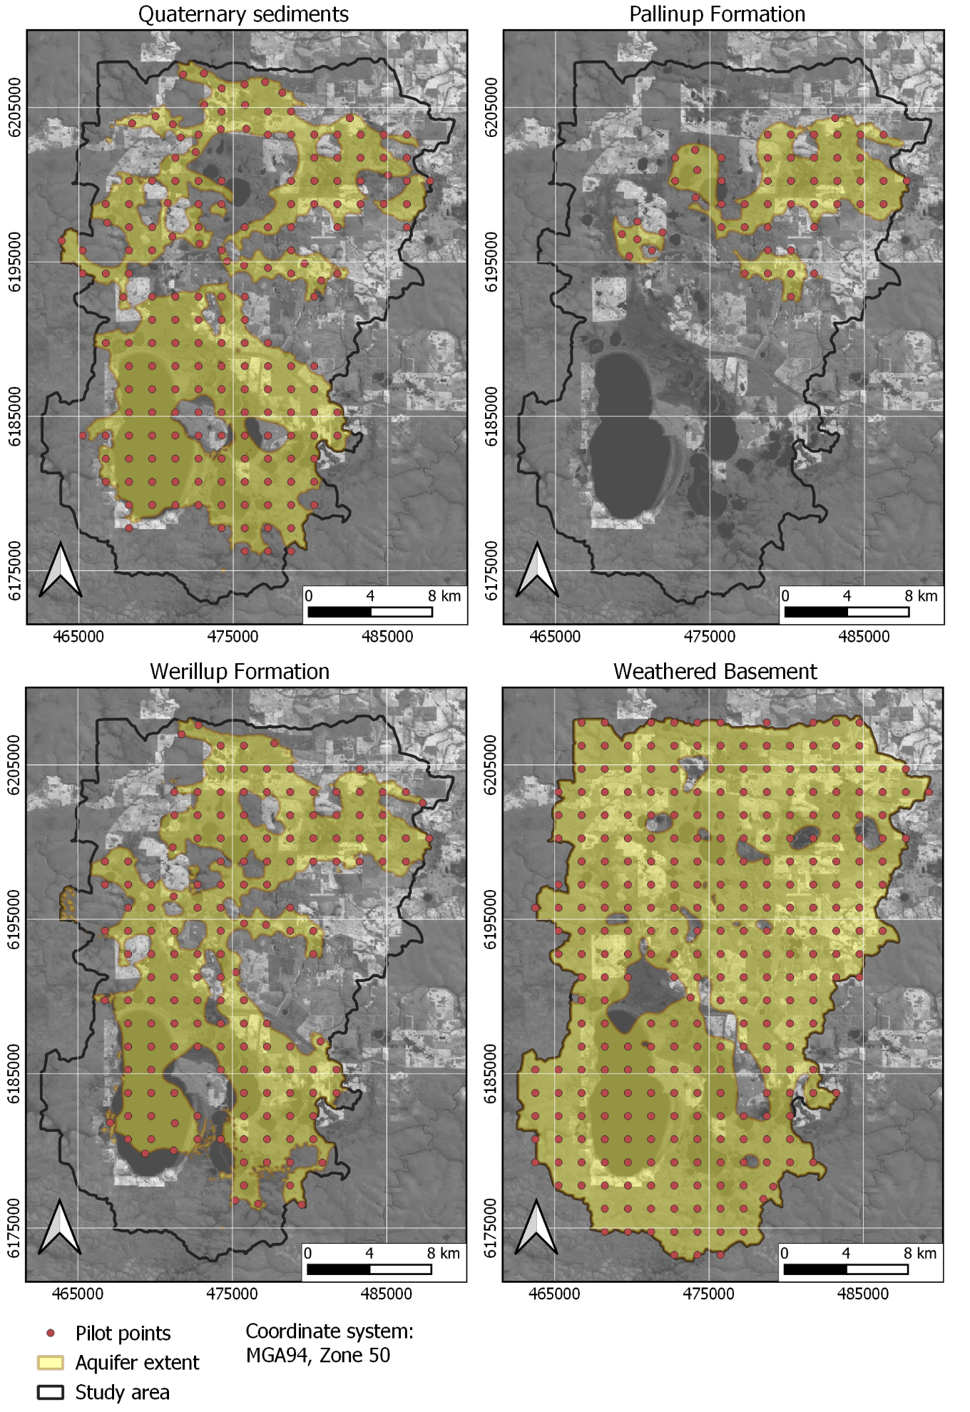
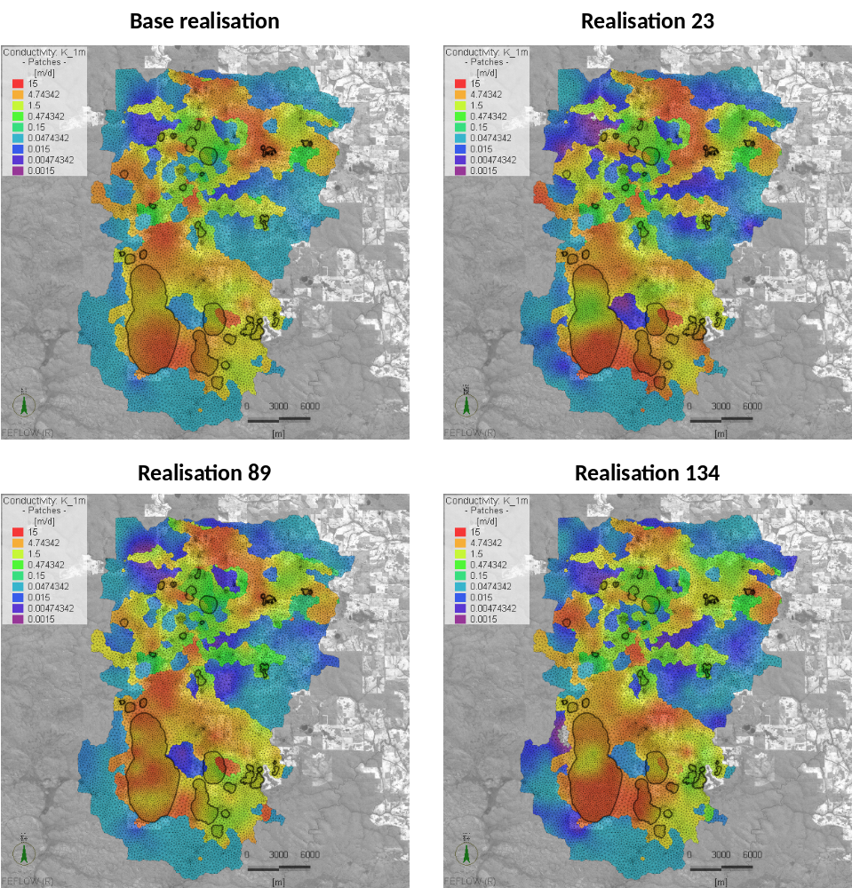
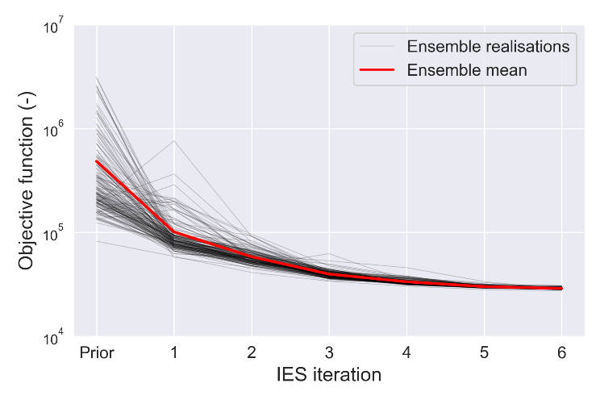
DA/UQ – Reducing uncertainty through history matching
Pilot point locations for different
parameter zones
Calibrated hydraulic conductivities
Optimisation objective function
for ensemble sets

Slide 11
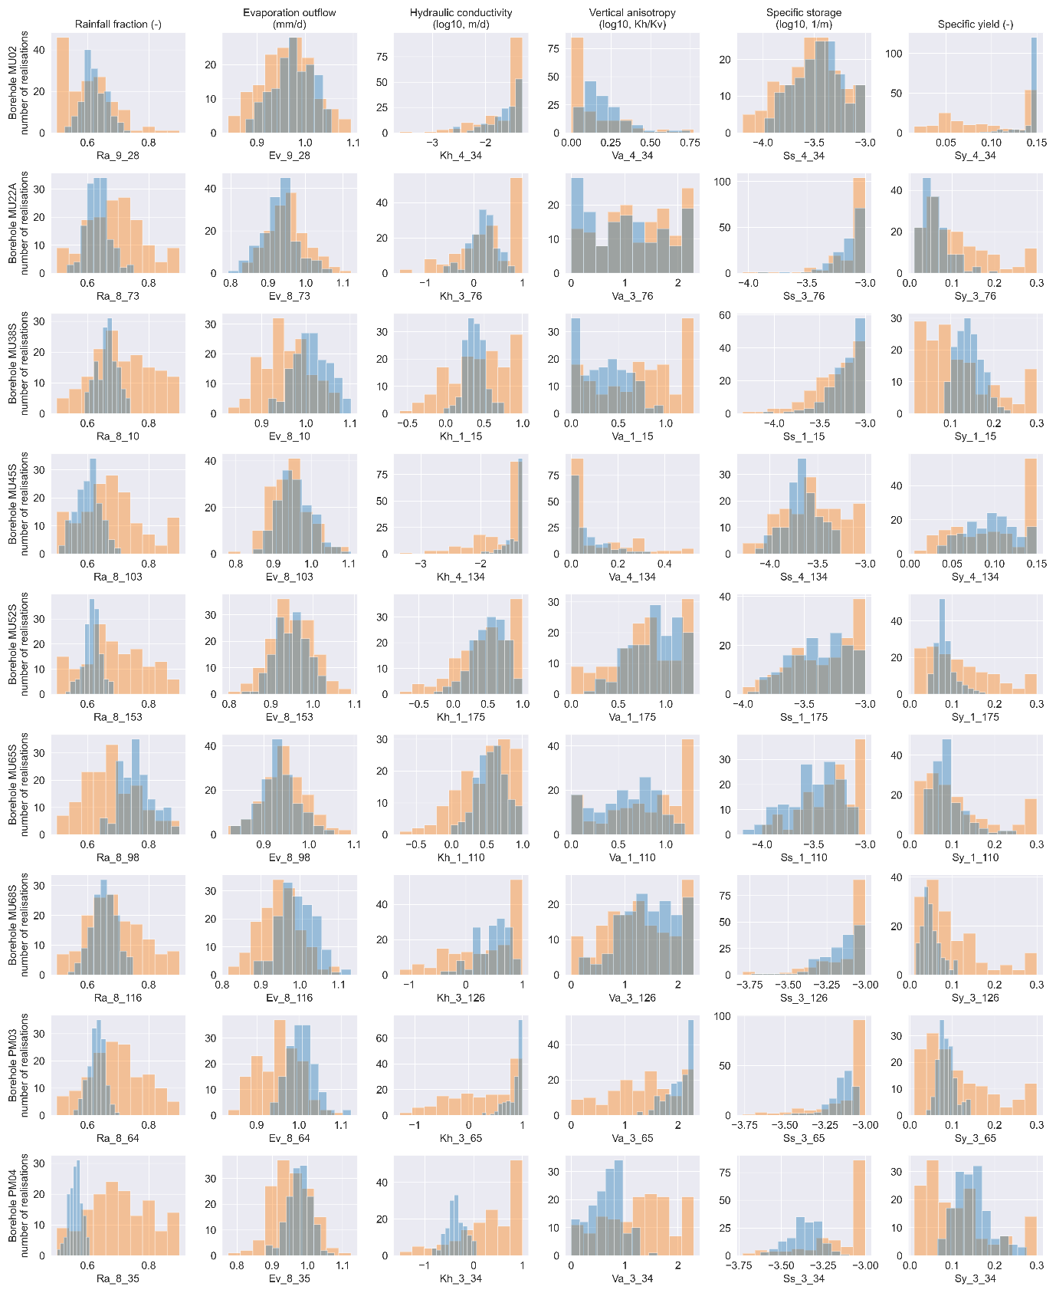
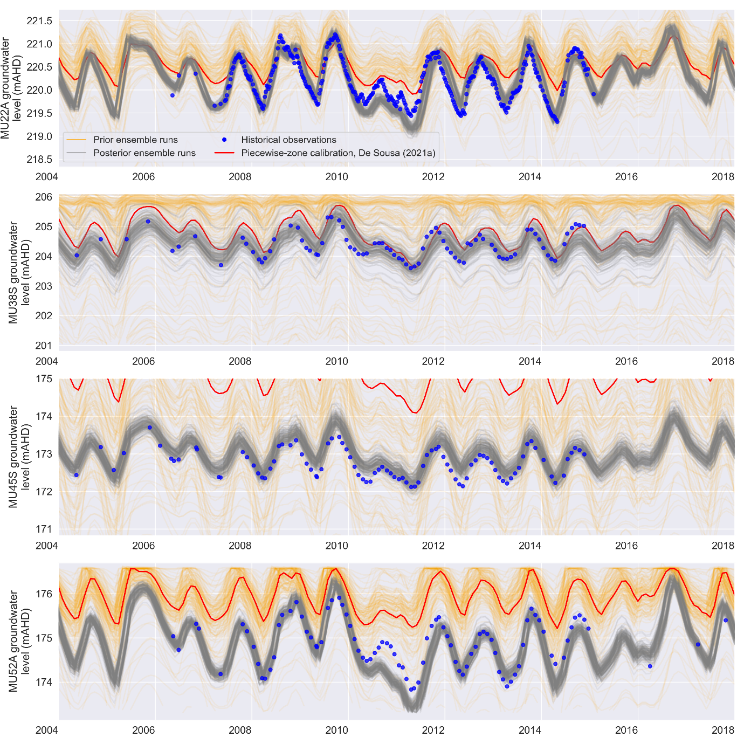
DA/UQ – Reducing uncertainty through history matching
Prior x Posterior parameter distributions
Prior x Posterior simulated
Groundwater levels

Slide 12
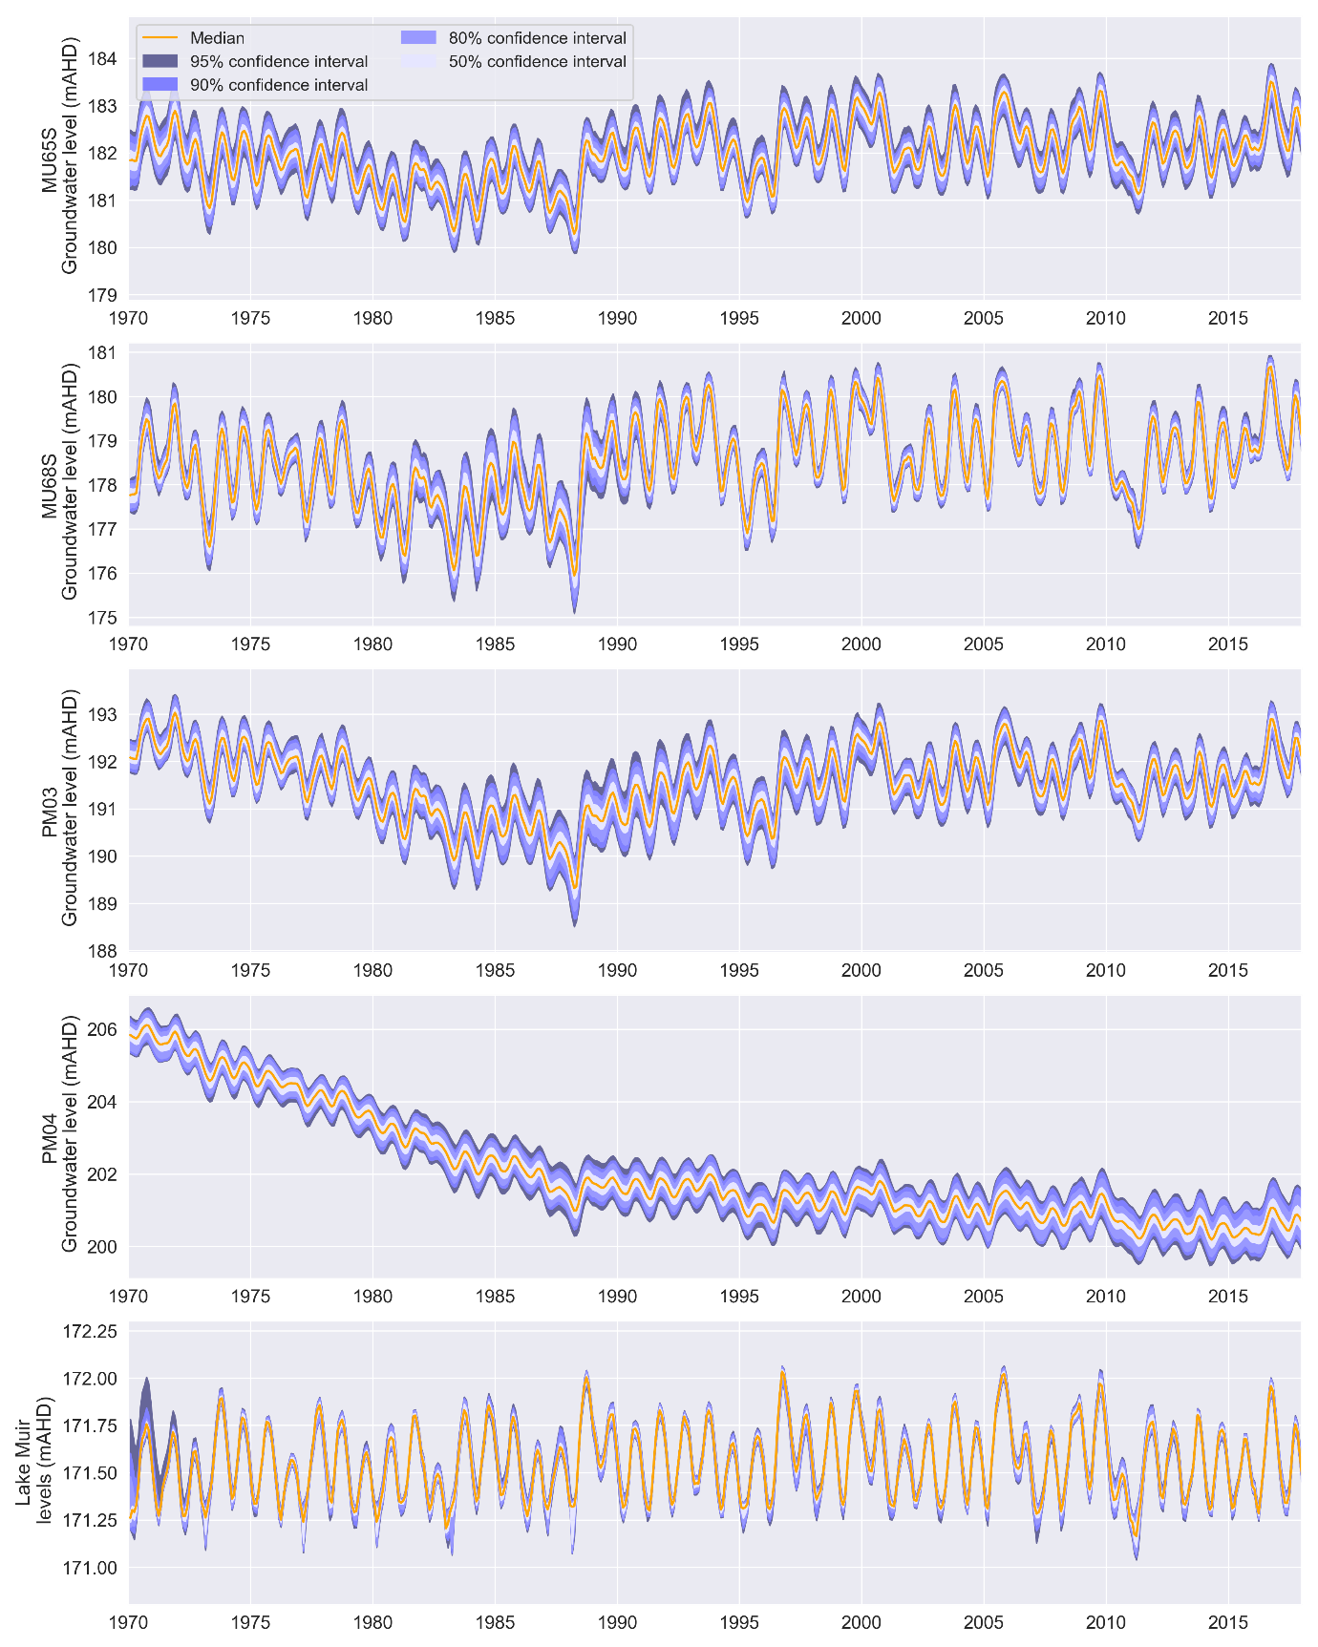
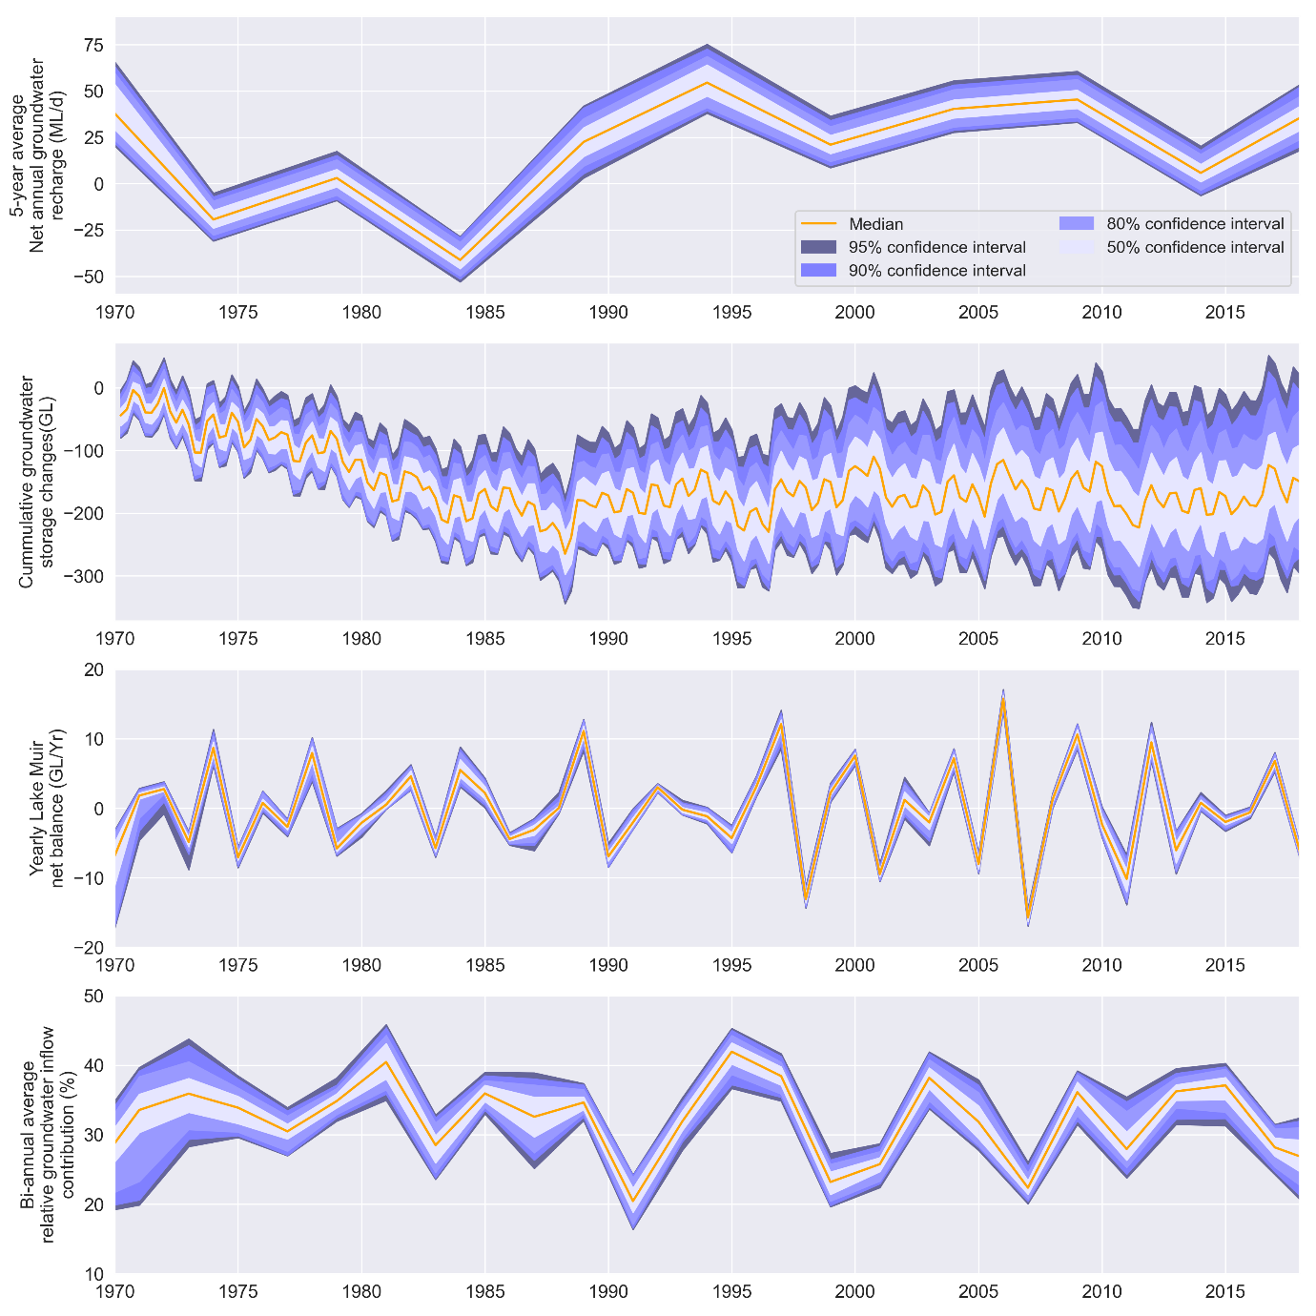
DA/UQ – Predictive uncertainty quantification
Lake and groundwater levels
Water balance

Slide 13
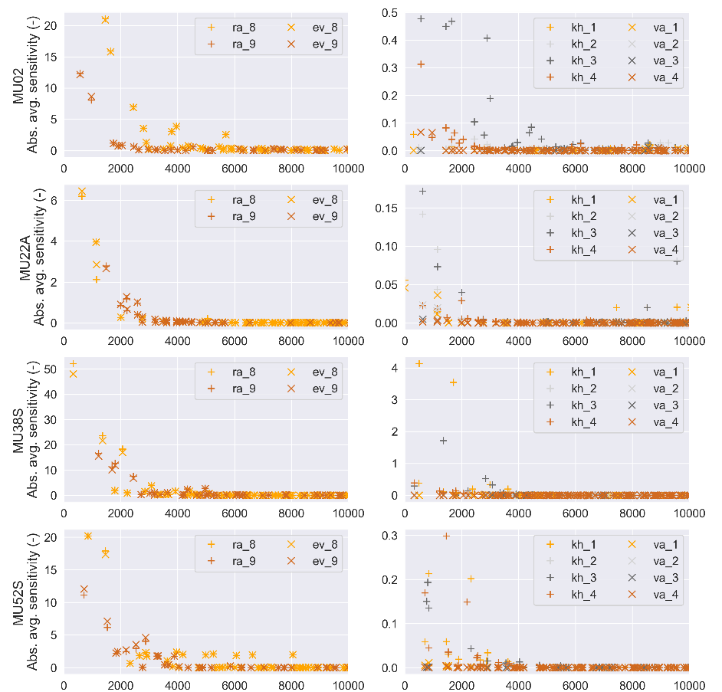
SA – Understanding system behaviour through sensitivity analysis
Sensitivities generated from 1st order approximation of partial derivatives
Useful to define distance-sensitivity relationships
Radius of influence from model parameters
Temporal behaviour of sensitivities
Distance x sensitivity relations

Slide 14
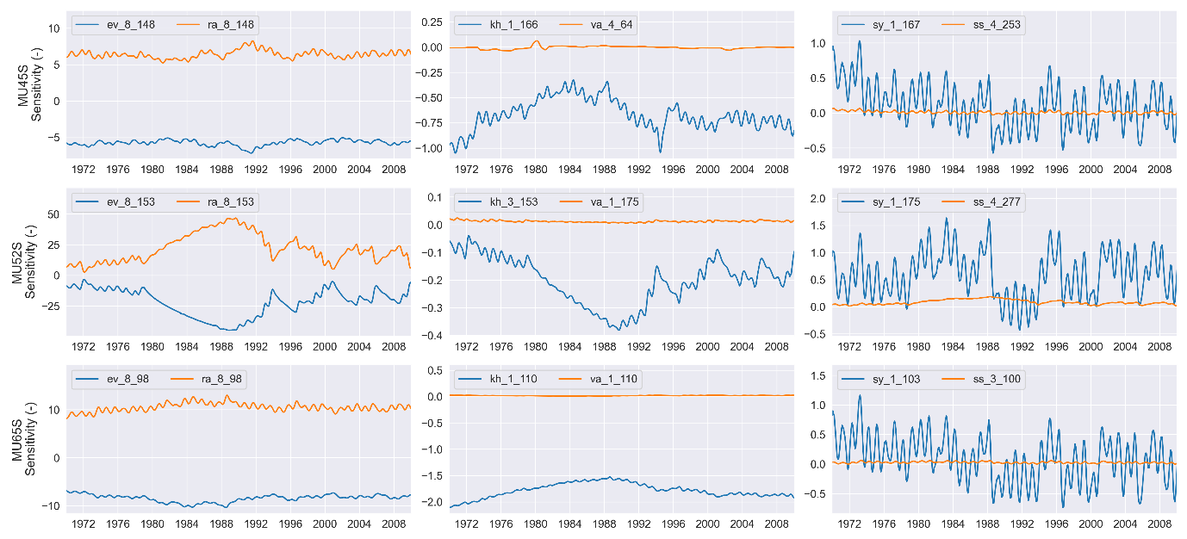
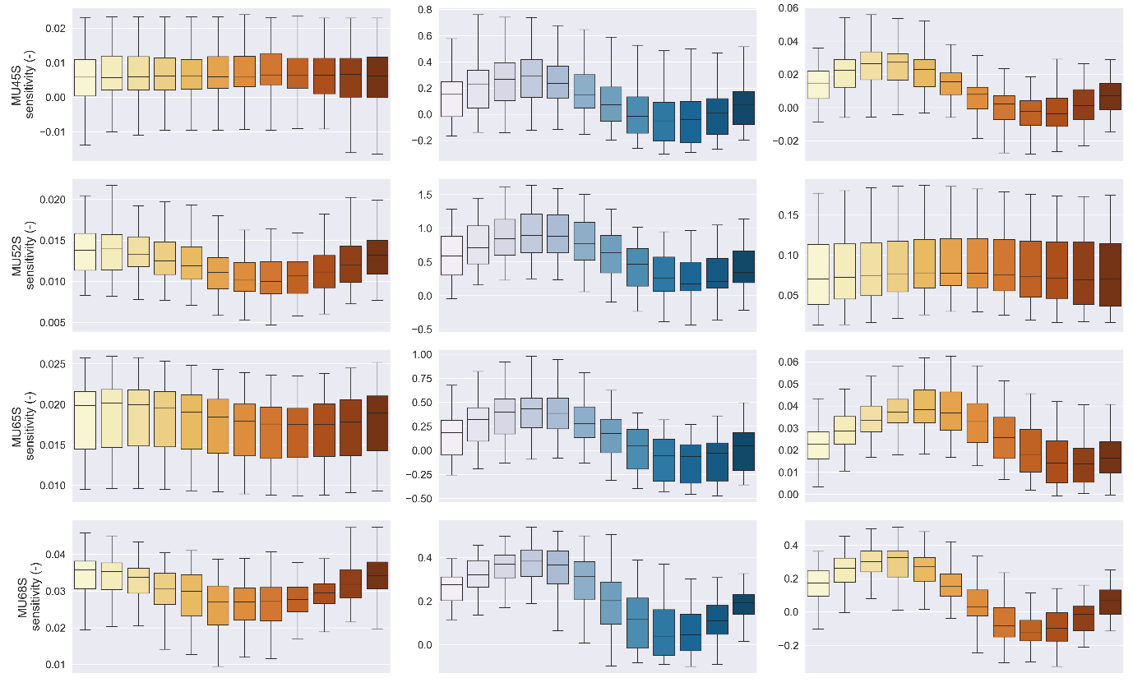
SA – Understanding system behaviour through sensitivity analysis
Observation time x
sensitivity relations
Sensitivities generated from 1st order approximation of partial derivatives
Useful to define distance-sensitivity relationships
Radius of influence from model parameters
Temporal behaviour of sensitivities
Seasonal sensitivity
behaviour

Slide 15
Conclusions
DA, UQ and SA techniques have potential to greatly help investigations in endorheic basins
Conventional application of these techniques often happen at the end of model exercises
It has been find that iterations between conceptualisation-modelling-DA-UQ-SA can greatly improve robustness of conceptual and numerical models

