Slide 1
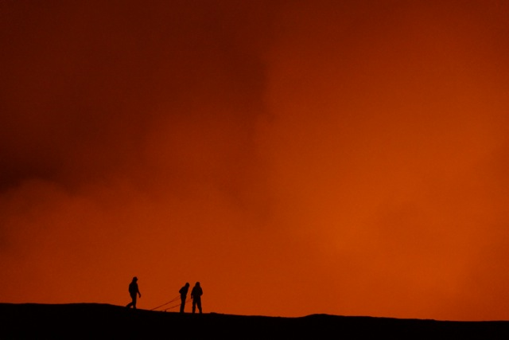


Trends in volcanic degassing through eruption cycles: insights from satellite measurements
S.A. Carn¹, V. Fioletov², C. McLinden², N.A. Krotkov³, C. Li^{3,4}
Michigan Technological University, MI, USA; scarn@mtu.edu
Environment & Climate Change Canada, Toronto, Canada
NASA Goddard Space Flight Center, MD, USA
ESSIC, Univ. of Maryland, MD, USA
We acknowledge funding from the NASA Aura Science Team

Slide 2
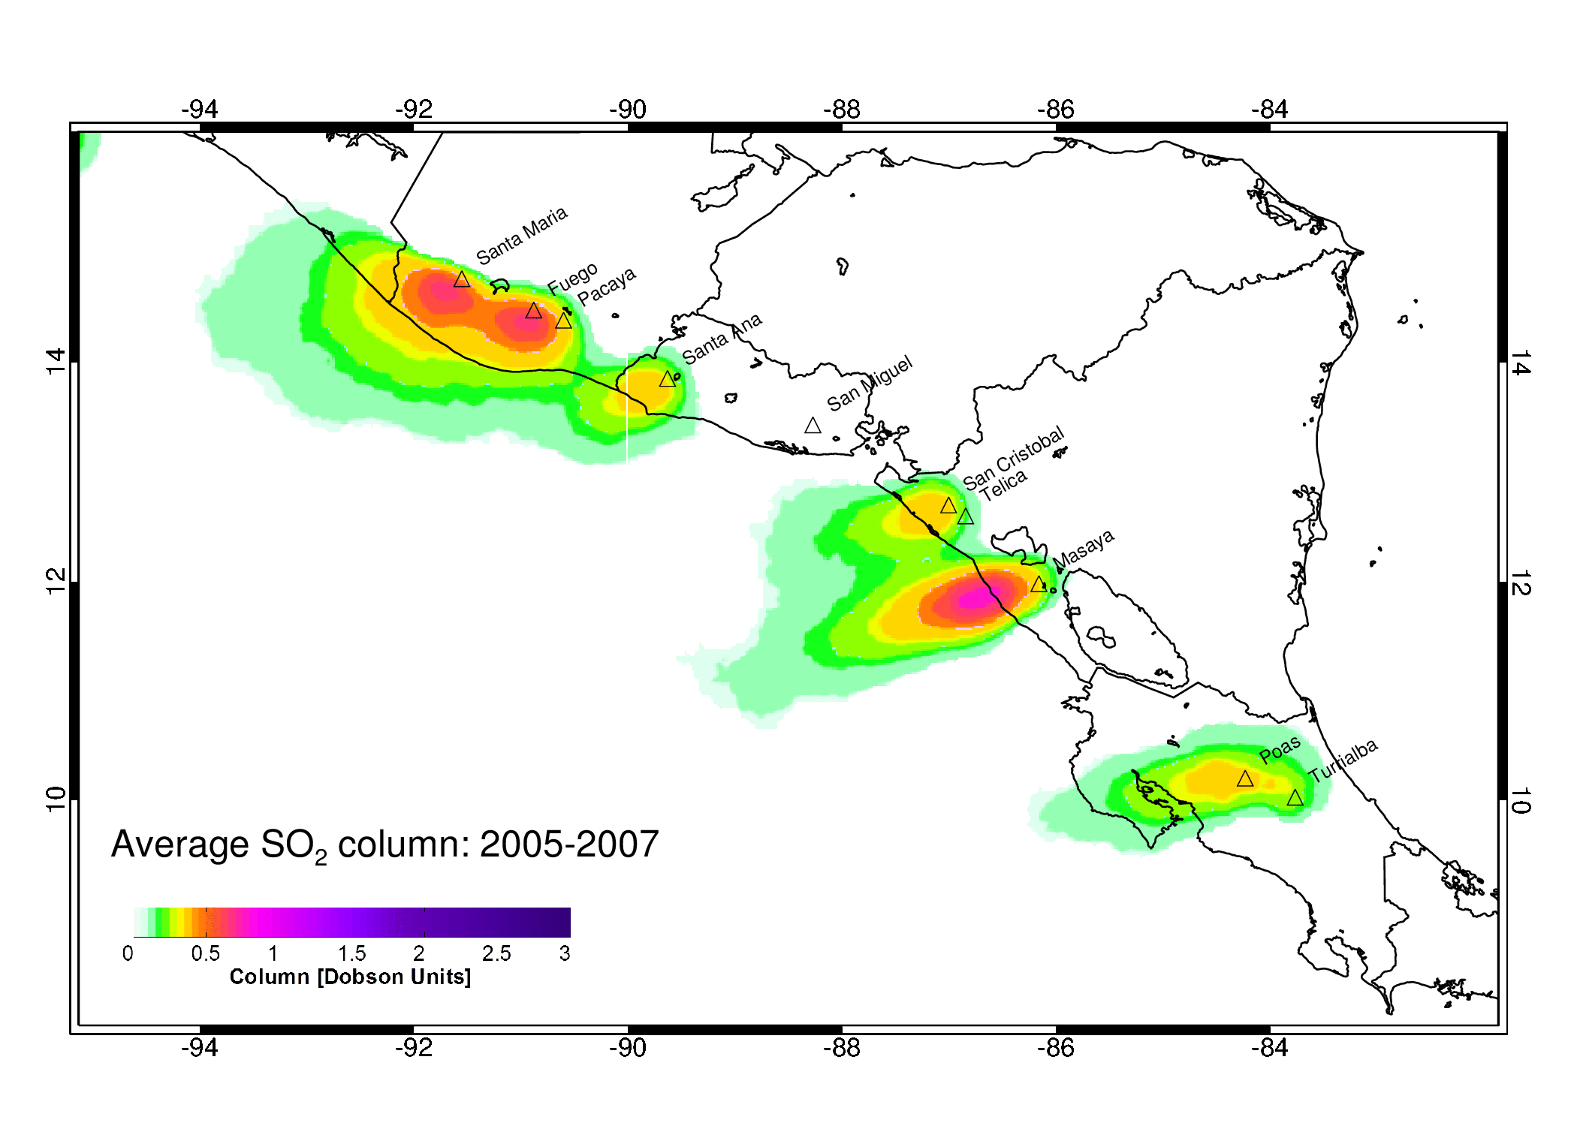
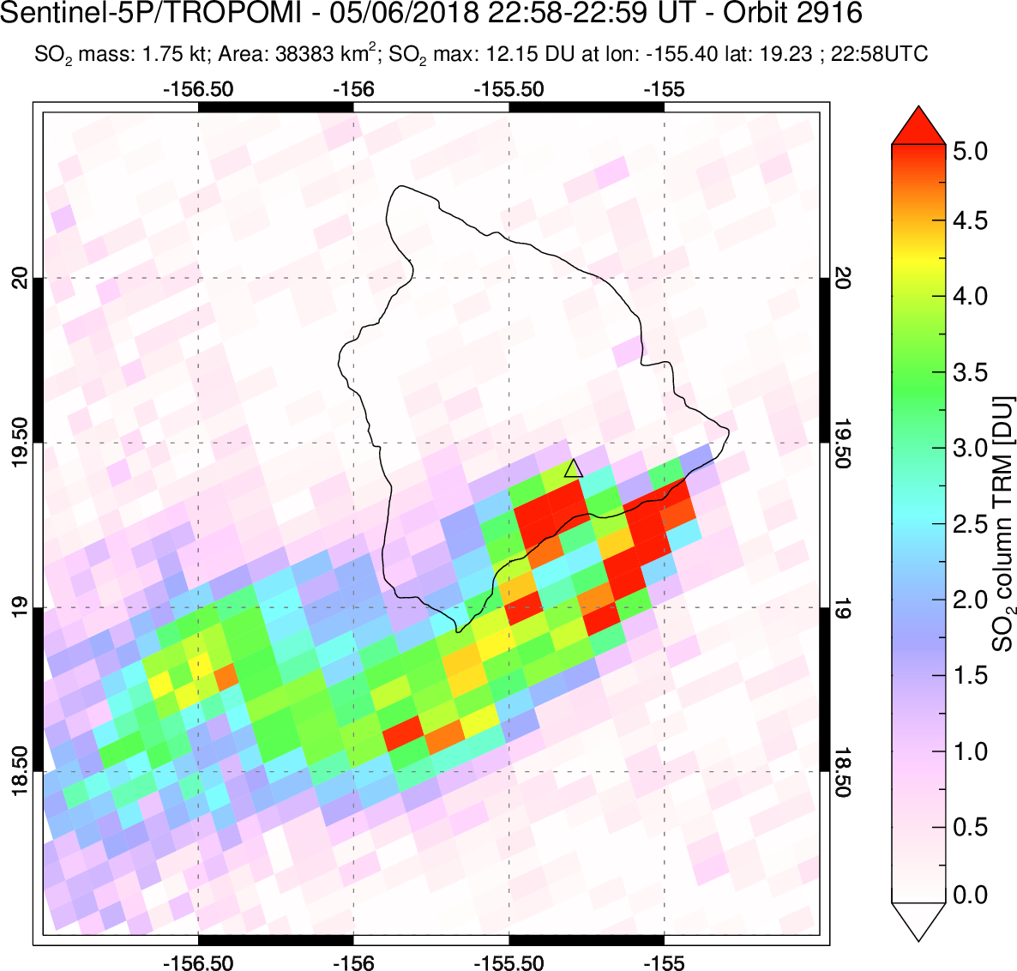

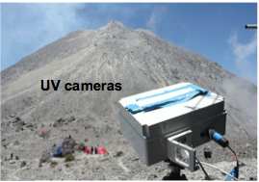
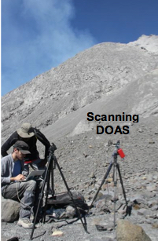
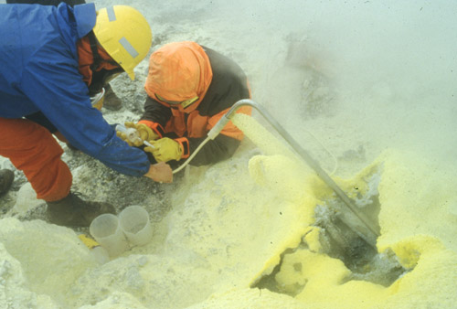
Multi-scale volcanic gas measurements
Daily satellite SO₂ data
Space
© Matthew Wordell
S5P/TROPOMI
Long-term average satellite SO₂ data
+MultiGAS
UV cameras
Direct sampling
DOAS
DCO-DECADE
UAVs
Time
In-situ MultiGAS (CO₂, SO₂, H₂O, H₂S)
Composition
Satellite data optimal for analyzing long-term (decadal) trends in degassing at many volcanoes

Slide 3
Satellite SO₂ measurements as indicator of unrest
Contingency table
(Based on eruptions in 1978-2016)
Furtney et al., 2018
SO₂ emissions are strongly associated with eruptions
Few systematic studies of pre-/post-eruption trends
Gas data (i.e., SO₂ fluxes) generally subordinate to seismicity & deformation as a volcanic unrest indicator (CO₂ emissions probably more useful than SO₂ – but the former are hard to measure)
Deformation regarded as the indicator of pre-eruptive unrest that on average provides the longest lead-time prior to an eruption (Philipson et al., 2013; Furtney et al., 2018)

Slide 4
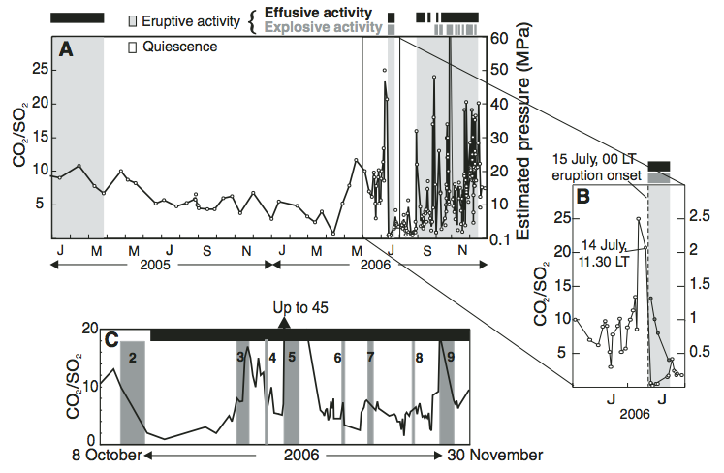
Variable CO₂/SO₂ ratios before explosive eruptions
Etna
Villarrica (Chile)
Excursions in CO₂/SO₂ (and H₂O/CO₂) observed weeks-months prior to eruptions at basaltic, open-vent volcanoes (MultiGAS)
But gas ratios are very difficult to measure from space
Focus here on trends in SO₂ emissions alone
[e.g., Aiuppa et al., 2007, 2009, 2017; de Moor et al., 2016]

Slide 5
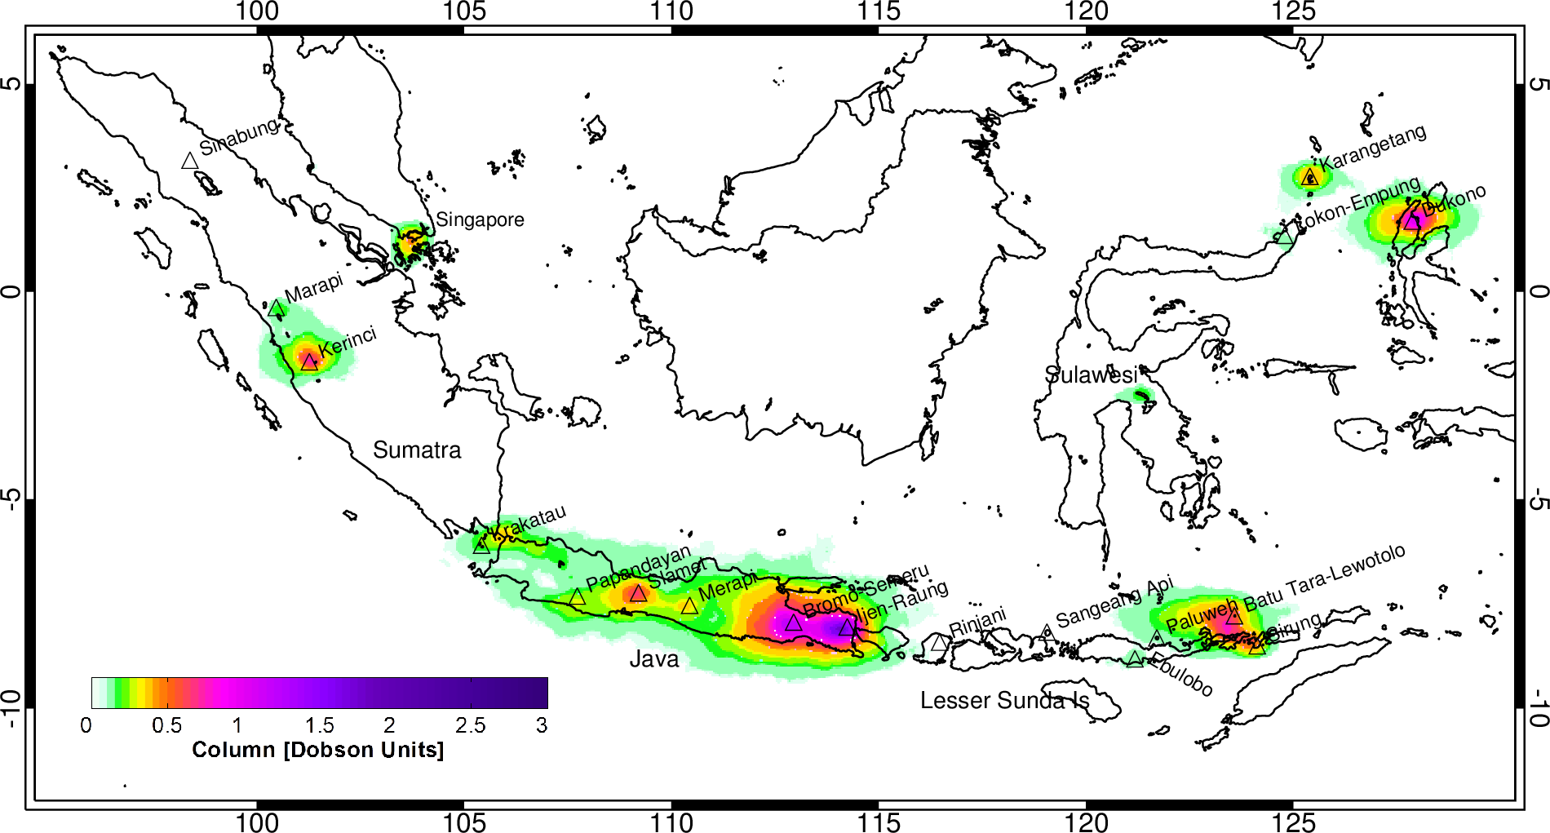
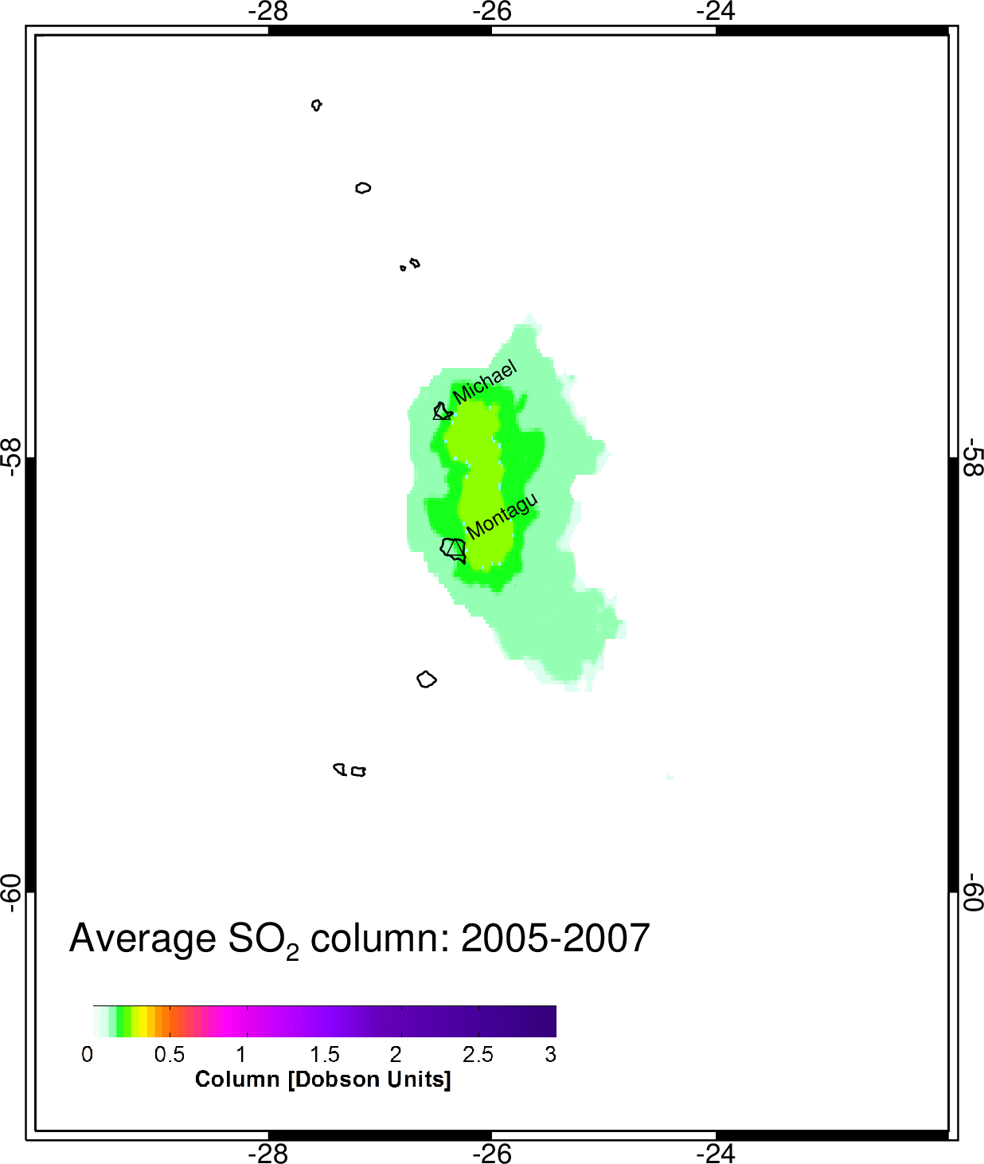
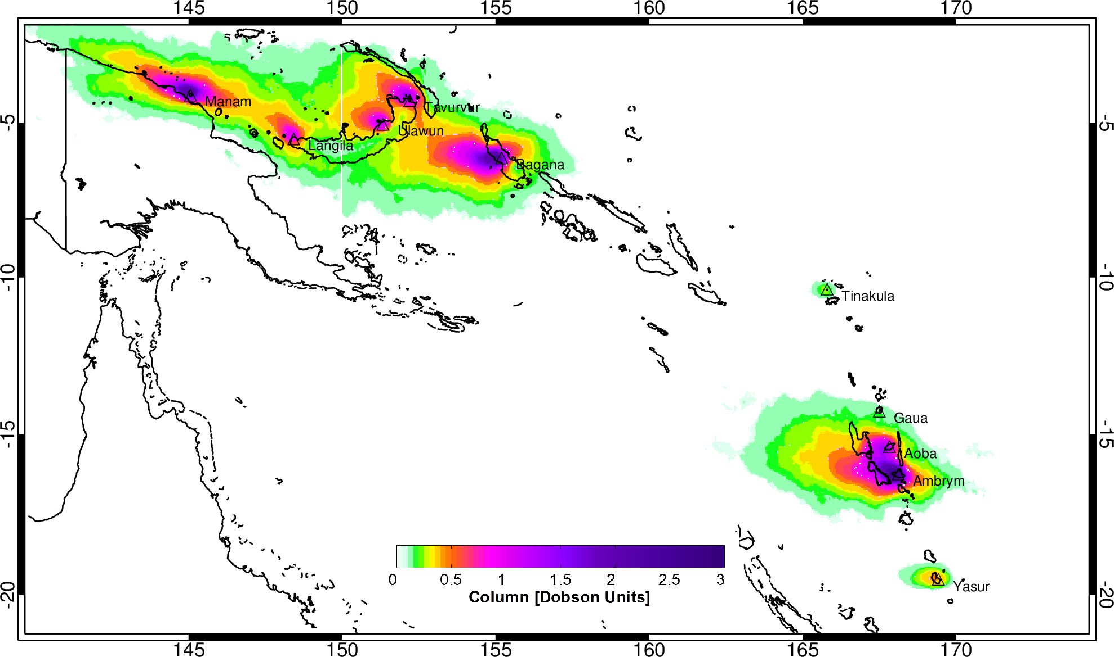
Satellite-based global volcanic SO₂ emission inventory
South Sandwich Is
Indonesia
Globally, 90-100 volcanic SO₂ sources quantified (10-20% ‘new’) using NASA Aura/OMI data
Total SO₂ flux of 23+/-2 Tg/yr (~63 kt/day); ~80-90% of total SO₂ flux from passive + eruptive degassing
Largely unconstrained by location or level of activity -> new insight into pre-/post-eruption SO₂ degassing
Papua New Guinea
Solomon Is
2005-2007 mean
OMI SO₂ columns
Vanuatu
Fioletov et al. (2016); Carn et al. (2017)

Slide 6
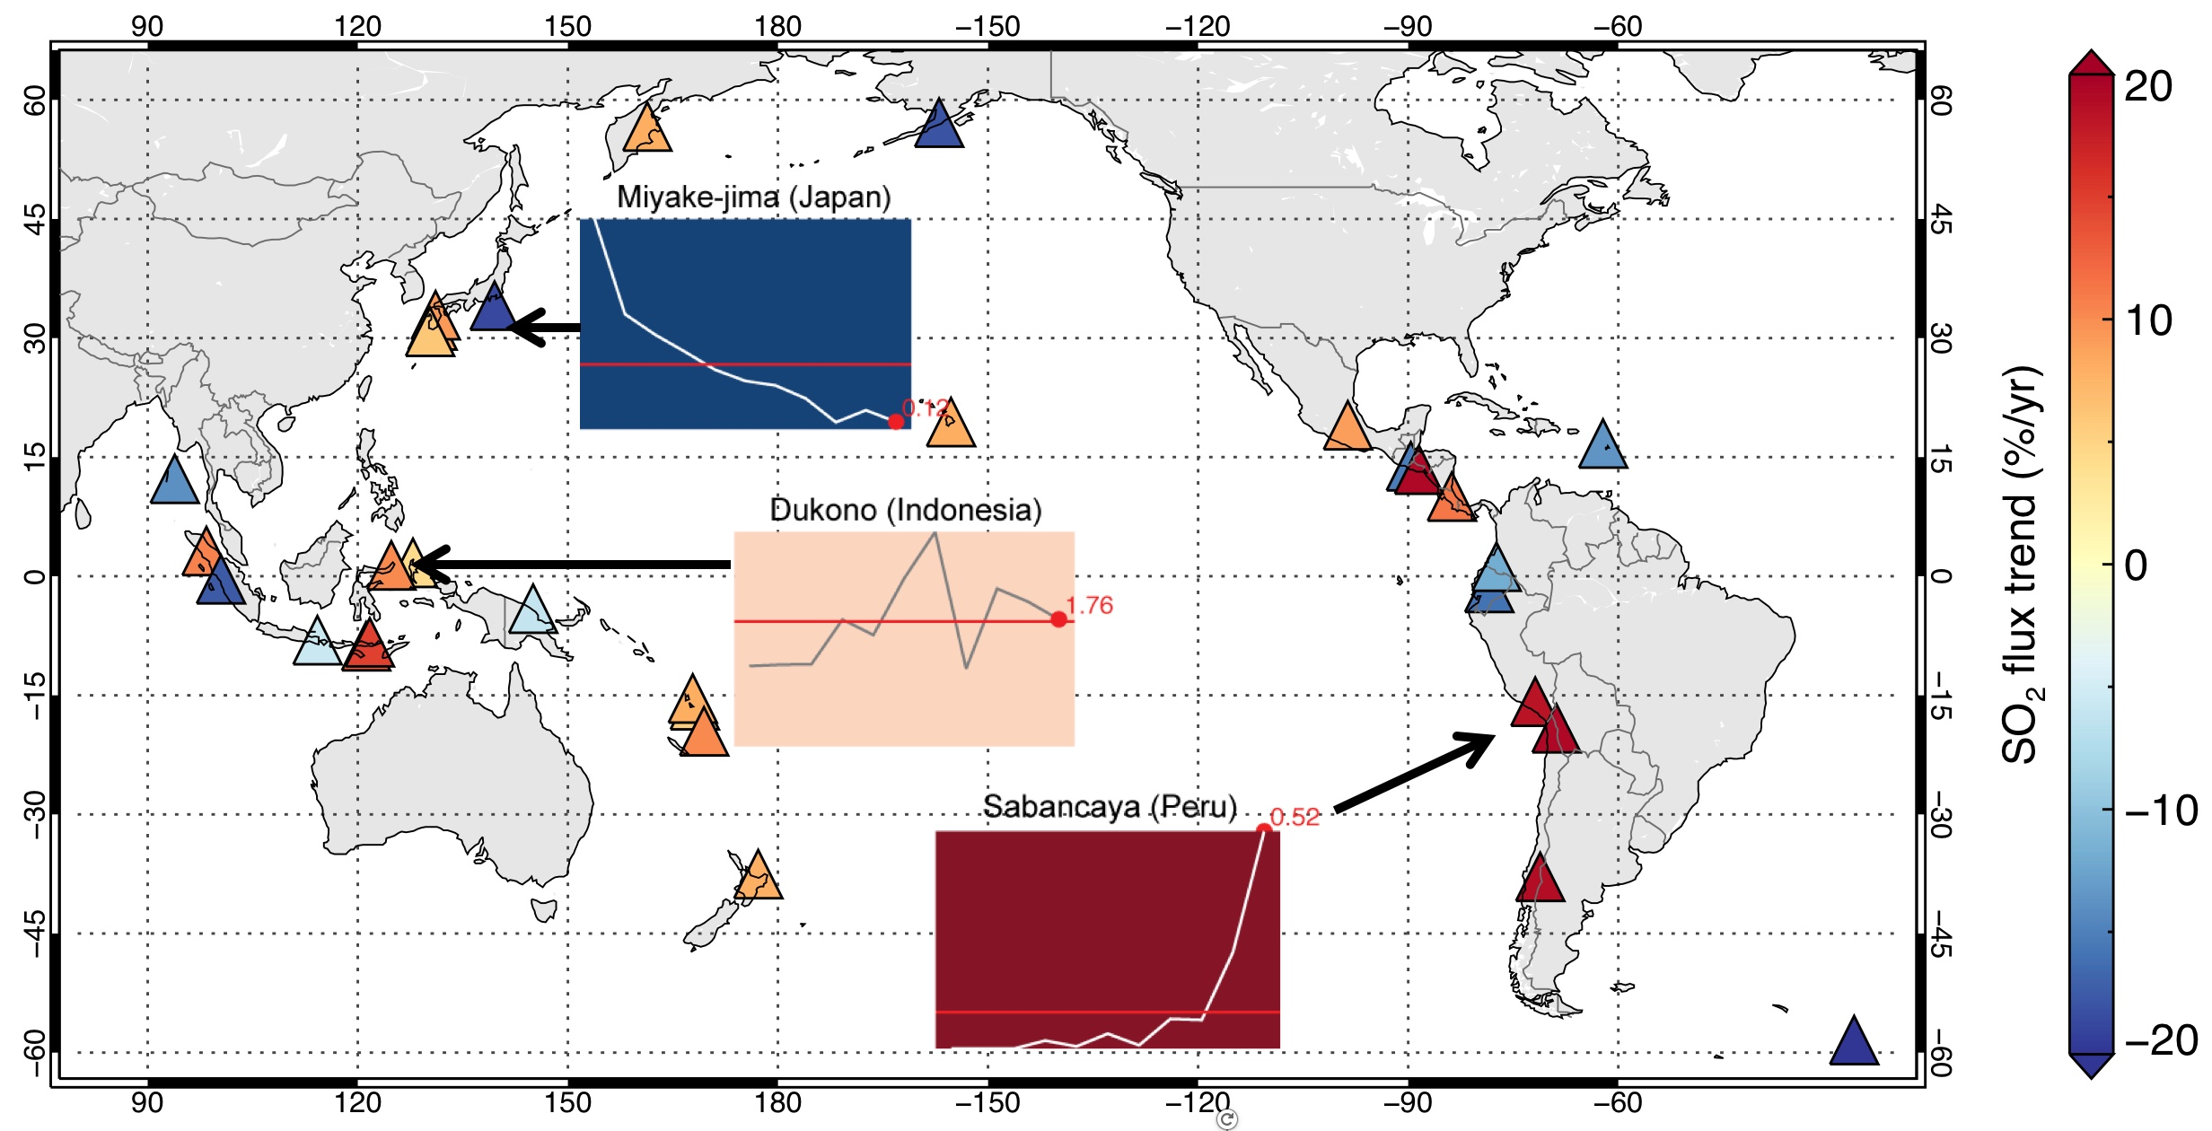
Trends in tropospheric volcanic SO₂ emissions
Carn et al. (2017)
Measurements capture various stages of long volcanic ‘life-cycles’ at open-system volcanoes
~80% of SO₂ sources erupted during the decade (VEIs < 5) – limited observations for VEI 5+ events
Unprecedented opportunity to analyze trends in SO₂ emissions during eruptive cycles

Slide 7
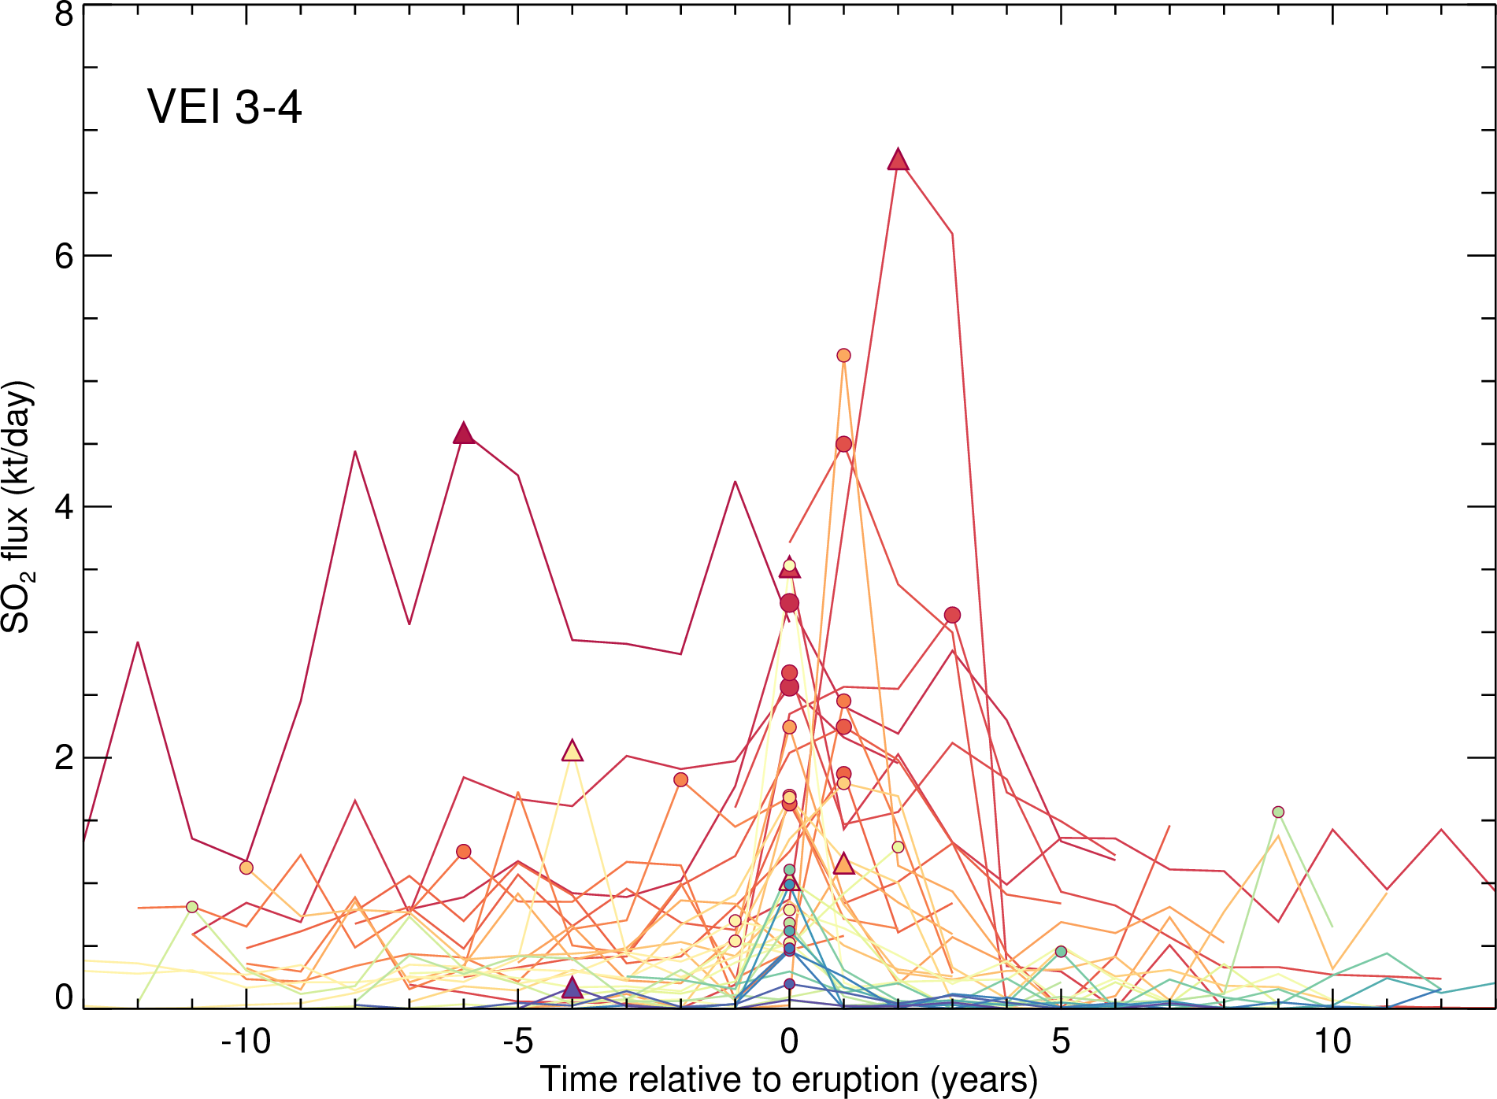
Trends in SO₂ emissions at erupting, open-vent volcanoes
2005-2019 OMI SO₂ data
Superposed Epoch Analysis (SEA): all SO₂ time-series aligned with eruption year at zero
Eruption dates and VEIs from Smithsonian GVP database (VOTW)
Syn- or post-eruptive peak in SO₂ emissions
No data for any VEI 5+ eruptions
Note some VEIs are also preliminary or uncertain
Symbol = max SO₂ flux

Slide 8
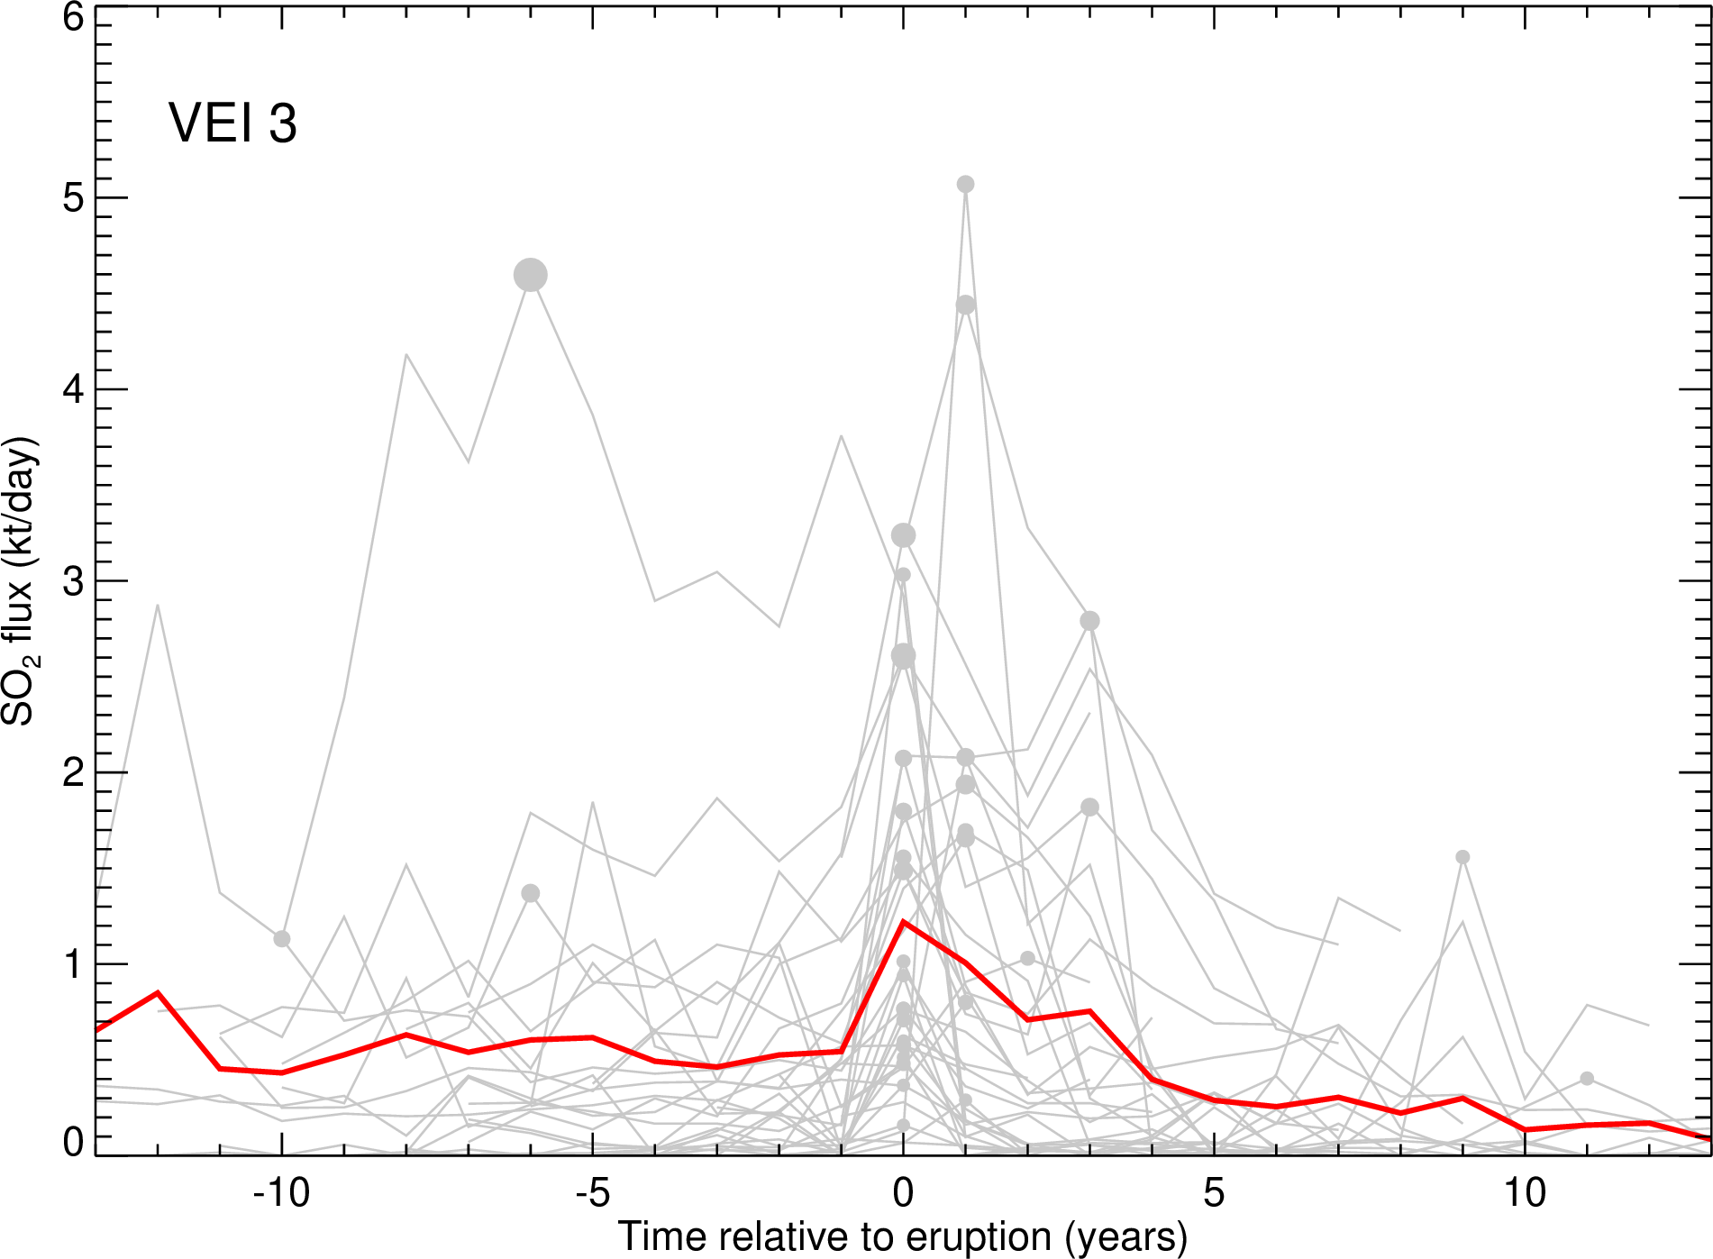
Trends in SO₂ emissions at erupting, open-vent volcanoes
2005-2019 OMI SO₂ data
SEA for all VEI 3 eruptions (34 events)
Mean trend for volcanoes that produced VEI 3 eruptions
Elevated SO₂ flux over decade before eruption (mean ~500 t/d)
Continued, elevated SO₂ flux for a few years after eruption
Mean VEI 3 trend
n = 35

Slide 9
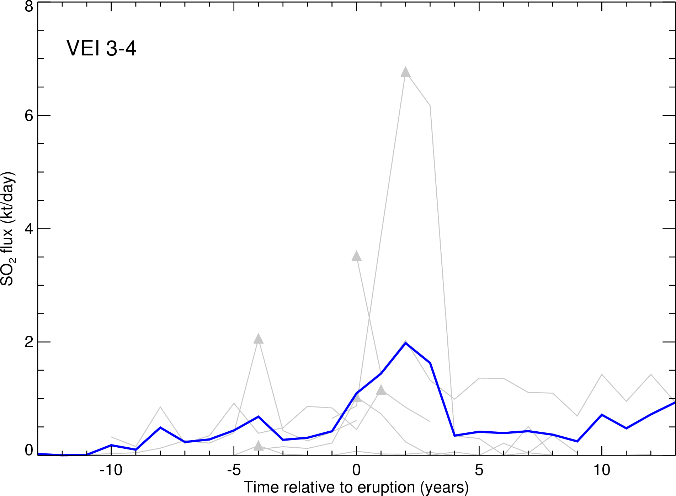
Trends in SO₂ emissions at erupting, open-vent volcanoes
2005-2019 OMI SO₂ data
SEA for all VEI 4 eruptions (only 6 events)
Mean trend for volcanoes that produced VEI 4 eruptions
Gradual increase in SO₂ flux over decade?
Continued, elevated SO₂ flux (>VEI 3) a few years after eruption
Mean VEI 4 trend
n = 6

Slide 10
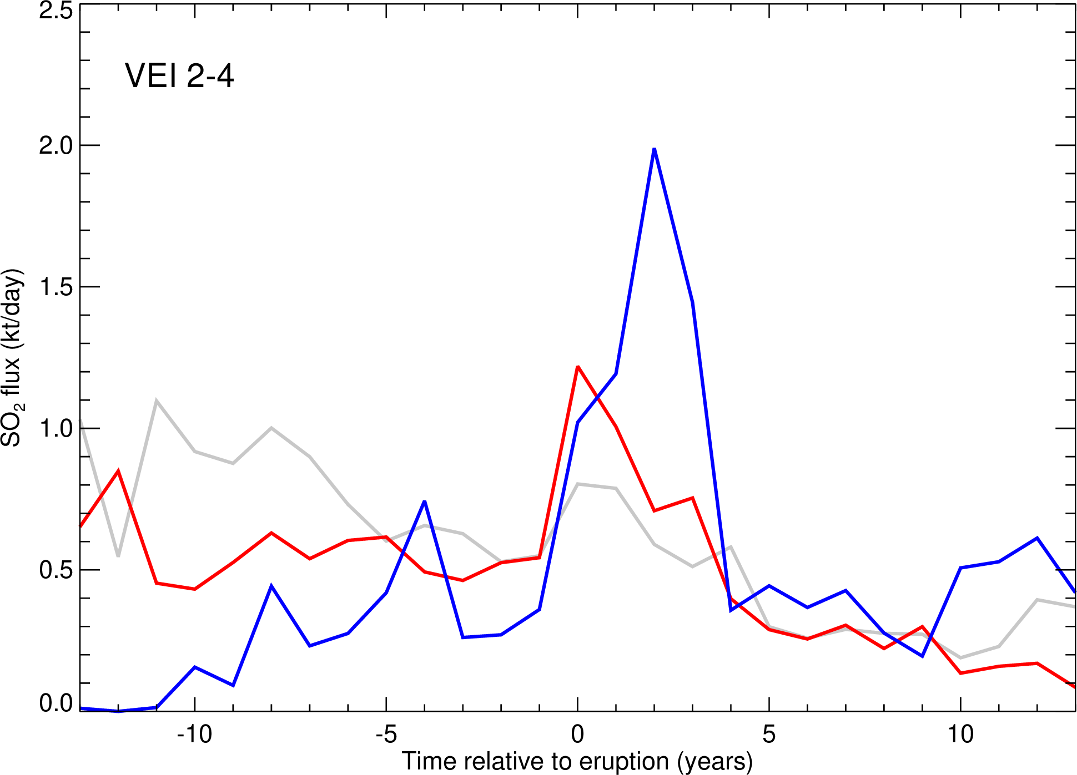
Trends in SO₂ emissions at erupting, open-vent volcanoes
2005-2019 OMI SO₂ data
SEA for all VEI 2-4 eruptions
Mean trends for all VEI 2-4 eruptions
Inverse correlation between pre-eruptive SO₂ flux and VEI -> Increased degassing inhibits large eruptions?
Correlation between post-eruptive SO₂ flux and VEI (larger magma intrusions?)
Mean VEI 2 trend
Mean VEI 3 trend
Mean VEI 4 trend

Slide 11
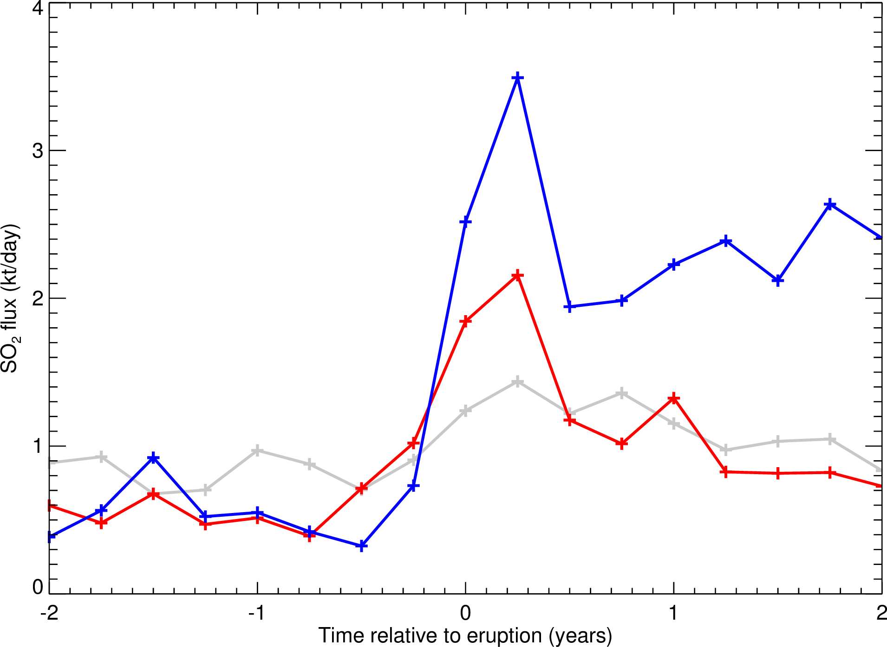
Insights from seasonal trends in SO₂ emissions
2005-2018 OMI SO₂ data
SEA for all VEI 2-4 eruptions using seasonal SO₂ emissions (DJF, MAM, JJA, SON)
Mean seasonal trends for all VEI 2-4 eruptions
SO₂ flux increases ~6-9 months before eruption:
VEI 3: ~6 (t/d) d⁻¹
VEI 4: ~12 (t/d) d⁻¹
Inverse correlation between eruption ‘run-up’ time and VEI? Higher VEI = deeper magma source?
Mean VEI 2 trend
Seasonal Emissions
Mean VEI 3 trend
Mean VEI 4 trend

Slide 12
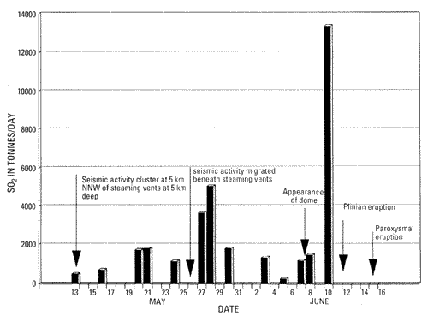
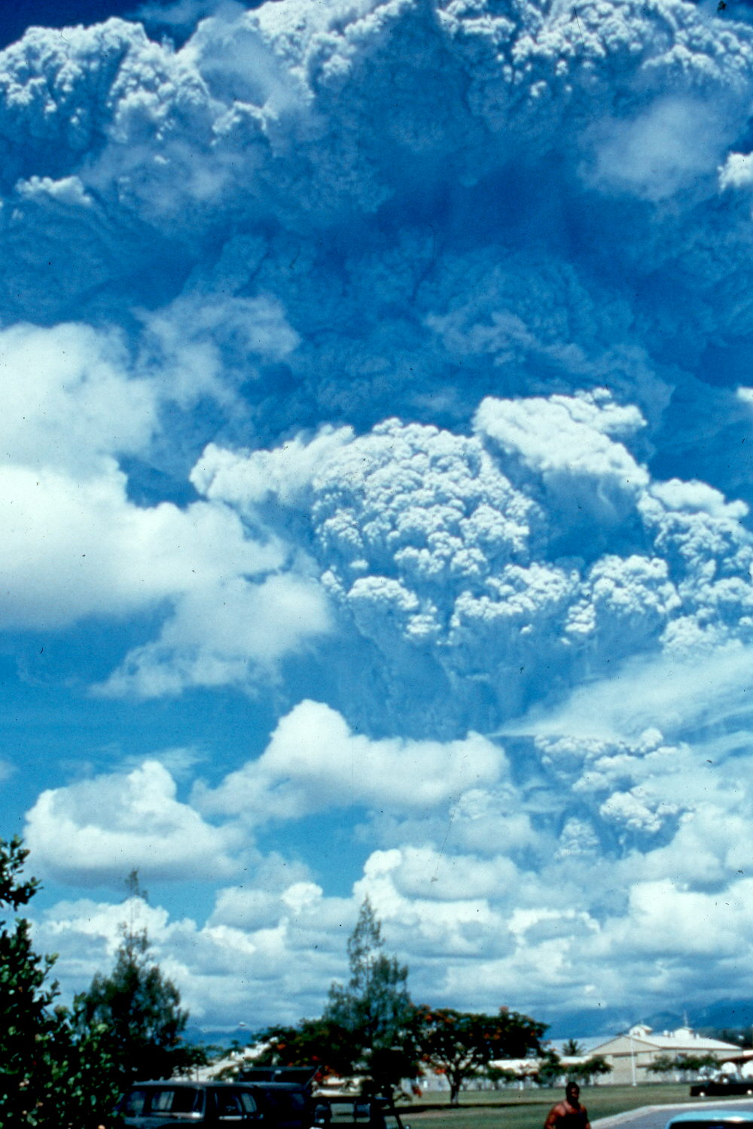
Do ‘pre-eruptive’ SO₂ emissions scale with magnitude?
Decadal trends in SO₂ emissions analyzed for erupting, open-vent volcanoes (VEI 2-4).
We find relationships between pre-/post-eruption SO₂ flux and eruption magnitude, and increasing SO₂ fluxes 6-9 months before eruptions.
Long-term average SO₂ fluxes also permit STA/LTA approaches to eruption forecasting using gas data.
COSPEC data
Daag et al. (1996)
Release of stored vapor phase?
~(210 t/d) d⁻¹
Pinatubo 1991
Such analyses could pave the way towards increased use of SO₂ emissions data in long-term probabilistic volcanic hazard assessment (along with deformation, heat flux, and seismic data), and improved constraints on volcanic life-cycles (e.g., coupled with petrological timescales).

