Slide 1


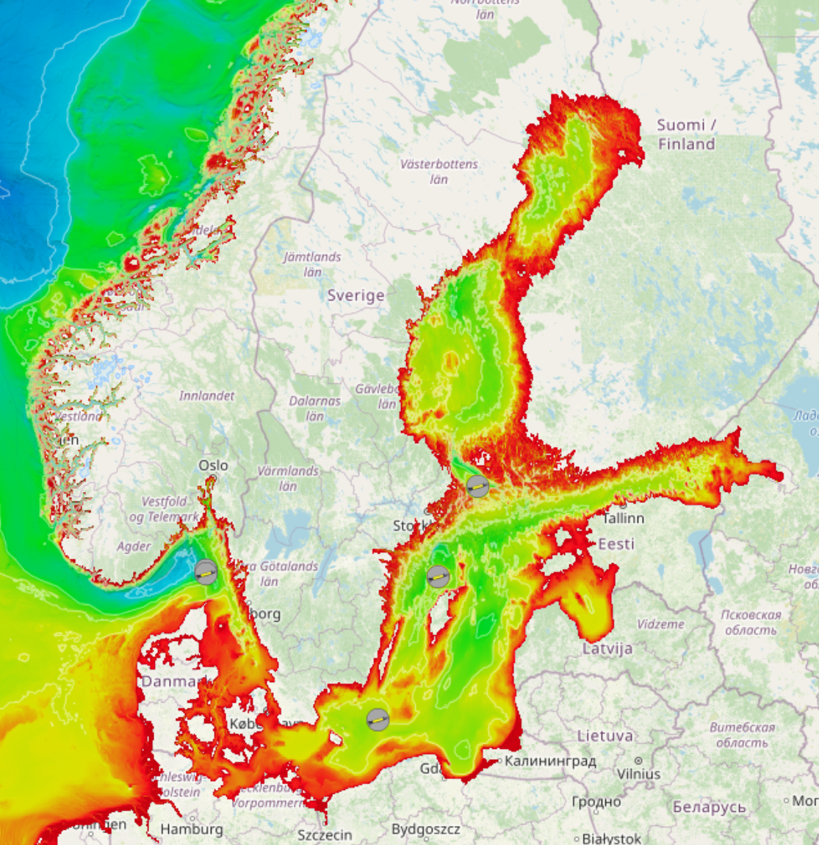
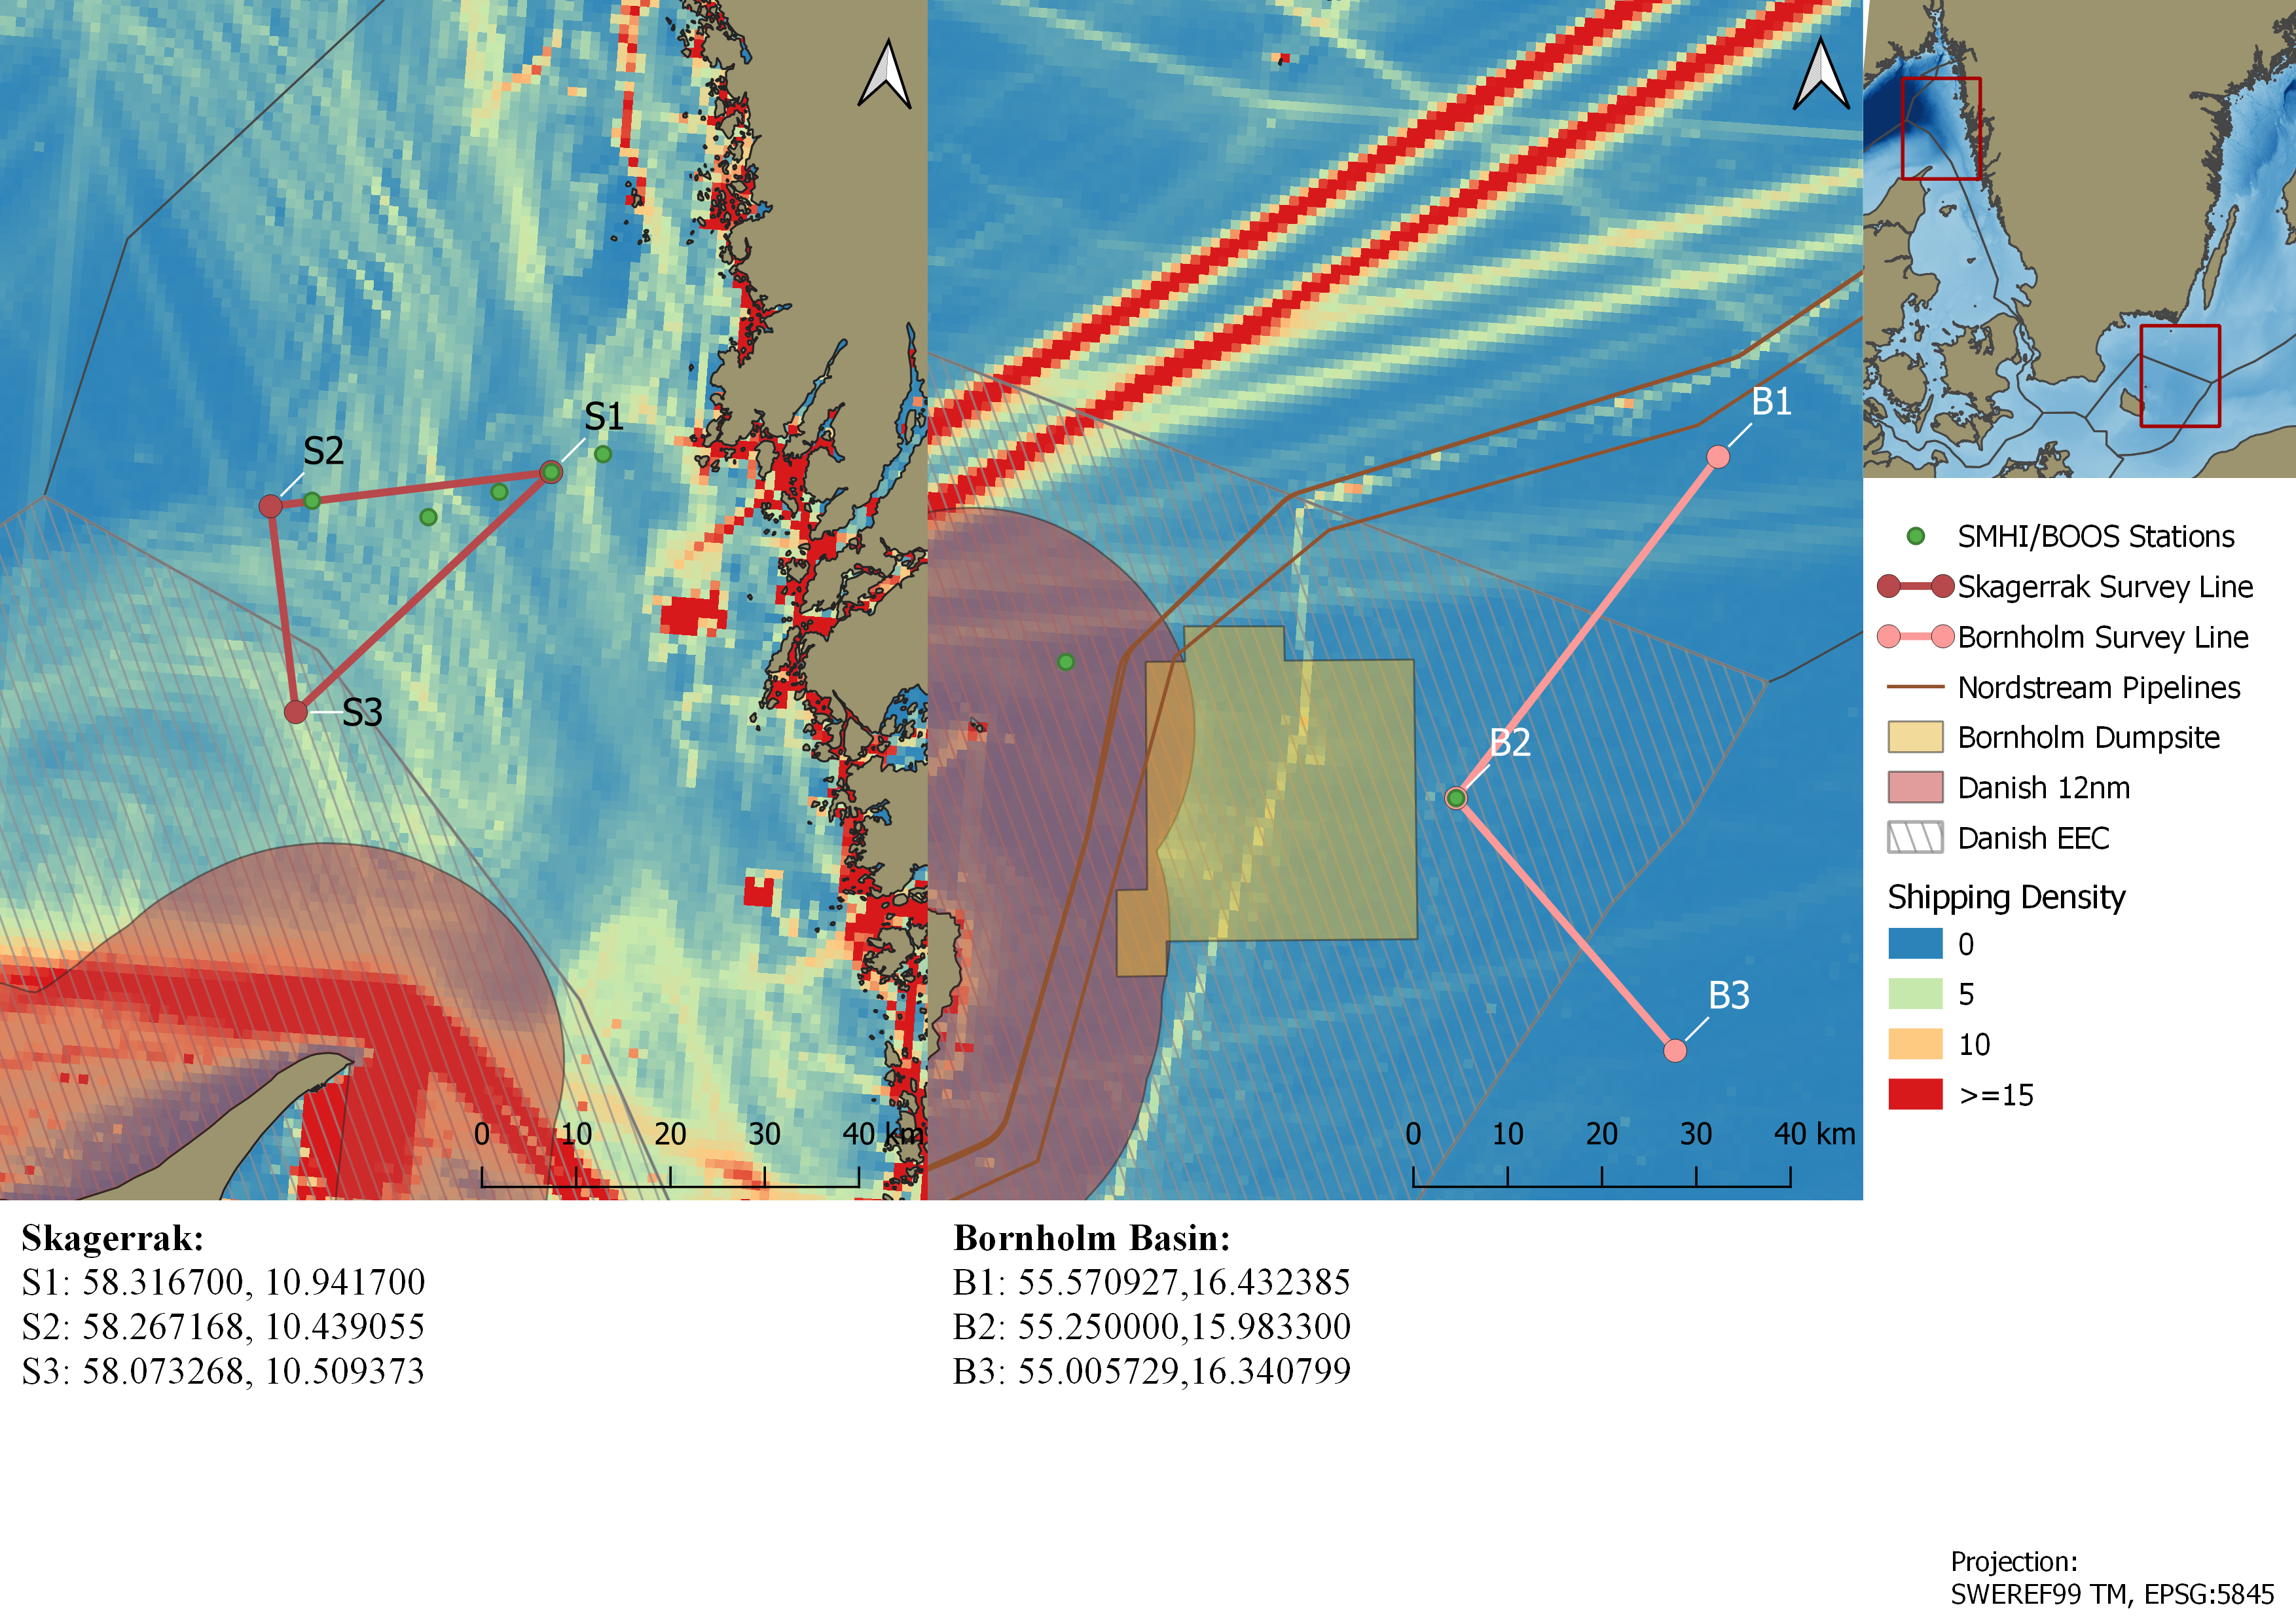
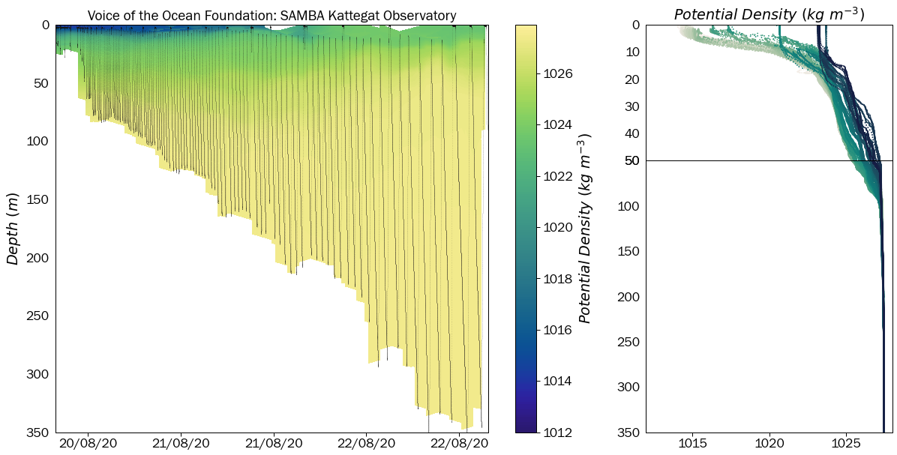
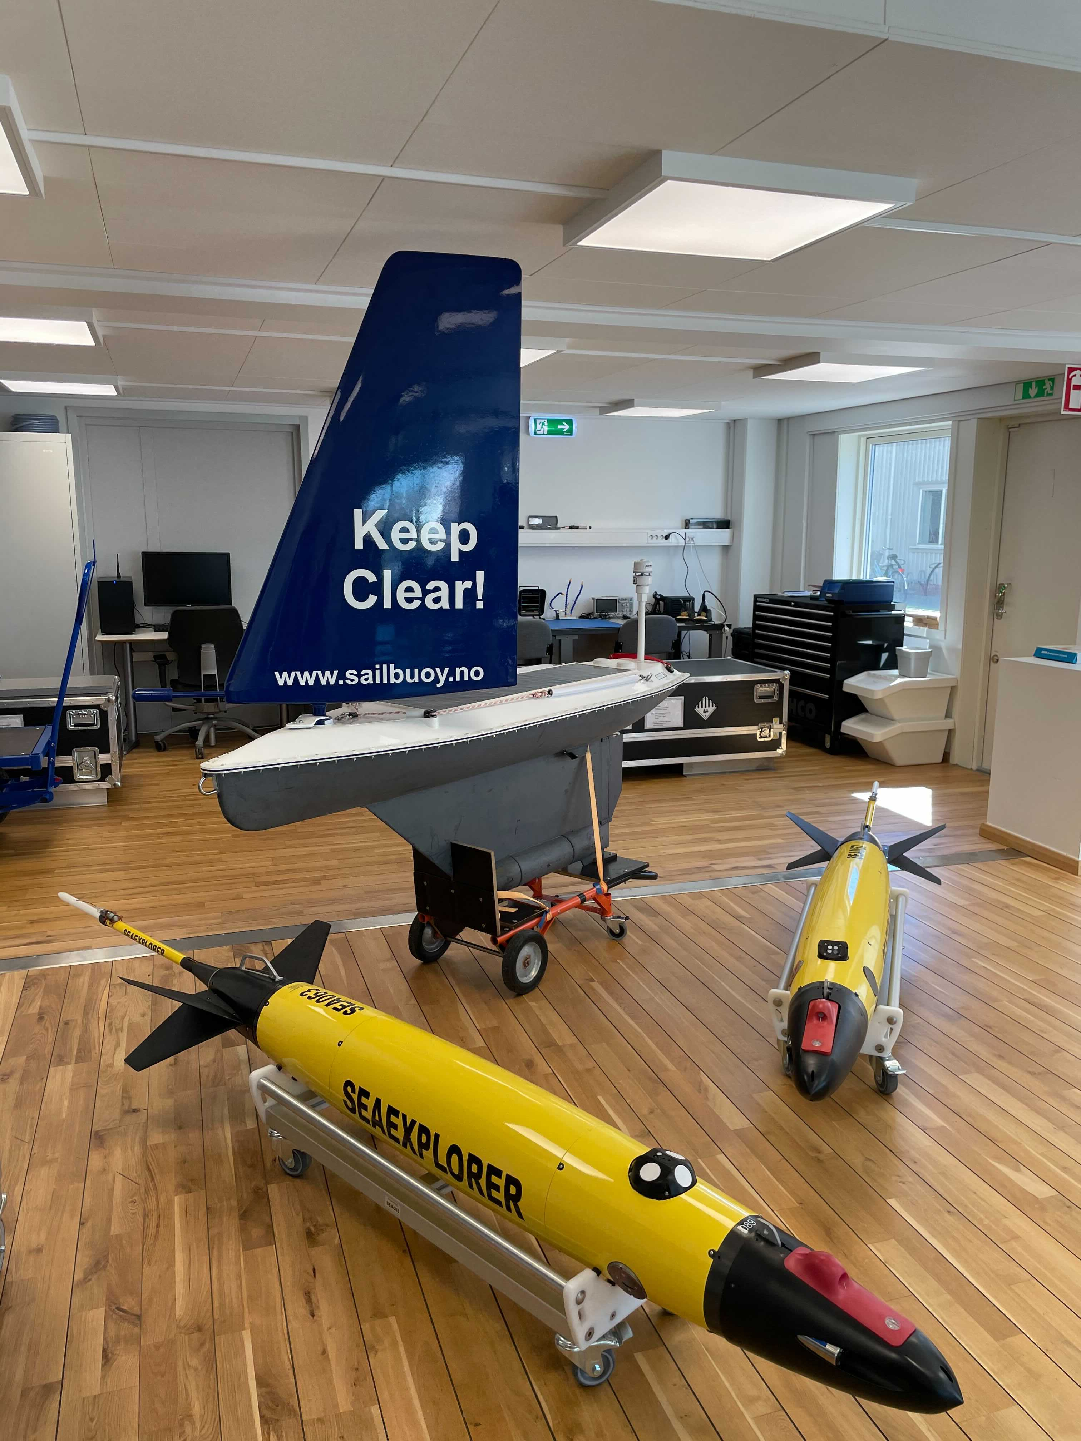
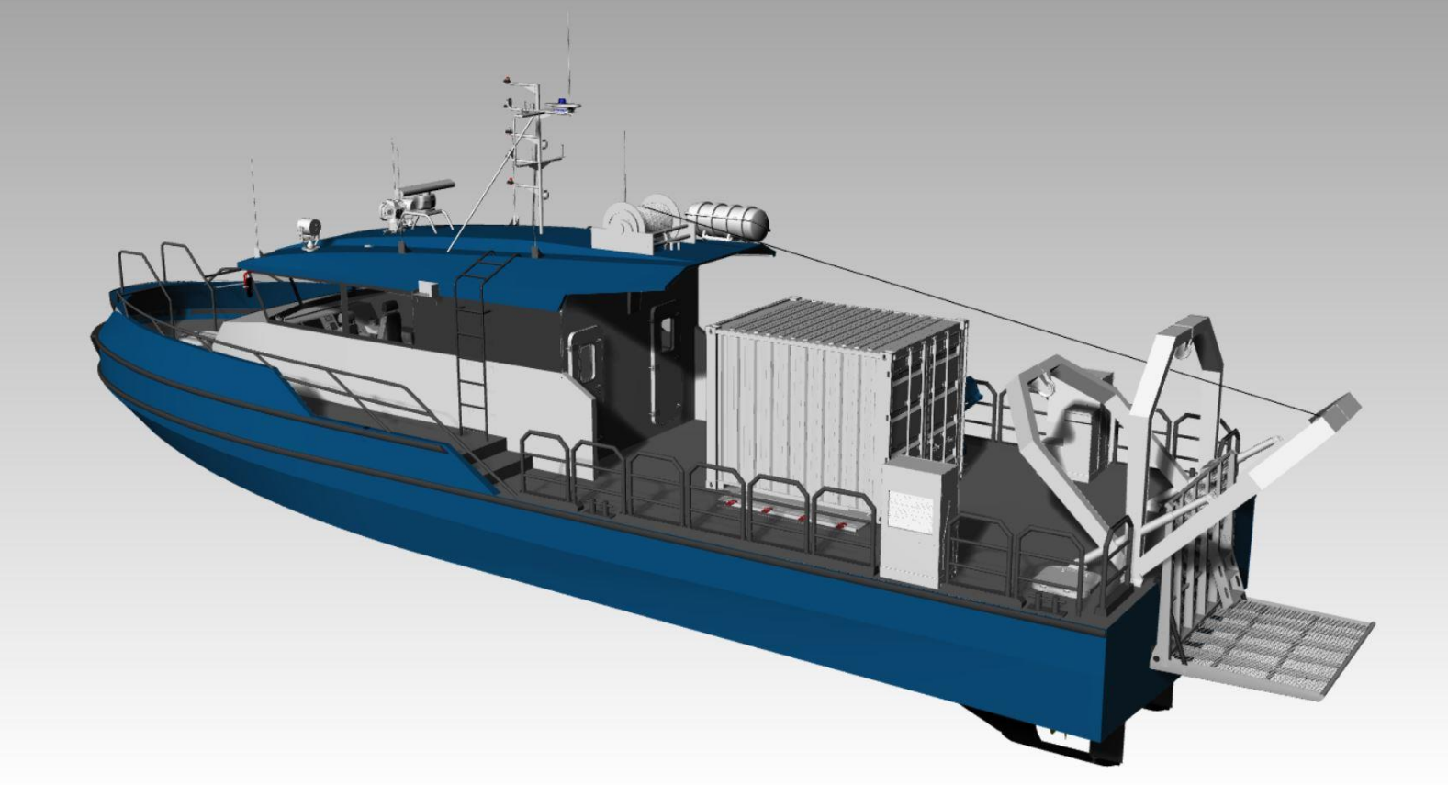
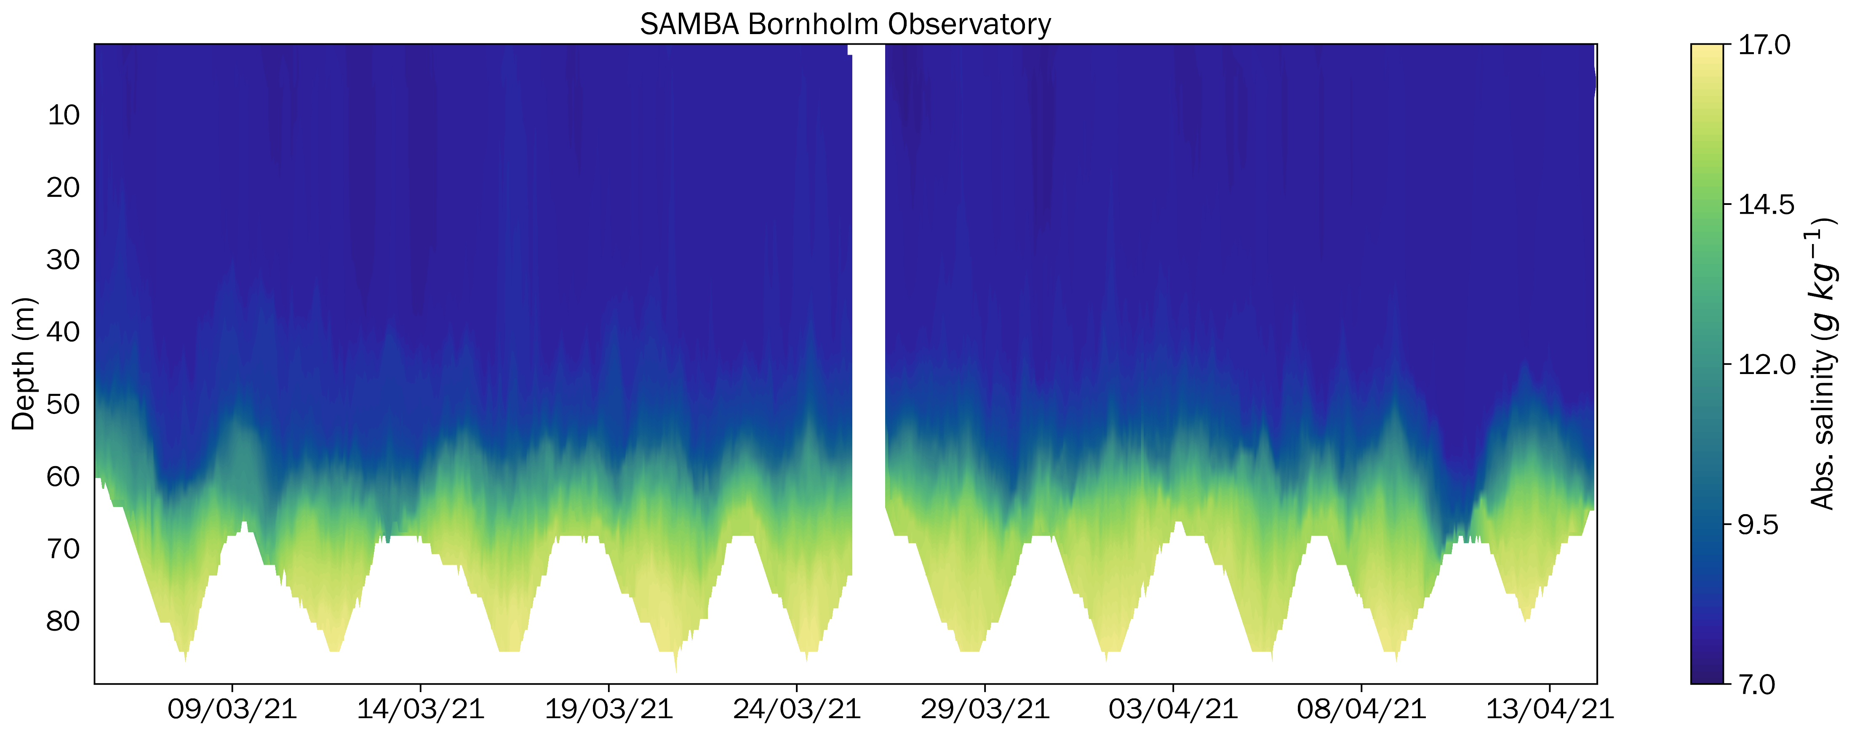
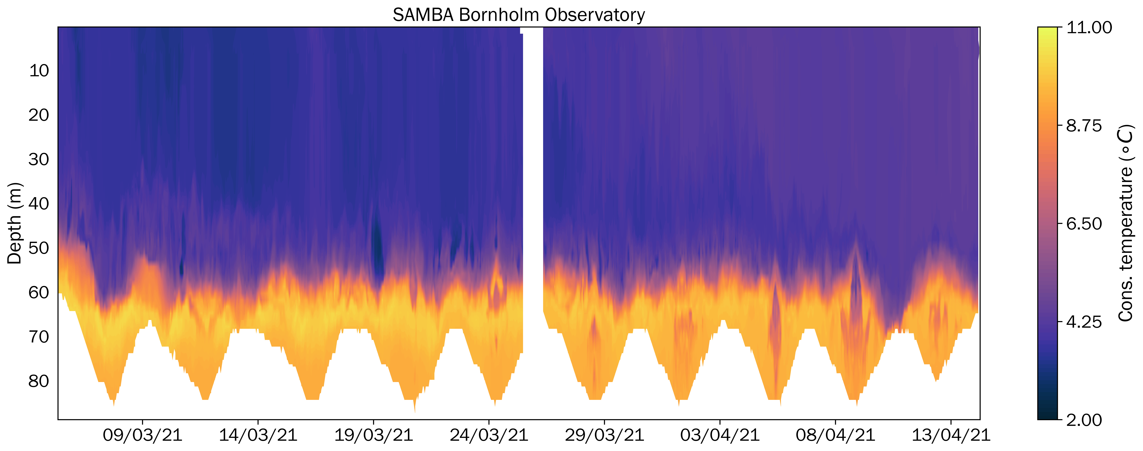
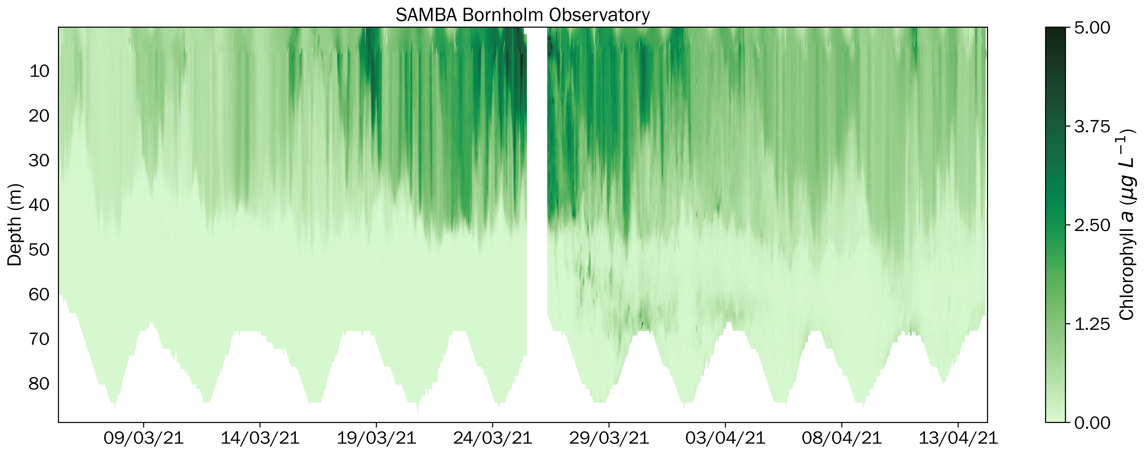
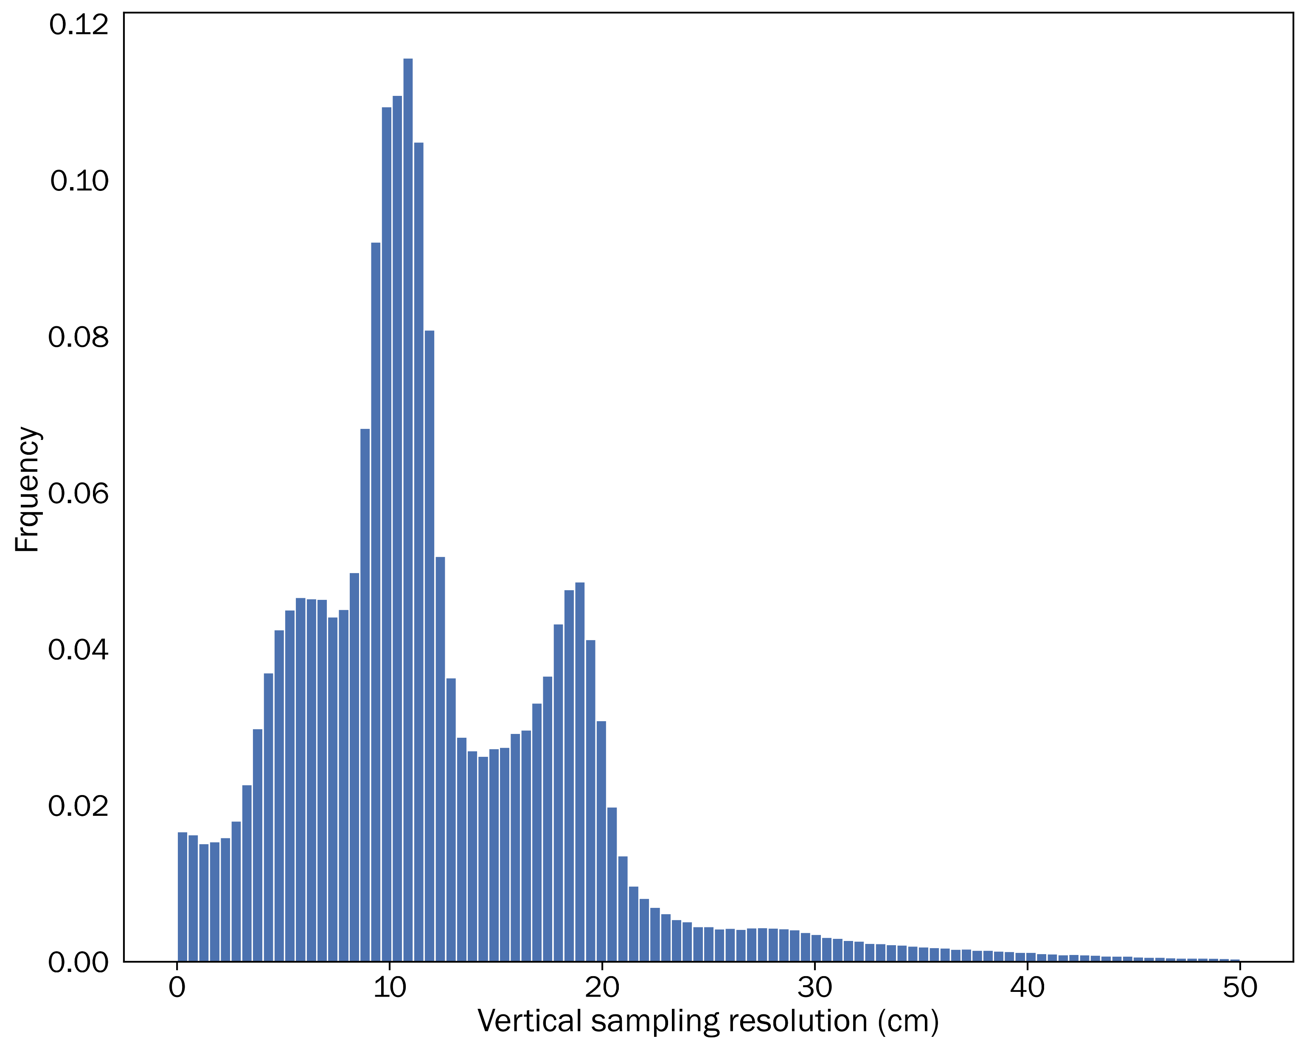
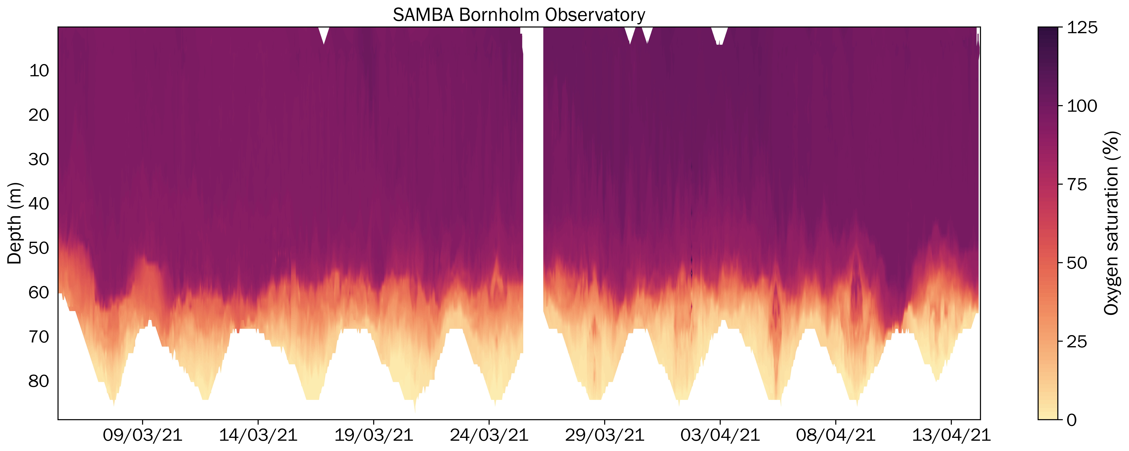
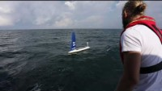
Observing Baltic Sea exchanges: results from a new multi-platform autonomous observatory
Bastien Y. Queste⁽¹⁾, Sebastiaan Swart⁽¹⁾, Louise C. Biddle^{(1,2)}, Olle Petersson⁽²⁾ , Aleksandra K. Mazur⁽²⁾ , Marcus Melin⁽²⁾
Contact: bastien.queste@gu.se or http://voiceoftheocean.org/knowledge
1. Department of Marine Sciences, University of Gothenburg, Gothenburg, Sweden
2. Ocean Knowledge, Foundation Voice of the Ocean, Skeppet Ärans Väg 3, 42671 Västra Frölunda, Sweden
Smart Autonomous Monitoring of the Baltic Sea (SAMBA) is an infrastructure project, funded by Voice of the Ocean Foundation (VOTO), combining short term science objectives detailed further below and the long-term vision of establishing several persistent ocean observatories across the Baltic Sea for international collaboration.
Both the Kattegat and Bornholm observatories (left, below) began March ’21, and another two sites are planned in the next year. Final locations are subject to modification.
Persistent deployments in the region are challenging. Autonomous vehicles are particularly sensitive to strong density gradients, fast currents, shipping and fishing. The complications of international permits and cooperation agreements has often slowed the growth of glider infrastructure around the world.
VOTO, SAMBA and the platform manufacturers have been working together to optimise glider capabilities in such regions. Incremental increases in capabilities are being made available to the other users through collaborative work in the region. The partnership of academia, industry and the VOTO foundation is a cornerstone of the project and key to future success.
VOTO’s Ocean Knowledge division wants to help scientists understand the sea as a system through the collection of data and provision of infrastructure. Ocean Knowledge works along two different timelines: (1) collection of data for current scientific research, (2) collection of data to contribute to long-term data series, with the aim of helping science in the future (10 years and beyond) to answer questions that may arise over time.
Data collected by the Ocean Knowledge division at Voice of the Ocean provides its data publicly, with a data delivery system for direct delivery to EMODnet under construction. In the meantime, access to VOTO infrastructure, described below, or data can be done by getting in touch with the foundation through the website:
http://voiceoftheocean.org/knowledge/
10 x SeaExplorer gliders (left, yellow). Equipped with rechargeable batteries and interdisciplinary sensor payloads: RBR Legato temperature and salinity sensors; RBR Coda or JFE Rinko AROD-FT oxygen sensors; Wetlabs Triplet ECOpucks for chlorophyll a, phycocyanin and optical backscatter; SeaBird OCR504i 4-channel PAR sensors; Nortek 1MHz ADCP.
4 x Sailbuoy surface vehicles (left, blue). Equipped with combinations of N.Brown G-CTD, Aanderaa 4319, or RBR Legato temperature and salinity sensors, Airmar 200WX meteorology, FT Technologies FT7 wind sensor, Datawell wave recorder, EK80 WBT mini echosounder, Aanderaa DCPS current profiler.
2 x Rapid science vessels (above) for quick and easy autonomous vehicle turnarounds (recover/recharge/redeploy) over a single day, along with in situ calibration of sensors using a full CTD and rosette configuration.
The following plots show data from the first 40 days of the Bornholm Observatory. These figures are composites of 5876 individual profiles, sampled at vertical resolutions of ~10 cm. The observatories are still new, and we do not yet exploit the full capability of the gliders in terms of endurance or resolution. Piloting in such conditions is challenging and significant effort is dedicated to optimising flight to increase endurance. As is always the case in science, a luck component is ever present, and the first glider turnaround at this location occurred during the peak of the spring bloom.
Each observatory will be surveyed by two underwater gliders and one surface vehicle. The combination of platforms allows distinction between spatial and temporal changes in such a dynamic environment (“are observed changes due to the glider moving elsewhere, or to an evolution of the environment over time?”). Surface vehicles will measure local air-sea processes, while gliders are split between biogeochemical payloads for estimating primary productivity and physical payloads for measuring of fine-scale ocean currents and shear.
In the short term, the data collected by VOTO Ocean Knowledge’s SAMBA project will serve to address a few key questions before the wider infrastructure can be used to investigate questions across the Baltic and longer periods:
What is the variability of water mass properties and transport across the Danish Straits, and how do these influence both small and large scale Baltic inflows?
How do physical processes affect rates of primary production, export of organic matter and remineralisation at depth across the Baltic?
How is the upper ocean impacted by heat and momentum fluxes, and how do these affect oxygenation of Baltic deep water?
What is the optimal strategy for long-term gliders observations in the Baltic Sea?
We plan to make all SAMBA data accessible and visible online by the end of the year. Information will be provided on the VOTO website and over @VOTO_Knowledge’s twitter.
SAMBA’s current research component is led by Bastien Queste and Sebastiaan Swart at the University of Gothenburg, Sweden. The SAMBA project will however collect a huge amount of data and welcomes collaborations on all topics. VOTO Ocean Knowledge’s remit is to foster international collaboration and this extends to SAMBA. The high resolution observations at these sites can reveal new insights into short term, patchy and submesoscale process, but real step changes in our understanding of the Baltic will come from combined use of existing long-term infrastructure, new technological developments and collaboration with experts from around the world. Don’t hesitate to get in touch with us.

