Slide 1
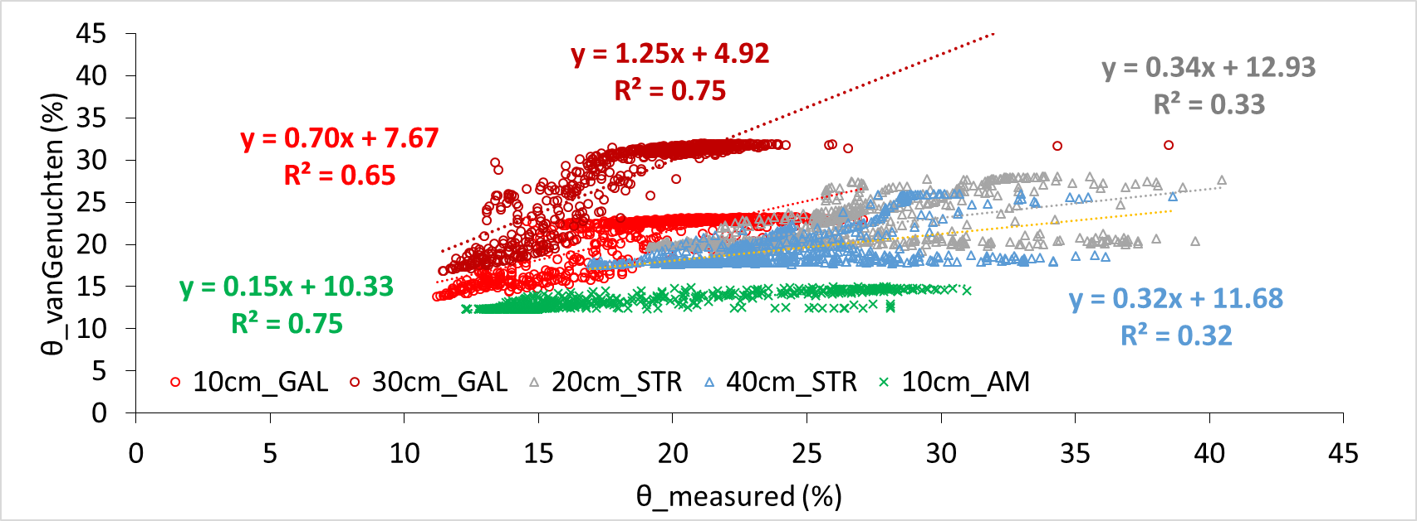
Soil water dynamics in forested and irrigated sites in Cyprus
Marinos Eliades*, Adriana Bruggeman*, Hakan Djuma*, Melpomeni Siakou*, Panagiota Venetsanou*, Christos Zoumides*, Christof Huebner ^
* Energy, Environment and Water Research Center, The Cyprus Institute; ^TRUEBNER GmbH, Neustadt, Germany (www. truebner.de)
Water storage in soil is a dynamic process that changes with soil, vegetation and climate properties
The overall objective is to derive soil-water retention curves at forested and irrigated sites in Cyprus from in-situ soil moisture and soil water potential observations
The shape of water retention curves can be characterized by the van Genuchten model:
θ, θ_{r},, θ_{s}: water content, residual water content, total saturated water content (%)
a­, N, M: empirical constants
h: soil water potential (cm)
Soil water observations can be corrected for temperature with a calibration equation derived from the time series (Saito et al, 2013)
θ $=θ_{r}+\frac{\left(θ_{s}−θ_{r}\right)}{{\left[1+{\left(ah\right)}^{N}\right]}^{M}}$
 | A. Marina (AM) | Galata (GAL) | Strakka (STR)
Species | P. brutia | Peach | Olive
Rainfall (mm/y) | 425 | 502 | 298
Soil depth (cm) | 15 | 100 | 100
Soil texture | Sandy loam | Clay loam | Loam
Irrigation | - | Drip | Drip
Soil water content derived from the soil water potential measurements with the van Genuchten model gave good relations with the measured soil water for 3 of the 6 sensor locations
Contact: m.eliades@cyi.ac.cy

