Slide 1





2021 European General Assembly
26-30 April, 2021
26 April 2021
Global runoff estimation through a regionalized STREAM model
Stefania Camici⁽¹⁾, Gabriele Giuliani⁽¹⁾, Luca Brocca⁽¹⁾, Christian Massari⁽¹⁾, Angelica Tarpanelli⁽¹⁾, Marco Restano⁽²⁾, and Jérôme Benveniste⁽³⁾
Research Insititute for Geo-hydrological Protection (IRPI), National Research Council (CNR), Italy
SERCO, ESA-ESRIN, Largo Galileo Galilei, Frascati, 00044, Italy
European Space Agency, ESA-ESRIN, Largo Galileo Galilei, Frascati, 00044, Italy

Slide 2

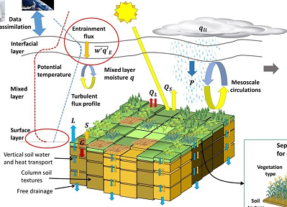
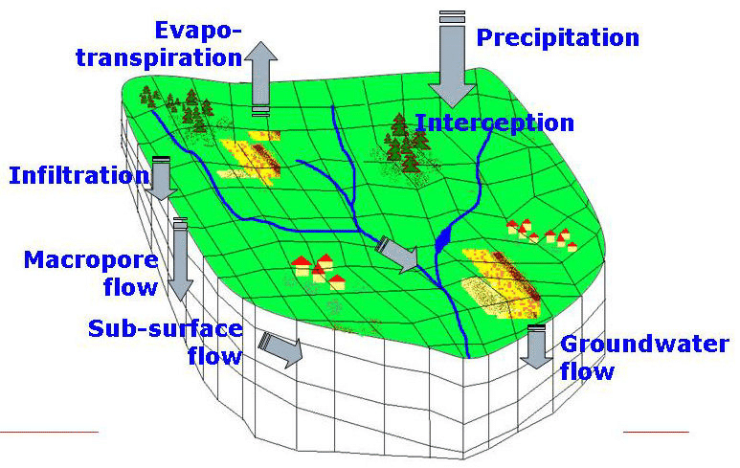
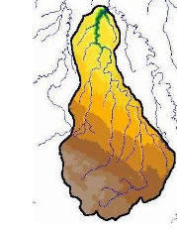
THE PROBLEM: MODELS
Land Surface Models
REAL WORLD
Global Hydrological Models
Catchment rainfall-runoff models
MODEL COMPLEXITY
Precipitation
Evapo-
transpiration
WATER BUDGET MODEL
ENERGY BUDGET MODEL
REPRESENTED PROCESSES
Notes:
runoff can be estimated through model-based approaches whose outputs can be highly model or data dependent and characterised by large uncertainties.

Slide 3
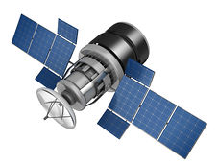
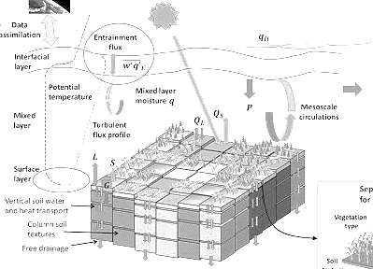
SaTellite based Runoff Evaluation And Mapping (STREAM) model
The STREAM model is a conceptual hydrological model, alternative to existing model-based runoff estimates, for deriving runoff estimates from the ESA Climate Change Initiative, ESA CCI, soil moisture (SM) product, the Tropical Rainfall Measuring Mission, TRMM 3B42 precipitation (P) product and terrestrial water storage anomalies (TWSA) from GRACE.
Land Surface Models
REAL WORLD
Global Hydrological Models
Catchment rainfall-runoff models
MODEL COMPLEXITY
Precipitation
Evapo-
transpiration
WATER BUDGET MODEL
ENERGY BUDGET MODEL
REPRESENTED PROCESSES
Notes:
Whitin the SaTellite based Runoff Evaluation And Mapping (STREAM) PROJECT, an “observational” physically-based approach, alternative to existing model-based runoff estimates, has been developed and tested for deriving daily runoff estimates by using the ESA Climate Change Initiative, ESA CCI, soil moisture (SM) product, the Tropical Rainfall Measuring Mission, TRMM 3B42 precipitation (P) product and terrestrial water storage anomalies (TWSA) from GRACE.

Slide 4










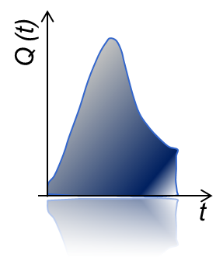



THE MODEL CONCEPT
RIVER DISCHARGE IS MADE UP OF TWO COMPONENTS
Precipitation
Rainfall+Snowfall
Camici et al. (2021). Synergy between satellite observations of soil moisture and water storage anomalies for global runoff estimation. Geosci. Model Dev. Discuss, In review.
https://doi.org/10.5194/gmd-2020-399
Total discharge
=
Quick Flow +
Slow Flow
Terrestrial Water Storage Anomalies
Soil Moisture
Quick Flow
Upper Storage
Lower Storage
Slow Flow

Slide 5
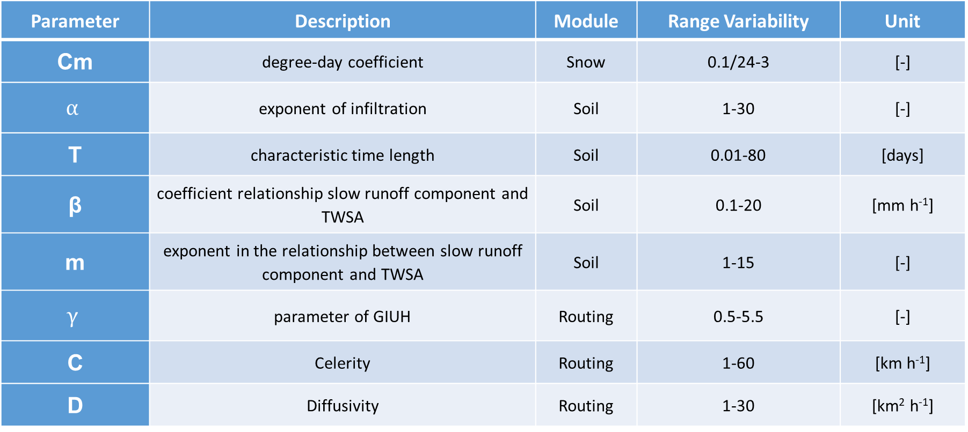
THE MODEL PARAMETERS
EIGHT PARAMETERS NEED TO BE CALIBRATED
Parameter | Description | Module | Range Variability | Unit
Cm | degree-day coefficient | Snow | 0.1/24-3 | [-]
$$α$$ | exponent of infiltration | Soil | 1-30 | [-]
T | characteristic time length | Soil | 0.01-80 | [days]
β | coefficient relationship slow runoff component and TWSA | Soil | 0.1-20 | [mm h⁻¹]
m | exponent in the relationship between slow runoff component and TWSA | Soil | 1-15 | [-]
$$γ$$ | parameter of GIUH | Routing | 0.5-5.5 | [-]
C | Celerity | Routing | 1-60 | [km h⁻¹]
D | Diffusivity | Routing | 1-30 | [km² h⁻¹]
Camici et al. (2021, GMDD, In review). doi: 10.5194/gmd-2020-399

Slide 6
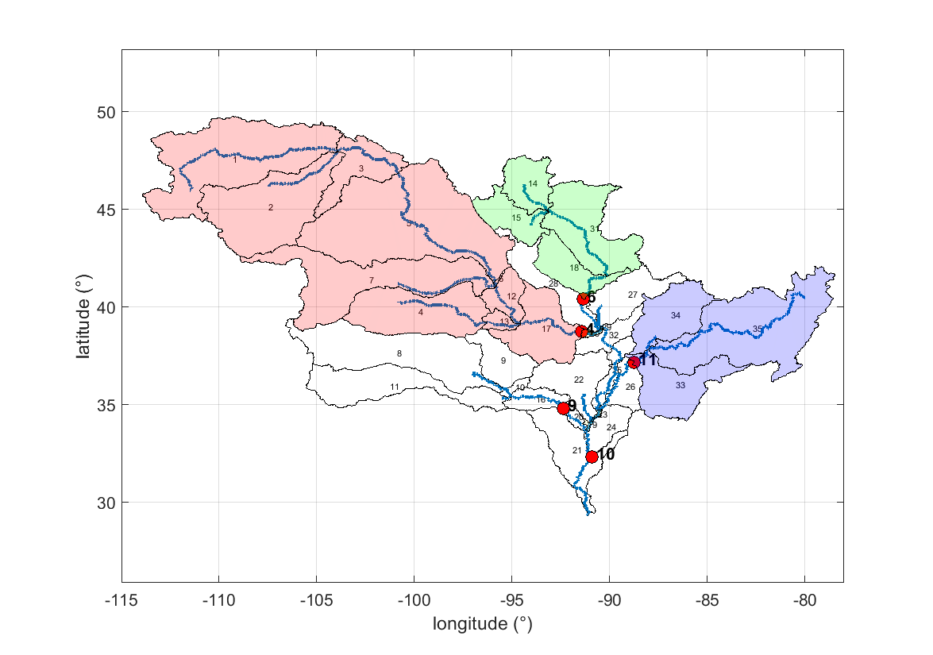
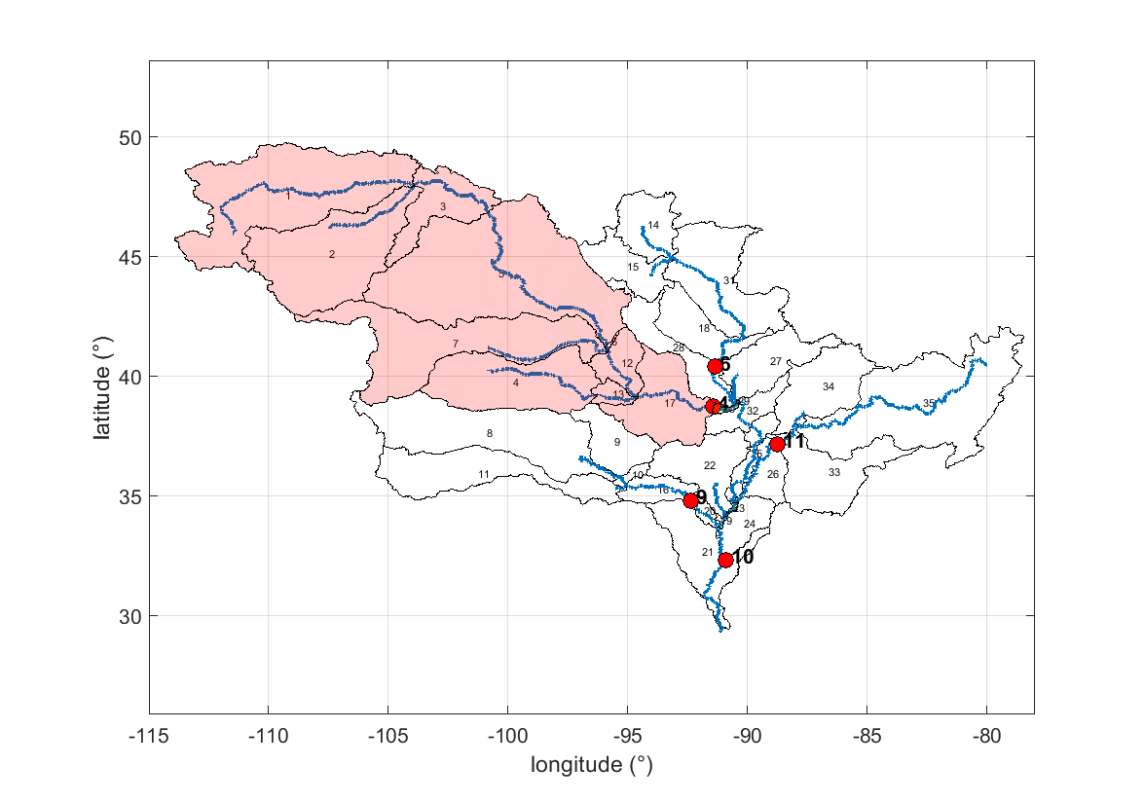
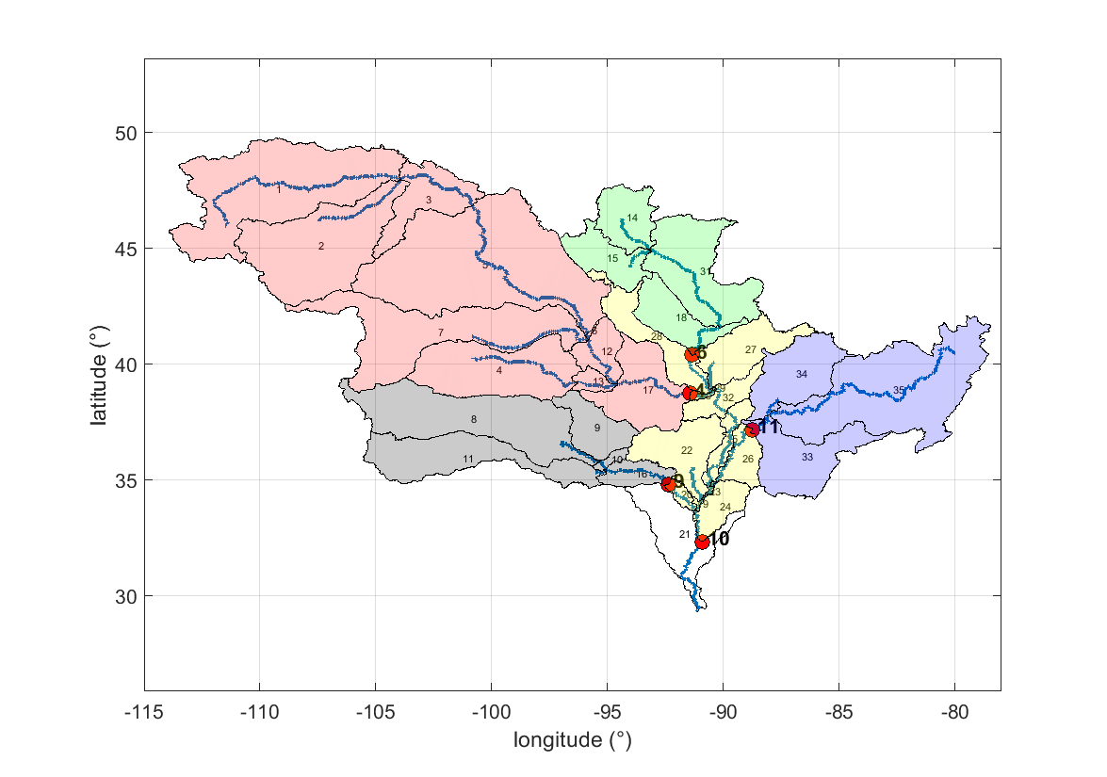
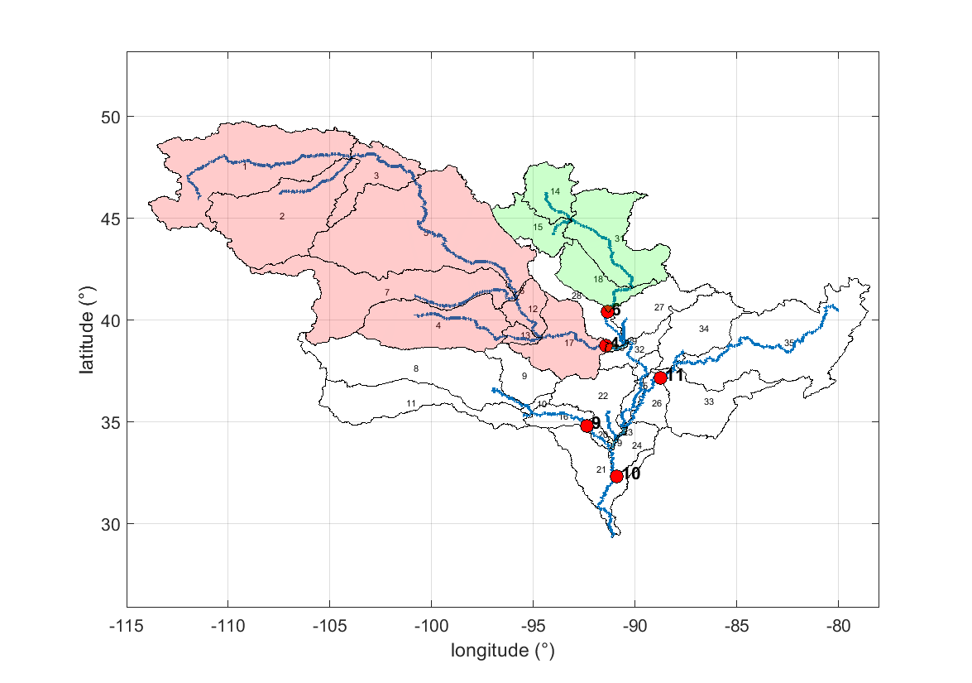
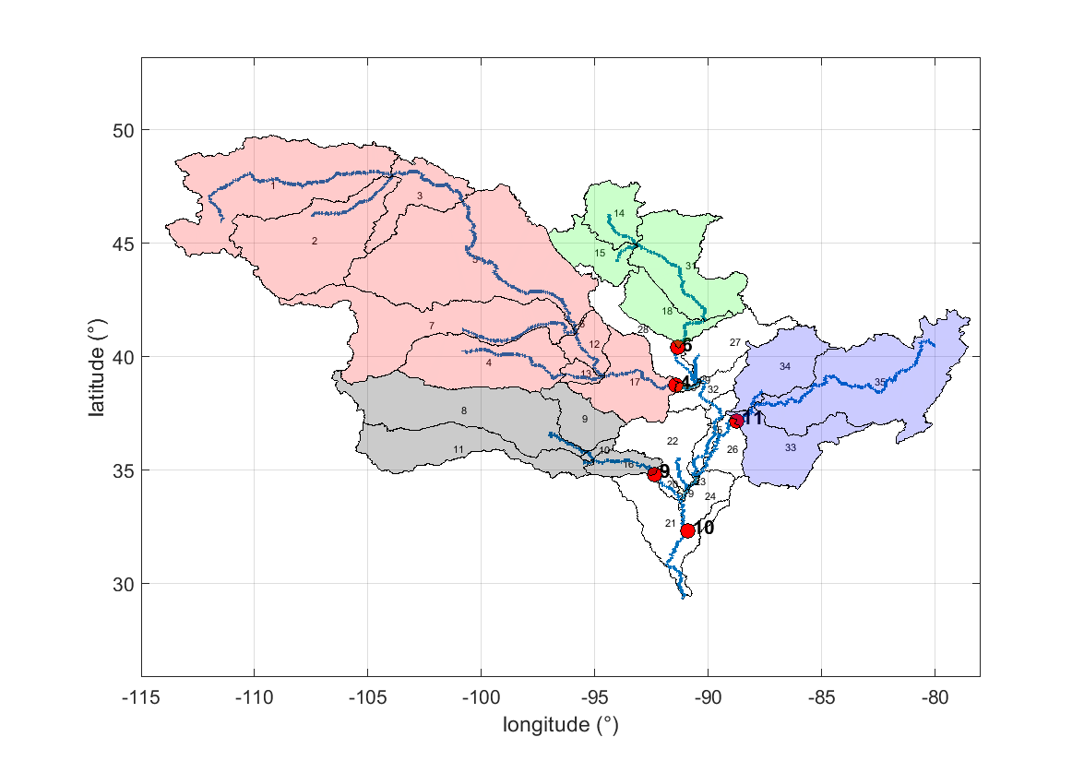
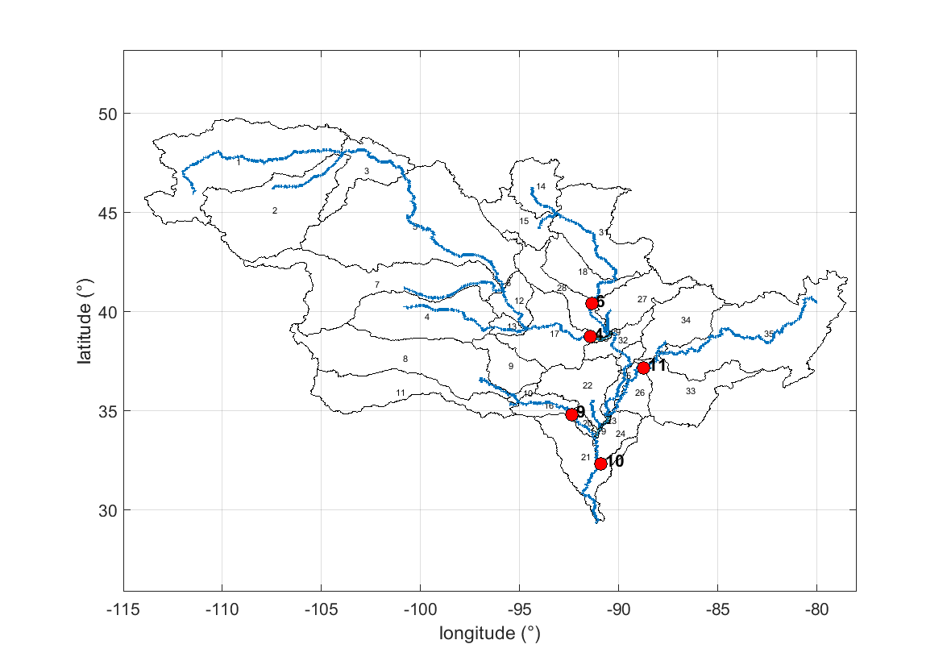
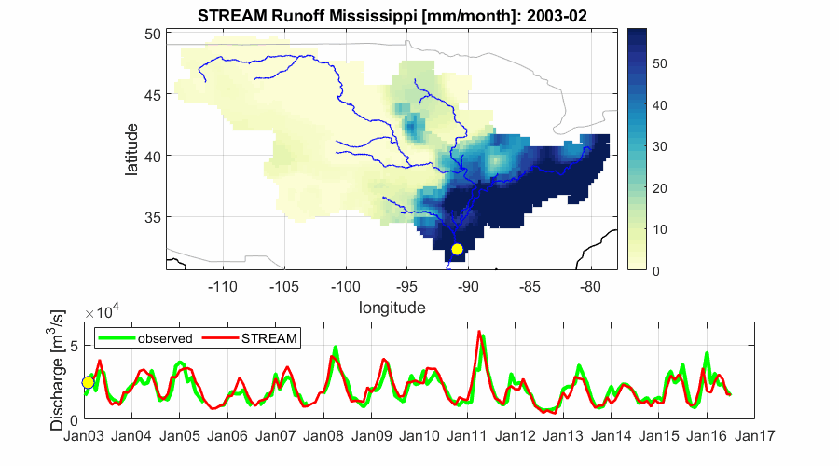
THE PROCEDURE
STREAM MODEL CALIBRATION
Digital Elevation Model
Location of gauging station
Input data
Precipitation (TMPA 3B42)
Air Temperature (in situ)
Soil Moisture (ESA CCI)
Terrestrial Water Storage Anomalies (GRACE)
Processing steps
Reference data
Sub-basin delineation
Output data
Input data extraction for each sub-basin
In situ river discharge reference stations
STREAM calibration
STREAM gridded runoff (0.25-degree) and river discharge at the outlet of each sub-basin
Discharge gauging stations

Slide 7
THE PROCEDURE
STREAM MODEL REGIONALIZATION
Digital Elevation Model
Location of gauging station
Input data
Precipitation (TMPA 3B42)
Air Temperature (in situ)
Soil Moisture (ESA CCI)
Terrestrial Water Storage Anomalies (GRACE)
Processing steps
Reference data
Sub-basin delineation
Output data
Input data extraction for each sub-basin
Predictors (Aridity index, basin slope, soil texture)
STREAM model regionalization
STREAM gridded runoff (0.25-degree) and river discharge at the outlet of each sub-basin

Slide 8
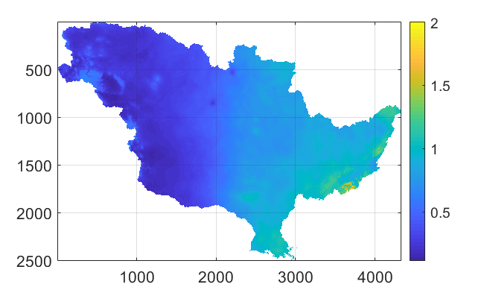
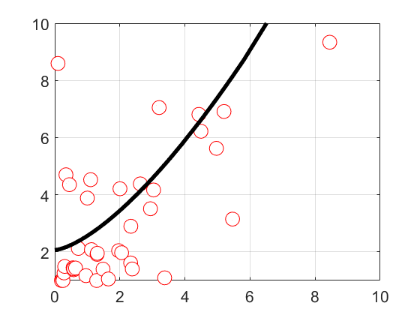
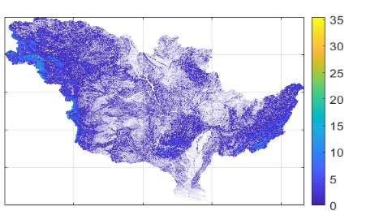
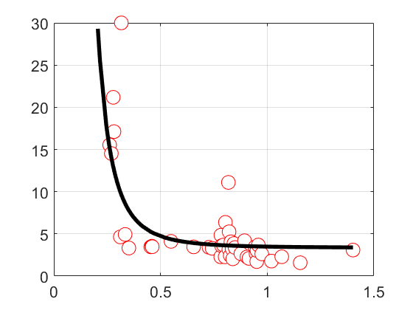
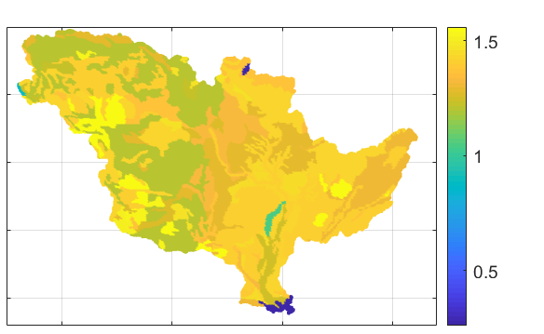
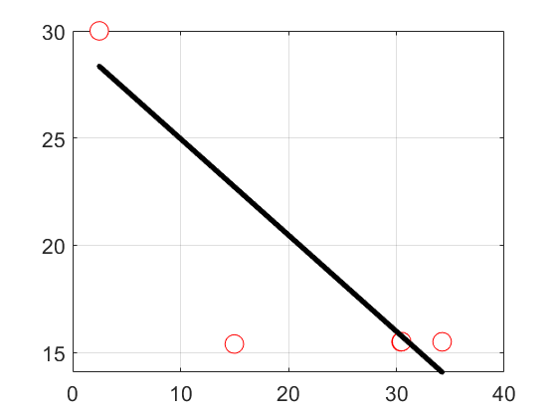
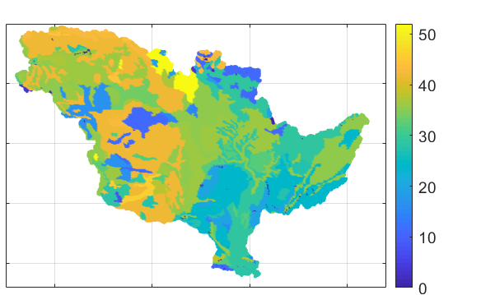












THE PROCEDURE
STREAM MODEL REGIONALIZATION
Variables
Predictors
Variable- Predictor Relation
Additional relations
$$α$$
Aridity Index
m
$$y=a_{1}∗x^{b_{1}}+c_{1}$$
T
Slope
$$β$$
$$Variable$$
$$y=a∗x^{b}+c$$
$$β$$
$$y=a_{2}∗x+b_{2}$$
Bulk density
$$D$$
The regionalization of STREAM parameters has been setup for Mississippi and tested for Danube river basin
$$Predictor$$
$$γ$$
Subsilt
(30-100 cm)
$$C$$
$$Cm=1.5$$

Slide 9
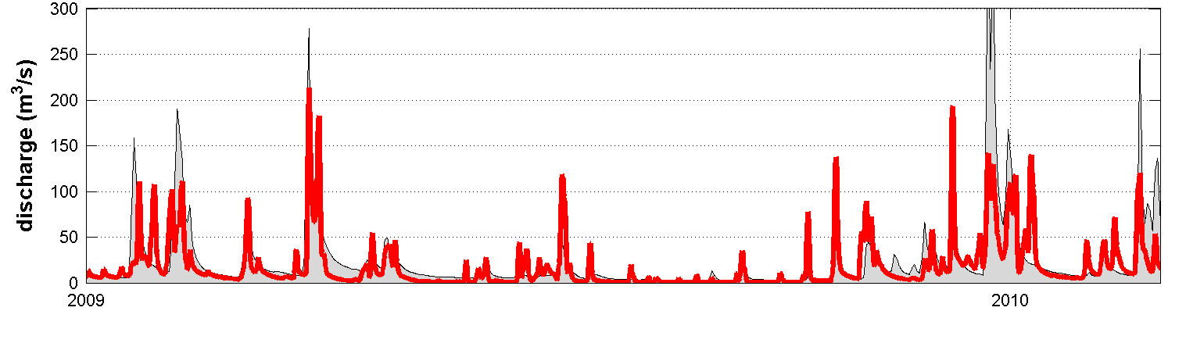
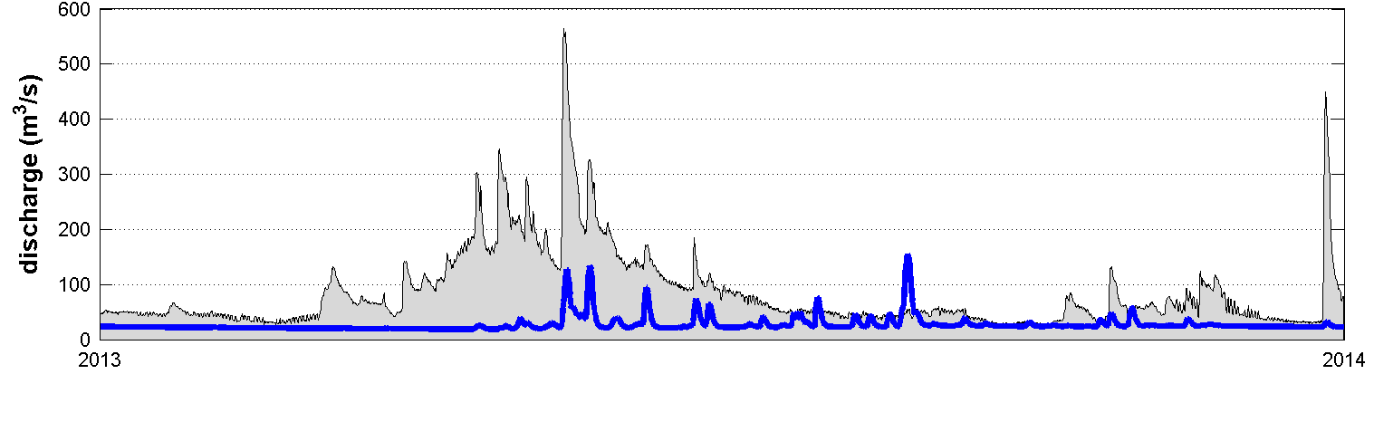
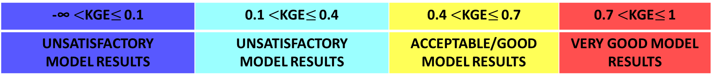

PERFORMANCE INDICES
KGE, R AND RRMSE SCORES
SATISFACTORY
MODEL PERFORMANCE
Kling-Gupta Index (Gupta et al., 2009)
KGE= 0.52
$$KGE=1−\sqrt{{\left(r−1\right)}^{2}+{\left(α_{1}−1\right)}^{2}+{\left(β_{1}−1\right)}^{2}}$$
r = correlation coefficient
α₁ = relative variability between observed and simulated discharge
β₁ = bias normalized by the standard deviation
UNSATISFACTORY
MODEL PERFORMANCE
KGE= -0.30
-∞ $<$KGE$≤$ 0.1 | 0.1 $<$KGE$≤$ 0.4 | 0.4 $<$KGE$≤$ 0.7 | 0.7 $<$KGE$≤$ 1
UNSATISFACTORY MODEL RESULTS | UNSATISFACTORY MODEL RESULTS | ACCEPTABLE/GOOD MODEL RESULTS | VERY GOOD MODEL RESULTS
Correlation coefficient
Relative root mean square error

Slide 10
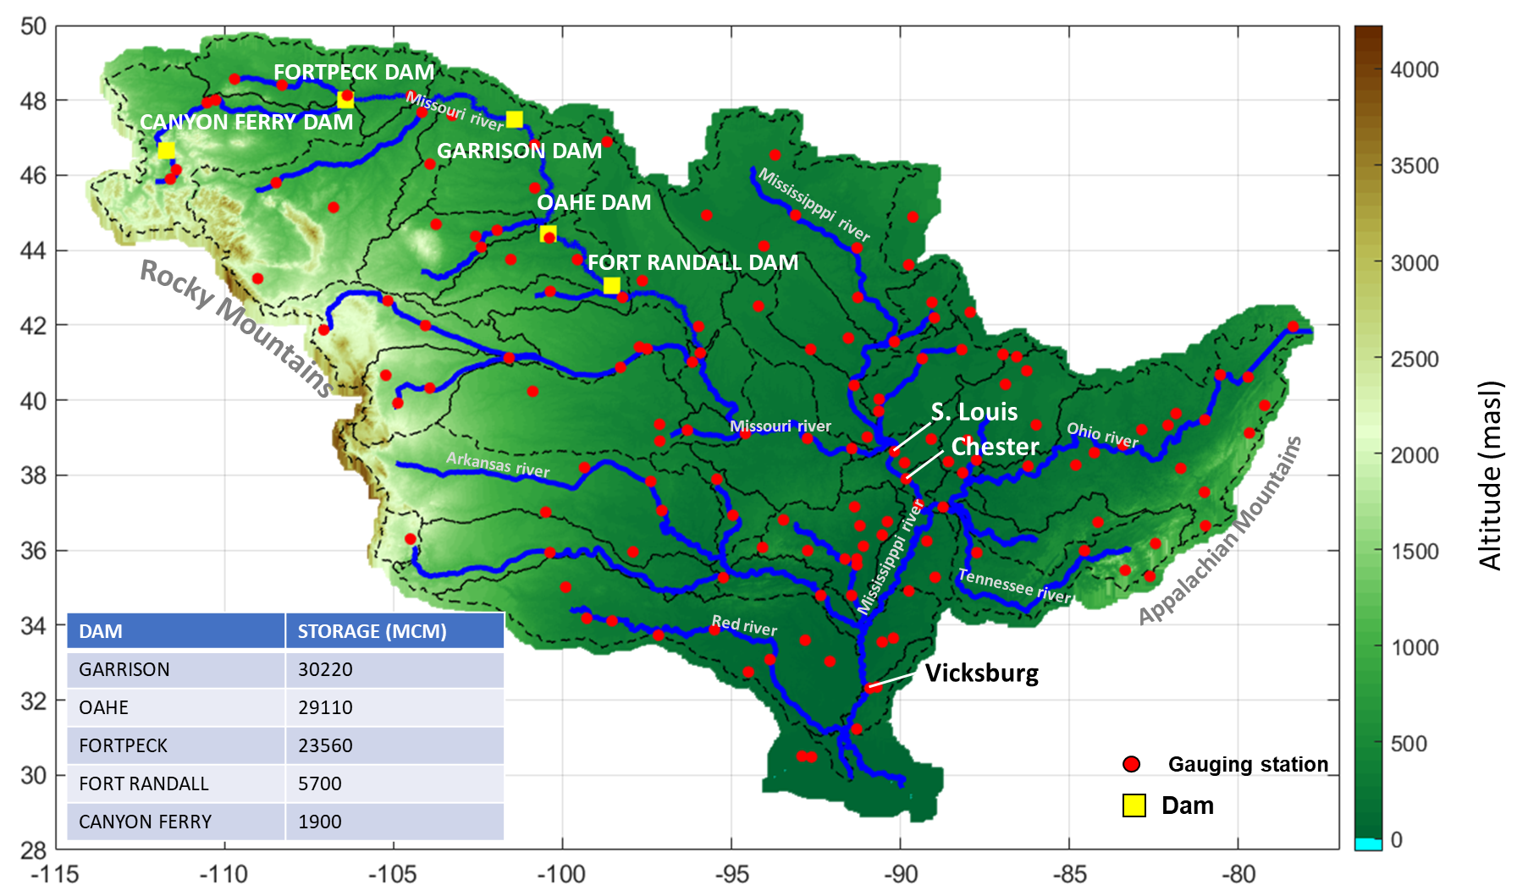
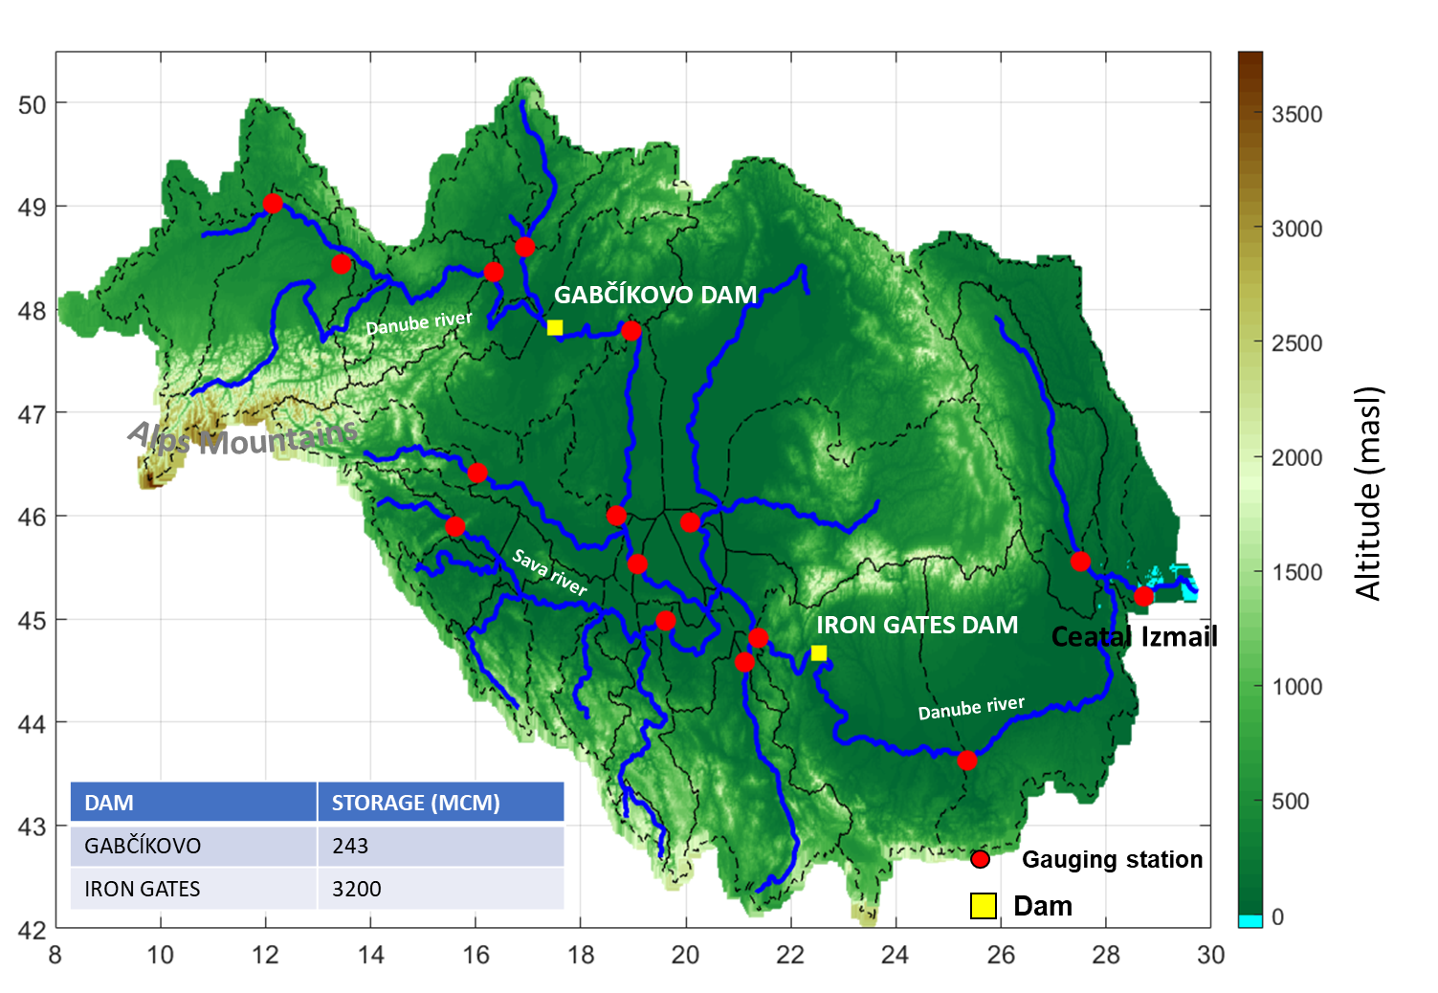
STUDY AREAS
MISSISSIPPI AND DANUBE RIVER BASINS
Discharge and runoff estimates have been simulated for the period 2003-2017 for two basins, Mississippi and Danube characterized by different physiographic/climatic features.
Notes:
The study areas comprises 5 pilot areas throughout the world (Mississippi, Amazon, Niger, Danube and Murray Darling) whose characteristcs are summarized in the table within the figure.

Slide 11
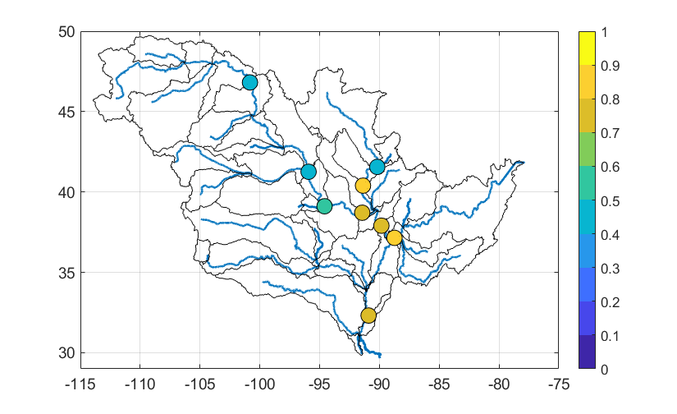
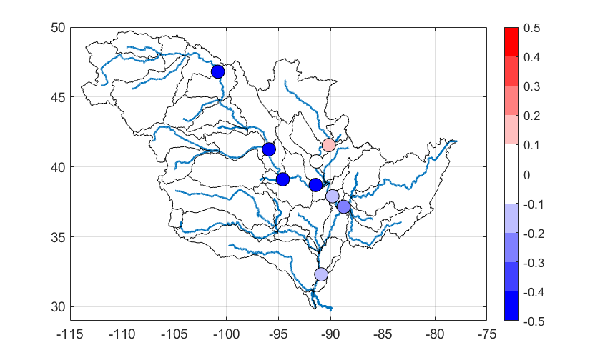
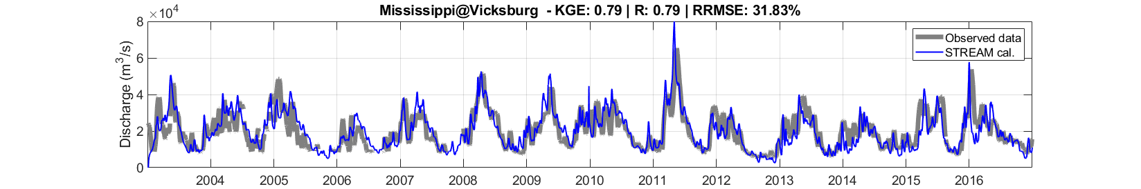
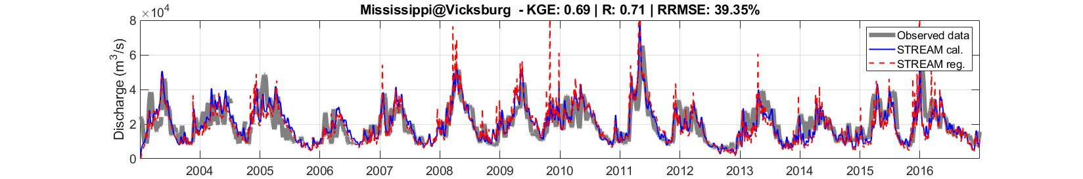
MODEL PARAMETER CALIBRATION (cal) AND REGIONALIZATION (reg)
MISSISSIPPI RIVER BASIN
KGE_{cal}
∆ KGE = KGE_{cal} - KGE_{reg}
STREAM performances are good over all the sections except downstream dams. KGE index decreases over these sections in by using regionalized model parameters
Mean (KGE_{cal}) = 0.66
Mean (∆ KGE) = 0.46
KGE
Vicksburg
Vicksburg

Slide 12
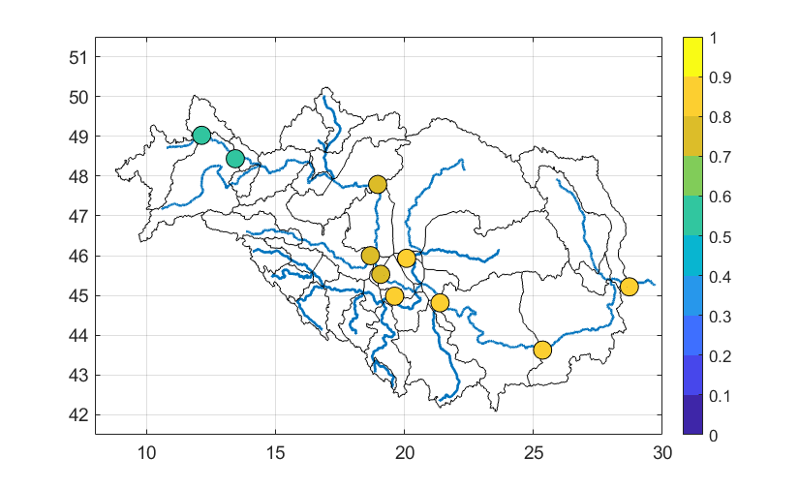
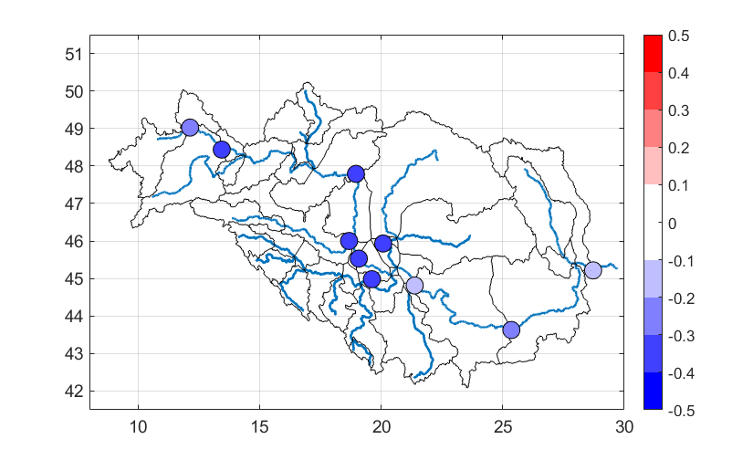
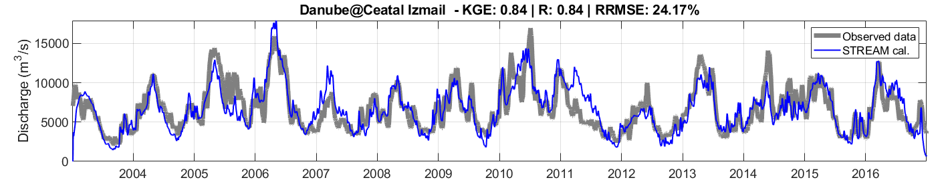
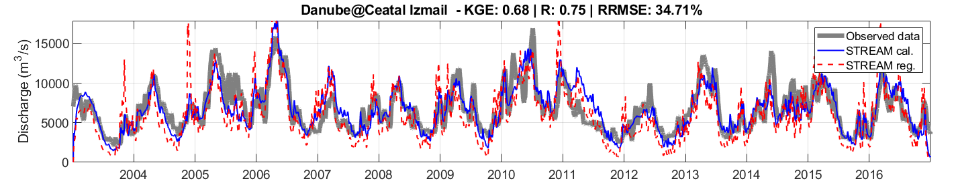
MODEL PARAMETER CALIBRATION (cal) AND REGIONALIZATION (reg)
DANUBE RIVER BASIN
KGE_{cal}
∆ KGE = KGE_{cal} - KGE_{reg}
Mean (KGE_{cal}) = 0.75
Mean (∆ KGE) = - 0.31
STREAM performances are still good when the model is run by using regionalized parameters
KGE
Ceatal Izmail
Ceatal Izmail

Slide 13
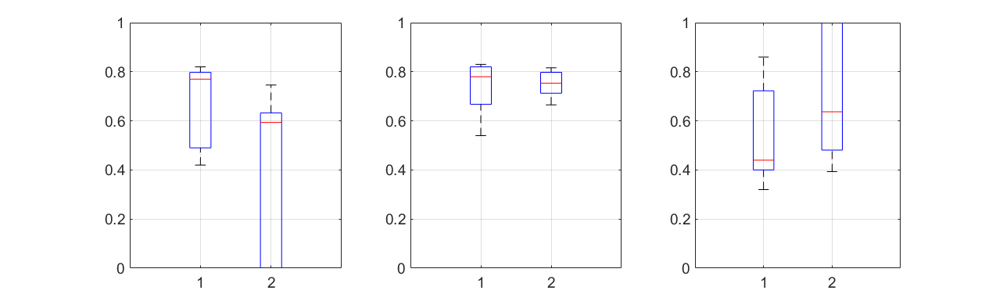
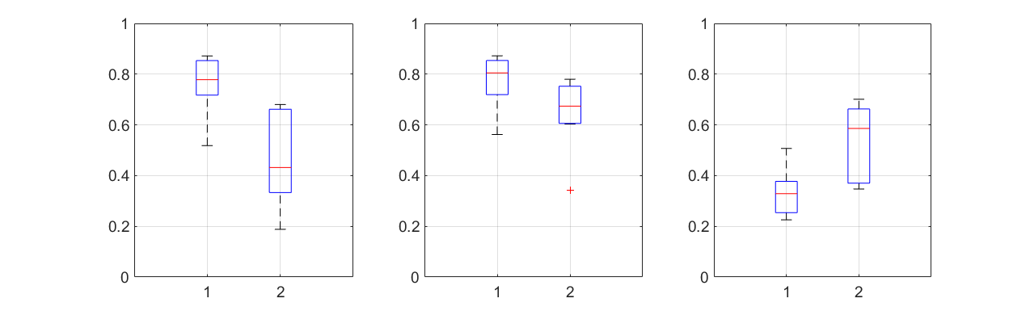
MODEL PARAMETER CALIBRATION (cal) AND REGIONALIZATION (reg)
MISSISSIPPI AND DANUBE RIVER BASINS
Median values
0.77
0.60
0.78
0.75
0.44
0.64
Mississippi
KGE
R
RRMSE
Median values
0.78
0.43
0.81
0.67
0.33
0.59
KGE
R
Danubio
RRMSE
cal
reg
cal
reg
cal
reg

Slide 14

TAKE HOME MESSAGE
STREAM results demonstrate that:
A conceptual approach using satellite soil moisture, precipitation and GRACE is able to provide good performances in river discharge estimation
Regionalization of STREAM parameters provide promising results for the model implementation at global scale
Next step: runoff estimation at global scale.
stefania.camici@irpi.cnr.it
idrologia@irpi.cnr.it
http://hydrology.irpi.cnr.it
@Hydrology_IRPI

Slide 15
Thank you for having viewed the slides
"For further information on the STREAM model, please write to: stefania.camici@ irpi.cnr.it and visit:
http://hydrology.irpi.cnr.it/projects/stream
and
https://eo4society.esa.int/projects/stream/
for updates"
stefania.camici@irpi.cnr.it
idrologia@irpi.cnr.it
http://hydrology.irpi.cnr.it
@Hydrology_IRPI

