Slide 1




A new release of the SURE database of earthquake surface ruptures suited to Fault Displacement Hazard Analysis
STRIKE-SLIP, NORMAL AND REVERSE EARTHQUAKES
Stéphane Baize, Annamaria Blumetti, Paolo Boncio, Francesca Cinti, Riccardo Civico, Luca Guerrieri, Fiia Nurminen
vEGU 2021 – Session “NH4.3 Seismic hazard assessments for disaster risk reduction”

Slide 2
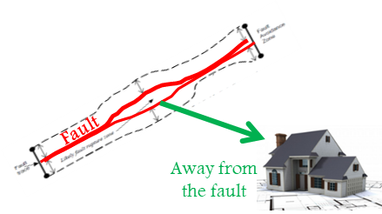

How can we diminish the risk from Fault Displacement?
1) Avoiding the hazard
  Deterministic approach: defining the fault location
2) Mitigating the hazard if the fault cannot be avoided or if the fault is discovered after structure construction
  Probabilistic approach: estimating the likelihood of displacement at the site
Fault

Slide 3
Methodological background
Probabilistic fault displacement hazard analysis
The methodology was developed for estimating the probability of occurrence of surface displacement and exceedance of a displacement level during an earthquake at sensitive sites
Conceptually similar to PSHA approach
The calculations are based on empirical parameters which have a direct impact on the applicability of the hazard modelling
Our first steps were focused on Distributed rupturing (reverse faulting earthquakes)
The new approach and new empirical regression parameters were published recently in Frontiers in Earth Sciences (Nurminen et al., 2020)

Slide 4
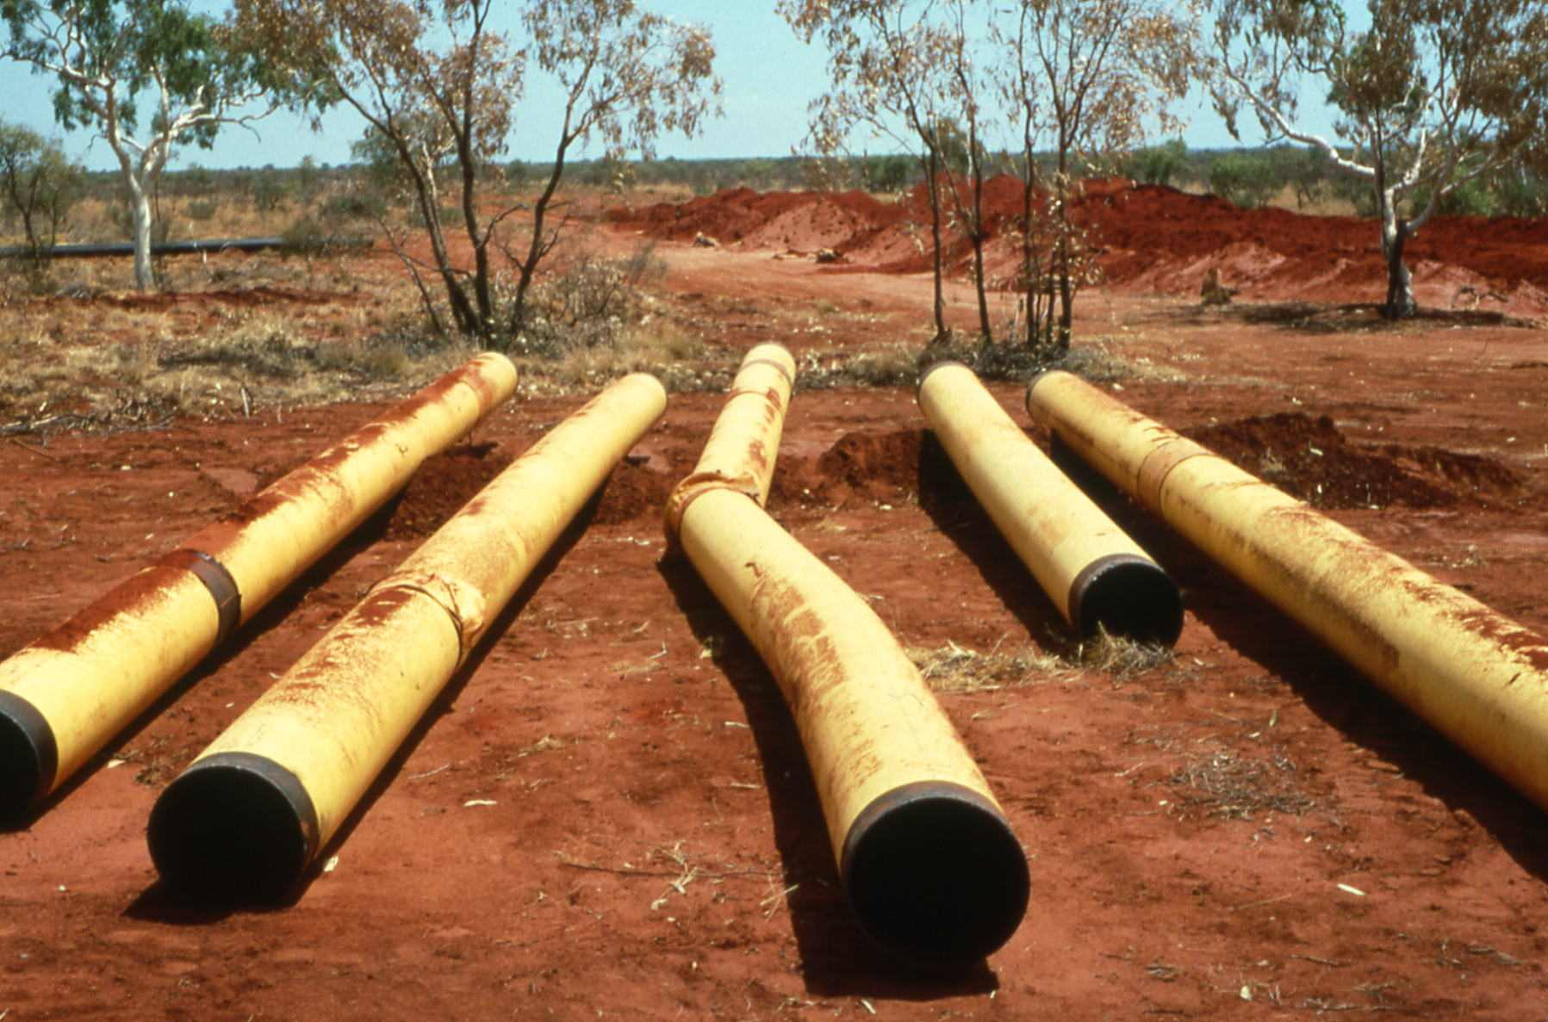
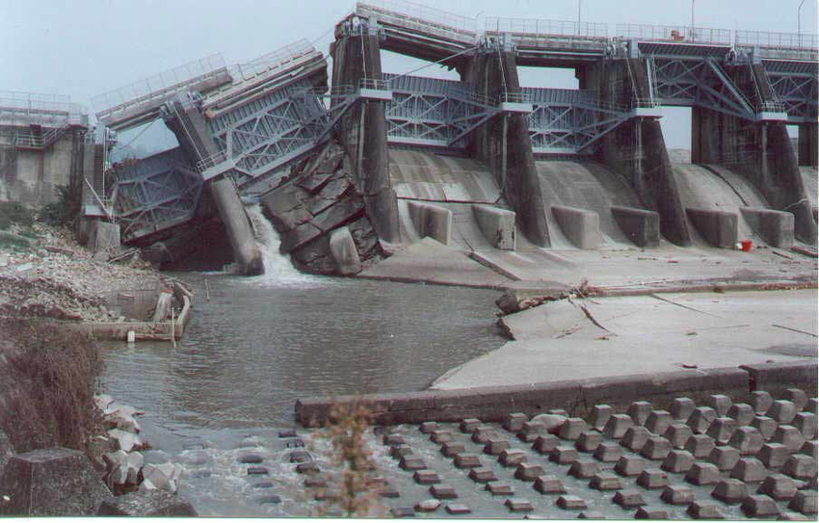
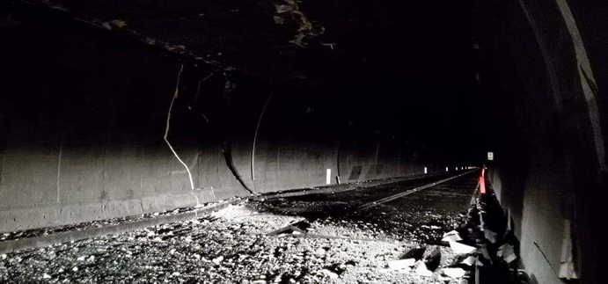
Probabilistic Fault Displacement Hazard
Objective
  Mitigate the effects of surface rupture on infrastructures and facilities
  Because SR are complex, the aim is to predict Distributed Rupturing (DR) and Principal Faulting
How?
  Analyzing Empirical Data (historical surface ruptures), considering geological criteria.
  Similar to Probabilistic Seismic Hazard Analysis (ground shaking)
  Probability of occurrence of surface displacement and exceedance of a displacement level
1999 M 7.6 Chi Chi, TW
MCEER 2000
2016 M 7.8 Kaikoura, NZ
1988 M 6.6 Tennant Creek, AU
aees.org.au
2016 M 6.5 Italy
from fb
Local Hazard due to Surface Faulting. Can damage buildings/facilities on or close the fault trace.
May come from Principal or Distributed rupturing.
Principal Fault Rupturing
Distributed Rupturing (DR)

Slide 5
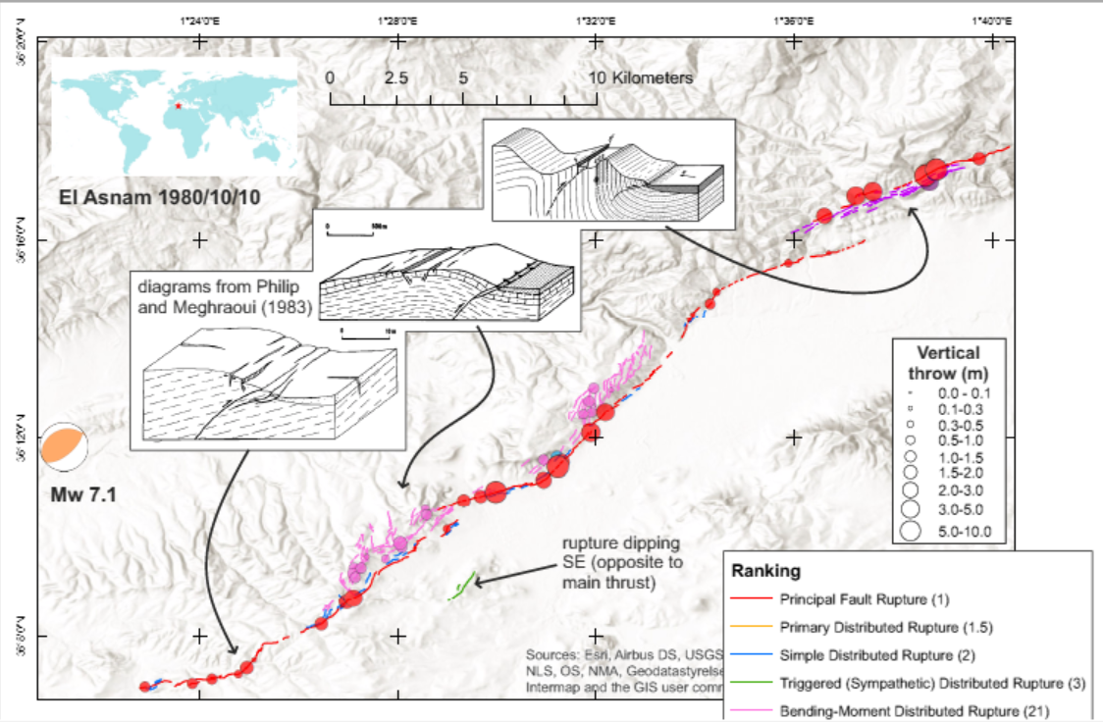
Our « ranking scheme » is based on earthquake-related and geological considerations
Nurminen et al., 2020

Slide 6
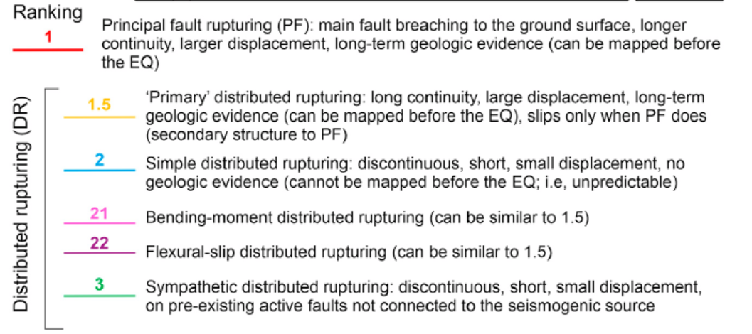
Ranking: reverse
Nurminen et al., 2020

Slide 7
Using the ranking in the PFDHA modelling
By simple distributed rupturing we mean all the «randomly» occurring DR that cannot be associated to any pre-existing structures, and thus can be seen as a direct response to the movement along the PF.
The complex types of DR are different by their nature, because they are related to pre-existing faults or other geological structures, and thus we recommend to consider this difference in fault displacement hazard modelling.

Slide 8
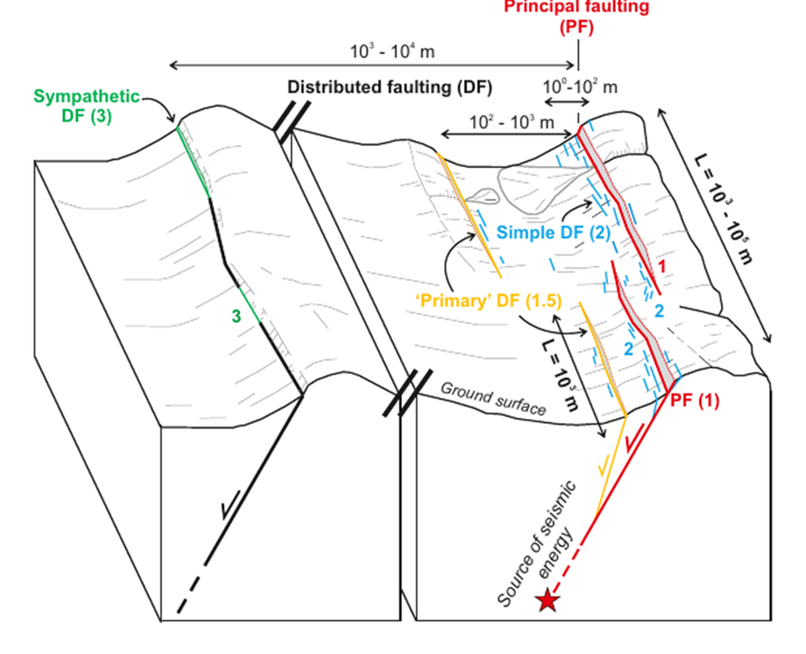
Ranking: normal

Slide 9
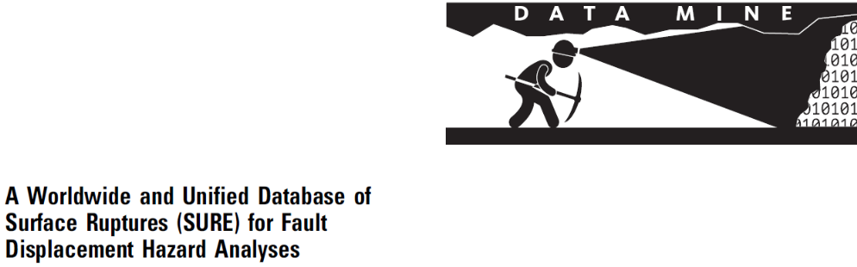
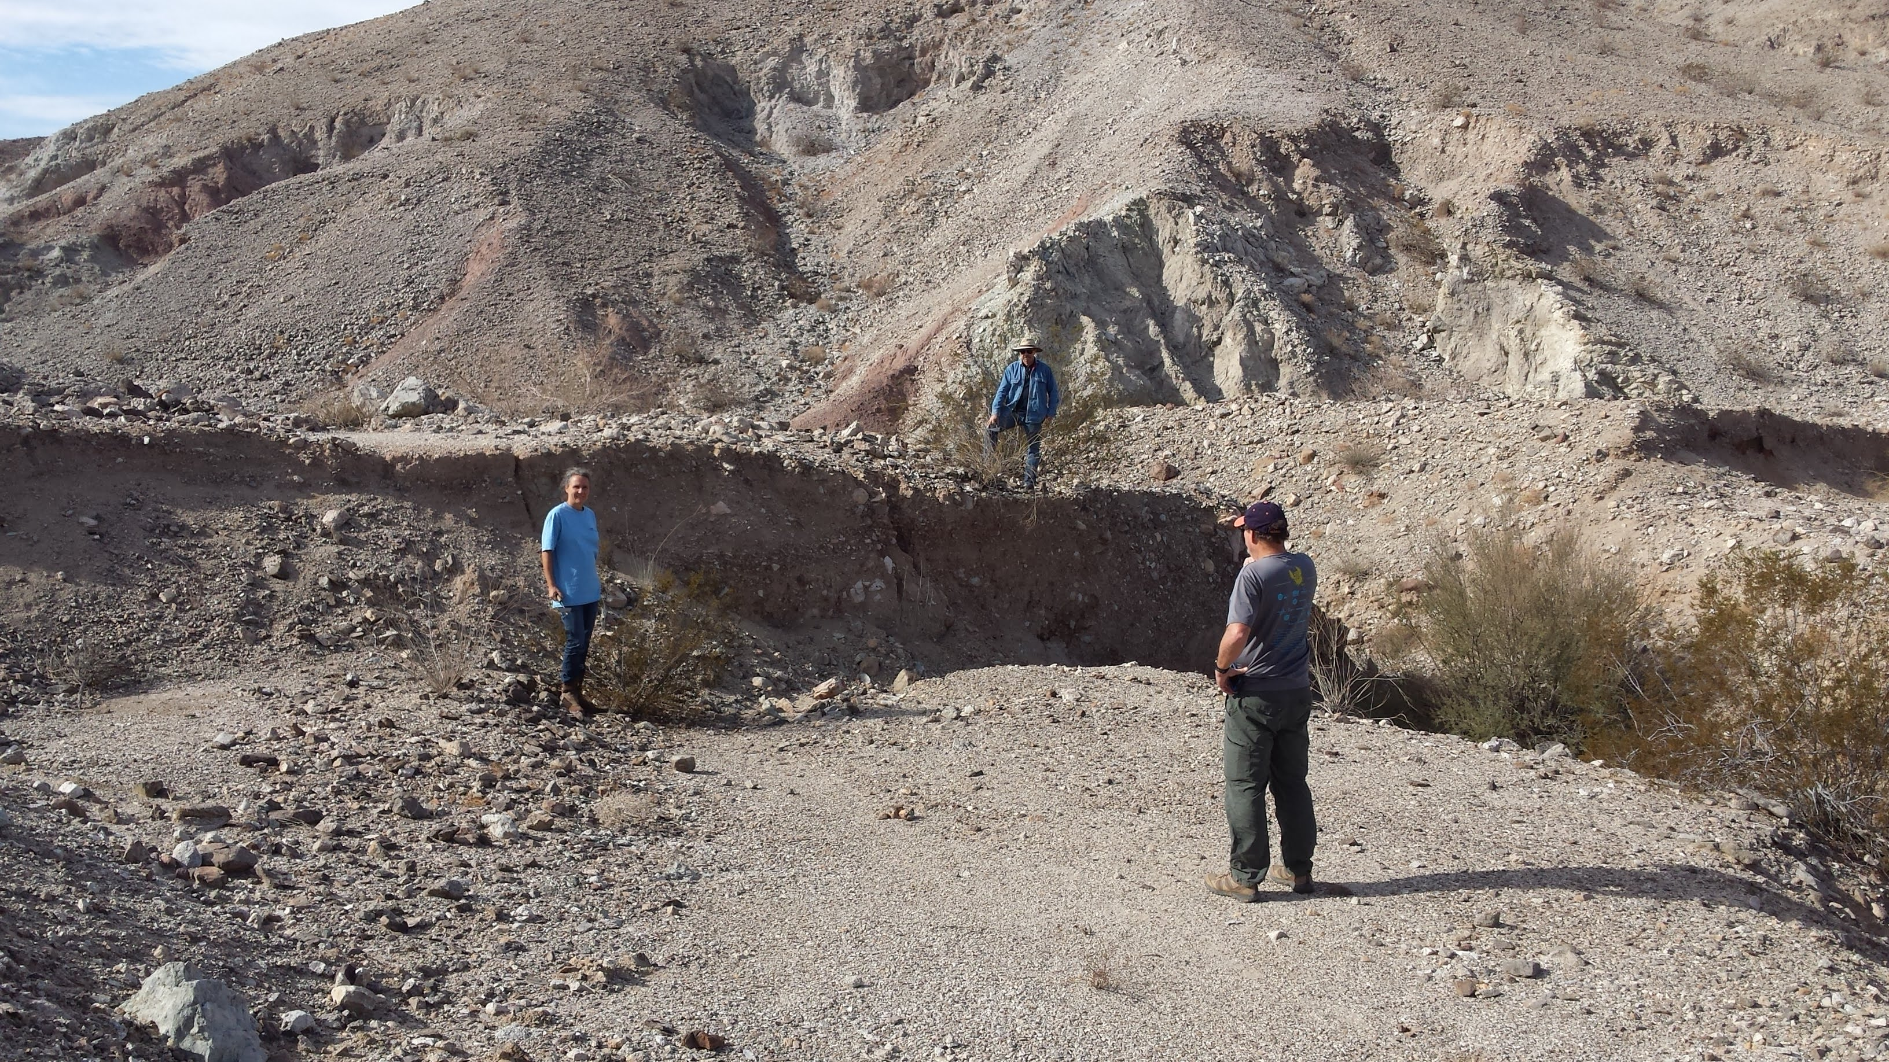
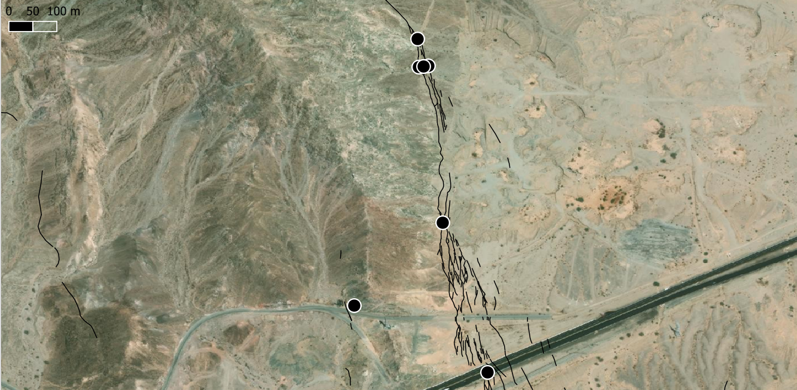
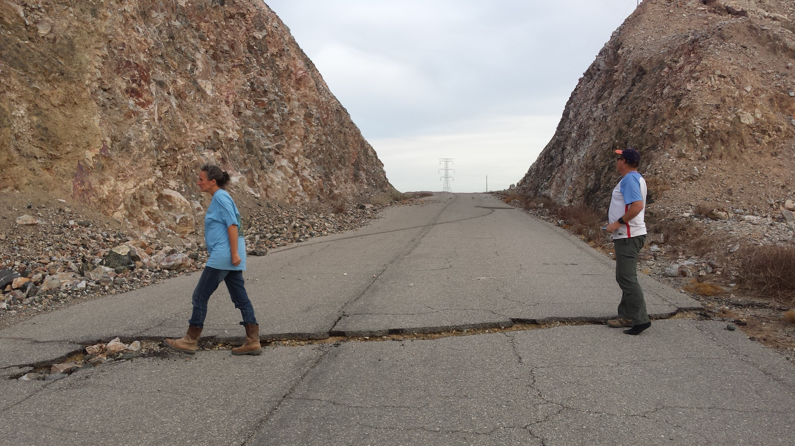
SURE 1.0 → SURE 2.0
Baize et al., 2019 SRL
SURE 1.0 was revisited
  Adjustments were performed (incl. modified geometry)
  Several events were abandoned
Cases were added
  New publications on historical events (e.g. Australia, USA)
Completion of « ranking »
  A crucial analytical step to complete FHDA tools
Nurminen et al. 2020

Slide 10
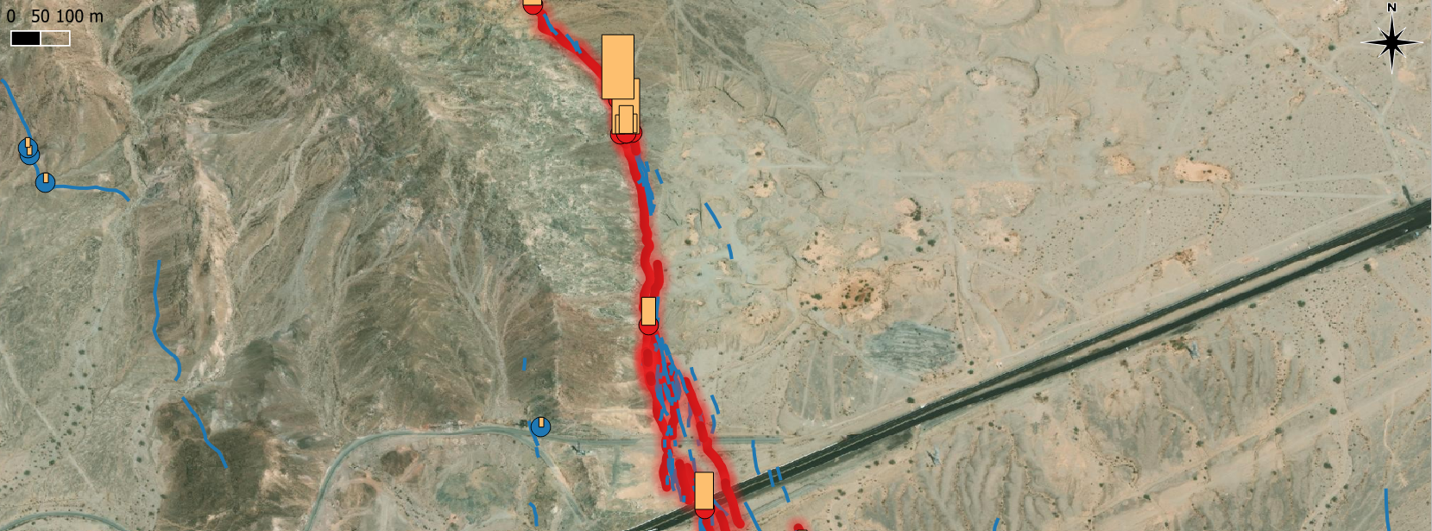
Normal faults
Reverse faults
Strike-Slip faults
15 events (1887 – 2016)
  M_{w} 5 – 6: 2
  M_{w} 6 – 7: 8
  M_{w} 7 - : 5
> 2,000 segments
> 10,000 points
15 events (1970 – 2019)
  M_{w} 4.9 – 6: 5
  M_{w} 6 – 7: 6
  M_{w} 7 - : 4
> 2,000 segments
> 1,000 points
15 events (1872 – 2019)
  M_{w} 4.95 – 6: 2
  M_{w} 6 – 7: 6
  M_{w} 7 - : 7
> 30,000 segments
> 3,000 points

Slide 11
SURE 2.0
IdE | Date yyyy/mm/dd | Name | Region | M_{w} | FM
18720326 | 1872/03/26 | Owens Valley | USA | 7.45 | SS
19110103 | 1911/01/03 | Chon Kemin | Kyrghystan | 7.7 | R
19151003 | 1915/10/03 | Pleasant Valley | USA | 6.8 | N
19461110 | 1946/11/10 | Ancash | Peru | 7.3 | N
19501214 | 1950/12/14 | Fort Sage mnt | USA | 5.6 | N
19541216 | 1954/12/16 | Fairview Peak | USA | 7.1 | N
19541217 | 1954/12/16 | Dixie Valley | USA | 6.6 | N
19590818 | 1959/08/18 | Hebgen Lake | USA | 7.2 | N
19680409 | 1968/04/09 | Borrego | USA | 6.6 | SS
19700310 | 1970/03/10 | Calingiri | Australia | 5.0 | R
19710209 | 1971/02/09 | San Fernando | USA | 6.7 | R
19750801 | 1975/08/01 | Oroville | USA | 5.9 | N
19780620 | 1978/06/20 | Thessaloniki | Greece | 6.5 | N
19791015 | 1979/10/15 | Imperial Valley | USA | 6.5 | SS
19800525 | 1980/05/25 | Mammoth Lake | USA | 6.2 | N
19801010 | 1980/10/10 | El Asnam | Algeria | 7.1 | R
19810224 | 1981/02/24 | Pisia | Greece | 6.6 | N
19810304 | 1981/03/04 | Corinth | Greece | 6.2 | N
19830611 | 1983/06/11 | Coalinga (Nuñez) | USA | 5.4 | R
19860611 | 1986/03/30 | Marryat Creek | Australia | 5.8 | R
19871124 | 1987/11/24 | Superstition Hills | USA | 6.5 | SS
19880122 | 1988/01/22 | Tennant Creek | Australia | 6.6 | R
19881207 | 1988/12/07 | Spitak | Armenia | 6.8 | R
19920628 | 1992/06/28 | Landers | USA | 7.3 | SS
19930929 | 1993/09/29 | Killari | India | 6.2 | R
19990817 | 1999/08/17 | Izmit | Turkey | 7.6 | SS
19991016 | 1999/10/16 | Hector Mine | USA | 7.1 | SS
19990920 | 1999/09/21 | Chi-Chi | Taiwan | 7.6 | R
20021103 | 2002/11/03 | Denali | USA | 7.9 | SS
20051008 | 2005/10/08 | Kashmir | Pakistan | 7.6 | R
20080512 | 2008/05/12 | Wenchuan | China | 7.9 | R
20090406 | 2009/04/06 | L’Aquila | Italy | 6.3 | N
20100326 | 2010/03/26 | Pisayambo | Ecuador | 4.95 | SS
20100404 | 2010/04/04 | El Mayor | Mexico | 7.2 | SS
20100903 | 2010/09/03 | Christchurch | NZ | 7.0 | SS
20120323 | 2012/03/23 | Pukatja | Australia | 5.4 | R
20140824 | 2014/08/24 | Napa | USA | 6.0 | SS
20141122 | 2014/11/22 | Nagano | Japan | 6.2 | N
20160415 | 2016/04/15 | Kumamoto | Japan | 7.0 | SS
20160520 | 2016/05/20 | Petermann | Australia | 6.1 | R
20161030 | 2016/10/30 | Norcia | Italy | 6.5 | N
20161201 | 2016/10/30 | Parina | Peru | 6.2 | R
20190704 | 2019/07/04 | Ridgecrest-1 | USA | 6.4 | SS
20190705 | 2019/07/05 | Ridgecrest-2 | USA | 7.1 | SS
20191111 | 2019/11/11 | Le Teil | France | 4.9 | R
Soon available…
We are looking for collocating the surface rupture database project in a dynamic european framework in order to maintain and develop the initiative

Slide 12
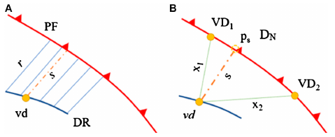
Distance parameters for probability calculation
P. of occurrence
Distances r (rupture – rupture) and s (point of displacement – rupture) are measured to the nearest PF
  For simple DR also to the primary DR (rank 1.5), whichever the closest
The interval of measuring r is ≤ the bin size used
For the points associated with a distance parameter s, also the factor of D_{N} is calculated from the two nearest displacement points along the PF, considering their distances (~ profiling)
P. of displ. exceedance
Nurminen et al., 2020

Slide 13
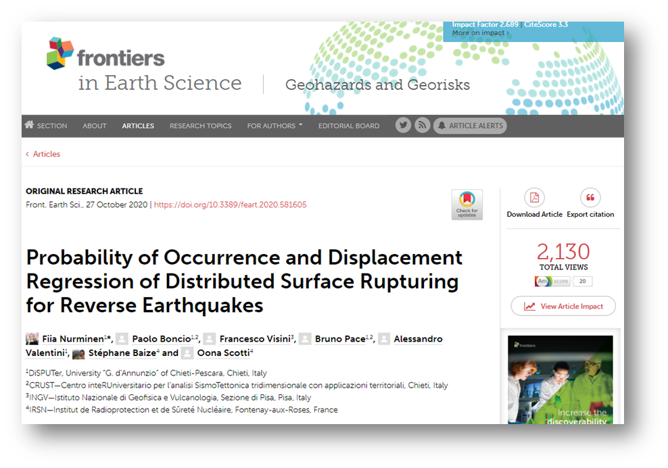
Nurminen F, Boncio P, Visini F, Pace B, Valentini A, Baize S and Scotti O (2020) Probability of Occurrence and Displacement Regression of Distributed Surface Rupturing for Reverse Earthquakes. Front. Earth Sci. 8:581605. doi: 10.3389/feart.2020.581605

