Slide 1


Station Classification and
Reference Station Selection
Juliette Legrand and Carine Bruyninx
Royal Observatory of Belgium

Slide 2
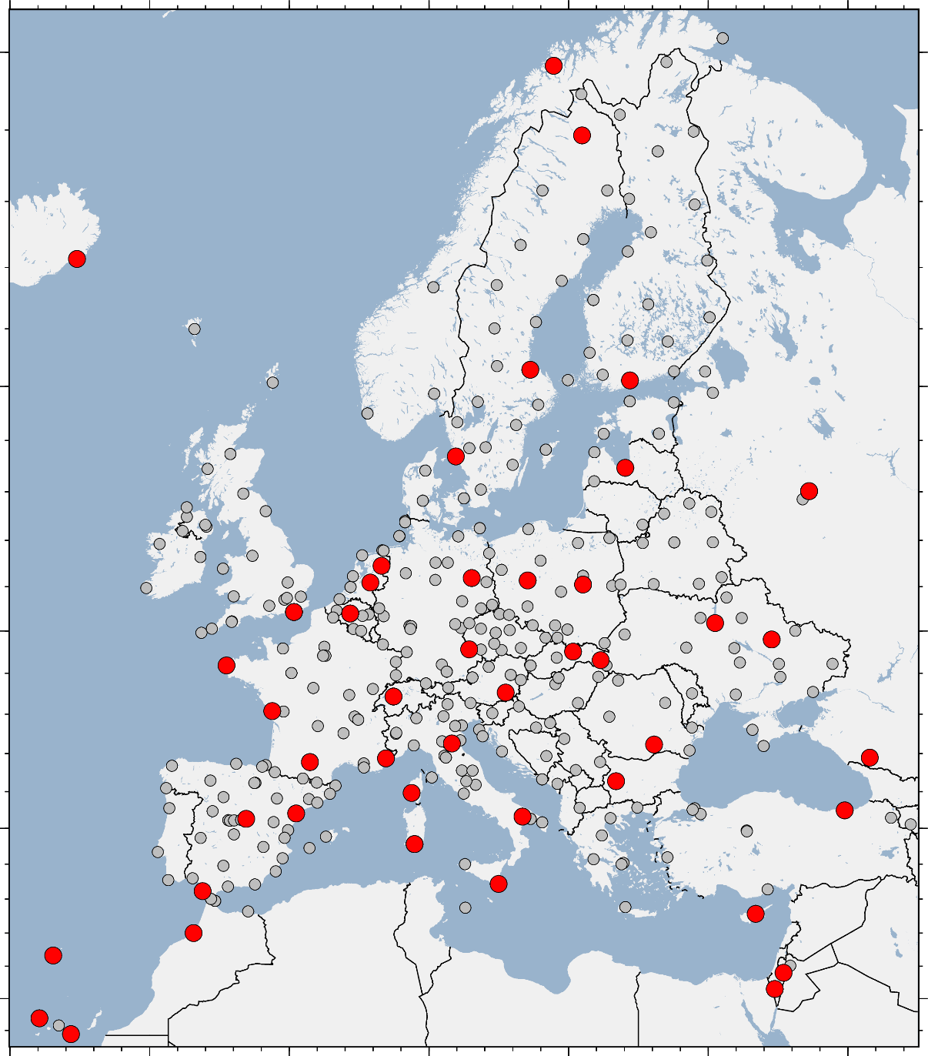
Context
How to find the best reference stations when using the EUREF Reference Frame product ?
EUREF proposes:
  a station classification
  a web tool
Basic idea:
  To provide potential reference stations to be added to be processed with the densification solution
  The stations will be used to align the densification solution to the reference solution
https://www.epncb.oma.be/_productsservices/ReferenceFrame

Slide 3
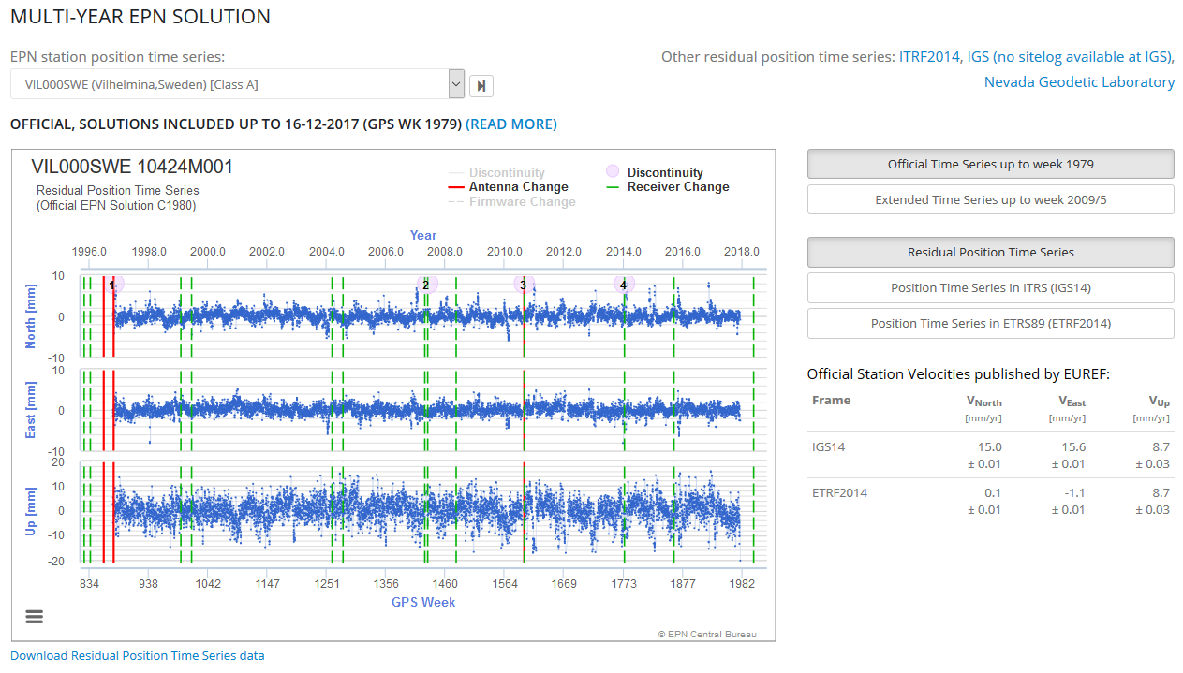
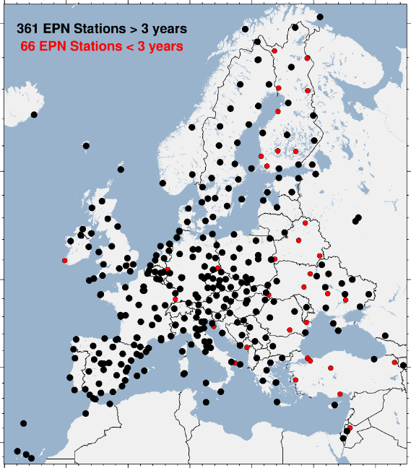
What is EUREF Reference Frame Product ?
Multi-year position & velocity solution
  using CATREF [Altamimi et al. 2007]
  expressed in IGb14
EPN daily SINEXs: 1996-now
  EPN-repro2 solutions (1996-2013)
  Operational solutions (2014-now)
Solution is updated each 15 weeks:
  Official Positions & Velocities in IGS14, ETRF2000 and ETRF2014 for stations with more than 3 years (360+ stations)
  List of position & velocity discontinuities
  List of daily outliers
  Cleaned position time series
Rapid time series (updated on a daily basis)
https://epncb.oma.be/_productsservices/timeseries
https://epncb.oma.be/_productsservices/coordinates
DOI of the last EPN Reference Frame Product
https://doi.org/10.24414/ROB-EUREF-C2130

Slide 4
How to select reference stations ?
Basic principle:
  A good agreement between the densification positions/velocities and the reference positions/velocities
  Spatial distribution of the reference stations around and in the area of interest
But we don’t know if the station shows a good agreement before the processing !
How to increase the chance of having a good agreement between position and velocity estimates?
  Use same processing options as the reference solution
  Use the same position/velocity discontinuities
  Use the same outlier rejection policy
  Select stable and suitable reference stations:
    Use the Web Tool for Reference Station Selection to:
      Choose reference stations following a decision model
      Show reference stations on a map to verify the spatial distribution

Slide 5
Tool Principle
Input period of observation of the densification solution ⇒ choose solution type:
    Position solution (< 3 years)
    Position and velocity solution (> 3 years)
Show stations on an interactive map
  Stations having data during the considered period:
    Color coded recommendation: Recommended, Usable, Not recommended
    Recommendation based on station categories, period of observation, solution type
  For each station with data, detailed relevant information showing the performance of the station
User can:
  Browse through the potential reference stations in and around his area of interest
  Decide if he/she wants to include the station based on information and plots:
    Select only “recommended” reference stations
    Select “not recommended” reference stations making the choice based on the performance of the station
  Select chosen stations
  Export the list of selected stations in various format

Slide 6
Tool Principle
Input period of observation of the densification solution ⇒ choose solution type:
    Position solution (< 3 years)
    Position and velocity solution (> 3 years)
Show stations on an interactive map
  Stations having data during the considered period:
    Color coded recommendation: Recommended, Usable, Not recommended
    Recommendations are based on station categories, period of observation, solution type
  For each station with data, detailed relevant information showing the performance of the station
User can:
  Browse through the potential reference stations in and around his area of interest
  Decide if he/she wants to include the station based on information and plots:
    Select only “recommended” reference stations
    Select “not recommended” reference stations making the choice based on the performance of the station
  Select chosen stations
  Export the list of selected stations in various format

Slide 7
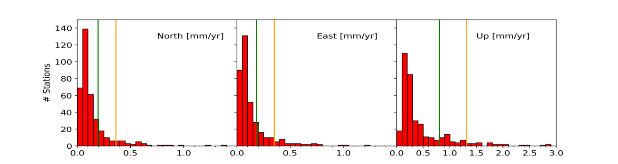
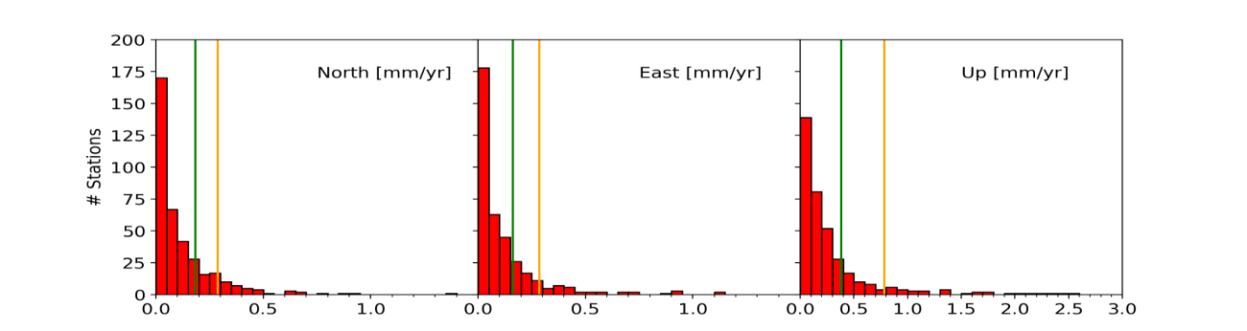
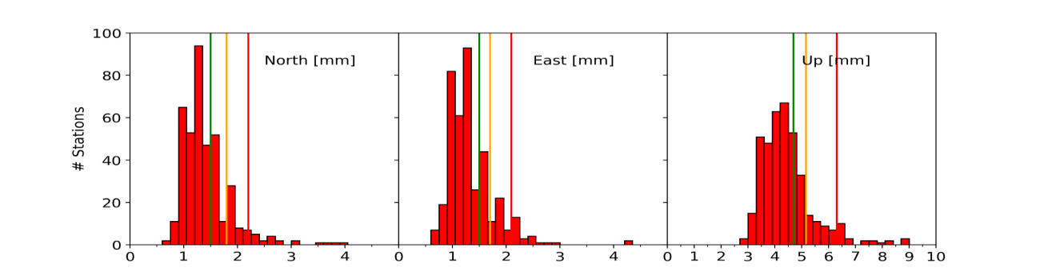
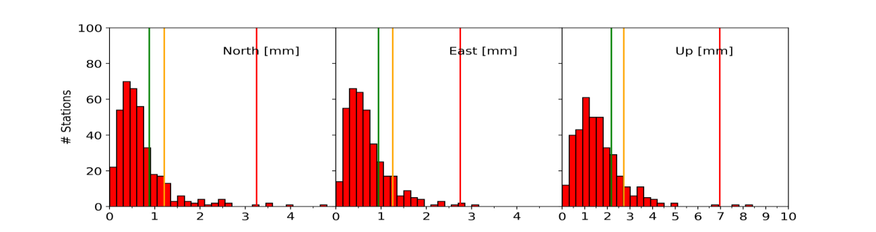
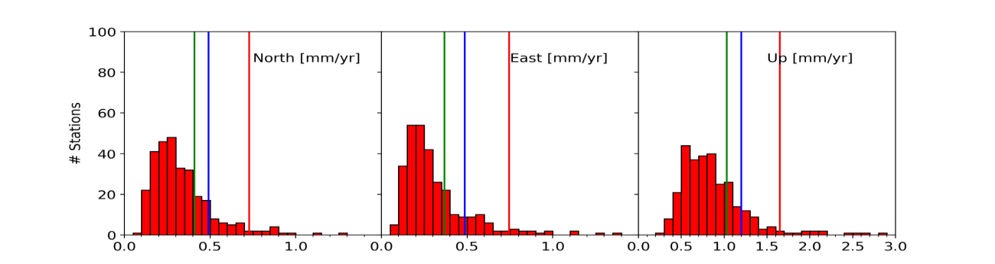
Station Categories (1/2)
temporal correlated noise
⇒
more realistic velocity error estimates
σV from Hector
6 categories based on the performance
of the station on 5 criteria
Reliability of the Velocity Estimation
Position Time Series
Scattering & Signals
CATREF-Hector Velocity difference
Time Series STD
Stability of the Station Over Time
1 year signal Amplitude
Velocity Variability

Slide 8

Station Categories (2/2)
Percentile
75
Percentile
85
Percentile
95
 |  | Criteria |  |  |  |  | Comment
Name | Number | Velocity variability | Timeseries RMS | Amplitude 1Y signal | DV_{Catref-Hector} | σ_{Hector} | Comment
C0 | 58 | < Percentile 75 | < Percentile 75 |  |  |  | Most Stable Stations
C1 | 37 | < Percentile 75 | < Percentile 85
C2 | 48 | < Percentile 75 | No threshold |  | < Percentile 85 |  | Stable but Noisy or with Seasonal Signals
C3 | 12 | < Percentile 85 | < Percentile 85 |  |  |  | Less Stable
C4 | 15 | Not Available - Short time series | < Percentile 85
C5 | 73 | < Percentile 85 | No criteria > Percentile 95 |  |  |  | Even Less Stable
C6 | 124 | velocity variability > Percentile 85 and/or 1 or more other criteria > Percentile 95 or Short time series with 1 or more criteria > Percentile 85 |  |  |  |  | Less Reliable
Short | 60 | < 3yr - not applicable |  |  |  |  | No velocity published
Value < Percentile 75
  Keep the 75% best stations for the considered criteria
  Reject the 25 % worst stations for the considered criteria

Slide 9
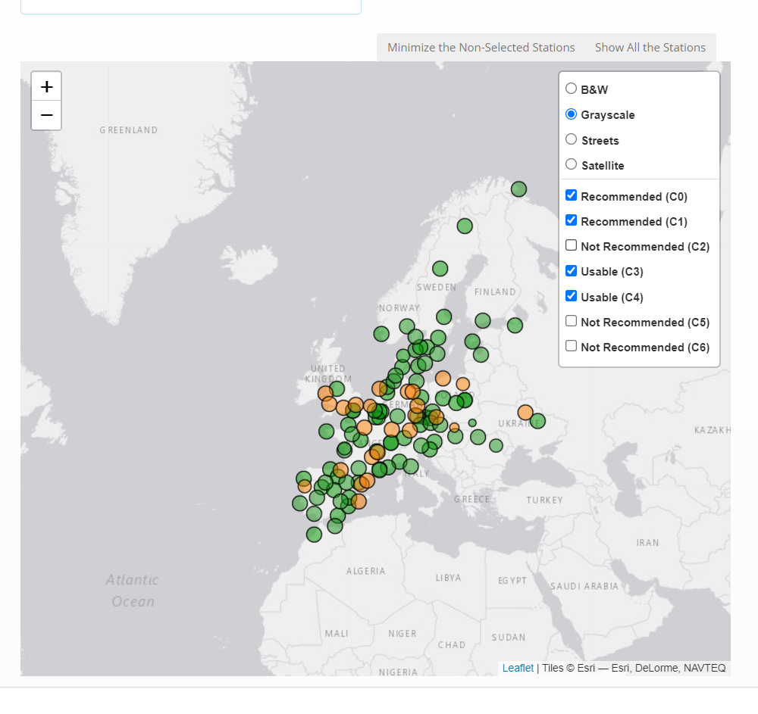
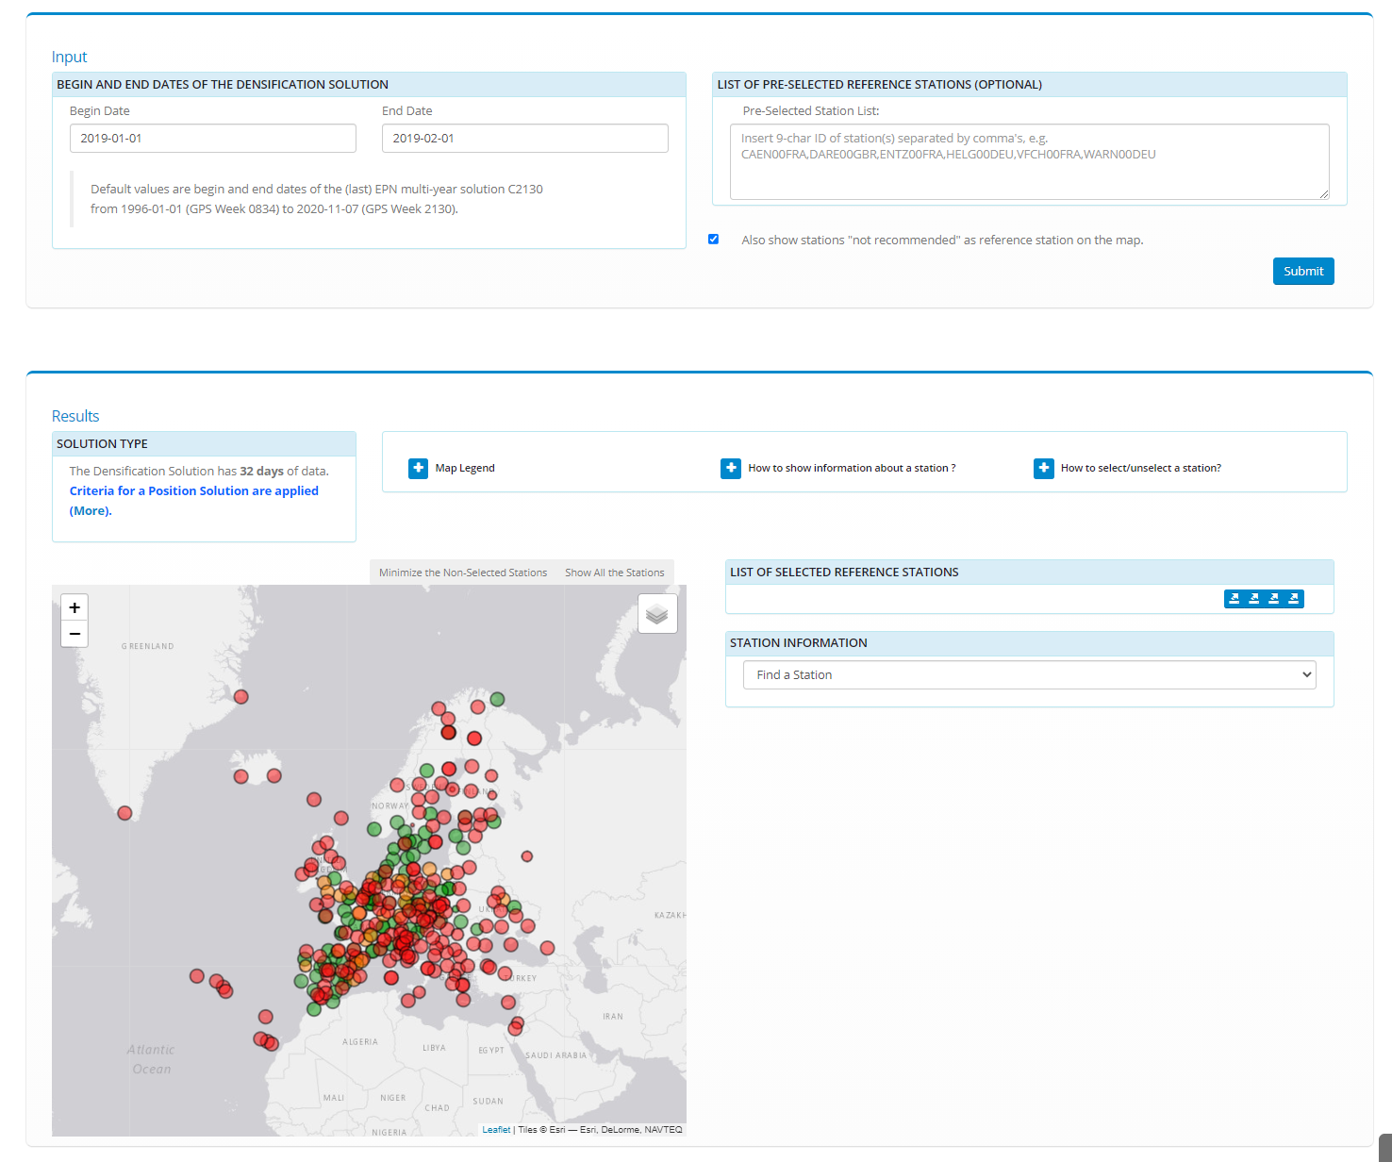
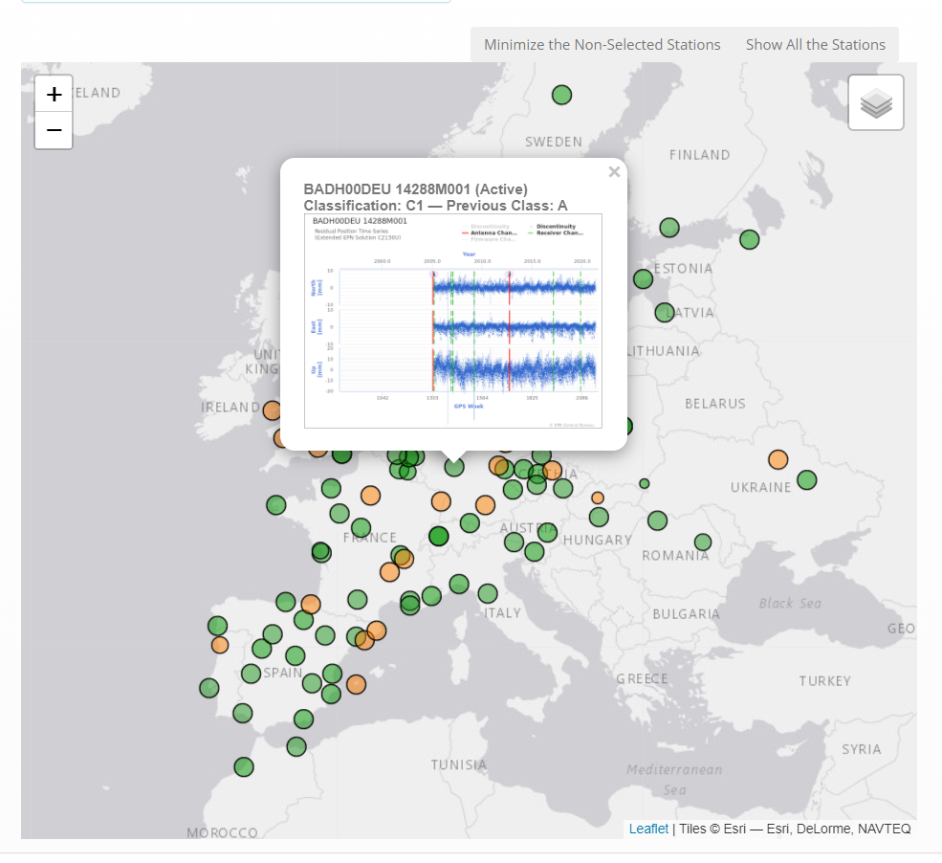
Tool Principle
show and hide stations by category
on station over, the time series of the station is shown

Slide 10
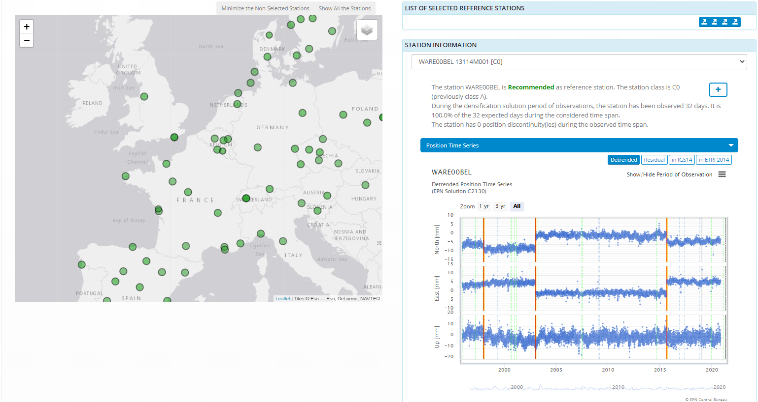
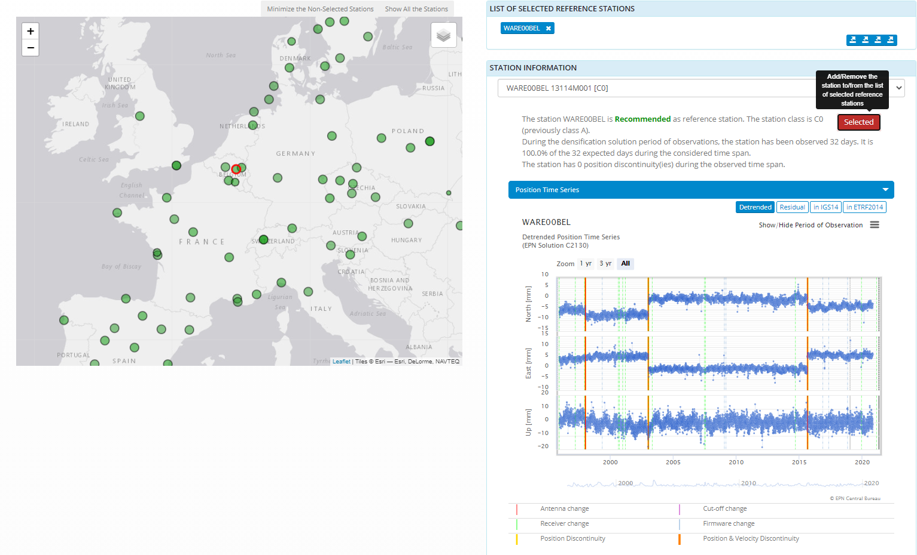
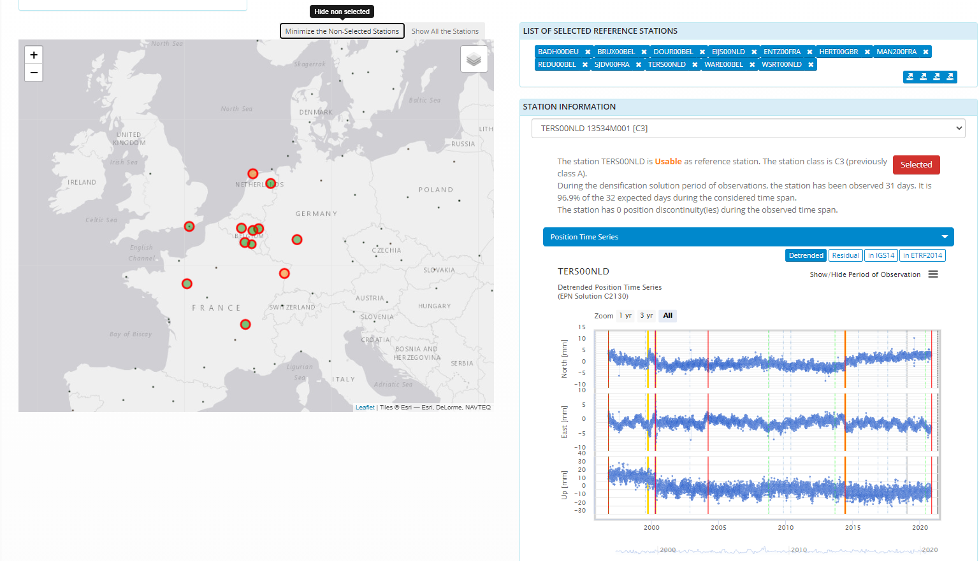
Tool Principle
add the station to the selected list of reference stations
Click on station to show station details
Export the list of selected stations:
List of Stations
CATREF
BERNESE (FIX)
Table with criteria values
Show/hide non selected stations
Export list of the selected reference stations in various formats:
List of Stations
CATREF
BERNESE (FIX)
Table with criteria values

Slide 11
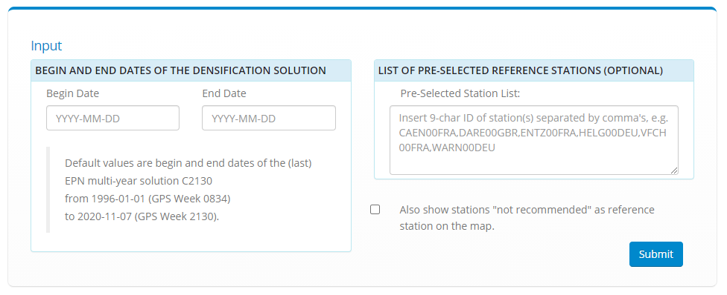
Solution Types
https://www.epncb.oma.be/_productsservices/ReferenceFrame
Input: period of observation of the densification solution
Two types of solutions:
  Position solutions
    < 3 years
  Position & Velocity solutions
    > 3 years
Criteria used to recommend stations will depend on:
  Solution type
  Station categories
  Observation availability in the EUREF Reference Frame Product
Begin Date
End Date
< 3 years
> 3 years
Position
Solution
Position & Velocity
Solution

Slide 12
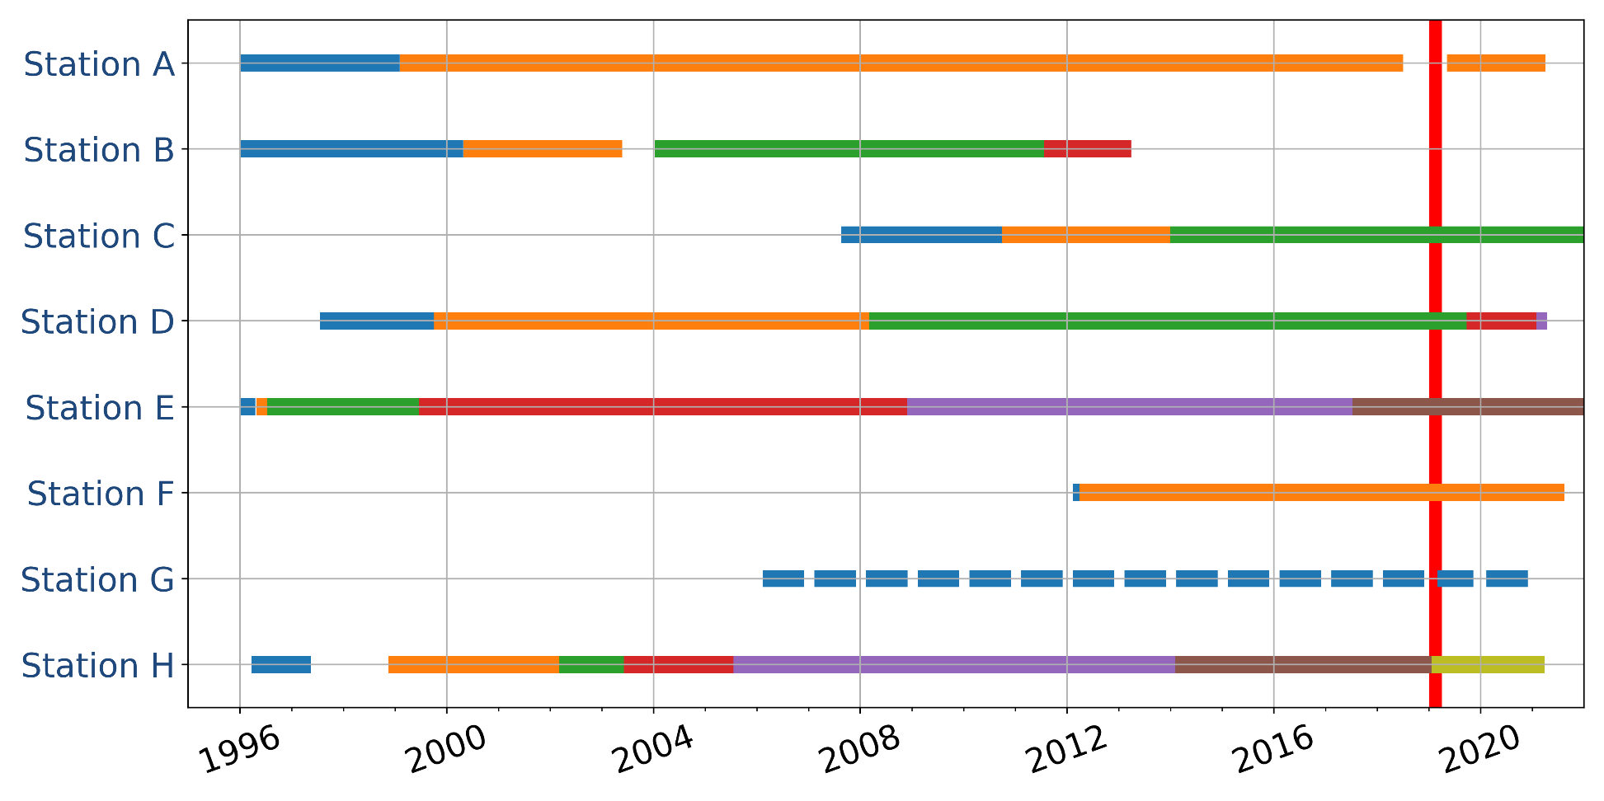
Solution type 1: Positions
Period of observation: 2019-01-01 − 2019-02-01
Potential reference frame stations
2019-01-01
2019-02-01
No data
during the period
of observation
Has data
during the period
of observation
Few data
during the period
of observation
Position discontinuity
during the period
of observation
Observation availability in the EUREF Reference Frame Product

Slide 13
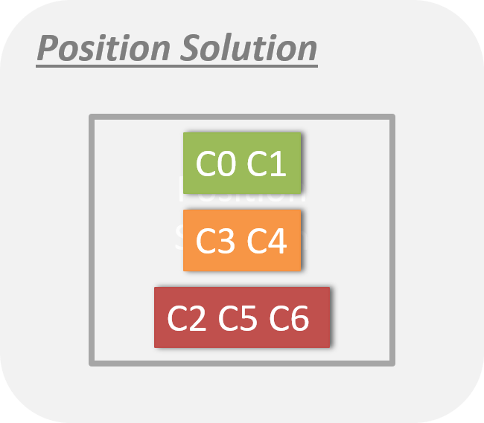
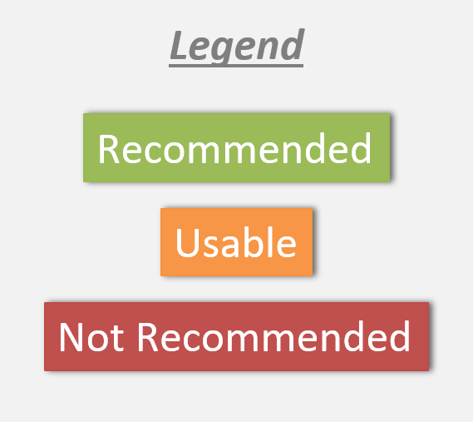
Solution type 1: Positions – Decision Model
Criteria 1: Observation availability in the EUREF Reference Frame Product during the period of observation
  no days available ⇒ station not proposed in the list
  Number of days in time series shown on the map with marker size
Criteria 2: based on station categories
  Recommended: C0, C1
  Usable: C3, C4
  Not Recommended: C2, C5, C6
    C2: noisy time series and/or seasonal signals
    C5/C6: instabilities and/or noisy time series and/or seasonal signals
Relevant information:
  Number of discontinuities during the period of observation
  Detrended position time series
  Plots showing the performance of the station

Slide 14
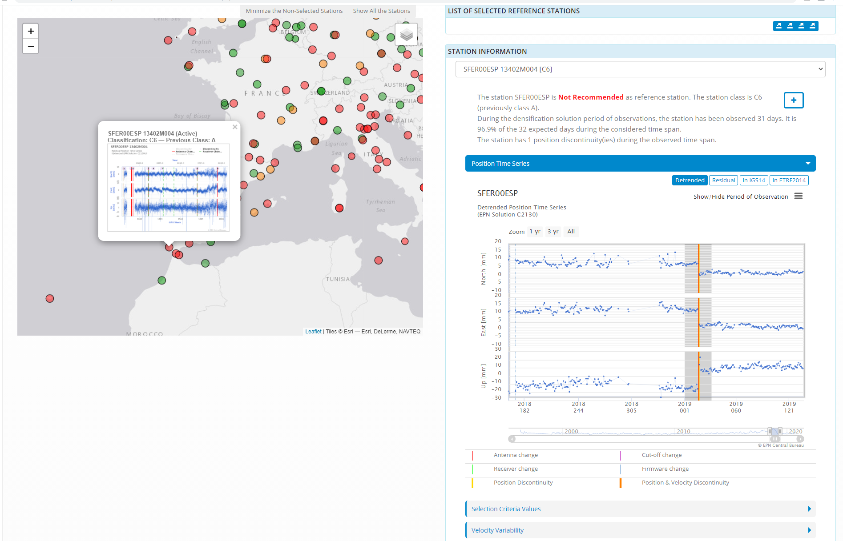
Solution type 1: Positions – Tool
Click or select a station ⇒ relevant information:
  Recommendation
  Category of the station
  Number of days of observation
  Number of position/velocity discontinuities during the considered period
  Detrended position time series to see the position changes
  Station Performances

Slide 15
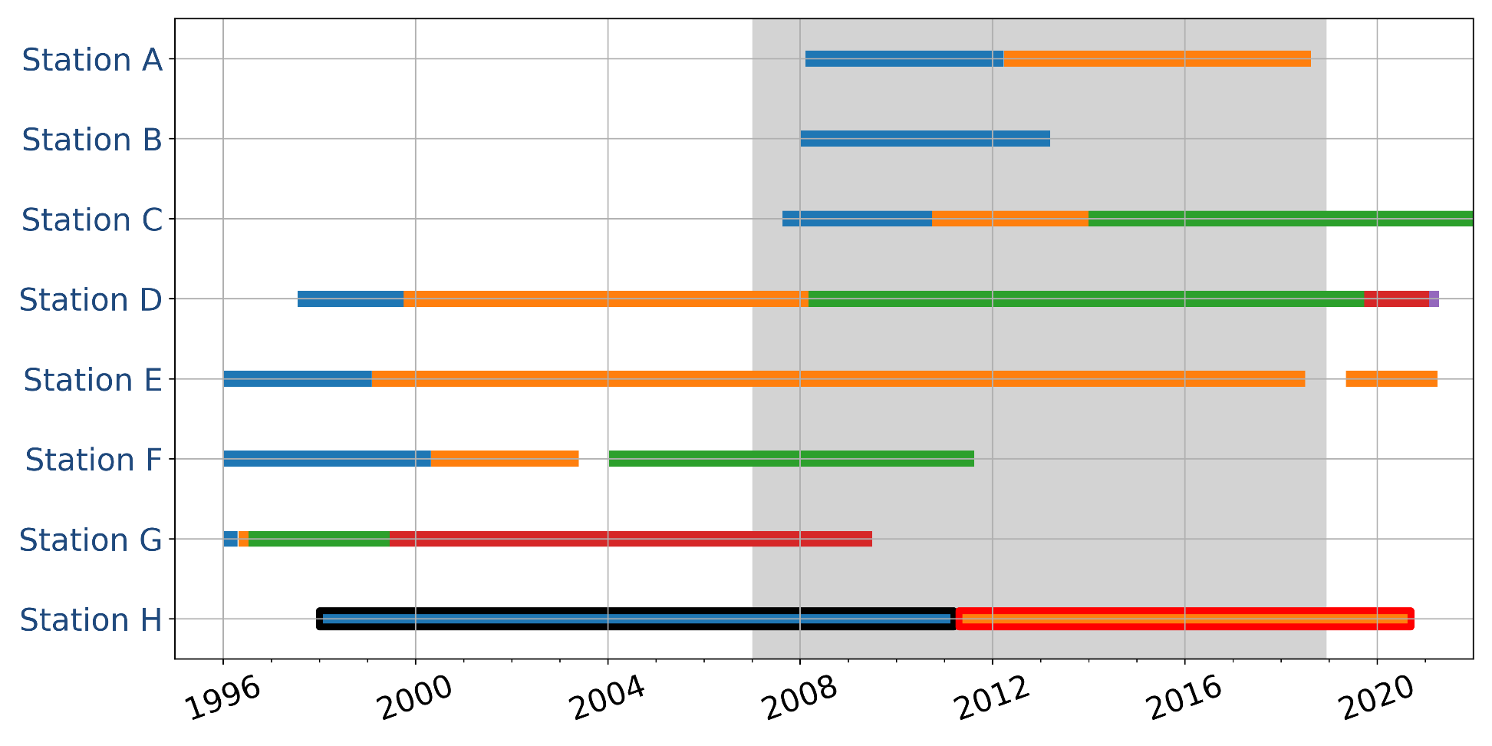
Solution type 2:
Positions - Velocities
Period of observation: 2007-12-01 − 2018-12-31
Potential reference frame stations
2007-12-01
2018-12-31
same period of observation in both solutions
≠ periods of observation > 6 years
≠ periods of observation
< 6 years
< 3years
Velocity change during the period of observation
Observation availability in the EUREF Reference Frame Product

Slide 16
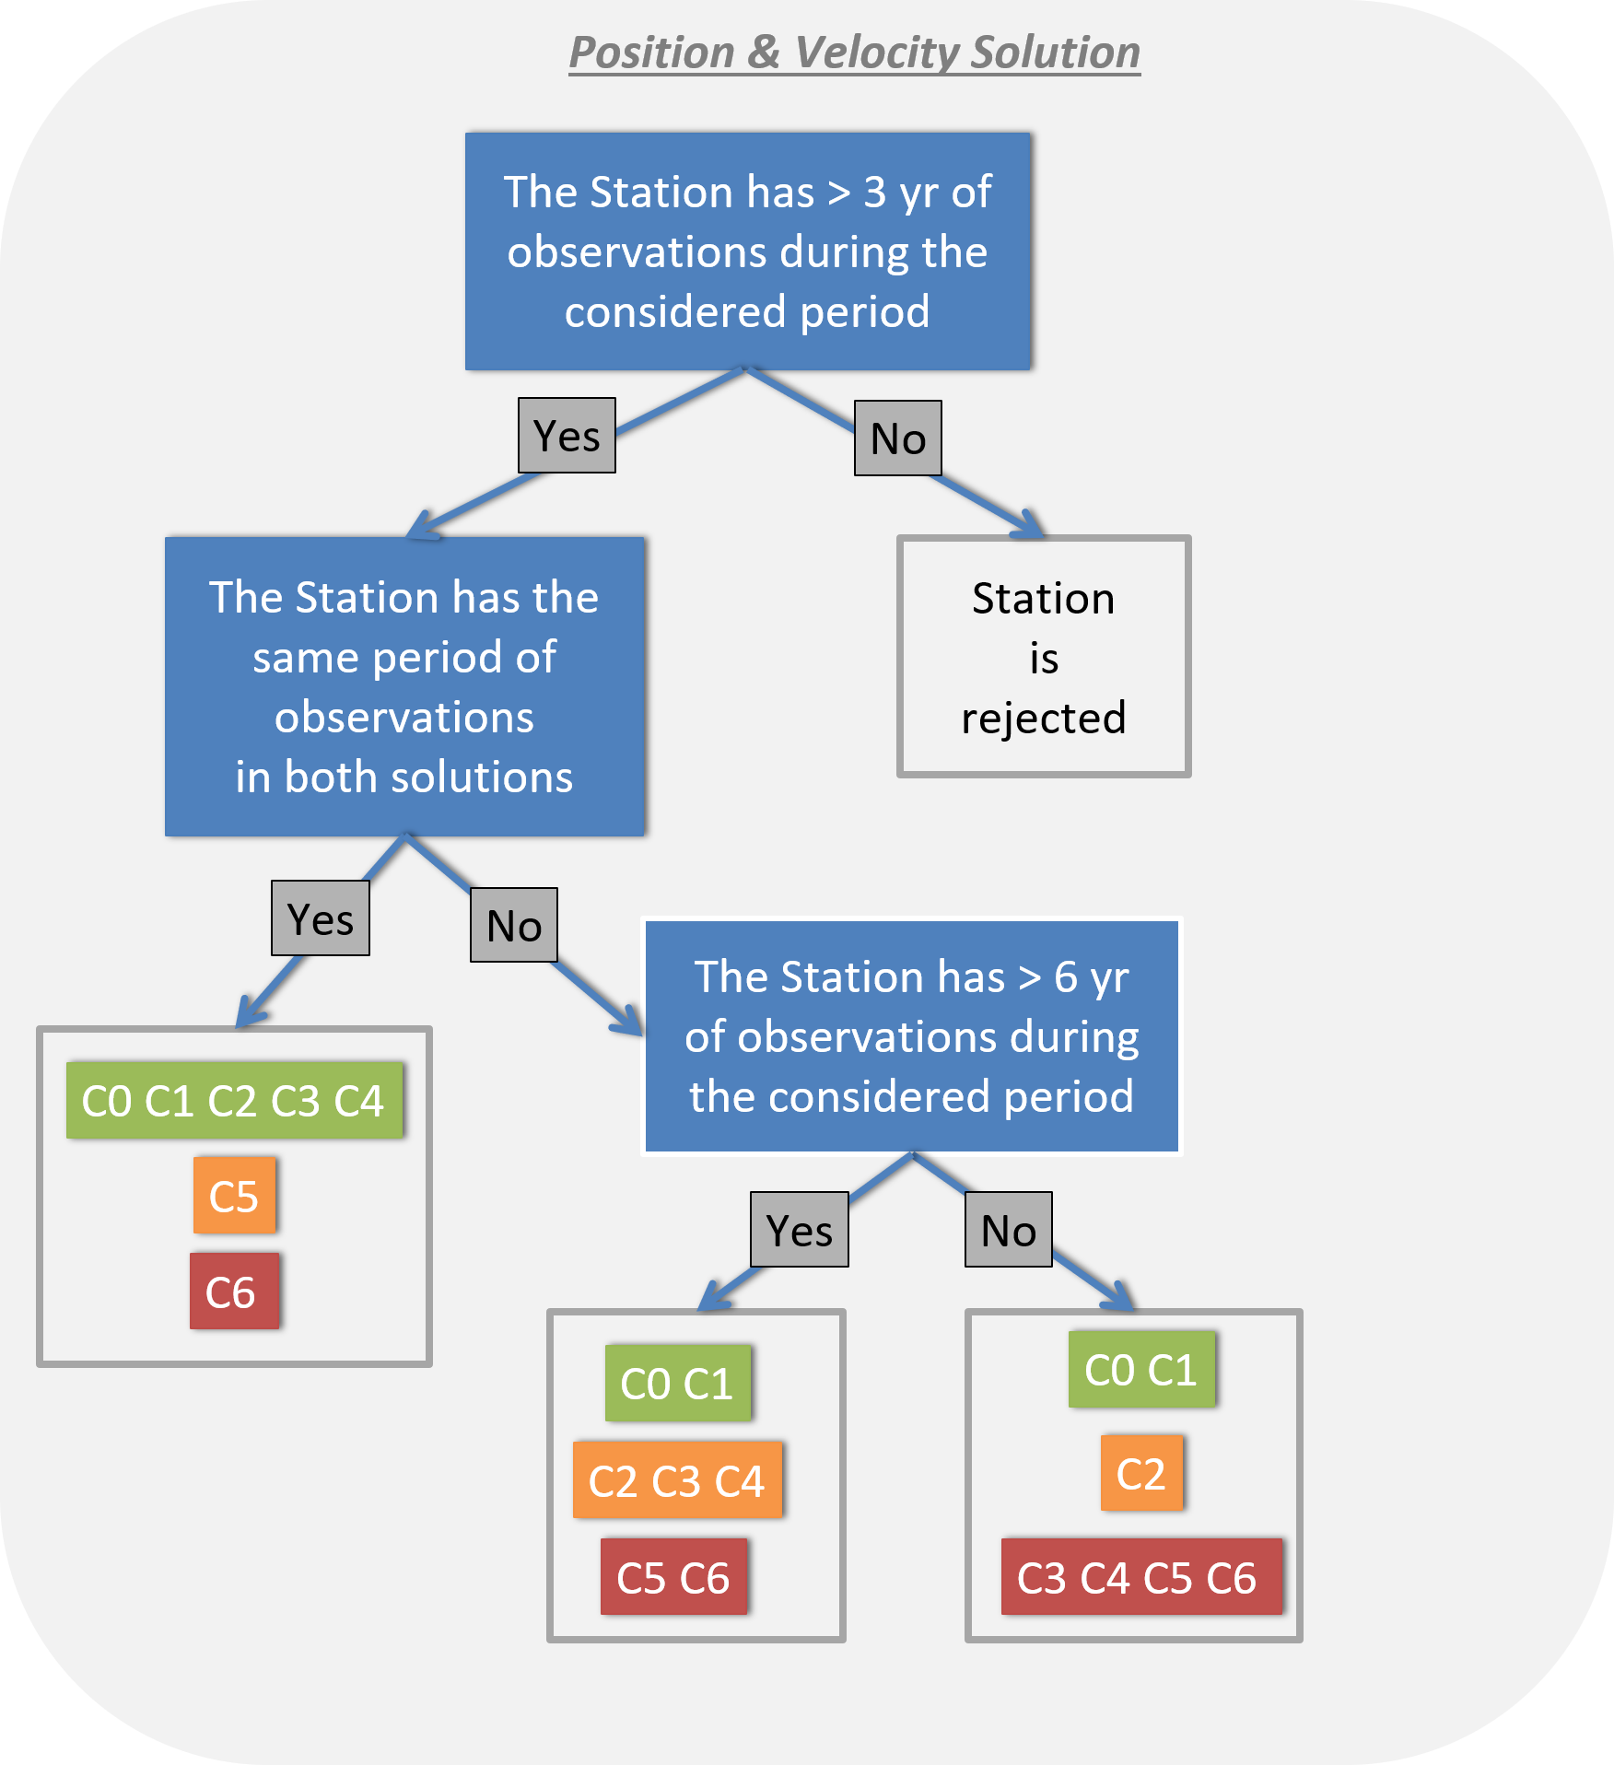
Solution type 2: Positions – Velocities
Decision Model
Criteria 1: Observation availability in the EUREF Reference Frame Product during the period of observation
  < 3 years ⇒ station not proposed in the list
  Number of years in time series shown on the map with marker size
Criteria 2: based on station categories
  Depends on the number of years of observation
Relevant information:
  Number of position/velocity discontinuities during the period of observation
  Collocated stations with velocity constrained
  De-detrended position time series
  Plots showing the performance of the station
  Velocity variability plots

Slide 17
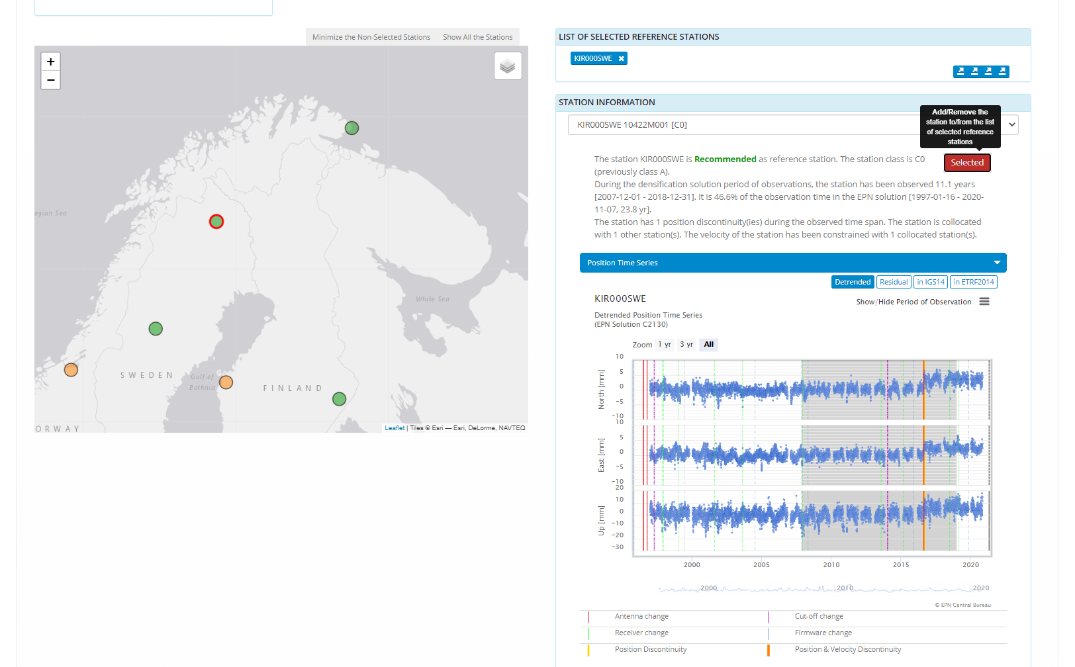
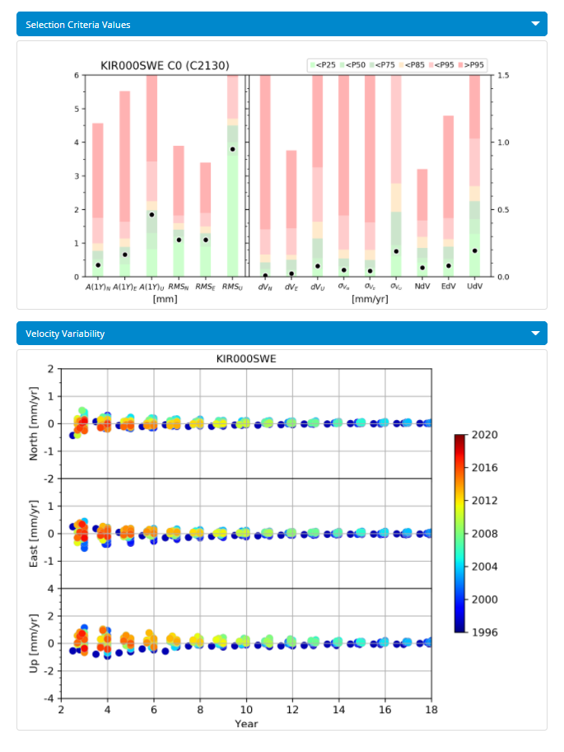
Solution type 2: Positions – Velocities
Tool
Relevant information:
Recommendation
Station category
Number of years of observation
Number of position/velocity discontinuities during the period of observation
Collocated stations with velocity constrained
De-detrended position time series
Plots showing the performance of the station
Velocity variability plots

Slide 18
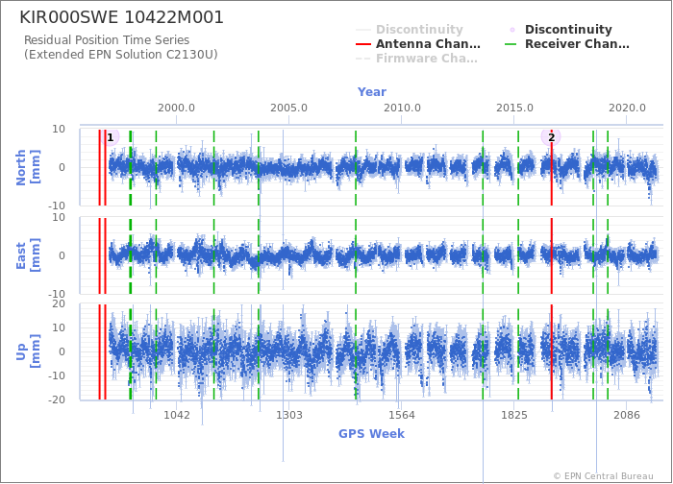
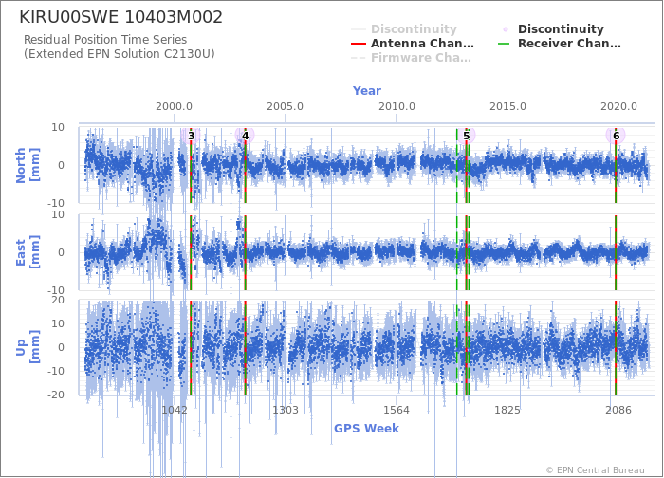
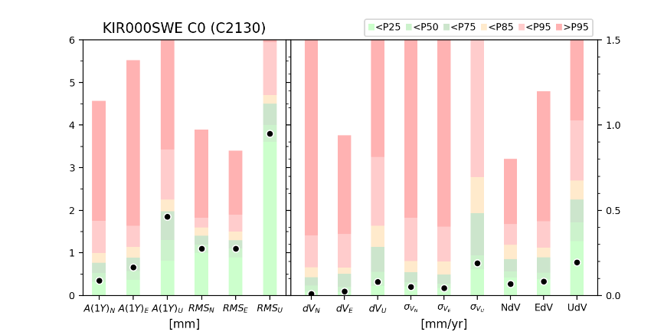
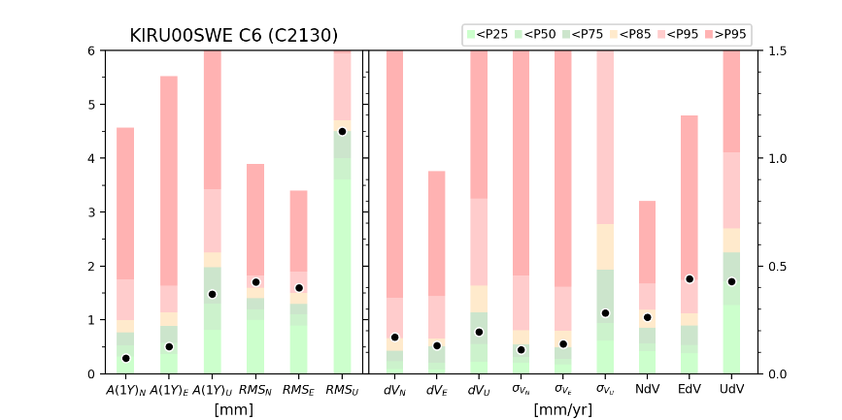
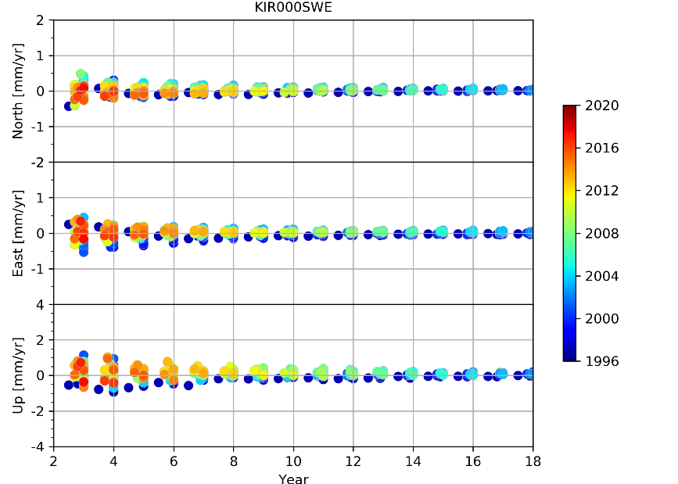
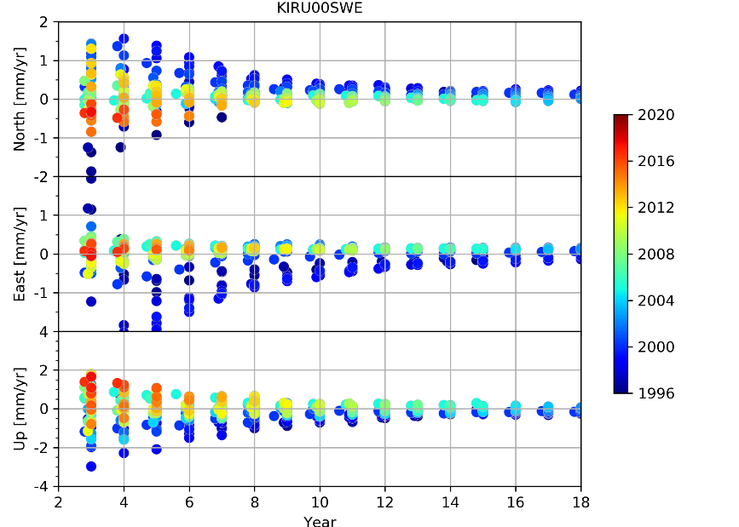
Performance of the stations: Examples
Position time series
Performance of the station on the 5 criteria
Compare the performance of a station (black dots) with the performance of the EPN stations (percentiles shown with colored bars)
Velocity Variation
Difference between velocity estimated using data from different moving time windows with the velocity obtained using the full data set of the station as it is included in the multi-year EPN solution

Slide 19
Conclusion
EUREF Reference Frame Product: Multi-year position & velocity solution in IGb14 updated each 15 weeks
How to select suitable reference stations from this product ?
  Web Tool to help the selection of optimal reference station
    Show stations on an interactive map
    With recommendation: Recommended, Usable, Not recommended
    based on station categories, solution type (Positions, Positions & Velocities), period of observation
    provides necessary information for the user to decide to select or not a reference station
The web tool is operational and results are updated at each release of the EUREF Reference Frame Product (15 weeks)
In the future:
  Revisit the station categorization to refine the recommended reference station list
  Extend the tool to work on the extrapolated part of the station time series
  Develop API

Slide 20
Links
EUREF Permanent Network Central Bureau
https://epncb.oma.be/
EUREF Reference Frame Product
https://epncb.oma.be/_productsservices/coordinates/
https://epncb.oma.be/_productsservices/timeseries/
Tool
https://epncb.oma.be/_productsservices/ReferenceFrame/
Background on the Station Categories https://epncb.oma.be/_productsservices/ReferenceFrame/Station_Classification.php
Background on the tool
  https://epncb.oma.be/_productsservices/ReferenceFrame/Tool.php
Contact
juliette.Legrand@oma.be or epncb@oma.be

