Slide 1
Meteoroid trajectories from BRAMS data
H. Lamy
Royal Belgian Institute for Space Aeronomy

Slide 2
Acknowledgement
Mathias Vandenbossche, MSc student at U Liège, for working on this topic
Prof. Gunter Stober at University of Bern, for very useful discussions and guidance
Mr. Carl Johannink, CAMS-BeNeLux, for providing the CAMS-BeNeLux data for trajectories and speed

Slide 3
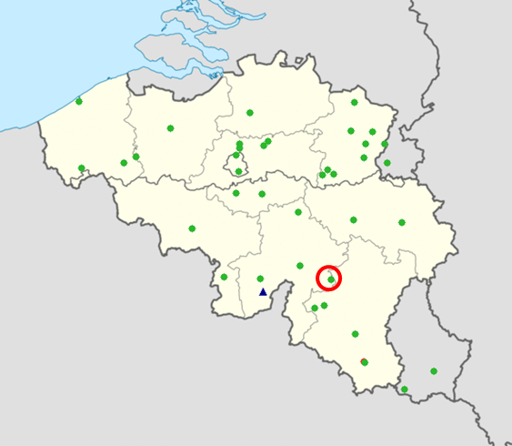
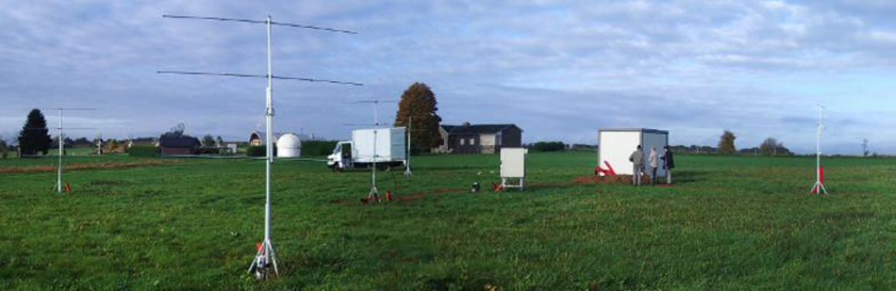
The BRAMS network
BRAMS network : forward scatter
1 dedicated Tx in Dourbes : 49.97 MHz, CW, 130 Watts, circular polarization (blue triangles)
37 receiving stations (green dots)
1 interferometer in Humain (red circle)

Slide 4
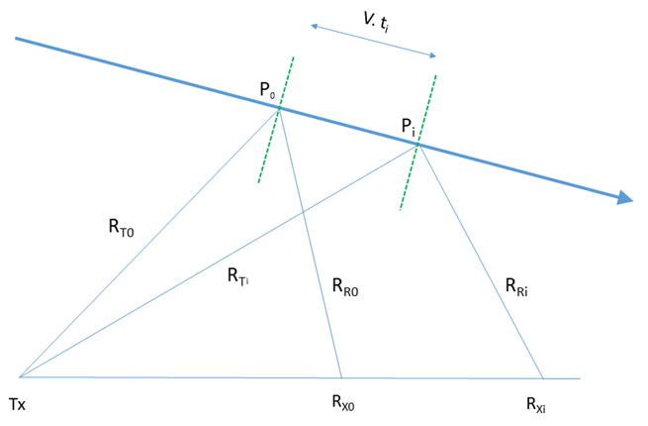
Meteoroid trajectory reconstruction
Specular reflection : S_{i} = R_{Ti} + R_{Ri} must be minimum for each station i
6 unknowns: 3 coordinates of one specular point P₀ + 3 components of speed v
6 non-linear equations : dS_{i} / dt = 0 i=1, …, 6

Slide 5
3 methods of reconstruction
Using only time delays between meteor echoes observed at ≥ 6 stations
Using data from interferometer + 3 time delays between the interferometer and other stations
Using time delays + total range from 3 stations (assuming total range is available)

Slide 6
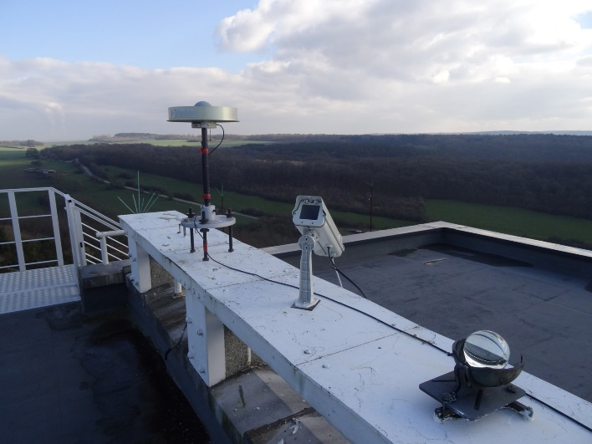
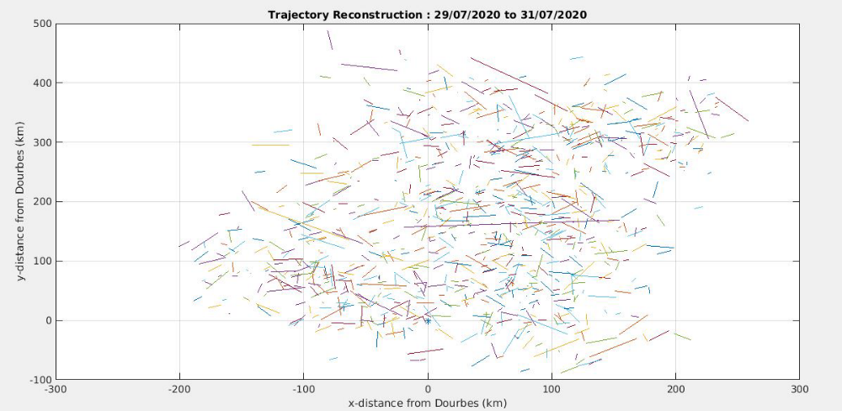
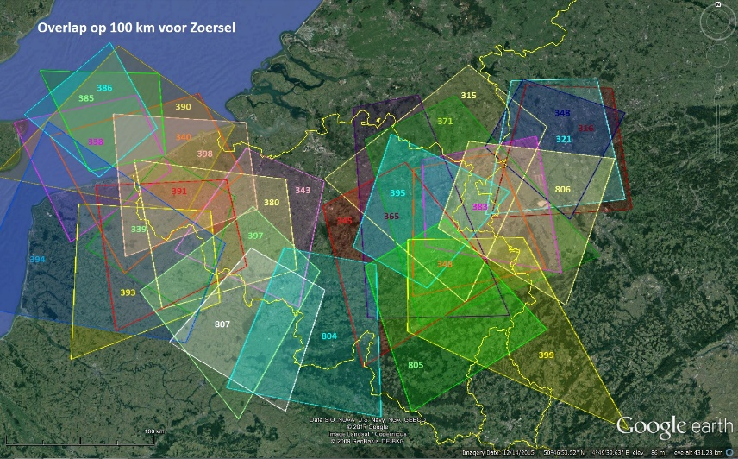
Validation
Comparison with trajectory and speed obtained with data from the optical CAMS-BeNeLux network
Data from 29 to 31 July 2020
Projection of all the CAMS trajectories in an horizontal plane centered on the BRAMS Tx
Credit: Paul Roggemans

Slide 7
Method 1
Uses a set of six non-linear equations involving time delays between 6 stations and a reference one. Assumes speed is constant along the meteoroid path
The method has recently been described also in Mazur et al. (2020) for analysis of CMOR data using TOF only. However, in the case of CMOR, two assumptions (main site being a bi-static station and remote stations being very close to the Tx) simplifies the general equation a lot and lead to a linear system of equations for the speed only. This simplified method is not valid for BRAMS
Currently, method 1 does not work because there are ambiguity among the solutions that the solver cannot overcome. We keep investigating.

Slide 8
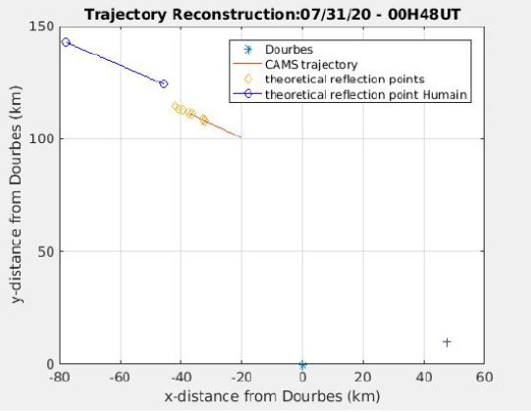
Example of result : method 2
Red : projection of CAMS trajectory
Blue : reconstructed BRAMS trajectory
The two curves do not overlap although speed and directions are retrieved correctly but altitude of reflection point is wrong

Slide 9
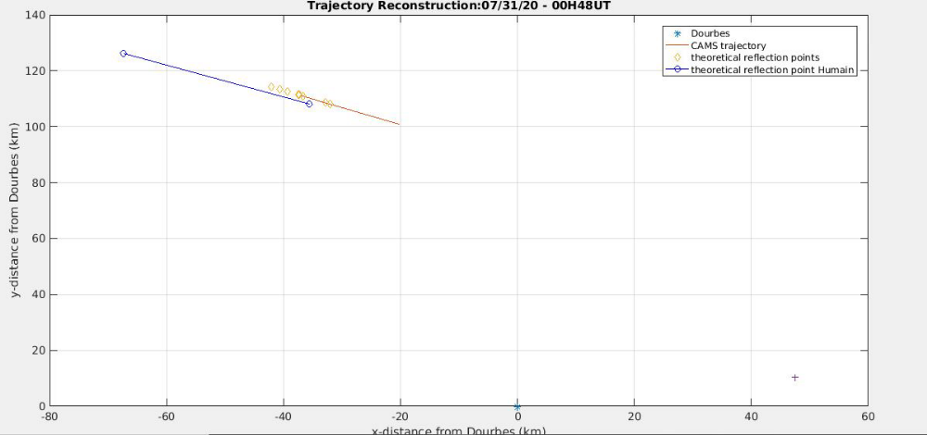
Example of result : method 3
With the additional information about the total range traveled by the radio wave, the two trajectories nearly overlap
Sensitivity studies about timing measurements errors, influence of altitude difference between the stations, etc…
To obtain the total range, we need to add something to the current version of the BRAMS network, e.g. using phase coding described in Vierinen et al. (2016)

Slide 10
Conclusions
Method 1 does not work yet (simplified version used for CMOR does not apply to BRAMS)
Method 2 provides correct speed and direction but height of the reflection point is not constrained
Method 3 works but obtaining total range must be implemented (hardware and software modifications)

