Slide 1
Evaluation of the ERA5 reanalysis as a reference dataset for fine-scale hydrological modelling over alpine basins
Susen shrestha¹, Mattia Zaramella¹, Mattia Callegari², Felix Greifeneder², Marco Borga¹
1 Department of Land, Environment, Agriculture and Forestry, University of Padova, Italy
2 EURAC, Institute for Earth Observation, Bolzano, Italy
EGU21-14265, https://doi.org/10.5194/egusphere-egu21-14265, 2021.

Slide 2
Research gap
While several works have already analysed the potential of ERA5 reanalysis as input for daily, large scale hydro- modelling, so far no studies are available concerning the assessment for small alpine basins at hourly temporal resolution.
This is important for the use of ERA5 as input for analysis and forecasting at the typical small scale size of basins feeding hydropower systems in the Alps.

Slide 3
Objectives
To assess the ERA5 precipitation performance with basins of different size.
To assess model prediction for basins of different size
To assess ERA5 input runoff with station input runoff for basins of different size.
To assess ERA-5 input runoff during the flood events.

Slide 4
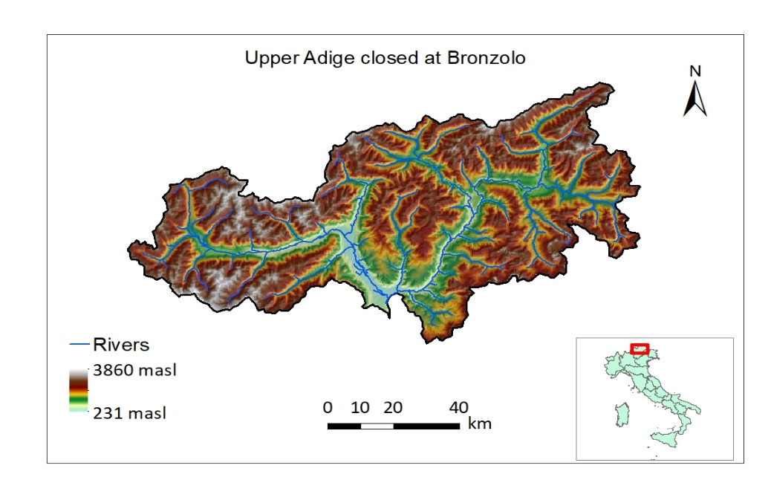
Study Area
Upper Adige river basin at Bronzolo, Italy.
Area: 6924 km²
Elevation ranges: from 200-3900 m.a.s.l
Mean annual precipitation ranges from 500 to 1100 mm

Slide 5
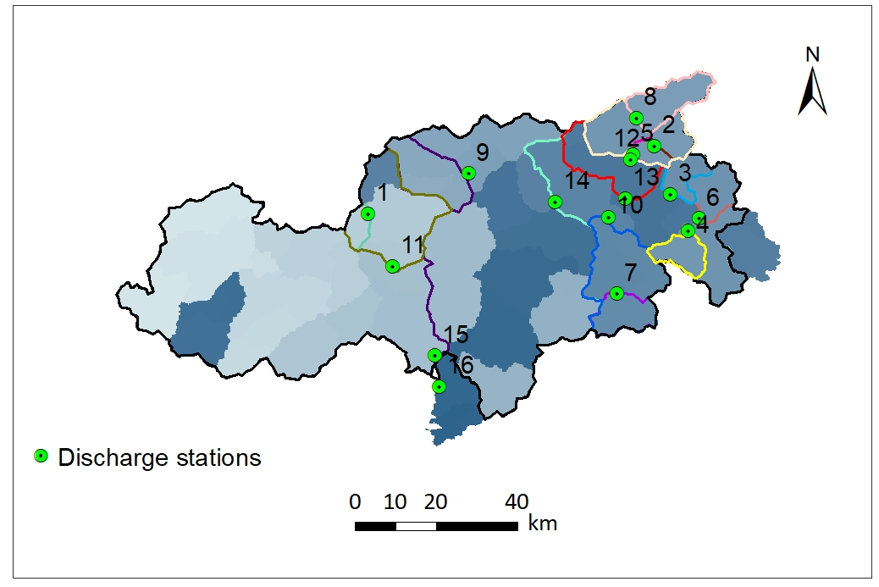
To understand the effect of basin size to the comparison 16 watershed were identified with varying size from 49Km² to 6924Km², within the study area.
SN | Name | Elevation(m) | Area (Km²)
1 | Rio Plan | 2163 | 49
2 | Rio Riva at Seghe | 1831 | 76
3 | Rio Anterselva at Bagni | 2072 | 82
4 | Rio Braies at Braies | 2188 | 93
5 | Rio Riva at Caminata | 1829 | 115
6 | Rio Casies at Colle | 2162 | 117
7 | Rio Gadera at Pedraces | 1911 | 125
8 | Aurino at Cadipietra | 1796 | 150
9 | Rio Ridanna at Vipiteno | 1700 | 210
10 | Gadera at Mantana | 1915 | 397
11 | Rio Passirio at Merano | 1533 | 414
12 | Aurino at Caminata | 1887 | 420
13 | Aurino at S.Giorgio | 1847 | 608
14 | Rienza at Vandoies | 1916 | 1919
15 | Adige at Ponte Adige | 1878 | 2732
16 | Adige at Bronzolo | 1885 | 6924

Slide 6
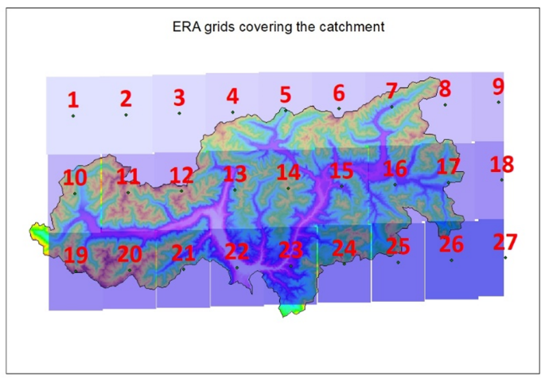
ERA-5 dataset
Reanalysis dataset
Combines model data with observations
Data-1979 to present
Spatial resolution-0.25 degree(28 km×19 km )
Temporal resolution-1 hour
The ERA tiles named 1-27
Observed dataset
Observed precipitation was collected from 88 gauges and temperature from 124 gauges, from October 1992 till September 2019.
The hourly observed runoff data were collected from the Hydrographic Office of Bozen for the time period ranging from October 1992 to September 2019, during which data are available with continuity in time. Nonetheless, some hydrometric stations that reported limited runoff data availability are listed in Table.
Basin | Availability
Rio Plan at Plan | Oct, 1994-Sep,2019
Rio Riva at Seghe | Oct, 2001-Sep,2008
Rio Braies at Braies | Oct,2013-Sep,2019
Rio Riva at Caminata | Oct,2003-Sep,2019
Gadera at Pedraces | Oct,2003-Sep,2019
Gadera at Mantana | Oct,1992-Sep,2018
Passirio at Merano | Oct,2013-Sep,2019

Slide 7
ARRFS Hydrological model
ARRFS (Adige River Flood Forecasting System) model integrates a lumped integrated catchment hydrological model (Norbiato, Borga, Merz, Blöschl, & Carton, 2009) which transforms the excess precipitation and the contribution of snowmelt into runoff at the outlet of the basin.
Snow melt fed by Enhanced Temperature Index snowpack model; TOPMELT (Zaramella et al. 2019).
Potential evapotranspiration is estimated through the Hargreaves method (Hargreaves & Samani, 1982).
The soil moisture routine exploits a probability distribution to describe the spatial variation of water storage capacity across a basin, according to the Probability Distributed Model (PDM) and ICHYMOD (Moore, 2007; Norbiato et al., 2004.

Slide 8
Methodology
1. To assess the ERA5 precipitation performance with basins of different size
The hourly precipitation from 1-27 ERA5 grid were considered .
The ERA5 date time from UTC is converted to CEST.
The ERA5 precipitation threshold of 0.001 was applied to consider the station's inability to measure the precipitation below the given threshold.
The ERA5 precipitation is distributed over 16 sub-basins using Thiessen polygon.
The ERA5 precipitation is compared with the station precipitation.
To calculate the performance statistics(NSE, KGE and its’ three components), the time step in which both the data source had zero precipitation were neglected for the analysis.
The performance calculated was NSE and KGE with its three constituents and plotted with respect to basin size.
The Quantile-Quantile between the two data source were also plotted for each basin.

Slide 9
2. To assess model prediction for basins of different size
Time series: October, 1992 till September 2019.
Calibration period: October 2003 till September 2019
except for
Rio Riva Seghe (oct, 2003-sep, 2008)
Rio Riva a Caminata and Gadera a Pedraces (oct, 2003-sep, 2011)
Braies and Passirio (oct, 2013-sep, 2016)
Gadera Mantana (oct, 2003-sep, 2018)
Validation period: October 1992 till September 2003.
except for
Rio Plan (oct, 1994-sep, 2003)
Rio Riva Seghe(Oct, 2001-Sep, 2003)
Rio Riva a Caminata (oct, 2011-sep, 2019)
Gadera a Pedraces (oct, 2011-sep, 2018)
Braies and Passirio (oct, 2016-sep, 2019)
NSE, KGE and its three component were plotted with increasing area for the runoff simulation for calibration and validation period.

Slide 10
3. To assess ERA5 input runoff with station input runoff for basins of different size.
The runoff from station input from 1992-2019 is considered as a reference and compared with the runoff obtained from ERA-5 input.
NSE, KGE and its three component were plotted with increasing area for the runoff simulation for calibration and validation period.
4. To assess ERA-5 input runoff during the flood events
For each hydrological year, observed maximum flood is identified and a time window of 4 days is selected: which is 3 days prior and 1 day after the flood event.
The analysis of ERA5 precipitation and ERA5 runoff within this time window is done for all the watersheds.
The relative bias of first day runoff, maximum runoff is calculated with the the station input runoff
The relative bias maximum precipitation is calculated with the observed station.

Slide 11
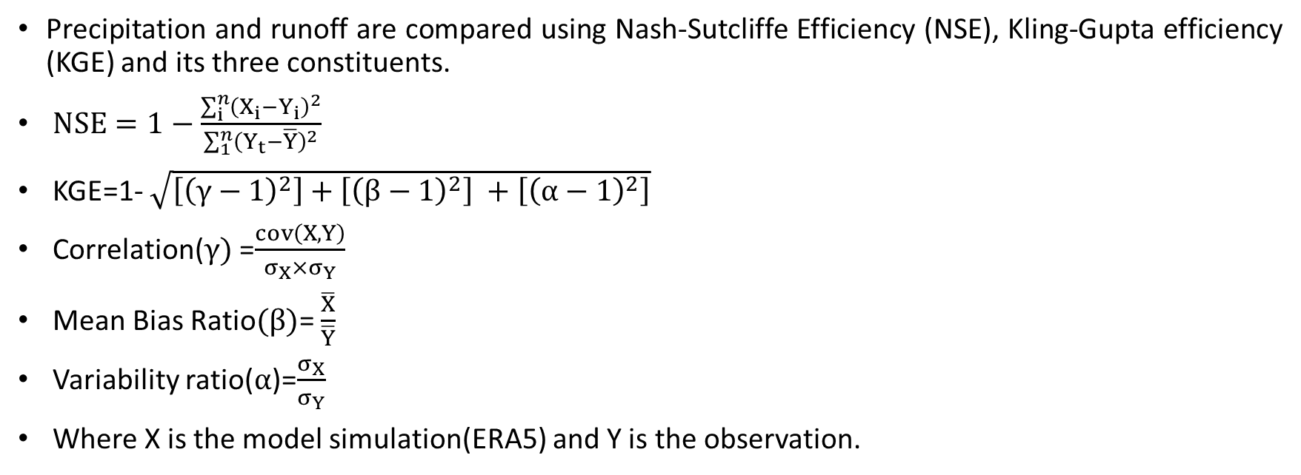
Comparison Statistics
Precipitation and runoff are compared using Nash-Sutcliffe Efficiency (NSE), Kling-Gupta efficiency (KGE) and its three constituents.
$NSE=1−\frac{\sum_{i}^{n}{{\left(X_{i}−Y_{i}\right)}^{2}}}{\sum_{1}^{n}{{\left(Y_{t}−\overline{Y}\right)}^{2}}}$
KGE=1- $\sqrt{\left[{\left(γ−1\right)}^{2}\right]+\left[{\left(β−1\right)}^{2}\right] +\left[{\left(α−1\right)}^{2}\right]}$
Correlation($γ)$=$\frac{cov\left(X,Y\right)}{σ_{X}×σ_{Y}}$
Mean Bias Ratio$(β)$= $\frac{\overline{X}}{\overline{Y}}$
Variability ratio($α$)=$\frac{σ_{X}}{σ_{Y}}$
Where X is the model simulation(ERA5) and Y is the observation.

Slide 12
RESULTS

Slide 13
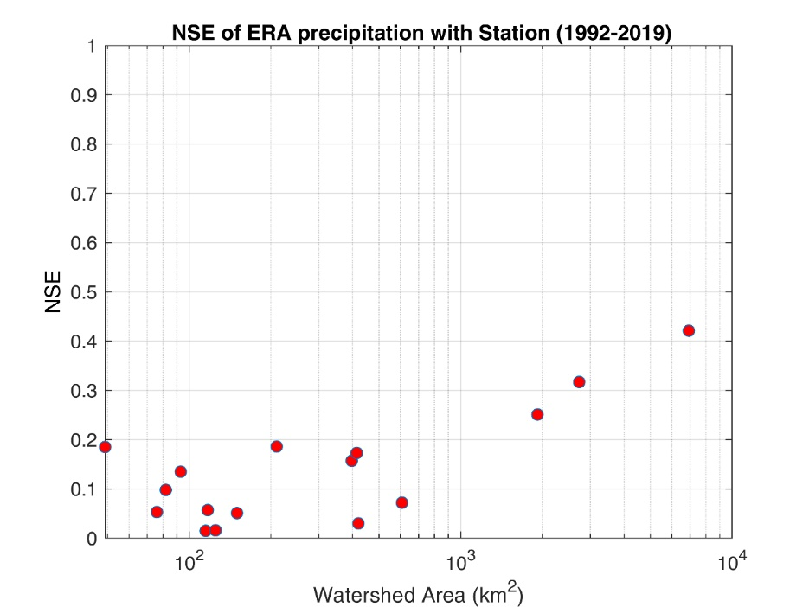
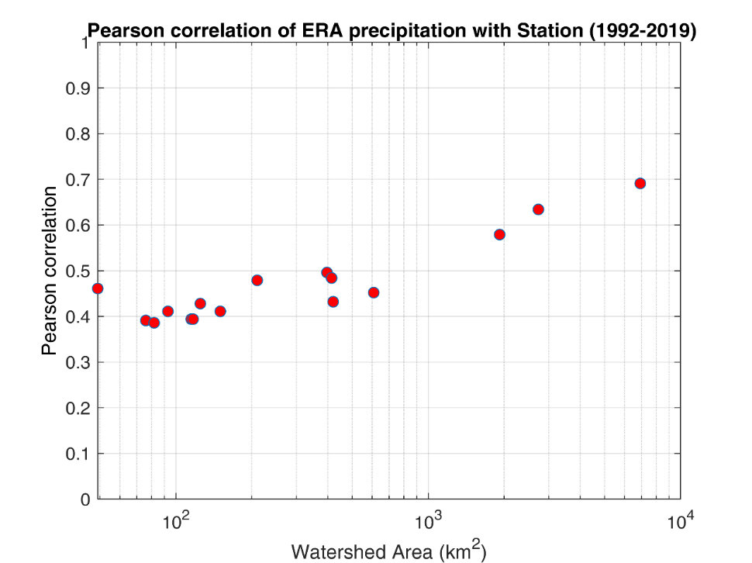
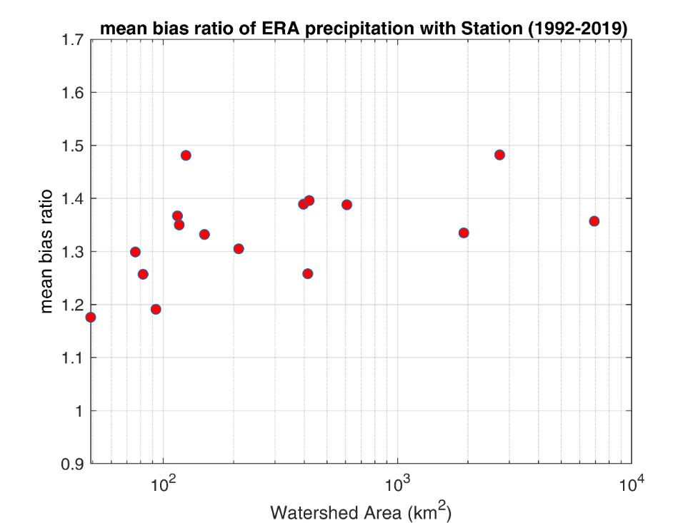
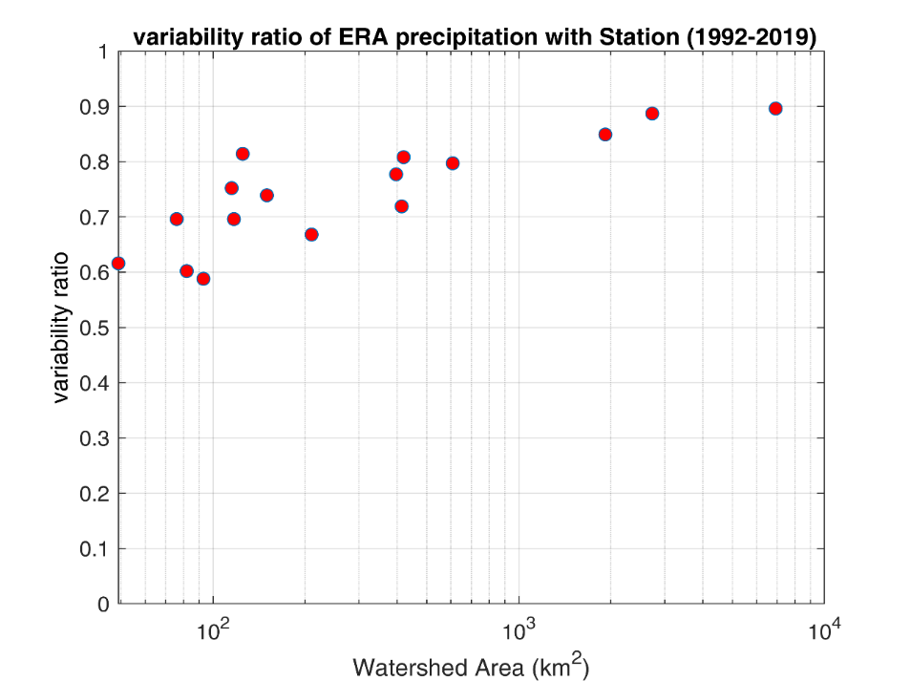
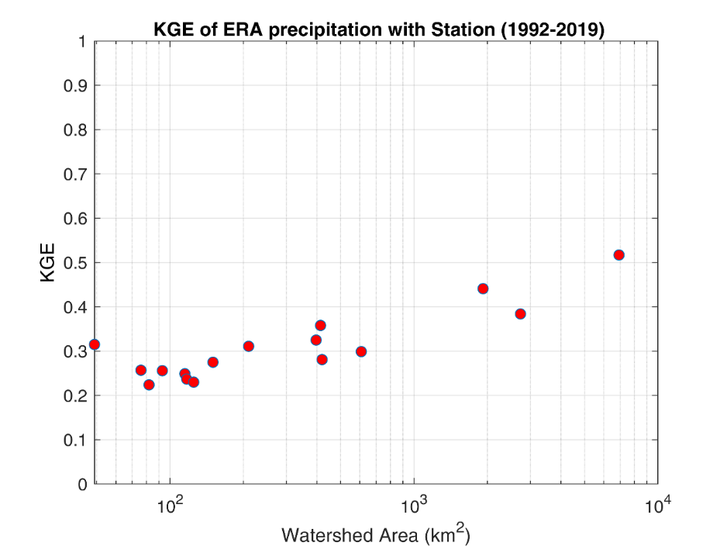
1. To assess the ERA5 precipitation performance with basins of different size.
NSE, correlation, annual variability and KGE increasing with basin area.
Mean bias ratio always greater than 1.

Slide 14
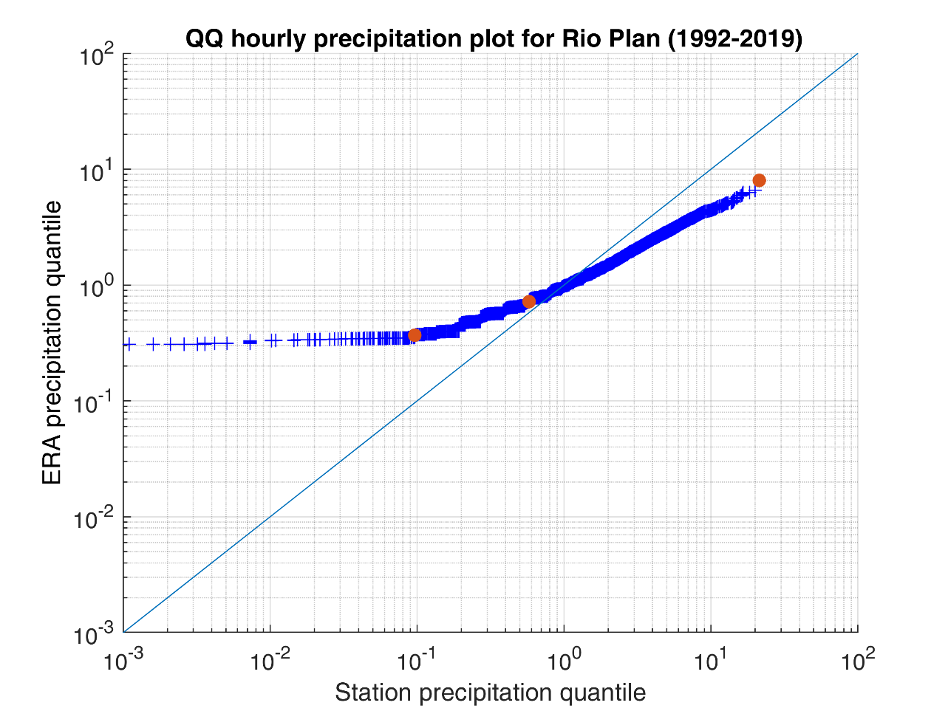
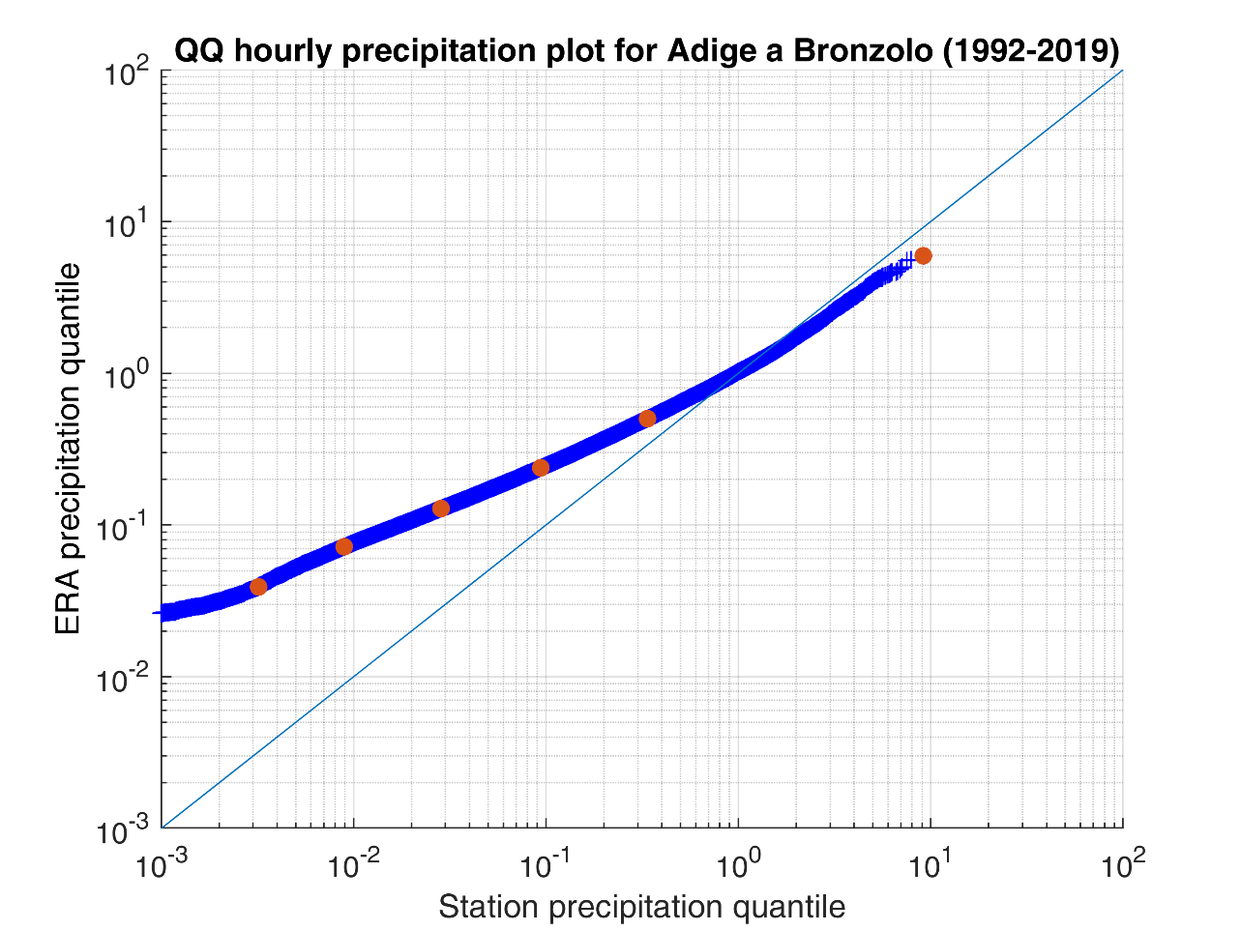
Quantile –Quantile(QQ) plot
The QQ plot for hourly precipitation shows, perfect predictor line and the QQ plot line intersecting at the scale of 1 mm
The result is consistent for all the basins.

Slide 15
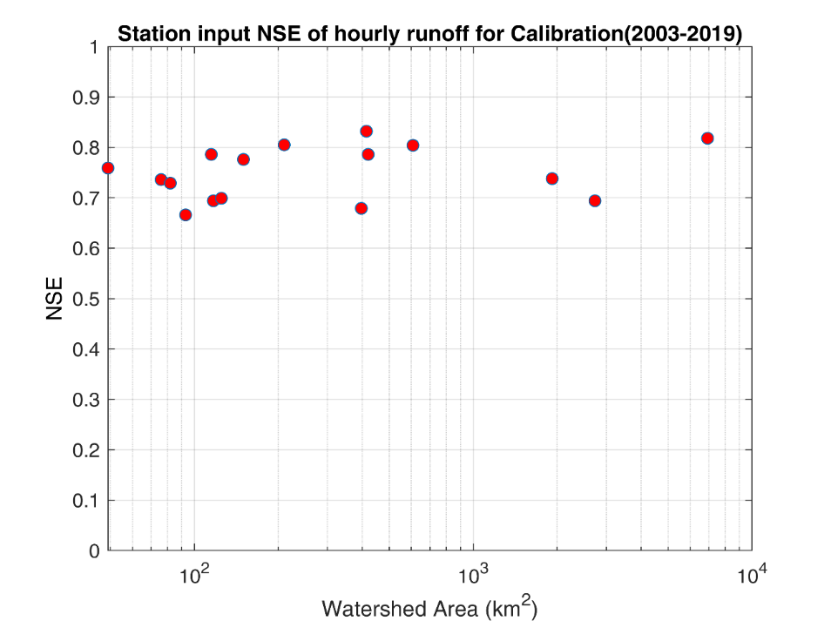
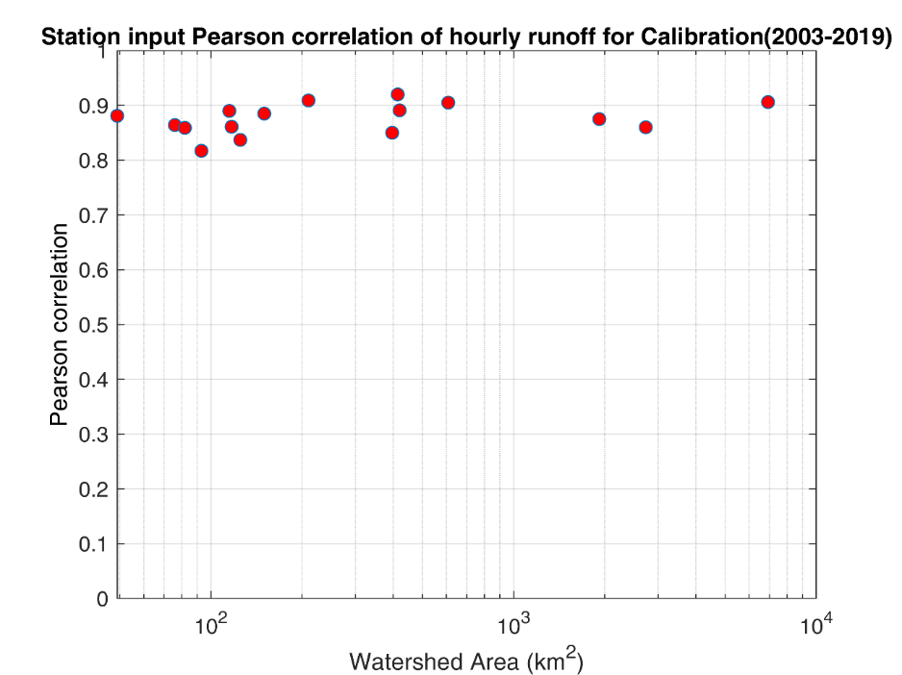
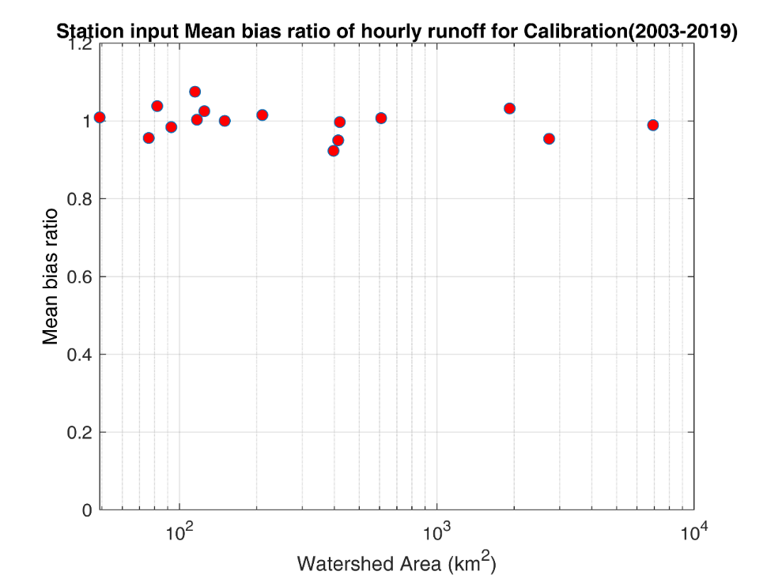
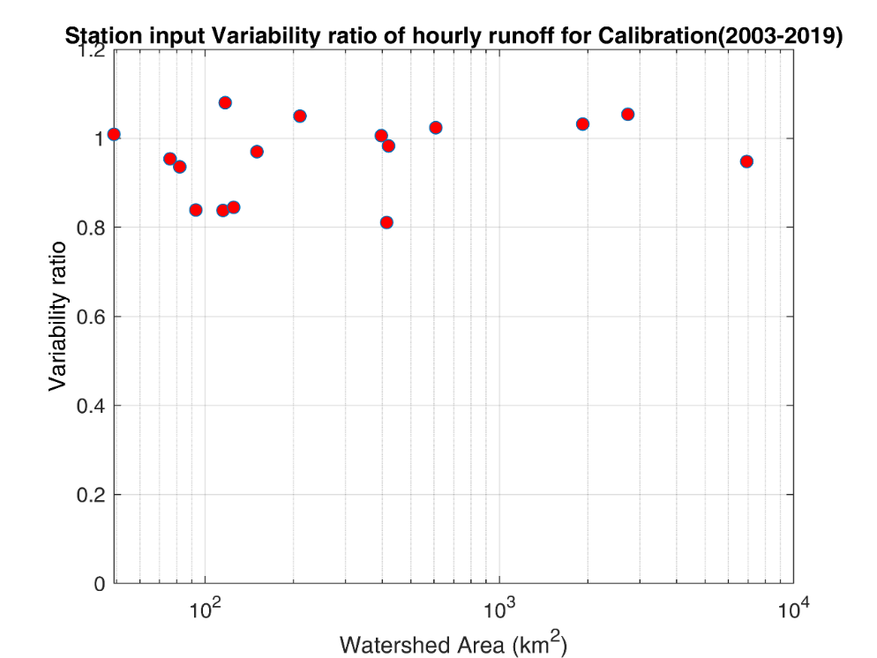
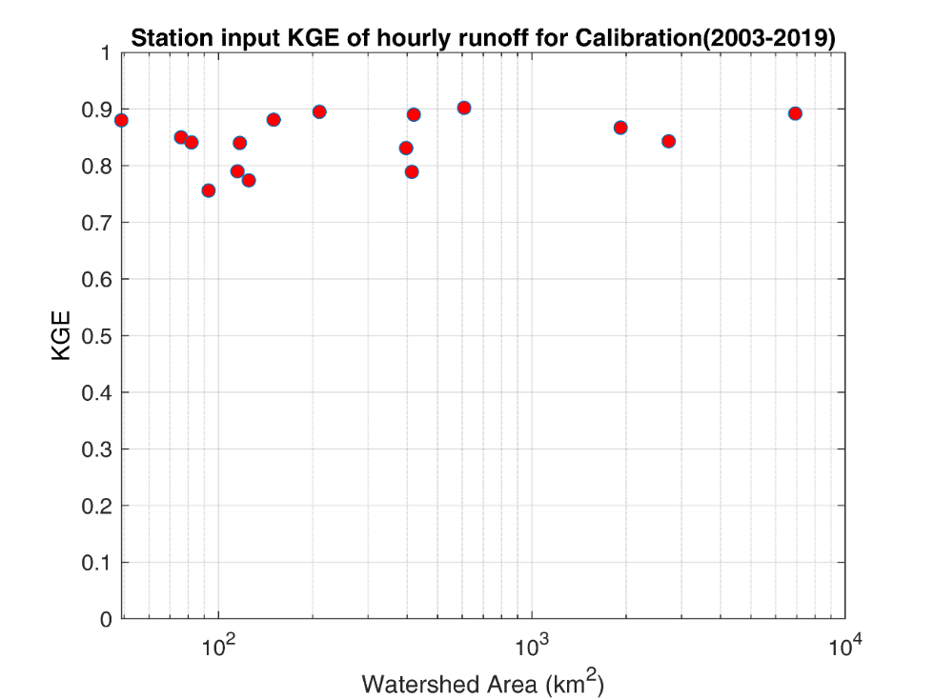
2a. To assess model prediction for basins of different size (calibration)
NSE, correlation, annual variability and KGE increasing with basin area.
Mean bias ratio (0.92-1.07).

Slide 16


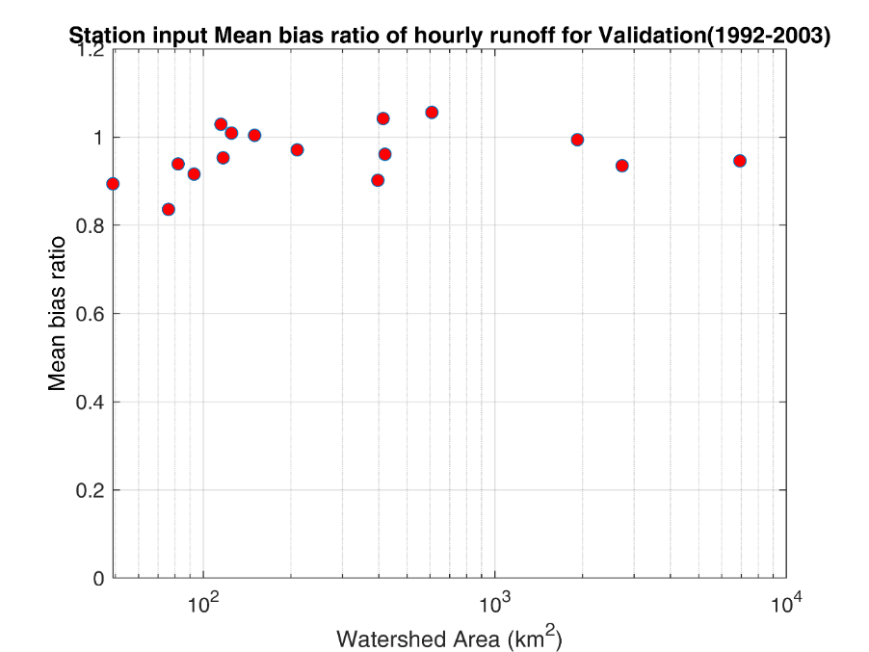
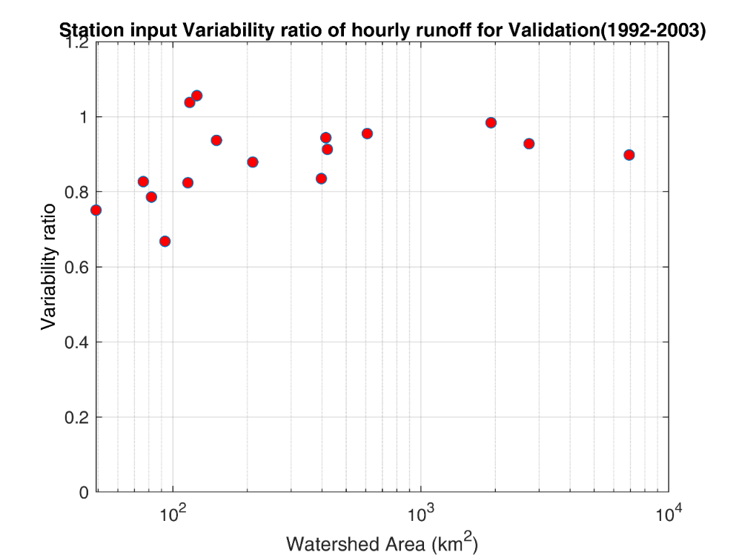
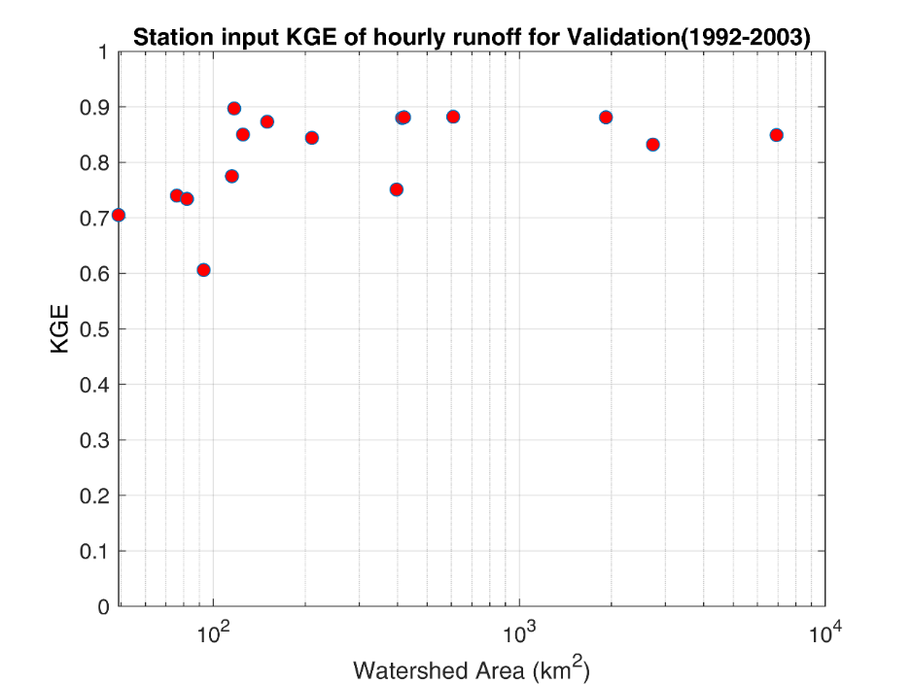
2b. To assess model prediction for basins of different size (validation)
NSE, correlation, annual variability and KGE increasing with basin area.
Mean bias ratio (0.84-1.06)

Slide 17
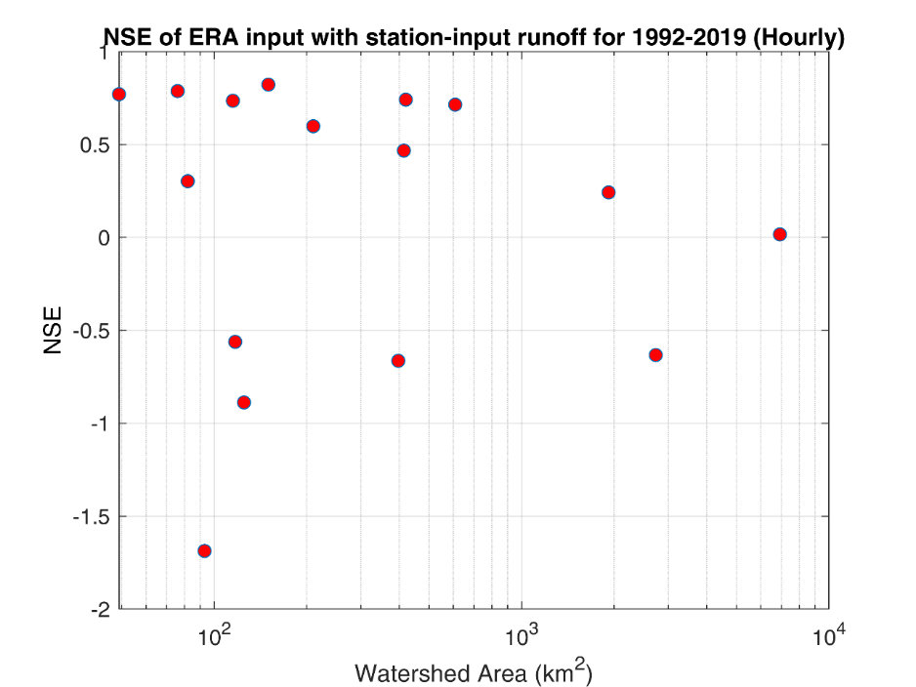
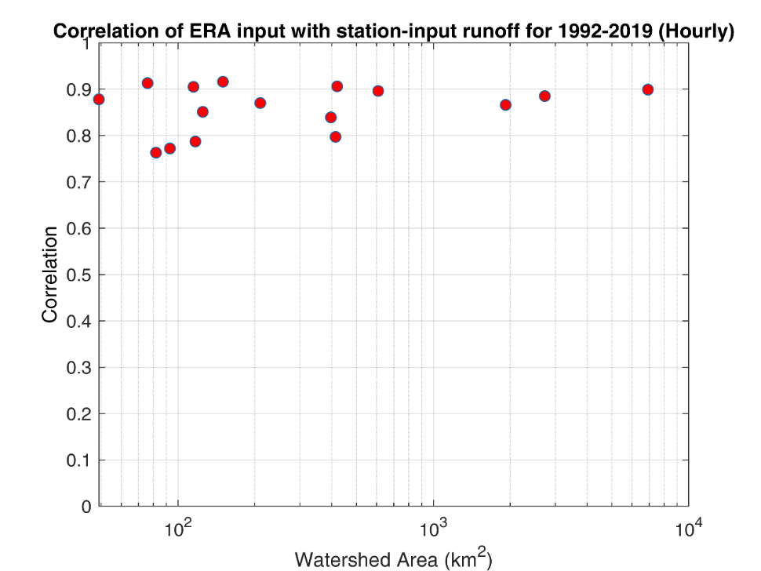
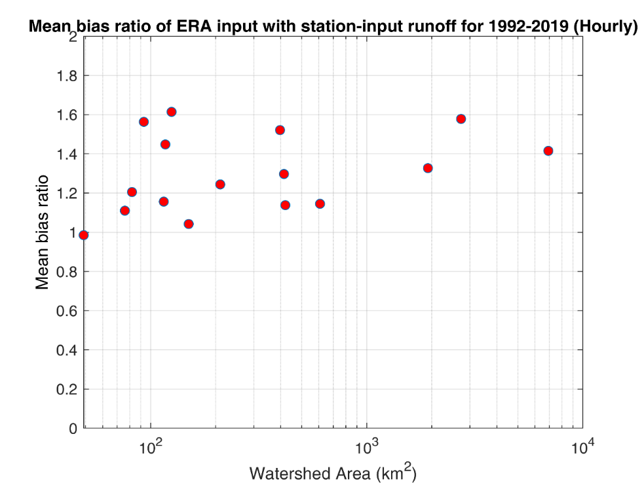
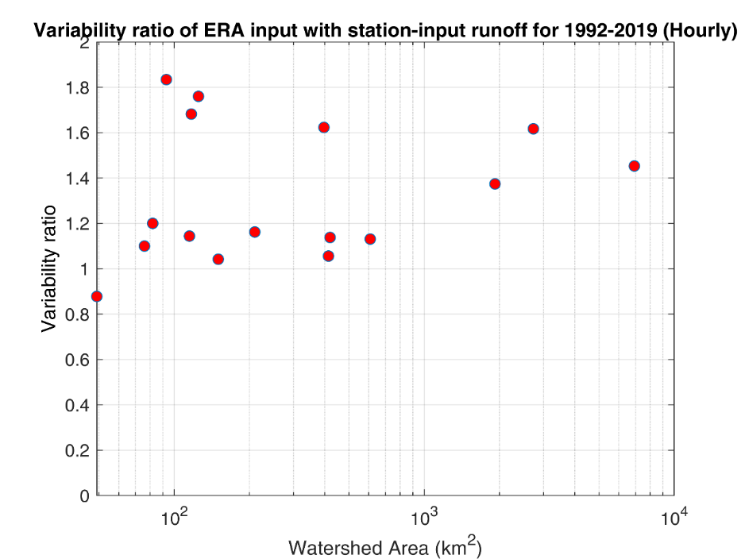
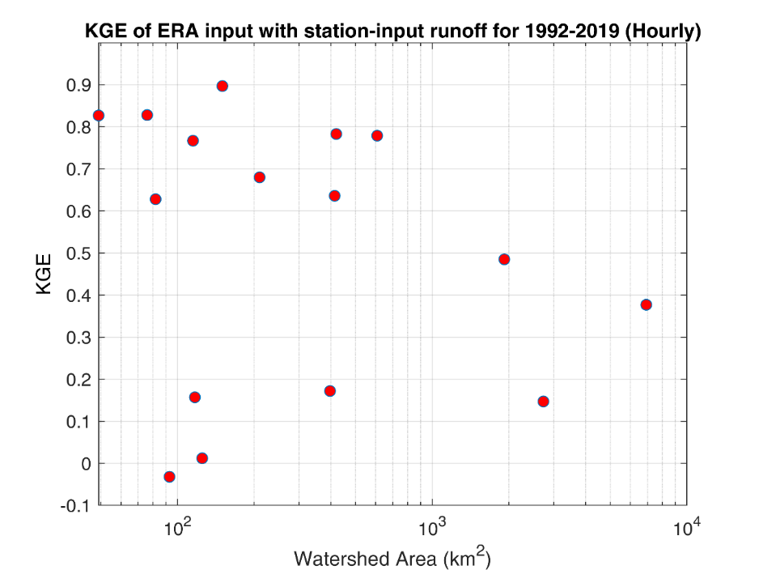
3. To assess ERA5 input runoff with station input runoff for basins of different size
Correlation increasing with basin area.
NSE, KGE decreasing with basin area.
Mean bias ratio always greater than 1(Rio Plan 0.985)

Slide 18
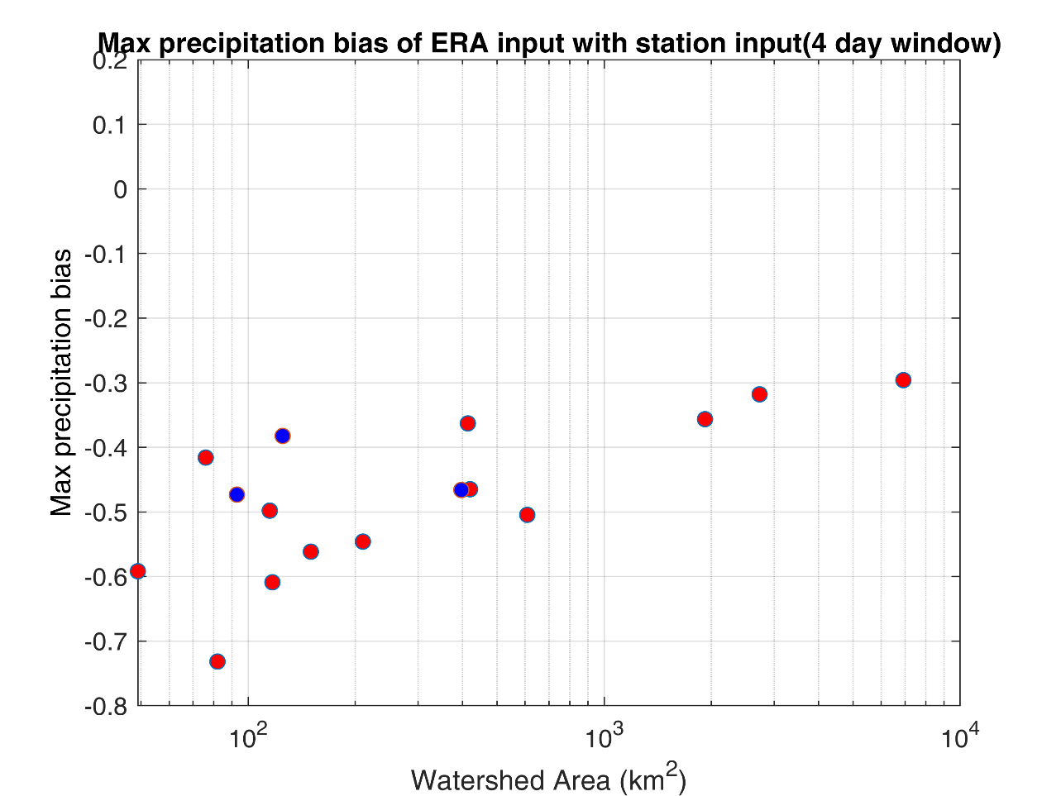
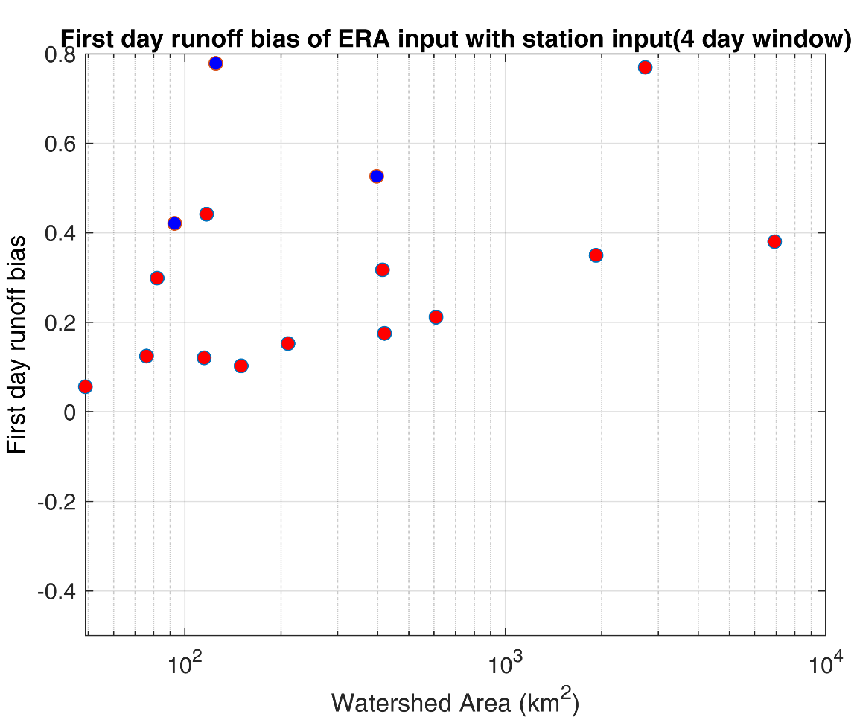
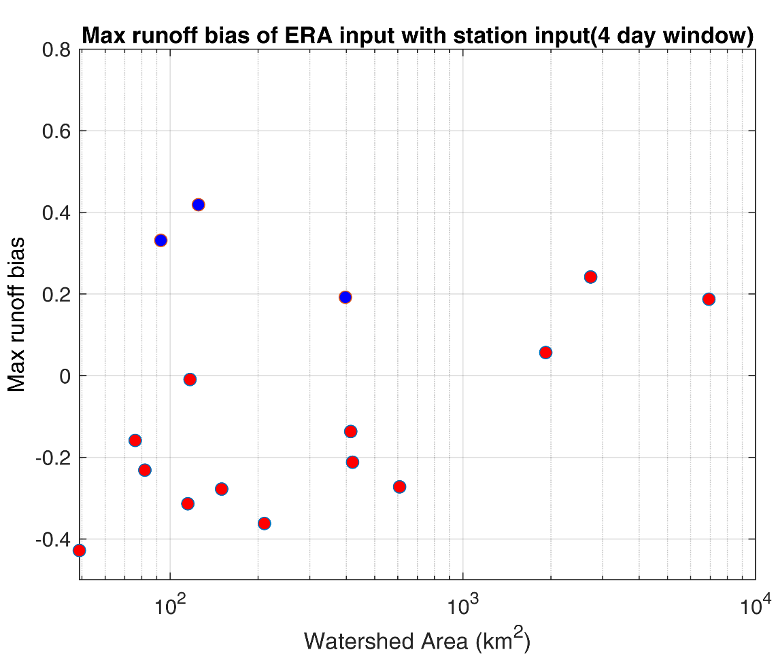
4. To assess ERA-5 input runoff during the flood events
The maximum precipitation by ERA5 is always underpredicted.
Relative bias ranges: -0.73 to -0.30
ERA5 input max runoff for smaller basin(<1000 km²) is underpredicted except for Braies, Gadera Predaces , Gadera Mantana.
While for larger basin(>1000km²) the ERA input max-runoff is overpredicted.
Relative bias ranges: -0.43 to 0.42
The first day runoff is always overpredicted
The relative bias ranges: 0.06 to 0.77
The bias increases with increase in basin area

Slide 19
Conclusion
The ERA5 hourly precipitation performance (NSE, correlation, variability ratio,KGE) is increasing with basin size
The ERA5 precipitation is always overpredicting. The mean bias ratio is always greater than 1.
The QQ plot also shows that the ERA5 precipitation bias generating during the low intensity rainfall while during the high intensity the ERA5 is underpredicting the station precipitation.
The ARRFS model has performed well with the range of basin size.
The model performance is increasing with increase of basin area which is a expected characterstics of a hydrological model.(For both calibration and validation)
The model has also performed better in calibration as compare to the validation period. This is also expected.
The high correlation refers to the timing of the runoff well captured by the ERA-fed runoff.
ERA-fed runoff is overpredicting the station-fed runoff as the mean bias ratio is always greater than 1(except Rioplan-0.985). The positive bias of precipitation is also translated to runoff simulation.
During the flood event the results of ERA5 runoff are comparable due to the following reasons:
Wetting of the ground prior to the flood event owing to the lower precipitation event.
Underprediction of the maximum rainfall.

