Slide 1
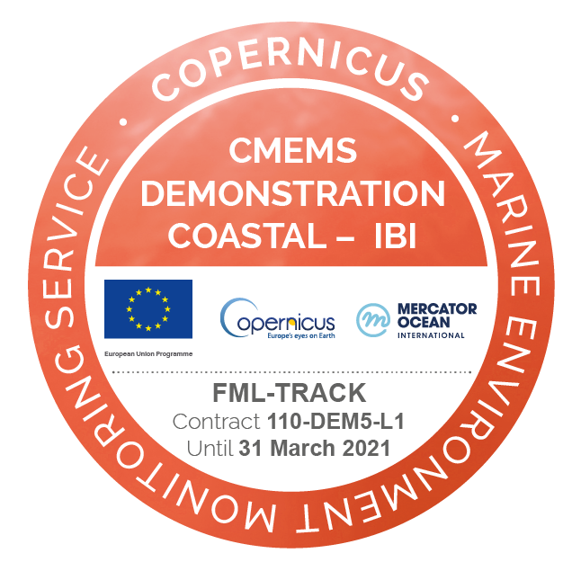
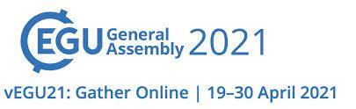



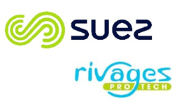



Characterization of 3D Coastal Mesoscale Structures and Transports from Multiplatform Observations and a Data Reconstruction Method
Ivan Manso-Narvarte (1)*, Anna Rubio (1), Gabriel Jordà (2), Jeffrey Carpenter (3), Lucas Merckelbach (3), Amandine Declerck (4), Matthias Delpey (4), Ismael Hernández-Carrasco (5), Julien Mader (1) and Ainhoa Caballero (1)
AZTI, Marine Research, Basque Research and Technology Alliance (BRTA), Pasaia, Spain
(2) Instituto Español de Oceanografía, Centre Oceanogràfic de Balears, Palma de Mallorca, Spain
(3) Helmholtz-Zentrum Geesthacht, Institute of Coastal Research, Geesthacht, Germany
(4) Centre Rivages ProTech, SUEZ Eau France, Bidart, France
(5) Instituto Mediterráneo de Estudios Avanzados, CSIC-UIB, Esporles, Spain
* correspondence: aivan_625@hotmail.com

Slide 2
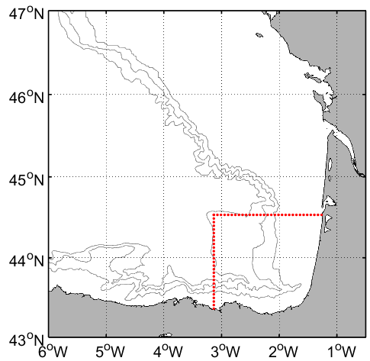
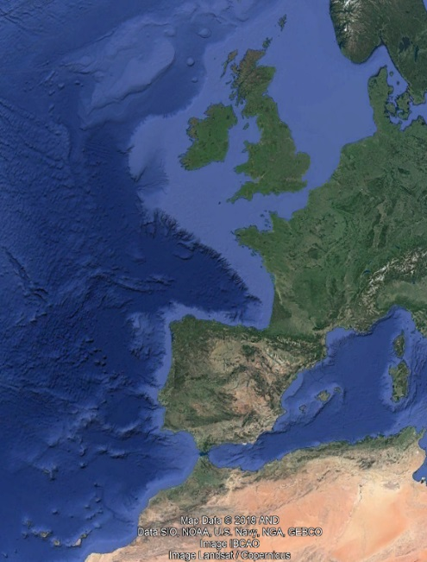
AIM I: MAIN APPROACH|RESULTS|CONCLUSIONS
INTRODUCTION
AIM II: MAIN APPROACH|RESULTS|CONCLUSIONS
Coastal mesoscale processes modulate surface along- and cross-shelf exchanges
However, their characterization at subsurface levels remains a challenge.
Methods to reconstruct 3D current fields from the combination of multiplatform data enables the study of these processes and associated transports, providing an improved background to explore bio-physical interactions.
slope current
Open water SWODDIES
Study area and mesoscale circulation patterns
typical SWODDY in the study area
Aims:
To characterize the 3D structure of a recurrent coastal eddy and its associated water volume transport for the first time using a previously validated data-reconstruction method and different CMEMS products and glider data.
Simulate the advection of anchovy eggs and larvae at surface and subsurface levels from 3D reconstructed fields
Used data:
CMEMS data | Product
EuskOOS HF radar | INSITU_GLO_UV_L2_REP_OBSERVATIONS_013_044
EuskOOS mooring | INSITU_IBI_NRT_OBSERVATIONS_013_033
Satellite imagery | OCEANCOLOUR_ATL_CHL_L3_NRT_OBSERVATIONS_009_036
IBI simulation | IBI_MULTIYEAR_PHY_005_002
Other data
2 gliders (BB-Trans glider mission)
BIOMAN campaign

Slide 3
AIM I

Slide 4
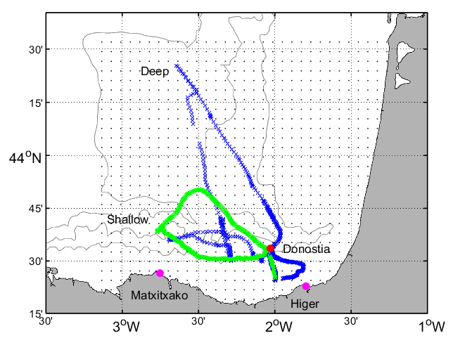
AIM I: MAIN APPROACH|RESULTS|CONCLUSIONS
INTRODUCTION
AIM II: MAIN APPROACH|RESULTS|CONCLUSIONS
A mode-water eddy was detected during the BB-Trans glider campaign run in the study area from 16 May until 14 June 2018
The eddy was characterised by analysing:
  The observed characteristics: by HF radar, gliders and satellite imagery (Chl-a)
  The reconstructed 3D current velocity fields:
  Reconstructions were made by the Reduced Order Optimal Interpolation (ROOI) (Kaplan et al., 1997, 2000) method. Its feasibility in the study area was tested in Manso-Narvarte et al. (2020) and it is fed with:
      Historical data by means of a spatial covariance matrix from: IBI simulation
      Observations from: HF radar, glider and mooring data
Figure. Grey dots: HFR grid points. Pink dots: location of the HFR stations. Red dot: location of the Donostia mooring. Green and blue crosses: shallow and deep gliders’ trajectories, respectively. Adapted from Manso-Narvarte et al. (2021)

Slide 5
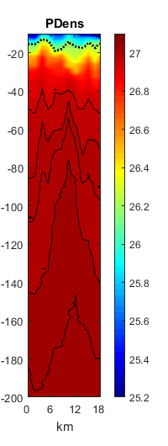
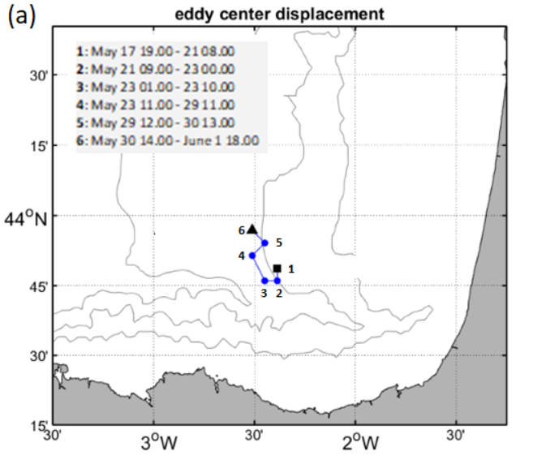
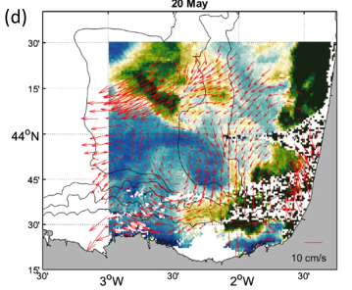
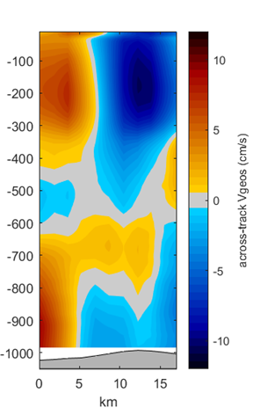
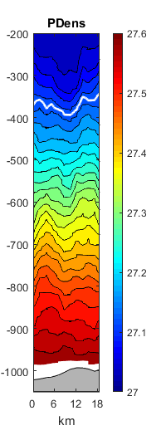
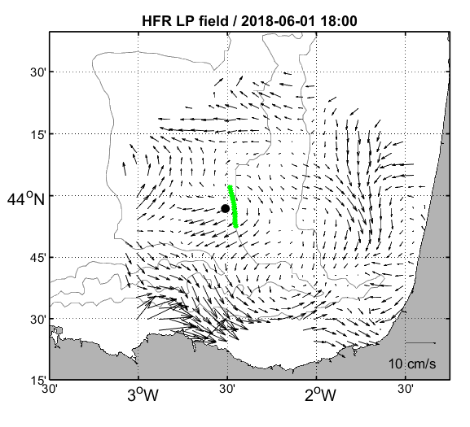
AIM I: MAIN APPROACH|RESULTS|CONCLUSIONS
INTRODUCTION
AIM II: MAIN APPROACH|RESULTS|CONCLUSIONS
source: Manso-Narvarte et al. (2021)
Observations at the surface
The eddy cores derived from the HF radar data show how the eddy drifts northwestwards
Chl-a images also detect this eddy and agree with the HF radar fields
E
Observations in the water column
When the deep glider (green crosses) crossed the core of the eddy it showed a mode-water eddy behaviour: an uplift of the isopycnals in the near-surface and a downlift deeper in the water column
Extends until ≈-480 m
Diameter: ≈18 km
The vertically integrated across-track geostrophic currents show an anticyclonic flow
W
source: Manso-Narvarte et al. (2021)

Slide 6
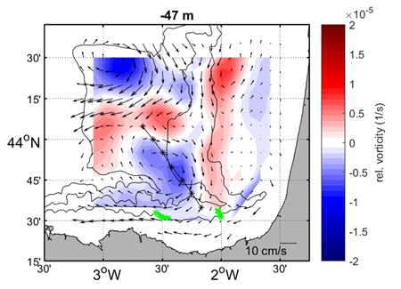
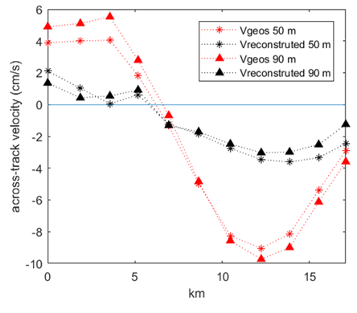
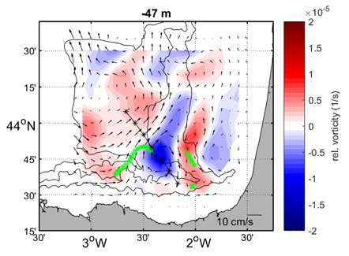
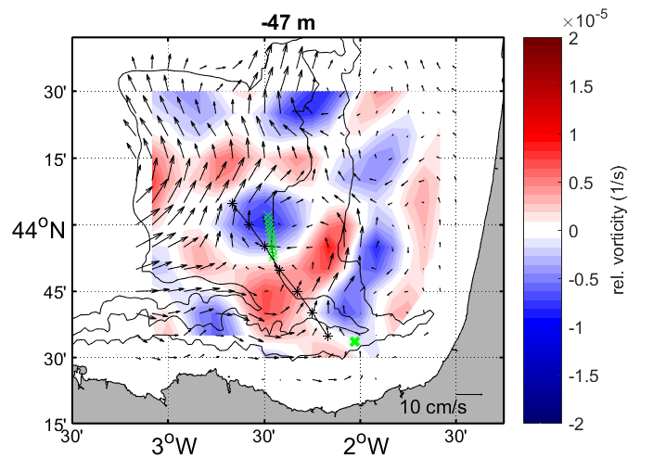
AIM I: MAIN APPROACH|RESULTS|CONCLUSIONS
INTRODUCTION
AIM II: MAIN APPROACH|RESULTS|CONCLUSIONS
Reconstructed fields
P1
Reconstructed fields
The reconstructions were made for three periods (P1, P2, P3) where the eddy or its near field were measured simultaneously by at least the HF radar and one glider
Reconstructions were made from surface until -100m
Here one example for each period is shown corresponding to -47 m:
  An anticyclonic eddy is reconstructed for the three periods
  Similar characteristics comparing with eddies at the surface and in the water column in nearby areas
source: Manso-Narvarte et al. (2021)
P2
Reconstructed fields vs Observed fields
P3 also is the period when the deep glider crossed the eddy core:
  Comparing the reconstructed and observed across glider track currents the same behavior is shown for -50 and -90 m, thus partially validating the reconstructions
Reconstructed volume transports
P3
The water volume transport estimations from surface until -100 m across the straight black line in the reconstructed fields provide offshore (inshore) transports of: 0.05 Sv (-0.11 Sv), 0.12 Sv (-0.05 Sv) and 0.15 Sv (-0.01 Sv) in P1, P2 and P3, respectively, agreeing with estimations made in nearby areas

Slide 7
AIM I: MAIN APPROACH|RESULTS|CONCLUSIONS
INTRODUCTION
AIM II: MAIN APPROACH|RESULTS|CONCLUSIONS
Eddy characterization:
A coastal eddy was studied in 3D in the study area for the first time
It showed a mode-water eddy behavior with similar characteristics to eddies found in the literature at open water regions nearby
The joint analysis of multiplatform observations highlights the potential of this kind of approach for a better characterization of the different oceanic features, especially in coastal areas
Data reconstruction:
A 3D data reconstruction method was used to assess its capability to reconstruct eddy-like structures and to further study the characteristics of the detected eddy:
  The results show that the method is able to reconstruct mesoscale eddies in different scenarios
  Their associated cross-shelf transports provide reasonable first results in the upper 100 m
The ROOI is here presented as a compelling tool for reconstructing coastal 3D circulation and transports
However, further validation with external data sources of current velocities or transport estimations would be valuable to ensure the robustness of the results
Future work:
Further validation of the reconstructions
Analysis of the main physical drivers responsible for the generation and evolution (e.g., migration, decay) of these recurrent coastal eddies
Use reconstructed velocity fields to study 3D coastal transports from a Lagrangian approach (related with AIM II)

Slide 8
AIM II

Slide 9
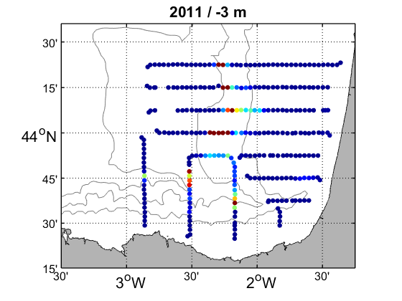
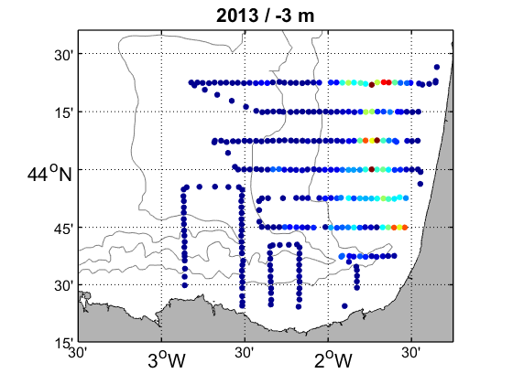

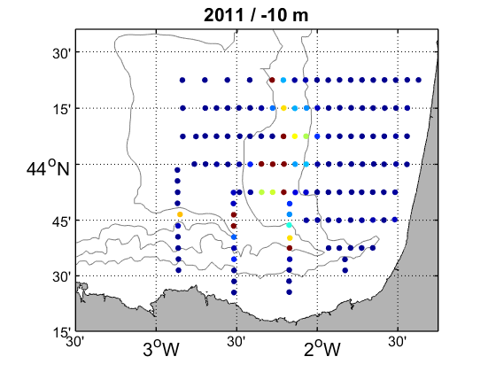
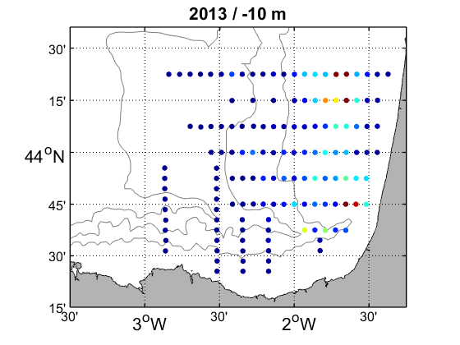
AIM I: MAIN APPROACH|RESULTS|CONCLUSIONS
INTRODUCTION
AIM II: MAIN APPROACH|RESULTS|CONCLUSIONS
The reconstructed current velocity fields were used as velocity forcing to simulate the advection of anchovy eggs and larvae for two periods, as a first step towards a wider analysis:
  Reconstructions made by the ROOI method fed with:
    Historical data by means of a spatial covariance matrix from: IBI simulation
    Observations from: HF radar and mooring data
  The initial conditions were set based on the egg abundances distributions observed during the BIOMAN oceanographic campaigns of 2011 and 2013 at -3 and -10m
Simulations:
  3 days backwards (origin)
  30 days forward (fate)
Number of particles

Slide 10
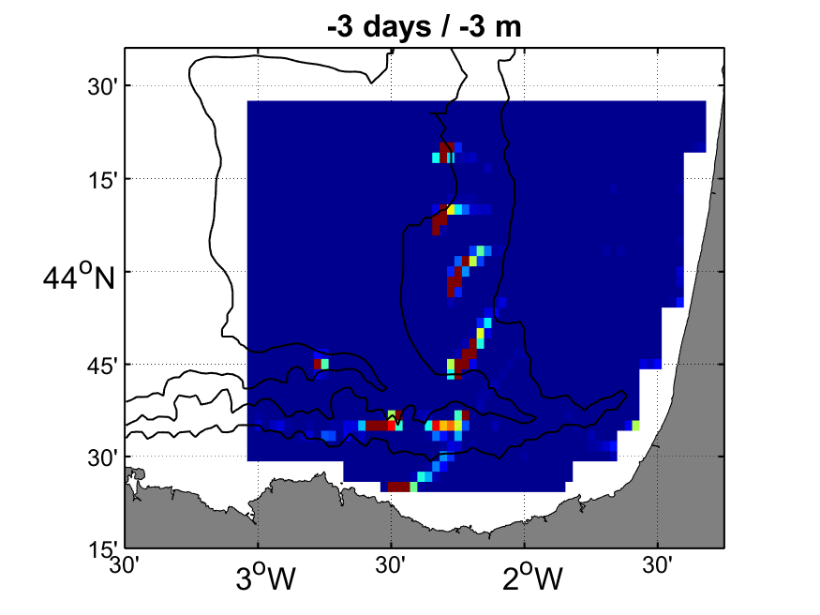
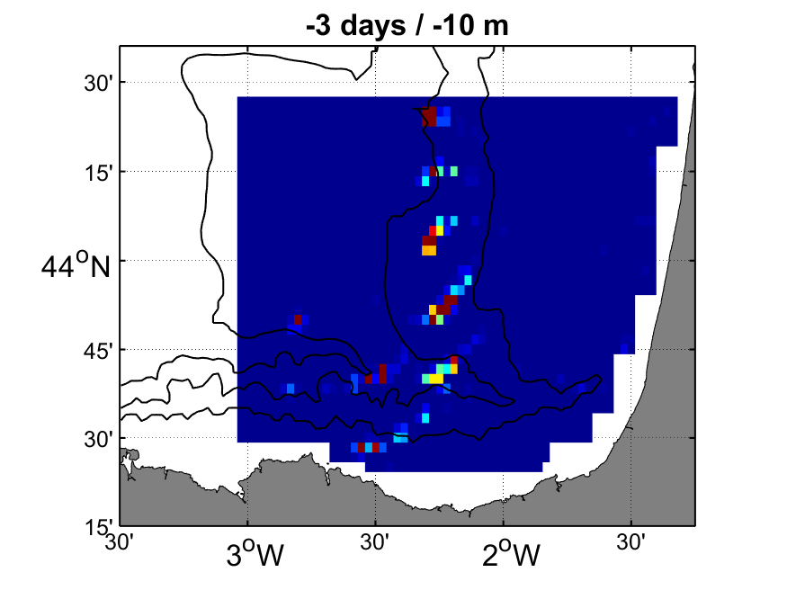
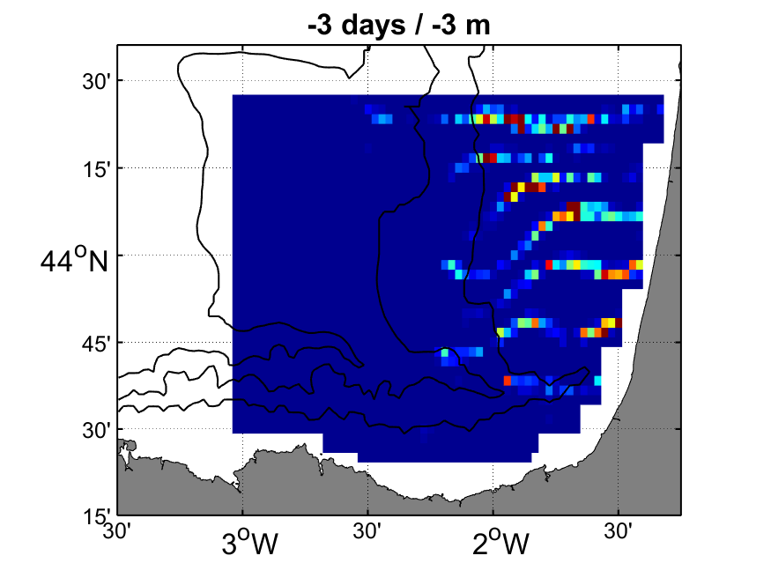
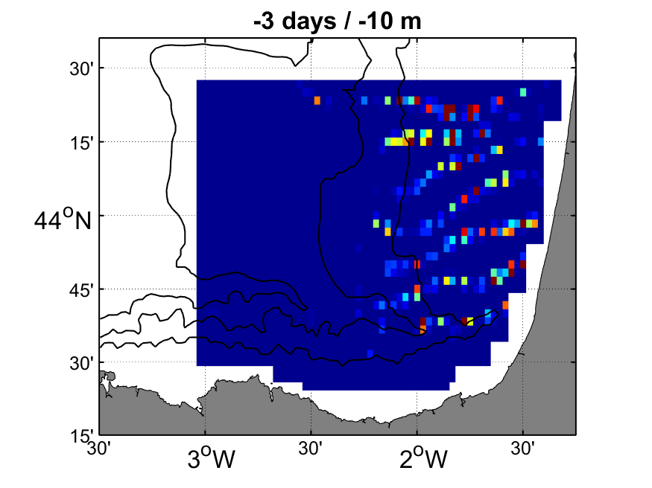
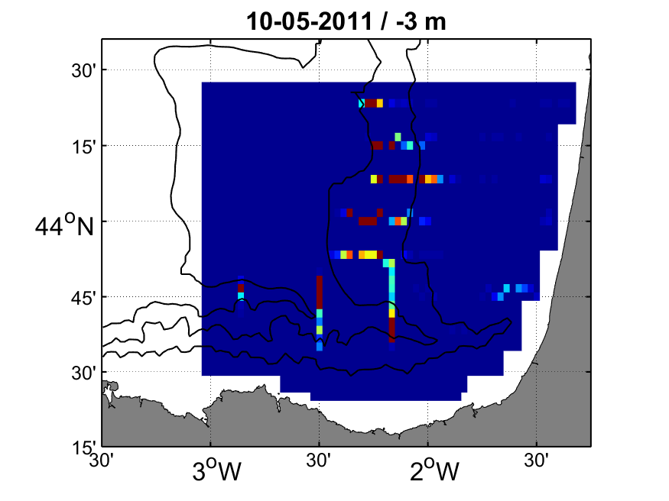



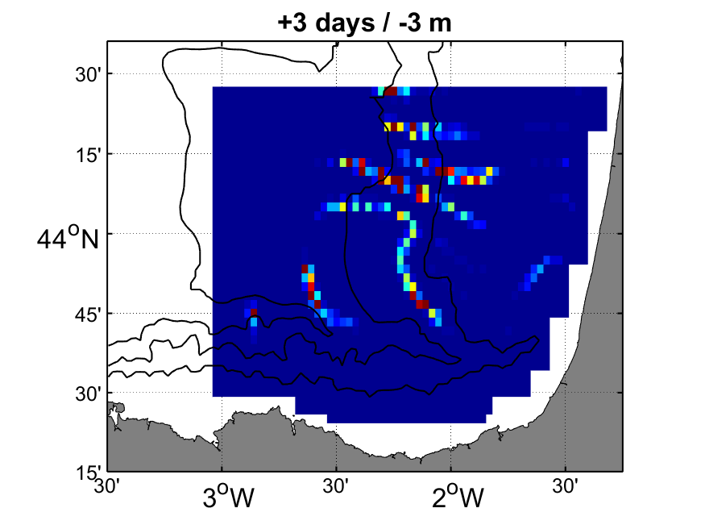
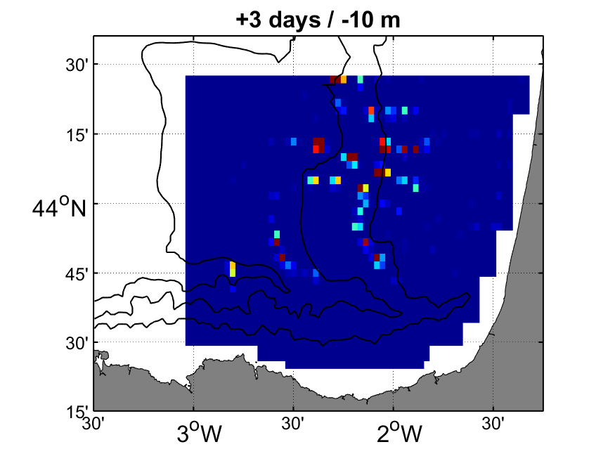
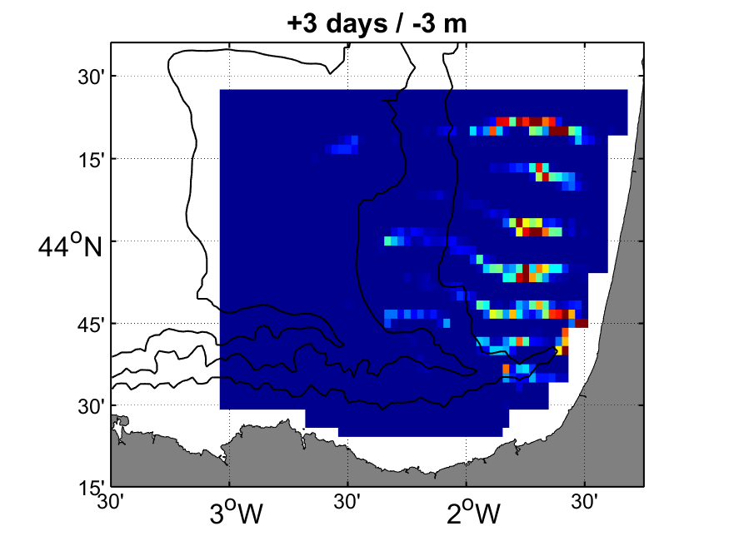
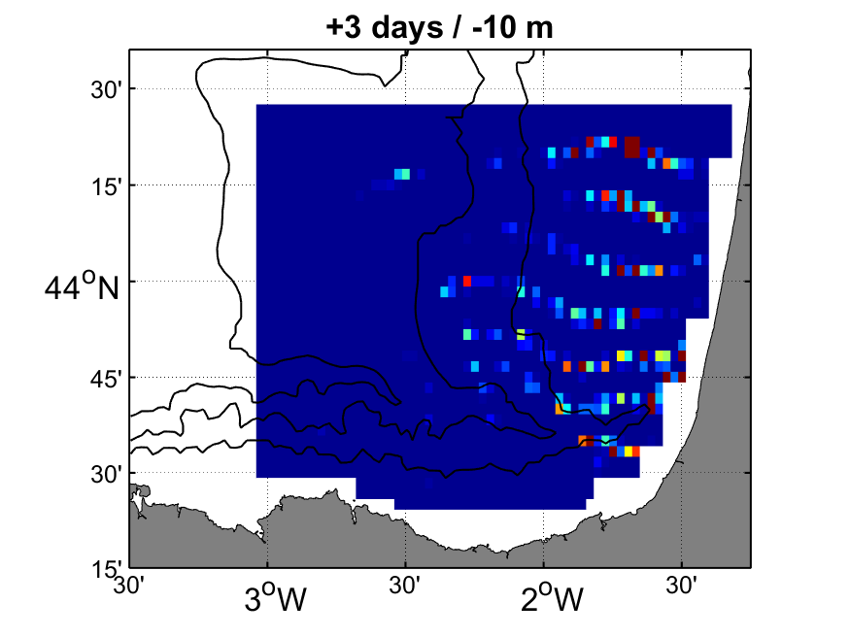
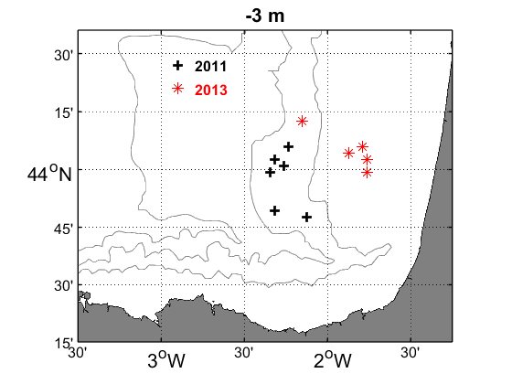
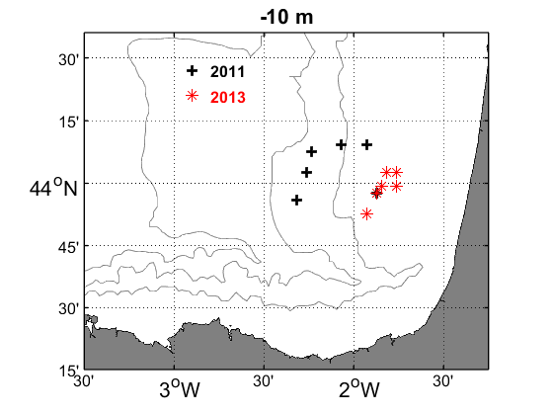
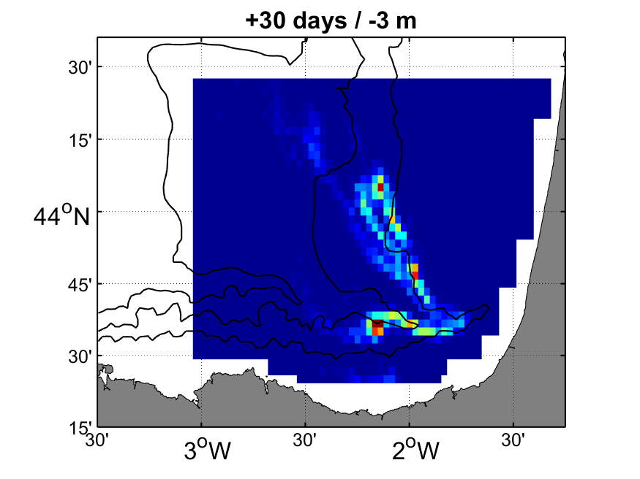

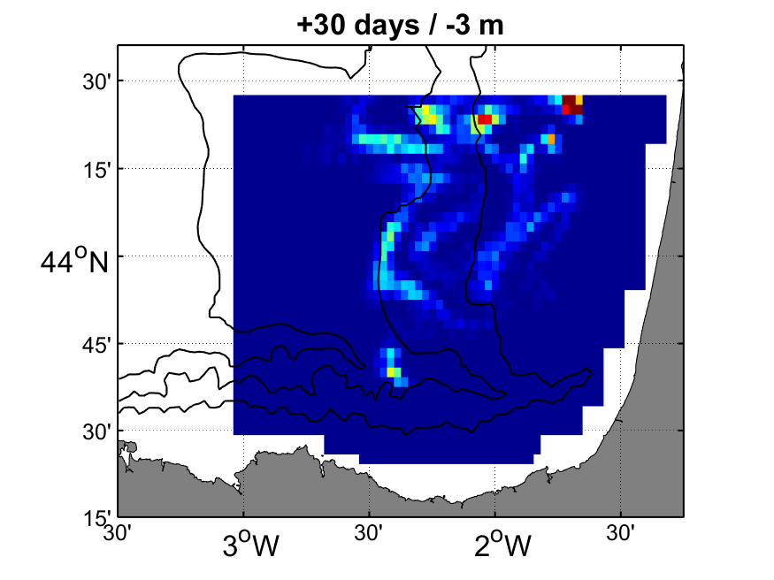
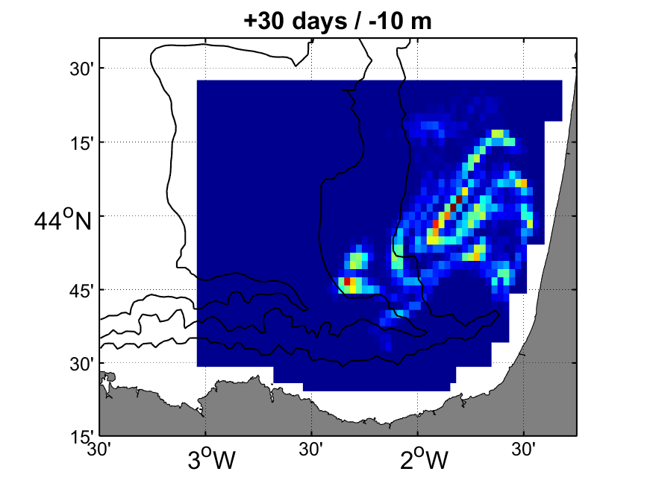
AIM I: MAIN APPROACH|RESULTS|CONCLUSIONS
INTRODUCTION
AIM II: MAIN APPROACH|RESULTS|CONCLUSIONS
2011
2013
Initially particles located over:
  The French slope in 2011
  The French shelf in 2013
Backtracking: particles almost in the same place. Thus, eggs spawned in the initial areas
Forward in time:
  Particles tend to gather
  Particles remain around the initial area. There are two exceptions:
    in 2011, at -10 m the particles gradually travel from the slope to the shelf
    in 2013 at -3 m the particles get away during the last 10 days
(a)
(b)
(a)
(b)
(c)
(d)
(c)
(d)
(e)
(f)
(e)
(f)
Centres of mass of the egg/larvae distributions
30
10
20
10
3
20
-3/10
3
-3
0
20
0
0
0
10
3
(g)
(h)
(g)
(h)
3
-3
30
30
-3
20
30
days from the start (0) of the simulation (from -3 to 30)

Slide 11
AIM I: MAIN APPROACH|RESULTS|CONCLUSIONS
INTRODUCTION
AIM II: MAIN APPROACH|RESULTS|CONCLUSIONS
First analysis of anchovy eggs and larvae advection
Eggs and larvae were in general retained near the spawning area
More years should be analysed to obtain reliable conclusions
Future work:
Analyse more years
Assessing the possible resampling of eggs due to advection during BIOMAN campaign
Study the transport patterns in the water column by means of Lagrangian techniques for a better understanding of biophysical interactions

Slide 12
References:
Kaplan, A.; Kushnir, Y.; Cane, M.A.; Blumenthal, M.B. Reduced space optimal analysis for historical data sets: 136 years of Atlantic sea surface temperatures. J. Geophys. Res. Oceans 1997, 102, 27835–27860.
Manso-Narvarte, I.; Fredj, E.; Jordà, G.; Berta, M.; Griffa, A.; Caballero, A.; Rubio, A. 3D reconstruction of ocean velocity from high-frequency radar and acoustic Doppler current profiler: A model-based assessment study. Ocean Sci. 2020, 16, 575–591.
Manso-Narvarte, I.; Rubio, A.; Jordà, G.; Carpenter, J.; Merckelbach, L.; Caballero, A. Three-Dimensional Characterization of a Coastal Mode-Water Eddy from Multiplatform Observations and a Data Reconstruction Method. Remote Sens. 2021, 13, 674. https://doi.org/10.3390/rs13040674

