Slide 1

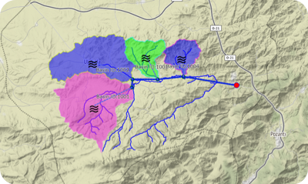
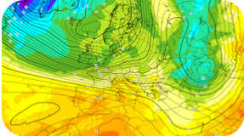

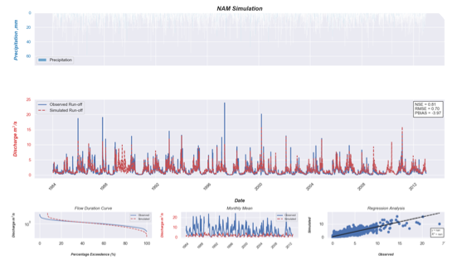
Evaluation of gridded near surface air temperature datasets across complex terrain over Turkey
Çağrı H. Karaman^{1*}, Prof. Dr. Zuhal Akyürek ^{1,2}
¹ Middle East Technical University, Graduate School of Natural and Applied Sciences, Geodetic and Geographic Information,Technologies (GGIT),
² Middle East Technical University, Civil Engineering Department
*cagri.karaman@metu.edu.tr

Slide 2
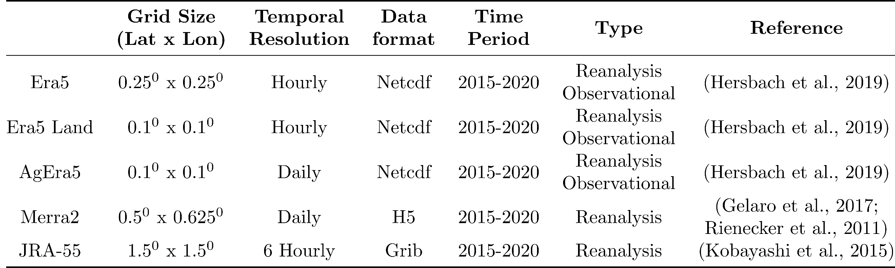
Introduction
This study aims
- to evaluate the Reanalysis Products (Era5, Era5 Land, AgEra5, MERRA2 and JRA55) over complex terrain for different climate classes
- to apply several downscaling methods on the best performed product to increase its spatial resolution.

Slide 3
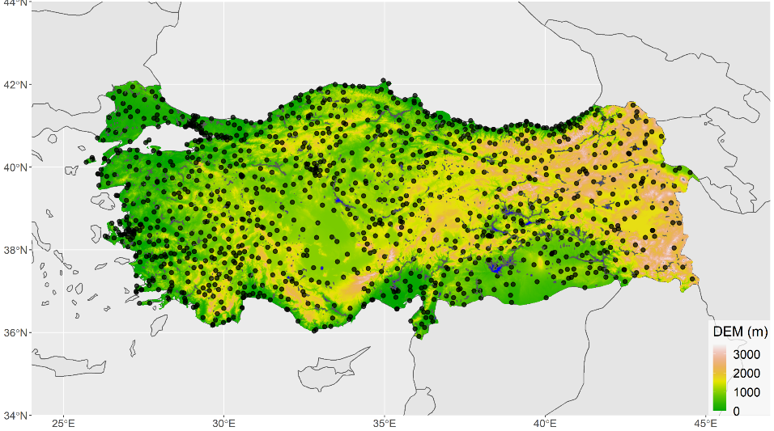
Ground-based observations
General Directorate of Meteorology (MGM)
1120 stations having continuous daily data between January 2015 and December 2019 on complex terrain and having different climate classes are used.

Slide 4
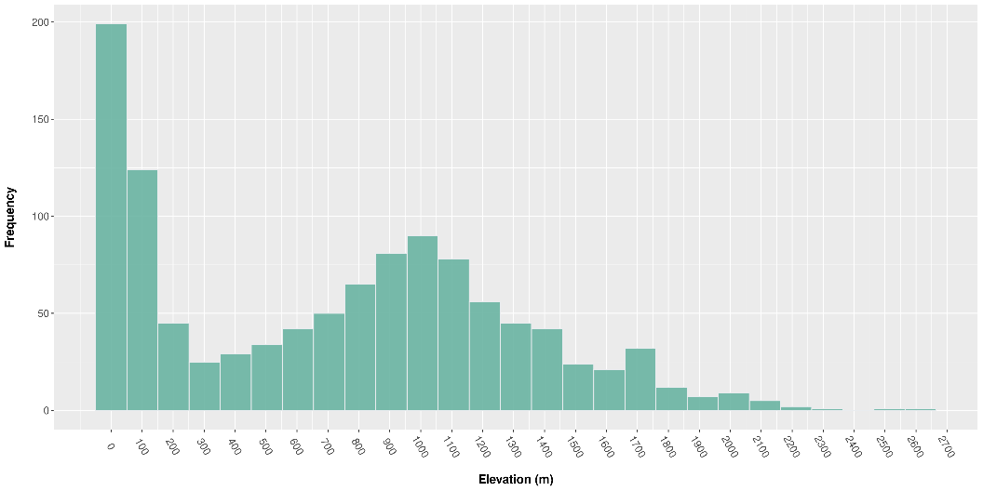
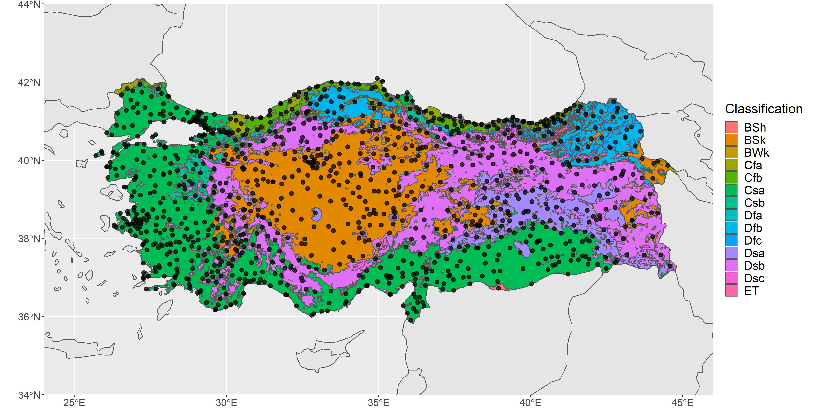
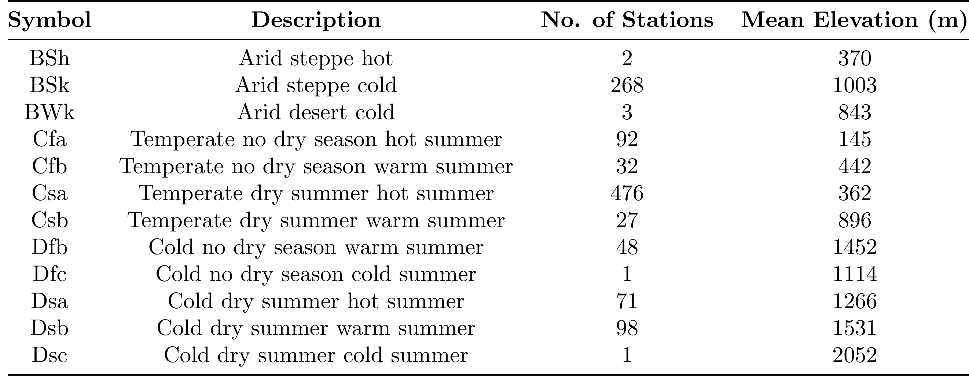
Ground-based observations
Köppen-Geiger climate classification System
Most of the stations fall in Csa class where the mean elevation of the stations is 362 m.

Slide 5
Methodology
Performance analysis of different reanalysis products over Turkey is peformed for
Daily time scale
Monthly time scale
Monthly
Seasonal (DJF , MAM, JJA , SON)
Annual basis

Slide 6
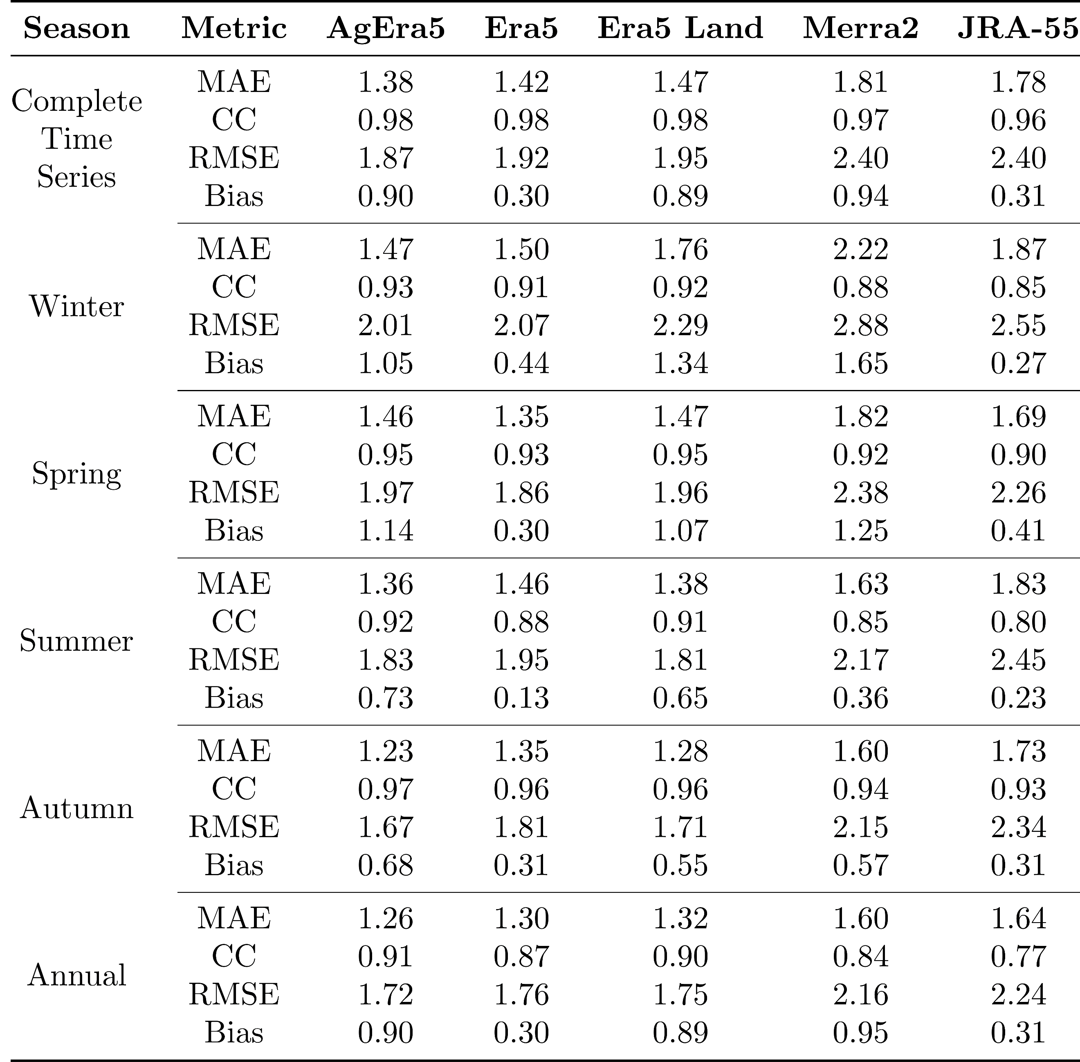
Results
Monthly time series
AgEra5 product shows least mean absolute error and bias
Era5 and Era5 land product give similar mean absolute error value
Estimation of annual average temperature of Merra2 and JRA-55 product is poor
All products have high correlation coefficient

Slide 7
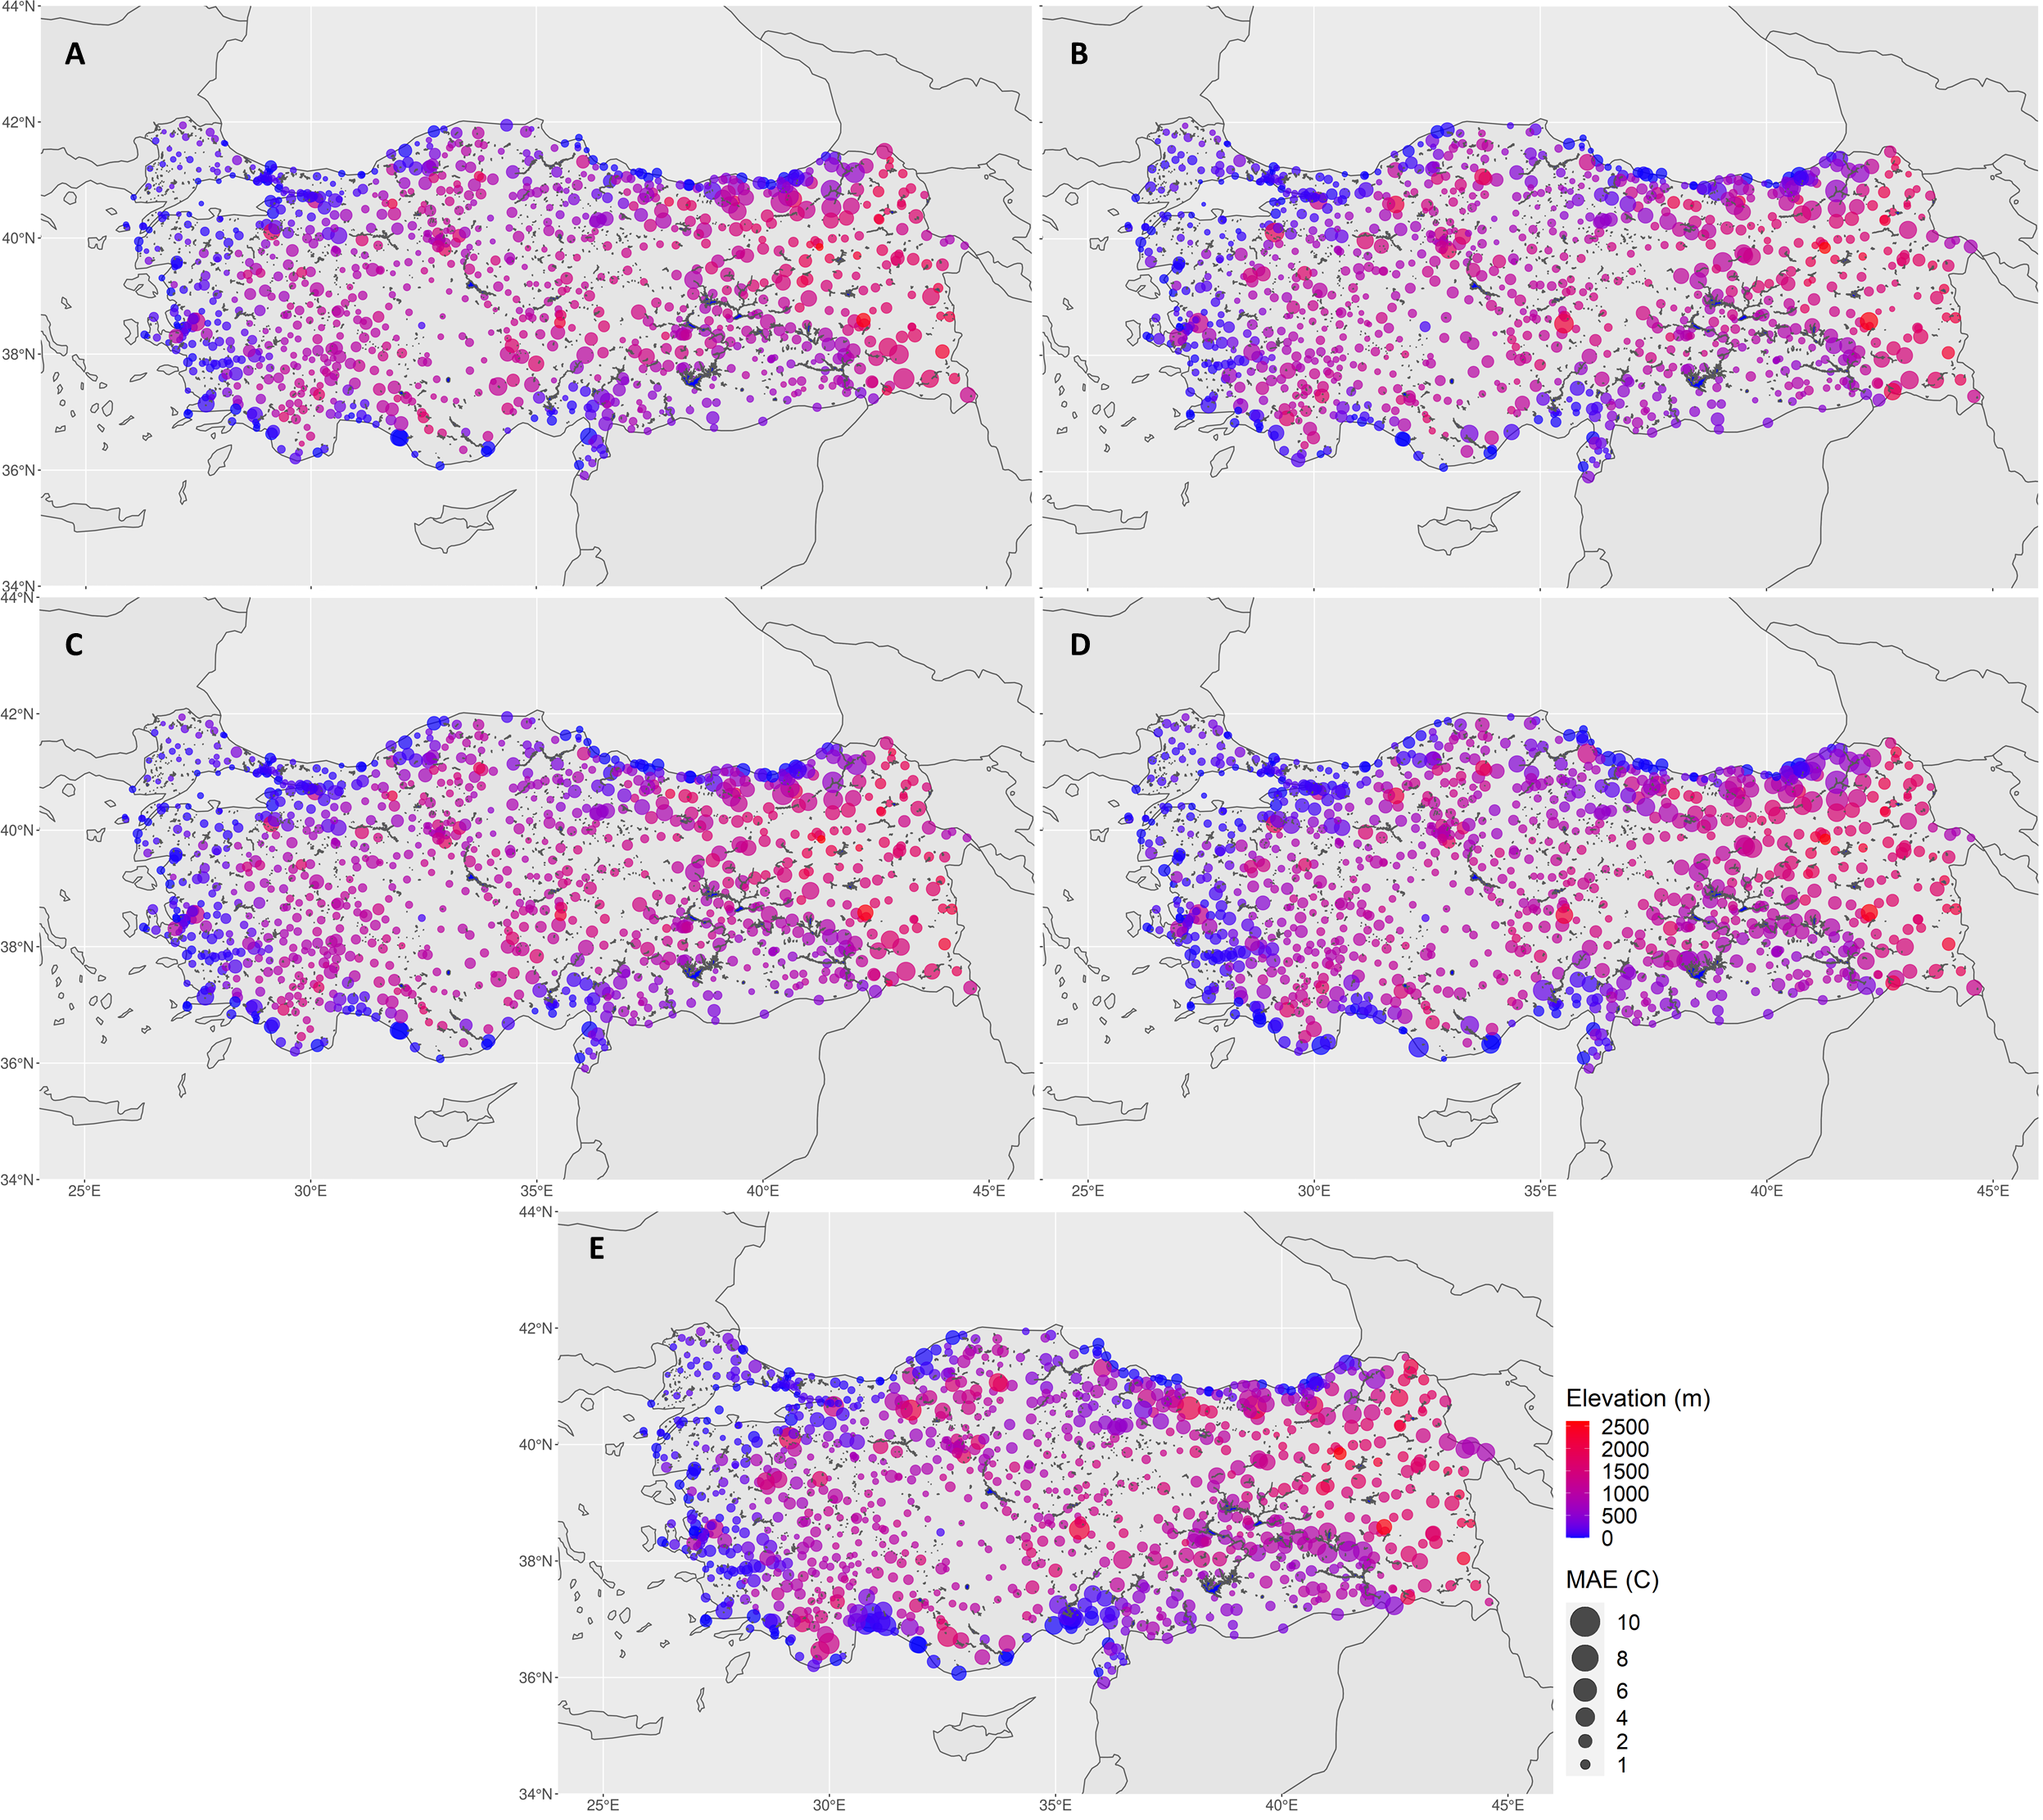
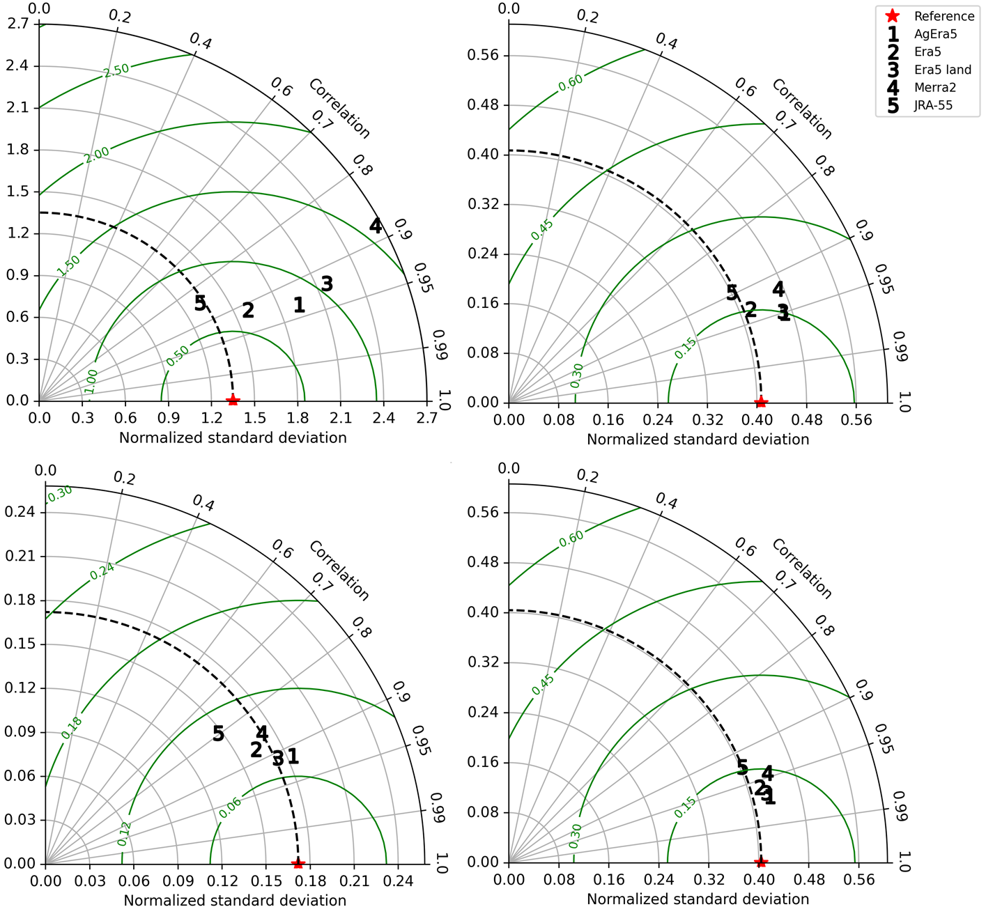
Results
Monthly time series
AgEra5, Era5 and Era5 Land products show similar spatial pattern
High error values in north-east and east part (places having high elevation change)
JRA-55 product is successful in capturing variations in near surface temperature
Merra2 product perform poor

Slide 8
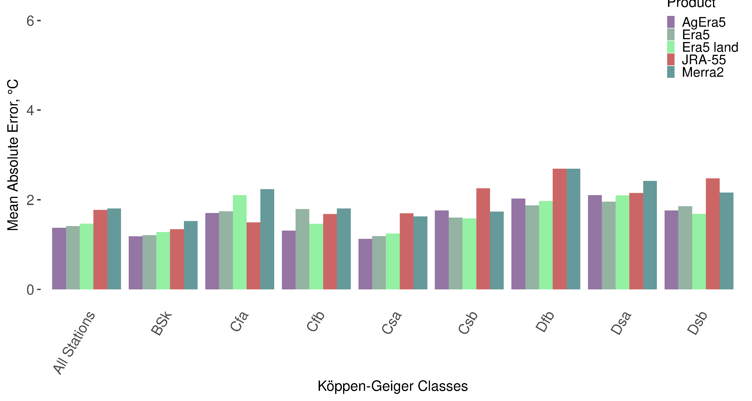
Results
Monthly time series
For all classes, AgEra5, Era5 and Era5 Land products show similar pattern
AgEra5 success over other products surpasses generally
JRA-55 product shows least success followed by Merra2 product

Slide 9

Results
Daily time series
AgEra5 performance is superior compared to other reanalysis products.
All products tend to overestimate the observed temperature
Error is highest in winter compared to warm seasons

Slide 10
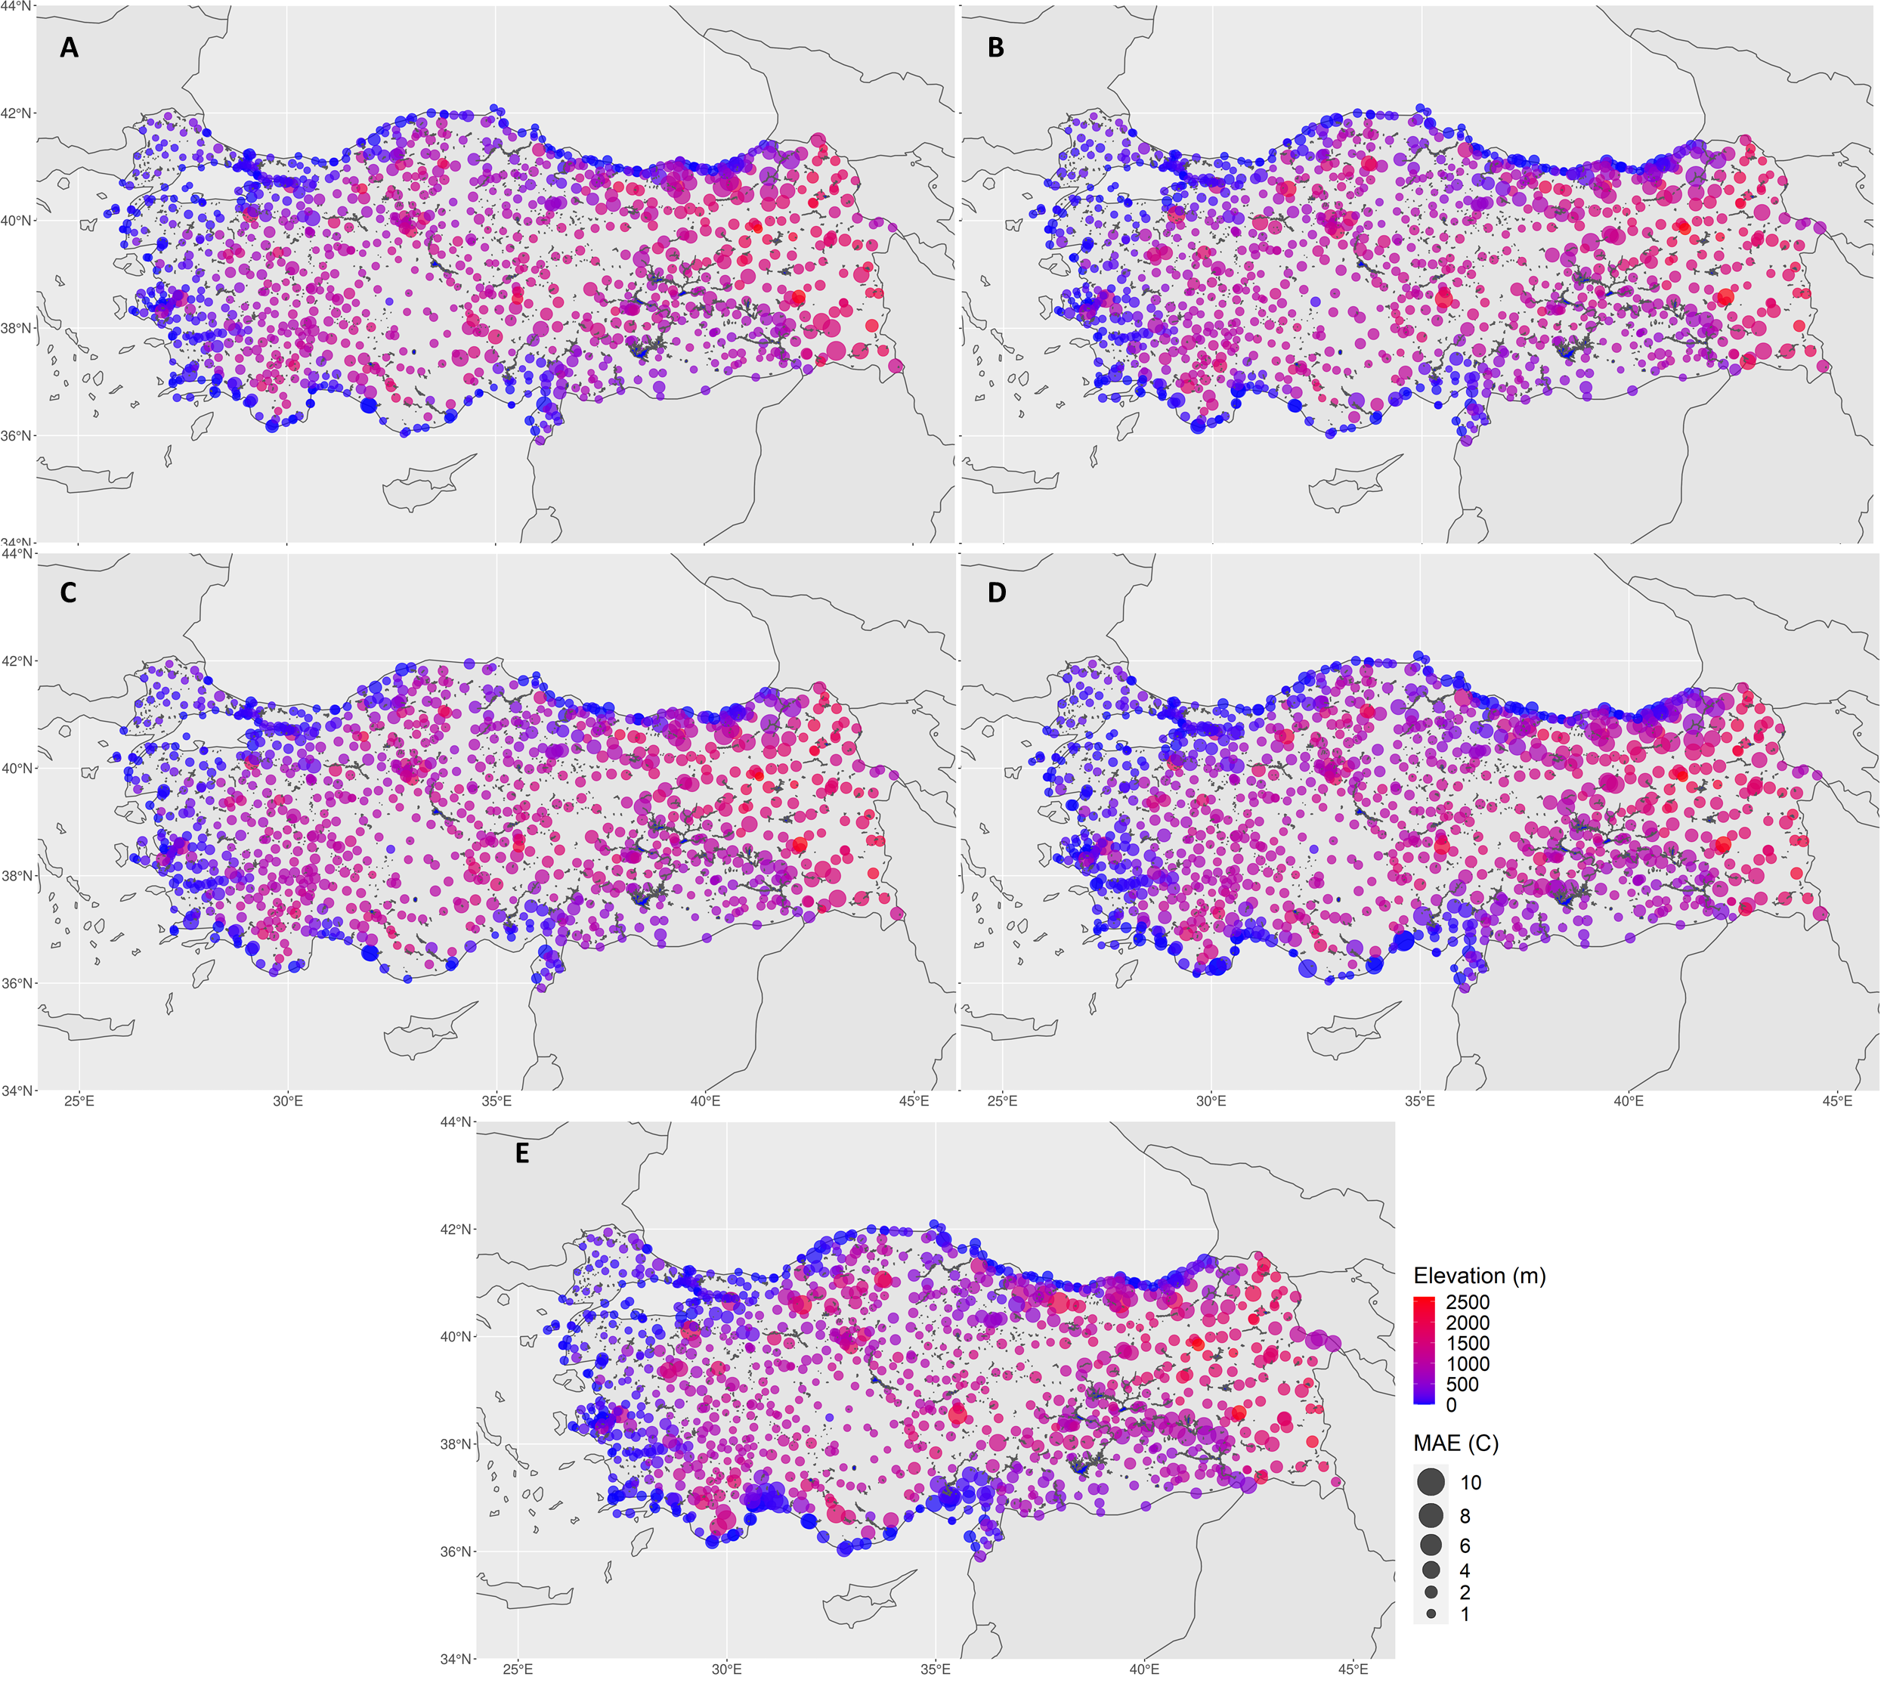
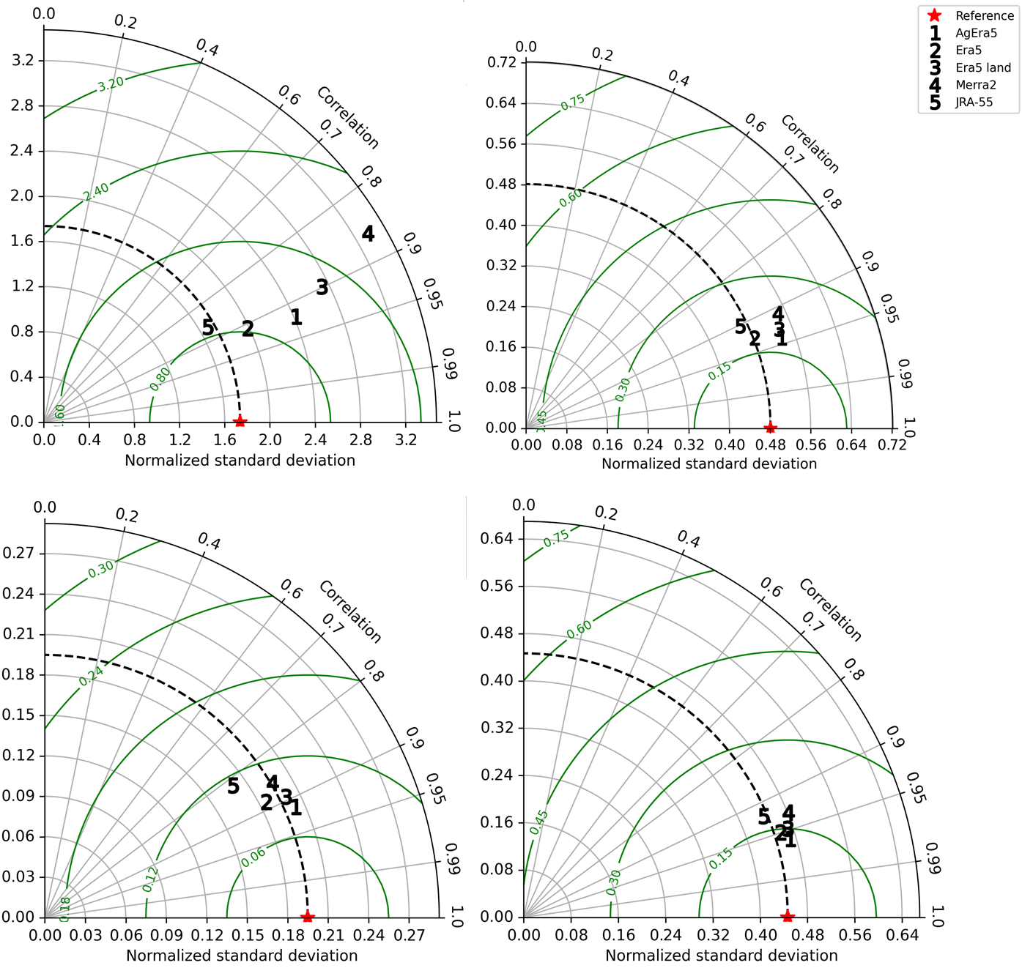
Results
Daily time series
AgEra5, Era5 and Era5 Land show similar spatial pattern of error distribution
High error values in regions having complex topography especially north-east, east, and coastal regions
Low errors in central regions where the topography is relatively flat.

Slide 11
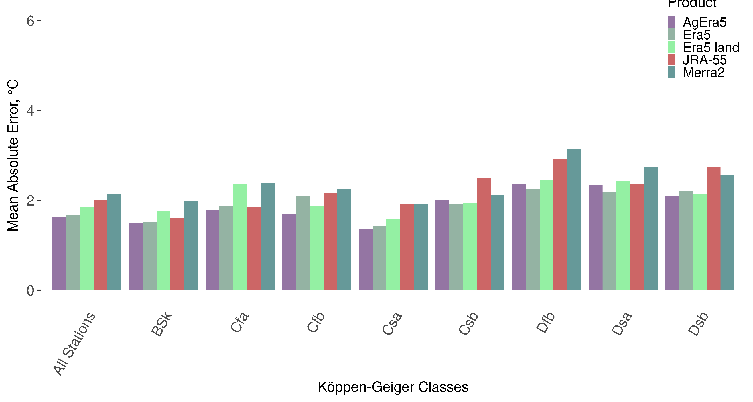
Results
Daily time series
AgEra5 product performs better in all climate classes
Merra2 product shows least success followed by JRA-55 product.

Slide 12
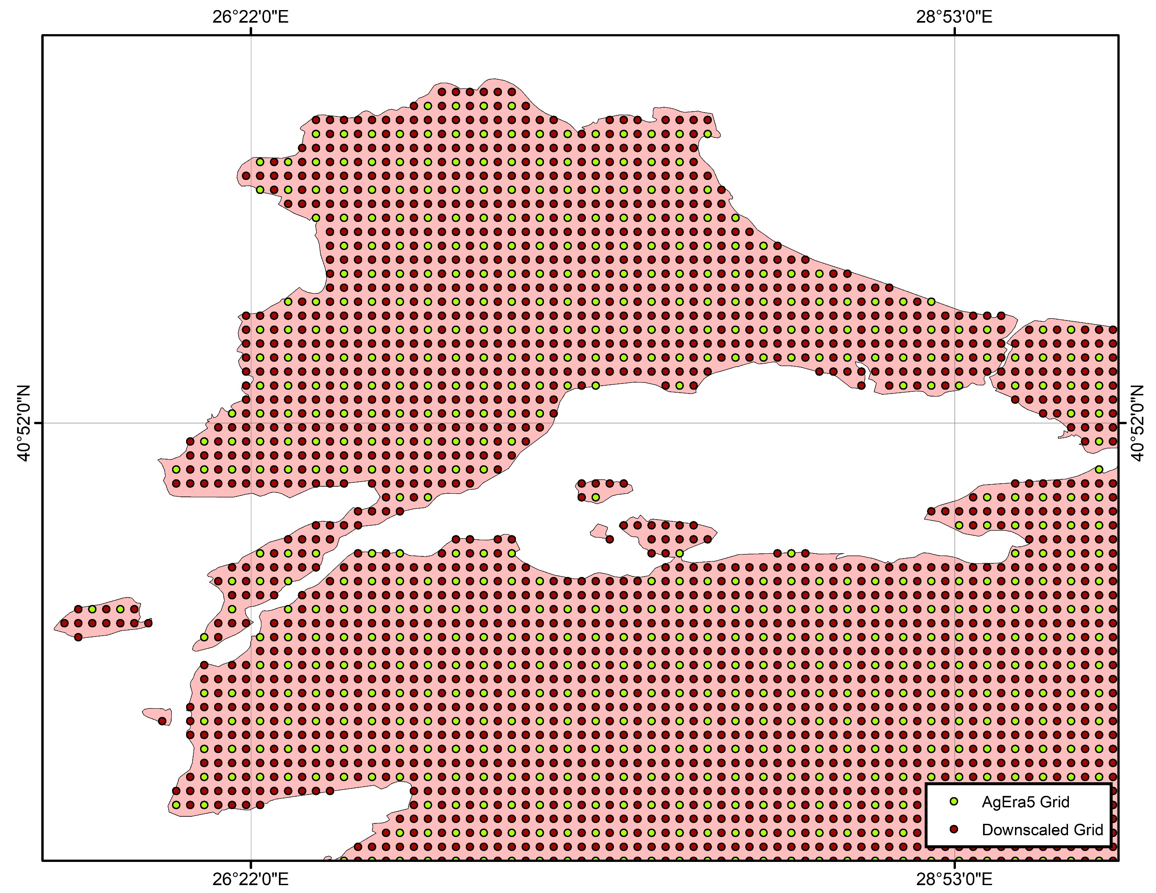
Downscaling of Air Temperature
Target grid having 0.05º spatial resolution
AgEra5 product is selected
Applied to monthly time series
Traditional distance-based interpolation methods

Slide 13
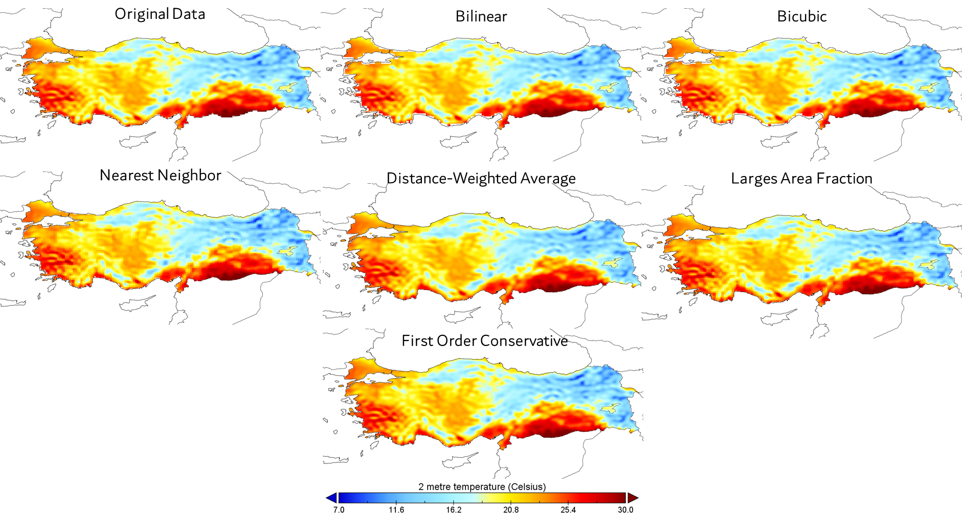
Downscaling of Air Temperature
Traditional distance-based interpolation methods
Nearest Neighborhood (NN)
Bilinear
Bicubic
Distance-weighted average remapping
Largest area fraction remapping
First-order conservative remapping

Slide 14
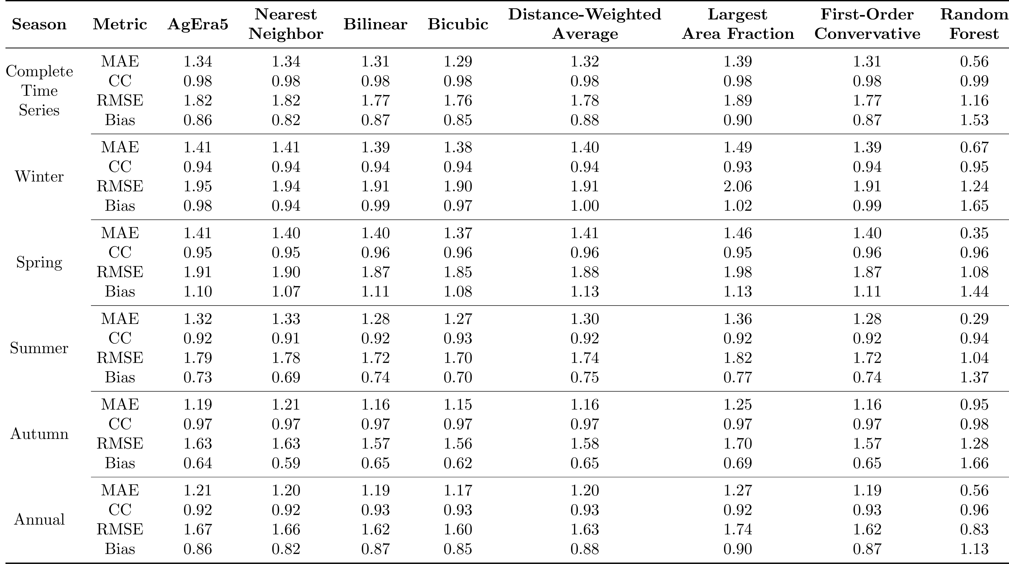
Donwscaling Results
Monthly time series
Slight improvement with bilinear, bicubic, distance-weighted average, first-order conservative methods
All methods demonstrated low errors/high correlation in winter, spring, summer, and autumn seasons.

Slide 15
Donwscaling Results
Monthly time series
All classic interpolation algorithms show similar results
Bicubic interpolation performs best to capture temporal pattern of air temperature whereas largest-area fraction method performs worst
Correlation coefficient is not affected by the type of interpolation

Slide 16
Conclusion
AgEra5, Era5, Era5 Land, Merra2 and JRA-55 products on estimation near surface air temperature across Turkey have been performed by comparing with the ground observations.
AgEra5 Land product is superior in estimating air temperature throughout Turkey both seasonally and annually
Spatial resolution of AgEra5 product is improved by using various distance-based interpolation algorithms
Results indicate that bicubic interpolation performs best on spatial downscaling monthly time series.
As a future work machine learning techniques like Random Forest algorithm will be used for the downscaling of AgEra5 near surface air temperature product over complex terrain in Turkey.

