Slide 1

Predicting extreme events using dynamics based machine learning
D. Lucente, G. Miloshevich, C. Herbert and F. Bouchet
  ENS de Lyon, CNRS
EGU General Assembly 2021- 28 April 2021
Session NP5.2: Complex systems science meets machine learning for new approaches to predictions and predictability estimation for geophysical systems

Slide 2
Outline
Prediction at the predictability margin: illustration of the problem
Committor Function
Example of a committor function: a toy model for El Niño
Prediction of heat waves through the analogue method
Conclusion

Slide 3
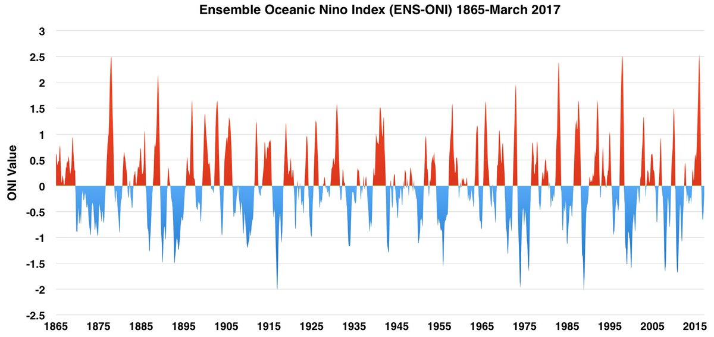
El Niño
Some prediction problems:
Will we have El Niño next year?
When will be the next strong El Niño?
The predictability time is of the order of the Lyapunov time.

Slide 4
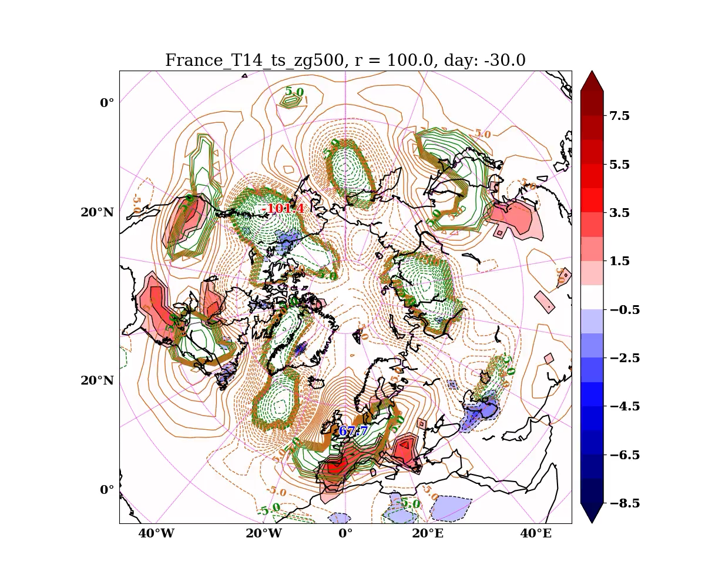
Heat waves
What is the probability of a heat wave of a given amplitude to happen next summer, given the state of the atmosphere, ocean, and soil moisture, in Spring?
Example of medium-range forecasting:
The prediction time is beyond the predictability time of the atmosphere.
The movie shows the development of a 14-day heat wave in France. The colors indicate the temperature anomalies (K) while the isolines correspond to the anomalies of the geopotential height at 500 mbar (m).

Slide 5
What is the mathematical concept of the predictability margin?
The predictability
margin
Weather
forecast
Seasonal forecast
Climate
Time
Initial value
problem
?
Invariant
measure
$$\frac{1}{λ}$$
Which probabilistic object?
Lyapunov time ?

Slide 6
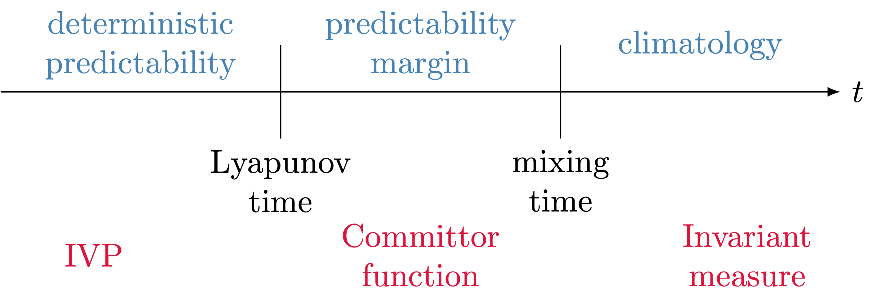
What is the mathematical concept of the predictability margin?
The relevant mathematical concept for prediction problems at the predictability margin is the committor function.

Slide 7
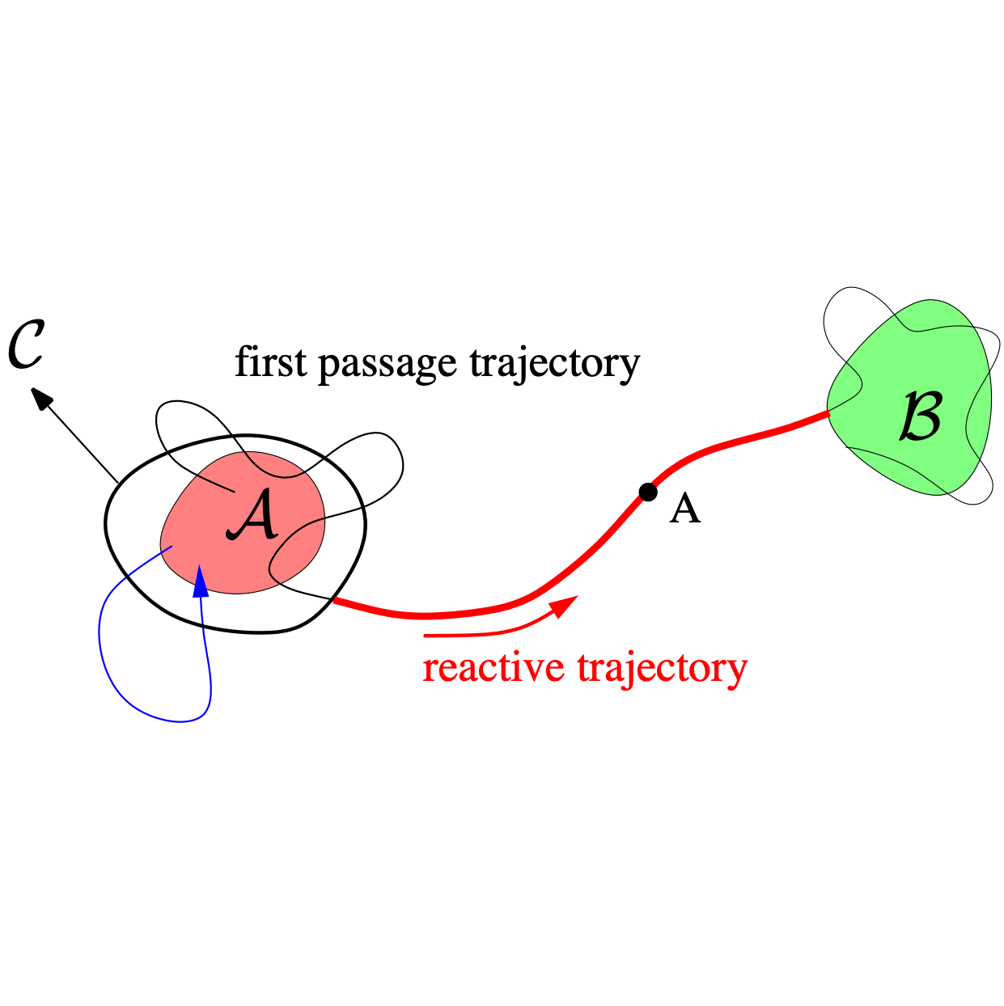
Committor function
Let $A$ be a subset of the phase space.
For a given realisation $\{X(t)\}_{0≤t<+∞}$ of the dynamics hitting time $τ_{A}$of $A$ is $τ_{A}=inf\{t|X(t)∈A\}.$
The committor function q(x) of the sets $A$ and $B$ is defined as the probability that a trajectory starting at the point x at the time 0 reaches the set B before the set A
$q(x)=P_{x}\left(τ_{B}<τ_{A}\right).$
We will also consider quantities like
$q(x,t)=P_{x}\left(X(t)∈A\right)=E_{x}\left(1_{X(t)∈A}\right),$
which is also a committor function for an auxiliary process.

Slide 8
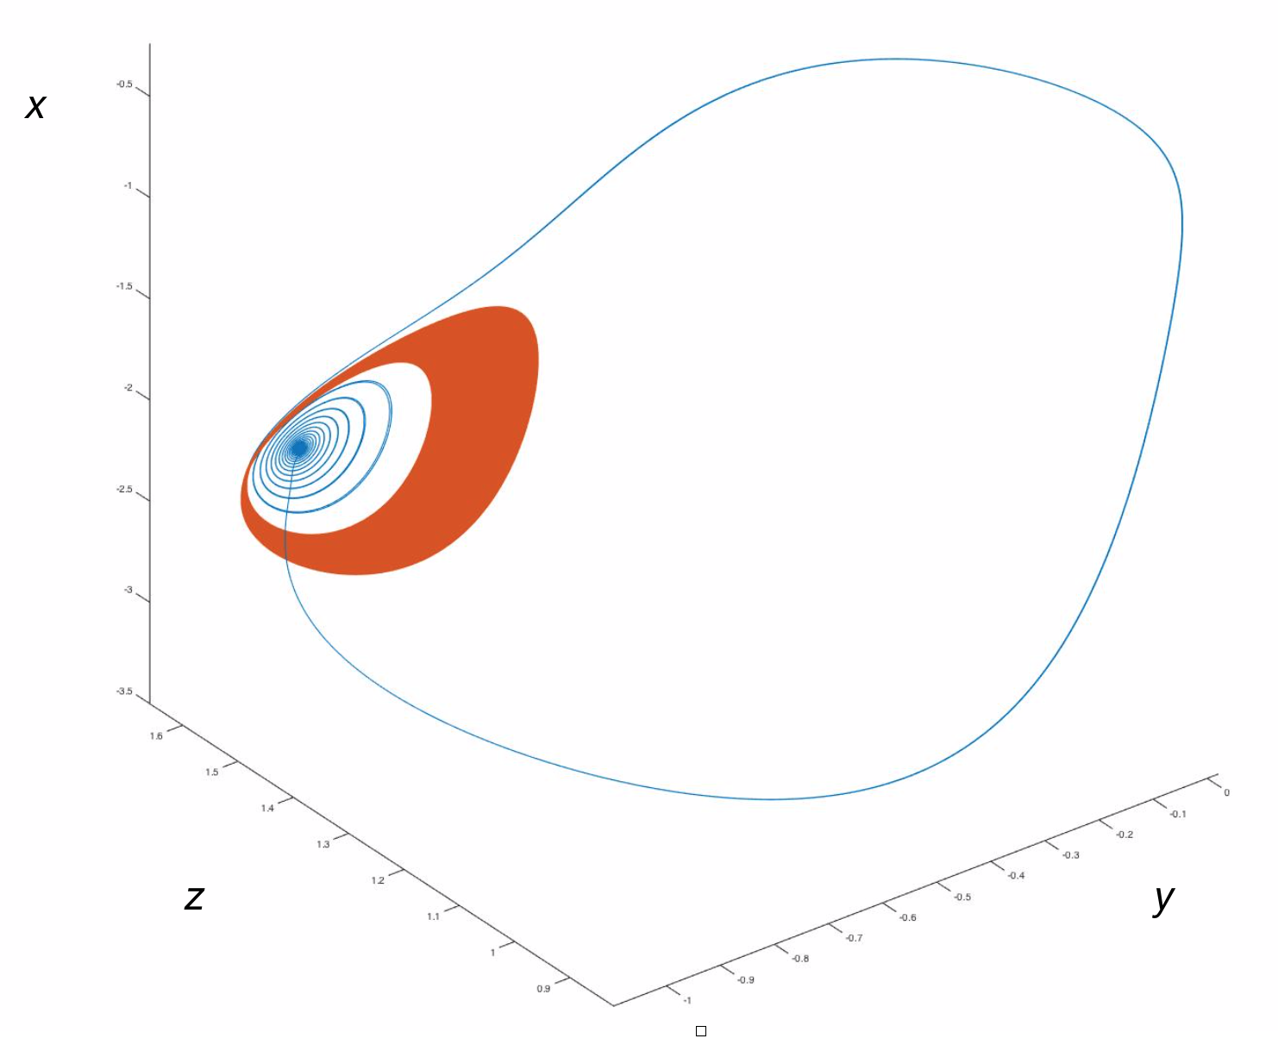
Model’s attractors
The Jin and Timmermann toy model for El-Niño
Three relevant variables:
The western SST of the Pacific Ocean $T_{1}$,
The eastern SST of the Pacific Ocean $T_{2}$,
The thermocline depth anomaly of the western Pacific $h_{1}$ which links them.
With dimensionless units, the equations are
$$\overset{·}{x}=ρδ(x^{2}-ax)+x(x+y+c-ctanh(x+z))-D_{x}(x,y,z)ξ_{t}$$
$\overset{·}{y}=-ρδ(x^{2}+ay)+D_{y}(x,y,z)ξ_{t}$
$$\overset{·}{z}=δ(k-z-\frac{x}{2})$$
Set $B$: limit cycle
Commitor:
$q(x,y,z)=P_{x}\left(τ_{B}<τ_{A}\right).$
Set $A$: chaotic attractor.

Slide 9
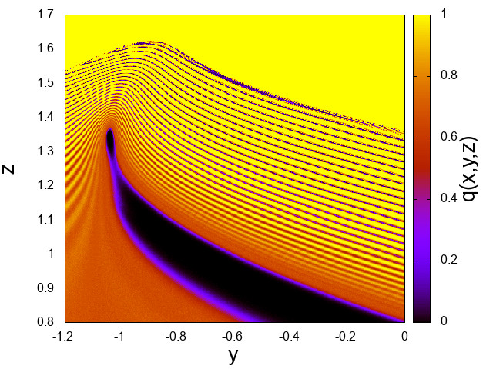
A cut of the committor function
3. Deterministic like
sensitivity
to initial condition
Hard potential predictability
1. Perfect predictability
$$x=-2.831$$
$$σ=5×{10}^{-5}$$
4. Smooth probability
Easy potential predictability of the probability
2. Perfect predictability

Slide 10
Heat waves
What is the probability of a heat wave of a given amplitude and duration will occur in $τ$ days, given the state of the atmosphere, temperature, and soil moisture, today?
Long term fluctuations of temperature:
$A(t_{0})=\frac{1}{T}∫_{t_{0}}^{t_{0}+T}dt\frac{1}{D}∫_{D}dr[T(r,t)-E[T](r,t)],$
$T=14$ days, and $D=$France.
Committor function:
$q(X,τ)=P(A(t_{0}+τ)>a|X(t_{0})=X)$.
$X$ can be the set of all the variables that describe the system (like temperature or geopotential heigth) or a part of them.

Slide 11
How to compute committor functions for heat waves?
A direct sampling of the committor is unfeasible for climate models.
The number of data required for a good computation of the committor function grows exponentially as the dimension of the system increases.
A stochastic generator (Analogue Method) helps to handle the problem.

Slide 12
The Analogue Method
Let $\{X_{n}\}_{0≤n≤T}$ be a trajectory of the system.
The idea is to build a Markov chain on this trajectory to generate new trajectories.
The generator of the Markov chain approximates the generator of the real dynamics.
For each point $X_{n}$ $K$ analogues are selected.
Let $G$ be the propagator of the Markov chain:
$G_{nj}=\frac{1}{K}$ if $j-1(X_{j-1})$ is one of the analogues of $n(X_{n}),$
$G_{nj}=0$ otherwise.

Slide 13
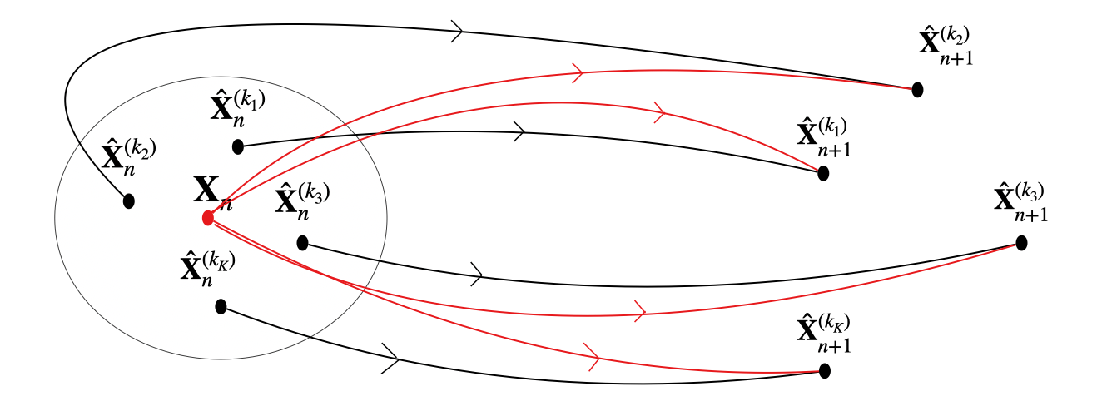
Sketch of the Analogue Method
On the left side there is the point $X_{n}$ with its analogues. On the right side there are the images of the analogues one time step forward.
The black lines correspond to the transitions observed in the time series. The red lines correspond to the transitions introduced with the analogue method. The probability of each transition is $\frac{1}{K}$.

Slide 14
Heat waves detection: Analogue based Classifier
Analogue Method
$$1$$
if $q(X)>\overline{q}$
Input:$X$
Committor function: $q(X)$
Output: $o$
$$0$$
if $q(X)≤\overline{q}$
Score: Matthewes correlation coefficient (MCC)
$$MCC=\frac{TP×TN-FP×FN}{\sqrt{(TP+FP)(TP+FN)(TN+FP)(TN+FN)}}$$
$TP=\text{True positives}$, $TN=\text{True negatives}$, $FP=\text{False positives}$, $FN=\text{False negatives}$
$MCC∈[-1,1]$, $MCC=0→\text{random classifier}$, $MCC=1→\text{perfect classifier.}$

Slide 15
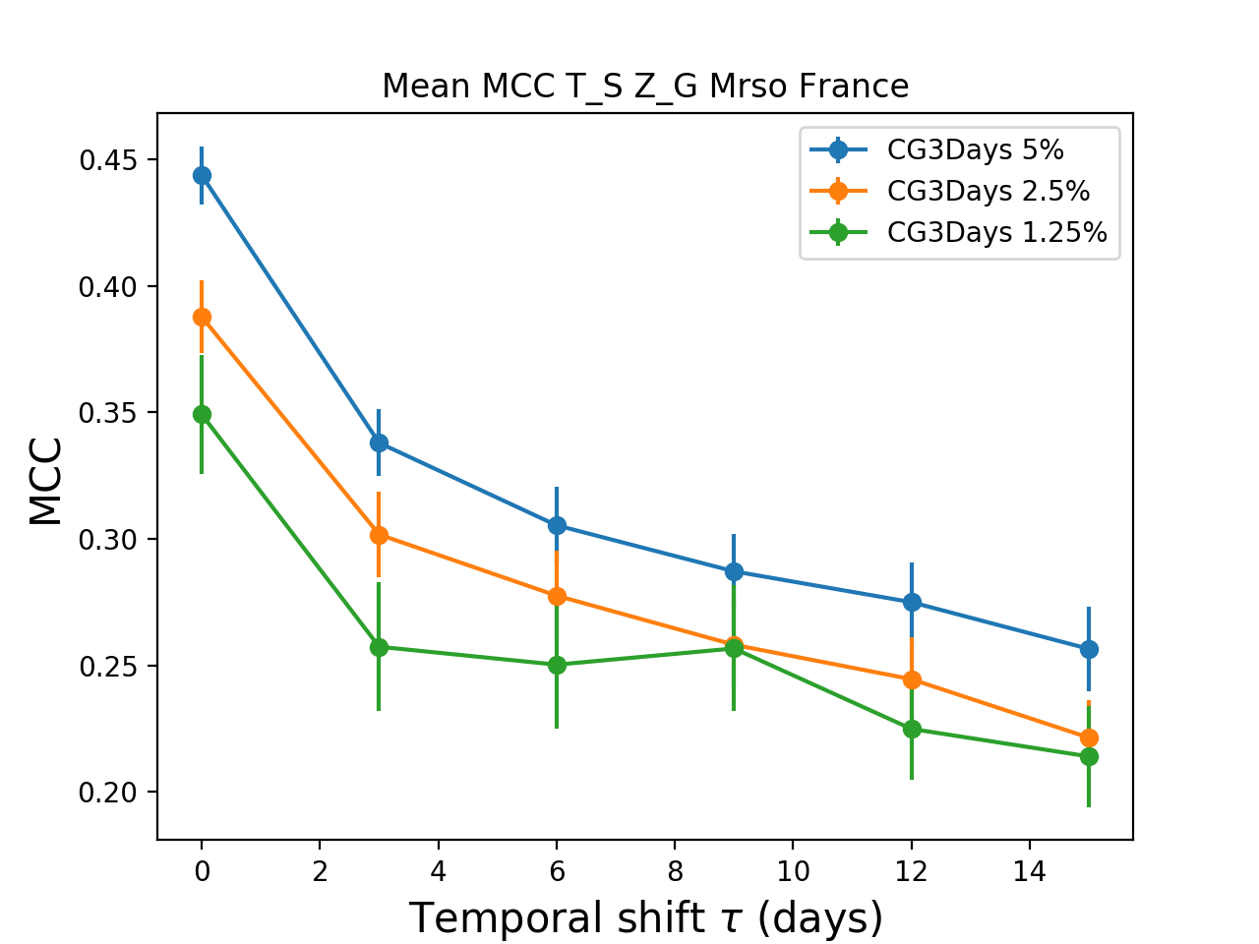
Performance of the Analogue based Classifier
$X=(T_{s},Z_{g},Mrso)$
where
$T_{s}=$temperature anomaly averaged over France,
$Z_{g}=$geopotential height anomaly averaged over France,
$Mrso=$soil moisture anomaly averaged over France.
$$q(X,τ)=P(A(t_{0}+τ)>a|X(t_{0})=X)$$
$a_{0}=3.08K(5\%)$, $a_{1}=3.7K(2.5\%)$, $a_{2}=4.23K(1.25\%).$
MCC far from zero
We can predict heat waves 15 days in advance.

Slide 16
Conclusions
Predictions at the Predictability Margin:
At the predictability margin, predictions should be probabilistic. The committor functions are the proper mathematical objects.
This is a proper characterisation of the predictability properties. It illustrates area of the phase space with and without predictability potential and quantifies the probability of the event.
This informs us on what to expect for a predictability problem at the predictability margin, in a perfect information context.
Αnalogue Method for the prediction of heat waves:
The analogue method allows the computation of the committor function. A significant fraction of heat waves are correctly detected up to 15 days in advance.

