Slide 1
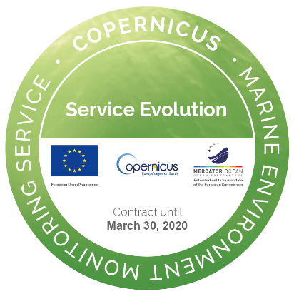


Evaluating a dynamically modelled river discharge as input for ocean systems through the monitoring of the ocean state from reanalysis
Eric de Boisséson, H. Zuo, E. Zsóter, S. Harrigan, F. Wetterhall, P. de Rosnay, and C. Prudhomme
Contact: Eric.Boisseson@ecmwf.int
vEGU21: Gather Online | 19–30 April 2021

Slide 2
Background
The BRONCO (Benefits of dynamically modelled River discharge input for OceaN and COupled atmosphere-land-ocean systems) project ran from 2018 to 2020 as part of the CMEMS Service Evolution
The objective was to develop a new time-varying freshwater input for ocean models from river discharge reanalysis (CEMS GloFAS) driven by consistent atmospheric forcing (C3S ERA5) that could replace the observation-derived climatology developed by Bourdallé-Badié and Trégiuer (2006 aka BT06) based on the work from Dai and Trenberth (2002)
The outcome was new time-varying global ocean river runoff product derived from GloFAS-ERA5 covering the period 1979-2017 that can be used as input for ocean models by CMEMS MFCs
Ultimately the impact of this river runoff product onto the ocean state was assessed wrt to the previous systems using BT06

Slide 3
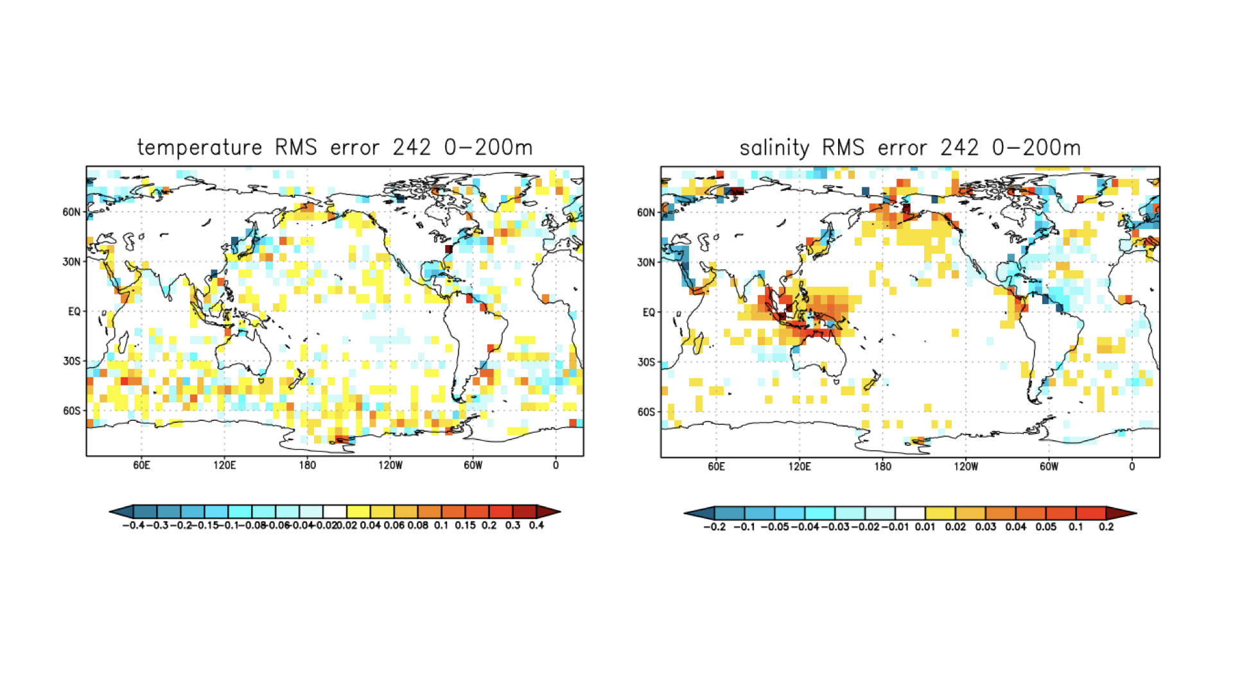
Evaluation of GloFAS-ERA5 in ORAS5 (CMEMS GLORAN)
The GloFAS-ERA5 river runoff climatology was plugged into the ECMWF ocean reanalysis system - ORAS5 (Zuo et al., 2019)
The system was run without data assimilation and compared to a control run using the reference BT06 river runoffs product
RMSE differences in simulated ocean states: GloFAS-ERA5 – BT06
(verified against EN4 in-situ obs between 2010-2017)
improvement
degradation
Model runs with climatological river discharge input, and without data assimilation

Slide 4
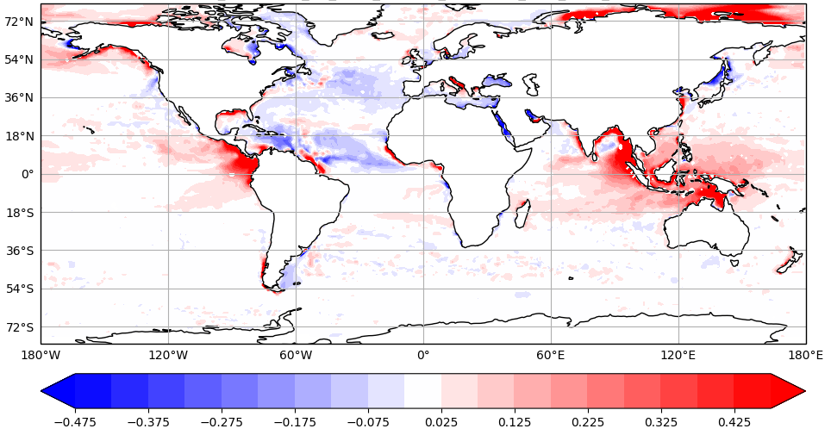
Evaluation of GloFAS-ERA5 in ORAS5 (CMEMS GLORAN)
The GloFAS-ERA5 river runoff climatology was plugged into the ECMWF ocean reanalysis system - ORAS5 (Zuo et al., 2019)
The system was run without data assimilation and compared to a control run using the reference BT06 river runoffs product
RMSE differences wrt to CMEMS MSSS: GloFAS-ERA5 – BT06
improvement
degradation
Model runs with climatological river discharge input, and without data assimilation

Slide 5
Tuning of GloFAS-ERA5 river discharges
The degradation to the system is investigated
RMSE differences: GloFAS-ERA5 – BT06
improvement
degradation
Salinity RMSE diff wrt EN4 0-200m
SSS RMSE diff wrt CMEMS MSSS
6 main areas of degradation are identified: Maritime Continent, Bay of Bengal, Western Coast of Central America, Siberian Arctic Coast, the Gulf of Alaska and the Bering Sea

Slide 6
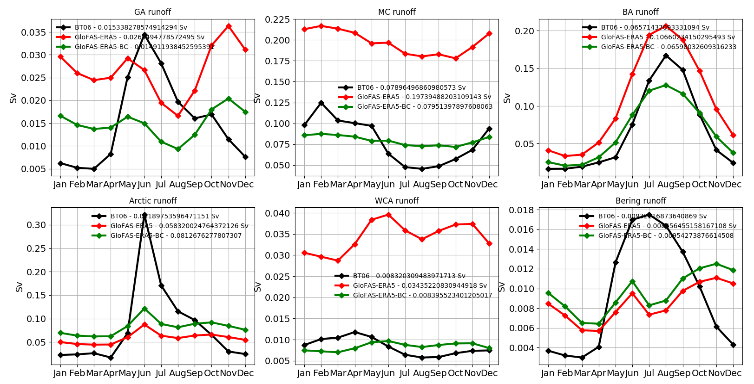
Tuning of GloFAS-ERA5 river discharges
The degradation to the system are investigated
SSS RMSE diff wrt CMEMS MSSS
Gulf of Alaska
Maritime Continent
Bay of Bengal
Arctic - Siberia
Central America
Bering Sea
GloFAS-ERA5 BT06 GloFAS tuned
Salinity degradation mostly linked to relatively large river discharges (Maritime Continent, Bay of Bengal and Central America) and weak discharges (Arctic, Bering Sea)
Test: tuning the annual mean of the GLOFAS-ERA5 discharge toward BT06 annual mean in degraded areas

Slide 7
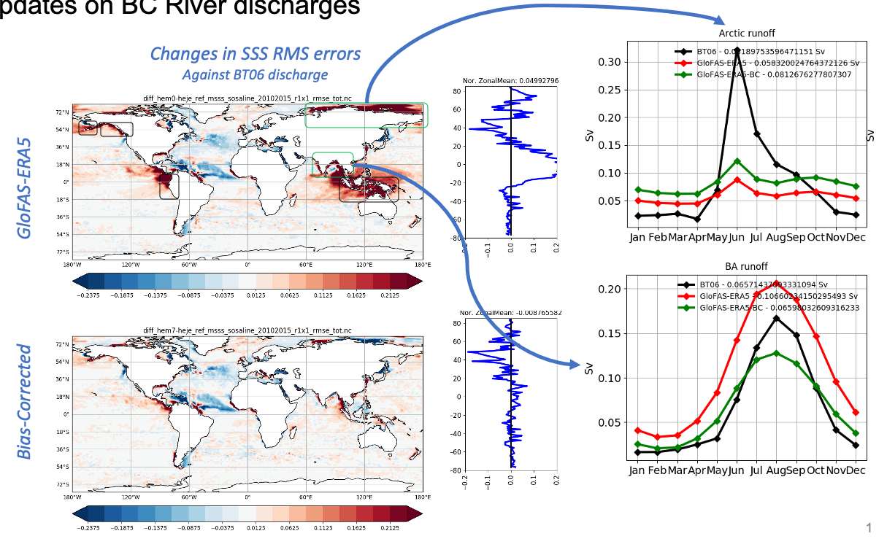
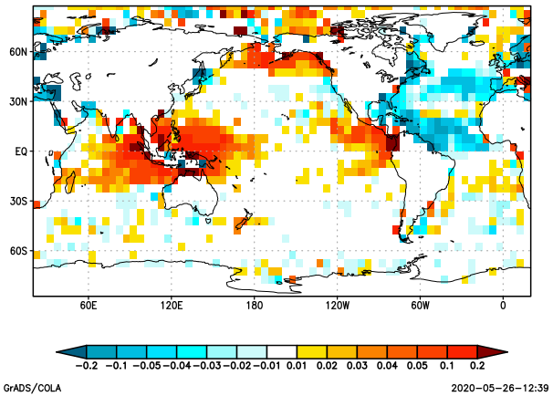
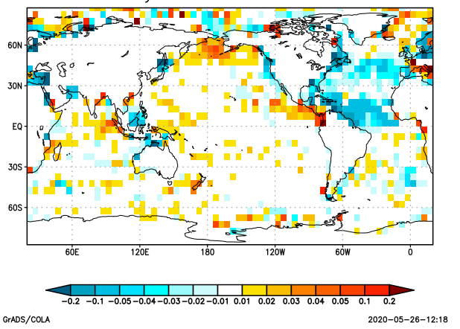
Tuning of GloFAS-ERA5 river discharges
Tuning the GLOFAS-ERA5 allows to dampen degradation
Salinity RMSE differences wrt to EN4 0-25m
GloFAS tuned GloFAS ERA5
GloFAS tuned GloFAS ERA5
GloFAS-ERA5 BT06 GloFAS tuned

Slide 8
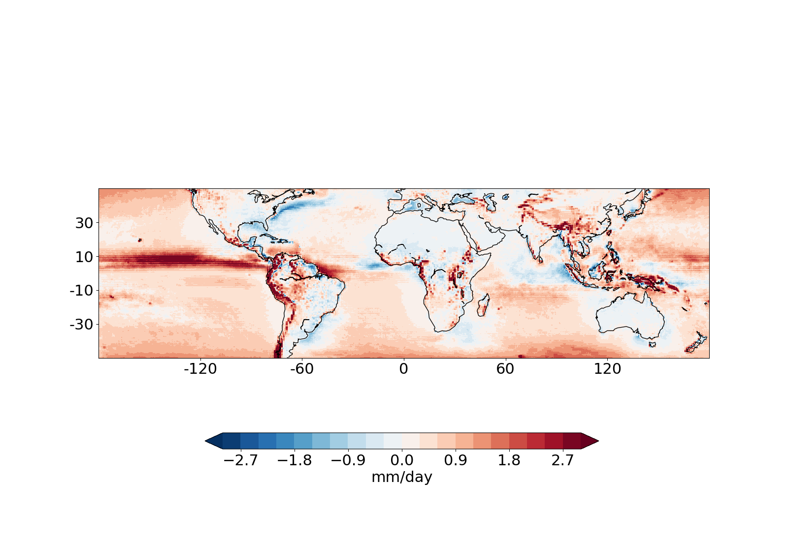
Preliminary signal attribution in GloFAS-ERA5
GloFAS-ERA5 is based on a river-routing model forced by ERA5 precipitation/snowmelt
GloFAS-ERA5 overestimates the river discharges mainly in the Tropics (Maritime Continent, Central America, Bay of Bengal) and underestimate the discharges in the Arctic
ERA5 minus TRMM (2000-2017) – Total precipitation
ERA5 precipitation over land overestimated in the Maritime Continent, Bay of Bengal and W. Central America?

Slide 9
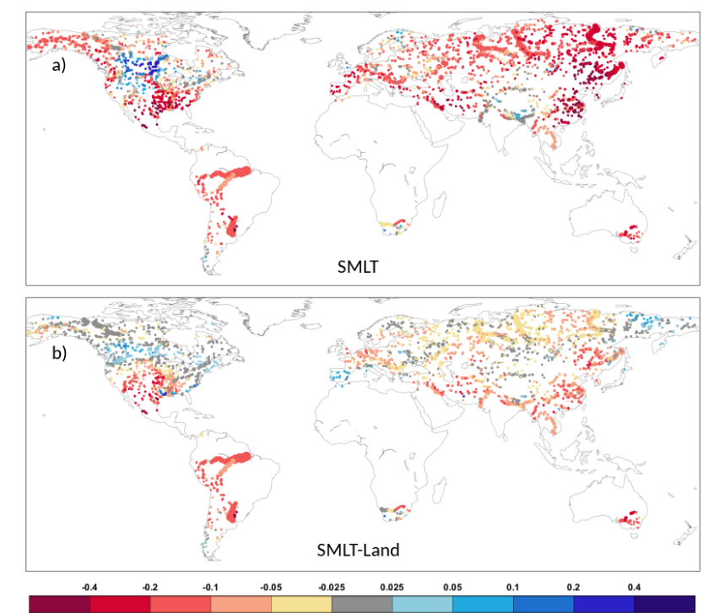
Preliminary signal attribution in GloFAS-ERA5
GloFAS-ERA5 is based on a river-routing model forced by ERA5 precipitation/snowmelt
GloFAS-ERA5 overestimates the river discharges mainly in the Tropics (Maritime Continent, Central America, Bay of Bengal) and underestimate the discharges in the Arctic
ERA5 snowmelt trend in GloFAS catchment areas (1981-2018)
Zsoter et al (2020)
ERA5 snowmelt shows a negative trend at high latitudes that is not seen in ERA5-Land. Suggest spurious signal that could contaminate GloFAS-ERA5 discharges

Slide 10
Conclusions
A dataset of river discharges into the ocean was built from the CEMS GloFAS-ERA5 reanalysis
GloFAS-ERA5 was tested into the ORAS5 system (CMEMS GLORAN) and showed positive impacts in the Atlantic, the Mediterranean and the North Sea. Degradation in salinity is seen in several areas both in the Tropics and at high latitudes
Fine tuning of the GloFAS-ERA5 discharge allow to dampen the degradation, suggesting the presence of biases
A preliminary attribution studies showed potential impacts from localized precipitation biases and snowmelt spurious trends in ERA5 precipitations and snowmelt
Next steps: a bias-corrected GloFAS-ERA5? Bias corrected ERA5? Hybrid GloFAS-ERA5 – Obs-based product (Dai and Trenberth)?

