Slide 1


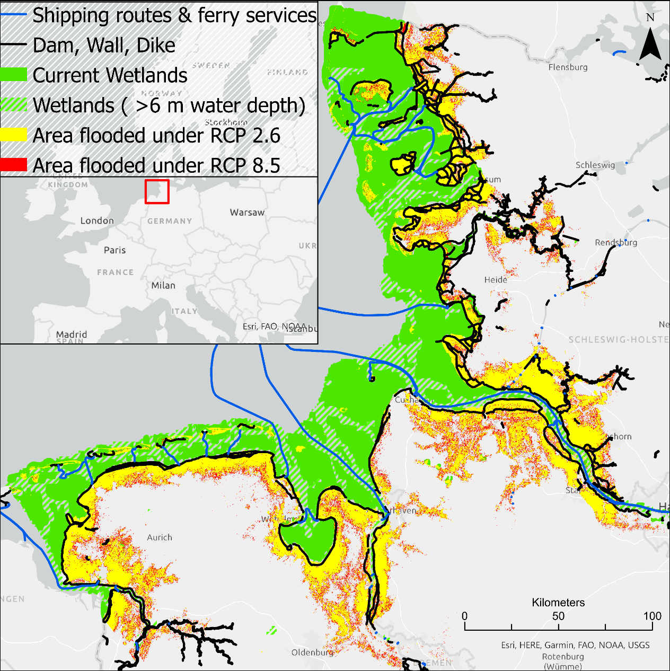
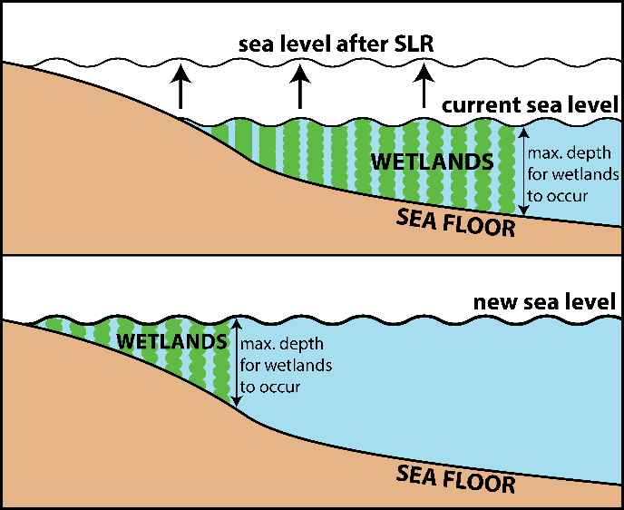
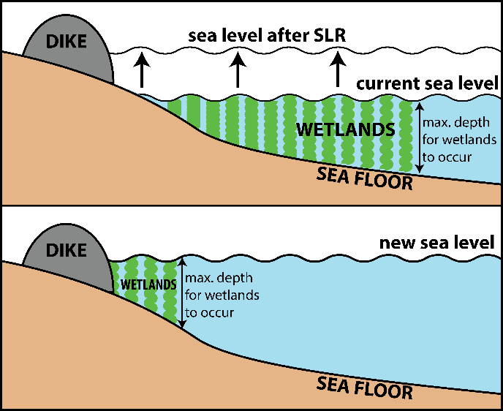
Coastal Wetland Dynamics Driven by Sea-Level Rise
Hannes Nevermann ¹, Amir AghaKouchak ², Nima Shokri ¹
(1) Hamburg University of Technology, Institute of Geo-Hydroinformatics, Hamburg, Germany
(2) Department of Civil and Environmental Engineering, University of California, Irvine, USA
Email: hannes.nevermann@tuhh.de
Introduction
Sea level rise (SLR) moves coastline inland → wetlands also move (Figs. 1 & 2)
If there is no space for accommodation, e.g. due to built environment, wetlands will be lost permanently (Figs. 3 & 4)
1
Objectives
To delineate impacts of SLR on wetland dynamics under changing climate on a global scale with a particular focus on consequences of build environment along the coastlines
We consider here the case of Wadden Sea, listed by UNESCO as World Heritage due to its unique ecological values
2
Methods
Data acquisition (Wetland data, DEM, etc.)
MERIT (Multi-Error-Removed Improved Terrain DEM)
DEM was used to determine flooding areas
Future projections forced by Representative Concentration Pathways RCP 2.6 and RCP 8.5 were considered as future climate scenarios
ArcGIS Pro 2.7 was used for data processing
3
5
Results
Due to the already built dam, wall and dike, wetlands of the Wadden Sea cannot “escape” during projected SLRs, thus they will be lost permanently if “business-as-usual emission scenario” continues
Moreover, our analysis show much of the current wetland area is already endangered due to shipping routes → nautical channels >6m water depth
4

