Slide 1


Variational Seismic Tomography using Normalizing Flows
Xuebin Zhao, Andrew Curtis and Xin Zhang
School of GeoSciences, University of Edinburgh

Slide 2
Outline
Variational Inference using Normalizing Flows
Synthetic Test of travel time tomography
Love Wave Tomography of the British Isles
Conclusion

Slide 3
Variational Inference using Normalizing Flows

Slide 4
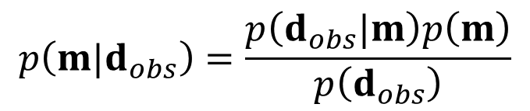
Bayesian Inference
Bayes’ rule:
Posterior pdf
Likelihood
Prior pdf
$$p\left(m|d_{obs}\right)=\frac{p\left(d_{obs}|m\right)p\left(m\right)}{p\left(d_{obs}\right)}$$
Evidence

Slide 5

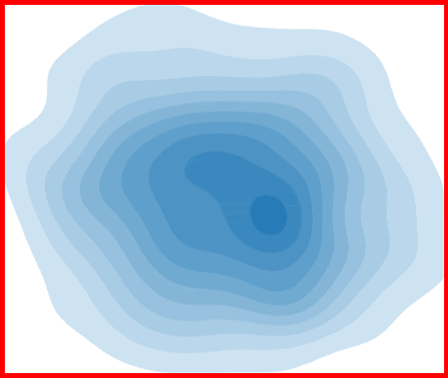


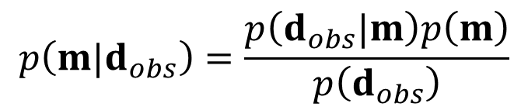
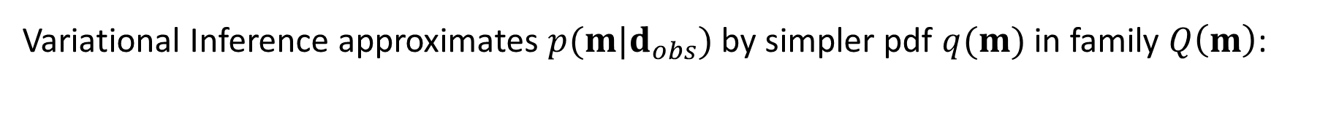
Variational Inference
$$p\left(m|d_{obs}\right)=\frac{p\left(d_{obs}|m\right)p\left(m\right)}{p\left(d_{obs}\right)}$$
Variational Inference approximates $p(m|d_{obs})$ by simpler pdf $q(m)$ in family $Q\left(m\right)$:
Posterior pdf $p(m|d_{obs})$
Variational pdfs $q(m)$ in $Q\left(m\right)$
Minimize difference/distance

Slide 6
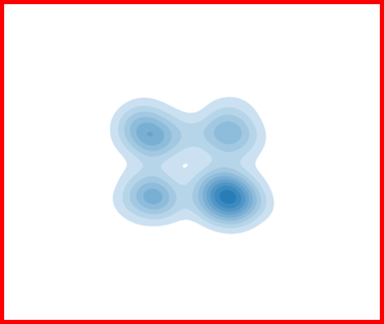

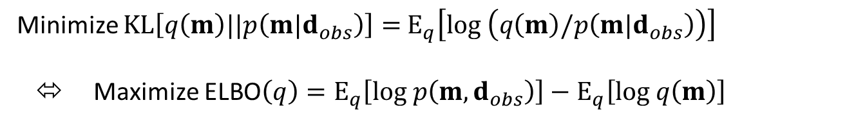

Variational Inference
Posterior pdf $p(m|d_{obs})$
Variational pdfs $q(m)$ in $Q\left(m\right)$
$$KL\left[q||p\right]$$
KL (Kullback-Leibler) divergence measures difference between $q$ and $p$:
Minimize $KL\left[q\left(m\right)||p\left(m|d_{obs}\right)\right]=$ $E_{q}\left[log \left(q\left(m\right)/p\left(m|d_{obs}\right)\right)\right]$
⬄ Maximize $\text{ELBO}\left(q\right)=E_{q}\left[log p\left(m,d_{obs}\right)\right]−E_{q}\left[log q\left(m\right)\right]$
Evidence lower bound

Slide 7
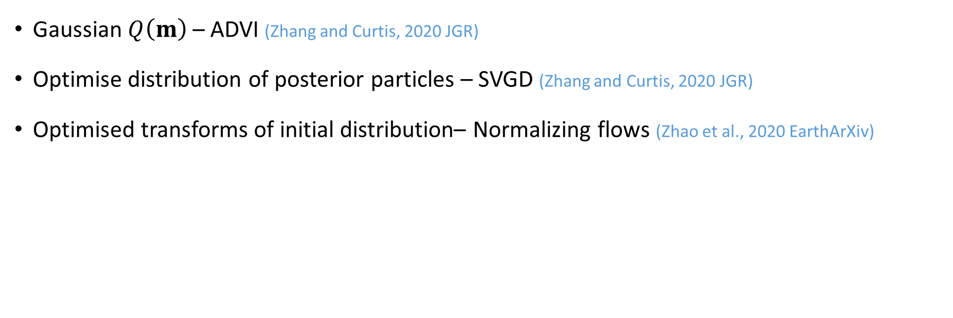
Variational methods
Gaussian $Q\left(m\right)$ – ADVI (Zhang and Curtis, 2020 JGR)
Optimise distribution of posterior particles – SVGD (Zhang and Curtis, 2020 JGR)
Optimised transforms of initial distribution– Normalizing flows (Zhao et al., 2020 EarthArXiv)

Slide 8
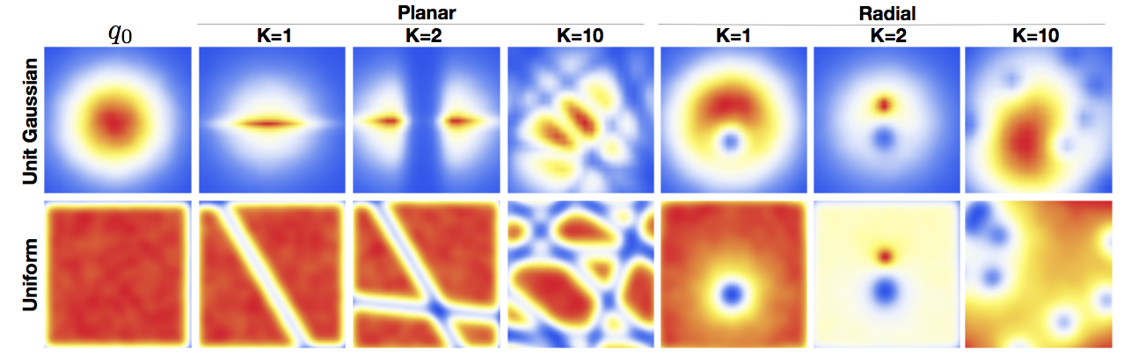




Normalizing Flows
Apply K invertible transforms to convert $q_{0}\left(m_{0}\right)$ to target pdf $q_{K}\left(m_{K}\right)$
Initial pdf $q_{0}\left(m_{0}\right)$
Target pdf $q_{K}\left(m_{K}\right)$
Transforms
(Flows)
$m_{K}=F\left(m_{0}\right)$ $=$ $f_{K}∘f_{K−1}∘⋯∘f_{2}∘f_{1}\left(m_{0}\right)$
$$q_{K}\left(m_{K}\right)=q_{0}\left(m_{0}\right)\left|det\frac{∂F}{m_{0}}\right|$$
Volume change
$${=q}_{0}\left(m_{0}\right)\prod_{i=1}^{K}{\left|det\frac{∂f_{i}\left(m_{i}\right)}{m_{i−1}}\right|}$$

Slide 9


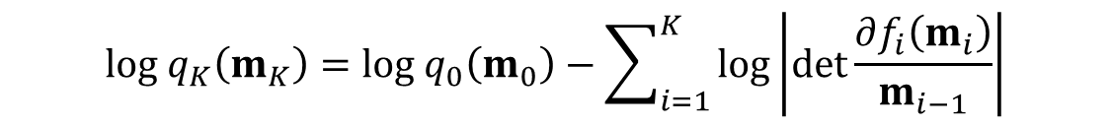
Variational Inference using Normalizing Flows
$$log{ q}_{K}\left(m_{K}\right)=log q_{0}\left(m_{0}\right)−\sum_{i=1}^{K}{log\left|det\frac{∂f_{i}\left(m_{i}\right)}{m_{i−1}}\right|}$$
$$log p\left(m | d\right)≈$$
Maximize $\text{ELBO}\left(q\right)$ w.r.t $F=\left\{f_{1},f_{2},⋯,f_{K−1 }, f_{K }\right\}$ using optimization
$$F^{t+1}=F^{t}+α^{t}∇_{F}\text{ELBO}\left(q_{K}\left(m_{K}\right)\right)$$
Update with many iterations
Gradient in linearized inversion
$$\begin{matrix}∇_{F}ELBO\left(q_{K}\left(m_{K}\right)\right)\text{=}E_{q_{0}\left(m_{0}\right)}\left[∇_{m_{K}}\left(log p\left(m_{K},d_{obs}\right)\right)∇_{F}m_{K}\right]+E_{q_{0}\left(m_{0}\right)}\left[∇_{F}\sum_{i=1}^{K}{log\left|det\frac{∂f_{i}\left(m_{i}\right)}{{∂m}_{i−1}}\right|}\right]\end{matrix}$$
Already known!
Easy to calculate with careful design of flows
Easy Monte Carlo Sampling
Small Number of Samples per Iteration

Slide 10


Constructing Flows
$$m_{i}$$
$$m_{i+1}$$

Slide 11




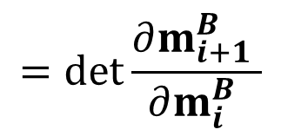


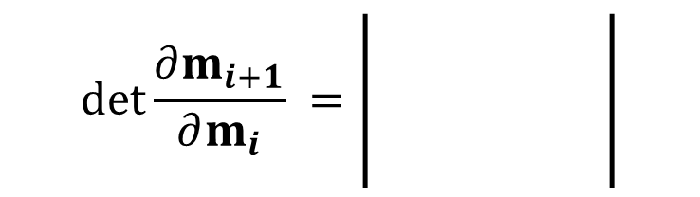



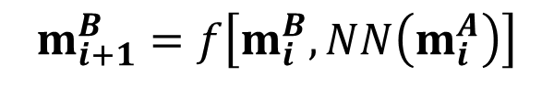

Constructing Flows
$$m_{i}^{A}$$
=
$$m_{i+1}^{A}$$
$$m_{i}$$
NN$(m_{i}^{A})$
$$m_{i+1}$$
$$m_{i}^{B}$$
f
$$m_{i+1}^{B}$$
Element-wise transform
$$\left|\begin{matrix} I & 0 \\ ? & \frac{∂m_{i+1}^{B} }{∂m_{i}^{B} }\end{matrix}\right|$$
$$\left|\begin{matrix} I & 0 \\ ? & \frac{∂m_{i+1}^{B} }{∂m_{i}^{B} }\end{matrix}\right|$$
$$\left|\begin{matrix} I & 0 \\ ? & \frac{∂m_{i+1}^{B} }{∂m_{i}^{B} }\end{matrix}\right|$$
$$\left|\begin{matrix} I & 0 \\ ? & \frac{∂m_{i+1}^{B} }{∂m_{i}^{B} }\end{matrix}\right|$$
$$\det{\frac{∂m_{i+1}}{∂m_{i}}} =\left|\begin{matrix}I & 0 \\ ? & \frac{∂m_{i+1}^{B} }{∂m_{i}^{B} }\end{matrix}\right|$$
$$m_{i+1}^{A}=m_{i}^{A}$$
$$m_{i+1}^{B}=f\left[m_{i}^{B}, NN\left(m_{i}^{A}\right)\right]$$
$$=\det{\frac{∂m_{i+1}^{B} }{∂m_{i}^{B} }}$$

Slide 12
Variational Inference using Normalizing Flows
Unknown True Posterior

Slide 13

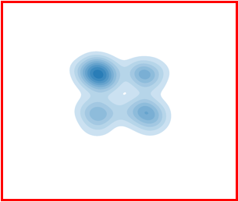




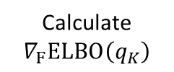
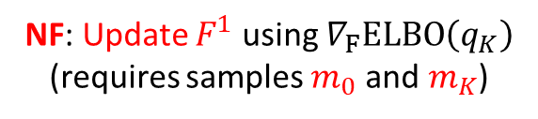

Variational Inference using Normalizing Flows
Unknown True Posterior
Distribution $q_{K}\left(m\right)$
Update Flows
Initial distribution $q_{0}\left(m\right)$
Calculate
$$∇_{F}\text{ELBO}\left(q_{K}\right)$$
Flows: $F^{1}$
$$m_{0}$$
$$m_{K}$$
NF: Update $F^{1}$ using $∇_{F}\text{ELBO}\left(q_{K}\right)$ (requires samples $m_{0}$ and${ m}_{K}$)

Slide 14




Variational Inference using Normalizing Flows
Unknown True Posterior
Distribution $q_{K}\left(m\right)$
Initial distribution $q_{0}\left(m\right)$
Flows: $F^{2}$

Slide 15

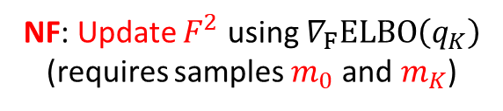



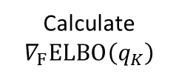

Variational Inference using Normalizing Flows
Unknown True Posterior
Distribution $q_{K}\left(m\right)$
Update Flows
Draw new samples from $q_{0}\left(m\right)$
Calculate
$$∇_{F}\text{ELBO}\left(q_{K}\right)$$
Flows: $F^{2}$
$$m_{0}$$
$$m_{K}$$
NF: Update $F^{2}$ using $∇_{F}\text{ELBO}\left(q_{K}\right)$ (requires samples $m_{0}$ and${ m}_{K}$)

Slide 16




Variational Inference using Normalizing Flows
Unknown True Posterior
Distribution $q_{K}\left(m\right)$
Initial distribution $q_{0}\left(m\right)$
Flows: $F^{3}$

Slide 17



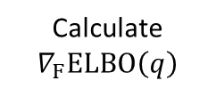

Variational Inference using Normalizing Flows
Unknown True Posterior
Distribution $q_{K}\left(m\right)$
Update Flows
Draw new samples from $q_{0}\left(m\right)$
Calculate
$$∇_{F}\text{ELBO}\left(q\right)$$
Flows: $F^{3}$
$$m_{0}$$
$$m_{K}$$
NF: Update $F^{3}$ using $∇_{F}\text{ELBO}\left(q_{K}\right)$ (requires samples $m_{0}$ and${ m}_{K}$)

Slide 18
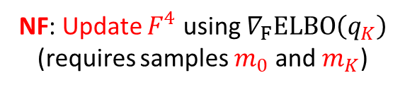



Variational Inference using Normalizing Flows
True Posterior distribution
Distribution $q_{K}\left(m\right)$
Initial distribution $q_{0}\left(m\right)$
Flows: $F^{4}$
NF: Update $F^{4}$ using $∇_{F}\text{ELBO}\left(q_{K}\right)$ (requires samples $m_{0}$ and $m_{K}$)

Slide 19
Synthetic Test of travel time tomography

Slide 20
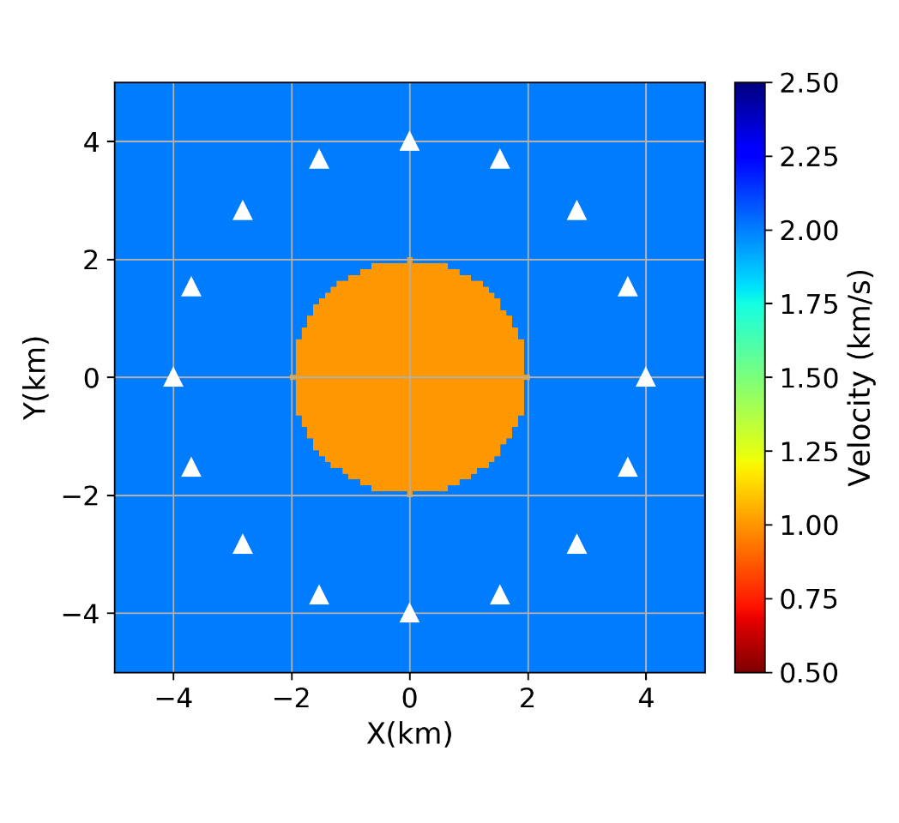
Travel Time Tomography
True Velocity Model

Slide 21
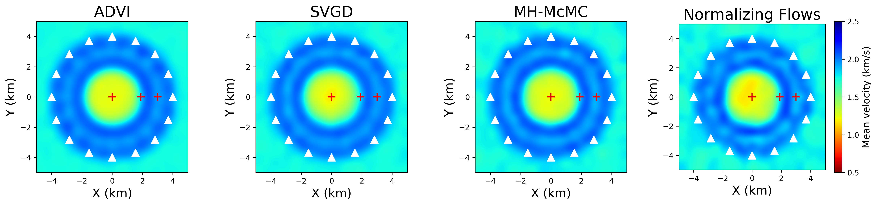
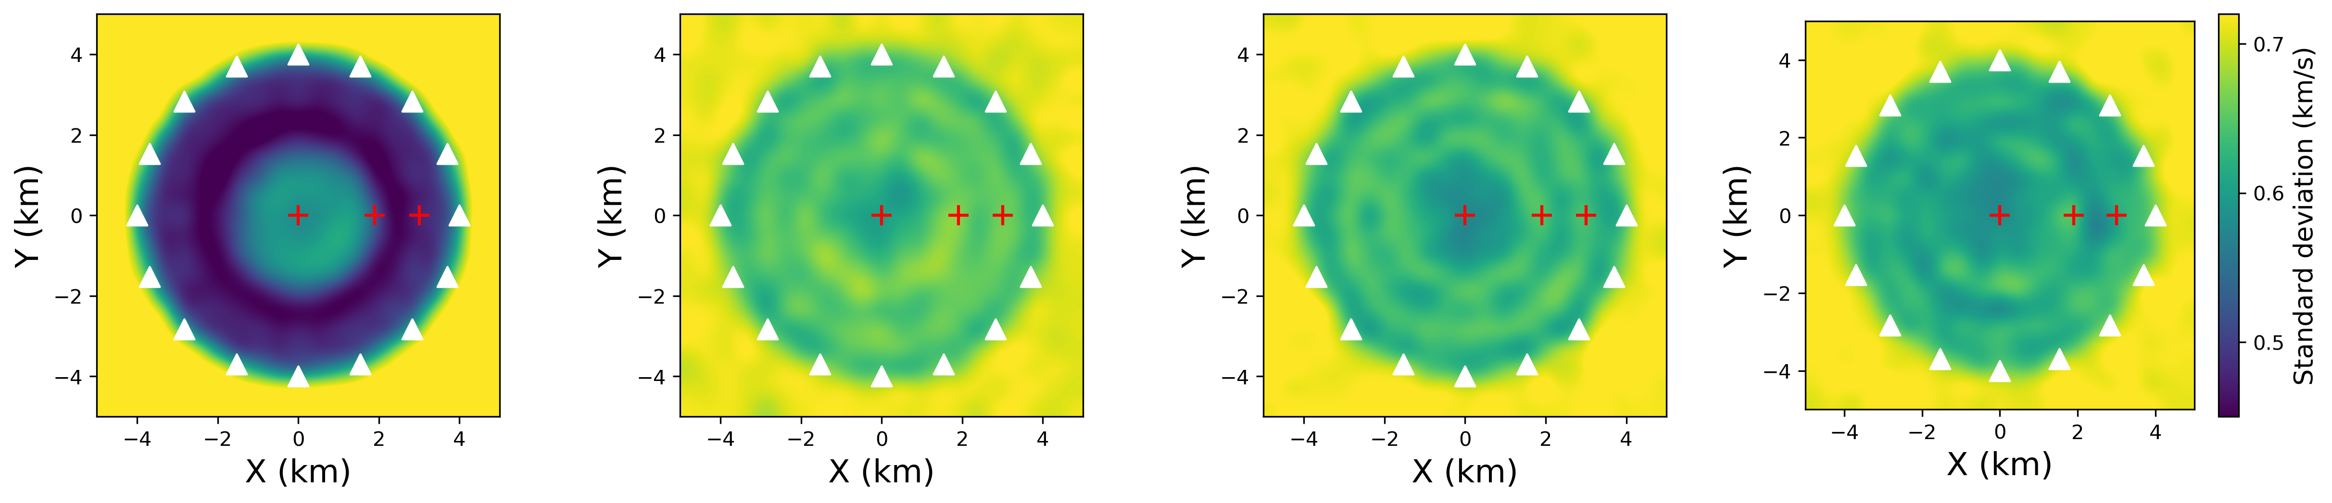
Travel Time Tomography: comparison

Slide 22
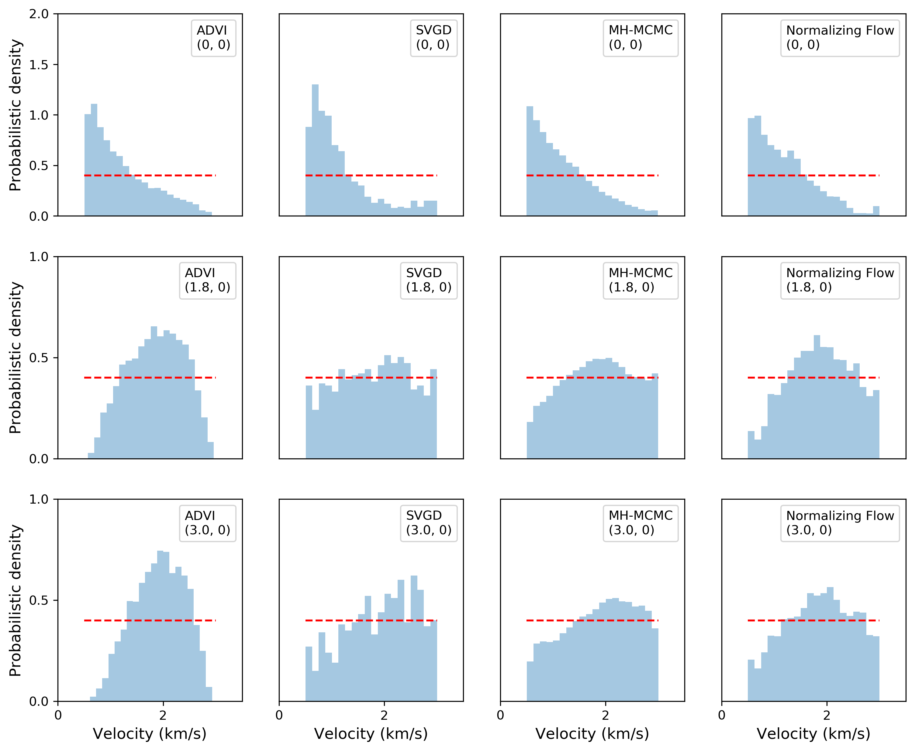
Marginals

Slide 23
Computational cost
Methods | Number of simulations
ADVI | 10,000
Normalizing Flows | 30,000
SVGD | 400,000
Rj-McMC | 3,000,000
MH-McMC | 12,000,000
Although cheapest,
Incorrect Uncertainty Results!!!
From Zhang and Curtis, 2020 JGR

Slide 24
Love Wave Tomography
of the British Isles

Slide 25
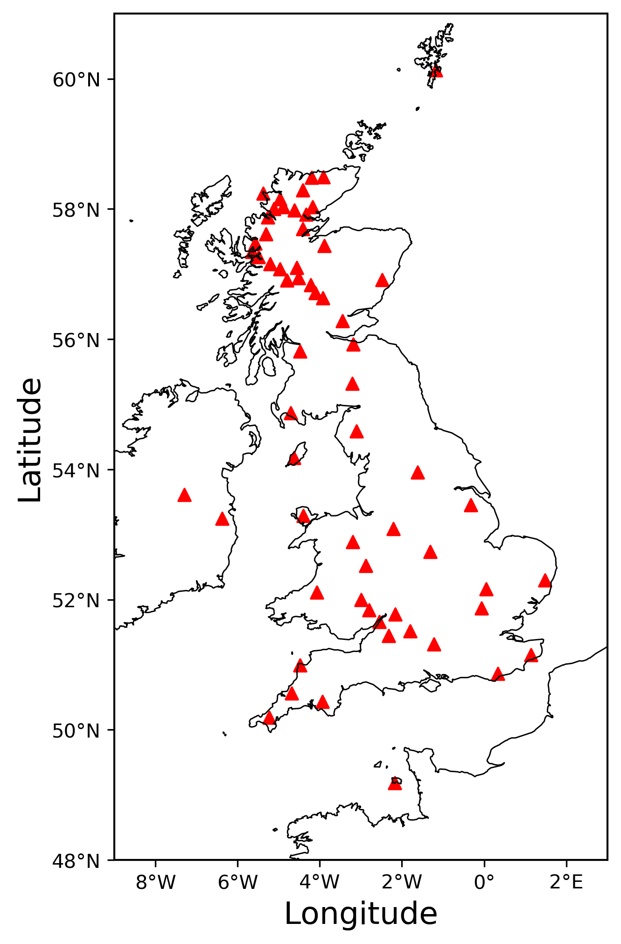
Receiver stations
Travel time data obtained from Galetti et al., 2017

Slide 26
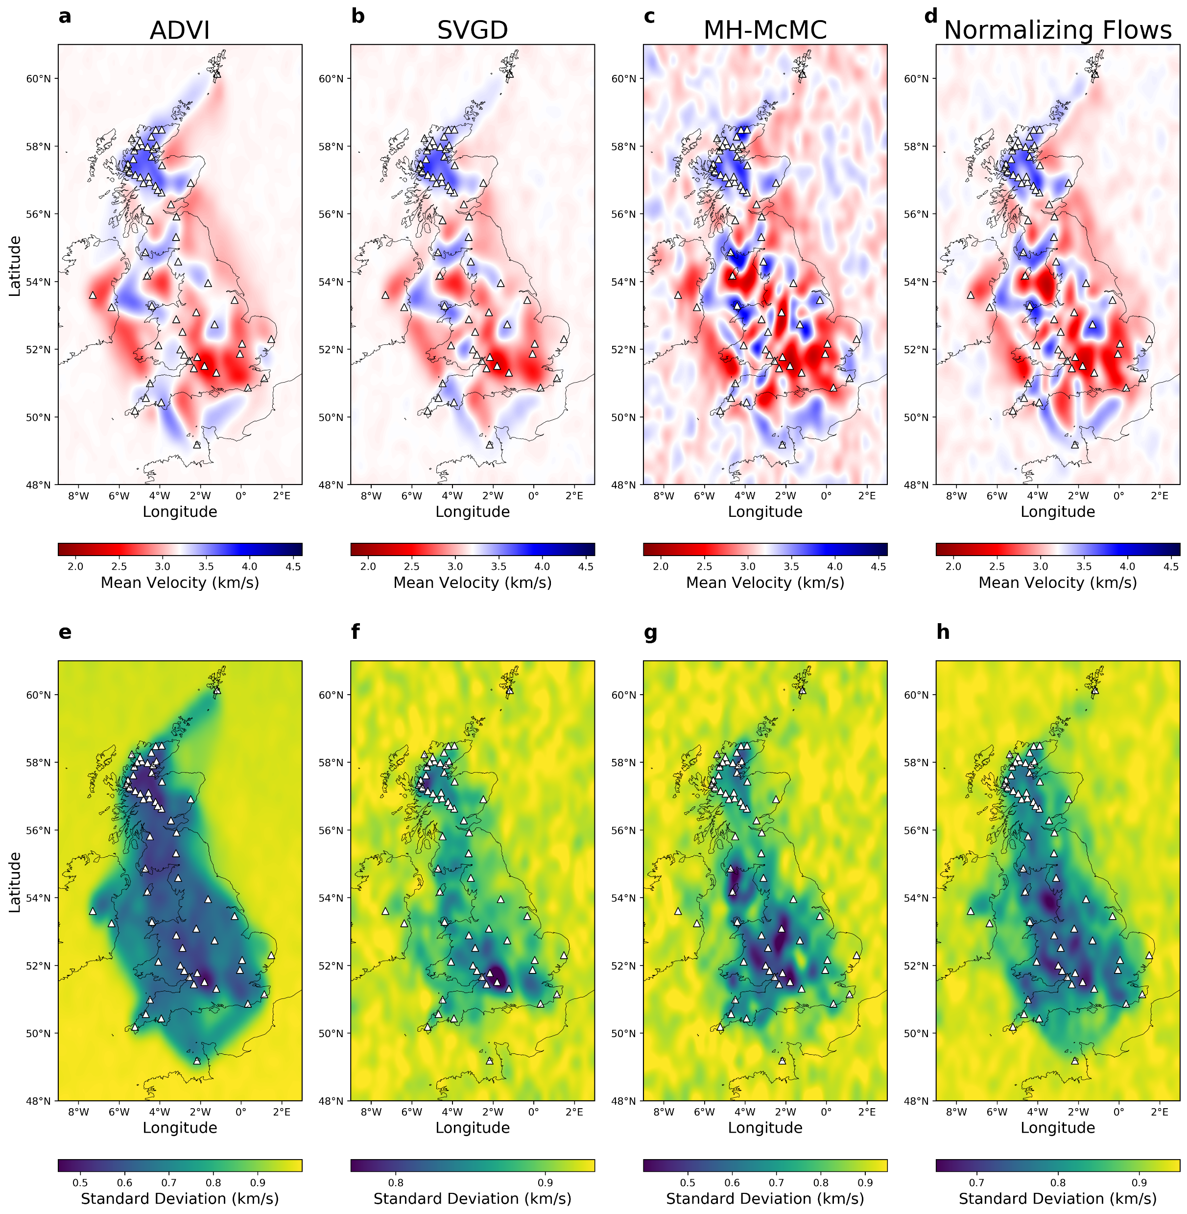
Results
Scotland Highlands
Midland Valley
Southern Uplands
Different resolution
in mean model
Irish Sea
Granites
London Basins
Uncertainty

Slide 27
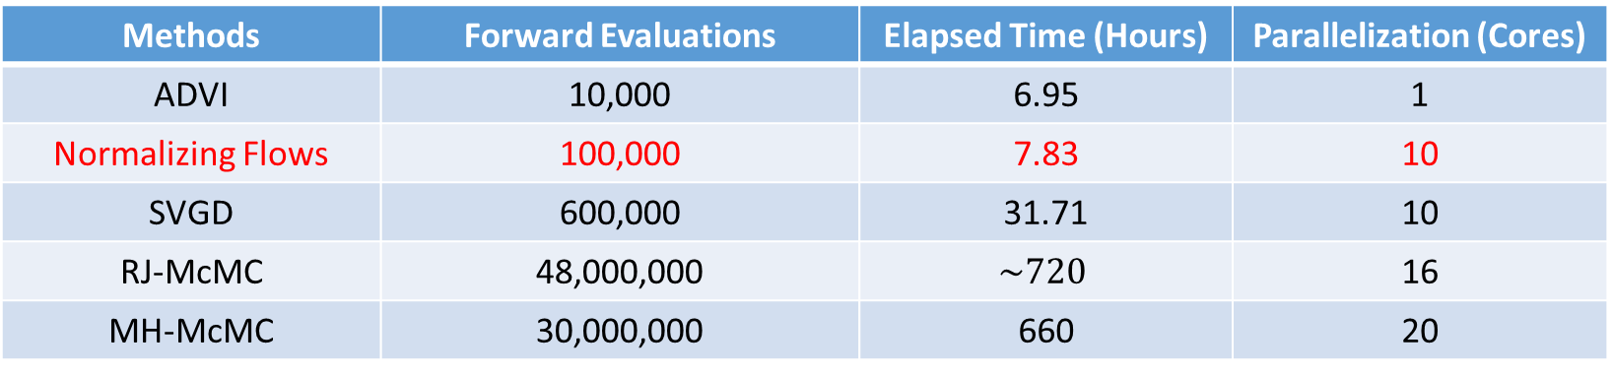
Computational cost
Methods | Forward Evaluations | Elapsed Time (Hours) | Parallelization (Cores)
ADVI | 10,000 | 6.95 | 1
Normalizing Flows | 100,000 | 7.83 | 10
SVGD | 600,000 | 31.71 | 10
RJ-McMC | 48,000,000 | $$\sim 720$$ | 16
MH-McMC | 30,000,000 | 660 | 20
From Galetti et al., 2017
(same dataset)

Slide 28
Conclusion
Normalizing flows: a chain of invertible transforms
Variational inference using normalizing flows: efficient and accurate
Love wave tomography of the British Isles

Slide 29



Thank you
For more details:
Zhao et al., 2020: Bayesian Seismic Tomography using Normalizing Flows. EarthArXiv
Email:
Xuebin.zhao@ed.ac.uk

