Slide 1
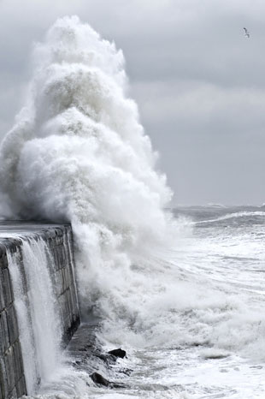



The use of ERDDAP in a self-monitoring and nowcast hazard alerting coastal flood system
@Wirewall_NOC
Louise Darroch, Thomas Gardner, Margaret Yelland, Christopher Cardwell, Emma Slater, Elizabeth Bradshaw, Justin Buck, Robert Jennings, Andrew Hale and Jennifer Brown

Slide 2

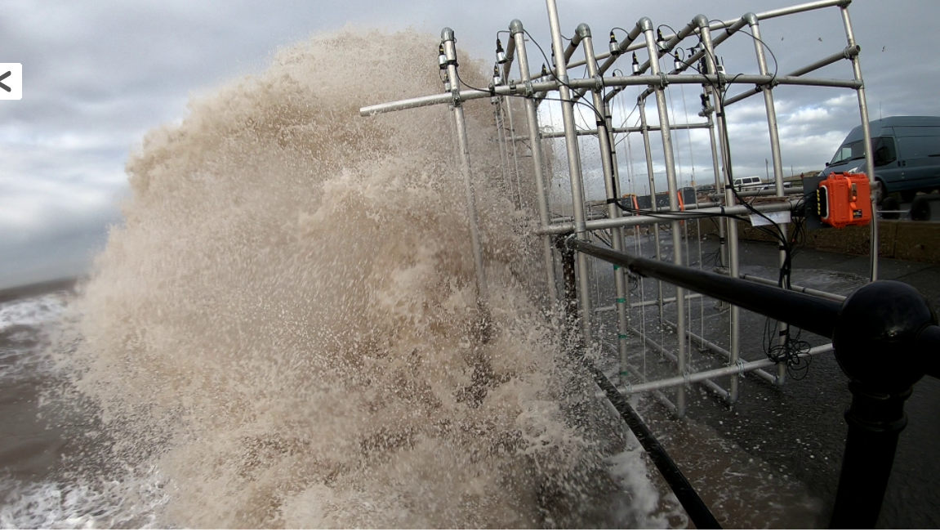
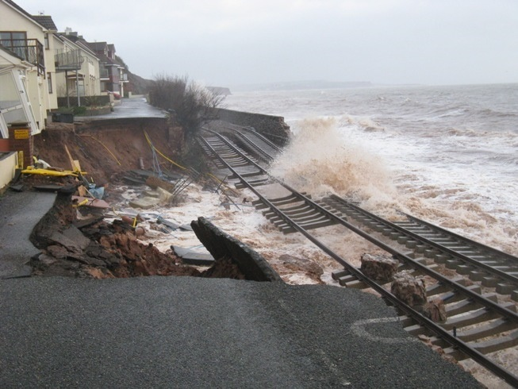
Coastal REsistance: Alerts and Monitoring Technologies
Novel capacitance wire sensor with 2-way telemetry
Nowcast hazardous flood detection system
detects floods in near real-time
validates flood forecast services

Slide 3




Coastal REsistance: Alerts and Monitoring Technologies
ERDDAP-based data control system using direct data ingest
Your favourite internet SENSOR
HTTP
direct data ingest
Your favourite internet server
DiGIR/
OBIS
SOS
WMS
Files
Database
DAP
Web
pages
…
https://linkedsystems.uk/erddap/
Automated analytics
Your favourite internet client
Message subscription service
Your favourite data format
apps.

Slide 4
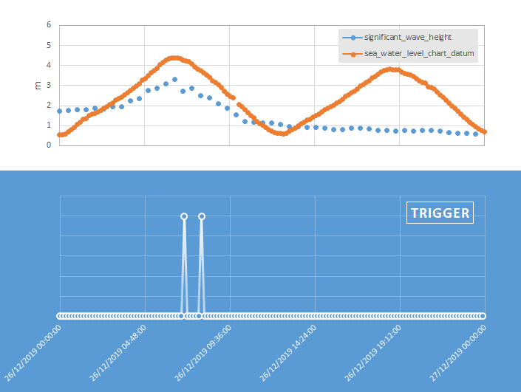
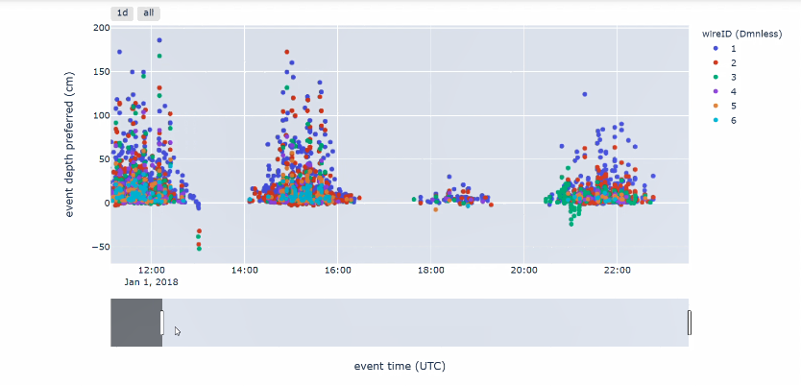
Coastal REsistance: Alerts and Monitoring Technologies
Automated SMART system
Monitoring triggers
Health alerts
Hazard alerts
Visual apps.

Slide 5
louise.darroch@bodc.ac.uk
@Wirewall_NOC

