Slide 1
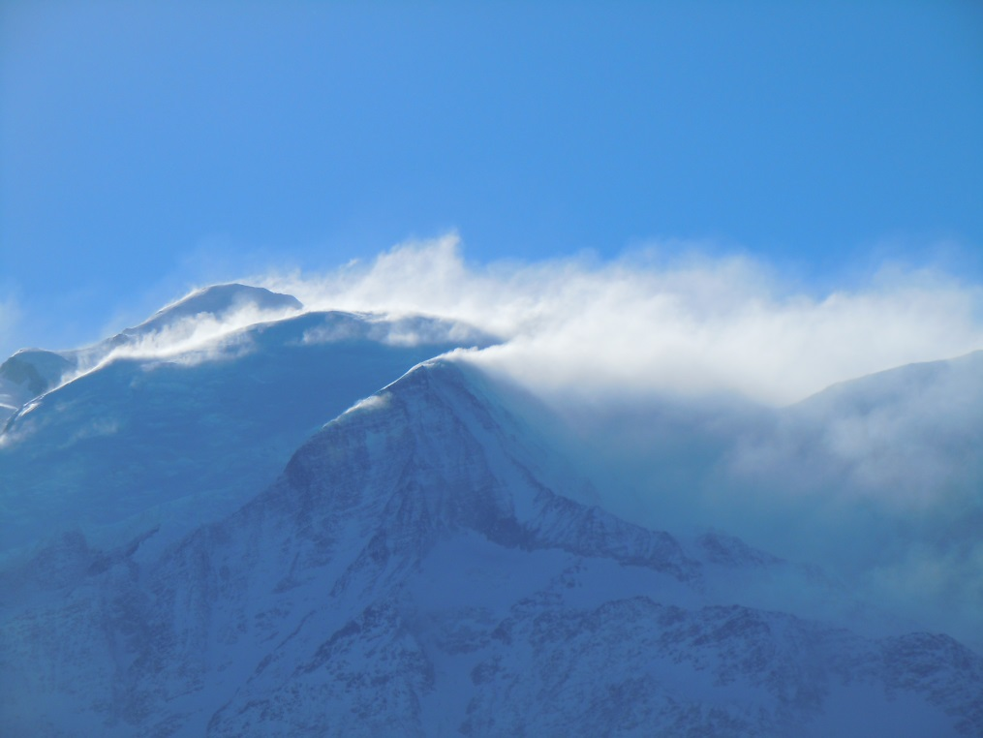




Local simulations of snow redistribution by wind with an intermediate-complexity snow cover model driven by different wind downscaling methods
Follow the blue links!
Or use the navigation buttons
L. Quéno, P. Morin, R. Mott, and T. Jonas
WSL Institute for Snow and Avalanche Research SLF, Davos, Switzerland

Slide 2
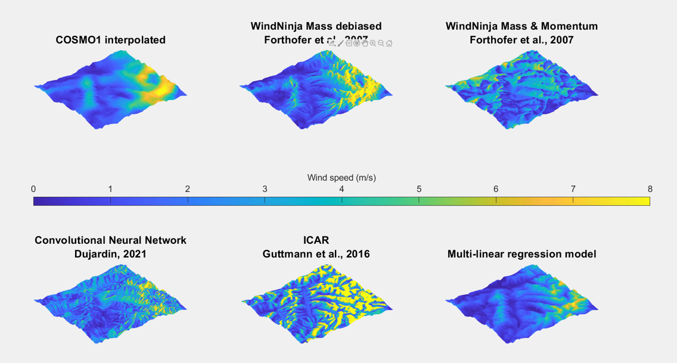
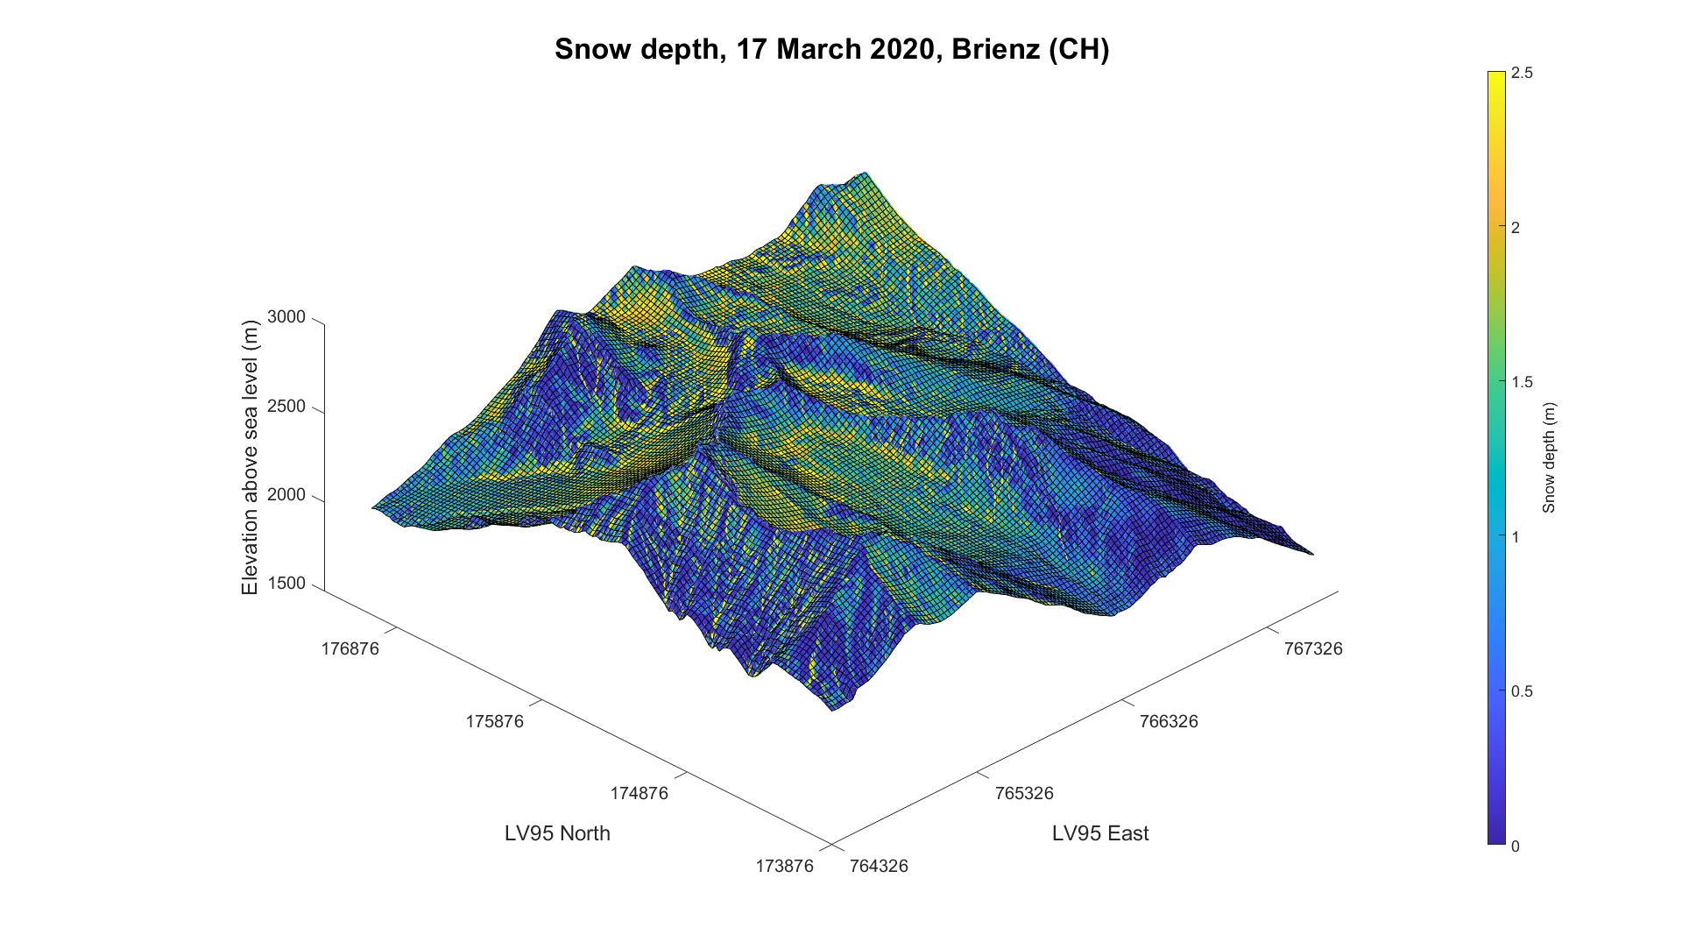
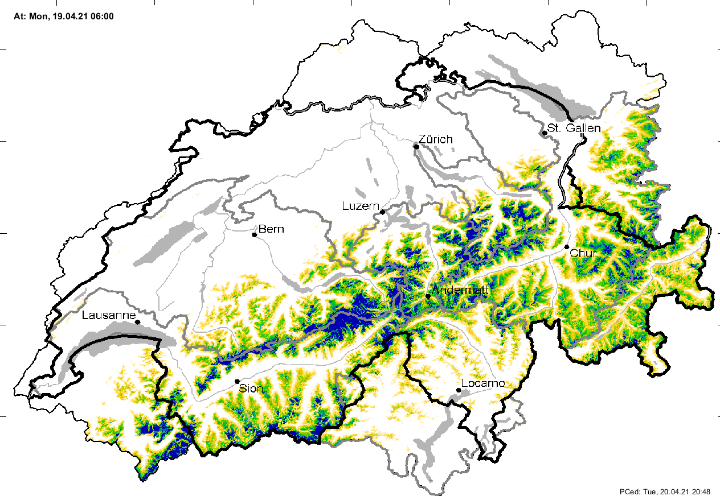
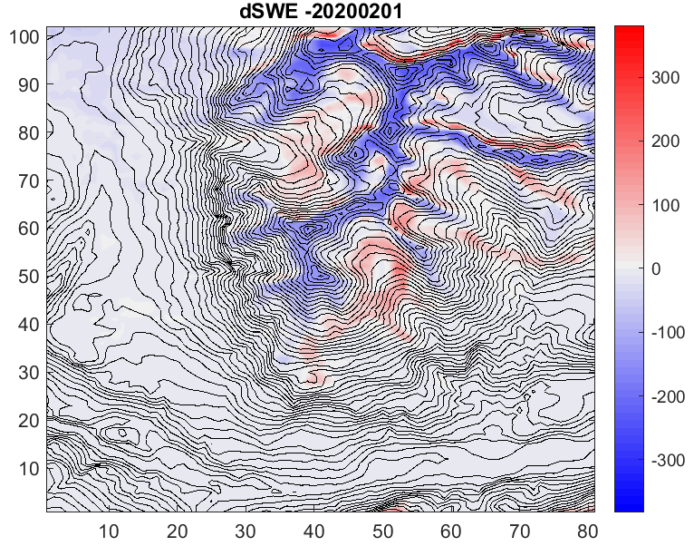
Problem
Data/methods
Results
Downscaling of wind fields
Assessment and comparison of wind downscaling methods
Implementation of snow transport in an intermediate-complexity snow cover model
Representing the impact of wind-driven snow transport on snow distribution and melt patterns with an intermediate complexity snow cover model over large domains
driving
Observational dataset
Snowpack/snowdrift simulations at 25 m -> 100 m resolution
100 km
Contact

Slide 3
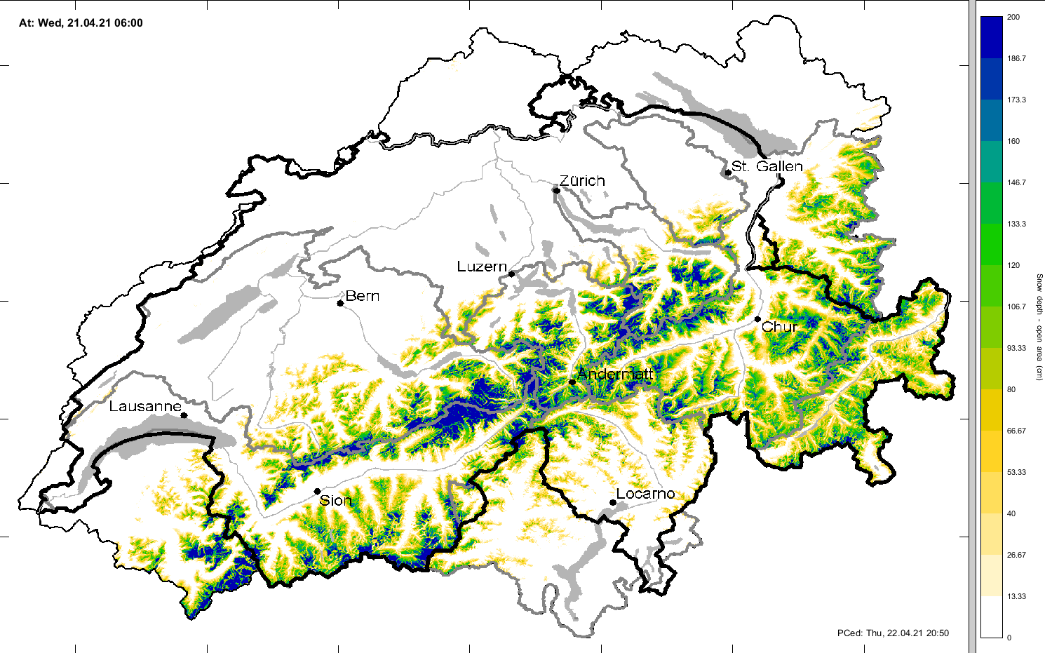
1. Importance of snowdrift for snow hydrology
Swiss operational snow hydrology service (OSHD): snow cover simulations over the Swiss Alps at 1 km to 250 m resolution
1 km resolution: representing snowdrift is not relevant
But at higher resolutions: a significant impact of snowdrift on snow distribution and melt patterns
Necessity to include snowdrift in our models while reaching ~ 100 m resolutions
Aim of the study
Find the best trade-off between complexity and cost to represent snowdrift…
at intermediate scales (for snow hydrology purposes)
with intermediate-complexity snow cover models
(i.e. without resolving the snow microstructure evolution)
to be run over large domains (Swiss Alps) over full seasons
See recent similar studies, e.g. Reynolds et al. (2020), Vionnet et al. (2021)
100 km
OSHD FSM simulated snow depth at 250 m resolution, 21/04/2021

Slide 4
2. Data and methods
Downscaling of wind fields
Implementation of snow transport in an intermediate-complexity snow cover model
Observational dataset

Slide 5
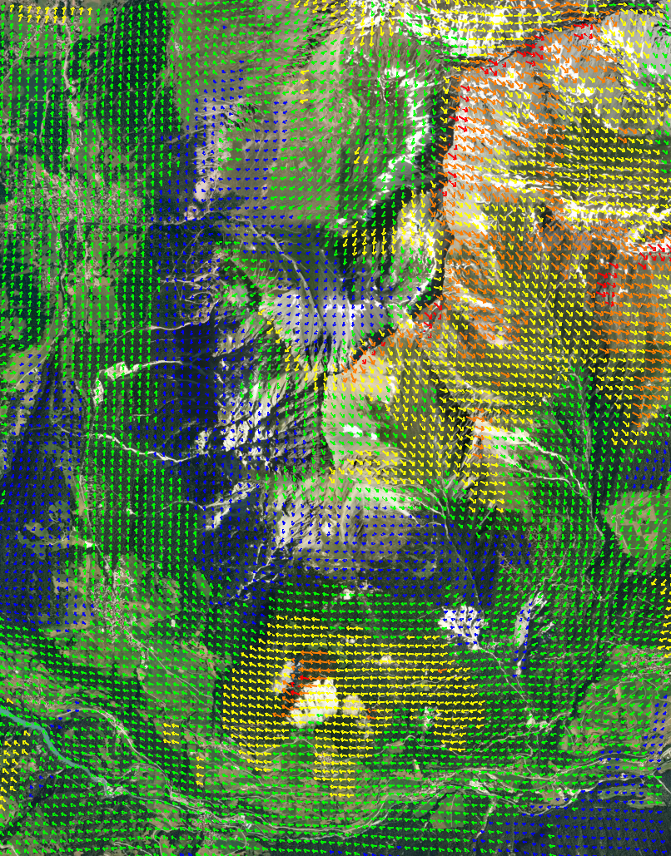
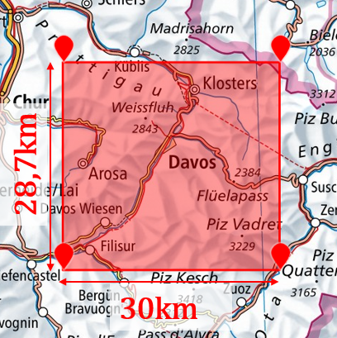
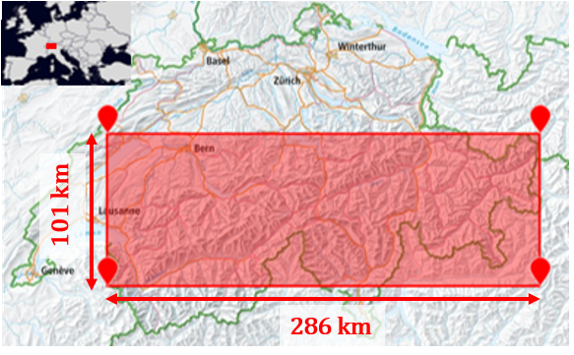
2.1 Downscaling of wind fields
COSMO 1 km resolution forecasts/analyses used as input for 4 wind downscaling methods (down to 100 m resolution):
Statistical:
Multilinear regression model, based on Winstral downscaling method (Winstral et al., 2017; Morin, 2021)
Convolutional neural network (Dujardin and Lehning, AGU 2020)
Dynamical:
WindNinja (Forthofer et al., 2014): Mass or Mass&Momentum version
ICAR (Gutmann et al., 2016; Reynolds et al., EGU 2021)
Intercomparison on 2 domains, 744 hours of data, March 2017
More information on the multilinear regression model
Validation: 13 weather stations
Validation: 169 weather stations
Example of COSMO-WindNinjaMass wind field near Davos,
backgroud image: GoogleEarth
(Map source: SwissTopo)

Slide 6
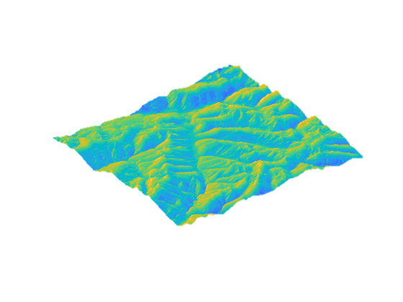
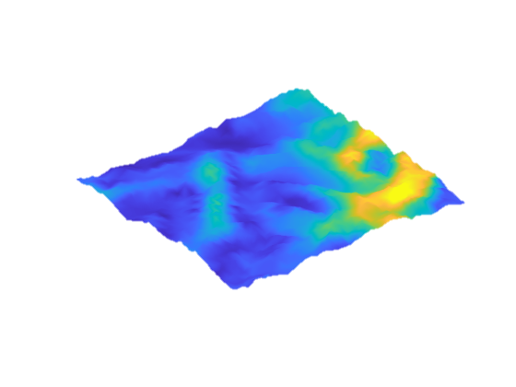
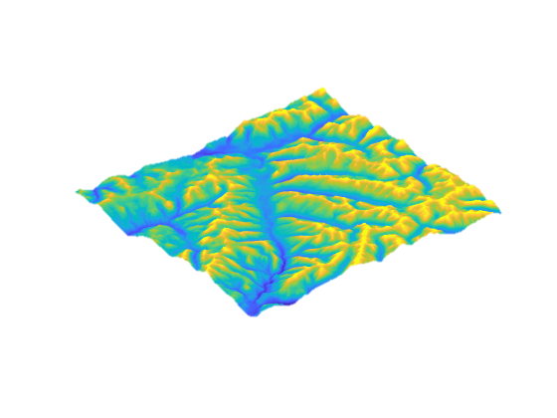

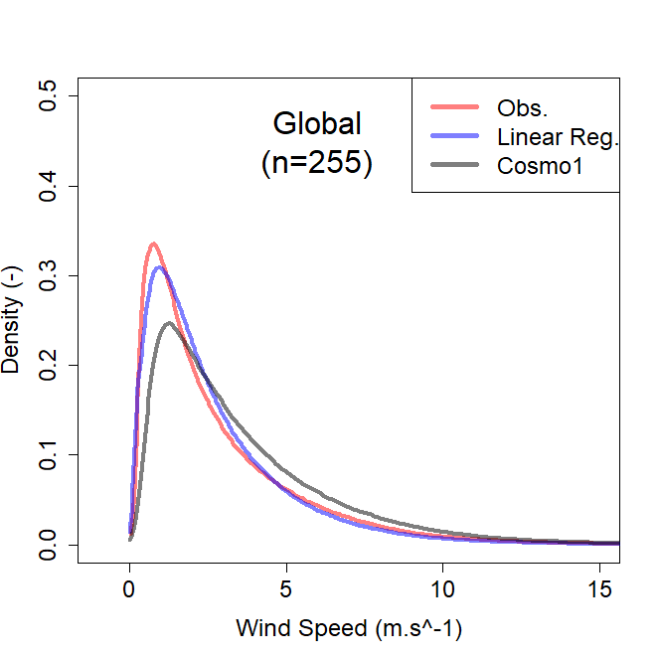
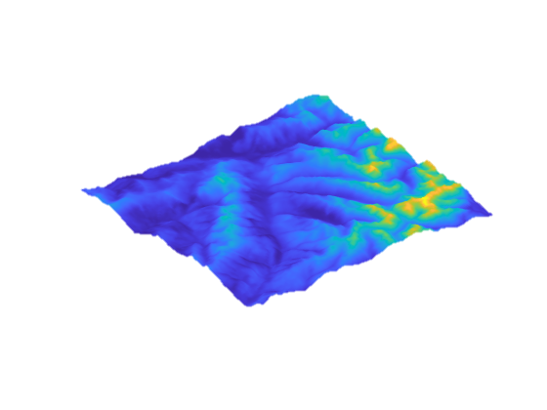





2.1 Downscaling of wind fields
Multilinear regression model: based on Winstral downscaling method, but without TPI steps (Winstral et al., 2017)
Sx (wind exposure)
Kilometric wind forecasts
TPI (topography index)
Exposed
Strong wind
Ridge
$$\underline{\underline{A}}$$
$$\underline{\underline{B}}$$
Sheltered
Low wind
$$\underline{\underline{C}}$$
Valley
Higher resolution forecasts
$$\underline{\underline{D}}$$
$\underline{\underline{D}}=\underline{\underline{B}}$($0,61+6,27∗10^{−4}$*$\underline{\underline{C}}$)-0,015*$\underline{\underline{A}}$
(Calibrated with one year of hourly data (Sep. 2016 - Aug. 2017), over the entire Switzerland, 255 weather stations)

Slide 7
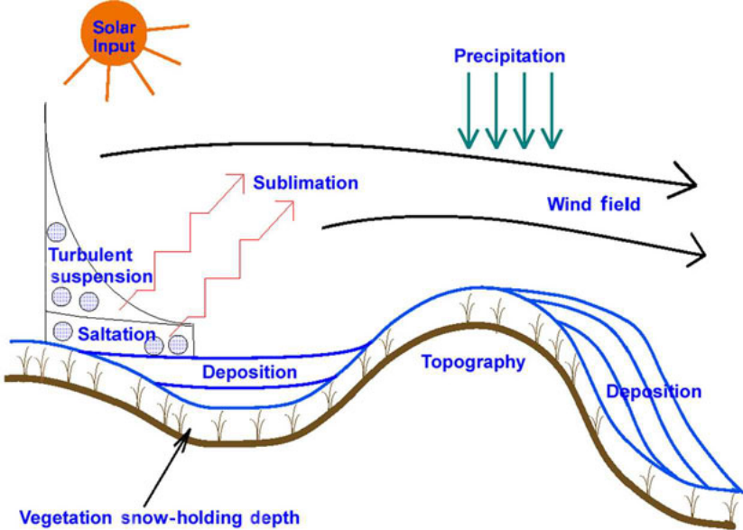
2.2 Implementation of snow transport in an intermediate-complexity snow cover model
Meteorological input, using OSHD modelling framework:
COSMO 1km forecast and analyses
Precipitation analyses
Data assimilation of snow monitoring data
Downscaling of meteo variables
Intermediate-complexity snowpack model FSM (Essery, 2015):
Solving mass and energy budgets
No representation of snow microstructure
Spatially distributed simulations
High resolution near-surface wind fields
Implementation of the snow transport module SnowTran3D (Liston et al., 2007)
(Liston et al., 2007)

Slide 8

2.2 Implementation of snow transport in an intermediate-complexity snow cover model
Development of new layering features to better determine erodible snow:
Density-dependent layering, with a flexible number of layers
New state variable of previous liquid water content (no transport for wet or refrozen snow)
Standard FSM fixed layering
Meteorological input, using OSHD modelling framework:
COSMO 1km forecast and analyses
Precipitation analyses
Data assimilation of snow monitoring data
Downscaling of meteo variables
Intermediate-complexity snowpack model FSM (Essery, 2015):
Solving mass and energy budgets
No representation of snow microstructure
Spatially distributed simulations
New density-dependent layering
High resolution near-surface wind fields
Implementation of the snow transport module SnowTran3D (Liston et al., 2007)

Slide 9
2.2 Implementation of snow transport in an intermediate-complexity snow cover model
Development of new layering features to better determine erodible snow:
Density-dependent layering, with a flexible number of layers
New state variable of previous liquid water content (no transport for wet or refrozen snow)
Meteorological input, using OSHD modelling framework:
COSMO 1km forecast and analyses
Precipitation analyses
Data assimilation of snow monitoring data
Downscaling of meteo variables
Intermediate-complexity snowpack model FSM (Essery, 2015):
Solving mass and energy budgets
No representation of snow microstructure
Spatially distributed simulations
Snow cover simulations with lateral snow redistribution at resolutions of 25 m / 50 m / 100 m
High resolution near-surface wind fields
Implementation of the snow transport module SnowTran3D (Liston et al., 2007)
Upscaling at higher resolution over a large domain?

Slide 10
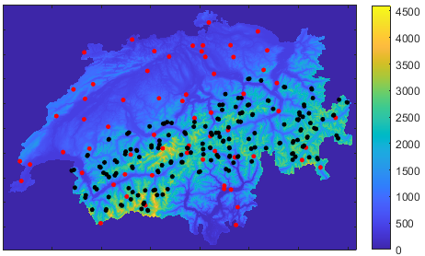
2.3 Observational dataset
LIDAR snow depth measurements in Davos area
Elevation (m)
Automatic weather stations from IMIS (black) and SwissMetNet (red) networks
Snow depth (m)
Wind and snow depth measurements from automatic weather stations

Slide 11
3. Results
Assessment and comparison of wind downscaling methods
Snowpack/snowdrift simulations at 25 m -> 100 m resolution

Slide 12
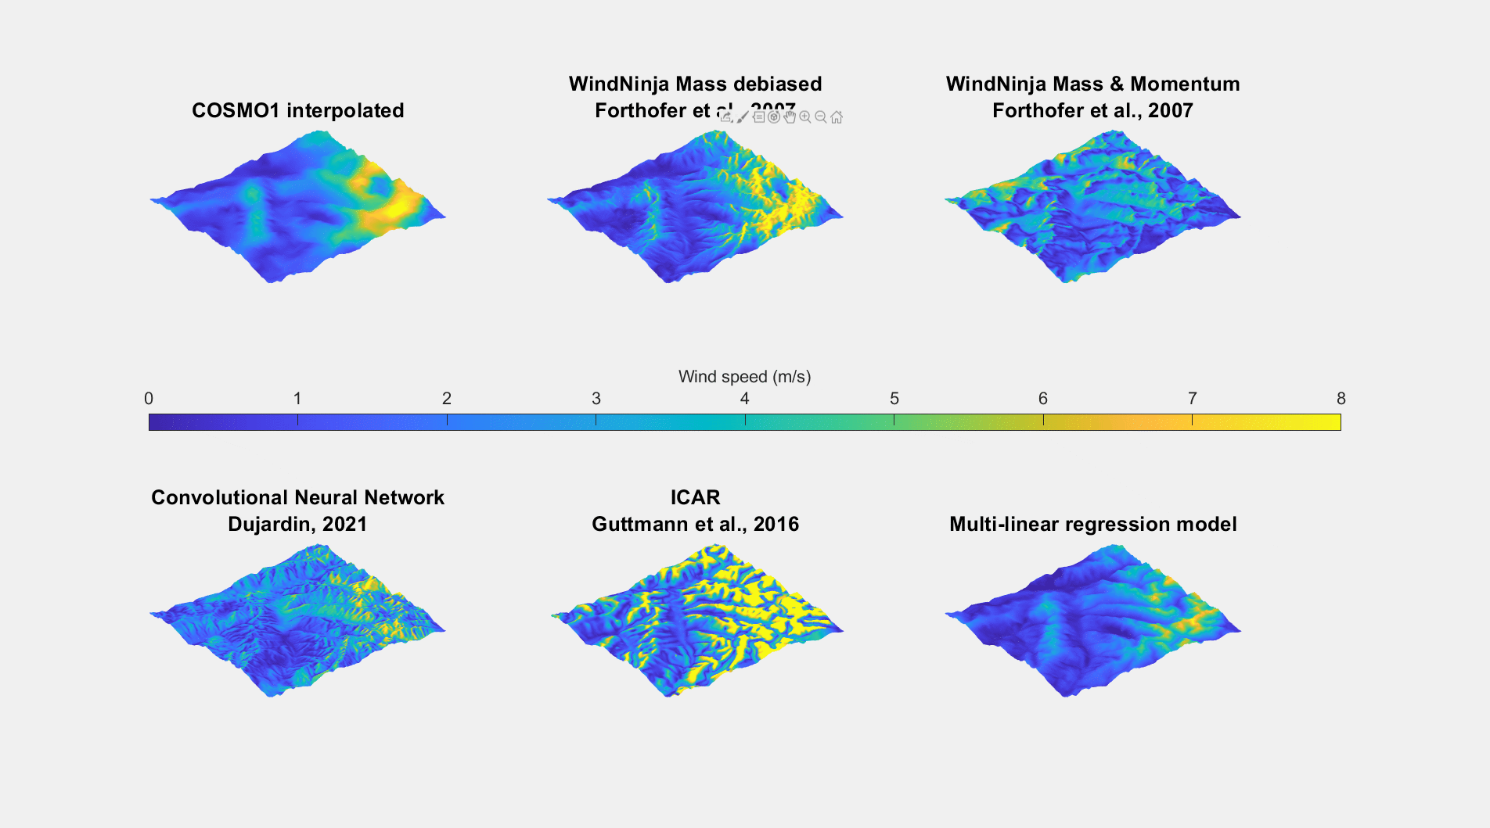
3.1 Comparison of wind downscaling methods
COSMO1 interpolated
WindNinja Mass debiased
WindNinja Mass&Momentum
Convolutional Neural Network
ICAR
Multilinear regression model

Slide 13
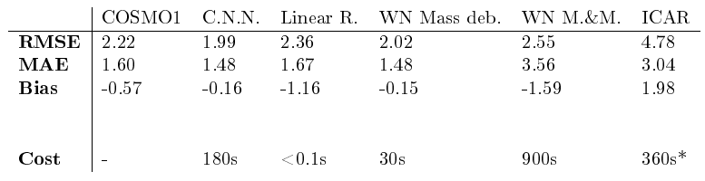
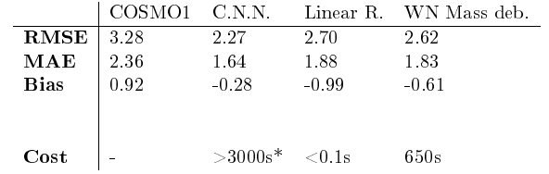
3.1 Comparison of wind downscaling methods
(with a constant debiasing factor)
(Version currently under development)
RMSE = Root Mean Square Error
MAE = Mean Absolute Error
Cost = Time to downscale an hourly forecast
* Estimation
Best performance metrics for the Convolutional Neural Network and WindNinja Mass (debiased)
Reasonable computational costs for WindNinja Mass to be run at 100 m resolution over the Swiss Alps
CNN computational costs are currently being improved
A finer representation of topography-induced wind patterns by dynamical methods and CNN
(Map source: SwissTopo)

Slide 14
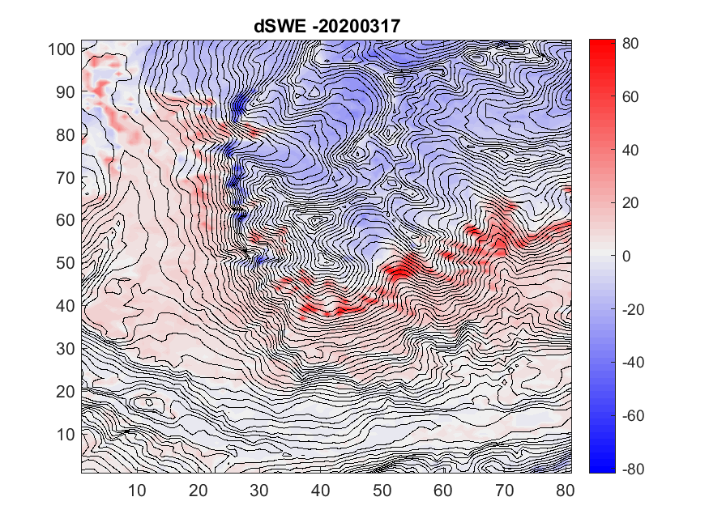
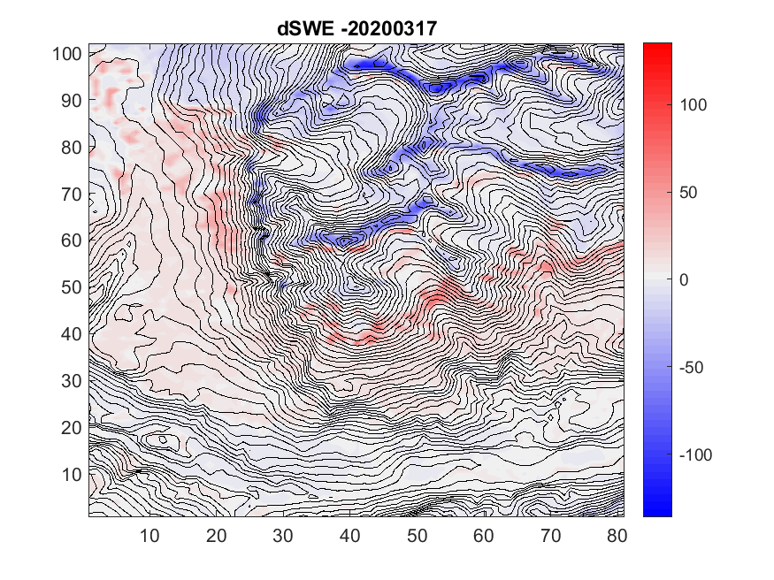
3.2 Snowpack/snowdrift simulations
20200317 ≈ "peak of winter"
Clear added value of downscaled wind fields to capture increased erosion at ridges
accumulation
accumulation
dSWE (mm)
dSWE (mm)
erosion
erosion
SWE by FSM/SnowTran3D – SWE by FSM/nosnowdrift (mm)
Driving wind field: simple interpolation of 1 km COSMO forecasts
SWE by FSM/SnowTran3D – SWE by FSM/nosnowdrift (mm)
Driving wind field: WindNinja Mass downscaling

Slide 15
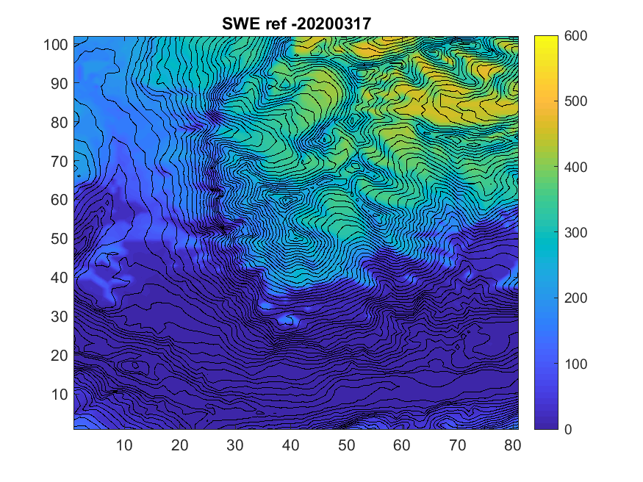
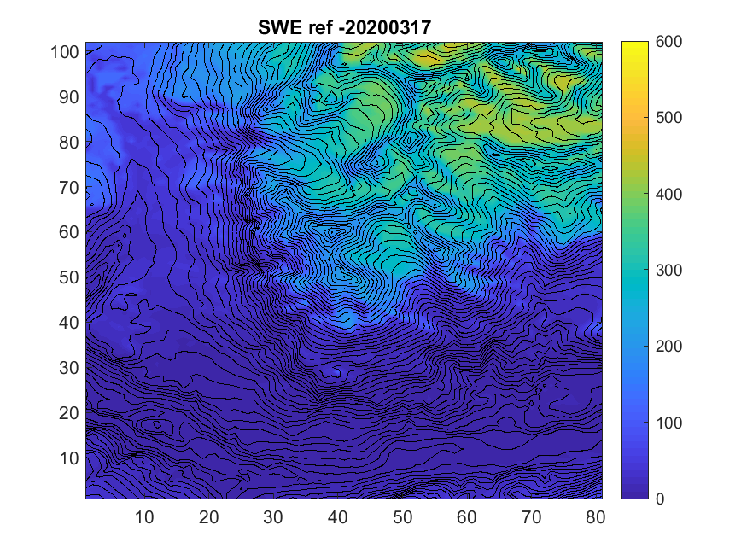
3.2 Snowpack/snowdrift simulations
FSM/nosnowdrift
Comparison of layering schemes
Standard layering: too much snow transported (too coarse layering) -> ridges totally eroded
New layering: excess of densification -> not enough erodable snow (only one significant simulated snowdrift event in the winter)
Densification issue needs to be fixed in the new layering
FSM/SnowTran3D
Difference
SWE (mm)
SWE (mm)
SWE by FSM/nosnowdrift (mm)
Driving wind field: WindNinja Mass downscaling
Standard layering
SWE by FSM/nosnowdrift (mm)
Driving wind field: WindNinja Mass downscaling
New layering

Slide 16
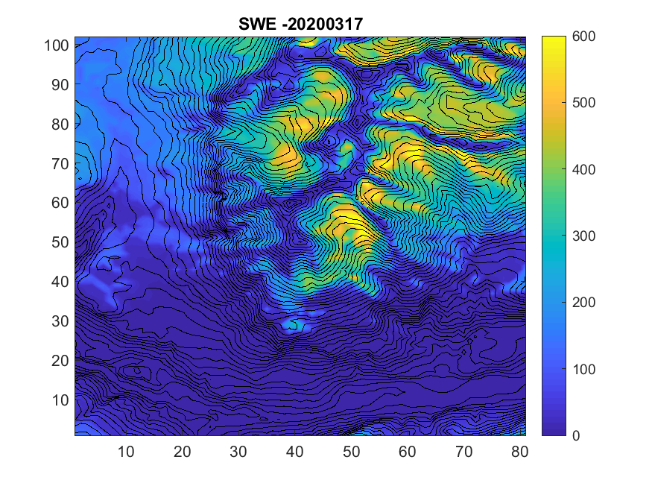

3.2 Snowpack/snowdrift simulations
FSM/nosnowdrift
Comparison of layering schemes
Standard layering: too much snow transported (too coarse layering) -> ridges totally eroded
New layering: excess of densification -> not enough erodable snow (only one significant simulated snowdrift event in the winter)
Densification issue needs to be fixed in the new layering
FSM/SnowTran3D
Difference
SWE (mm)
SWE (mm)
SWE by FSM/SnowTran3D (mm)
Driving wind field: WindNinja Mass downscaling
Standard layering
SWE by FSM/SnowTran3D (mm)
Driving wind field: WindNinja Mass downscaling
New layering

Slide 17
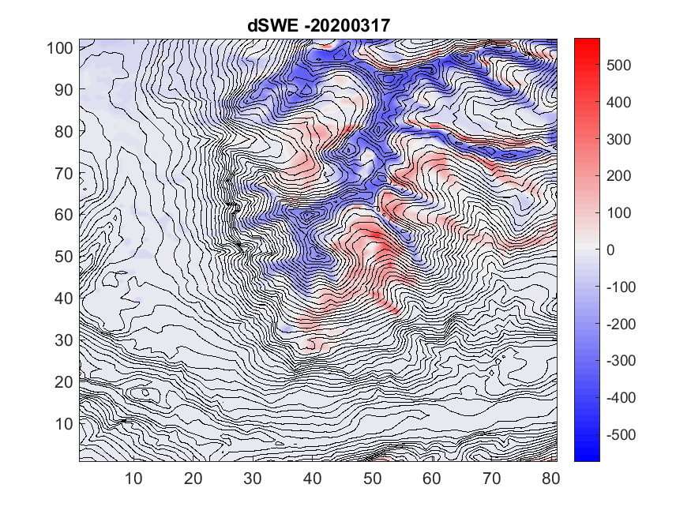
3.2 Snowpack/snowdrift simulations
FSM/nosnowdrift
Comparison of layering schemes
Standard layering: too much snow transported (too coarse layering) -> ridges totally eroded
New layering: excess of densification -> not enough erodable snow (only one significant simulated snowdrift event in the winter)
Densification issue needs to be fixed in the new layering
FSM/SnowTran3D
Difference
accumulation
accumulation
dSWE (mm)
dSWE (mm)
erosion
erosion
SWE by FSM/SnowTran3D - SWE by FSM/nosnowdrift (mm)
Driving wind field: WindNinja Mass downscaling
Standard layering
SWE by FSM/SnowTran3D - SWE by FSM/nosnowdrift (mm)
Driving wind field: WindNinja Mass downscaling
New layering

Slide 18
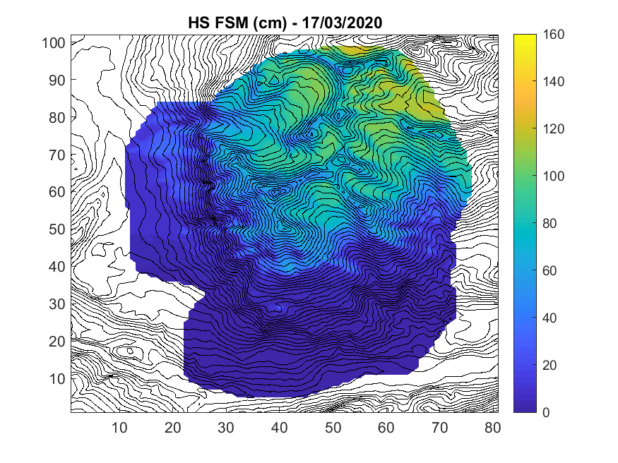
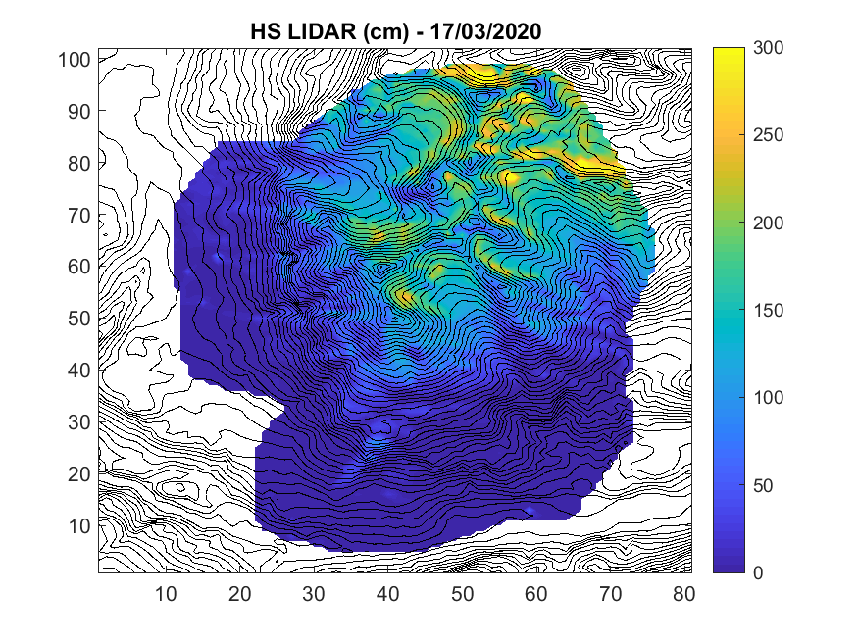
3.2 Snowpack/snowdrift simulations
Comparison to LIDAR snowdepth measurements
Transported snow patterns are too coarse in the simulations compared to the observed patterns
Necessity to go down to higher resolutions < 100 m
Snow depth (cm)
Snow depth (cm)
HS by FSM/SnowTran3D (cm)
Driving wind field: WindNinja Mass downscaling
New layering
LIDAR HS measurements (cm)

Slide 19
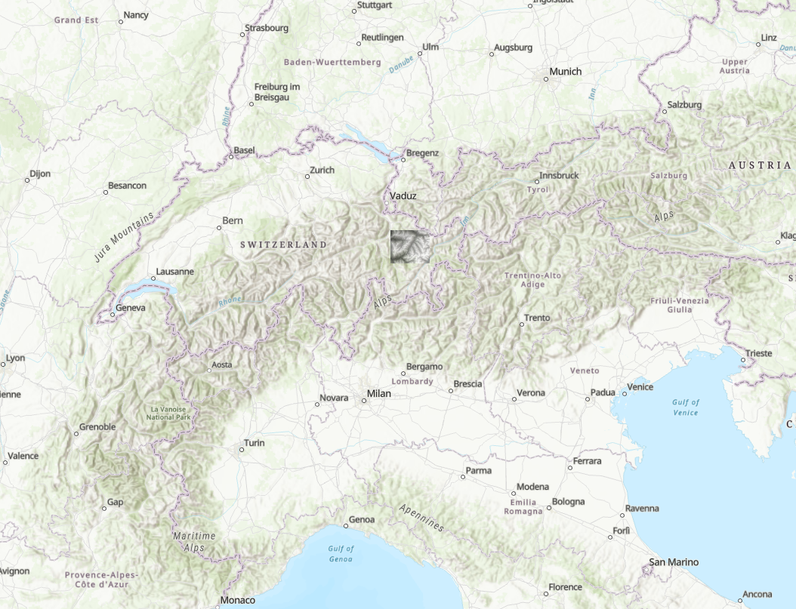
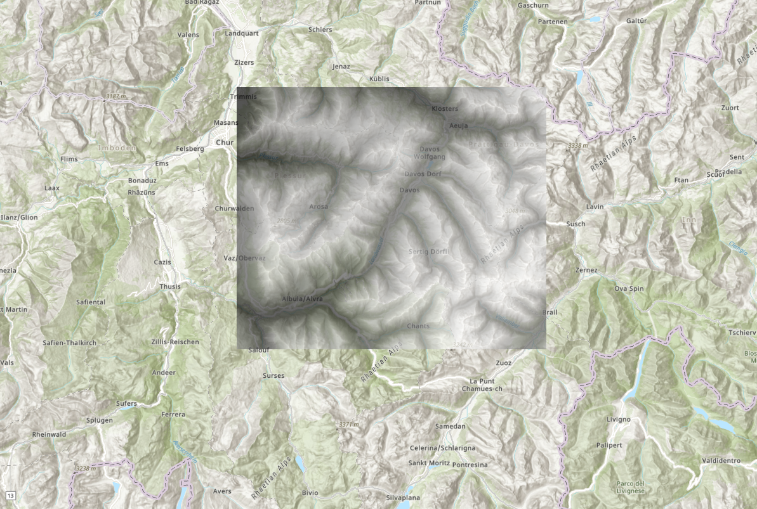
4. Ongoing work
More thorough intercomparison of the wind downscaling methods (extended domain, full years)
Seasonal FSM/SnowTran3D simulations at 25 m, 50 m and 100 m over the extended domain: choice of a relevant resolution
Solving the snow densification/layering issue for a better determination of the amount of transportable snow
31.6 km
Comparison of simulations with different LIDAR HS data
Including new snowdrift observations to assess the snowdrift triggering in simulations
37.3 km
New simulation domain at 25 m resolution, around Davos, Swiss Alps

Slide 20
References
Dujardin, J., and Lehning, M.: Multi-Resolution Convolutional Neural Network for High-Resolution Downscaling of Wind Fields from Operational Weather Prediction Models in Complex Terrain, AGU 2020.
Essery, R.: A factorial snowpack model (FSM 1.0), Geosci. Model Dev., 8, 3867–3876, https://doi.org/10.5194/gmd-8-3867-2015, 2015.
Forthofer, J., Butler, B., and Wagenbrenner, N.: A comparison of three approaches for simulating fine-scale surface winds in support of wildland re management. Part I. Model formulation and comparison against measurements, International Journal of Wildland Fire, 23, https://doi.org/10.1071/WF12089, 2014.
Gutmann, E., Barstad, I., Clark, M., Arnold, J., and Rasmussen, R.: The Intermediate Complexity Atmospheric Research Model (ICAR), Journal of Hydrometeorology, 17(3), 957-973, https://doi.org/10.1175/JHM-D-15-0155.1, 2016.
Liston, G., Haehnel, R., Sturm, M., Hiemstra, C., Berezovskaya, S., and Tabler, R.: Simulating complex snow distributions in windy environments using SnowTran-3D, Journal of Glaciology, 53(181), 241-256, https://doi.org/10.3189/172756507782202865, 2007.
Morin, P.: Downscaling of wind fields in mountainous terrain for snowpack modelling, Master’s thesis, Université de Technologie de Belfort-Montbéliard, 2021.
Reynolds, D., Pflug, J. M., and Lundquist, J. D.: Evaluating wind fields for use in basin-scale distributed snow models, Water Resources Research, 57, e2020WR028536, https://doi.org/10.1029/2020WR028536, 2020.
Reynolds, D., Kruyt, B., Gutmann, E., Jonas, T., Lehning, M., and Mott, R.: Improvements to an intermediate complexity atmospheric model for high-resolution downscaling in very complex terrain., EGU General Assembly 2021, online, 19–30 Apr 2021, EGU21-12662, https://doi.org/10.5194/egusphere-egu21-12662, 2021.
Vionnet, V., Marsh, C. B., Menounos, B., Gascoin, S., Wayand, N. E., Shea, J., Mukherjee, K., and Pomeroy, J. W.: Multi-scale snowdrift-permitting modelling of mountain snowpack, The Cryosphere, 15, 743–769, https://doi.org/10.5194/tc-15-743-2021, 2021.
Winstral, A., Jonas, T., and Helbig, N.: Statistical downscaling of gridded wind speed data using local topography, J. Hydrometeorol., 18, 335–348, https://doi.org/10.1175/JHM-D-16-0054.1, 2017.

Slide 21

Contact
Louis Quéno, PostDoc
WSL Institute for Snow and Avalanche Research SLF
Davos, Switzerland
louis.queno@slf.ch
Research Gate

