Slide 1






HS4.7|Emerging approaches: Hydrologic-hydraulic modelling for urban floods and Thresholds in hydrology
Assessing the utility of climate variability information in streamflow forecasting
(EGU21-14633)
Authors:
Prem Lal Patel, Ph.D.
Priyank J. Sharma, Ph.D.
Ramesh S. V. Teegavarapu, Ph.D.
Presenter:
Priyank J. Sharma, Ph.D.
Punjab Engineering College, Chandigarh, India.

Slide 2
Background of the Problem
Background
Model
Results
Conclusions
The prediction of total and peak streamflows are essential for effective management of water resources systems.
The hydroclimatic variables such as temperature, rainfall, streamflow, and others are influenced by the climate variability.
Large-scale coupled oceanic-atmospheric circulations such as El Niño-Southern Oscillation (ENSO), Pacific Decadal Oscillation (PDO), Indian Ocean Dipole (IOD), etc. have known to exert significant influences on hydroclimatic conditions across different regions of the globe.
Hence, an attempt is made to assess the utility of information related to ENSO circulations in improvement of streamflow forecasting (data-driven) model performance.
Summary: The present study aims to assess whether incorporation of climate variability information would lead to improvement in forecasting streamflows or not.

Slide 3
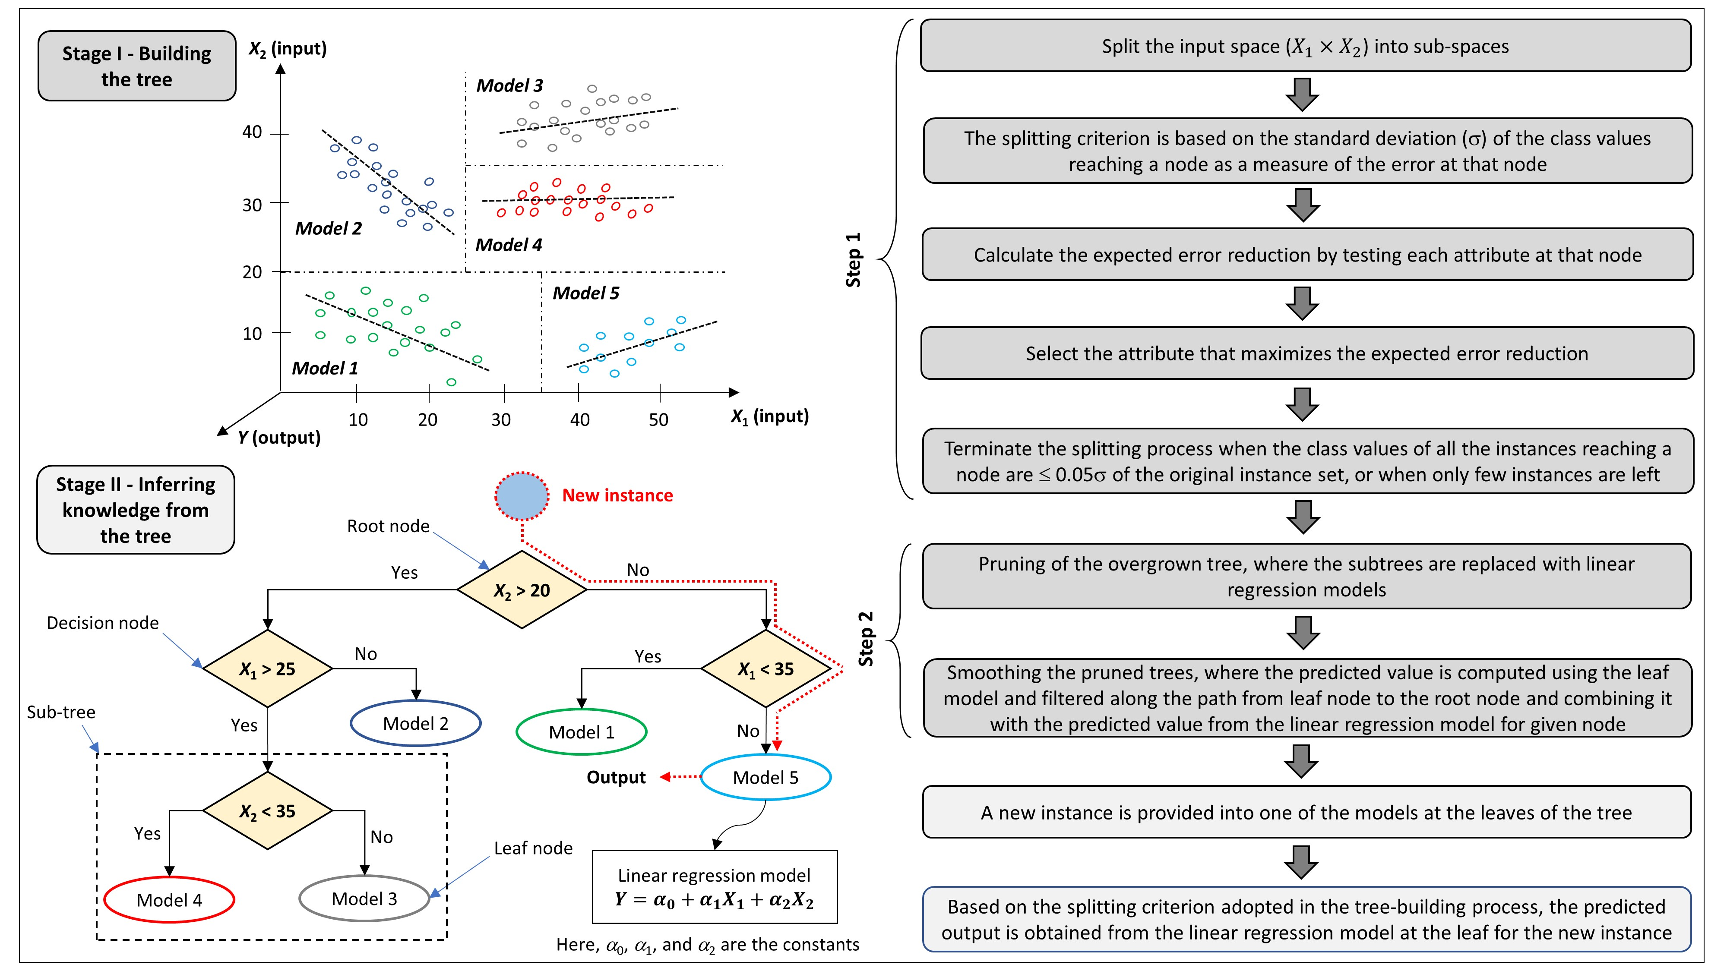
Model Development – Model Tree
Background
Model
Results
Conclusions
Model Tree variants
PS – pruned and smoothed
PUS – pruned and unsmoothed
UPS – unpruned and smoothed
UPUS – unpruned and unsmoothed
Sharma et al. (2021)
Summary: Model Tree involves piece-wise linearization of a non-linear process, which involves splitting of the parameter space into sub-spaces and formulating linear models for each of them.
3

Slide 4
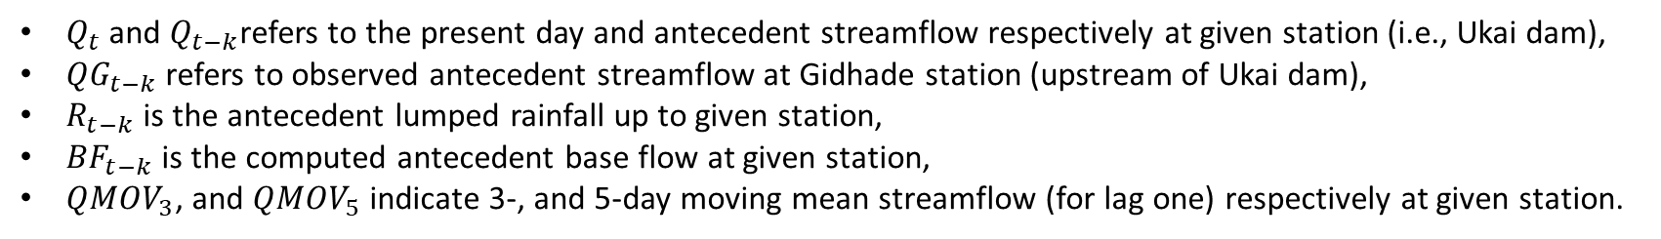
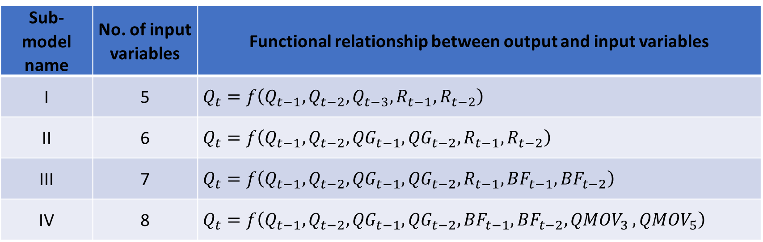
Model Development – Model Configuration
Sub-model name | No. of input variables | Functional relationship between output and input variables
I | 5 | $$Q_{t}=f\left(Q_{t−1},Q_{t−2},Q_{t−3},R_{t−1},R_{t−2}\right)$$
II | 6 | $$Q_{t}=f\left(Q_{t−1},Q_{t−2},{{QG}_{t−1},{QG}_{t−2},R}_{t−1},R_{t−2}\right)$$
III | 7 | $$Q_{t}=f\left(Q_{t−1},Q_{t−2},{{QG}_{t−1},{QG}_{t−2},R}_{t−1},{BF}_{t−1},{BF}_{t−2}\right)$$
IV | 8 | $$Q_{t}=f\left(Q_{t−1},Q_{t−2},{QG}_{t−1},{QG}_{t−2},{BF}_{t−1},{BF}_{t−2}{,QMOV}_{3},{QMOV}_{5}\right)$$
$Q_{t}$ and $Q_{t−k}$refers to the present day and antecedent streamflow respectively at given station (i.e., Ukai dam),
${QG}_{t−k}$ refers to observed antecedent streamflow at Gidhade station (upstream of Ukai dam),
$R_{t−k}$ is the antecedent lumped rainfall up to given station,
${BF}_{t−k}$ is the computed antecedent base flow at given station,
${QMOV}_{3}$, and ${QMOV}_{5}$ indicate 3-, and 5-day moving mean streamflow (for lag one) respectively at given station.
Summary: The input parameter configuration is selected based on the autocorrelation, partial autocorrelation, cross correlation, mutual information and false nearest neighbour approaches.
4

Slide 5
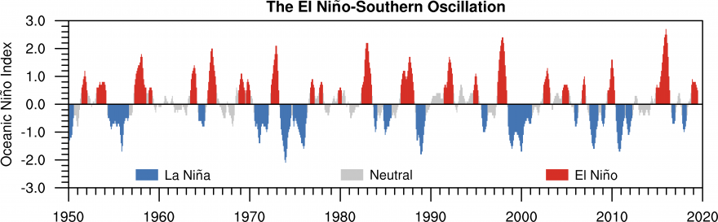
Model Development – Model Configuration
1
Global Model – considering daily monsoon flows for the entire period 1975-2013
2
El Niño Model – considering daily monsoon flows for the El Niño events during 1975-2013
El Niño and La Niña models are Local models
Total period: 1975 - 2013
Oceanic Niño Index (ONI), derived from Niño 3.4 SST, is used to classify the ENSO phases
https://fews.net/el-ni%C3%B1o-and-precipitation
3
La Niña Model – considering daily monsoon flows for the La Niña events during 1975-2013
Summary: Three model configurations, viz., Global, El Niño, and La Niña models, are formulated using the daily monsoon (June – September) inflows into Ukai reservoir for the period 1975-2013.
5

Slide 6
Model Development – Statistical Properties
Timeline of total period from 1975 to 2013
1975
2002
2013
Calibration set (70%)
Validation set (30%)
Model → | Global | El Niño | La Niña
No. of instances | 3294 | 668 | 763
Mean (m³/s) | 809.8 | 660.9 | 877.2
SD (m³/s) | 1506.9 | 1569.6 | 1490.4
CV | 1.9 | 2.4 | 1.7
Q90 (m³/s) | 1980.3 | 1431.0 | 2222.5
Max (m³/s) | 20796.3 | 18825.6 | 20094.0
% zero | 14.1% | 18.6% | 12.5%
Model → | Global | El Niño | La Niña
No. of instances | 1464 | 336 | 336
Mean (m³/s) | 962.6 | 778.6 | 1089.5
SD (m³/s) | 2033.6 | 1542.3 | 1824.5
CV | 2.1 | 2.0 | 1.7
Q90 (m³/s) | 2394.6 | 2270.4 | 2361.6
Max (m³/s) | 29045.8 | 14755.9 | 16517.1
% zero | 17.1% | 12.1% | 3.0%
Summary: During the study period, 36 (33) number of El Niño (La Niña) events were observed. In all, 16 model configurations were formulated for each of Global, El Niño, and La Niña models.
6

Slide 7
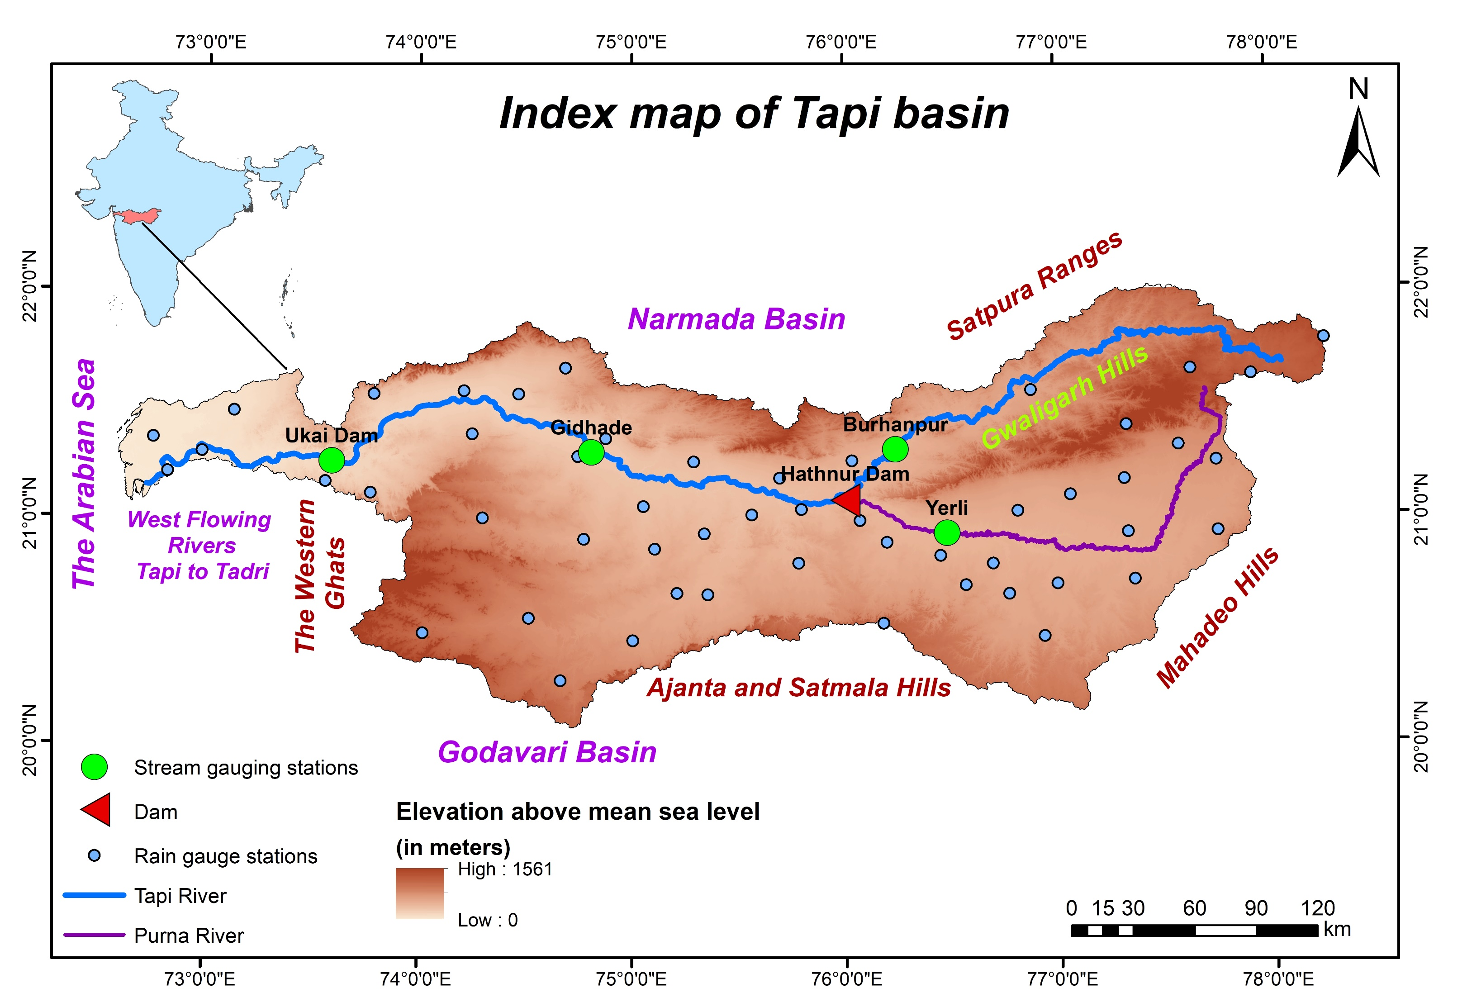
Case Study Domain
Tapi River Basin
Located in west-central India and draining westwards
Total geographical area: 65,145 km²
Length of the Tapi River: 729 mm
Mean annual rainfall in the basin: 814 mm
88% of annual rainfall is received during monsoon months (June – September)
Sharma et al. (2021)
Summary: The Tapi River basin exhibiting heterogeneous physiographic and climatic conditions is chosen as a case study region for streamflow forecasting at Ukai dam (area = 62,225 km²).
7

Slide 8
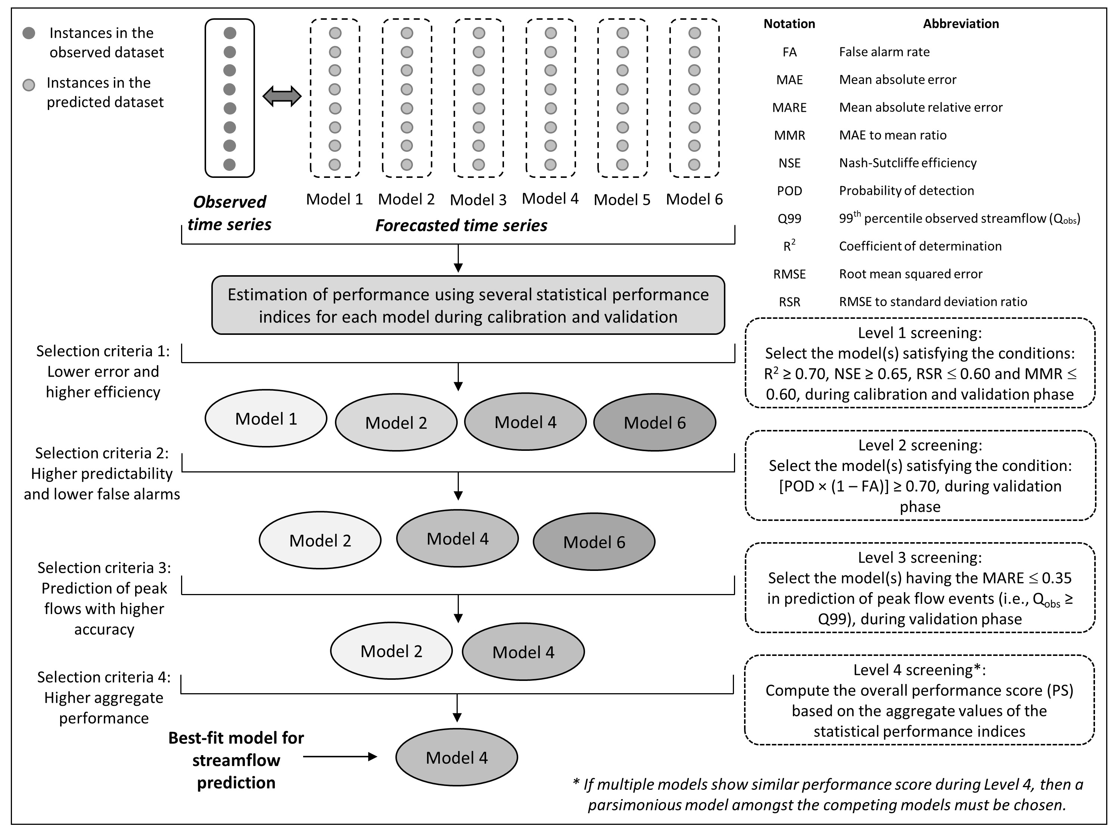
Model Evaluation
Several statistical performance indices adopted Root mean squared error (RMSE)
RMSE to standard deviation ratio (RSR)
Mean absolute error (MAE)
MAE to mean ratio (MMR)
Coefficient of determination (R²)
Nash Sutcliffe efficiency (NSE)
Probability of detection (POD)
False alarm rate (FA)
Mean absolute relative error (MARE)
Sharma et al. (2021)
Summary: A four-level screening procedure was adopted wherein, the models not adhering to the specified criteria were eliminated at each level and remaining models were carried forward.
8

Slide 9
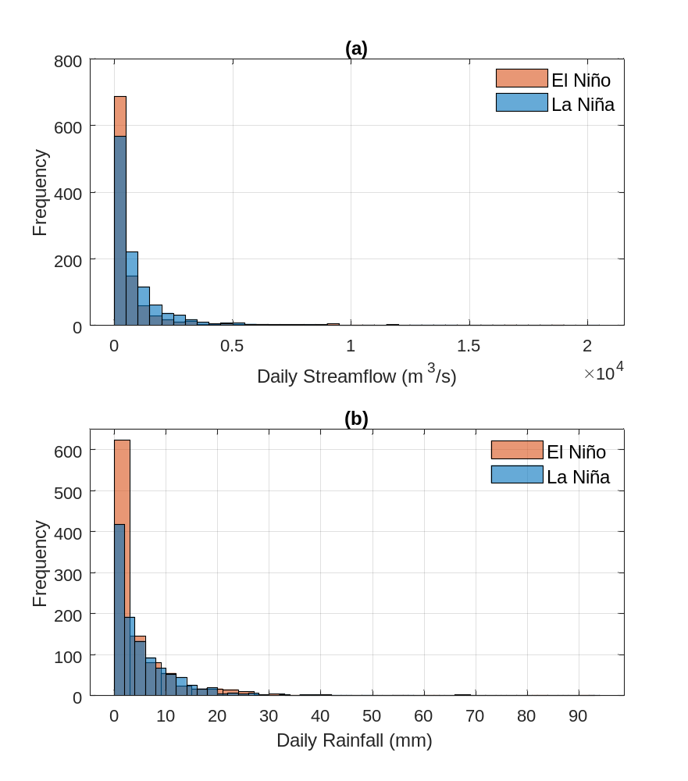
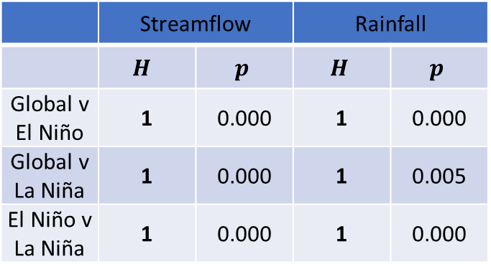
Results and Analysis
Background
Model
Results
Conclusions
Non-parametric Rank Sum Test
 | Streamflow |  | Rainfall
 | $$H$$ | $$p$$ | $$H$$ | $$p$$
Global v El Niño | 1 | 0.000 | 1 | 0.000
Global v La Niña | 1 | 0.000 | 1 | 0.005
El Niño v La Niña | 1 | 0.000 | 1 | 0.000
H = 1 indicates rejection of null hypothesis (H₀: median streamflow/rainfall are equal during El Niño and La Niña phases) at a5% significance level.
Summary: Higher streamflow and rainfall were noticed during La Niña as compared to El Niño phase, which was found to be statistically significant at a 5% significance level.
9

Slide 10
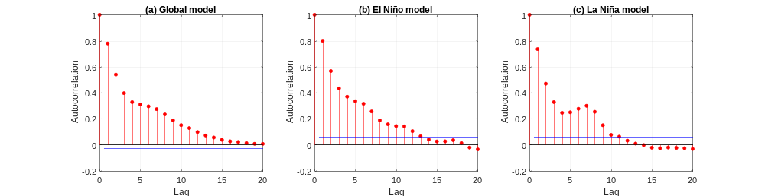
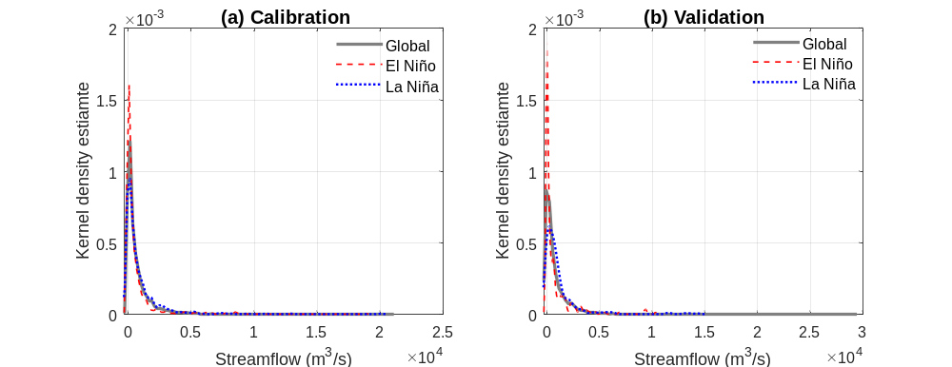
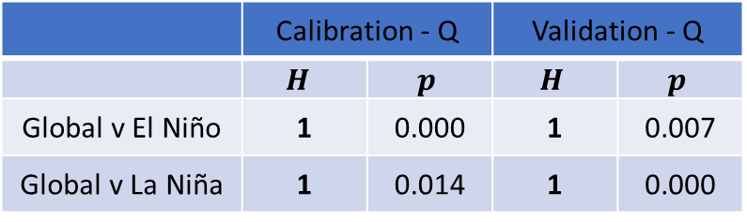
Results and Analysis
Autocorrelation structure of daily streamflows
Non-parametric distribution of streamflows using Kernel densities
Distribution similarity using Kolmogorov-Smirnov test
 | Calibration - Q |  | Validation - Q
 | $$H$$ | $$p$$ | $$H$$ | $$p$$
Global v El Niño | 1 | 0.000 | 1 | 0.007
Global v La Niña | 1 | 0.014 | 1 | 0.000
H = 1 indicates rejection of null hypothesis (H₀: distribution similarity exists between two datasets) at a5% significance level.
Summary: The daily streamflows during La Nina events show a relatively weaker autocorrelation structure compared to El Nino and Global model values, which also exhibit distributional variations.
10

Slide 11
Results and Analysis – Model Evaluation
16 models
Global Model
El Niño Model
La Niña Model
Local Models
1st Level Screening
13 models
4 models
2 models
Models satisfying the specified criteria after each level of screening
2nd Level Screening
4 models
4 models
2 models
3rd Level Screening
4 models
2 models
2 models
4th Level Screening
M4 UPUS
M4 UPUS
M4 UPUS
Summary: The model evaluation was carried out using a four-level screening process and M4 PUS model (i.e., model with 8 input variables & unpruned and unsmoothed configuration) was chosen.
11

Slide 12
Results and Analysis - Calibration
Calibration
Global model
Entire data from 1975-2001
Data of El Niño events during 1975-2001
El Niño model
Data of La Niña events during 1975-2001
La Niña model
Summary: The Global model showed better performance than El Niño and La Niña models during the calibration phase, whereas, the El Niño model showed marginal edge over the La Niña model.
12

Slide 13
Results and Analysis – Validation I
Validation
Global model
Entire data from 2002-2013
Data of El Niño events during 2002-2013
El Niño model
Data of La Niña events during 2002-2013
La Niña model
Summary: The Global model showed better performance than El Niño and La Niña models during the validation phase, whereas, the El Niño model showed marginal edge over the La Niña model.
13

Slide 14
Results and Analysis – Validation II
Calibration
Validation
El Niño model
Data of El Niño events during 1975-2001
Data of El Niño events during 2002-2013
G_El Niño model
Entire data from 1975-2001
La Niña model
Data of La Niña events during 1975-2001
Data of La Niña events during 2002-2013
G_La Niña model
Entire data from 1975-2001
Summary: The local model using climate variability information have not improved the performance of the forecast models compared to those of global model.
14

Slide 15
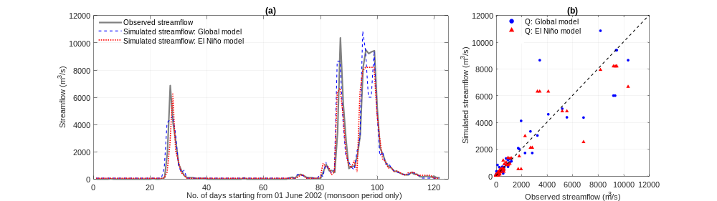
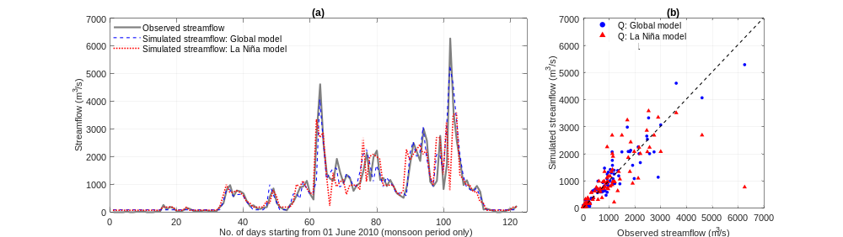
Results and Analysis – Comparison
Global model versus El Niño model for the year 2002
Global model versus La Niña model for the year 2010
Summary: The global model shows relatively better performance is forecasting daily streamflows as compared to the local models for El Niño and La Niña events as well.
15

Slide 16
Results and Analysis – Chosen Global Model
M4 UPUS model | Calibration | Validation
RMSE (m³/s) | 198.24 | 785.86
RSR | 0.13 | 0.39
MMR | 0.10 | 0.29
MAE (m³/s) | 82.08 | 274.77
R² | 0.98 | 0.85
NSE | 0.98 | 0.85
POD (%) | 95.74 | 77.72
FA (%) | 0.61 | 3.23
MARE | 0.06 | 0.24
Summary: The M4 UPUS Global model was chosen among all candidate models for streamflow forecasting at Ukai dam. The calibration performance was much better than validation.
16

Slide 17
Conclusions
Background
Model
Results
Conclusions
The model tree technique was adopted for streamflow forecasting considering a global model vis-à-vis climate variability specific models.
Higher streamflow and rainfall were noticed during La Niña as compared to El Niño, which were found to be statistically significant at a 5% significance level.
Overall, the global model exhibited lower errors (in terms of RMSE, RSR, MAE and MMR), higher efficiency (in terms of R² and NSE), and higher accuracy in prediction of peak flows (in terms of POD, FA and MARE) compared to the El Niño and La Niña models.
Local models using climate variability information have not improved the performance of the forecast models compared to those of the global model.
Lack of adequate sample size for building the local data-driven Model Tree models can be attributed to this weak performance.

Slide 18
Conclusions
Exhaustive analysis of the performances of local and global models requires evaluation of different forecasting methodologies and evaluate if specific flows (i.e., low, medium or high flows) are better forecasted using local and global models.
Also, inclusion of oceanic and atmospheric variables (such as sea surface temperature, atmospheric pressure, etc.) corresponding to various oscillation modes can be considered as additional inputs in the streamflow forecasting model to incorporate the climate variability information.
Additional research needs to be conducted in different regions of the globe to evaluate the utility of the climate variability information for improving short- and long-term forecasting.

Slide 19
Thank you!

