Slide 1
Are dykes just filled hydraulic fractures? - Inelastic deformation and emplacement mechanisms of igneous tabular intrusions (EGU21-14654)
Galland O., Schmiedel T., Bertelsen H., Guldstrand F., Haug Ø., Souche A.

Slide 2
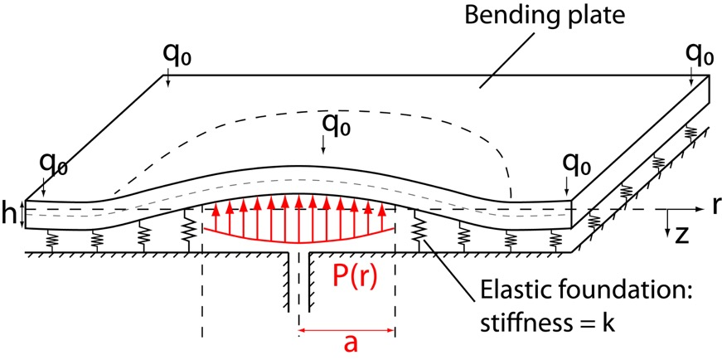
Theory: Linear Elastic Fracture Mechanics (LEFM)
Main physical assumptions
Intrusions propagate by tensile failure of host
Intrusion tips are sharp
Intrusions treated as single cracks
Host dominantly deforms by elastic bending
(Galland and Scheibert, 2013)

Slide 3
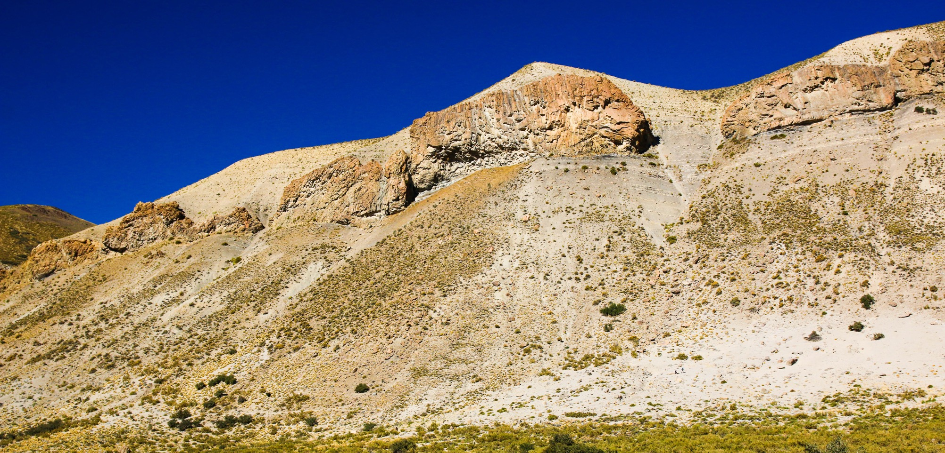
Field observations – Las Loicas, Neuquén Basin
Finger1
Main Sill
Finger2
Finger3

Slide 4
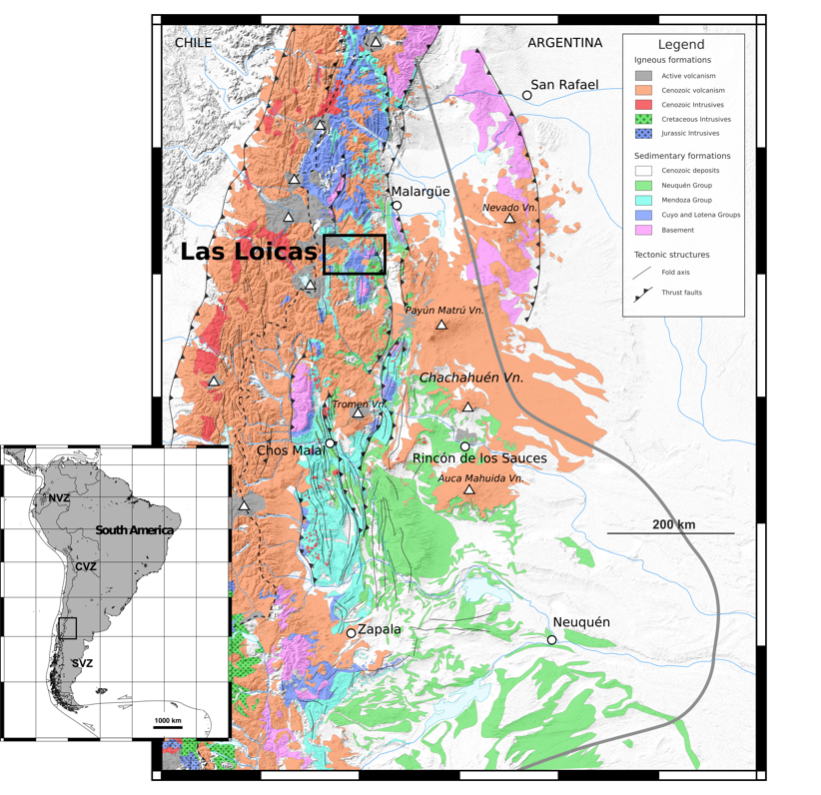
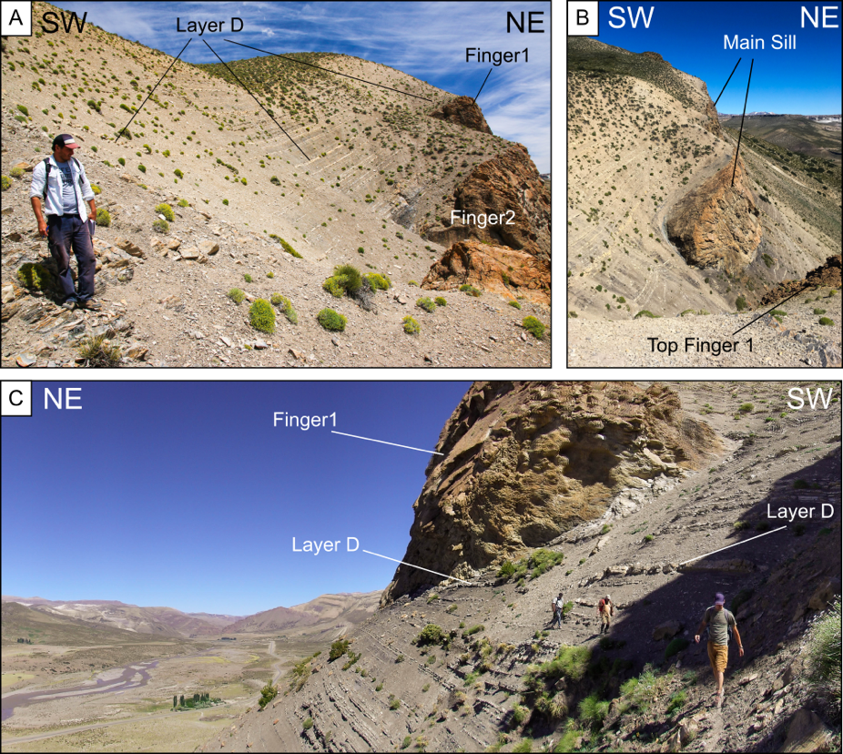
Field case study: Las Loicas intrusions, Mendoza Province
(Galland et al., JSG, 2019)

Slide 5
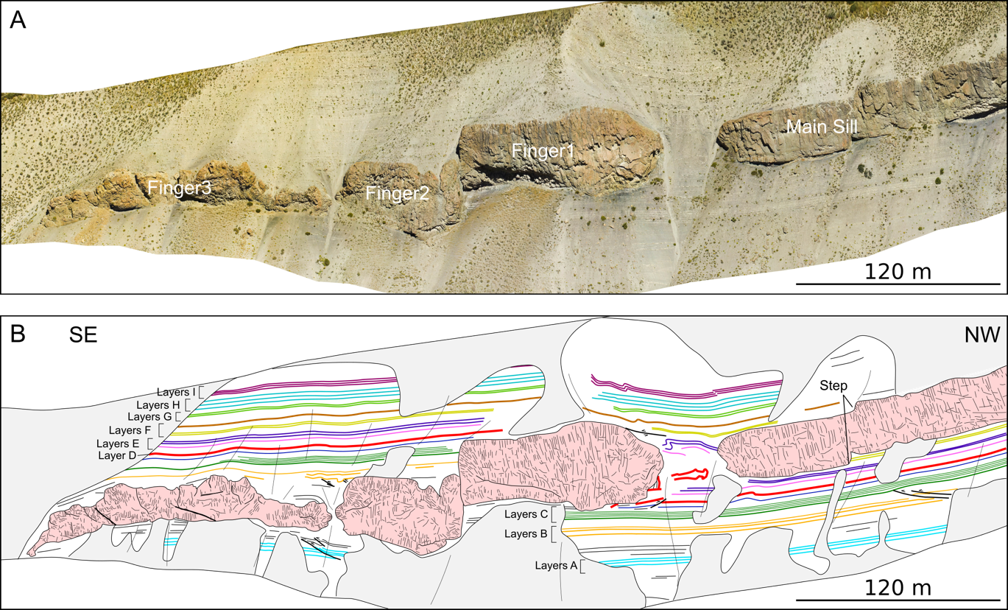
Field case study: Las Loicas intrusions, Mendoza Province
(Galland et al., JSG, 2019)
Drone survey
Orthorectified image of 1 km long outcrop
Mapping of intrusion shapes
Detailed mapping of layers of sedimentary host rock

Slide 6
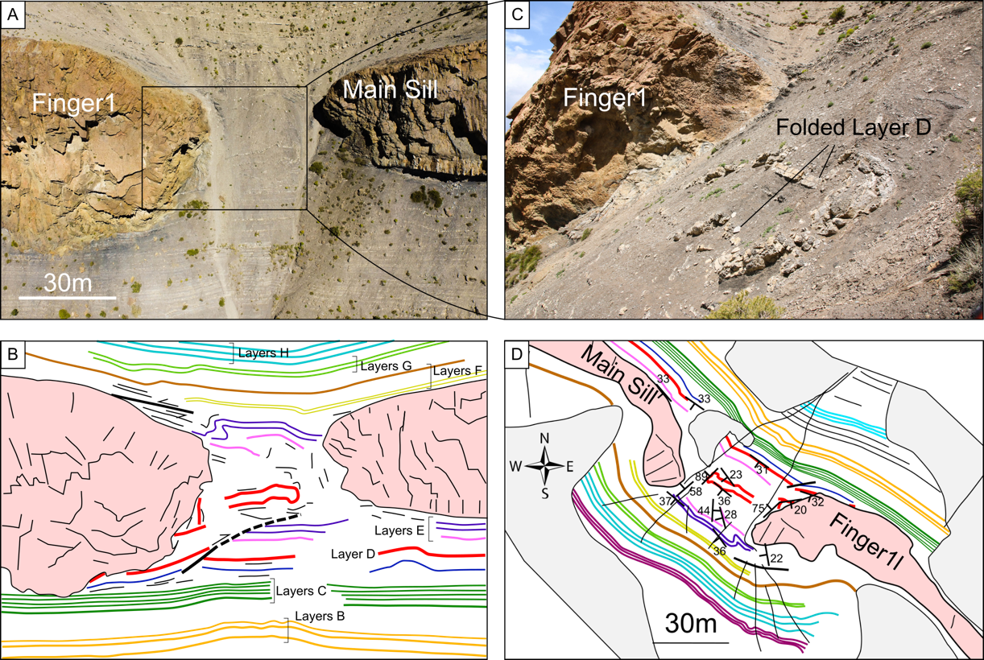
Geological observations: Las Loicas intrusions, Mendoza Province
(Galland et al., JSG, 2019)
Sill made of multiple segments
Round/blunt intrusion tips
Host rock layers display strong inelastic deformation
Deformation in host is compressional, and accommodates local thickening

Slide 7
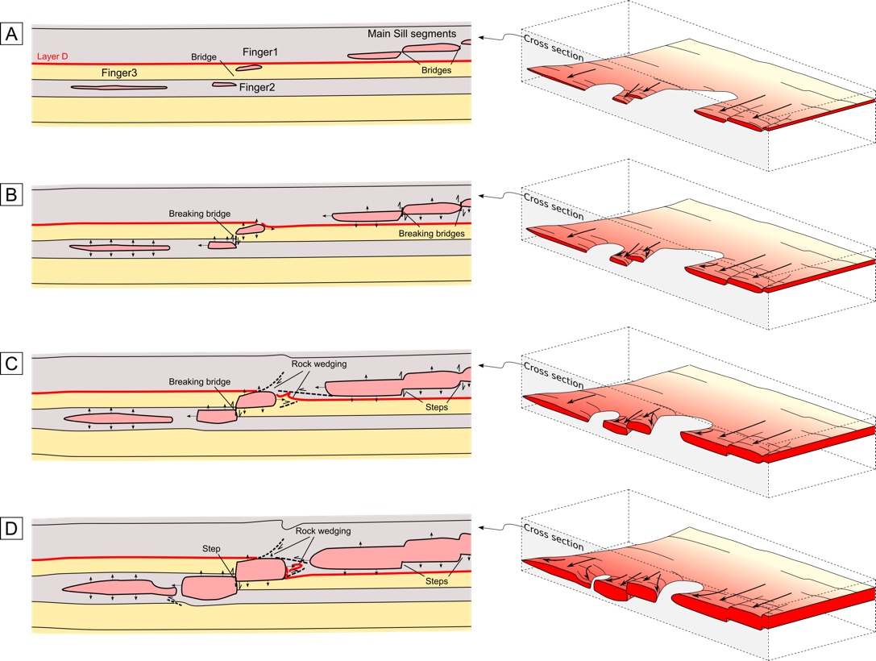
Summary model – Main conclusions
(Galland et al., JSG, 2019)
Fingers tips push their host rock: «Viscous indenter»
Observations in contradictions with the LEFM theory

Slide 8
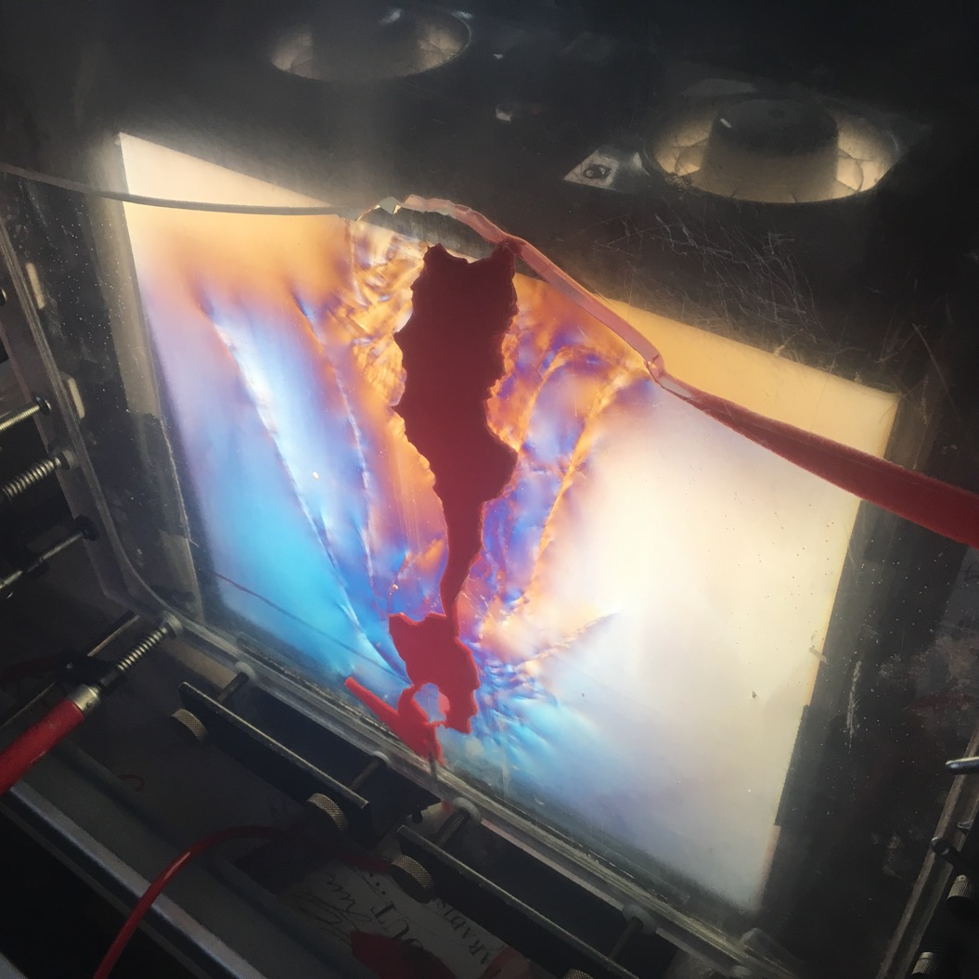

Laboratory modelling

Slide 9
Laboratory quasi-2D experiments
(Guldstrand et al., G3, in revision)
3 cm Thick Hele-Shaw Cell
Materials
Glass Beads/Silica Flour
Golden Syrup, 55 Pa s
Syringe Pump
Digital Image Correlation
monitoring displacement
DSLR
Camera
Pressure Sensor

Slide 10
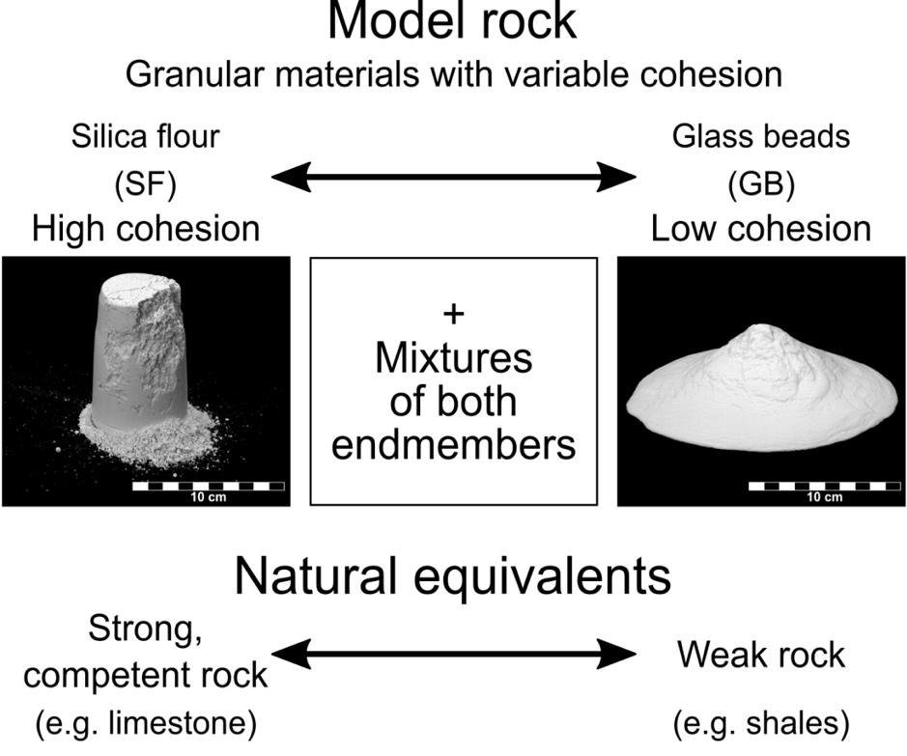
Model materials of variable properties
(Guldstrand et al., G3, in revision)
Materials of controlable and tunable cohesions
Low cohesion represent shale/unconsolidated sands, etc.
High cohesion represents limestone/consolidated sandstone, etc

Slide 11
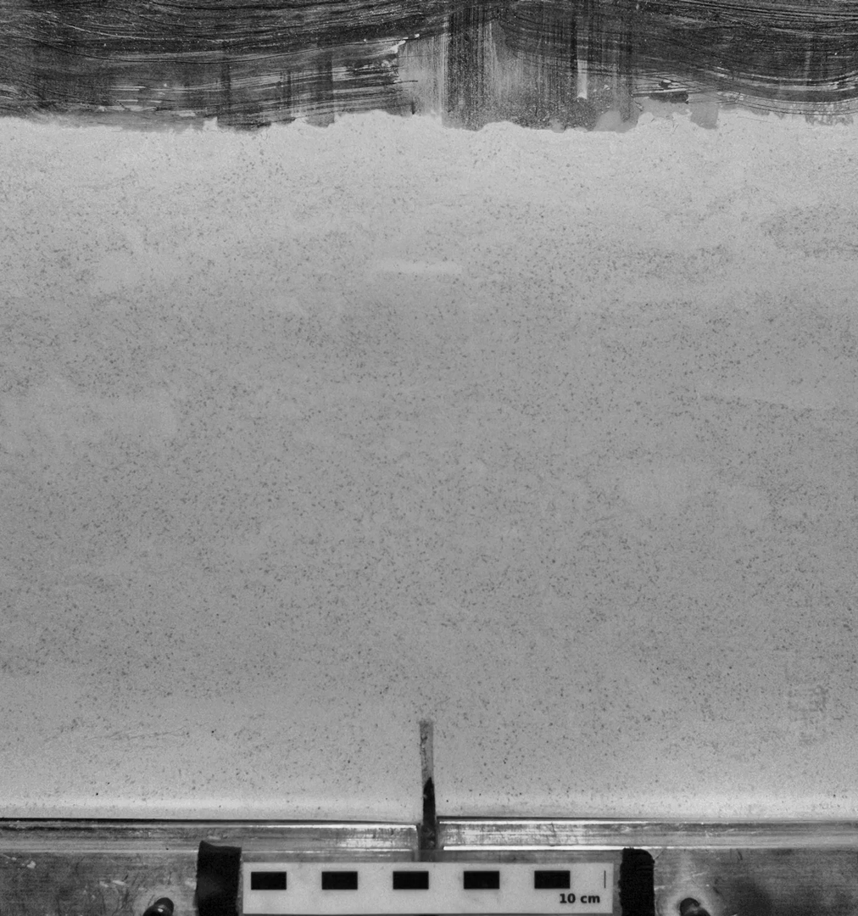
Experiment in cohesive Mohr-Coulomb material
(Guldstrand et al., G3, in revision)
Straight sheet shape
Host model rock: 50% glass beads/50% silica flour
This host material is cohesive
Resulting intrusion is a straight, continuous dyke

Slide 12
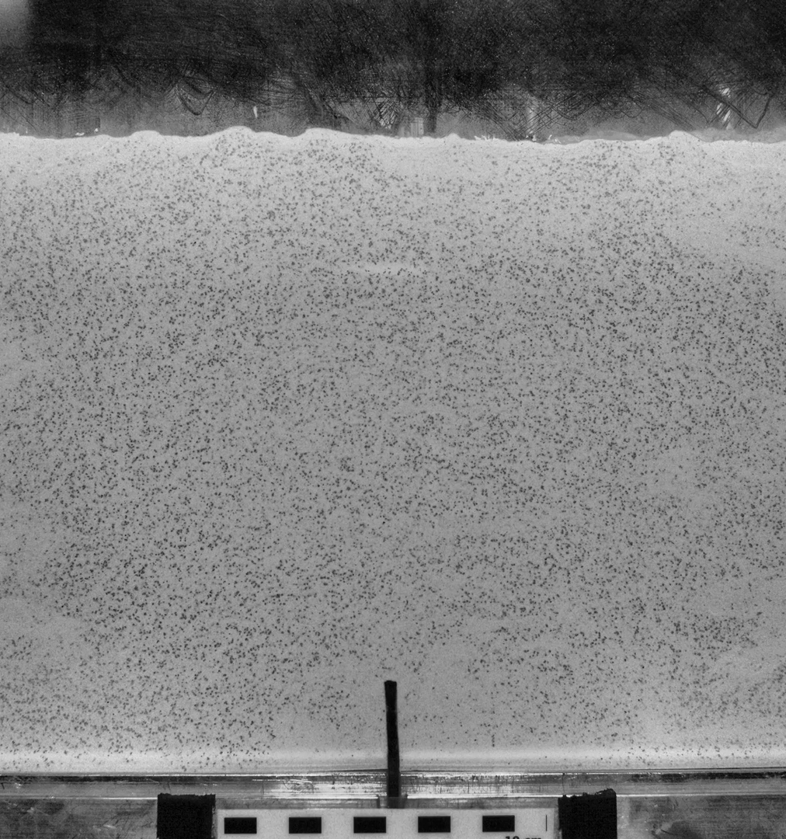
Experiment in low-cohesion Mohr-Coulomb material
(Guldstrand et al., G3, in revision)
Worm-like finger shape
Host model rock: 90% glass beads/10% silica flour
This host material has low cohesion
Resulting intrusion is a worm-like, discontinuous shape

Slide 13
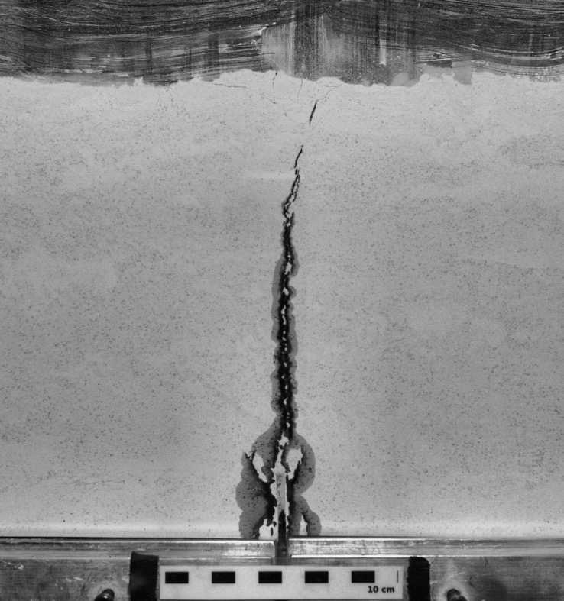
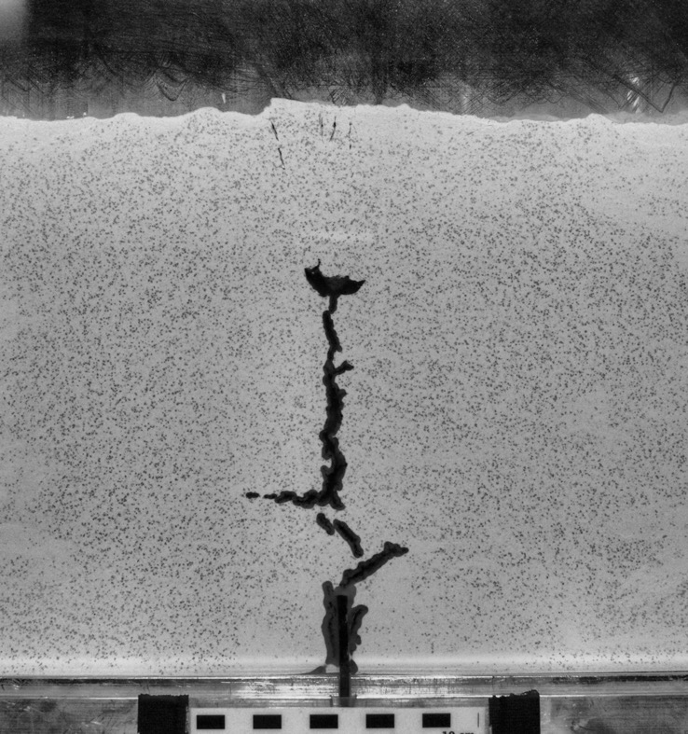
(Guldstrand et al., G3, in revision)
high-cohesion
low-cohesion
Free Surface
Interaction
Free Surface
Interaction
Vertical
Propagation
Vertical
Propagation
Inlet
Inlet

Slide 14
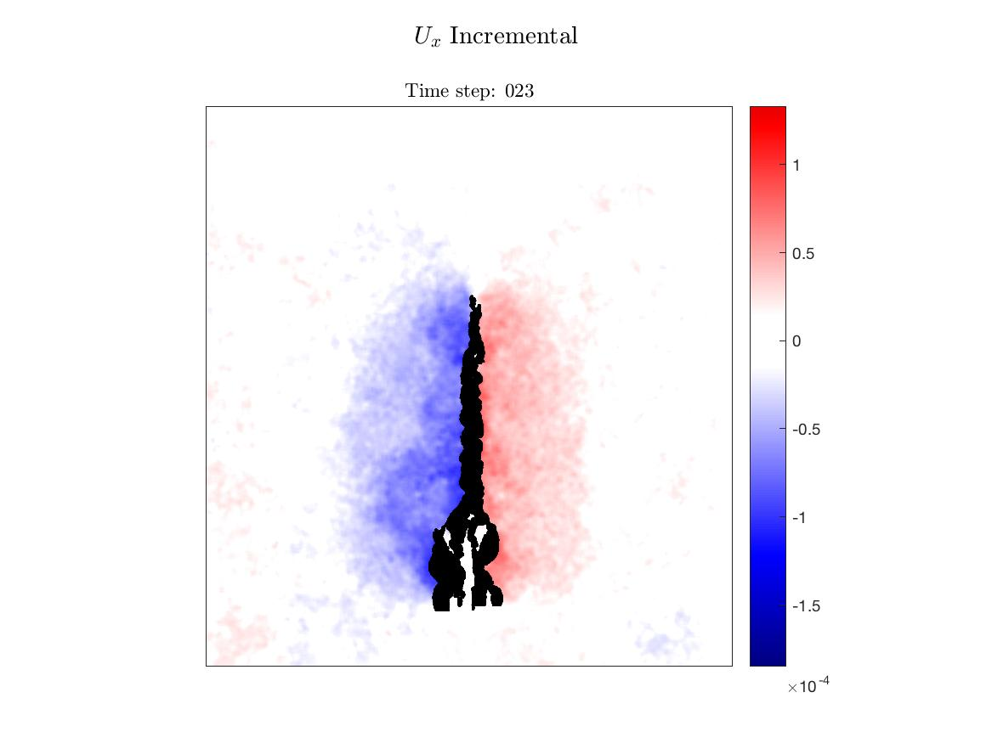
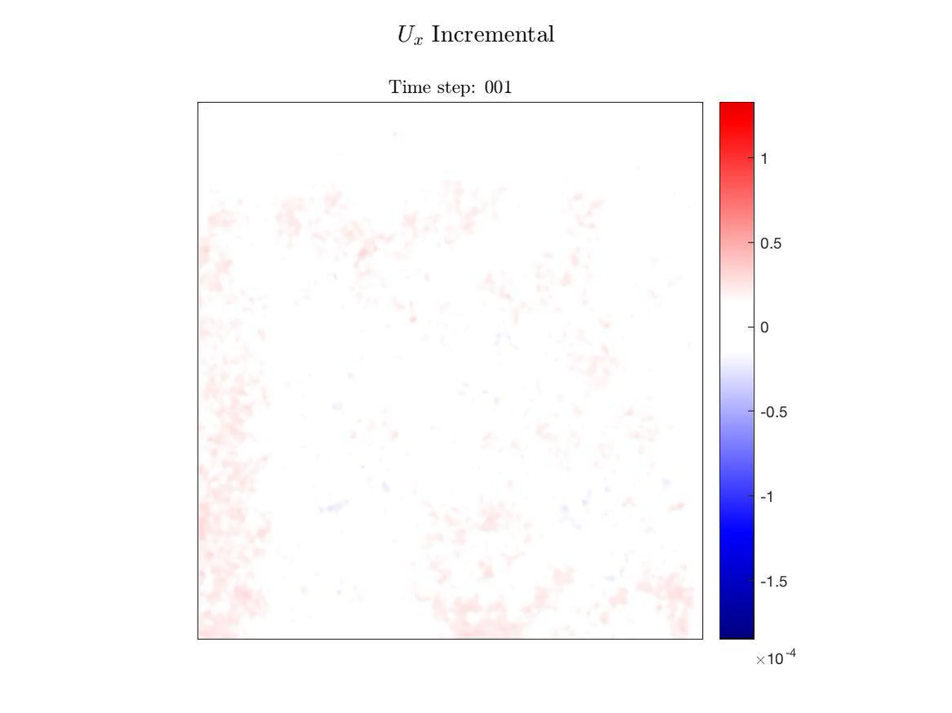
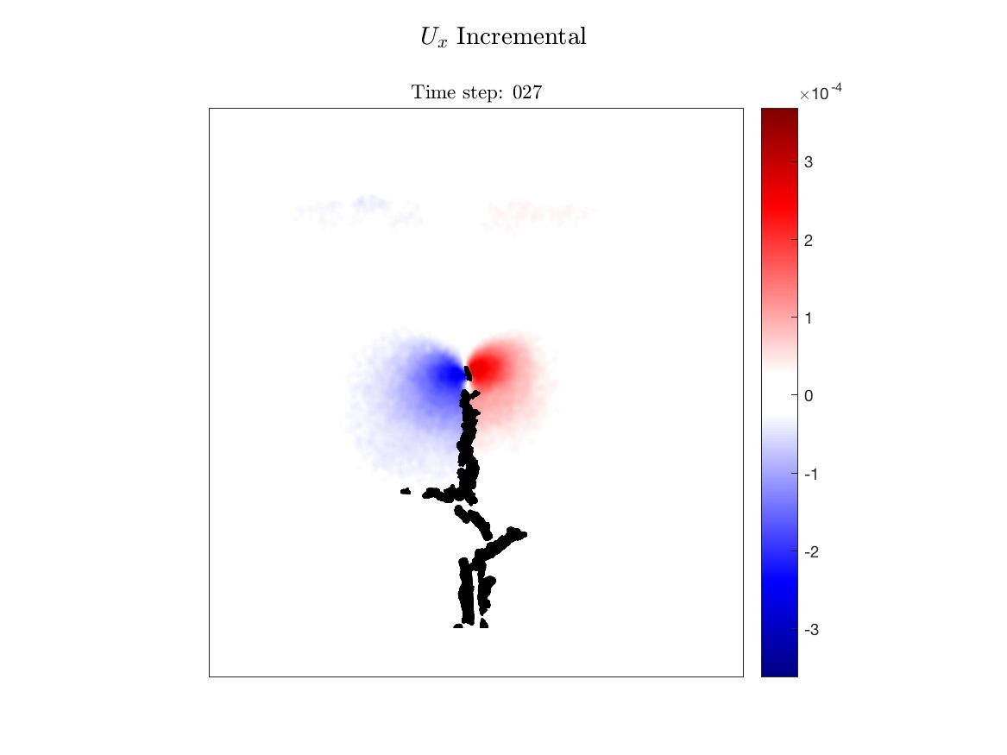
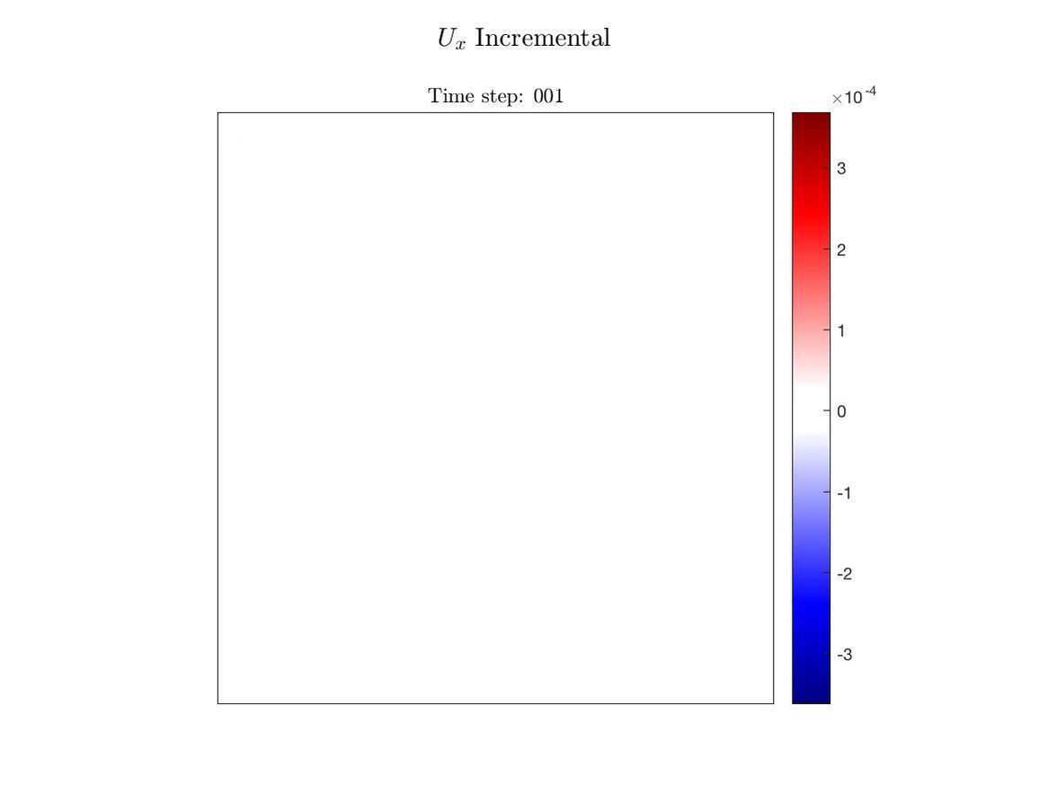
Digital Image Correlation | Vertical displacements U_{x}
High Cohesion Host
Low Cohesion Host
Opening of the whole crack
Opening of crack tip only
(Guldstrand et al., G3, in revision)

Slide 15
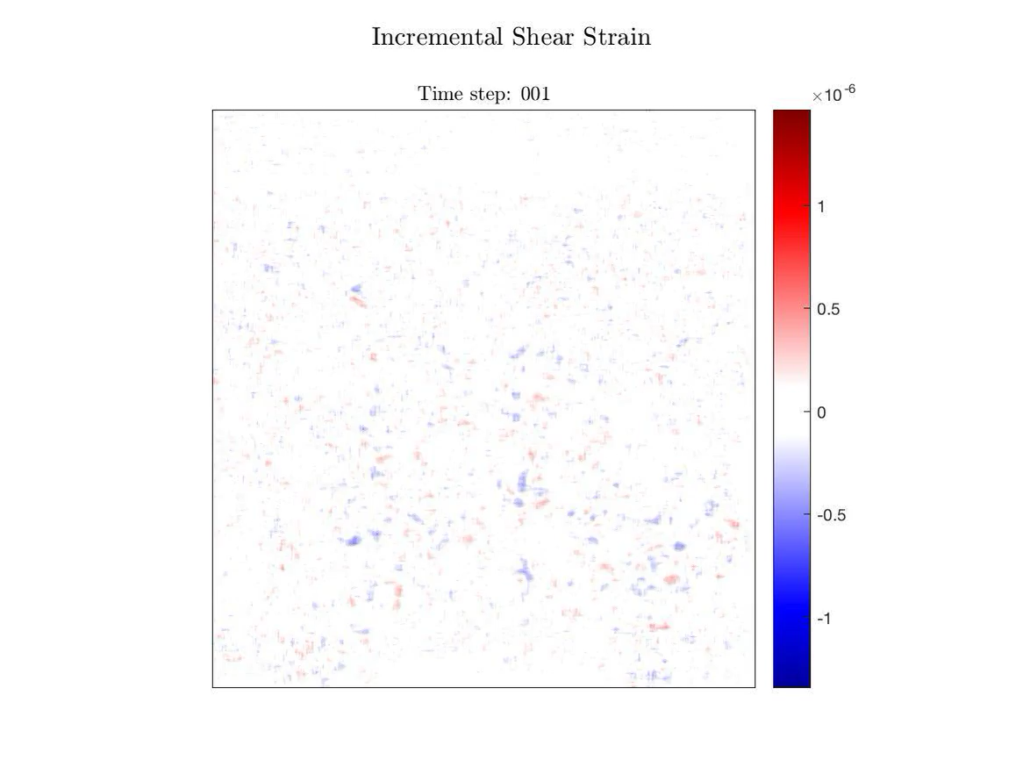
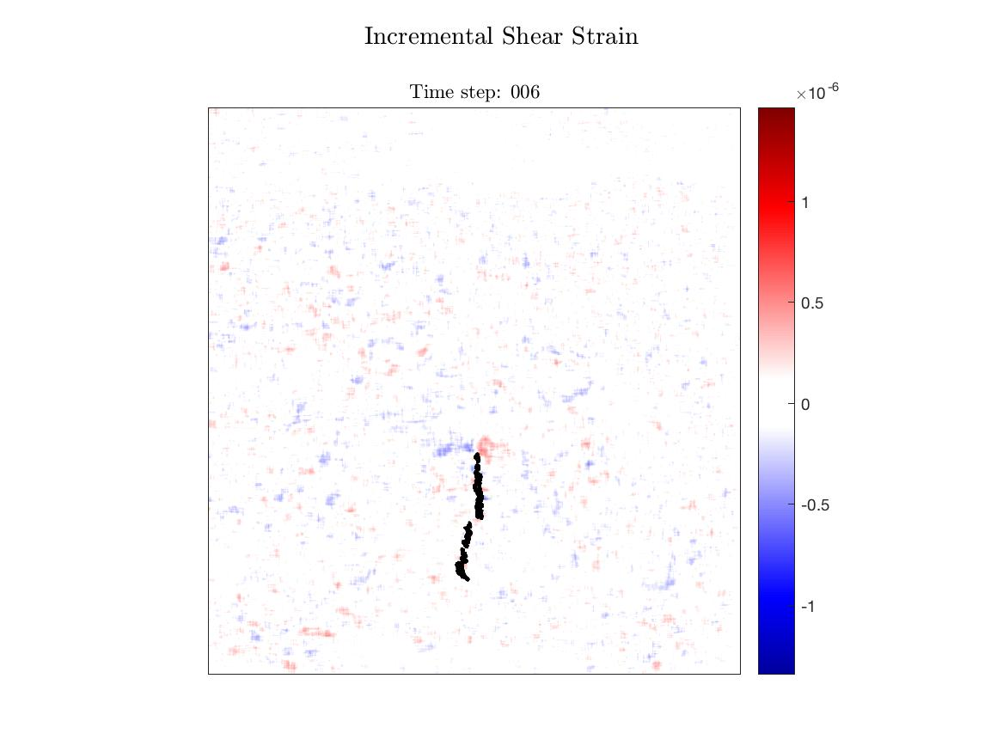
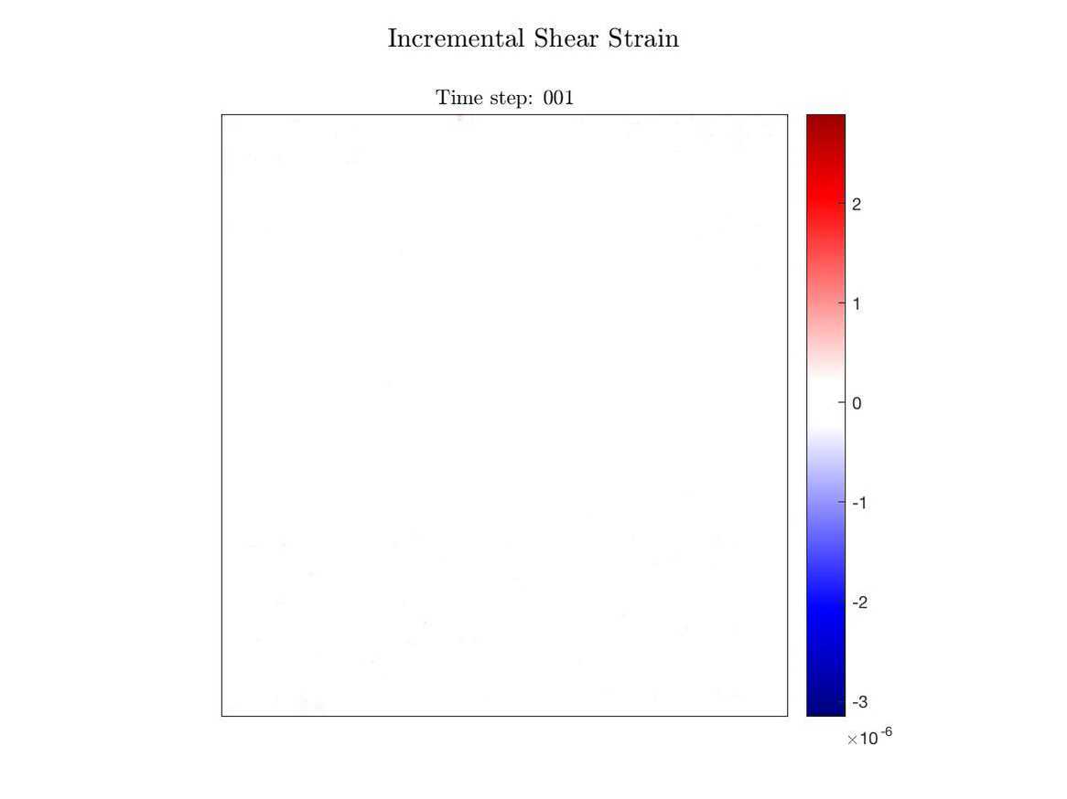
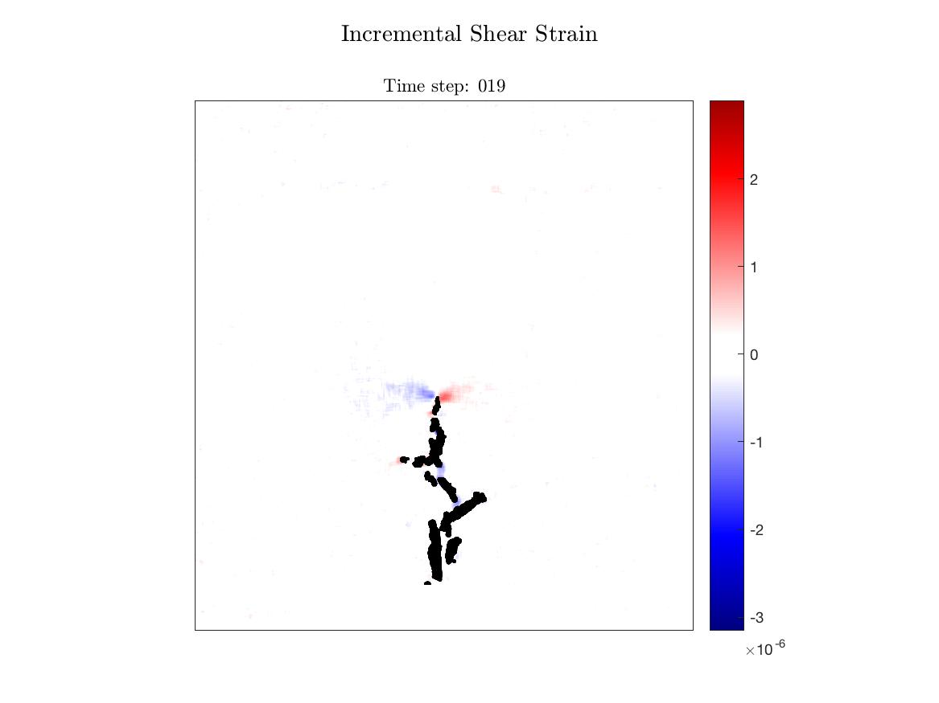
Digital Image Correlation | Shear strain bands
High Cohesion Host
Low Cohesion Host
Little shear damage
Significant shear damage
(Guldstrand et al., G3, in revision)

Slide 16
Summary and conclusions
High Cohesion Host
Low Cohesion Host
Fingers as indenters
High-cohesion rock: dominant opening
Low-cohesion rock: dominant shearing
Emplacement mechanisms drastically different
Fingers form preferably in low-cohesion rocks
Fingers trigger significant damage in the host rock
(Guldstrand et al., G3, in revision)

Slide 17
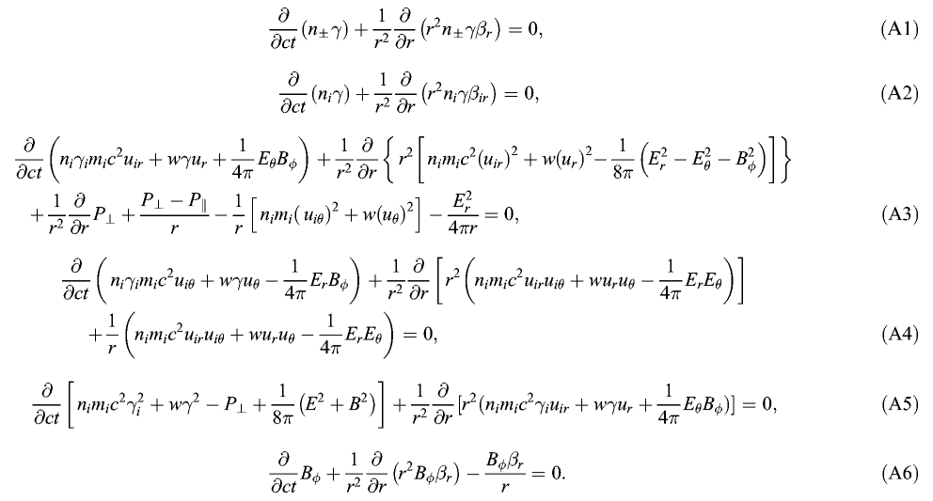
Numerical modelling

Slide 18
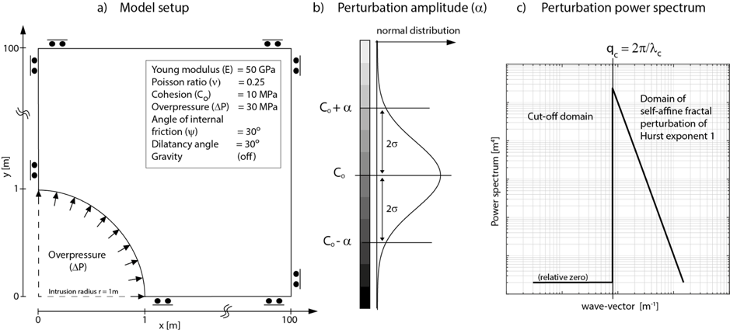
Numerical models: elasto-plastic
(Souche et al., 2019)

Slide 19
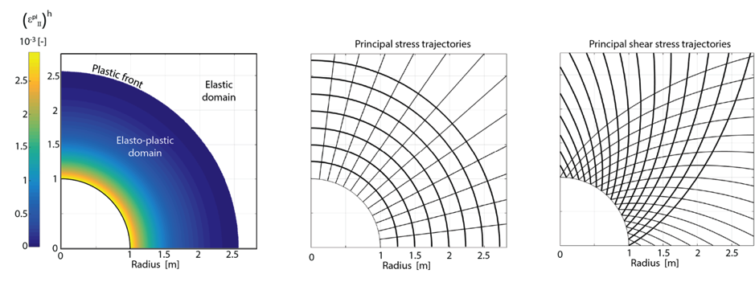
Results: homogeneous reference model
Classic stress interpretation: radial dykes
(Souche et al., 2019)

Slide 20
Results: homogeneous versus heterogeneous
(Souche et al., 2019)

Slide 21
Results: homogeneous versus heterogeneous
(Souche et al., 2019)

Slide 22
Results: homogeneous versus heterogeneous
(Souche et al., 2019)
Homogeneous
Heterogeneous
Stresses are not conclusive!

Slide 23
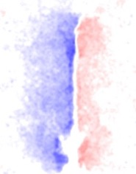
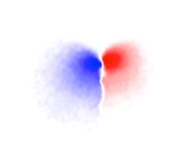
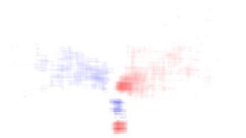
Conclusions
Plastic shear failure of host rock controls emplacement of sheet intrusions
Several emplacement mechanisms can lead to the emplacement of sheet intrusions (tensile elastic versus plastic shear)
Homogeneous rocks favour dilatant deformation, and so tensile opening of intrusions
Heterogeneities strongly favour shear failure of rocks and lead to drastically distinct damage patterns
Stress analysis is not conclusive to interpret propagation of magma intrusions, and plastic damage needs to be addressed

