Slide 1

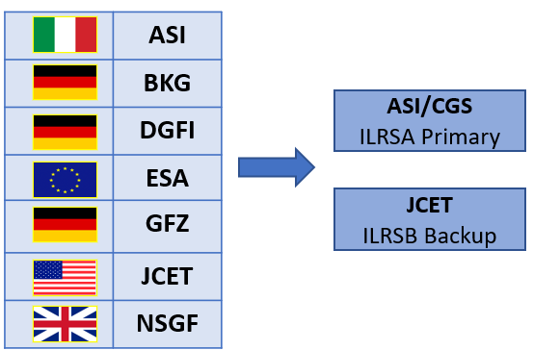
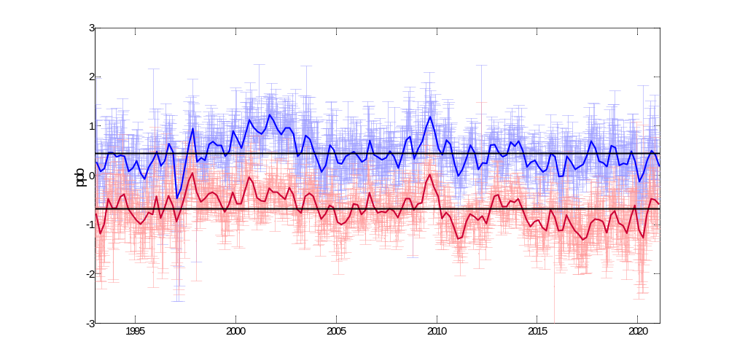



The ILRS Contribution to ITRF2020
The official ILRS analysis centers (ACs) produce weekly solutions that are combined by the two combination centers.
Solutions contain station coordinates and daily Earth orientation parameters, using LAGEOS and Etalon data, according to the ILRS/ASC guidelines
The ASI/CGS combination procedure is based on the direct combination of loose constrained solutions, with no need to estimate or remove relative rotations between the reference frames before combining the input AC solutions
The backup JCET/UMBC combination uses de-constrained normal equations and relative weighting of the input ACs series determined through Variance Component Estimation
The preliminary ILRSA solution 1993-2020 has been submitted. The final 1983-2020 is expected in a few weeks
Scale with respect to ITRF2014
Station Systematic Error Modelling Pilot Project, novel approach
  Improved “target signature” model (CoM)
  Estimation of persistent systematic errors at the millimeter level of each tracking system
Preliminary ILRSA
ILRSA for ITRF2014
Changes in station systematic behavior were identified and a set of long-term mean corrections were defined and applied a priori.
0.4 ppb
Reduced difference between SLR and VLBI scale
-0.7 ppb
$${scale}_{VLBI}−{scale}_{SLR_ITRF2014}≈1.38 ppb$$
$${scale}_{VLBI}−{scale}_{Preliminary_ILRSA}≈0.25 ppb$$
V. Luceri, A. Basoni, D. Sarrocco
e-GEOS S.p.A., ASI/CGS - Matera
E. C. Pavlis, M. Kuzmicz-Cieslak, K. Evans
JCET/UMBC – Baltimore, MD
G. Bianco
Agenzia Spaziale Italiana, CGS - Matera

