Slide 1
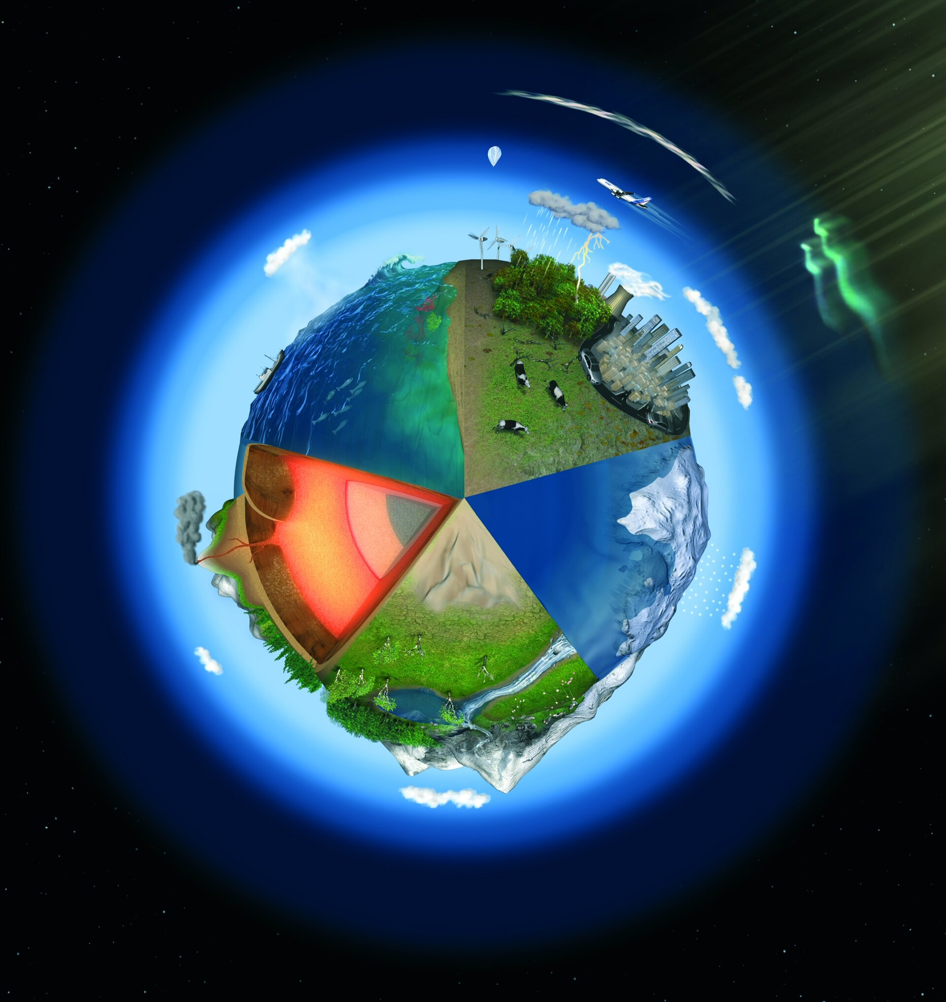



Possibilities of transdimensional inversion for estimating deep Earth velocity and density structure
Wolfgang Szwillus,
Christian-Albrechts-Universität zu Kiel, Institut für Geowissenschaften
EGU General Assembly 2021
30.4.2021

Slide 2
Introduction
Why and what?

Slide 3
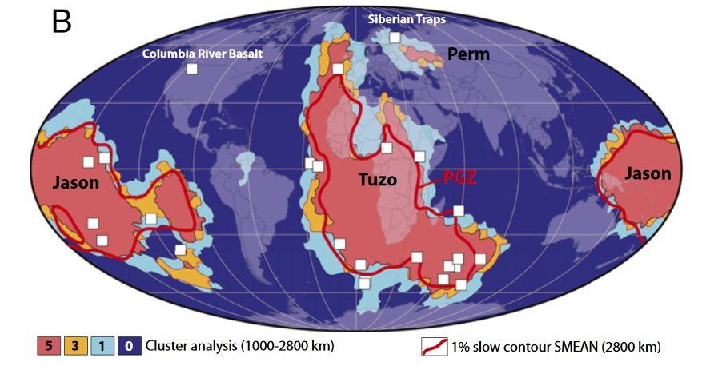
The „deep Earth“ - LLSVPs
Large low shear wave velocity provinces near core-mantle boundary (LLSVPs)
Long known seismically
Seem to correlate with large igneous provinces
„Plume generation zone“ at edges?
Many open question about
Nature
Origin
Stability
From Torsvik et al. 2014

Slide 4
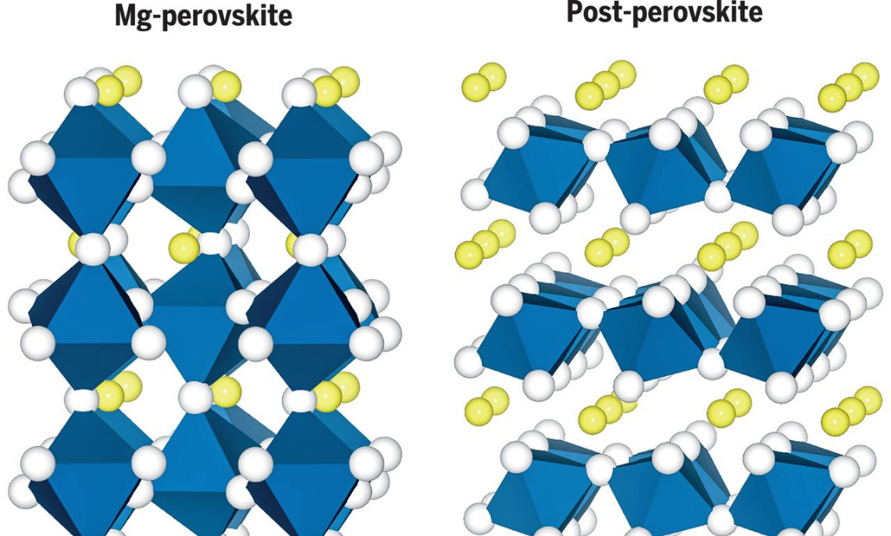
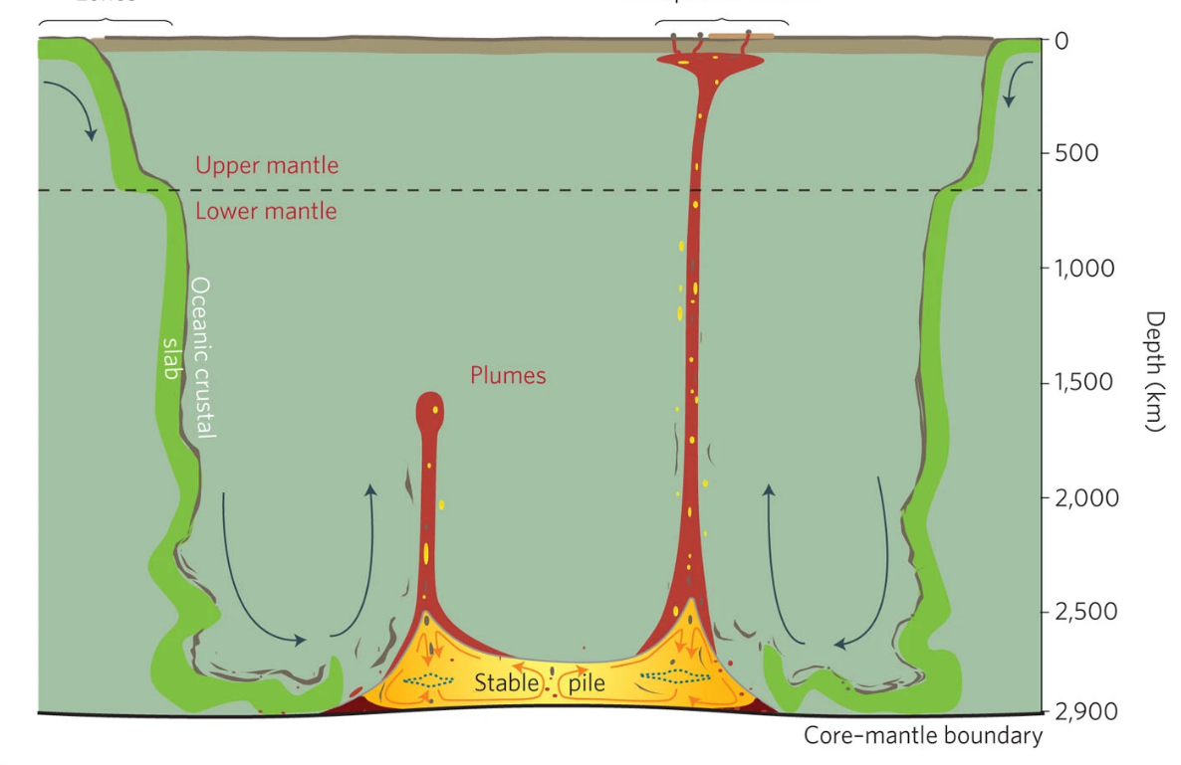

What are the LLSVPs?
Complex interplay of small-scale heterogeneity and phase transitions
Primordial reservoir of iron-rich (?) material
Slab Graveyard: Accumulated delaminated oceanic crust
Here lies an Unknown Oceanic Slab
R. I. P.
From Heirose et al. 2017
From Garnero et al. 2016
Density could help to differentiate!

Slide 5
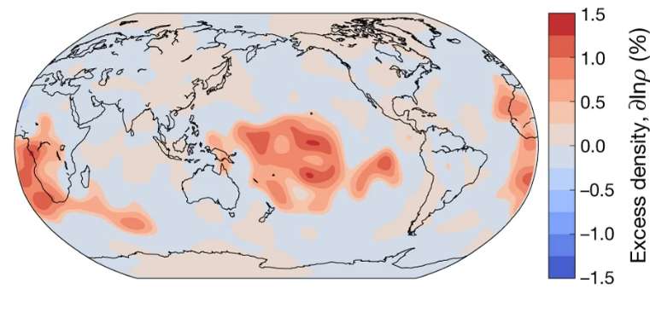
How dense are the LLSVPs?
Higher temperatures would explain decreased velocity
  Density should also be reduced
  But this has not been found conclusively
Tidal tomography result by Lau et al. (2018)
-> Jointly invert for velocity and density

Slide 6
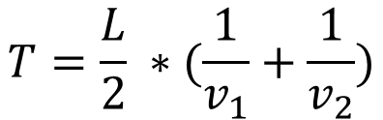
Spatial parametrization
Length L
v1
v2
Traveltime T
Grids are the main form of spatial parametrization in seismology
Regularization is necessary
Particularly important in the deep Earth
v3
v4
$$T=\frac{L}{2} ∗(\frac{1}{v_{1}}+\frac{1}{v_{2}})$$
No independent information about the two velocities!

Slide 7
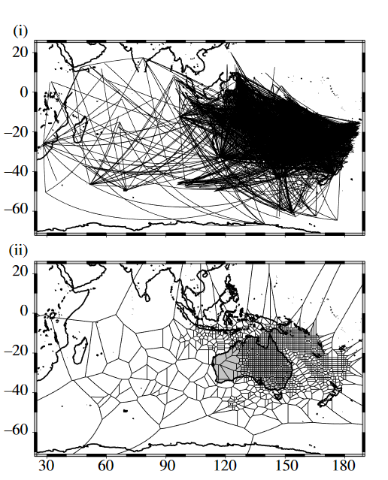
Transdimensional parametrization
Surface wave ray coverage
Result of transdimensional inversion
Transdimensional: The number of model parameters is treated as an unknown.
From Sambridge et al. 2013

Slide 8
Discrete Parametrization
Describe velocity and density as a collection of discrete anomalies
Goal: Use as many (or few) rectangles as required by the data
v1
v1
v2
v3
v4

Slide 9
Methods
How?

Slide 10
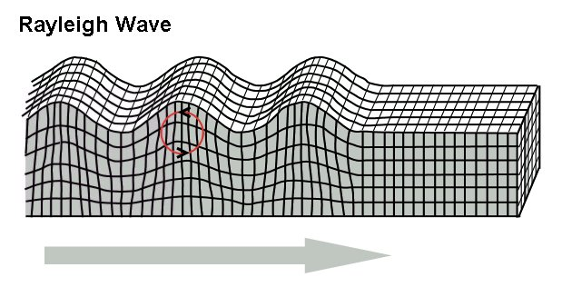
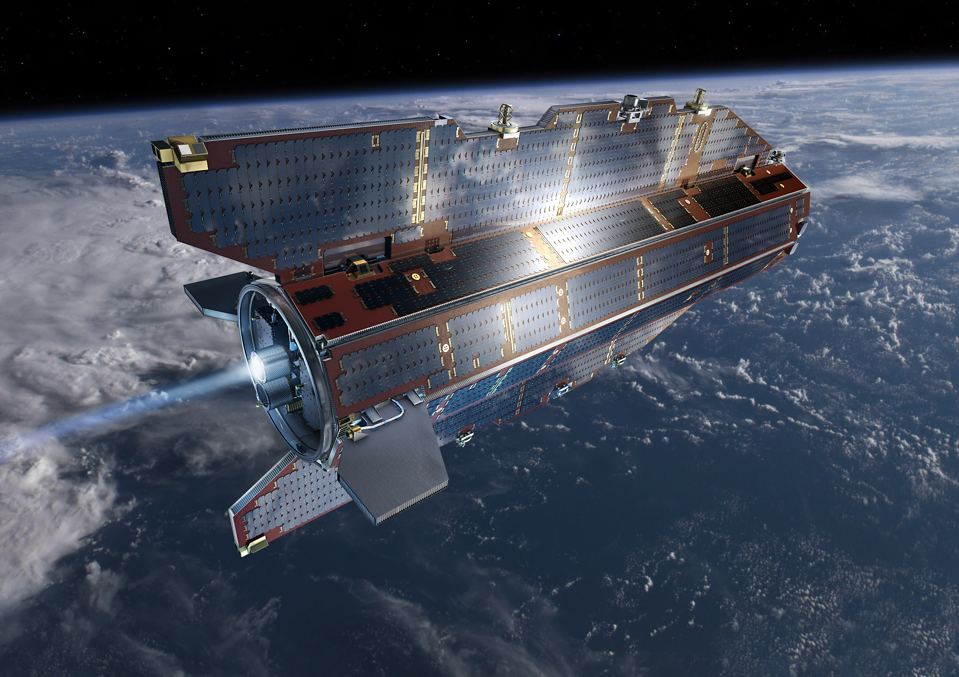
Data and methods
Input (Data)
Long period Rayleigh waves (Normal modes)
Satellite gravity data

Slide 11
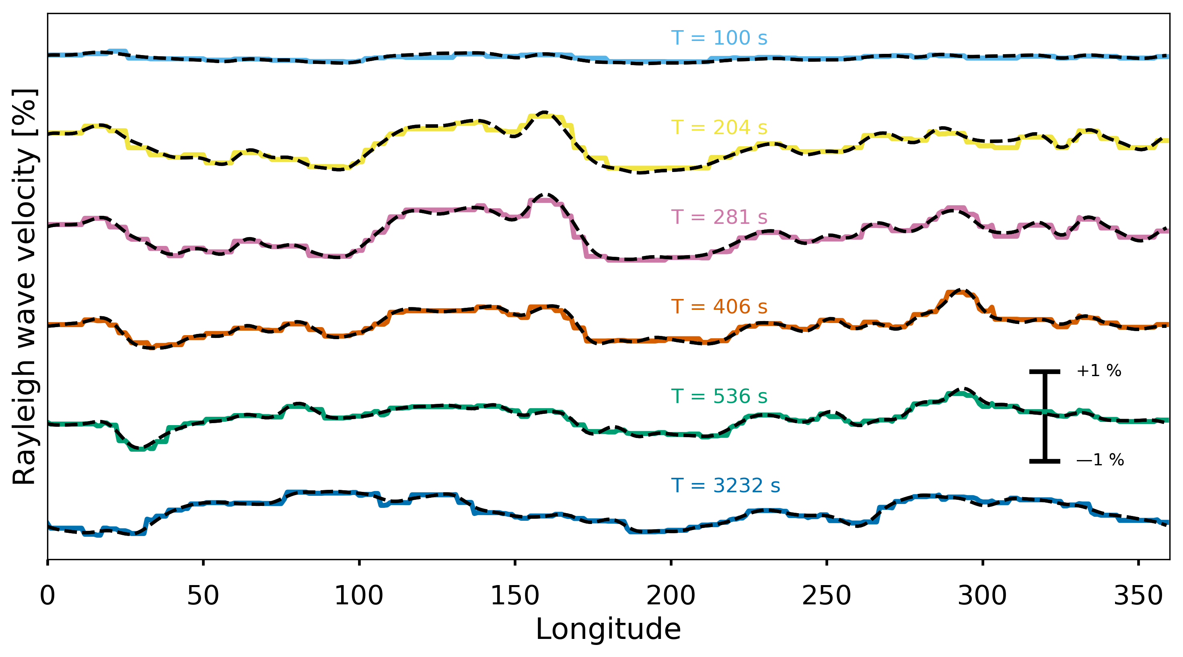
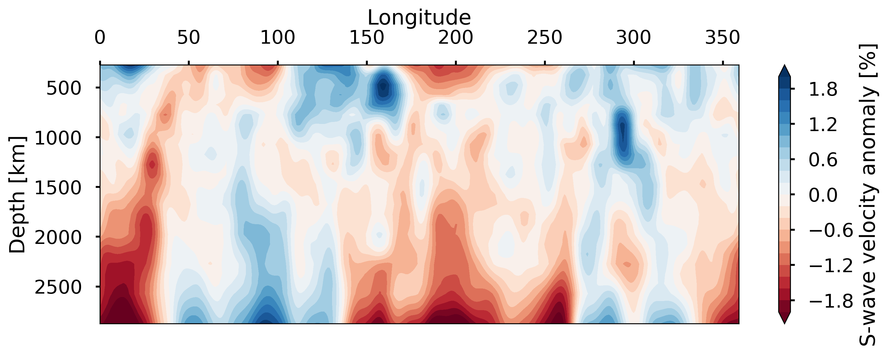
Surface waves
Their phase speed depends on period (dispersion)
At every location, phase speed only depends on velocity structure underneath (optimistic horizontal resolution!)
I treat all periods like surface waves (only useful for synthetic tests)
I only use 6 periods
Surface wave
Longer Period
Deeper sensitivity

Slide 12
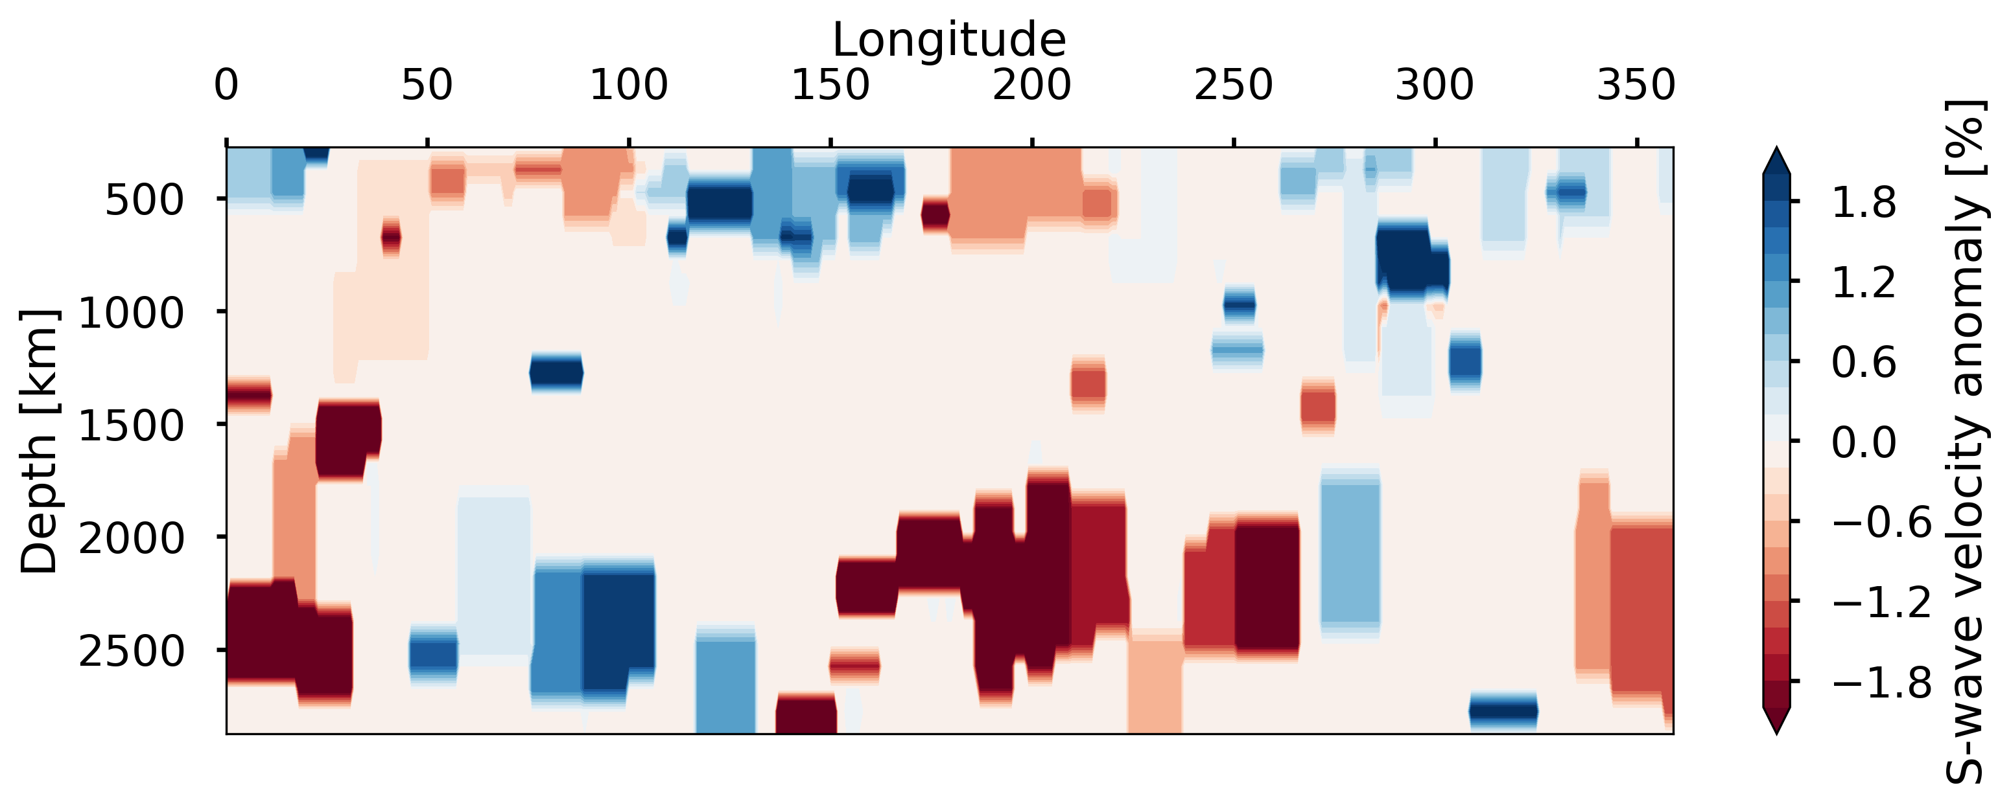
Data and methods
Inversion
Output (Models)
2-D Discrete velocity and density anomalies (gridless)
Model depth 275-2800 km
Input (Data)
Bayesian transdimensional inversion
Birth-Death Monte Carlo Markov Chain
Long period Rayleigh waves (Normal modes)
Satellite gravity data
Synthetic calculation

Slide 13

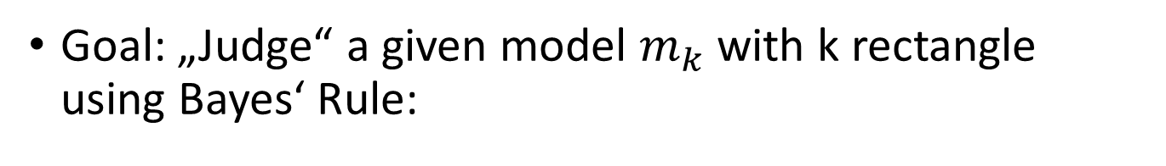

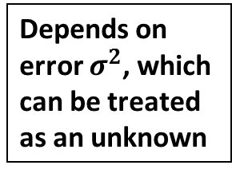
Bayesian perspective
Goal: „Judge“ a given model $m_{k}$ with k rectangle using Bayes‘ Rule:
$$Posterior \left(m_{k}\right)=Likelihood\left(Δy,σ^{2}\right)∗Prior\left(m_{k}\right)∗C$$
Good data fit
Simple models
Better models have higher posterior probability
How well does the model fit the data?
How complicated is the model?
Depends on error $σ^{2}$, which can be treated as an unknown
Basically $∝D^{−k}$

Slide 14
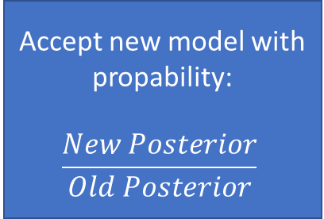
Inversion (Birth-Death MCMC*)
*MCMC = Monte Carlo Markov Chain
(Random) starting model
Randomly choose one
Add a node (birth)
Remove a node (death)
Move a node
Change a node
Update likelihood
Accept new model with propability:
$$\frac{New Posterior}{Old Posterior}$$
Calculate new posterior probability

Slide 15
Synthetic results
First results

Slide 16
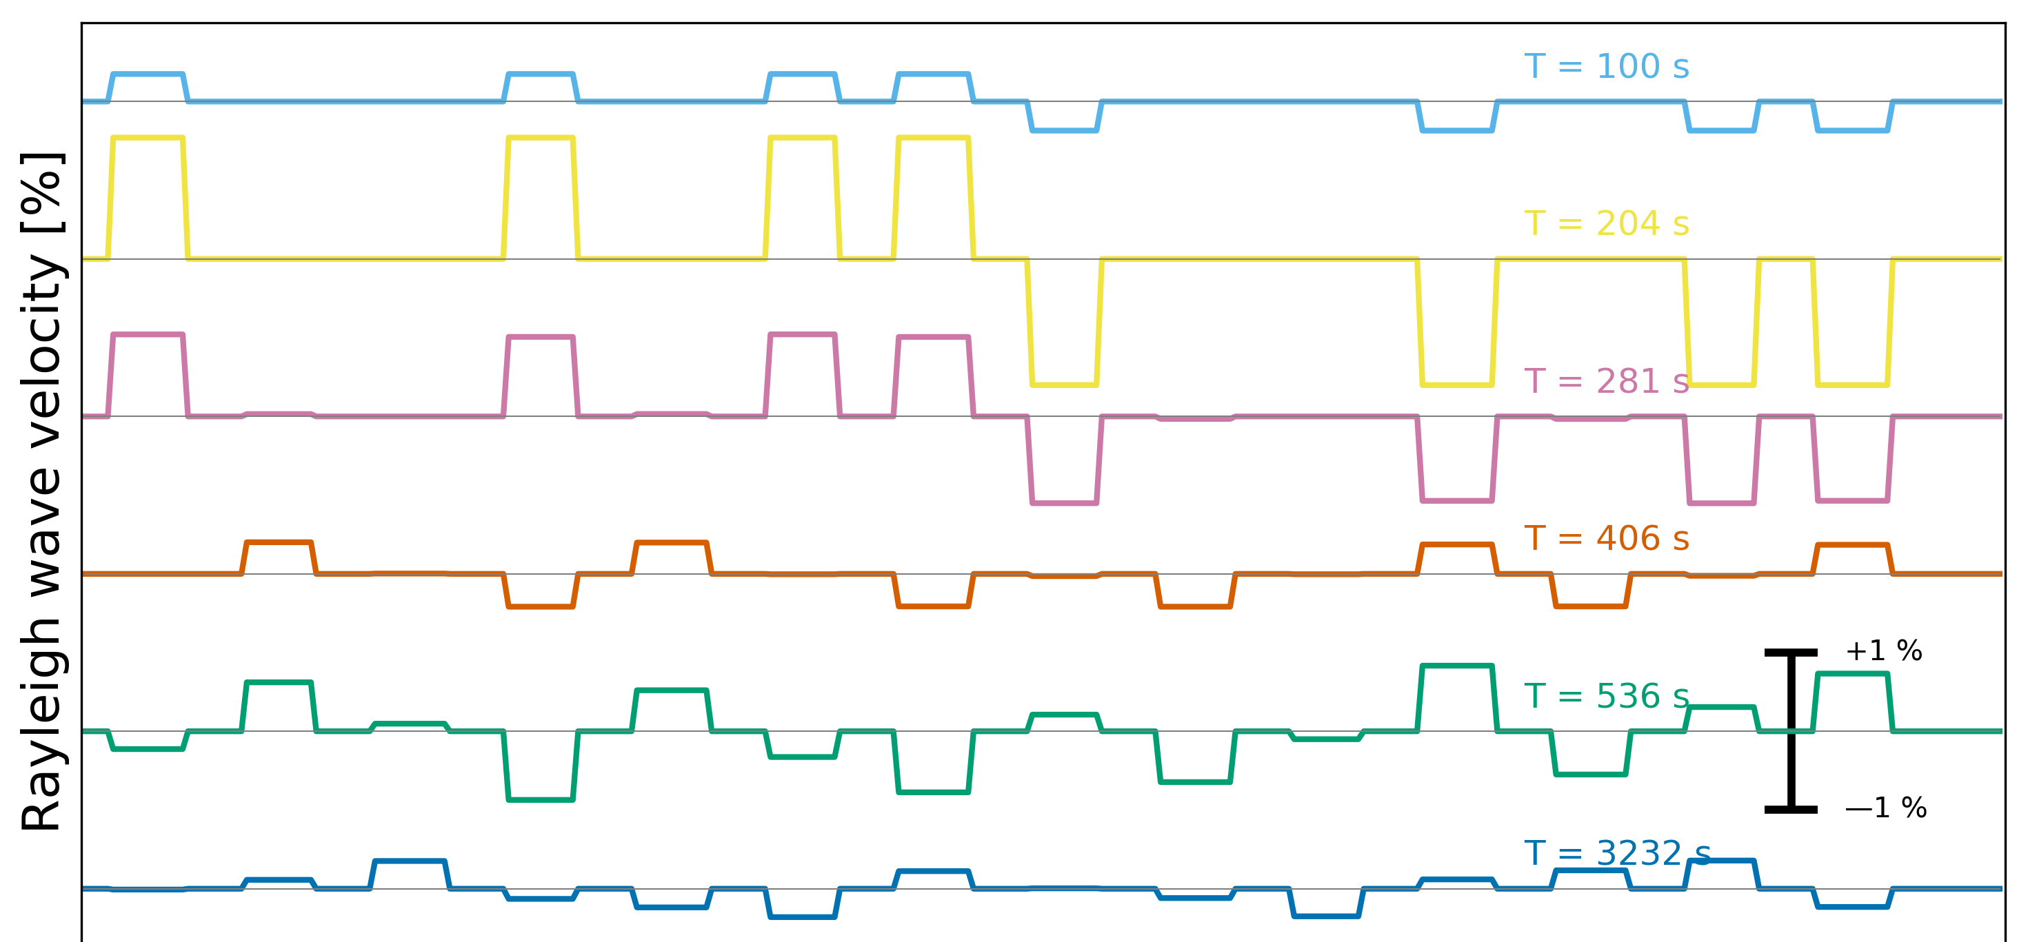
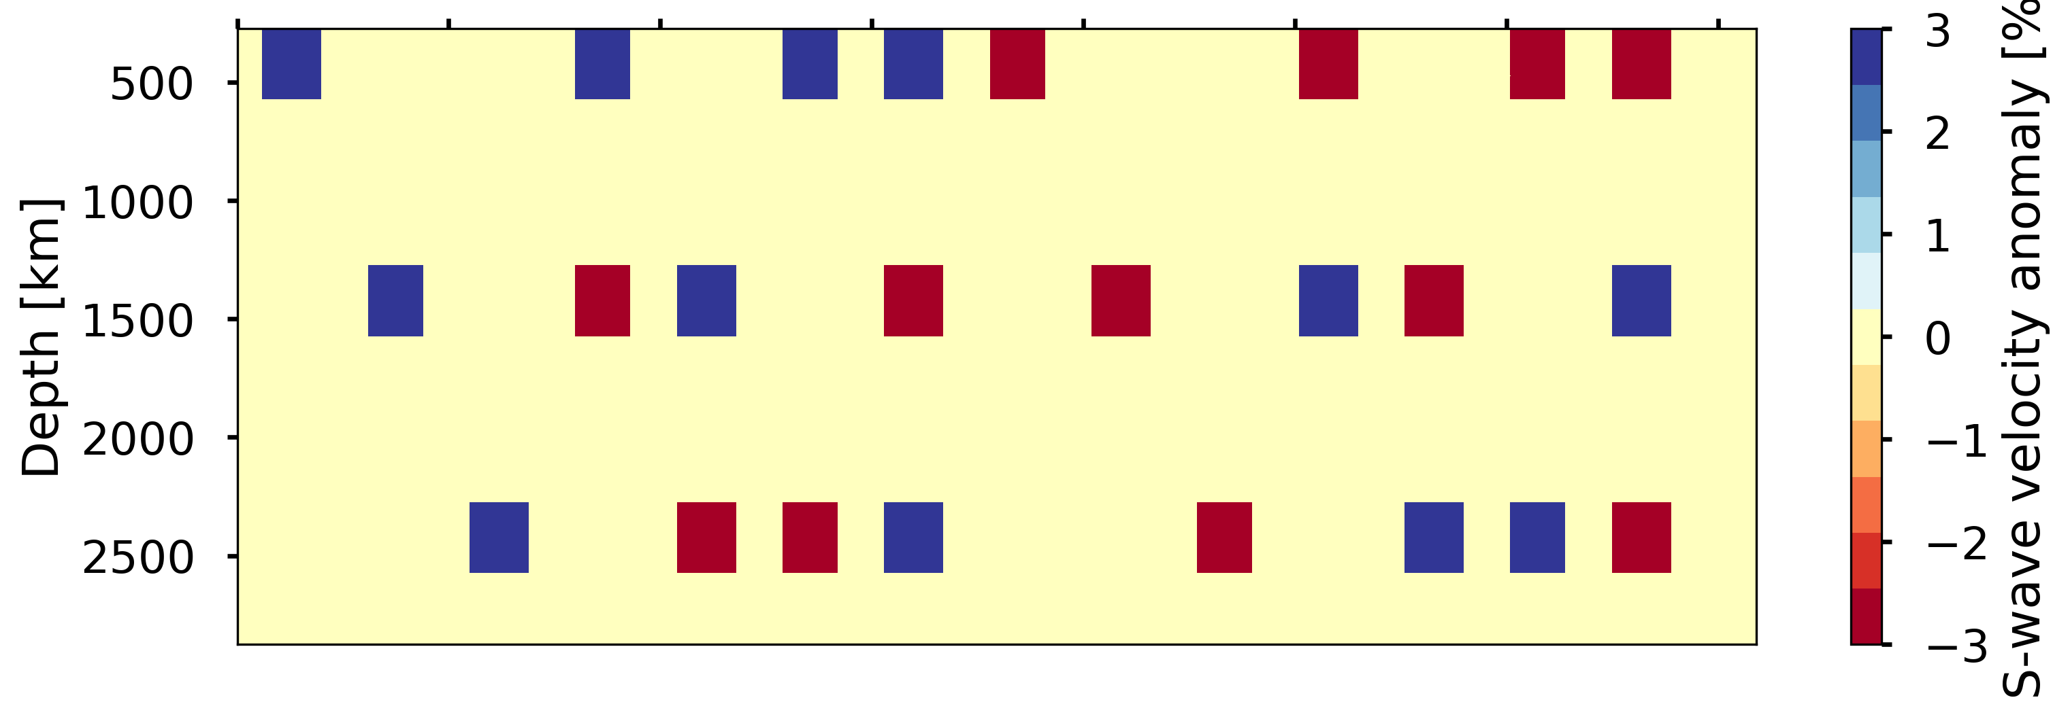
Synthetic example
Simple model consisting of velocity anomalies at separate depths
Density anomalies at the same location and strength

Slide 17
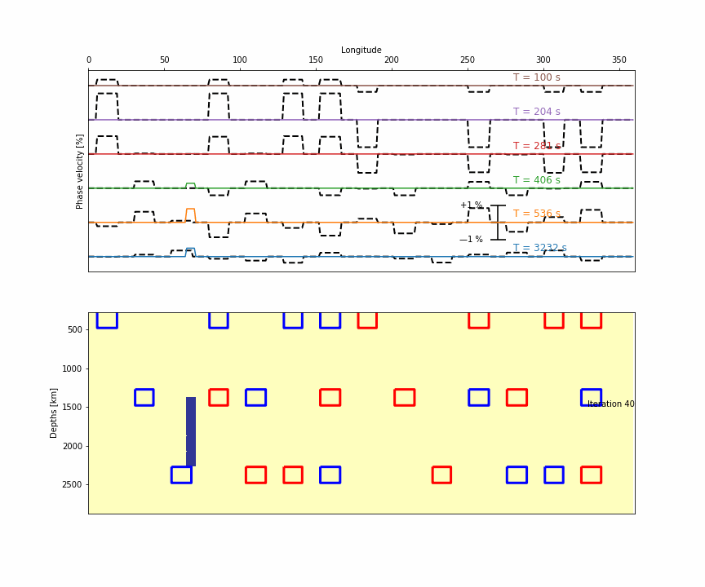
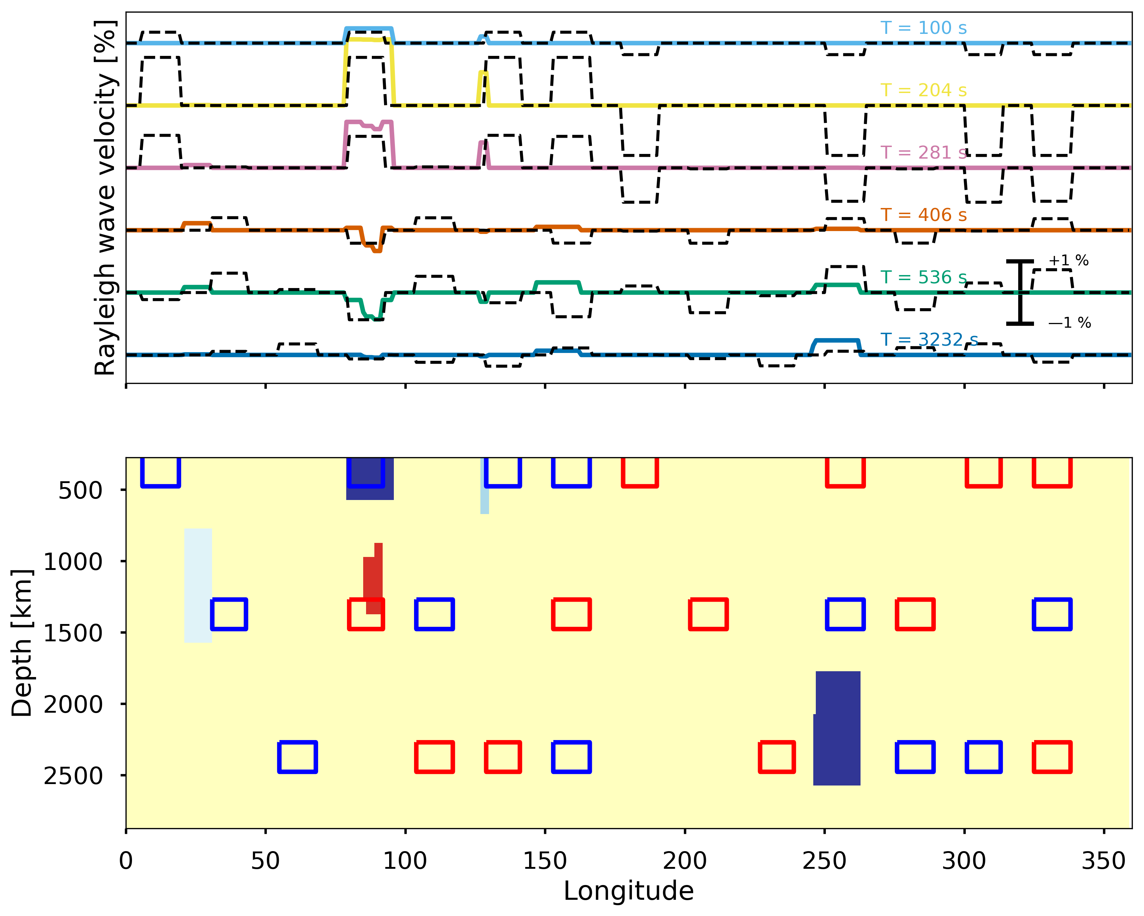
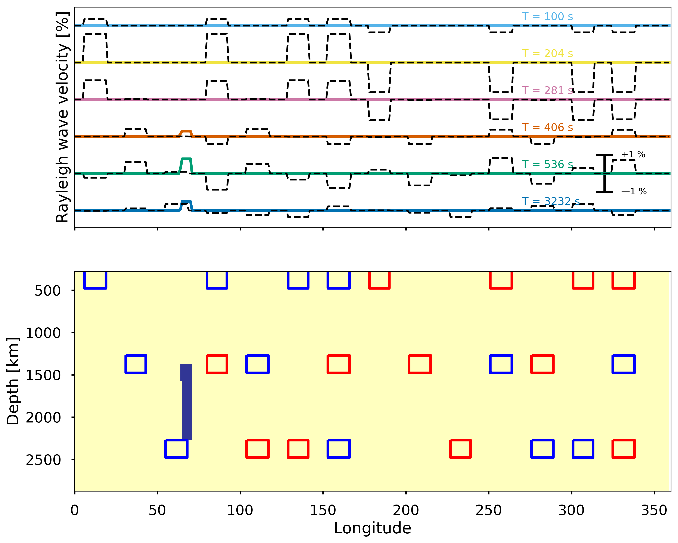
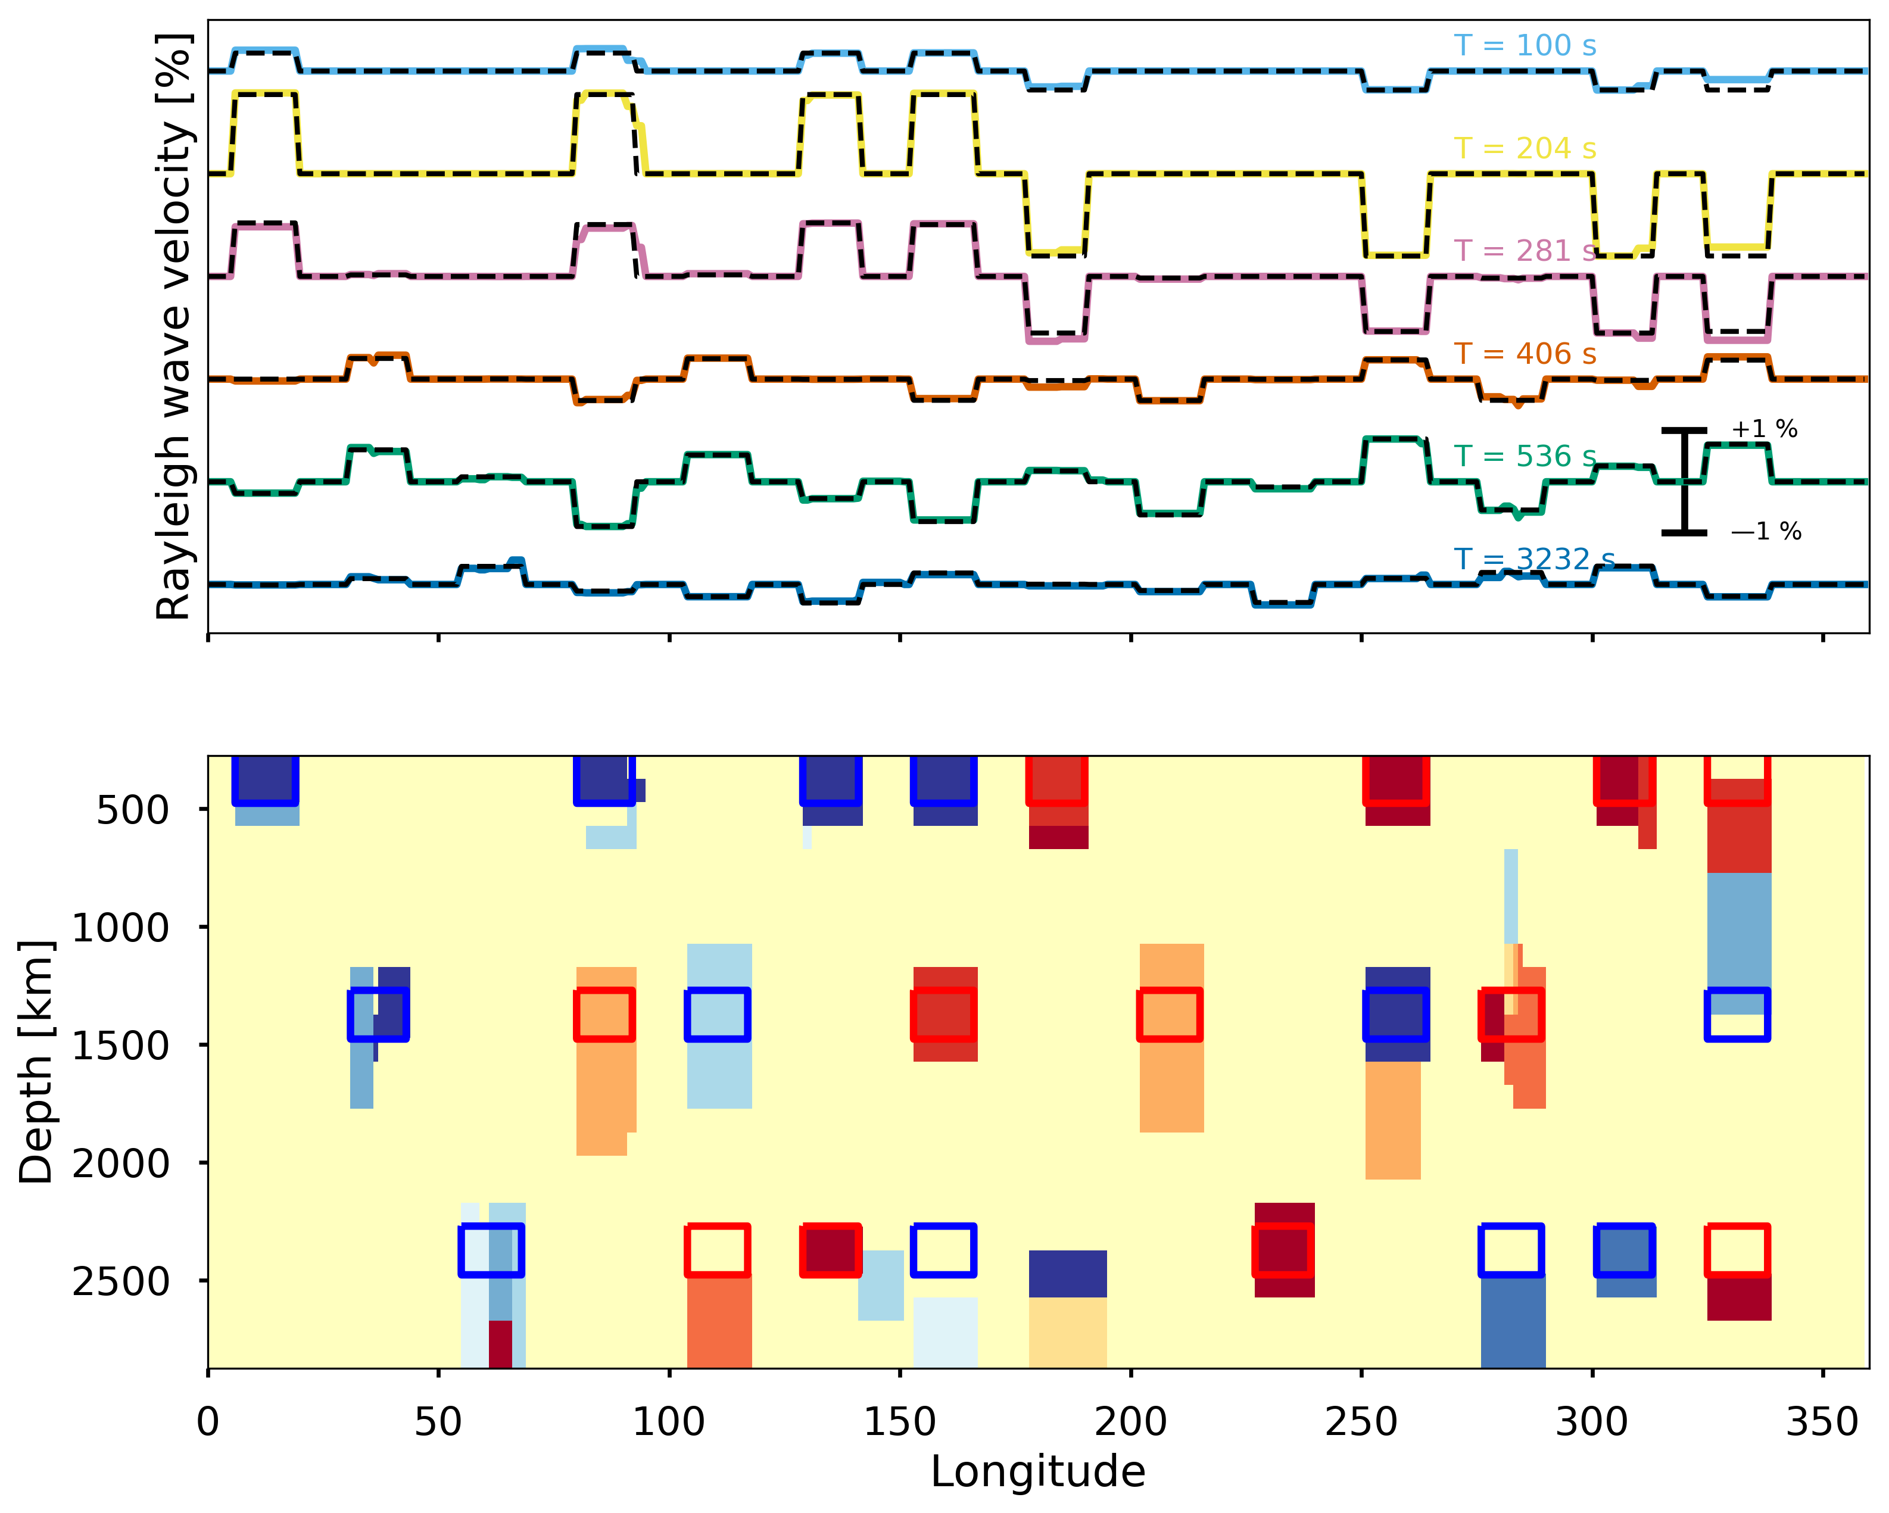
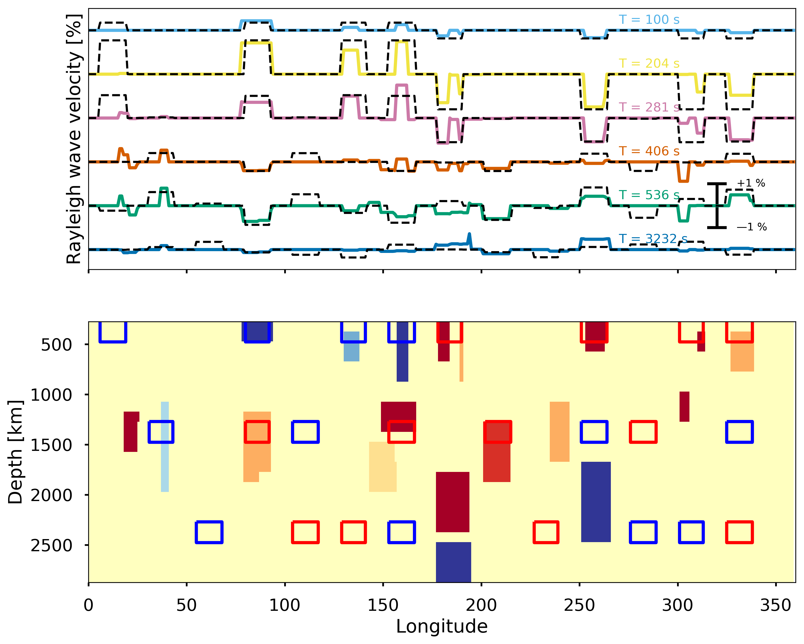
Model evolution (velocity)
After 40000 iterations
Starting model
After 400 iterations
After 80000 iterations

Slide 18
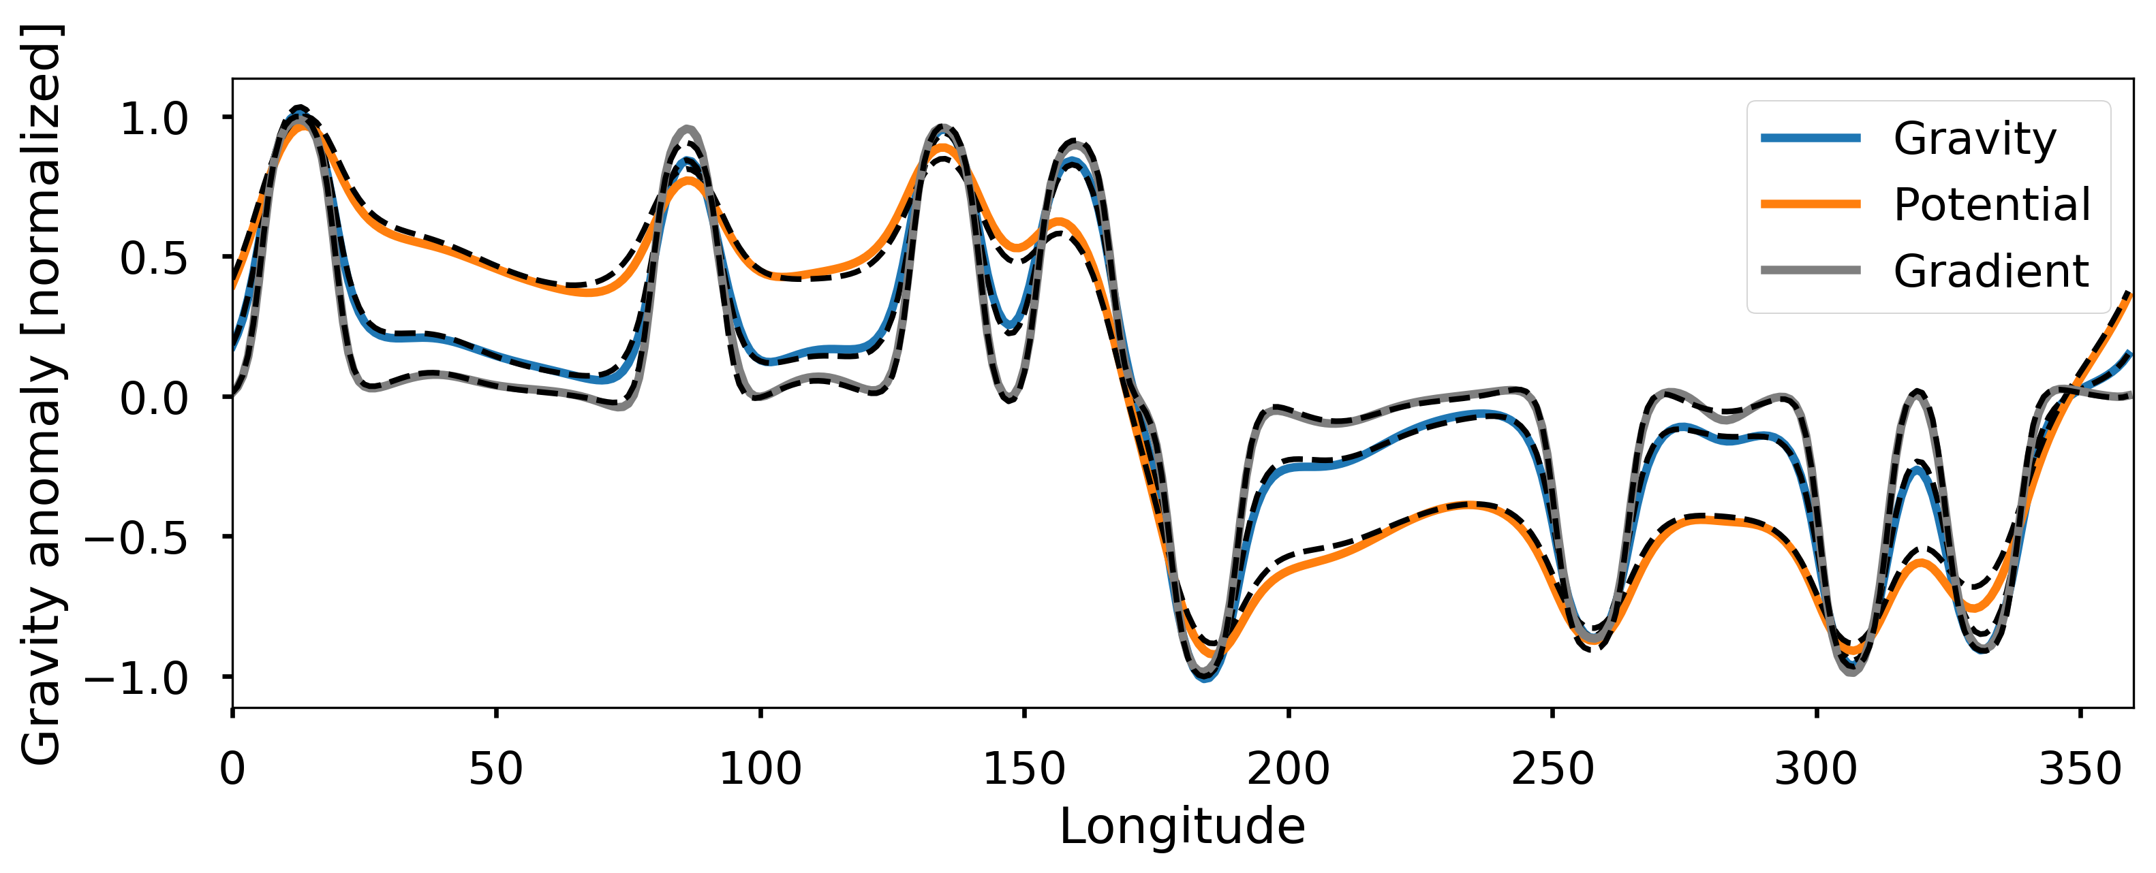
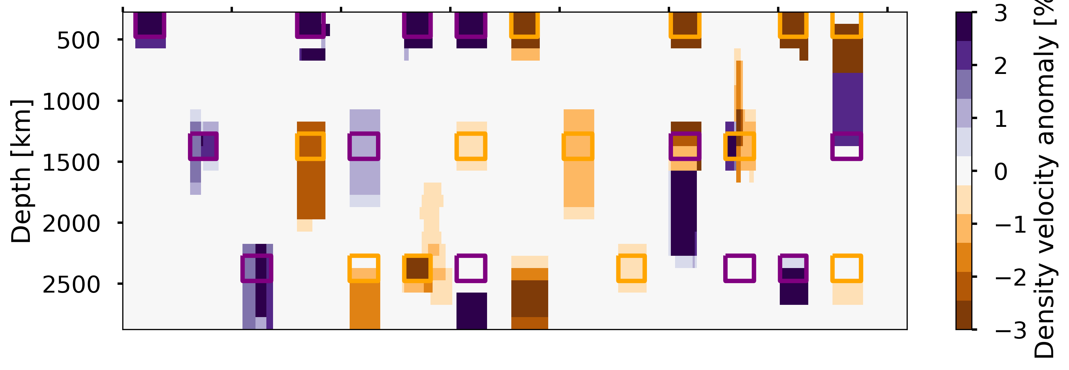
Satellite gravity
Synthetic density anomalies same as velocity
Satellite gravity in terms of gravity, potential and vertical gradient are inverted
Inherent correlations are considered

Slide 19
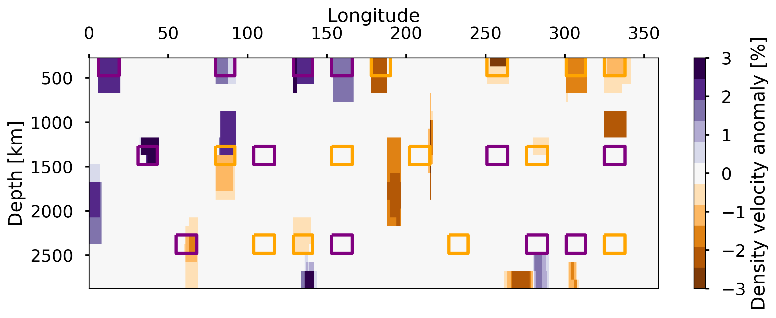
Why 3 gravity components?
Result with 3 components
Result with only gravity component

Slide 20
SMEAN2
Use seismic tomography as input
Calculate dispersion curves
Invert with MCMC

Slide 21
Conclusions and outlook
Proof-of-concept for discrete trans-dimensional inversion
The discrete parametrization is useful for combining data with vastly different spatial sensitivities, like surface waves and satellite gravity.
Best way to use normal modes?
  Love waves!
  Overtones?
  Splitting/Coupling?
Gravity
  Dynamic contribution
Include crust and lithosphere
Thank you for your attention!

Slide 22
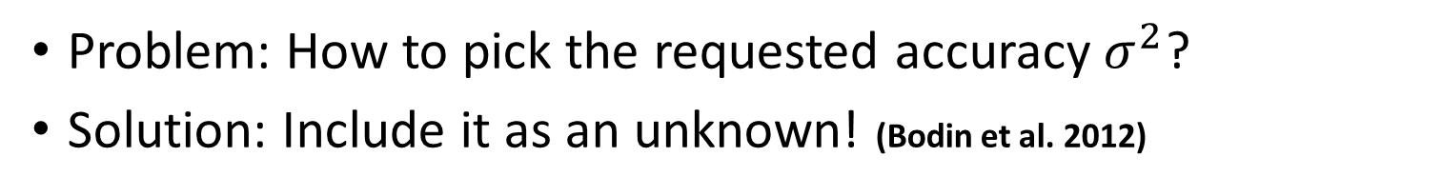
Hierarchical Bayesian
Problem: How to pick the requested accuracy $σ^{2}$?
Solution: Include it as an unknown! (Bodin et al. 2012)
$$Posterior \left(m_{k}\right)=Likelihood\left(Δy,σ^{2}\right)∗Prior\left(m_{k}\right)∗C$$
$$Posterior \left(m_{k},σ^{2}\right)=Likelihood\left(Δy,σ^{2}\right)∗Prior\left(m_{k}\right)∗Prior(σ^{2})$$

