Slide 1



Electrostatic waves in the shock ramp and their effect on plasma energetics.
Ahmad Lalti, Yuri Khotyaintsev, Daniel Graham,
Andris Vaivads, and Andreas Johlander.

Slide 2
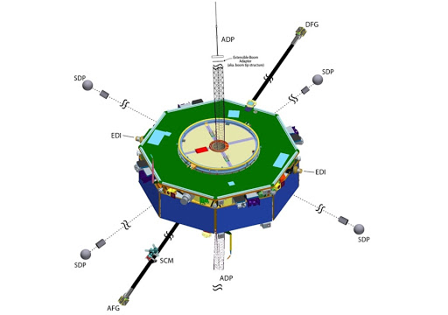
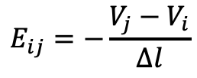
High frequency electrostatic (ES) waves are believed to be one of the key players in heating the solar wind across collision-less shocks. Understanding their properties and generation mechanism is essential for understanding shock dynamics. Their wavelength could reach the same order of magnitude as the Debye length.
The magnetospheric multiscale (MMS) mission is a constellation of 4 spacecraft launched in 2015 and equipped with high resolution particle and waves instruments.
What is important for ES wave characterization are the two spin plane double probes (SDP) and one axial double probe (ADP) which measures the local plasma potential with respect to the spacecraft, and by taking the difference between the potential of opposing probes and dividing by the probe separation allows for a full 3D measurement of the electric field up to 100
$$E_{ij}=−\frac{V_{j}−V_{i}}{∆l}$$

Slide 3
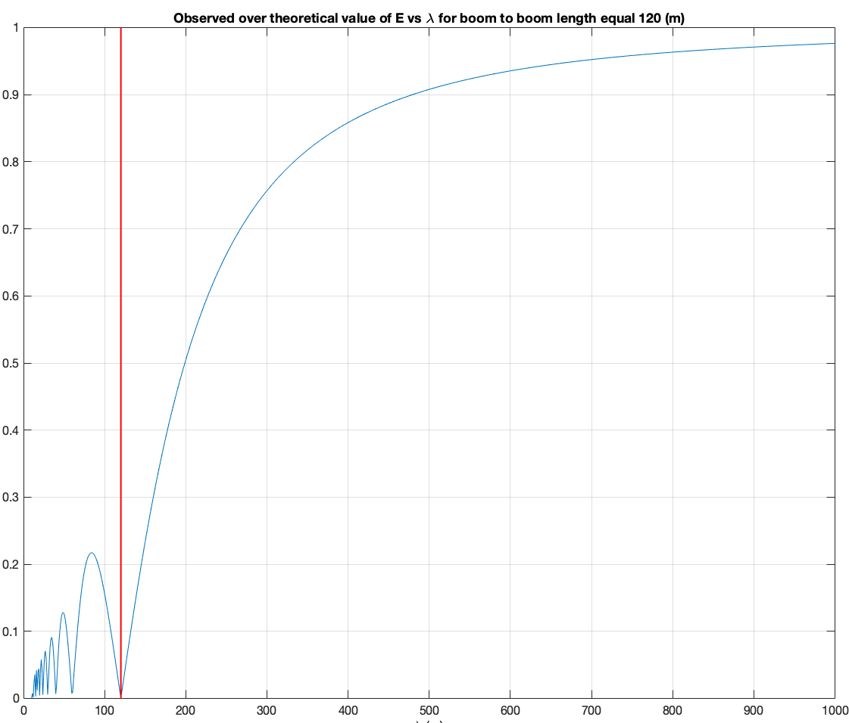


Using the potential difference to calculate the electric field is accurate when the wavelength of the waves is much larger than the probe separation. But when the wavelength become comparable to the probe separation the measured electric field in the direction of the probes will be underestimated.
We simulate this effect and show the results in the figure to the right. It shows the ratio of the observed amplitude over the actual amplitude vs the wavelength for a probe separation of 120 (m) (marked by the red vertical line).
$$α=\frac{E_{obs}}{E_{th}}$$
$$λ (m)$$

Slide 4
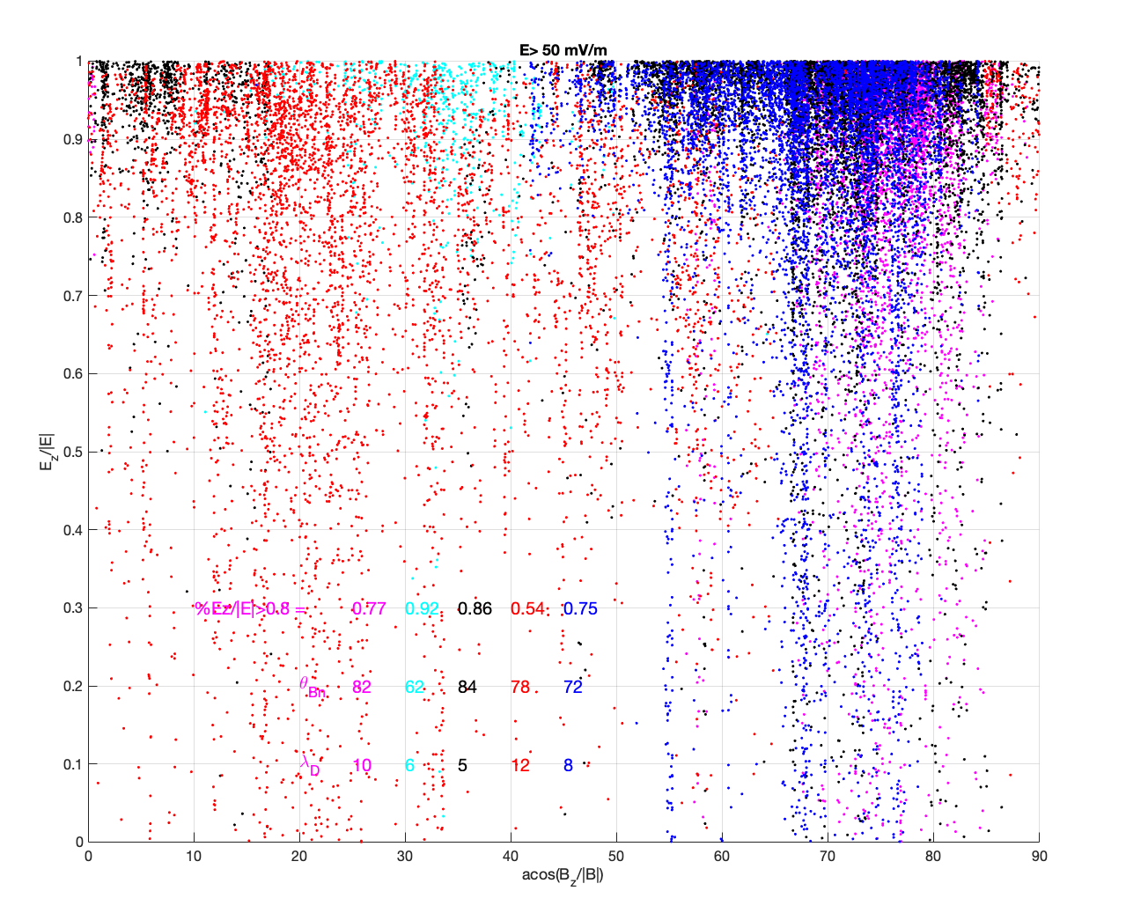
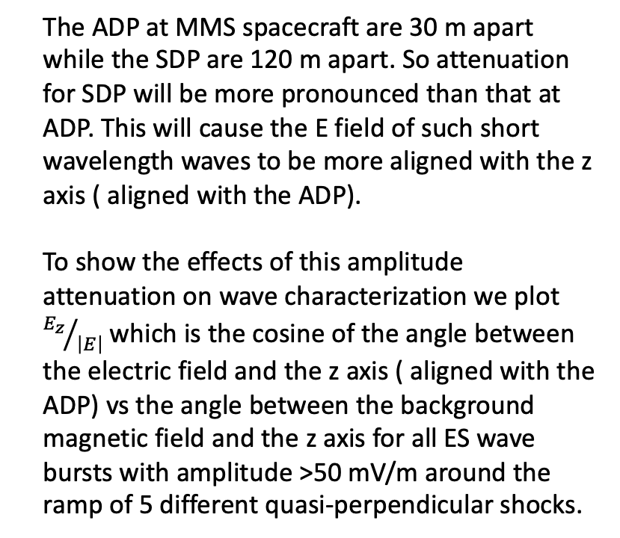
The ADP at MMS spacecraft are 30 m apart while the SDP are 120 m apart. So attenuation for SDP will be more pronounced than that at ADP. This will cause the E field of such short wavelength waves to be more aligned with the z axis ( aligned with the ADP).
To show the effects of this amplitude attenuation on wave characterization we plot ${E_{z}}/{\left|E\right|}$ which is the cosine of the angle between the electric field and the z axis ( aligned with the ADP) vs the angle between the background magnetic field and the z axis for all ES wave bursts with amplitude >50 mV/m around the ramp of 5 different quasi-perpendicular shocks.

Slide 5
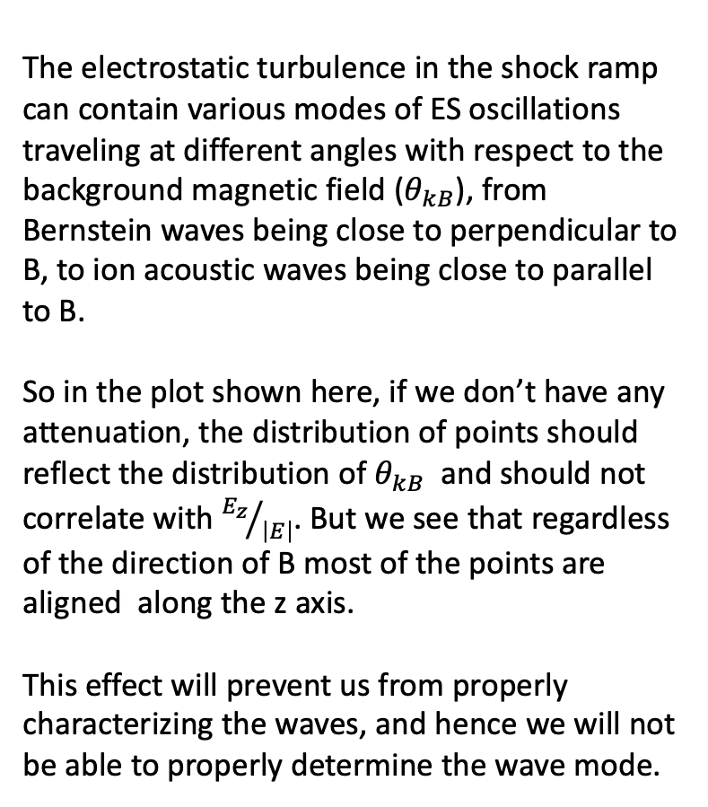
The electrostatic turbulence in the shock ramp can contain various modes of ES oscillations traveling at different angles with respect to the background magnetic field ($θ_{kB}$), from Bernstein waves being close to perpendicular to B, to ion acoustic waves being close to parallel to B.
So in the plot shown here, if we don’t have any attenuation, the distribution of points should reflect the distribution of $θ_{kB}$ and should not correlate with ${E_{z}}/{\left|E\right|}$. But we see that regardless of the direction of B most of the points are aligned along the z axis.
This effect will prevent us from properly characterizing the waves, and hence we will not be able to properly determine the wave mode.

Slide 6

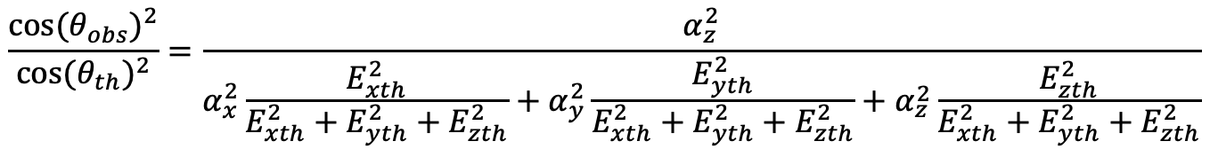

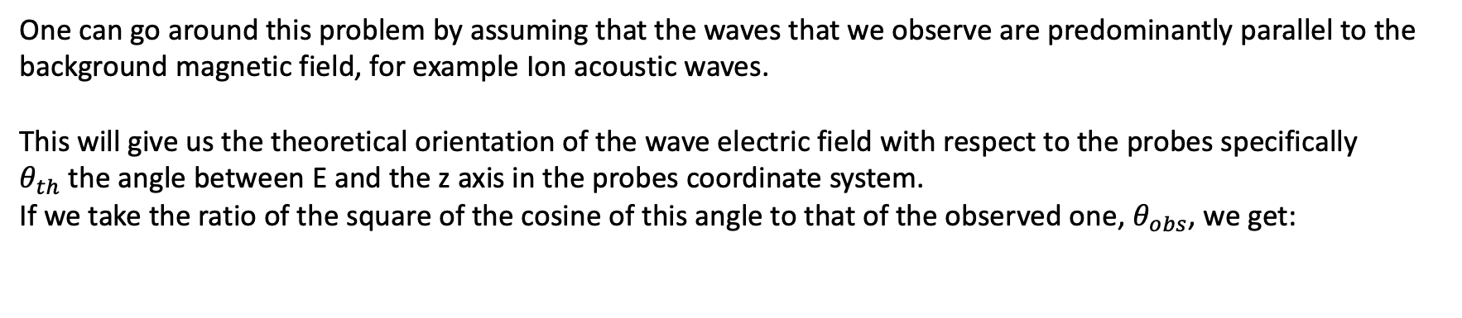

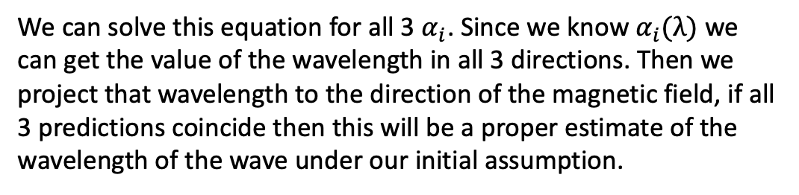
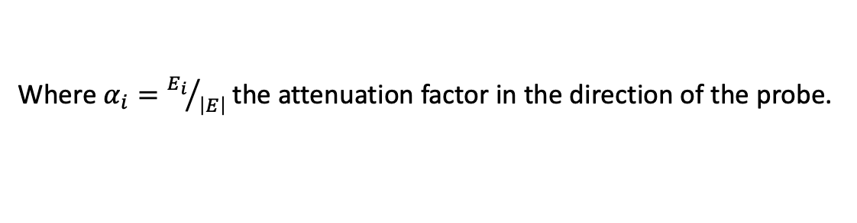
One can go around this problem by assuming that the waves that we observe are predominantly parallel to the background magnetic field, for example Ion acoustic waves.
This will give us the theoretical orientation of the wave electric field with respect to the probes specifically $θ_{th}$the angle between E and the z axis in the probes coordinate system.
If we take the ratio of the square of the cosine of this angle to that of the observed one, $θ_{obs}$, we get:
$$\frac{{cos⁡(θ_{obs})}^{2}}{{cos⁡(θ_{th})}^{2}}=\frac{α_{z}^{2}}{α_{x}^{2}\frac{E_{xth}^{2}}{E_{xth}^{2}+E_{yth}^{2}+E_{zth}^{2}}+α_{y}^{2}\frac{E_{yth}^{2}}{E_{xth}^{2}+E_{yth}^{2}+E_{zth}^{2}}+α_{z}^{2}\frac{E_{zth}^{2}}{E_{xth}^{2}+E_{yth}^{2}+E_{zth}^{2}}}$$
z
$$\vec{B}$$
5
4
Where $α_{i}={E_{i}}/{\left|E\right|}$the attenuation factor in the direction of the probe.
x
1
$$θ_{th}$$
We can solve this equation for all 3 $α_{i}$. Since we know $α_{i}(λ)$ we can get the value of the wavelength in all 3 directions. Then we project that wavelength to the direction of the magnetic field, if all 3 predictions coincide then this will be a proper estimate of the wavelength of the wave under our initial assumption.
$$φ_{th}$$
SC
3
2
6
y

Slide 7
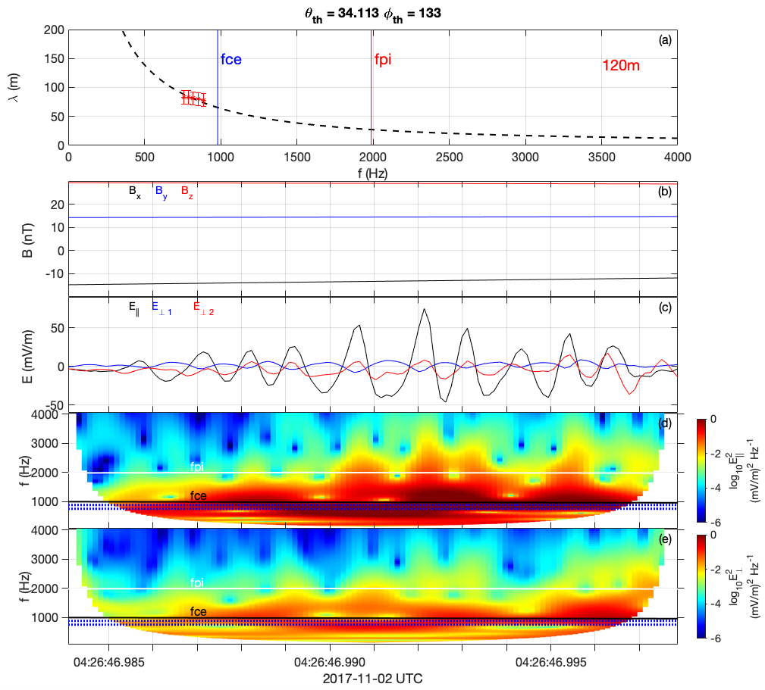
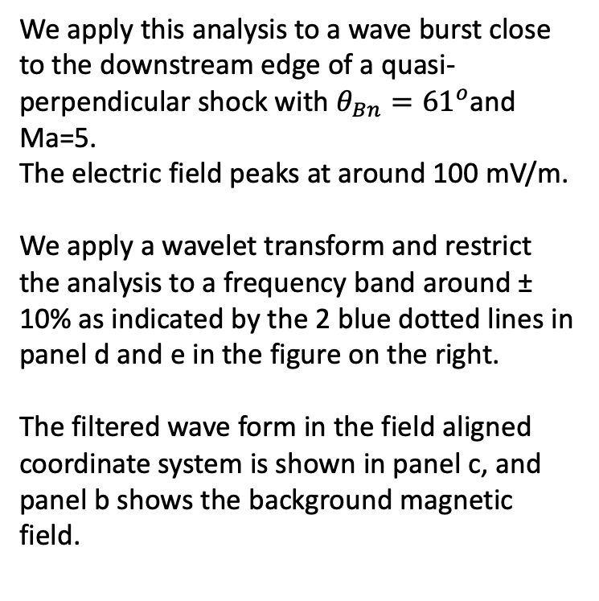
We apply this analysis to a wave burst close to the downstream edge of a quasi-perpendicular shock with $θ_{Bn}={61}^{o}$and Ma=5.
The electric field peaks at around 100 mV/m.
We apply a wavelet transform and restrict the analysis to a frequency band around ± 10% as indicated by the 2 blue dotted lines in panel d and e in the figure on the right.
The filtered wave form in the field aligned coordinate system is shown in panel c, and panel b shows the background magnetic field.

Slide 8
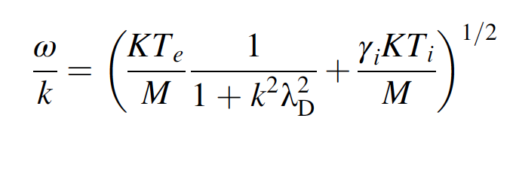
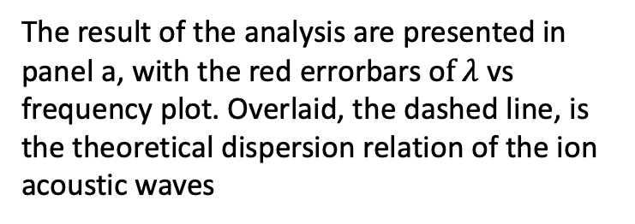
The result of the analysis are presented in panel a, with the red errorbars o$f λ$ vs frequency plot. Overlaid, the dashed line, is the theoretical dispersion relation of the ion acoustic waves
Along with the electron cyclotron frequency in blue and the ion plasma frequency in red calculated using local values of necessary parameters.
This shows good agreement with the dispersion relation of the ion acoustic.
Next step is to compare the results of this method with results of other methods for determining wavelength, namely interferometry between electric fields or probe potentials measured by different probes on a single spacecraft.

