Slide 1





Ensemble strategies for Flash Flood Forecasting: the 29 October 2018 event in the Eastern Italian Alps
Teresa Pérez Ciria¹, Mattia Zaramella¹, Eleonora Dallan¹, Lorenzo Giovannini², Dino Zardi^{2,3}, Silvio Davoli⁴, and Marco Borga¹
¹ University of Padova, AGRIPOLIS, TESAF , LEGNARO (PD), Italy (teresa.perezciria@unipd.it),
² Department of Civil, Environmental and Mechanical Engineering (DICAM), University of Trento, Italy,
³ C3A - Center Agriculture Food Environment, University of Trento, Italy,
⁴ Institute of Atmospheric Sciences and Climate, National Research Council of Italy, CNR-ISAC, Bologna, Italy
EGU21-14852
28 April 2021

Slide 2
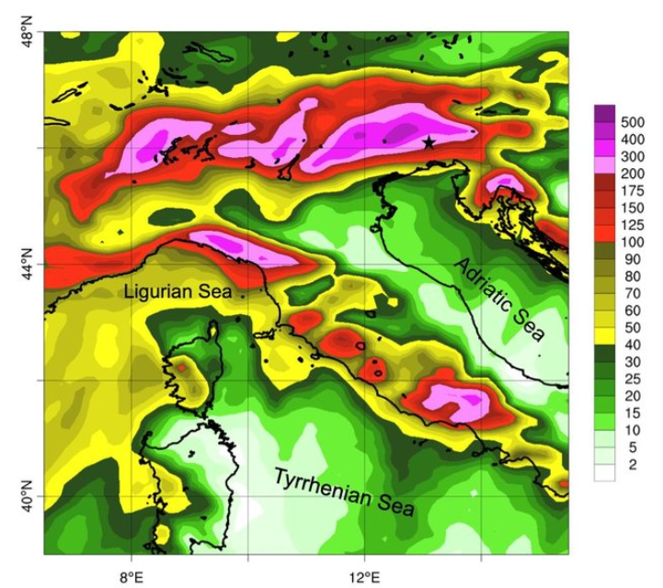
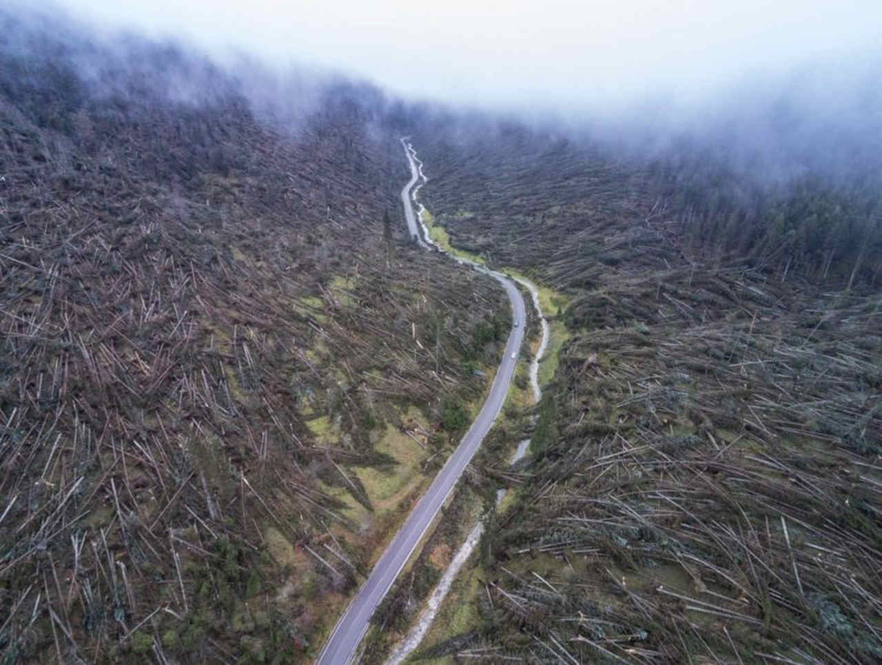
Vaia storm, an unprecedented event
On October 29, 2018, the Vaia storm hits the North-Eastern regions of Italy with extreme cumulated precipitation (up to 850 mm in three days) and wind, causing severe floods, landslides, loss of lives, extended damages to forests, interruption of traffic and electricity supply, as well as other infrastructural damages.
Impacts (Chirici et al., 2019; Biolchi et al., 2019; Giovannini et al., 2021):
  16 casualties from Trentino (northern Italy) to Campania (southern Italy)
  494 municipalities registered damages
  Destroyed or intensely damaged forest stands amounted to about 42,500 ha, 8.5 to 8.7 millions m3 = 7 times average annually harvested industrial round wood volume in Italy
Source: https://www.meteogiornale.it
72-h accumulated precipitation (0000 UTC 27 Oct. -0000 UTC 30 Oct., 2018) as simulated by BOLAM. The 915(Davolio et al., 2020)

Slide 3
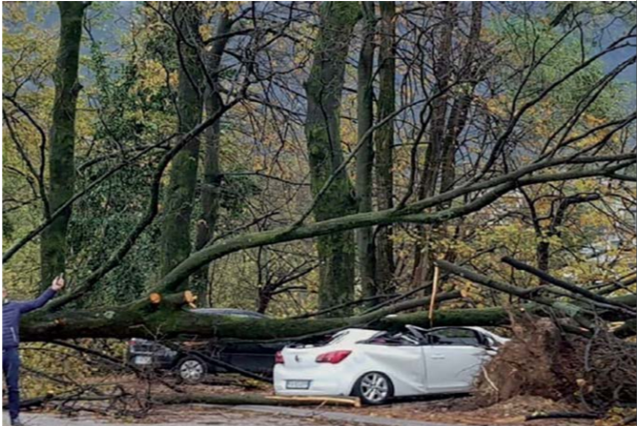
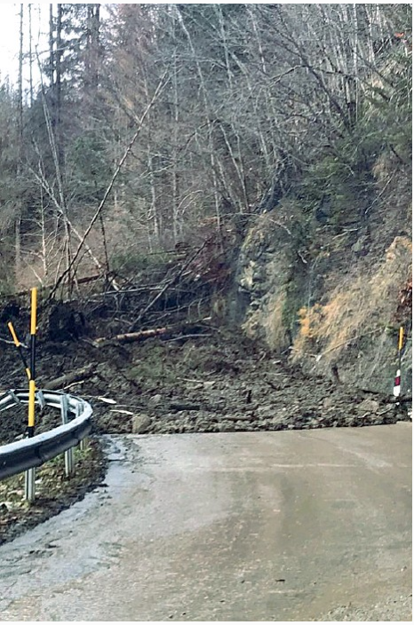
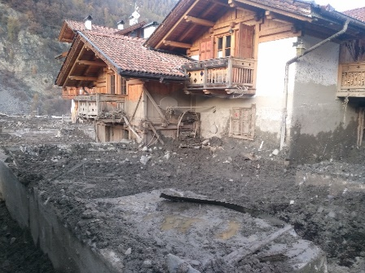
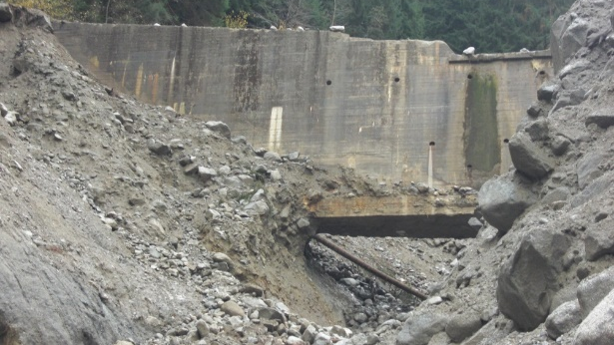
Vaia storm: photos
Source: https://www.meteogiornale.it
Source: https://impact.startupitalia.eu

Slide 4
Motivation
Introduction | Methods | Study area | Results | Discussion and outlook
For low-probability, high-intensity flood hazards such as the Vaia event, it is a challenge to forecast/hindcast the hydrological response due to the complex terrain and the events’ complex spatial and temporal characteristics.
However, with extreme precipitation over this region projected to increase significantly over the coming decades (e.g. Libertino et al, 2019), the need to reliably reproduce such events is high for both climate researchers and operational professionals.

Slide 5
Motivation
Introduction | Methods | Study area | Results | Discussion and outlook
In mountainous areas, like the Alps, where precipitation is strongly influenced by the terrain, spatial patterns of precipitation are not well captured by either sparse gauge data or gridded precipitation data sets (e.g. weather radar estimates).
High-resolution, convection-resolving modelling has exhibited great promise in addressing these issues and has the potential to be a powerful tool for hydrological prediction of extreme events.
However, there is poor knowledge on how errors in this type of precipitation and temperature simulations propagate to modelled discharges with varying catchment size.

Slide 6
Objectives
Introduction | Methods | Study area | Results | Discussion and outlook
This study presents an attempt to address the propagation of convection resolving meteorological simulations to flood predictions in the context of distributed hydrological simulations over a range of catchment sizes or scales.
Precipitation and temperature hindcasts with high spatiotemporal resolution generated from a convection resolving model are used as forcing to a fully distributed hydrologic model for flood prediction in a set of nested subbasins.
The accuracy of flood predictions relative to reference hydrological simulations obtained through the calibrated model is assessed.

Slide 7
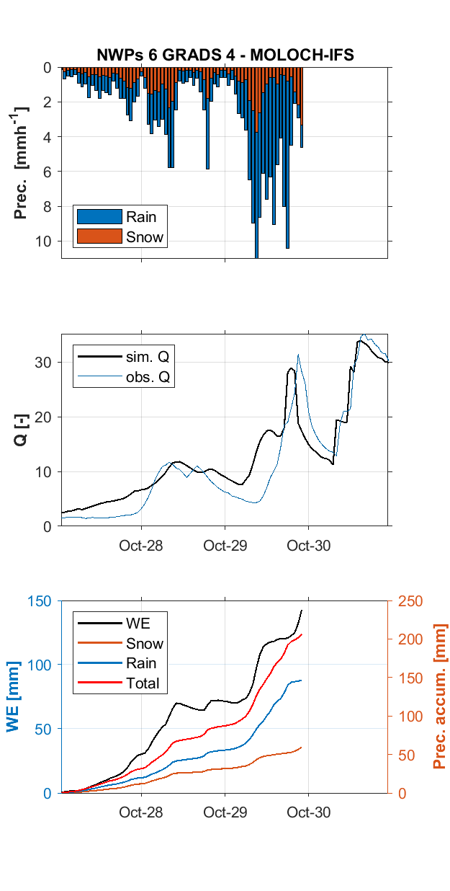

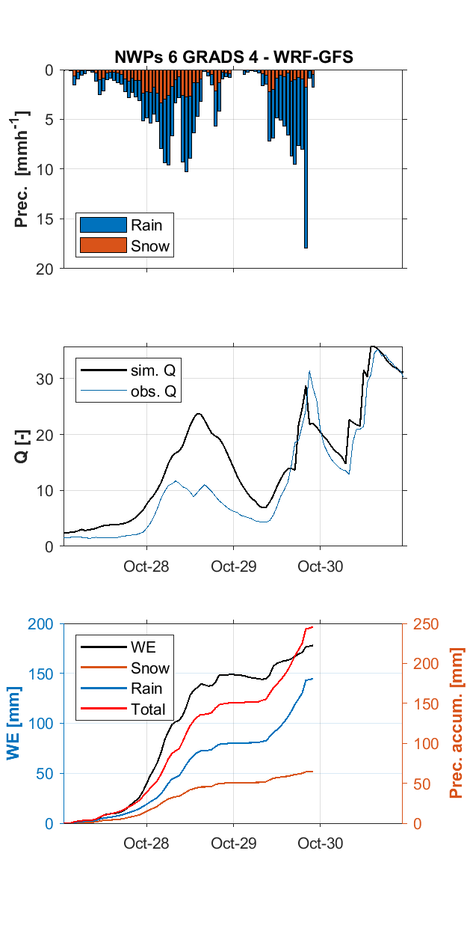
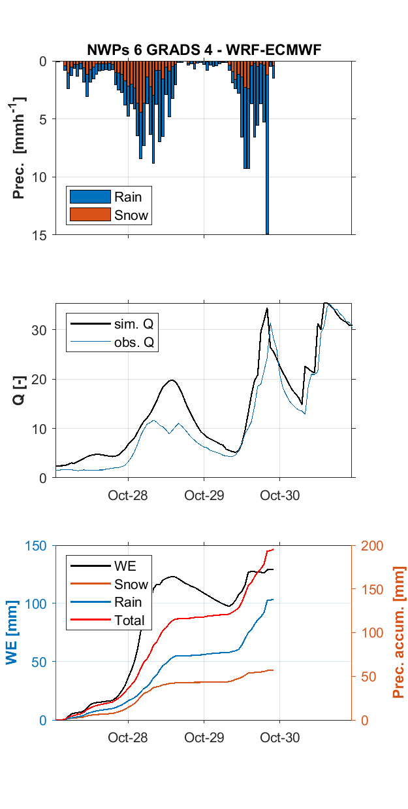
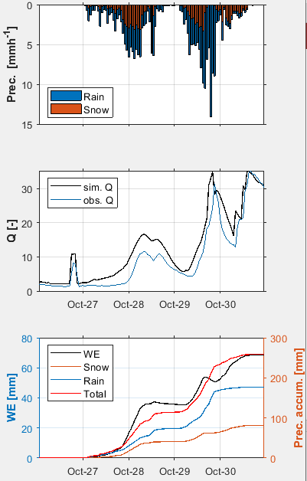
Introduction | Methods | Study area | Results | Discussion and outlook
Simulations ICHYMOD input data (precipitation and temperature):
Reference hydrological model (GRIS)
Numerical Weather Prediction models (NWPs):
  MOLOCH-IFS - WRF-ECMWF
  MOLOCH-GFS - WRF-GFS
Simulations ICHYMOD output analysis (q peak and volume). Error propagation:
-Total precipitation / precipitation phase 2
-Total rain / rain phase 2
GRIS

Slide 8
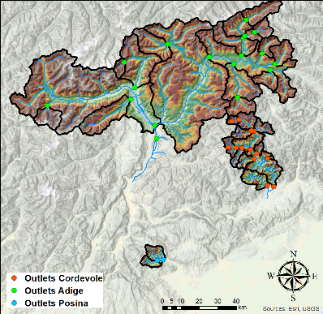
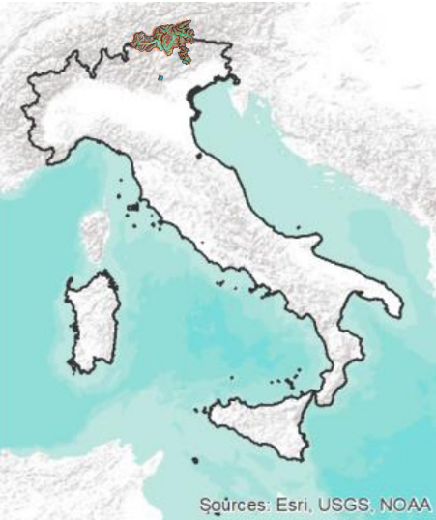
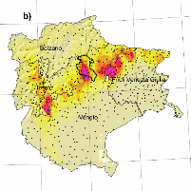
Study area: North of Italy
Introduction | Methods | Study area | Results | Discussion and outlook
Id | Gauging station | Catchment area (km²) | Mean elevation (m a.s.l)
1 | Solda | 130.50 | 2498
2 | Valdultimo | 282.63 | 1921
3 | Rio Plan | 49.94 | 2163
4 | Rio Riva at Seghe | 76.88 | 1831
5 | Rio Anterselva at Bagni | 82.50 | 2072
6 | Rio Braies at Braies | 92.75 | 2188
7 | Rio Riva at Caminata | 117.38 | 1829
8 | Rio Casies at Colle | 117.06 | 2162
9 | Gadera at Pedraces | 124.81 | 1911
10 | Aurino at Cadipietra | 155.88 | 1796
11 | Rio Ridanna at Vipiteno | 204.75 | 1700
12 | Gadera at Mantana | 394.75 | 1915
13 | Passirio at Merano | 414.19 | 1533
14 | Aurino at Caminata | 418.25 | 1887
15 | Aurino at S.Giorgio | 613.38 | 1847
16 | Rienza Vandoies | 1919.81 | 1916
17 | Adige at Ponte Adige | 2725.81 | 1878
18 | Adige at Bronzolo | 6834.75 | 1885
19 | Ponte Mas | 705.07 | 1602
20 | Saviner | 109.30 | 1907
21 | Fiorentina | 56.77 | 1857
22 | Corpassa | 24.81 | 1926
23 | Renaz | 27.63 | 2107
24 | Biois a Falcade | 52.30 | 1996
25 | Liera | 37.71 | 1994
26 | Pettorina | 55.05 | 1964
27 | Tegnas | 48.92 | 1737
28 | Vizza | 7.68 | 2271
29 | Cavia | 1.75 | 2261
30 | Missiaga | 4.97 | 1727
31 | Ghirlo | 420.70 | 1818
32 | Posina Stancari | 115.67 | 1105
33 | Posina Bazzoni | 41.64 | 1130

Slide 9
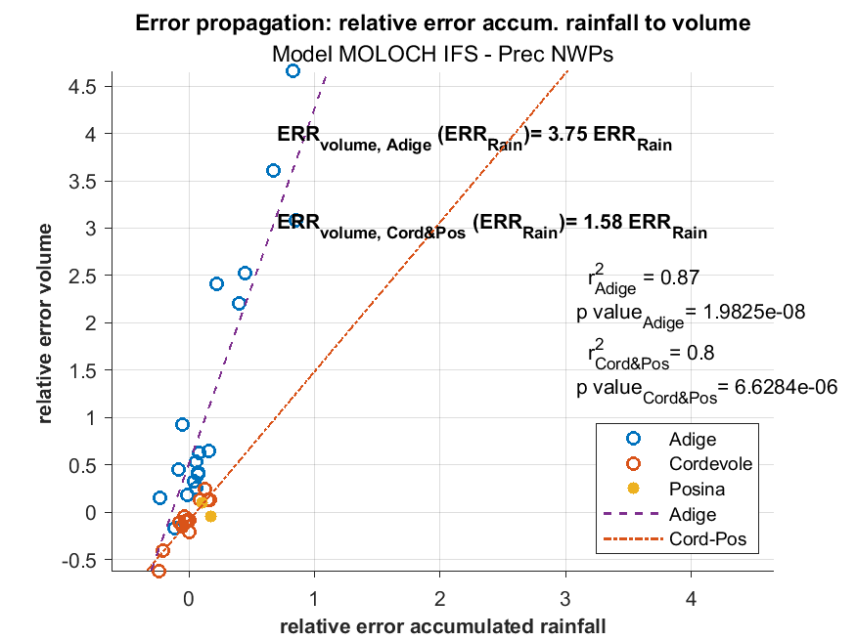
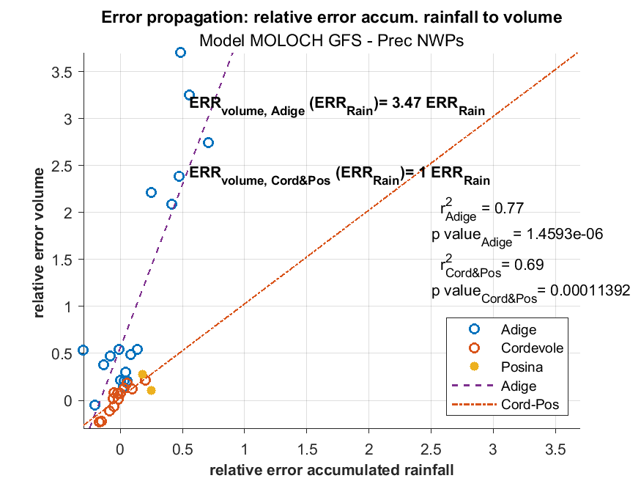
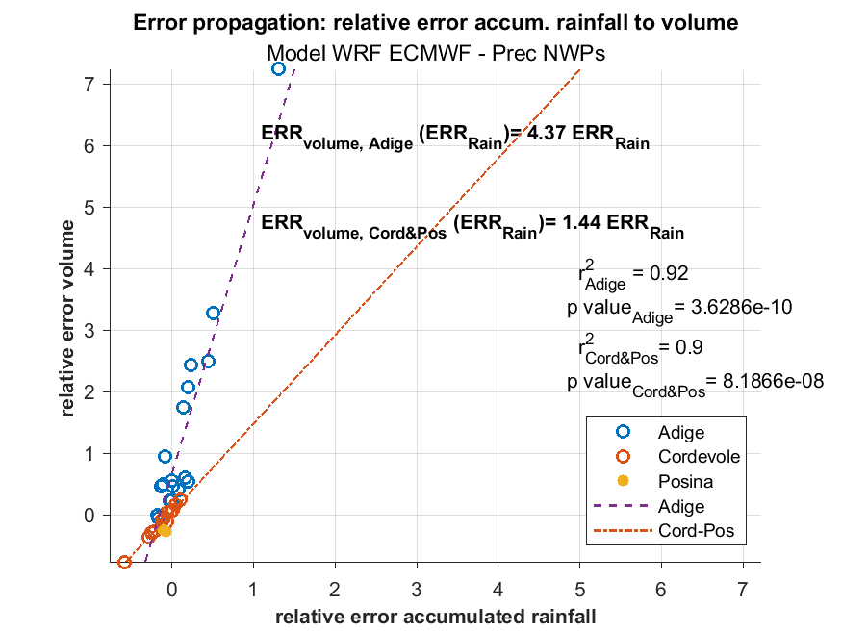
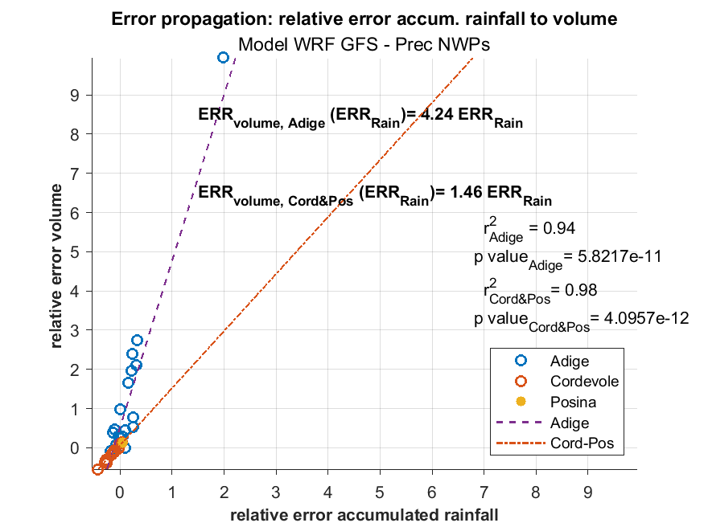
Error propagation Analysis: relative error accum. rainfall to volume
Introduction | Methods | Study area | Results | Discussion and outlook
Notes:
To investigate this outcome in detail, we used the DWT for a multiresolution analysis.

Slide 10
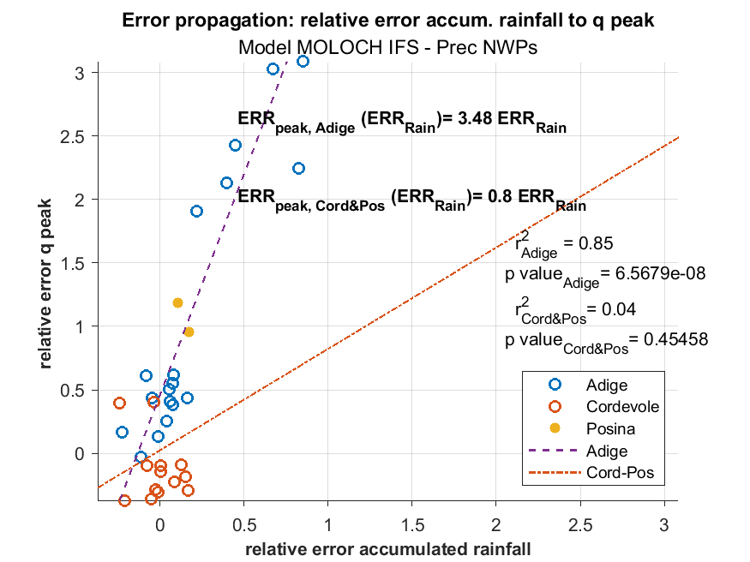
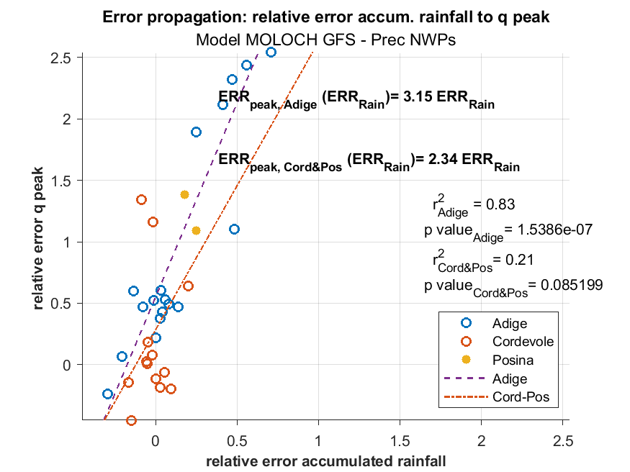
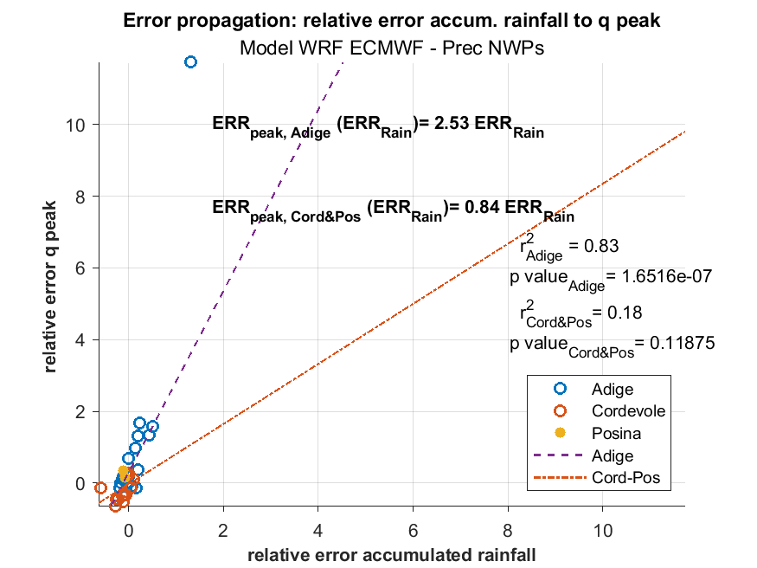
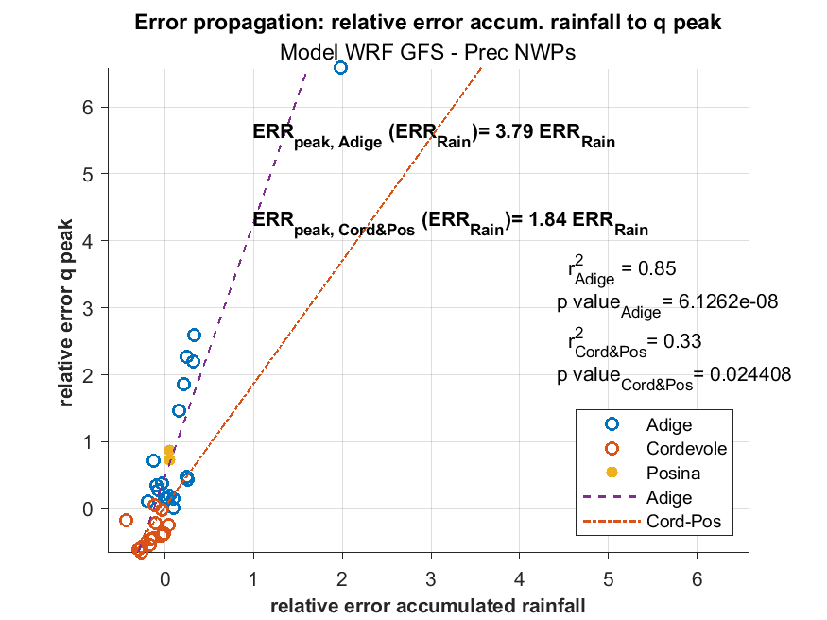
Error propagation Analysis: relative error accum. rainfall to q peak
Introduction | Methods | Study area | Results | Discussion and outlook
Notes:
To investigate this outcome in detail, we used the DWT for a multiresolution analysis.

Slide 11
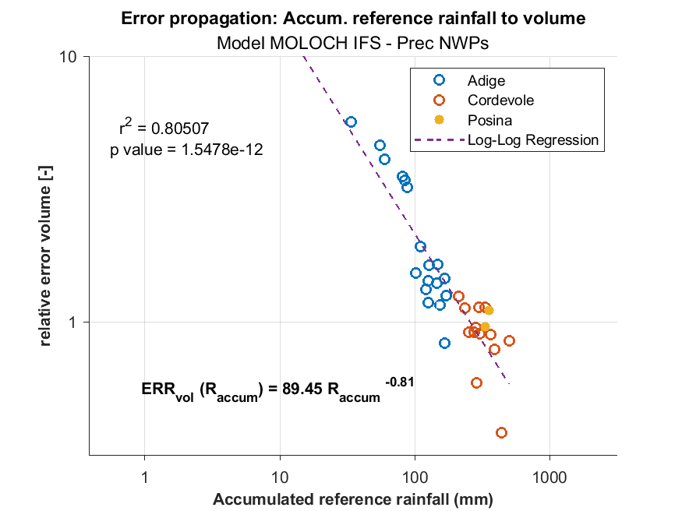
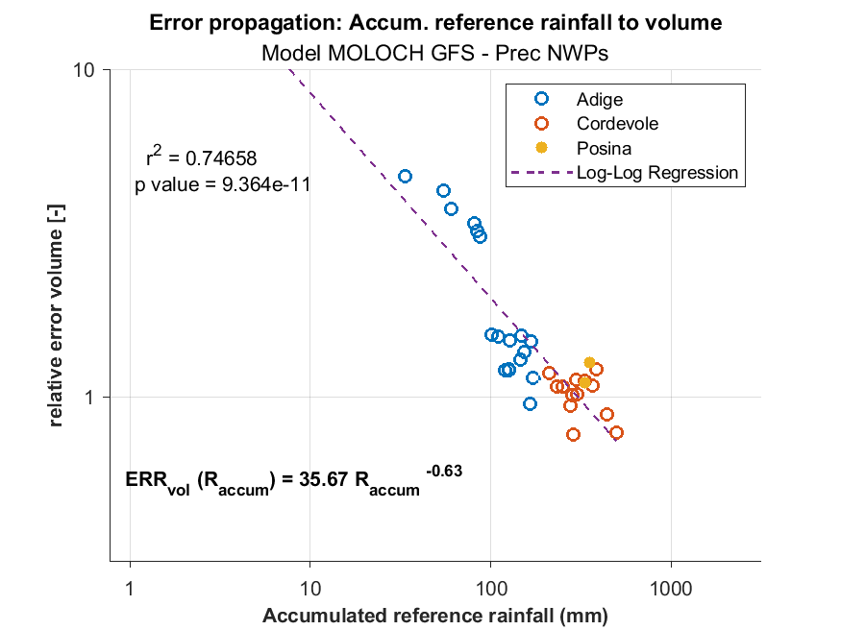
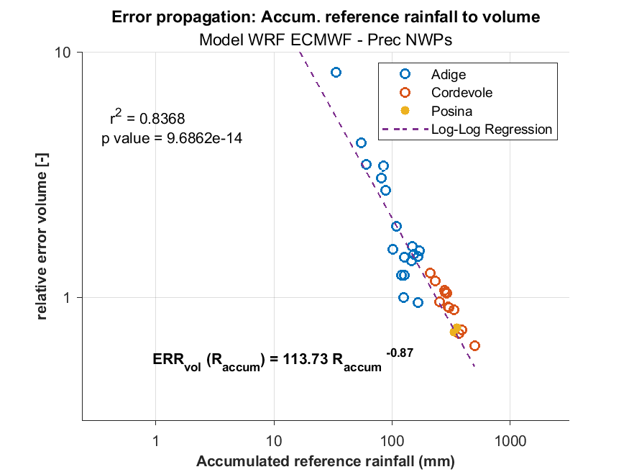
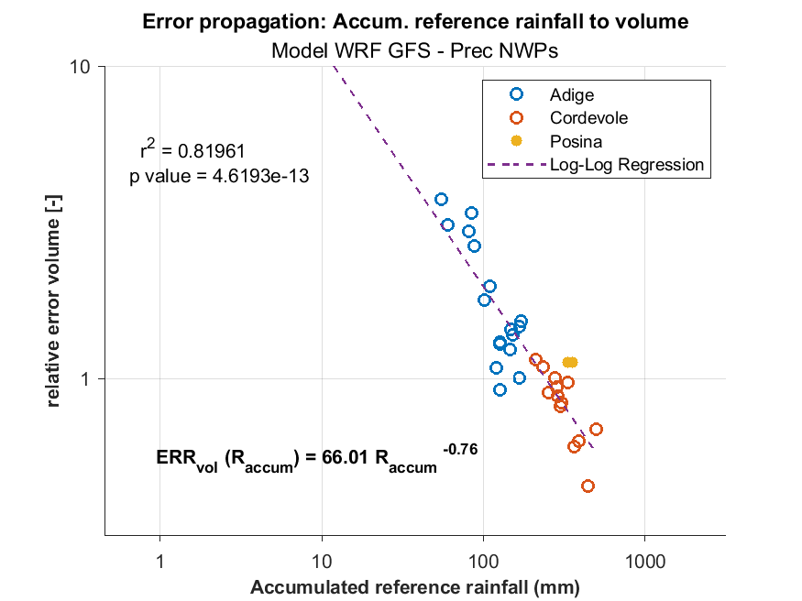
Error propagation Analysis: accum. rainfall to volume
Introduction | Methods | Study area | Results | Discussion and outlook
Notes:
To investigate this outcome in detail, we used the DWT for a multiresolution analysis.

Slide 12
Error propagation Analysis: accum. rainfall to q peak
Introduction | Methods | Study area | Results | Discussion and outlook
Notes:
To investigate this outcome in detail, we used the DWT for a multiresolution analysis.

Slide 13
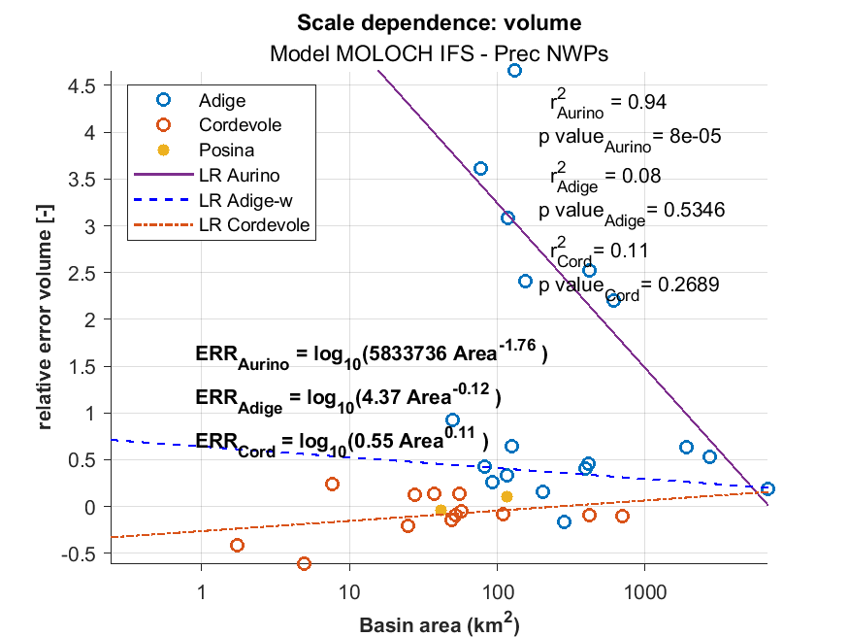
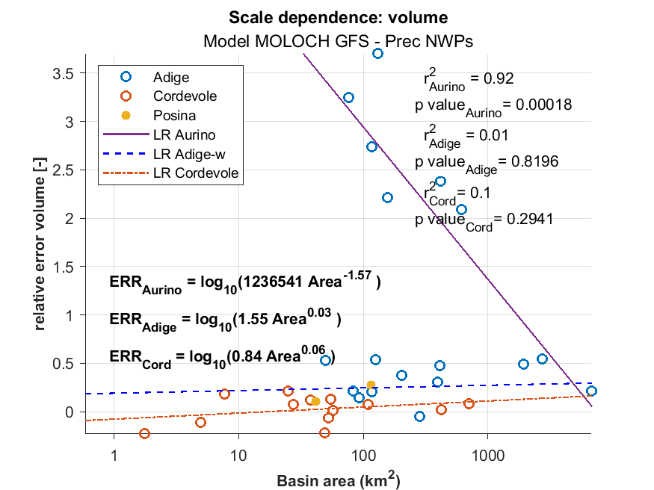
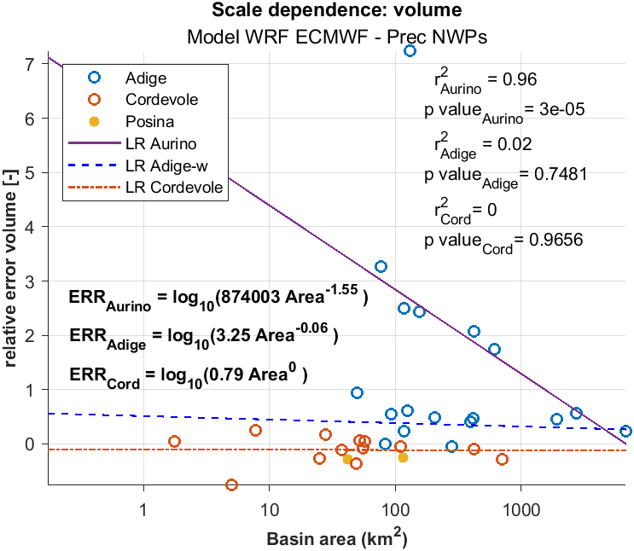
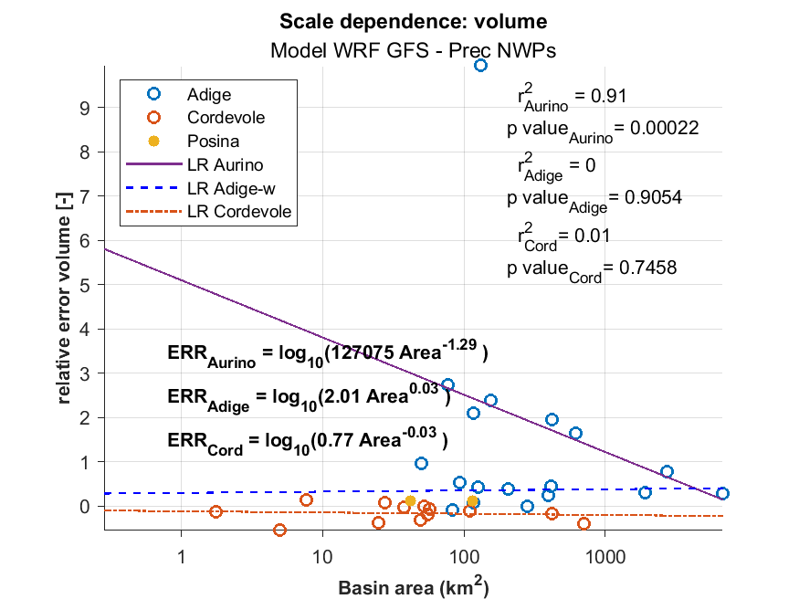
Scale dependence Analysis: catchment area vs. volume relative error
Introduction | Methods | Study area | Results | Discussion and outlook
Notes:
To investigate this outcome in detail, we used the DWT for a multiresolution analysis.

Slide 14
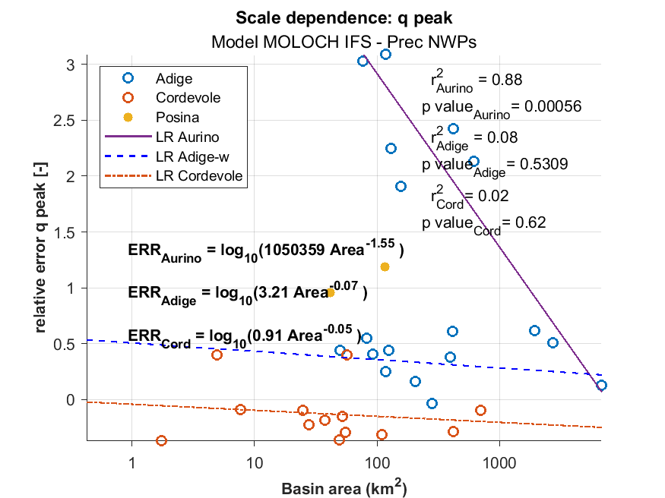
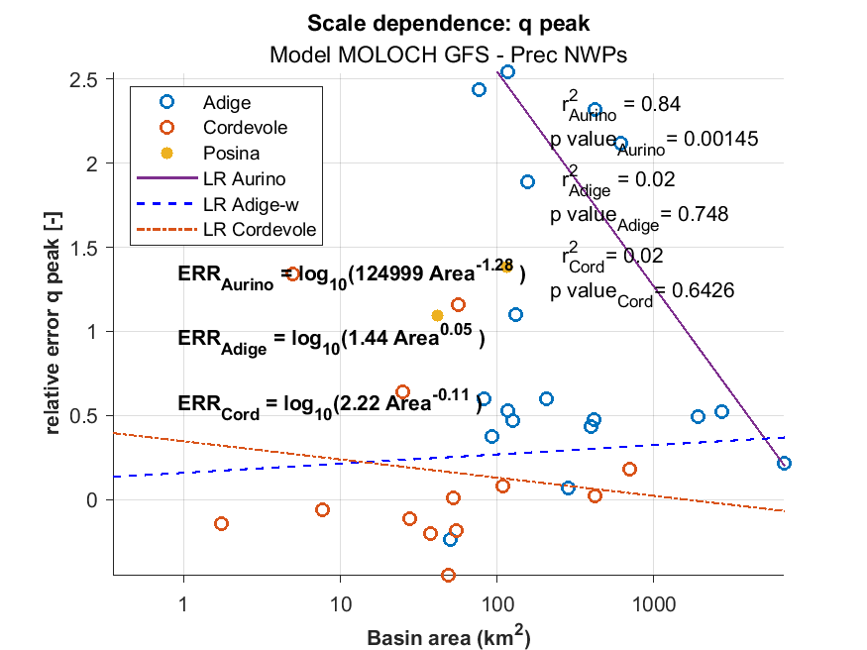
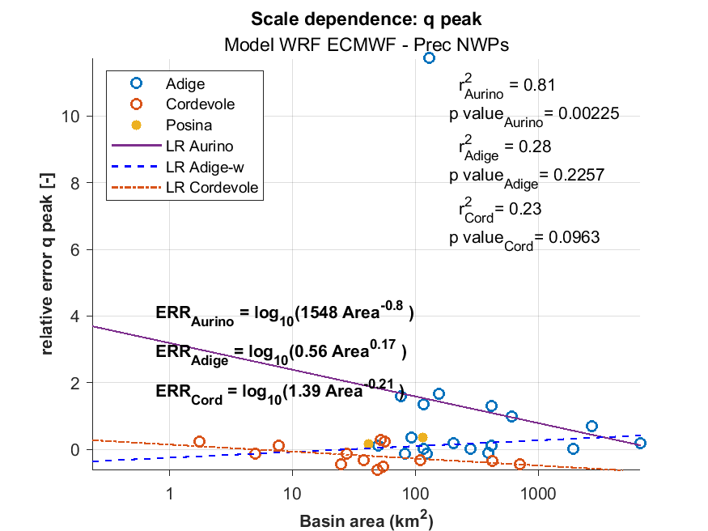
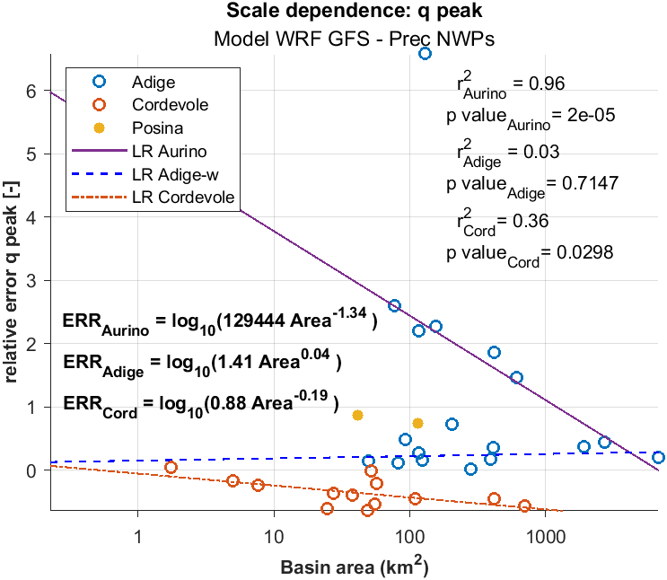
Scale dependence Analysis: catchment area vs. q peak relative error
Introduction | Methods | Study area | Results | Discussion and outlook
Notes:
To investigate this outcome in detail, we used the DWT for a multiresolution analysis.

Slide 15
Discussion and outlook
Introduction | Methods | Study area | Results | Discussion and outlook
The simulations capture the runoff behavior in locations with extreme convection (Cordevole and Posina).
Errors in precipitation or temperature propagate and magnify in regions where snow related processes play a relevant role (Upper Adige river basin).
Runoff errors increase (power law) with rainfall decrease.
Scale dependence of runoff error is more important in the snow-affected region
Each model shows specific relationships that allow us to assess the models performance taking into account different spatial scales and dominant processes.
These findings aim at improving hydrological forecasting
Thank you for your attention

