Slide 1
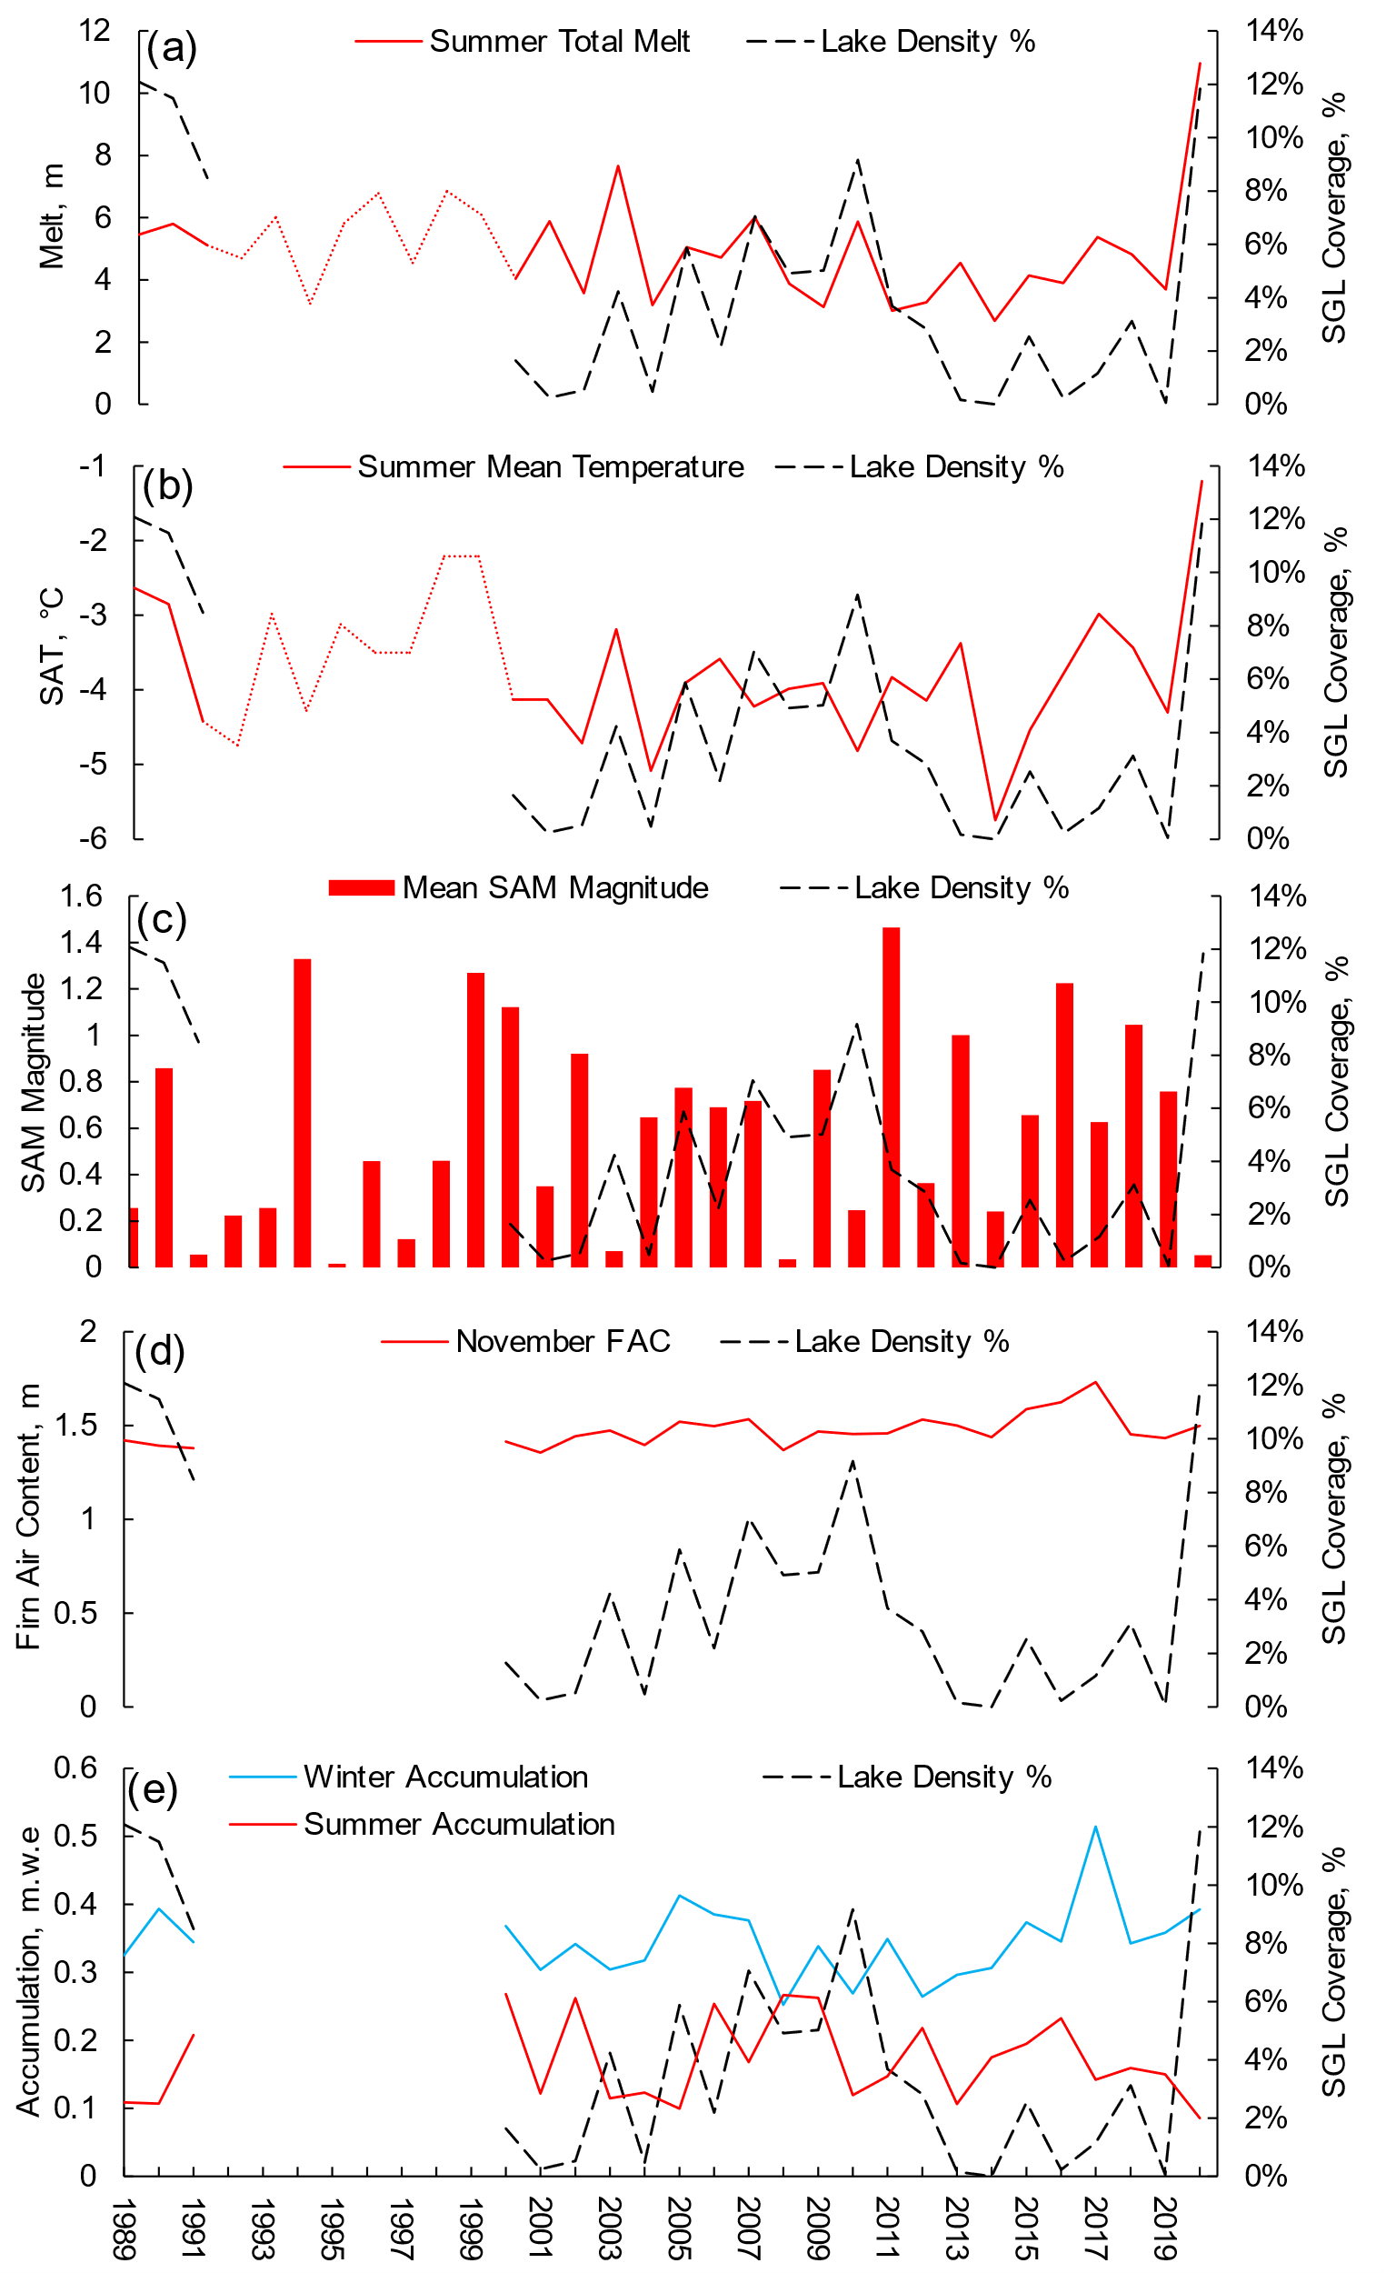
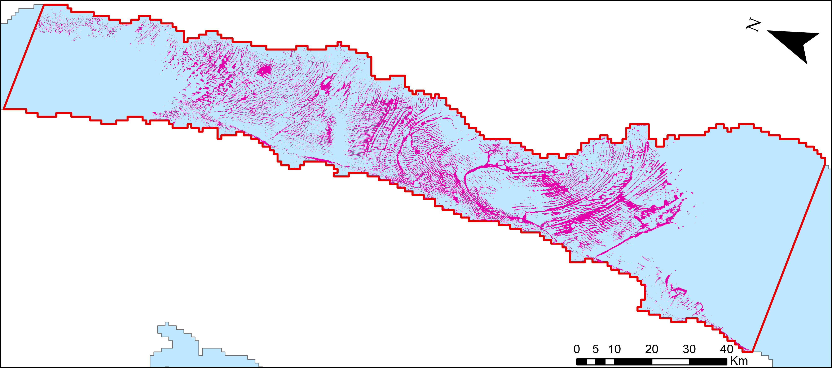
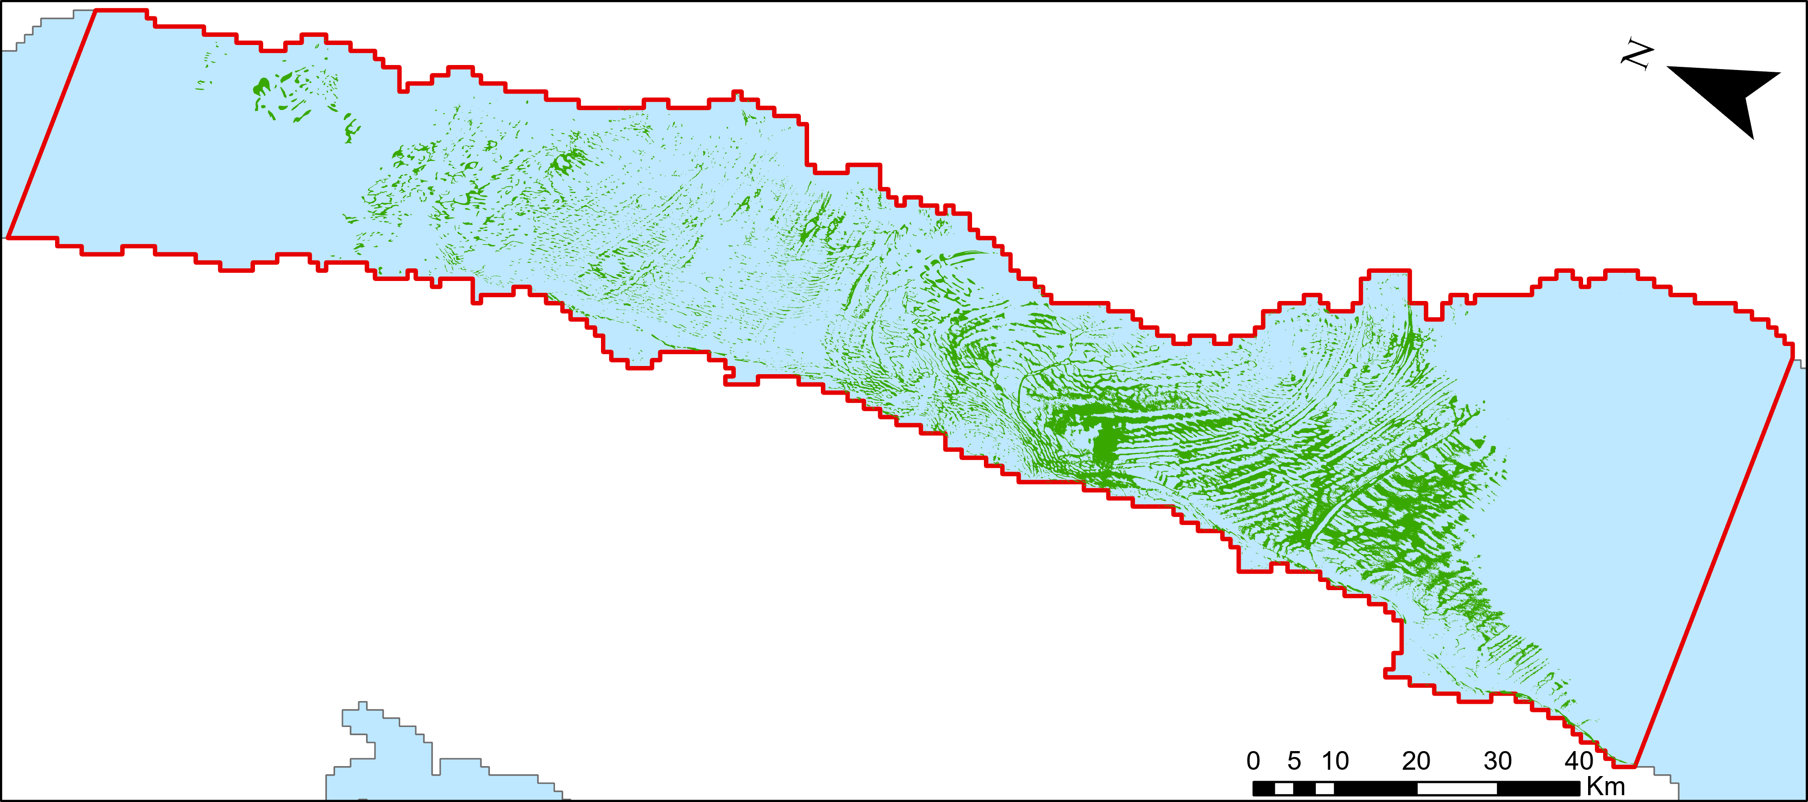
Used a semi-automated python-based NDWI methodology using the Green and NIR bands of S2 & L1-8 imagery to identify supraglacial lakes.
2020 and 1989 have similar lake coverage, but different latitudinal distribution.
2020
Histograms (supplementary) show much greater coverage in 1989 in the south.
This is despite high melt in 2020, therefore there must be a dampening factor influencing lake coverage.
We identified a complex relationship between accumulation, firn and lakes.
1989
Melt, Surface Air Temperature and Southern Annular Mode have expected impacts on lake extent.
  Partially a factor of multicollinearity between these variables.
Accumulation & Firn Air Content (FAC) have a complex dampening effect on lake extent.
FAC in the preceding November can dampen lake coverage.
  FAC is dependent on the preceding winter’s accumulation, but also build-up from prior seasons.
  The 2013-2019 period with low lake coverage is a factor in dampening lake response in 2020.
Figures from Barnes et al., (in draft)

Slide 2
Supplementary Information

Slide 3
NDWI (Normalised Difference Water Index)
Green & NIR ratio methodology.
Processed in Landsat 1-8 and Sentinel 2.
  Uncertainties in Landsat 1 due to the difference in band range.
Used a semi automated python methodology.
  Operated in ArcGIS Pro using arcpy.
  Each step operated manually due to the manageable dataset.
George VI ice shelf was found to work well with Green & NIR due to the low occurrence of reflectance altering surfaces such as blue ice on the floating ice.
Initial results showed good success with shadowed areas of ice being the most common false positives.
  These were easily removed.

Slide 4
Latitudinal Lake extent (0.05° lat)

Slide 5
Latitudinal Lake extent (0.05° lat)

Slide 6
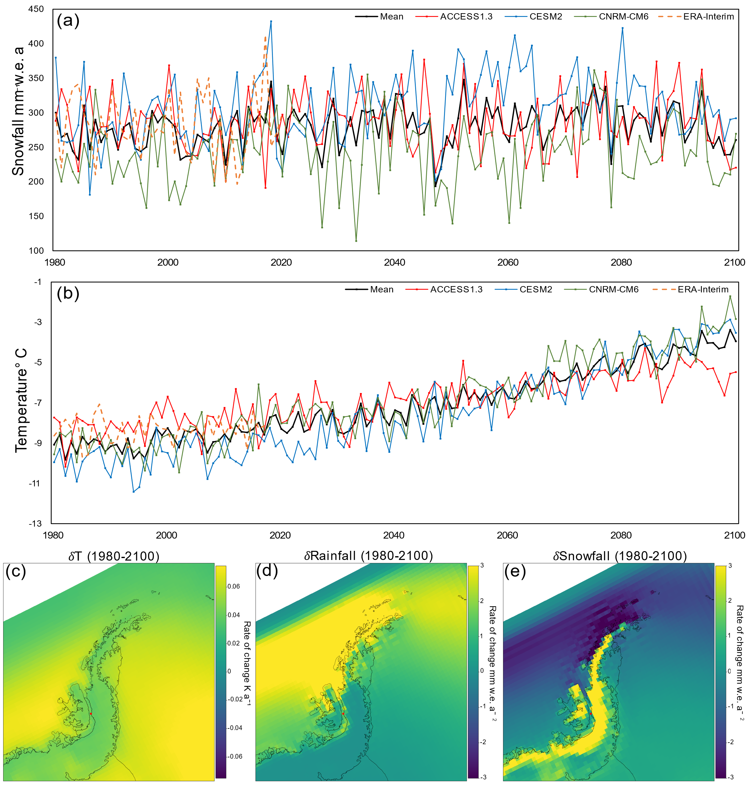
Future projections
Future projections of climate show there is likely to be an increase in lake coverage over the next 80 years.
Snowfall will likely remain at its current level.
Rainfall will likely increase and occupy a greater portion of the water phase.
Temperature will likely increase and remain above -9°C mean annually by 2040.
Therefore, lakes are likely to increase with increased drivers and decreased dampening factors.

