Slide 1
Comparison of the event and seasonal hillslope-stream hydrologic connectivity in an agricultural headwater catchment
Lovrenc Pavlin (1,2), Borbala Széles (1,2), Peter Strauss (3), Alfred Paul Blaschke (1,4) and Günter Blöschl (1,2)
(1) Centre for Water Resources Systems
(2) Vienna University of Technology
(3) Federal Agency of Water Management, Institute for Land and Water Management Research, Austria
(4) Interuniversity Cooperation Centre Water & Health, Vienna, Austria
pavlin@hydro.tuwien.ac.at

Slide 2
Introduction
Hydrological connectivity is the ability of water, solutes or microorganisms to move from one landscape unit to another along a water flow path.
  Control on runoff generation
  Flushuing of nutrients and pesticides
Connectivity changes over time and catchment
Few studies in agricultural catchments
Similarity of runoff, groundwater and soil moisture dynamics as a measure of connectivity

Slide 3
Science questions
What are the spatial and temporal patterns in the relationship between the streamflow, groundwater and soil moisture responses to precipitation events in an agricultural headwater catchment?
Is the relationship between the streamflow and groundwater or soil moisture dynamics more related to site- or event-characteristics?
How are event and seasonal connectivity of groundwater and soil moisture to streamflow related?
PRESENTED HERE

Slide 4
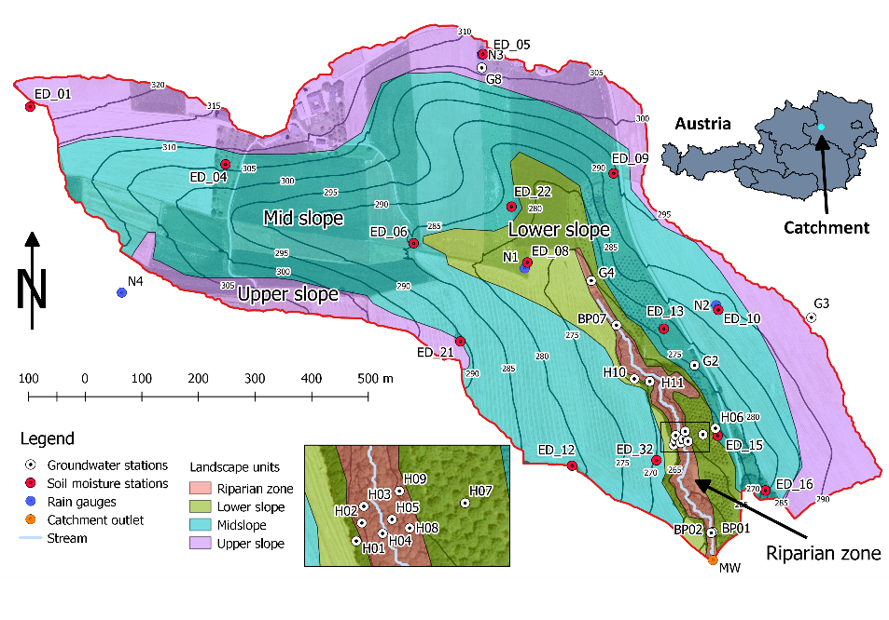
Study area
Hydrological Open Air Laboratory (HOAL), Lower Austria
Area: 66 ha
Hilly topography (268 – 323 m a.s.l.)
Mean slope: 8%
Land use: 87% arable
Mean precipitation: 781 mm yr⁻¹
Mean runoff: 170 mm yr⁻¹
Mean ET: 612 mm yr⁻¹
Silt loam soils
Contact to the lignite layer the depth of 4 to 36 m
Landscape units based on topographic position index (TPI)
Shallow and deeper groundwater system separated by a compact lignite layer.

Slide 5
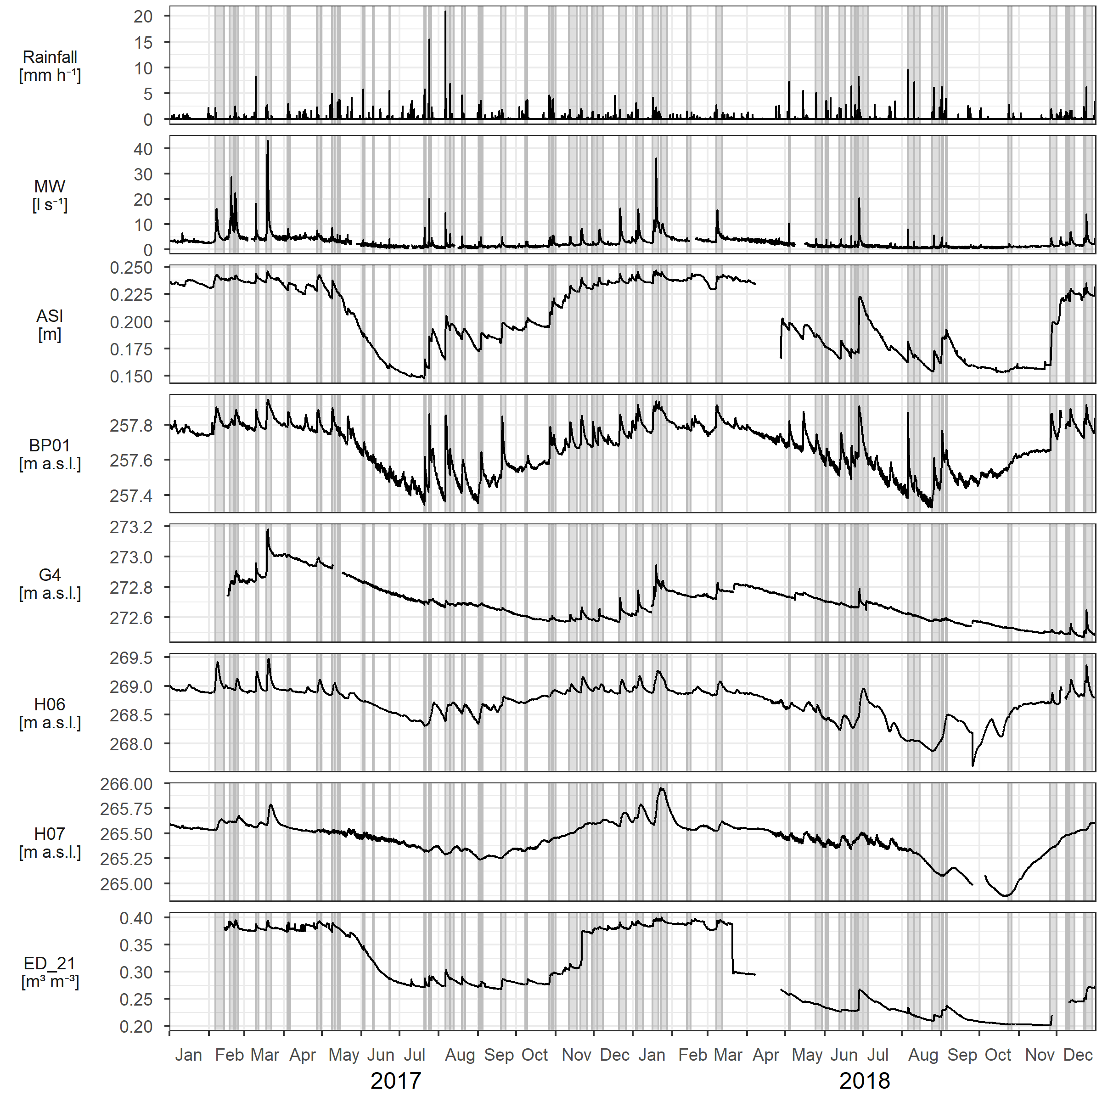
Data
Investigation period:
  2017-2018
  53 events
Time step:
  15 min on event scale
  7 days on seasonal scale
Data:
  Rainfall depth (4 gauges)
  Discharge at catchment outlet
  Groundwater levels (18 stations)
  Volumetric soil moisture (14 stations)

Slide 6
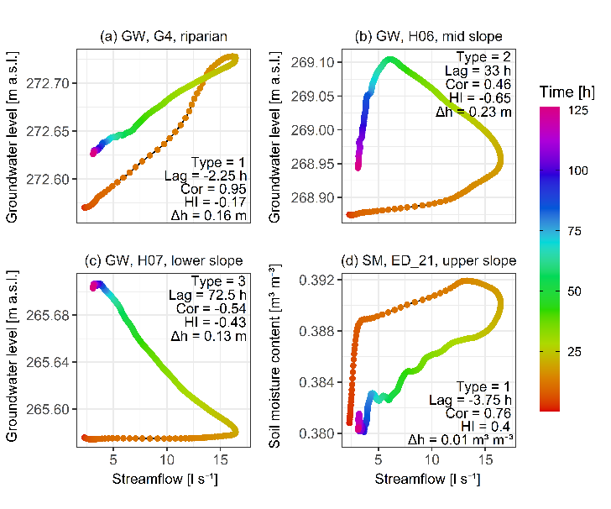
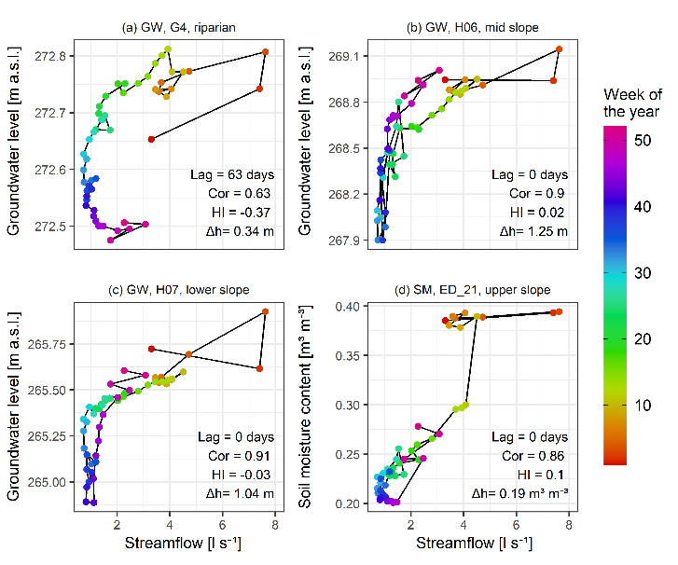
Connectivity quantification
Comparison of the event/seasonal dynamic of streamflow, groundwater levels and soil moisture content
Descriptors:
  Spearman correlation coefficient
  Hysteresis index (see Appendix)
  Peak-to-peak lag time (event),
  Seasonal shift - from cross corelation (seasonal)

Slide 7
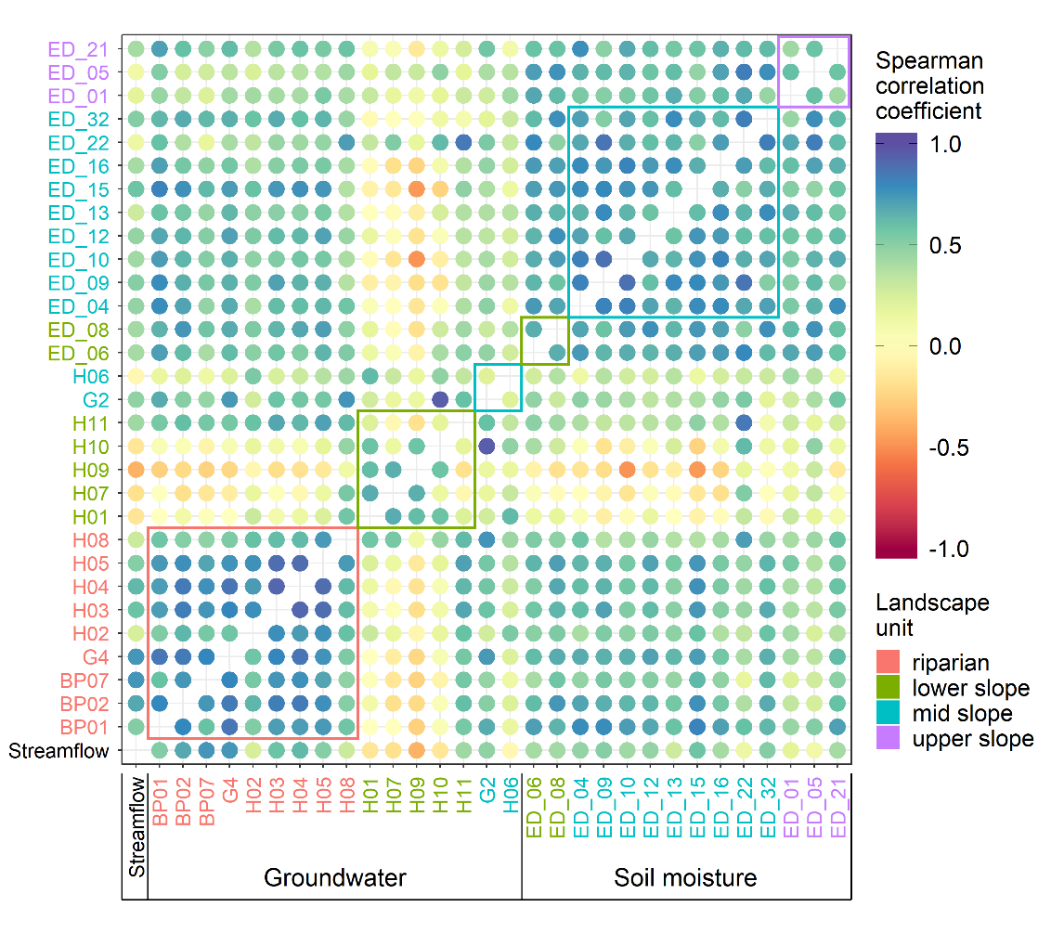
Results – Event similarity
Riparian groundwater stations best correlated to streamflow and to each other
Soil moisture stations well correlated to streamflow and each other
Lower slope groundwater stations poorly correlated to streamflow and other stations
Median Spearman correlation coefficient between streamflow at catchment outlet (Streamflow), groundwater stations (BP**, H**, G*) and soil moisture stations (ED_**) for all events. The circles' colour corresponds to the Spearman correlation coefficient The station names' colour corresponds to their landscape unit. Coloured rectangles enclose correlations of stations in the same landscape unit.

Slide 8
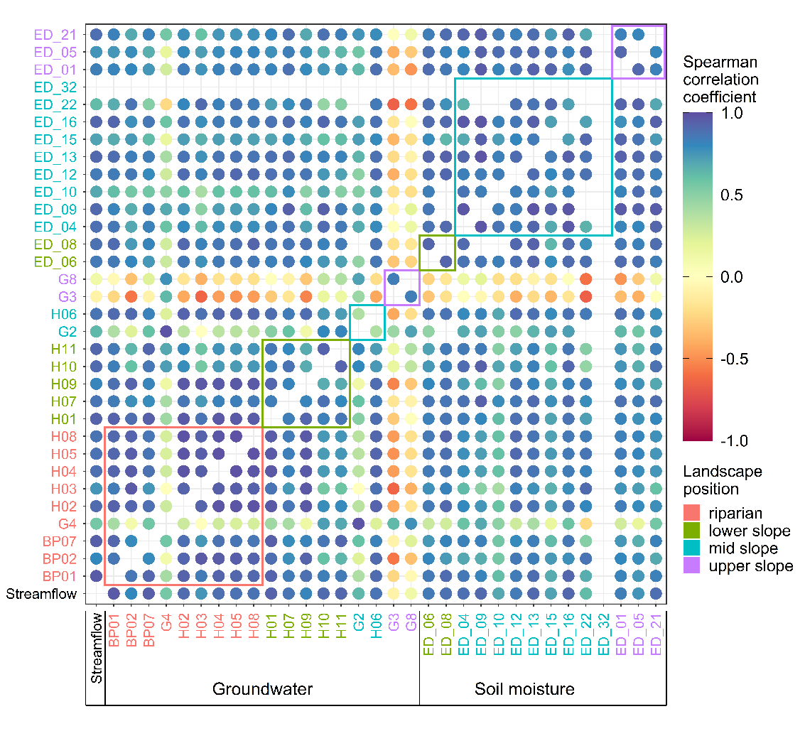
Results – Seasonal similarity
Correlation on seasonal scale is higher compared to event scale
Deep stations have lower seasonal similarity
Lower slope stations have higher correlation to other stations on seasonal scale compared to event scale
Riparian stations have very correlation to streamflow and each other.
Soil moisture stations have high correlation to streamflow and each other
Median Spearman correlation coefficient between median weekly streamflow at catchment outlet (Q), groundwater (BP**, H**, G*) and soil moisture (ED_**) over years 2017 and 2018. Circles' colour corresponds to the value of the Spearman correlation coefficient. The station names' colour corresponds to their landscape unit. Coloured rectangles enclose values of stations in the same landscape unit. Only time-series longer than 45 weeks per year are compared.

Slide 9
Event – seasonal scale comparison
 |  | Event similarity to streamflow
 |  | High | Low
Seasonal similarity to streamflow | High | Location: near or close to riparian zone Examples: BP01, BP07, H05 Shallow groundwater near the stream is constantly connected to it. | Location: lower and mid slope Examples: H06, H07, H09 Similarity on the event scale is low, probably due to slower flowpaths than those contributing to the streamflow. On the seasonal scale, shallow groundwater connects to the streamflow. Hence, the seasonal dynamics is synchronous.
 | Low | Location: lower and mid slope Examples: G2, G4 Groundwater at these locations are in contact with both the shallow and the deep groundwater system. The shallow groundwater flowpaths contribute to the relatively quick but normally small response on the event scale, which is similar to streamflow. But these event responses are smaller in amplitude compared to the underlying seasonal dynamics, driven by the deeper flowpaths. These are slow, causing the seasonal dynamics to shift, and have a low correlation to the streamflow dynamic. | Location: upper slope Examples: G3, G8 Locations where groundwater is deeper than 10 m and does not react to precipitation events or reacts on a much longer time scale than the streamflow. The slow celerity of flowpaths also causes seasonal dynamics to shift, resulting in a low correlation to the streamflow

Slide 10
Dominant controls on the similarity
Similarity | Event | Seasonal
Streamflow to groundwater levels | Similarity increases with decreasing Topographic position index and increasing Topographic wetness index, mean groundwater depth and rainfall duration. | Similarity increases with increasing slope, upslope area and Topographic wetness index, and decreasing distance to the stream, mean groundwater depth and Topographic position index
Streamflow to soil moisture | Similarity increases with increasing antecedent wetness and rainfall duration, and decreasing rainfall depth and distance to the stream | Similarity mostly uncontrolled by site‐characteristics.

Slide 11
Conclusions
We assessed the connectivity as a similarity between time-series as described by Spearman correlation coefficient, hysteresis index and peak-to-peak time
Comparing the seasonal and event similarity patterns revealed that the connectivity might change depending on the temporal scale we choose

Slide 12
Conclusions
The riparian zone is well connected to the stream on both scales, while the hillslope groundwater is better connected on the seasonal scale.
Differences in groundwater similarity patterns on different time scales allowed us to divide the groundwater stations into groups that relate to their interaction with the two subsurface systems.
Groundwater connectivity to the stream is mostly controlled by the site-characteristics
Soil moisture connectivity to the stream is mostly controlled by the event-characteristics

Slide 13

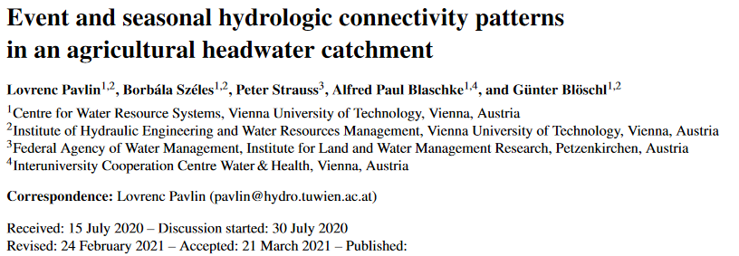

Find out more…

Slide 14
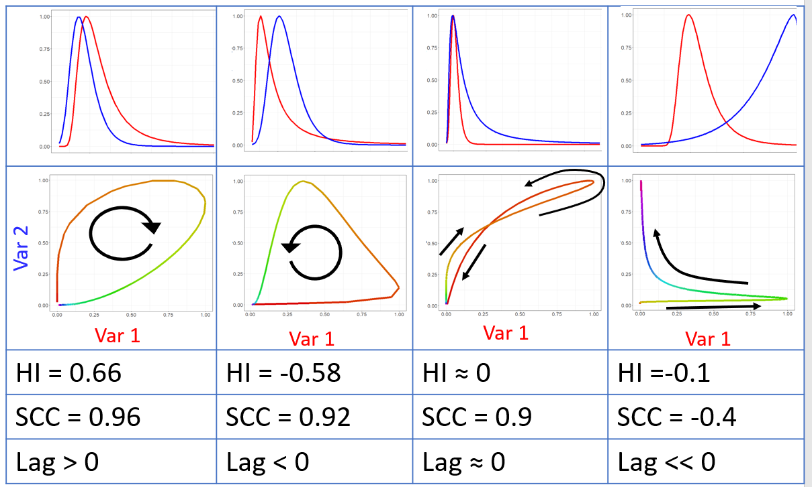
Appendix: Hysteresis index (HI)
-1 < HI < 1
HI > 0; if loop is clockwise
HI < 0; if loop is anticlockwise
HI ~ 0; if norm. time-series are very similar, norm. time-series are very dissimilar, figure-eight shape
HI is Hysteresis index
SCC is Spearman corelation coefficient
Lag is the peak-to-peak lag time

