Slide 1



Impacts of public water supply on global nitrogen cycling
liz flint, Matt ascott, Daren gooDdy, ben Surridge, mason stahl
Notes:
- Elizabeth Flint, first year PhD student at the BGS as part of the Envision Doctoral training partnership.
- I am researching ‘Impacts of public water supply on global nitrogen cycling’ in collaboration with Matt Ascott and Daren Gooddy from the BGS, Ben Surridge from Lancaster University Environment Centre and Mason Stahl from Union College in New York.
- In this presentation will introduce the work I have done in the past 7 months, the results I have so far, and my intentions going forward.

Slide 2
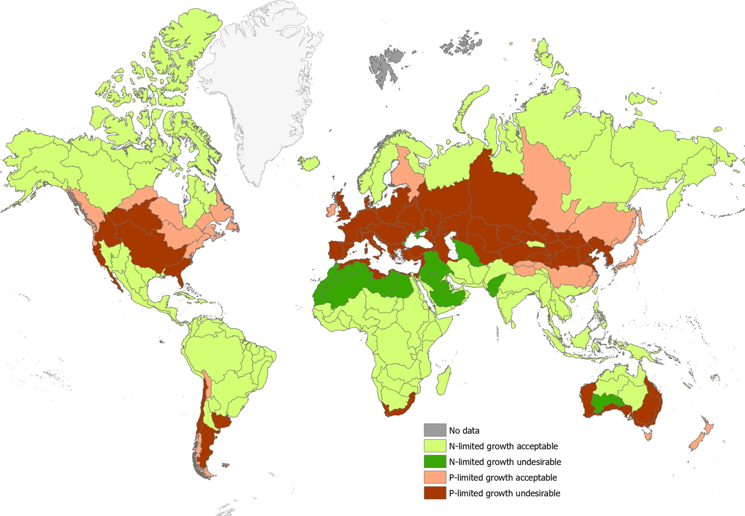
“You can’t manage what you can’t measure”
- Peter Drucker
2
Notes:
Nutrient pollution is a globally persistent problem, with the planetary boundary for biogeochemical cycling of nitrogen reportedly being crossed.
Widespread distribution of severe eutrophication in freshwater systems across the world has led to compromised human and environmental health and impair the productive and recreational use of water, all of which have large associated economic costs.
Tackling eutrophication requires the integrated management of nutrients, including identifying and quantifying all sources , flows and sinks of nutrients
- “You can’t manage what you can’t measure”
- Figure from McDowell 2020 ‘Global mapping of freshwater nutrient enrichment and periphyton growth potential’, figure shows large scale basins with undesirable algal growth as a result of N and P enrichment

Slide 3
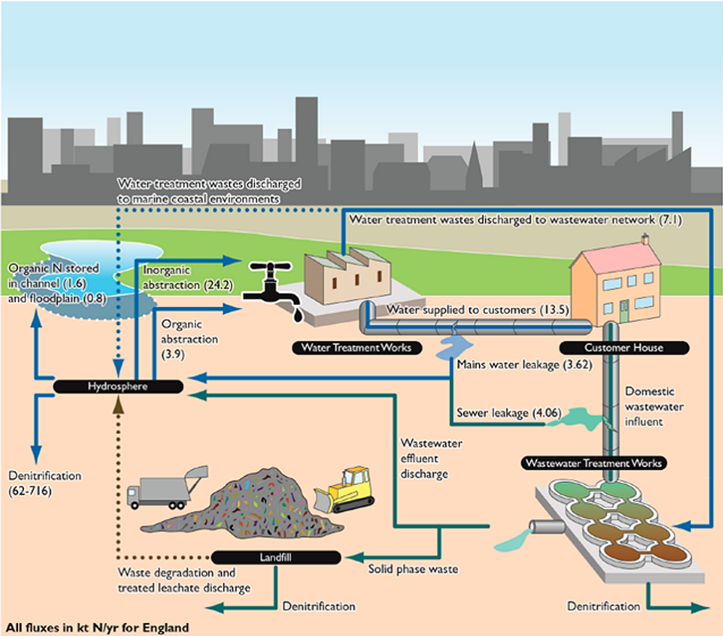
Retention flux from abstraction:
24.2 kT N/yr
(3-39% hydrosphere denitrification)
Return flux from mains water leakage:
3.62 kT N/yr
(15% of abstraction)
3
Notes:
- Recent work done in by Ascott et al has discovered PWS processes (abstraction, transfers and leakage of water) to be responsible for significant nitrate fluxes in England
Abstraction for public water supply acts as a significant temporary sink for NO3.
MWL a significant return of NO3, especially in urban areas (up to 20% of all N inputs in Thames Catchment).
The results highlighted the need for incorporation of these fluxes in nutrient budgets and source apportionment studies, as well as the need for assessment in other countries around the globe.

Slide 4
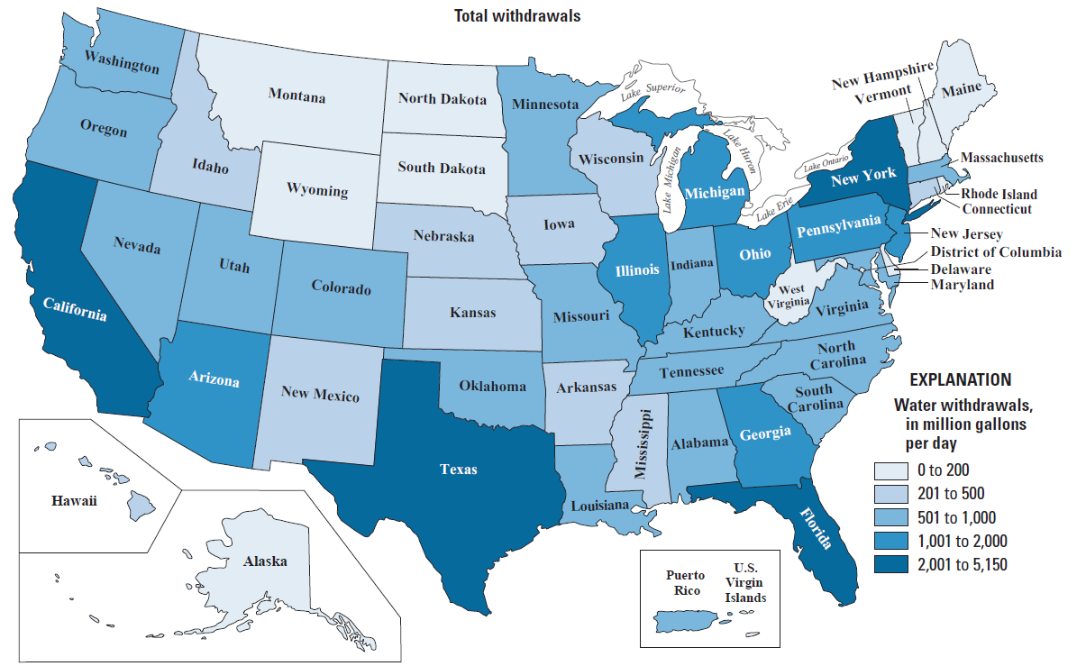
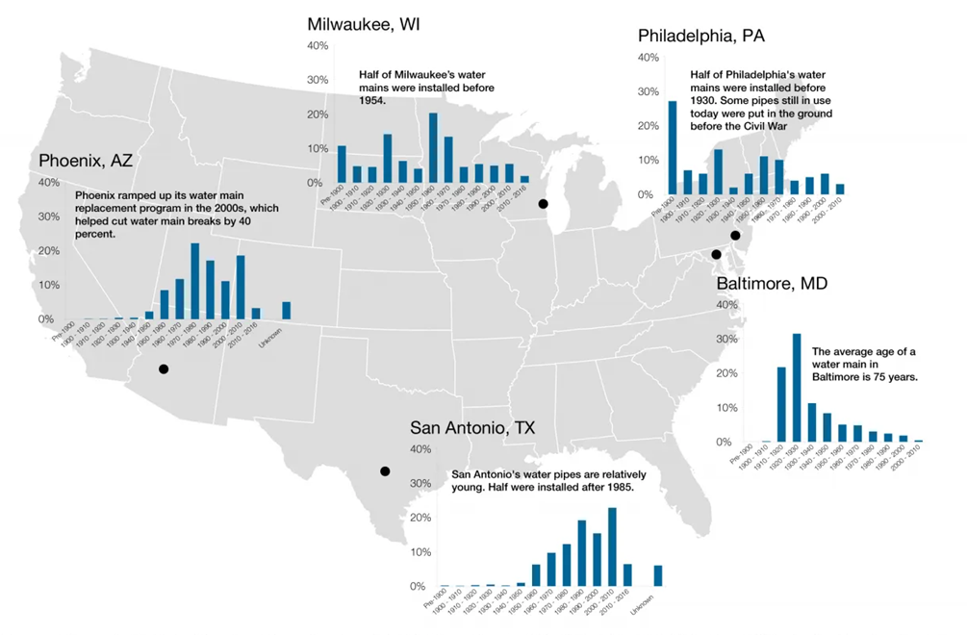
United States: Public Water Supply N Fluxes
4
Notes:
The primary focus of my work so far has been in the US, where nutrient pollution is leading cause of impaired natural water quality across the country and has led to eutrophication of natural waters as well as elevated nitrate levels in drinking water
Water use within the United States is some of the highest in the world, but there is large geographical variability across the country with regards to the amount of water abstracted for public use.
On average, 16% of water is lost during distribution through the countries pipe networks. There is also a spatial disparity across the country with regards to leakage, controlled largely by age of infrastructure, extreme weather events and seismicity.

Slide 5
Key Research Questions
1. Is abstraction a significant retention mechanism for nitrate across the United States?
2. Are mains water leakages returning a significant amount of nitrate back to the environment?
3. How will these fluxes change in the future?
Notes:
With this in mind, I am currently working on the following three main research questions
Is abstraction a significant retention mechanism for nitrate across the united states
Are mains water leakages returning a significant amount of nitrate back to the environment
How will these fluxes change in the future. Future changes in abstraction may be absolute, such as due to changing population and climate. Absolute changes in MWL due to anticipated leakage policy, but also relative to other return fluxes. Work with Ascott et al suggested that due to improvements in waste water treatment, the relative importance of mains water leakage N fluxes may increase in the future.

Slide 6
Methodology
Abstraction
State averaged raw water nitrate concentrations (Cr)
State PWS withdrawals (WD)
Mains Water Leakage
State averaged treated water nitrate concentrations (Ct)
State PWS withdrawals (WD)
State fractional leakage rate (f_{state})
ABS-N = (Cr x WD) _{GW} + (Cr x WD) _{SW}
MWL-N = Ct x LV
where LV = WD _{TOTAL} x f_{state}
Published comparison fluxes
Published comparison fluxes
Discharge from rivers to coastal waters
Denitrification from US waterways
Total retention in aquatic systems
Wastewater N input water concentrations
Urban N fertilizer
Notes:
I have adapted the methodology used for work in England by Ascott and others
Abstraction
Starting with abstraction, the total nitrate flux associated with abstraction for each state is the product of state averaged nitrate concentrations in raw ground water and the volume of withdrawn ground water, both averaged for that state, plus the product of nitrate concentrations in raw surface water and surface water withdrawals, again both averaged for each state.
The significance of results on a national level was then determined through comparisons to other published freshwater retention fluxes, including riverine discharge to coastal waters, denitrification form US waterways and total retention in aquatic systems.
Mains water leakage fluxes
The flux of nitrate associated with mains water leakage is the product of treated water nitrate concentrations and volume of leaked water, both averaged for each state. Where leakage volumes are determined by multiplying total withdrawals for public supply by a state averaged leakage factor
Treated Water Concentrations were sourced from the Environmental Working Group website, which is a compilation of State water authorities drinking water quality monitoring program results and fractional leakage rates were obtained from validated water audits, and if not possible a national average was assumed.
- Again, the significance of results on a national level were determined through comparison with other source fluxes of nitrate to the environment, including wastewater N input and use of urban fertilizer.

Slide 7
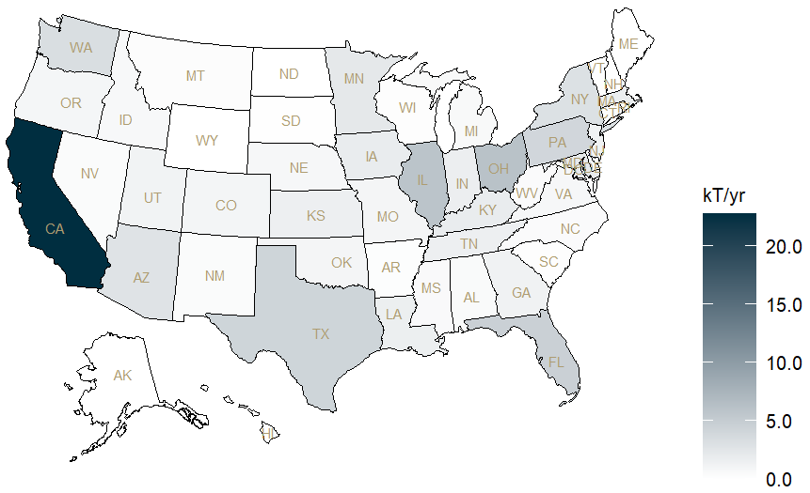
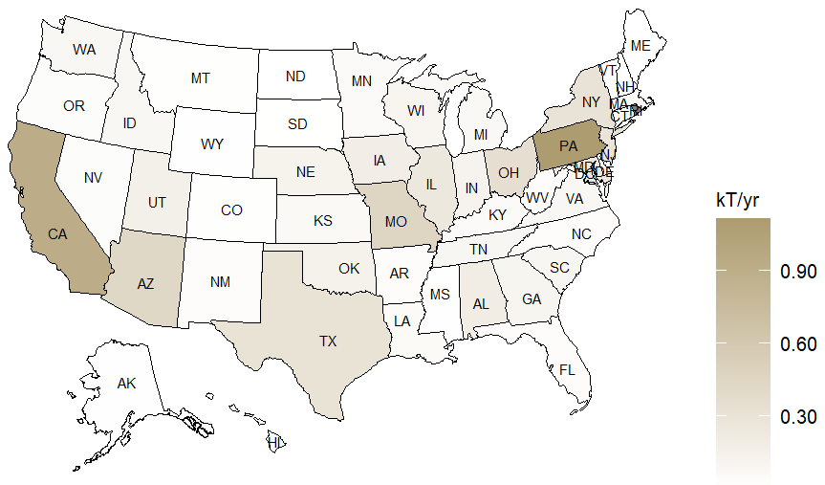
Results
Abstraction is a significant N retention flux
Mains water leakage is a significant return flux
12.0% of total denitrification from US rivers and streams
8.2% of ABS-N
3.6% of N from septic tank leachate
1.8% of riverine discharge to coastal waters
2.7% of N from urban fertilizer
1.1% of total N retention in US aquatic systems
Total: 87.7 kT/yr
0.9% of N from wastewater
Total: 7.20 kT/yr
Notes:
Results:
Abstraction is a significant retention flux of nitrate in the United States.
- Total : 87.66 kT/yr
- Large differences between States
Top states: California (23) >> Ohio > Illinois > Florida >Texas
Abstraction omits North Dakota, Maine and Misssissippi so national estimate likely an underestimate. (maybe supplement state average concs for these states)
Mains water leakage returns a significant amount of nitrate back to the environment
With a national total of 7.2 kT/yr
Again there are large variations in fluxes between states
Pennsylvania (1.11) and California having largest fluxes

Slide 8
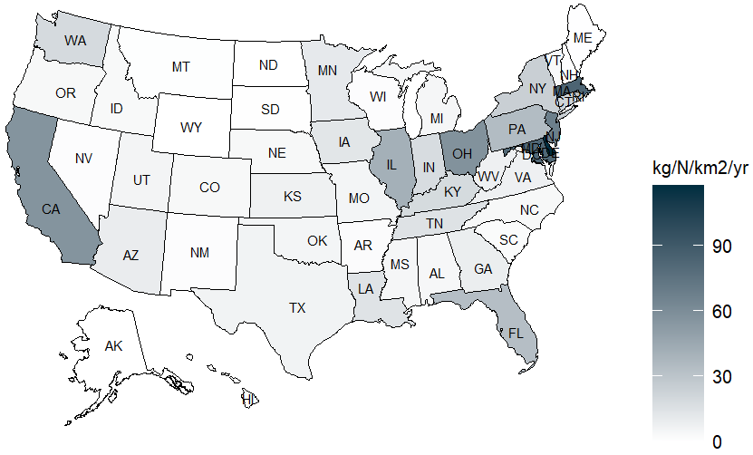
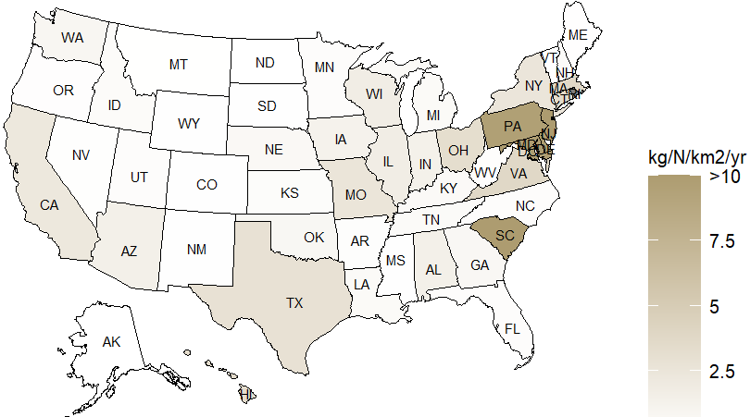
Results (normalised)
Abstraction
Mains water leakage
Notes:
- Results were then normalised in order to account for state area, and again results vary greatly between states.
- Abstraction normalised: Delaware, Massachusetts. Maryland, New Jersey and Ohio
- Leakage Normalised: South Carolina (37)>Delaware (20)> New Jersey (15) > Maryland > Pennsylvania
In general fluxes are larger on the eastern side of the country, likely reflecting the higher population density

Slide 9
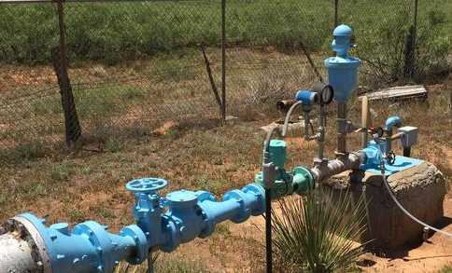
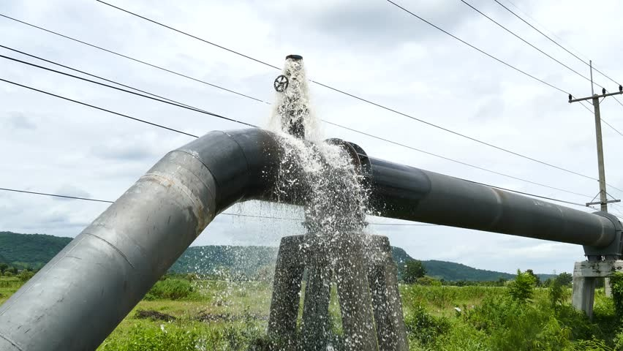
Conclusion
Abstraction for PWS is significant temporary N retention mechanism
MWL is an important return flux of N to the environment
Regional differences observed across the country, even after normalisation
9
Notes:
In conclusion, public water supply fluxes make a notable contribution to redistribution of N within the US, and thus should be taken into account when deriving national nutrient budgets. However, it is likely that there are disproportionately important hotspots.

Slide 10
Future Work
1. Make localised PWS N flux estimates in the US (e.g. California)
2. Determine potential future significance of PWS N fluxes
3. Determine the significance of non-public supply withdrawal N fluxes in the US (e.g. self-supply, agriculture and industry)
4. Make estimates of other macronutrient fluxes associated with PWS (e.g. MWL-P)
5. Determine similar fluxes for countries at contrasting stages of development, in order to make a more global assessment
Notes:
- Given differences between states, and significance of these fluxes in urban areas in other countries, hotspots should be investigated (e.g. California, which has high transparency of data collection and reporting).
- Determine if these fluxes are likely to change in the future
PWS only 12% of withdrawals in the US, thus the total flux N associated with all water withdrawal is likely to be much higher.
Phosphate corrosion inhibitors are widely used within the US. MWL of treated water will likely be a significant flux of P to the environment in some places.
The significance in the US has implications for other developed countries, such as those in Europe, and suggests that less developed countries may be subjected to more significant leakage fluxes

Slide 11
I look forward to receiving any questions or comments in the breakout session later
Thank you
11
Notes:
Questions I’d like to ask in breakout room:
Information of orthophosphate dosing across US
Notes:
Global assessment is necessary in order to target further investigation. Iterative process.
Studies have been done on site specific/catchment scale, but not regional and national scales.
Think about return times for abstraction / residence times of water.

