Slide 1




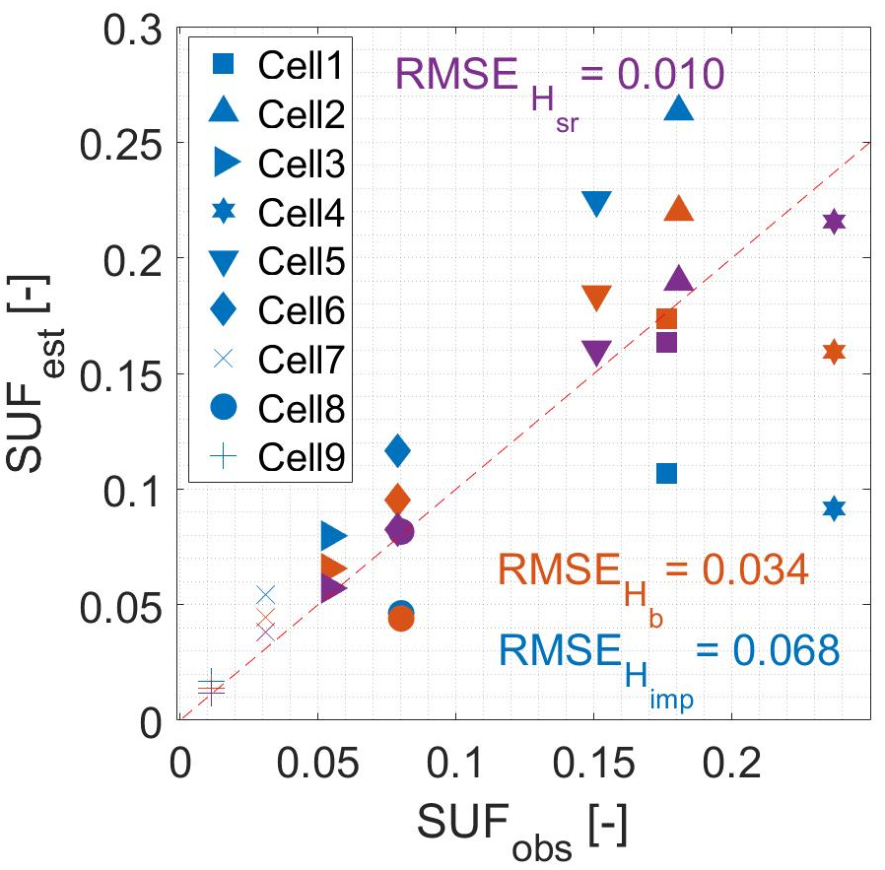
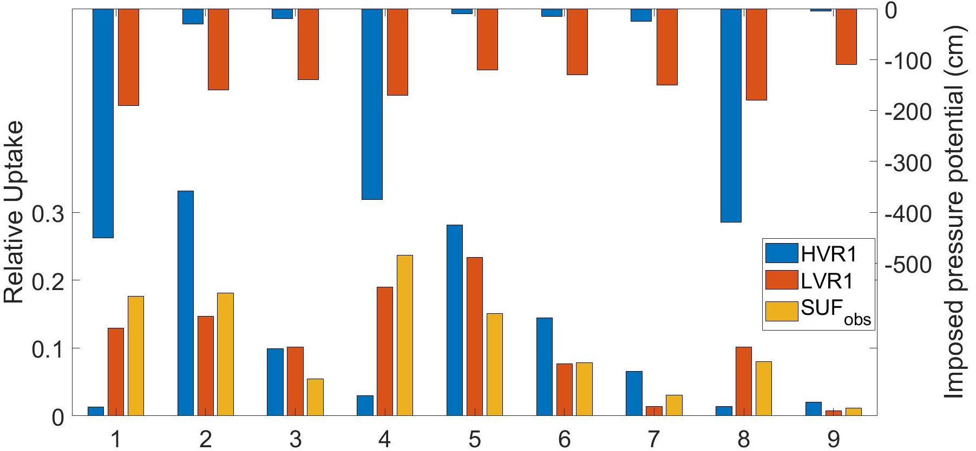
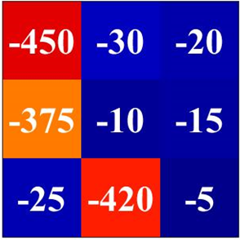
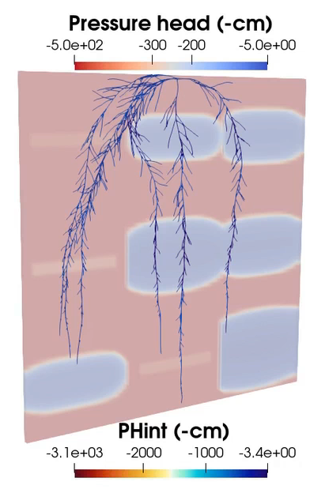
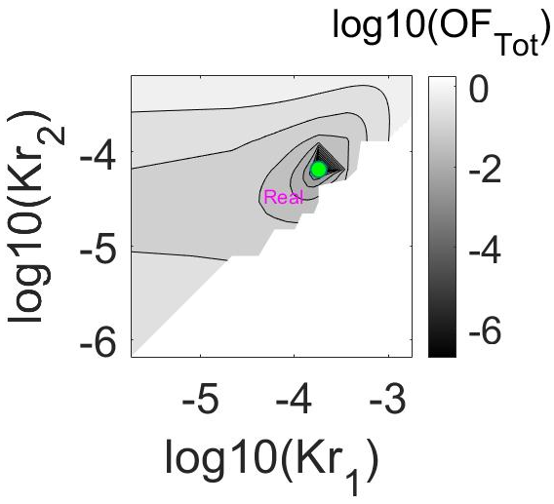
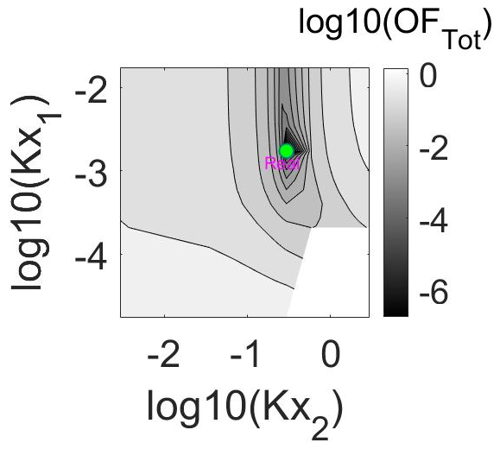
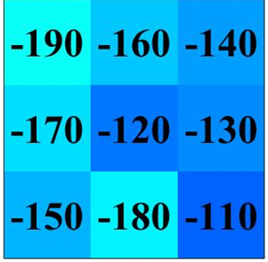
Impact of soil water potential pattern on root water uptake distribution and leaf water potential
ali.Mehmandoostkotlar@uclouvain.be¹ , Mathieu Javaux¹
¹
¹
Background
Estimation of Macro Parameters
The knowledge of root hydraulic properties (RHPs) including radial (Kr), axial (Kx) conductivity, root system equivalent (Krs) and compensatory root water uptake conductance (Kcomp) and standard uptake fraction (SUF) are of great importance to support models.
Underestimation of SUF
in driest cells
Relative cell uptake variation
H | log10(Krs) | log10(Kcomp)
Himp | -1.890 | -1.231
Hb | -1.861 | -1.287
Hsr | -1.723 | -1.676
Obs | -1.684 | -1.679
Objective
Inversely estimate RHPs profile for maize plant using information obtained from rhizotron experiment
Cell number
The more accurate information on soil pressure potential, the better estimation of SUF and conductances.
Rhizotron
Estimation of Kx and Kr
Imposed pressure head at cells (Himp)
HVR
Kx3
Shapes of RS demonstrate the global minimum and can be used to find insensitive parameters
Soil water content in cells using
light transmission imaging (Hb)
Kr1
Kx2
Kr2
Kx1
Kr3
LVR
HVR
Supported by HYDRAMAIZE project (ARC 16/21-075)
age
Response surface of objective functions

