Slide 2
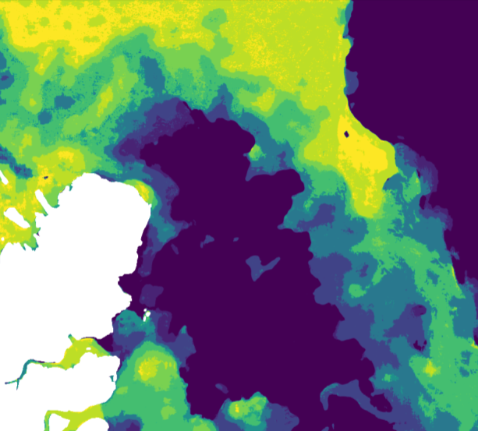
Deep Learning models for Arctic sea ice charting
Φ-Lab Seminar,
Andreas Stokholm

Slide 3
Overview
Context
Objective
The AI4Arctic Data Set
The U-Net Model
Preprocessing and Data Pipeline
Sea Ice Charting Results
Data Fusion Results

Slide 4
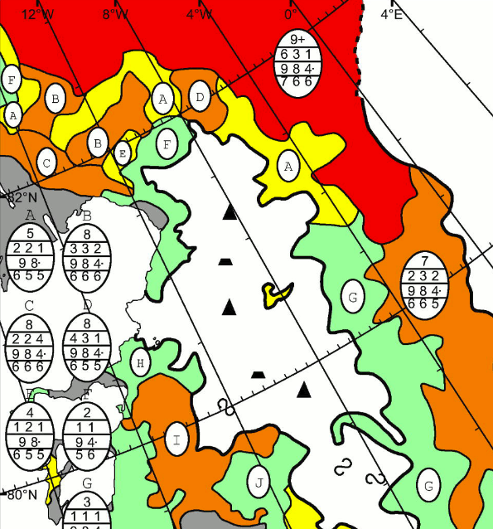
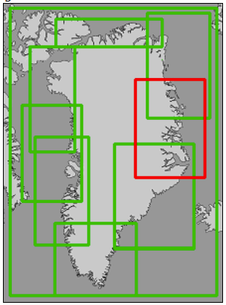
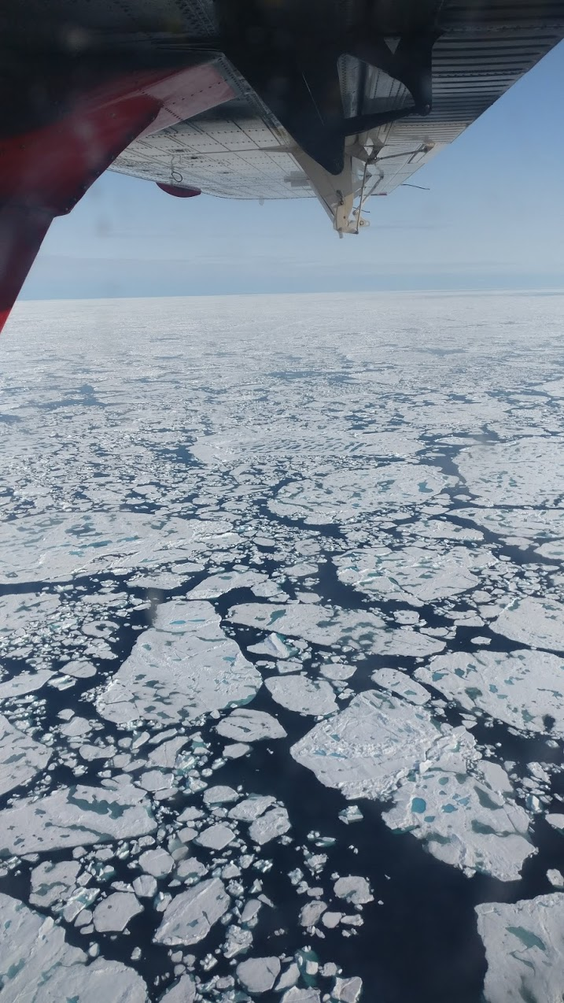
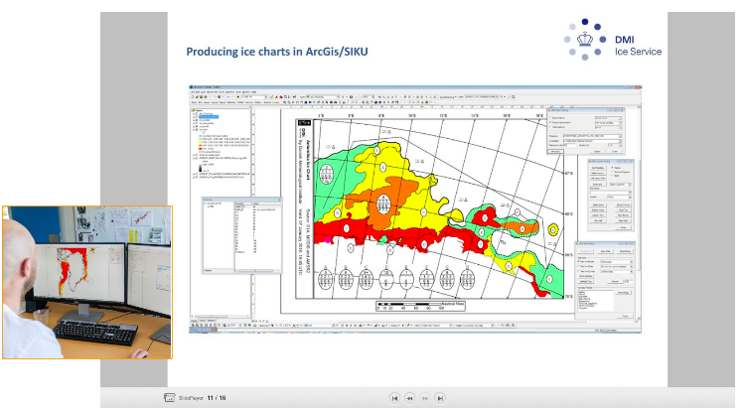
Context
What is Sea Ice?
Unique formation History
Can be multiple meter thick
Moves Constantly
  4-17 km/day
What is an ice chart?
  Total Sea Ice Concentration
    0 % open water
    100 % full sea ice cover

Slide 5
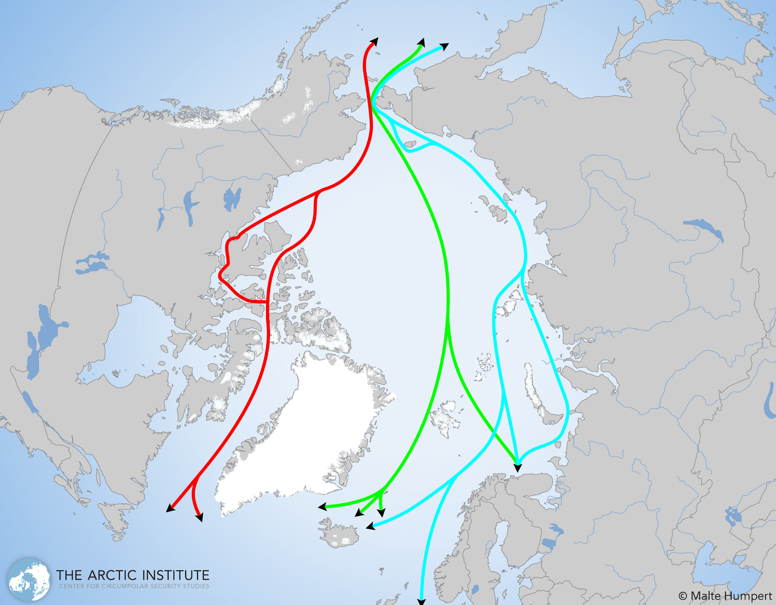
Context
Renewed interest in the Arctic
  Less sea ice -> Arctic more accessible
Resources
  22 % of remaining oil and gas
  Mining operations
Northern sea routes
  decrease shipping costs by 10%
  Shorten shipping time by up to 13 days
(SK to NL, 48 -> 35 days)

Slide 6
Objective
Create Algorithm to correctly classify Total Sea Ice Concentration (SIC) using Synthetic Aperture Radar (SAR)
Convolutional Neural Network (CNN) for Semantic Segmentation of Sea Ice
Obstacles
  Formation history create diverse and unique textures
  Ambiguities such as wind roughened seas
Investigate performance of SAR-only trained model
Investigate data fusion of SAR data with the incidence angle and Passive Microwave Radiometer
Compare model performances

Slide 7
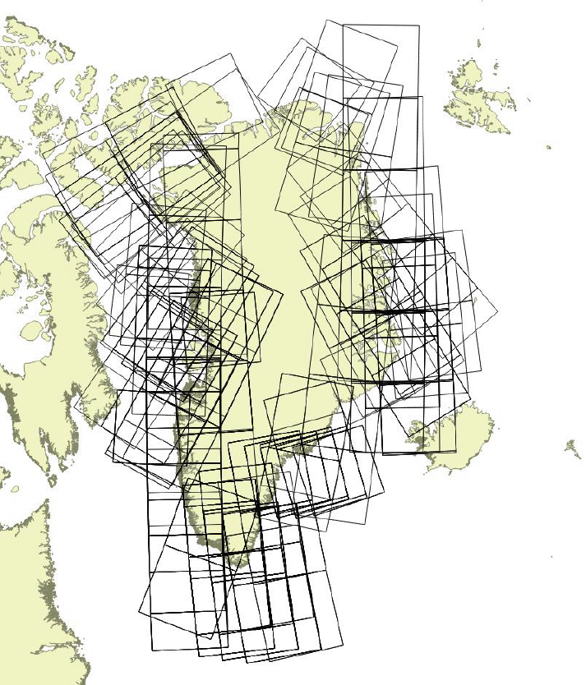
The AI4Arctic V2 Data Set
461 scenes, from March 2018- May 2019
  295 used for training + validation
Each scene contains:
  Sentinel-1 EW Level-1 GRDM SAR image, HH + HV, Misc. variables e.g. incidence angle, 2 noise correction processing chains (ESA + NERSC)
  AMSR2, Passive Radiometer brightness temperatures, 7 frequencies (6.9GHz - 89 GHz)
  DMI derived sea ice concentration chart
    Total Sea Ice Concentration used
Pixel spacing: SAR - 40 m; AMSR2 - 2 km

Slide 8
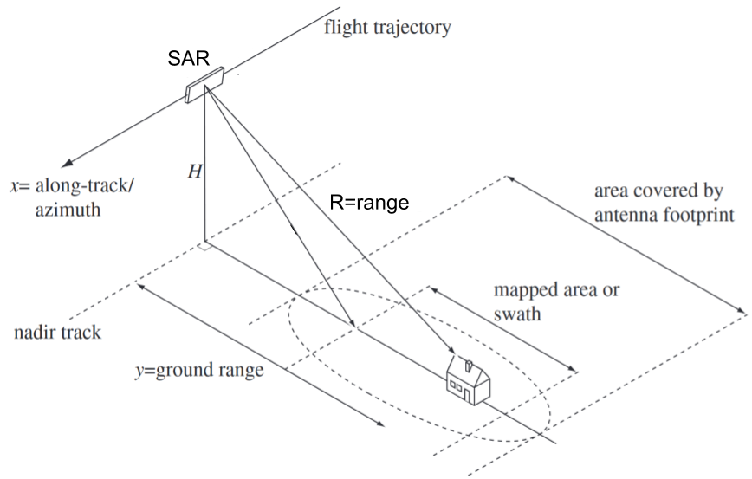
Synthetic Aperture Radar

Slide 9
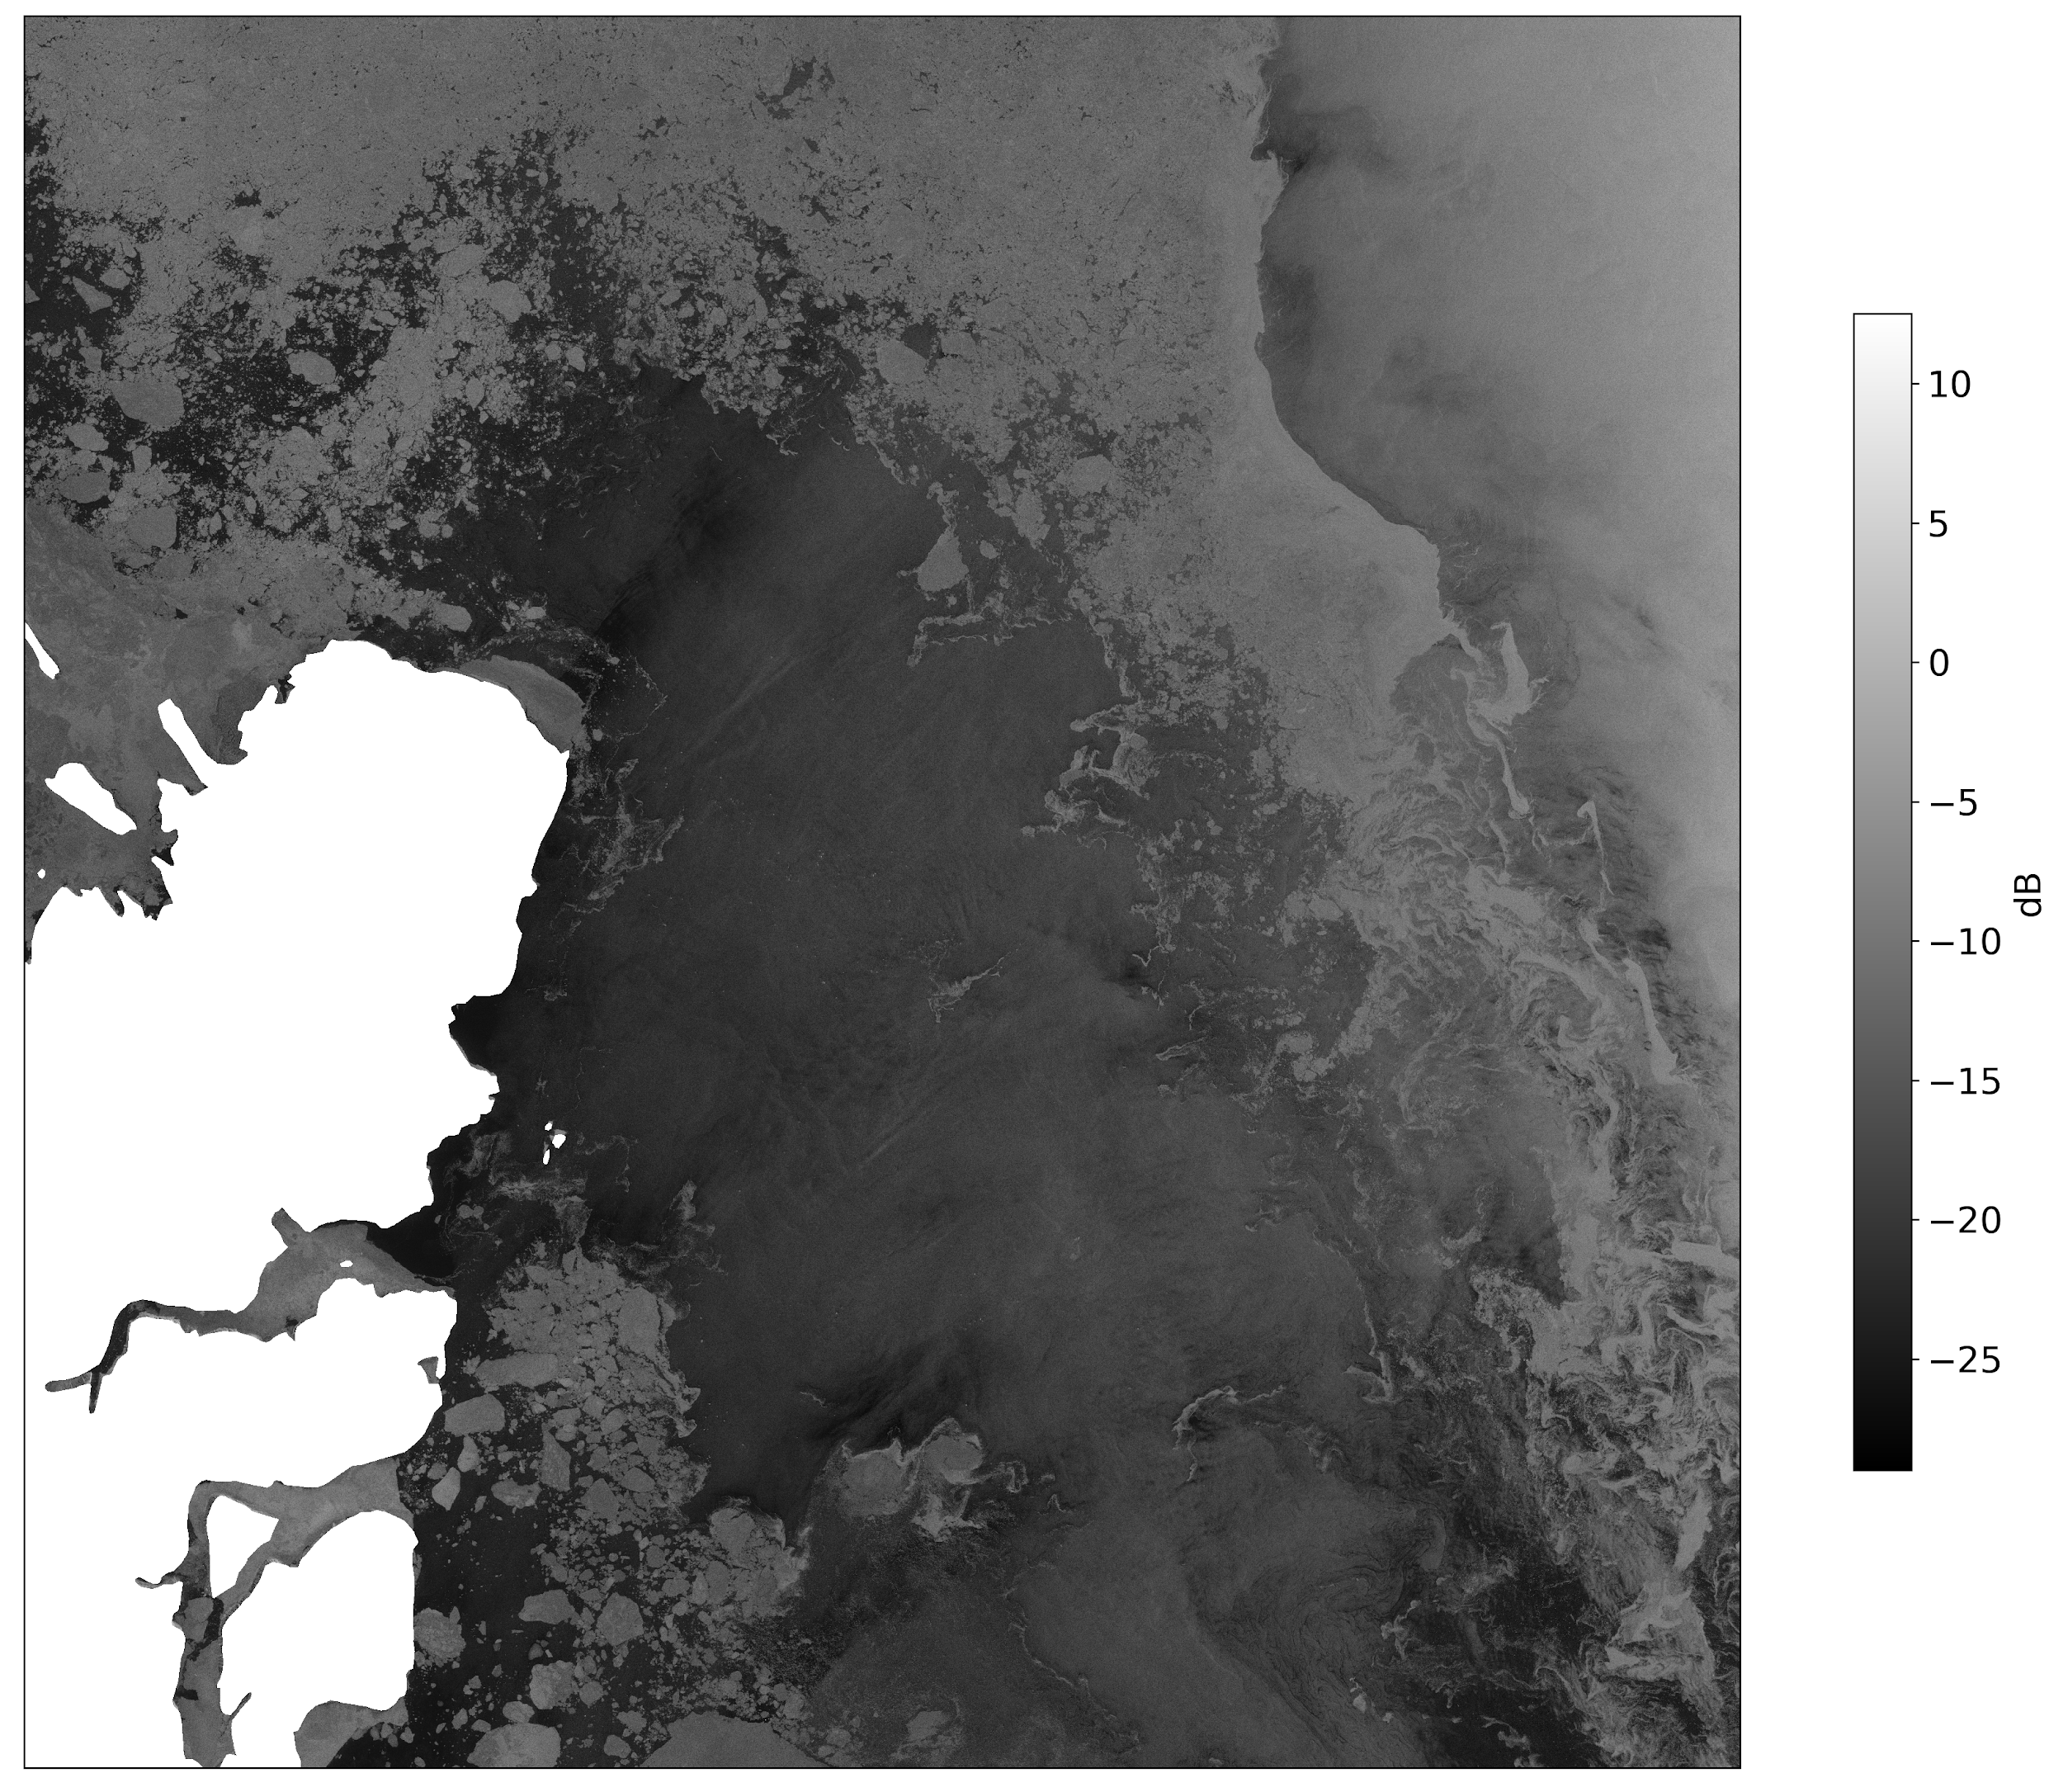
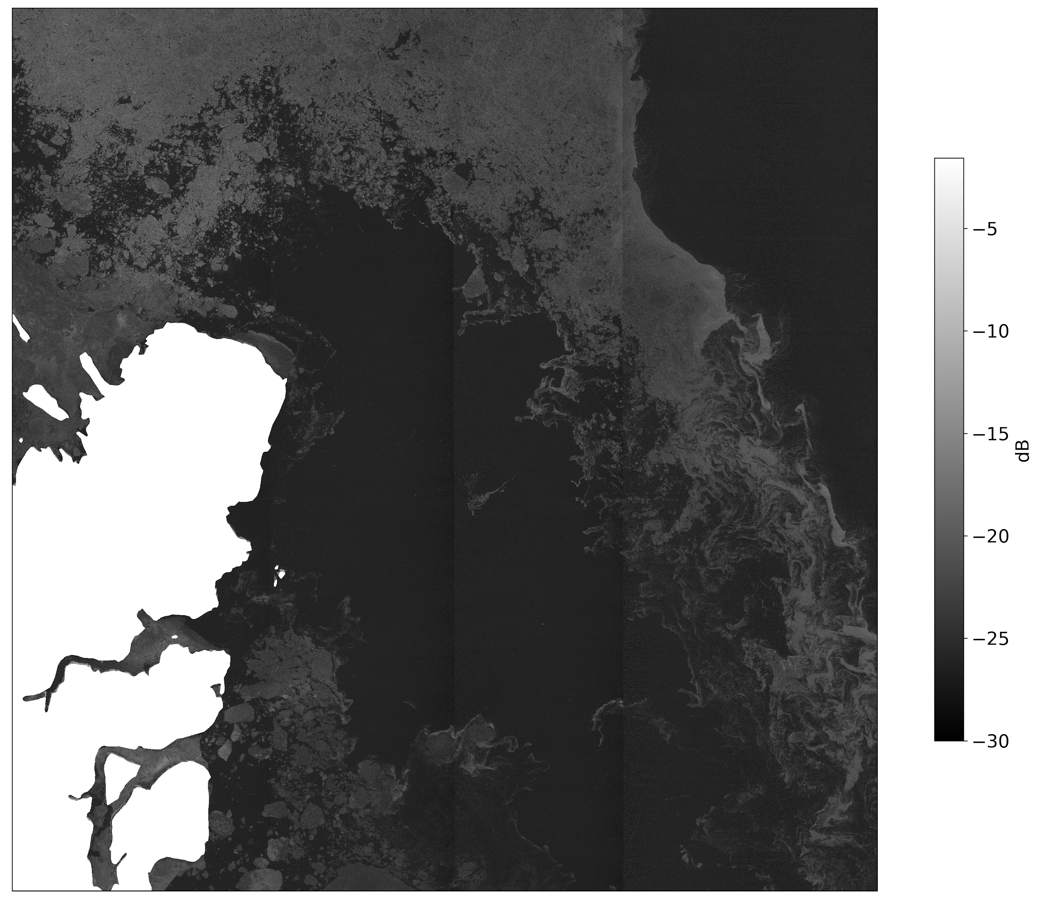

Sentinel-1 SAR Scene Example
SAR HH
SAR HV

Slide 10
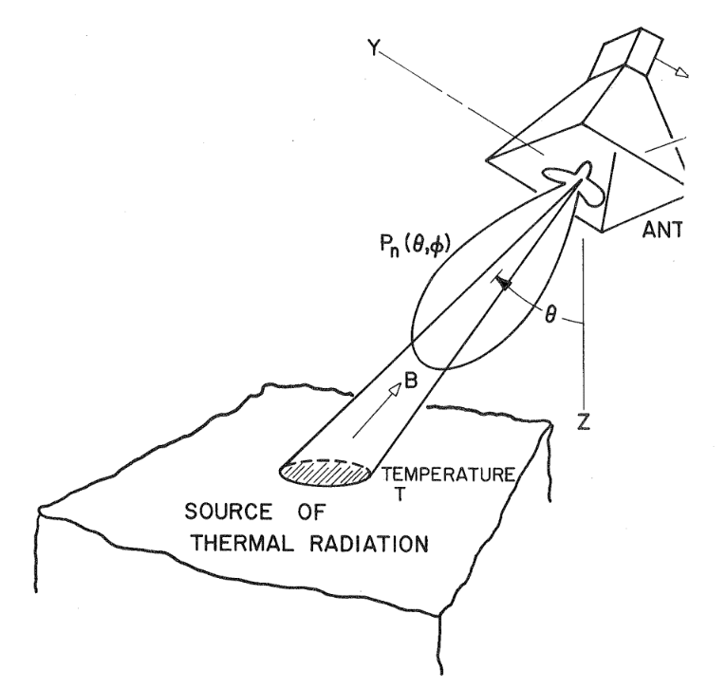
Passive Microwave Radiometer
Antenna

Slide 11
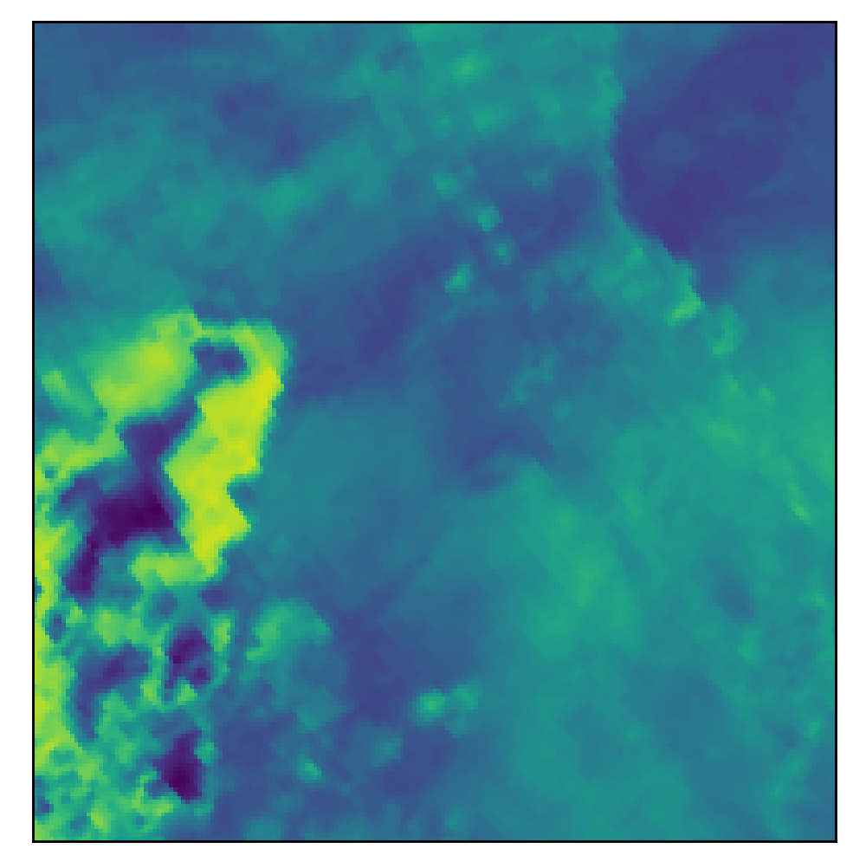
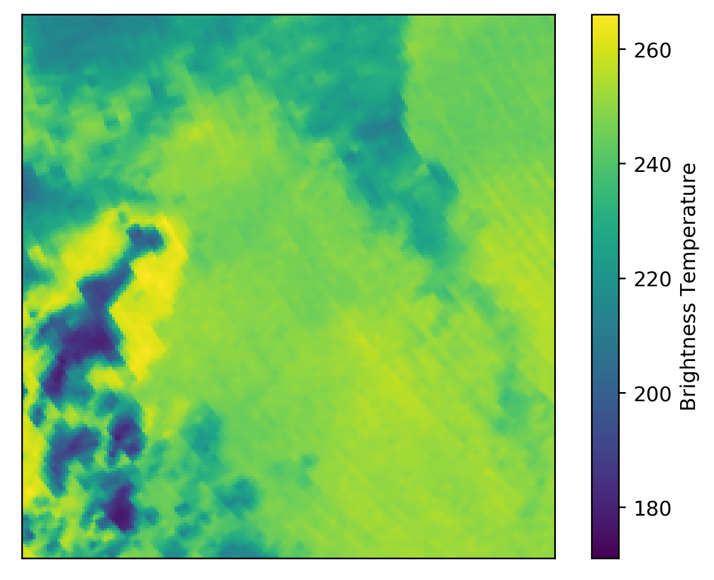
AMSR2 89 GHz Scene Example
H
V

Slide 12
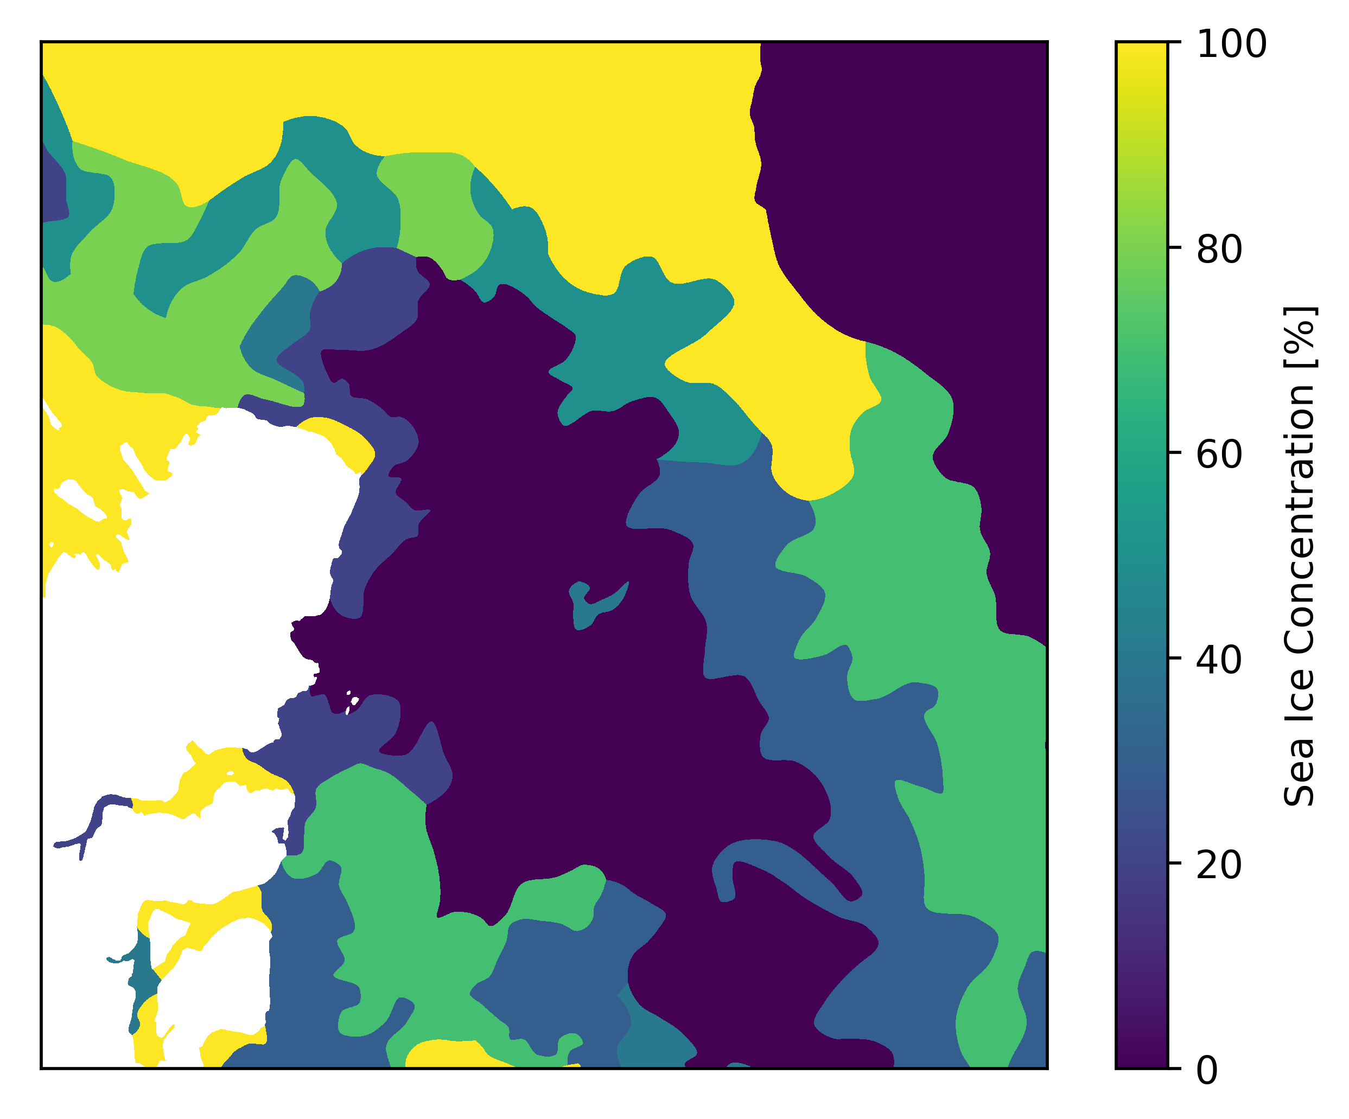
DMI Ice Chart

Slide 13
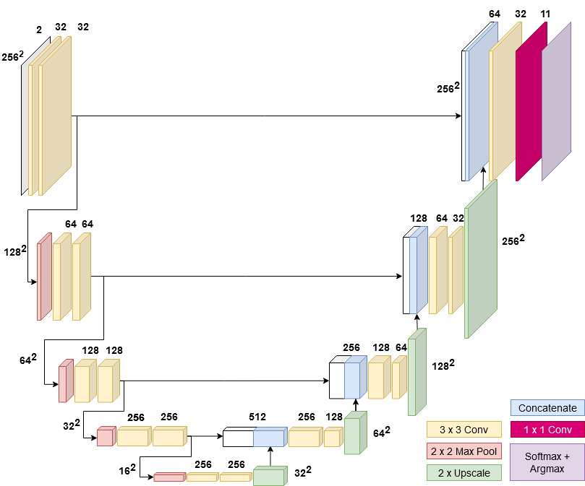
The U-Net CNN
Semantic Segmentation with Fully Convolutional Neural Networks

Slide 14


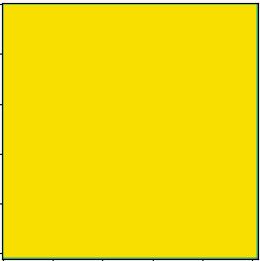
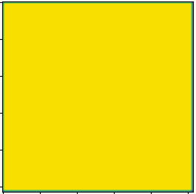
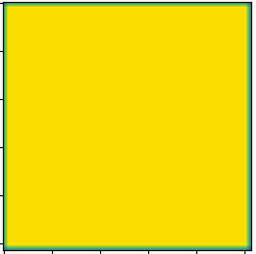
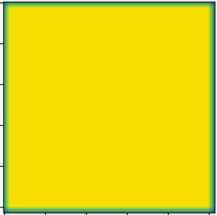
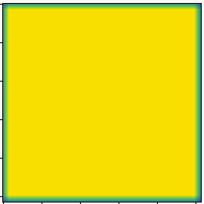
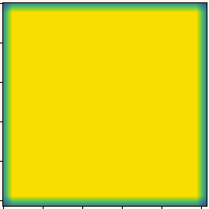
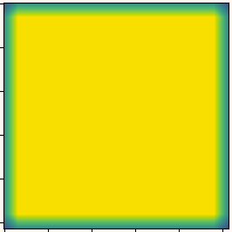
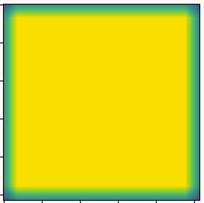
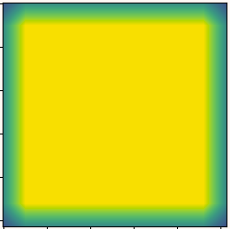
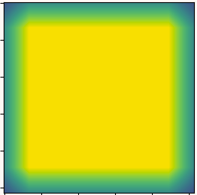
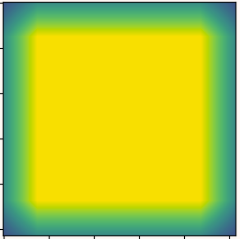
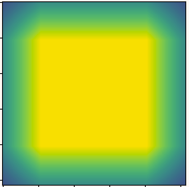
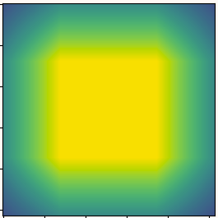

The Receptive Field
First conv layers
Second conv layers
Pooling layers
256
3
5
1st level
256
Conv
Layer
6
10
14
2nd level
Pooling
Layer
16
24
32
3rd level
128²
64²
36
52
68
4th level
32²
76
108
140
Bottom level
16²
0
100
Receptive field utilization [%]

Slide 15
The U-Net CNN
Classification Approach
Cross Entropy Loss
Adam (W) optimizer
  Learning rate: 10⁻⁴
Batch Normalization, dropout,
L2 Regularization & Early Stopping
Batch size: 64

Slide 16

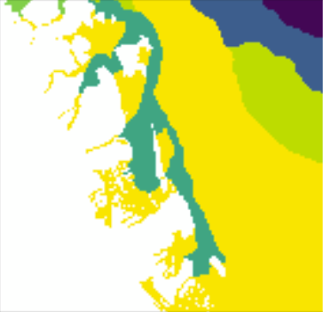
Data Pipeline
256
Rotation
Flip
Diagonal Flip
256
Original
90°
180°
270°
295
Data augmentation
Training data
4
3
2
1
Normalize ± 1,
Shuffle windows
Validation data
Resample SAR 80m

Slide 17
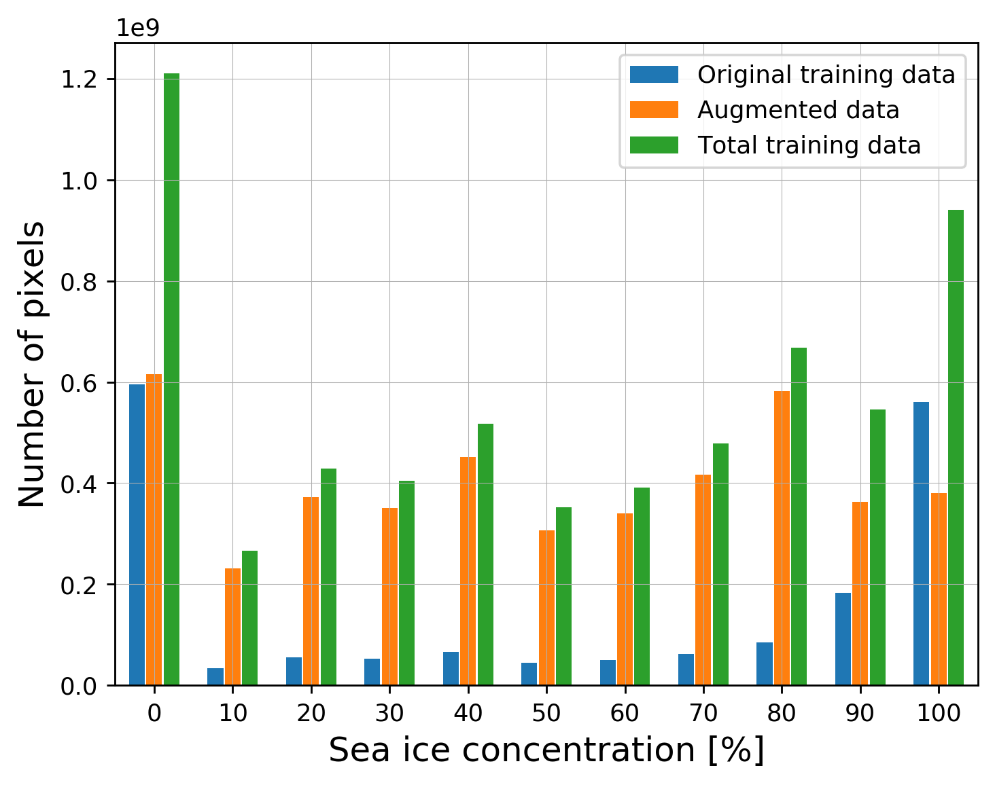
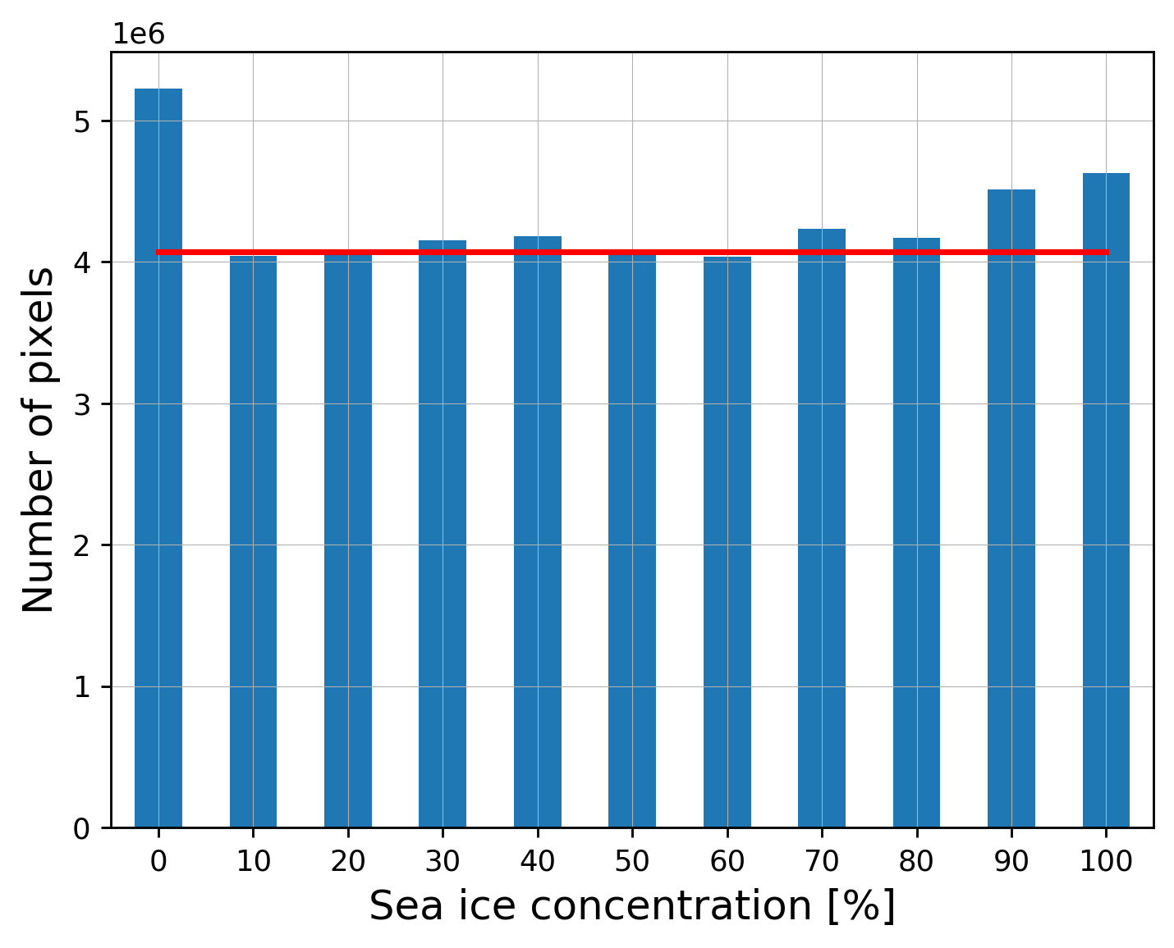
Data Distribution
Median Frequency weighting Scheme

Slide 18
Sea Ice Charting and Data Fusion Experiments
SAR Trained U-Net - baseline
SAR + Incidence Angle U-Net
  2 sub experiments
SAR + AMSR2 U-Net
  3 sub experiments
SAR + Incidence Angle + AMSR2 U-Net
Metrics used: Accuracy, Confusion Matrix and R² coefficient
SAR Trained U-Net - baseline
SAR + Incidence Angle U-Net
  2 sub experiments
SAR + AMSR2 U-Net
  3 sub experiments
SAR + Incidence Angle + AMSR2 U-Net
Metrics used: Accuracy, Confusion Matrix and R² coefficient

Slide 19
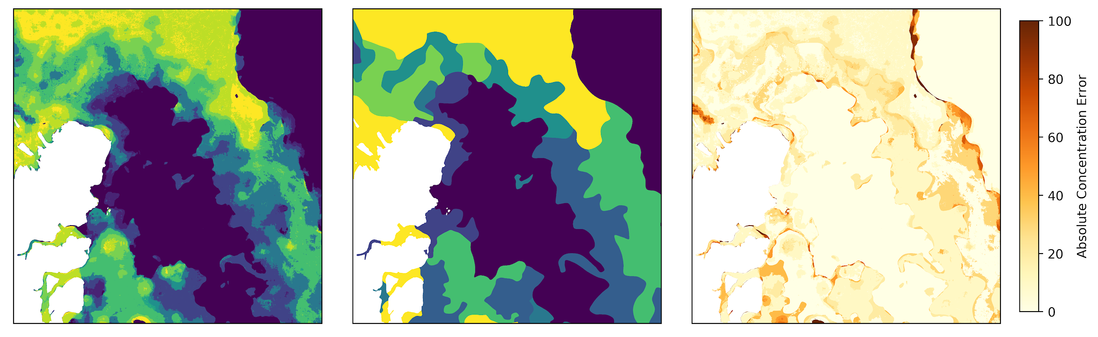
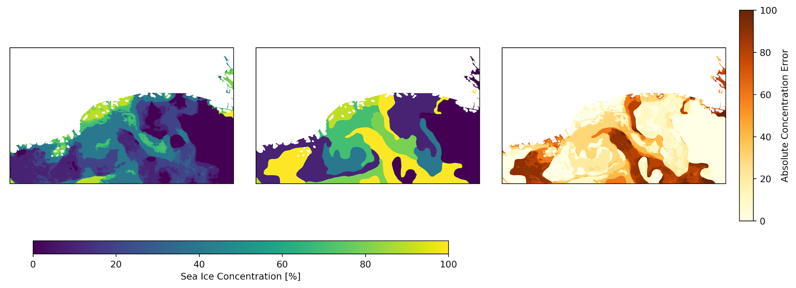
SAR U-Net Inference Scene 1
Accuracy: 51.34 %, R²: 83.46 %
Prediction
Truth
Error
A
B

Slide 20
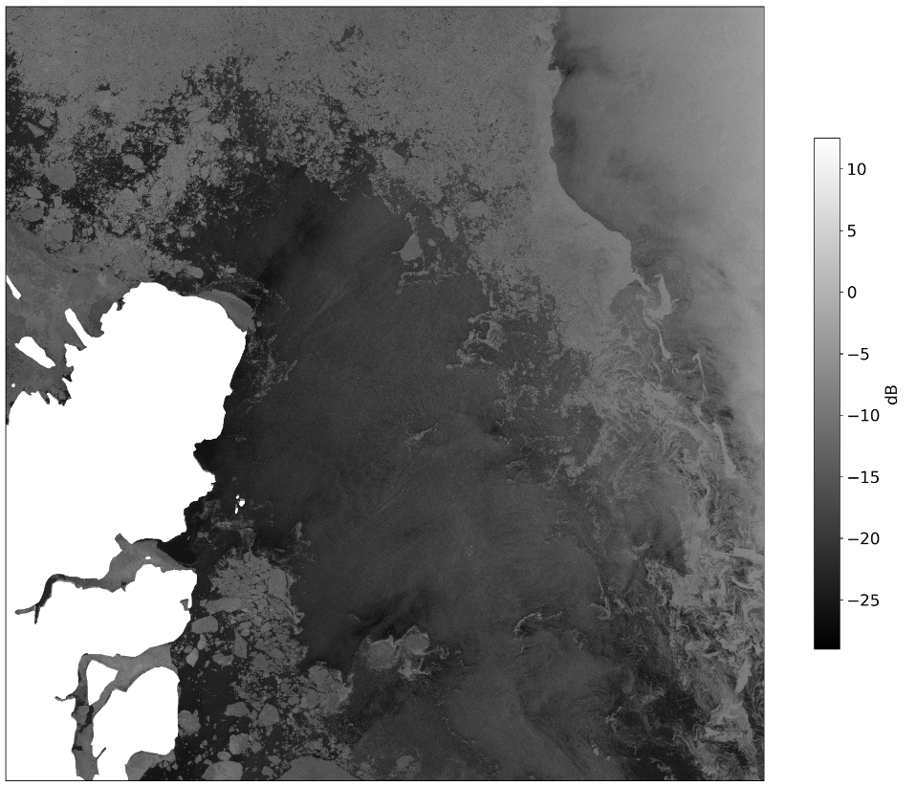
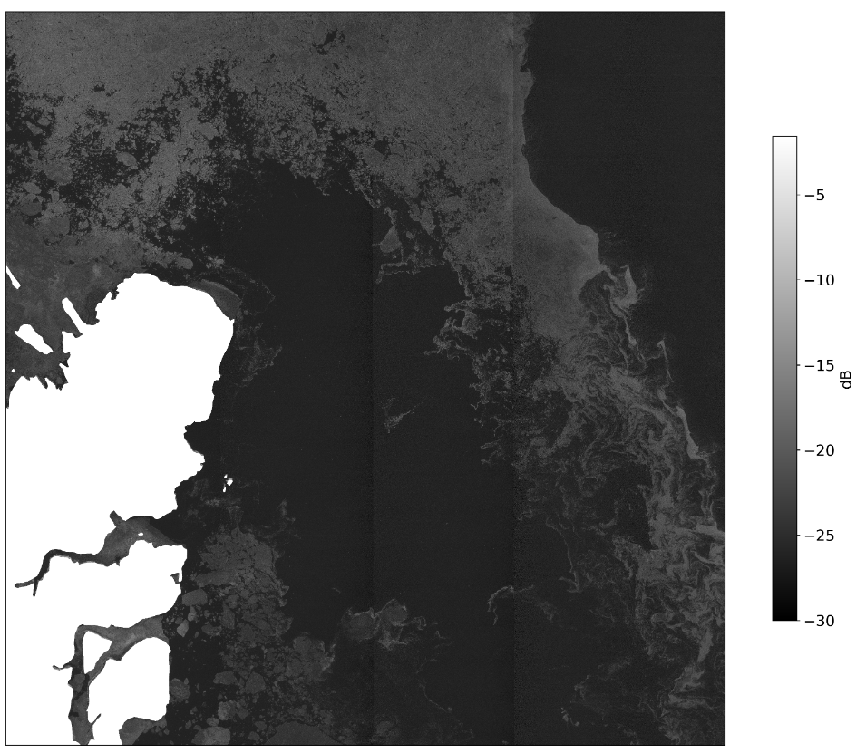
SAR U-Net Inference Scene 1
SAR HH
SAR HV
B
B

Slide 21
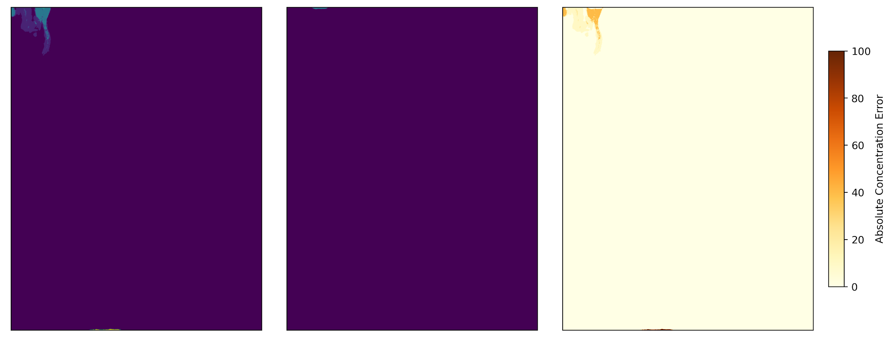
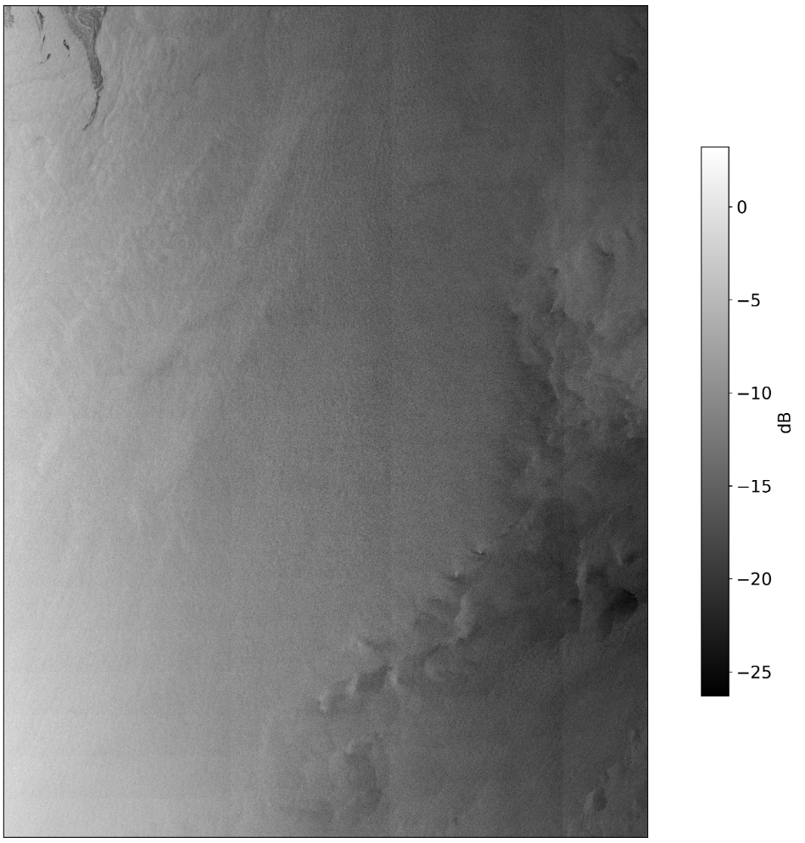
SAR U-Net Inference Scene 2
Accuracy: 98.99 %, R²: -1515.15 %
Prediction
Truth
Error
SAR HH
C
C

Slide 22
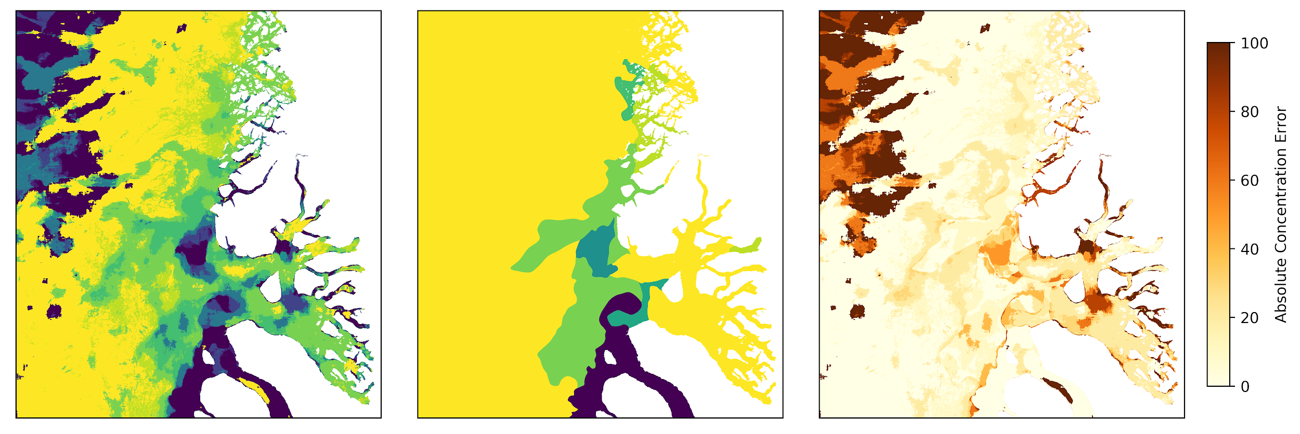
SAR U-Net Inference Scene 3
Accuracy: 46.20 %, R²: -218.99 %
Prediction
Truth
Error
D

Slide 23
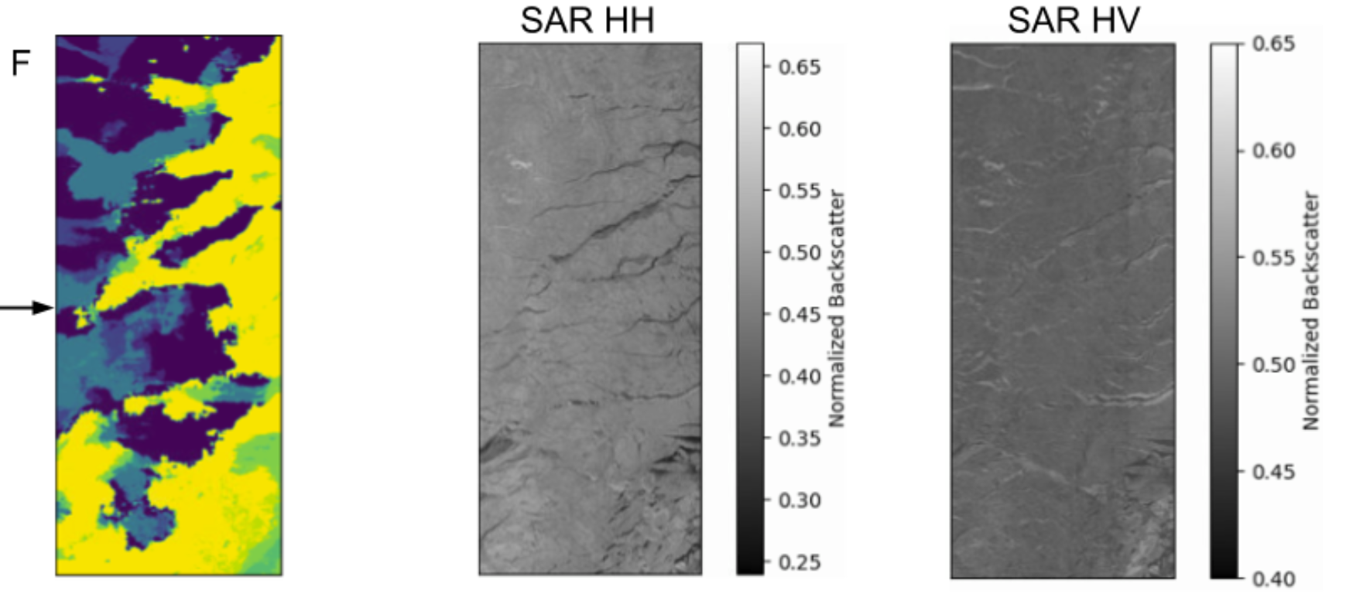
Area-D Zoom-In

Slide 24
Sea Ice Charting and Data Fusion Experiments
SAR Trained U-Net - baseline
SAR + Incidence Angle U-Net
  2 sub experiments
SAR + AMSR2 U-Net
  3 sub experiments
SAR + Incidence Angle + AMSR2 U-Net
Metrics used: Accuracy, Confusion Matrix and R² coefficient
SAR Trained U-Net - baseline
SAR + Incidence Angle U-Net
  2 sub experiments
SAR + AMSR2 U-Net
  3 sub experiments
SAR + Incidence Angle + AMSR2 U-Net
Metrics used: Accuracy, Confusion Matrix and R² coefficient

Slide 25
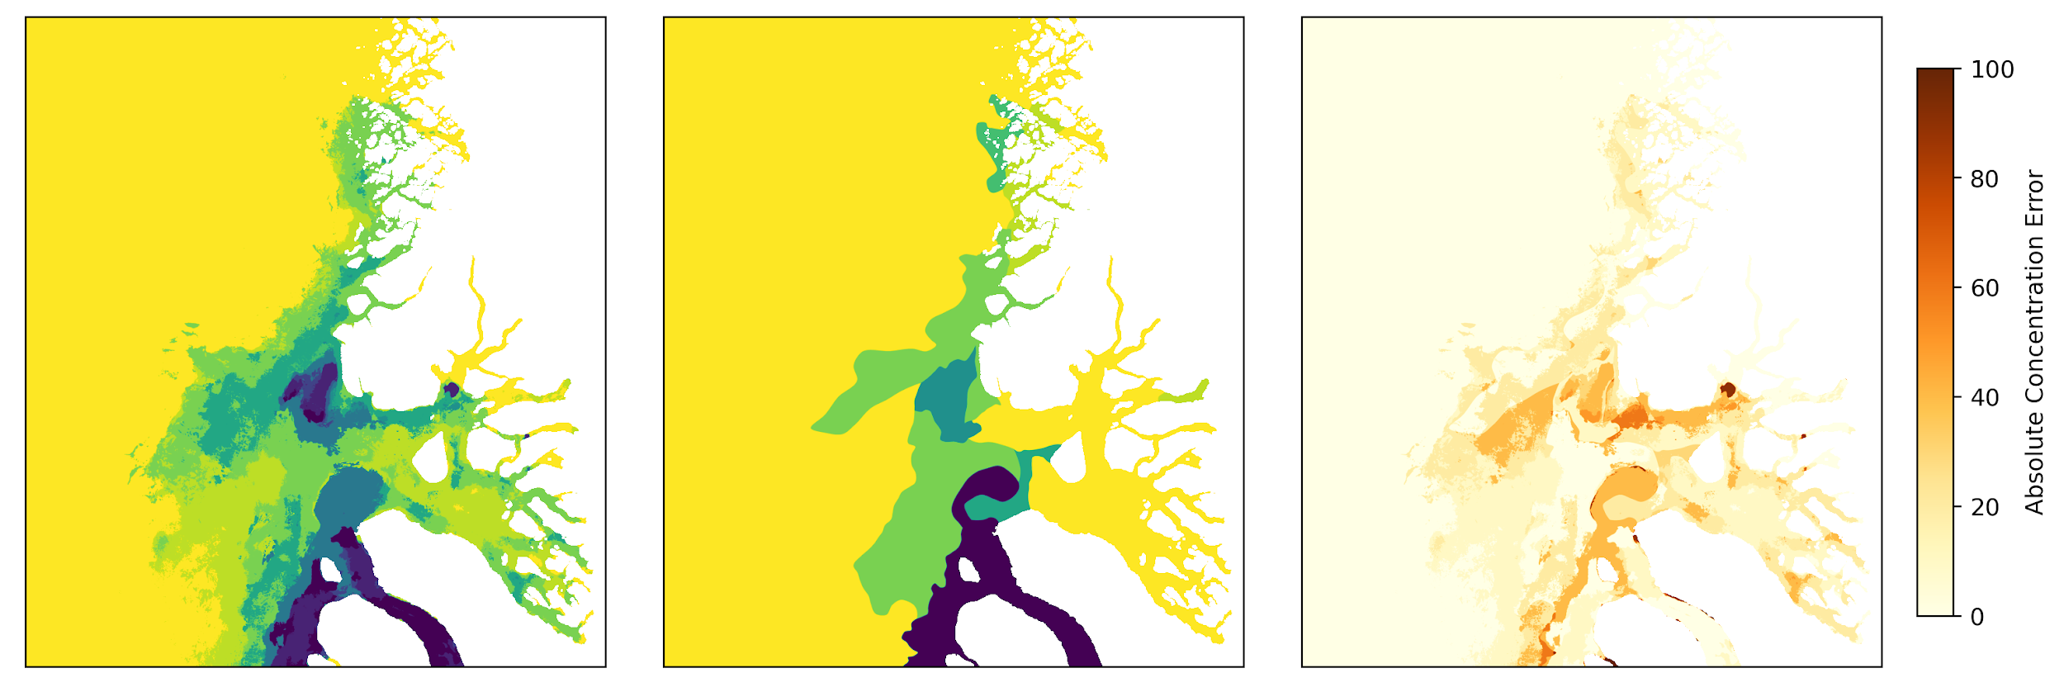
SAR + AMSR2 U-Net Inference Scene 3
Accuracy: 69.91 %, R²: 64.6 %
Prediction
Truth
Error

Slide 26
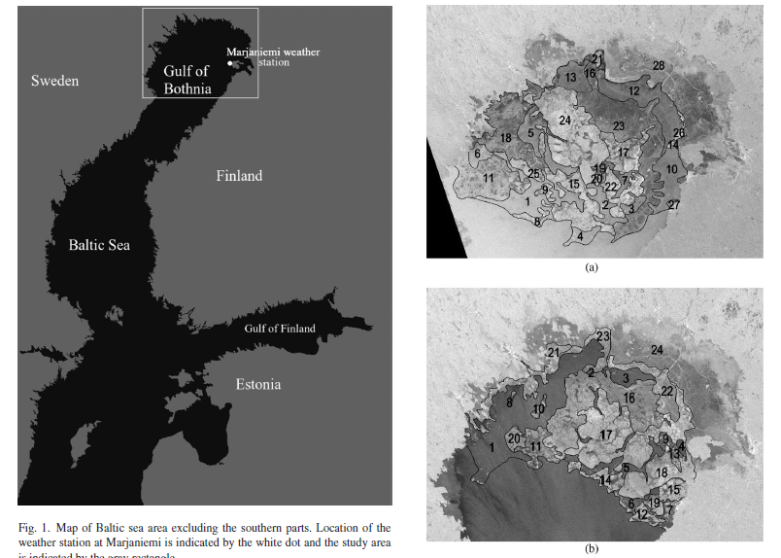
Uncertainty in Ice Charts
Notably findings: at least 20 % uncertainty
up to 60 % disagreement
[Juha Karvonen 2015, A Comparison Between High-Resolution EO-Based and Ice Analyst-Assigned Sea Ice Concentrations]

Slide 27
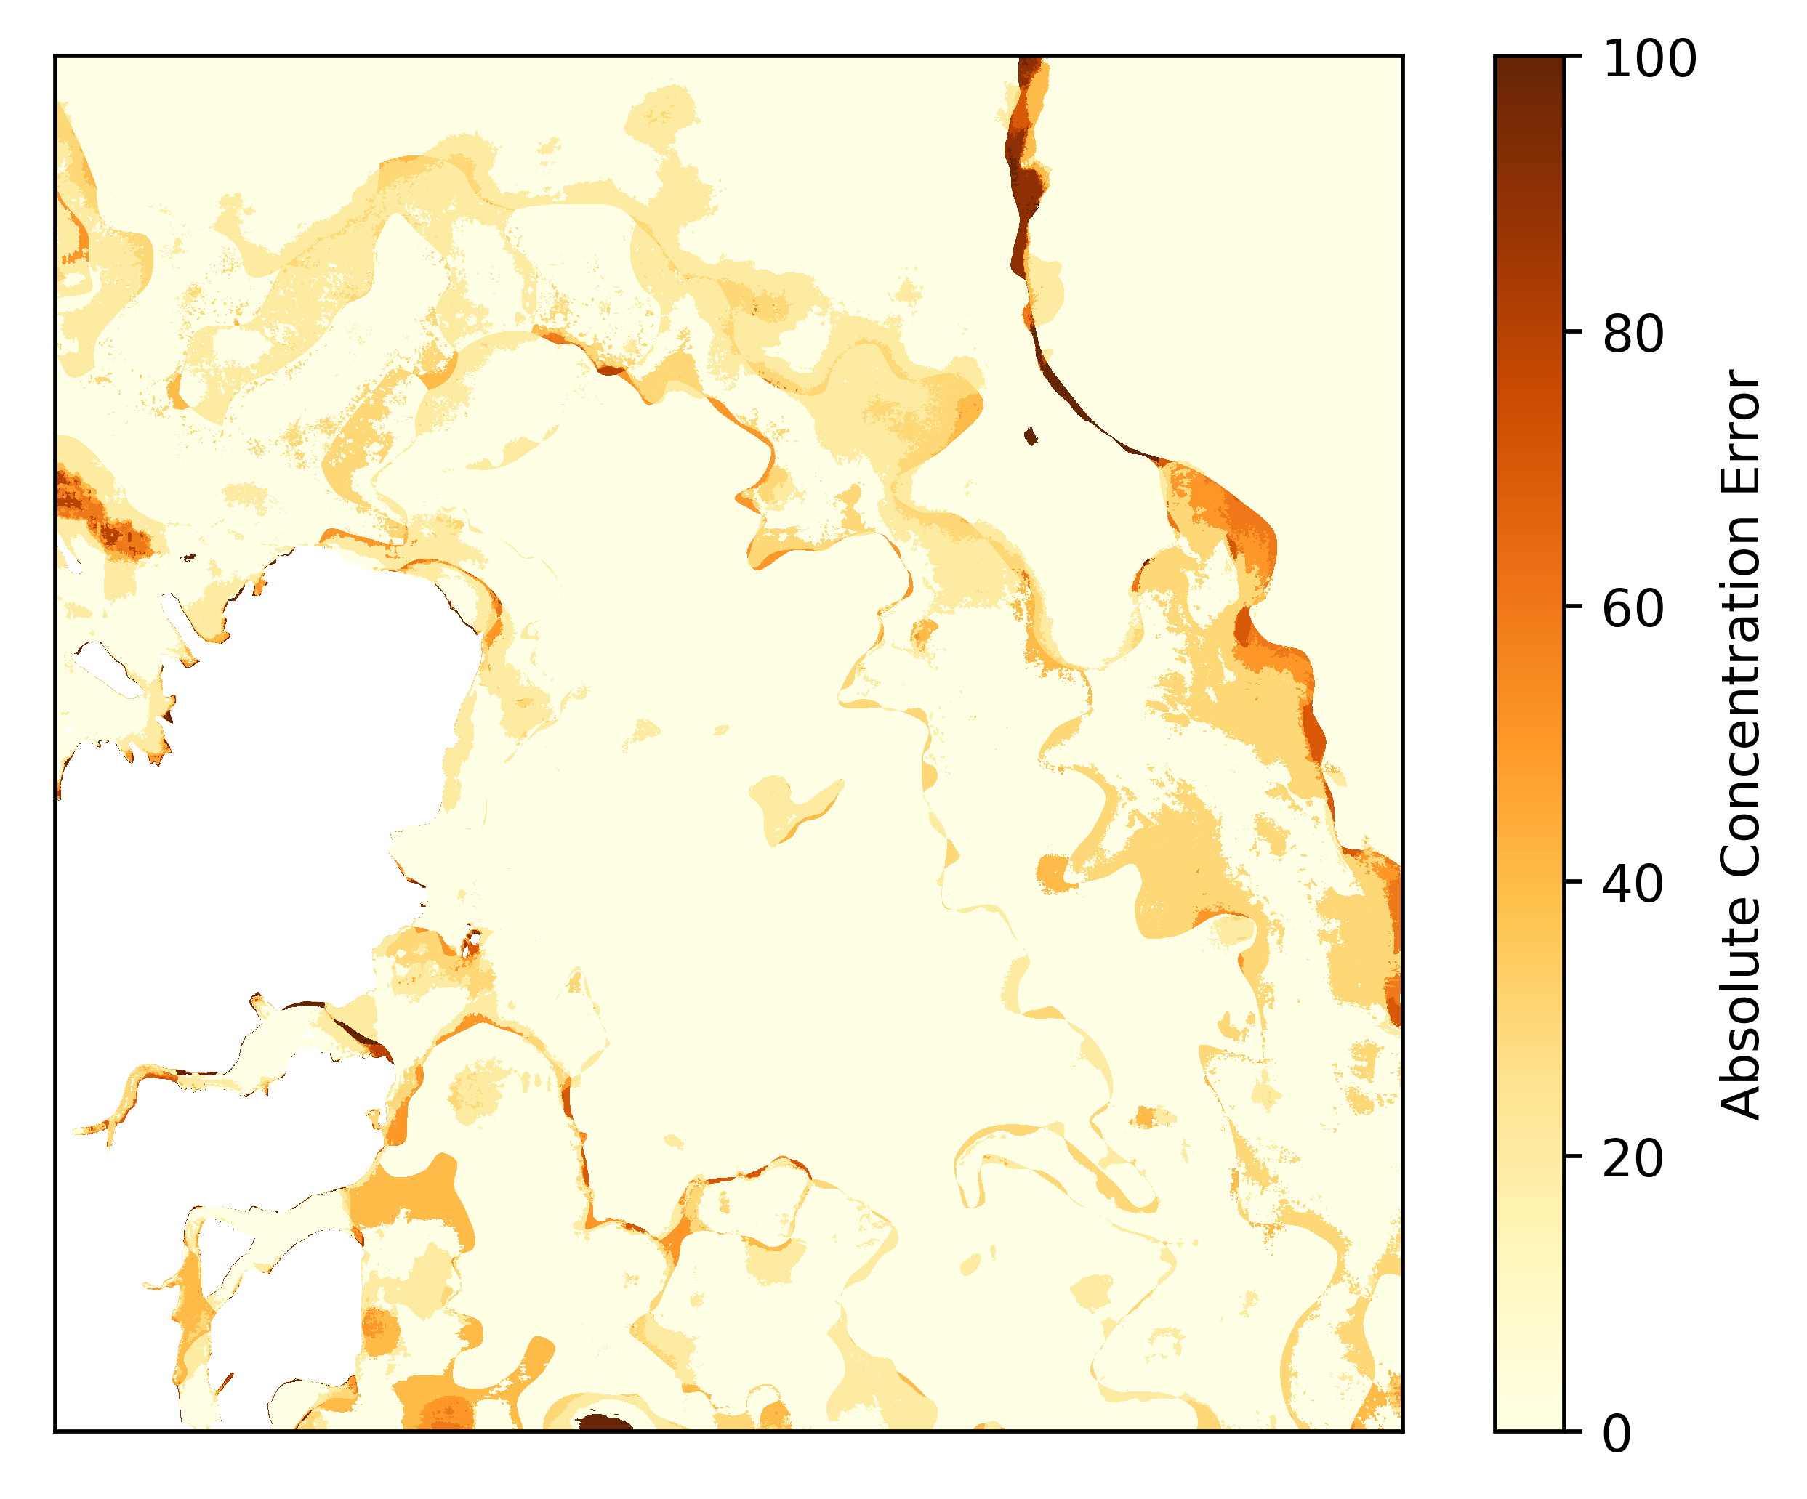
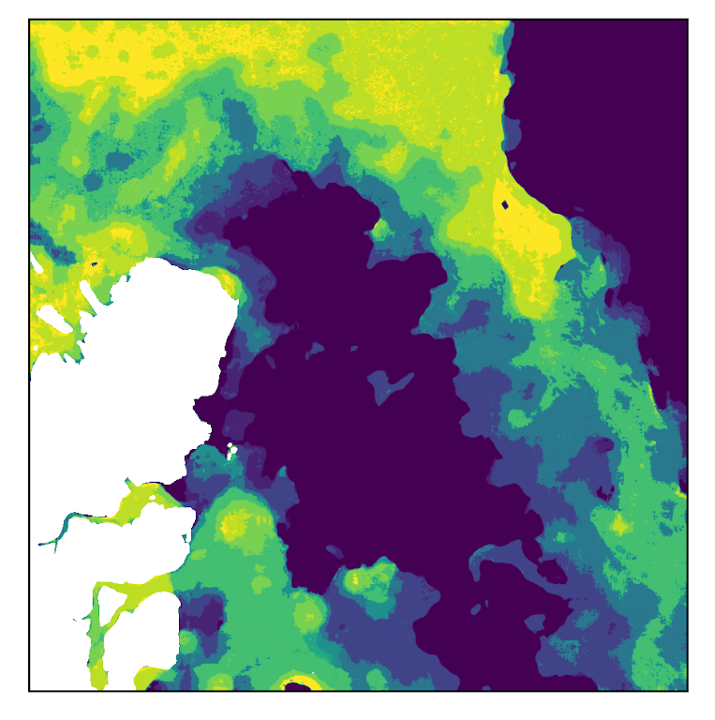
SAR U-Net Inference Scene 1 with Error Margin
Accuracy: 79.64 %, R²: 85.32 %
Error
Prediction

Slide 29
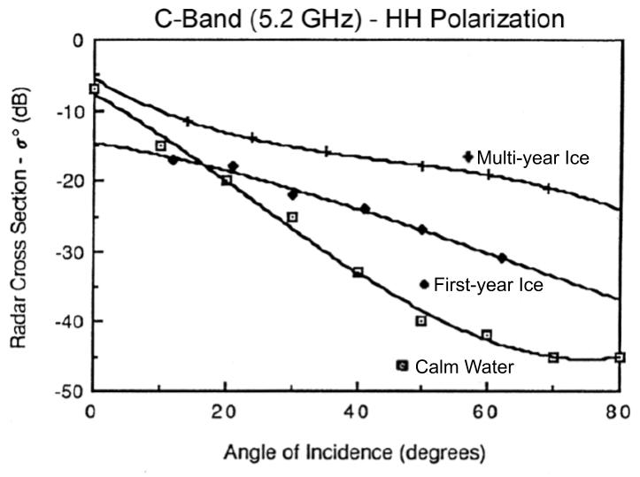
Incidence Angle Effect

Slide 30
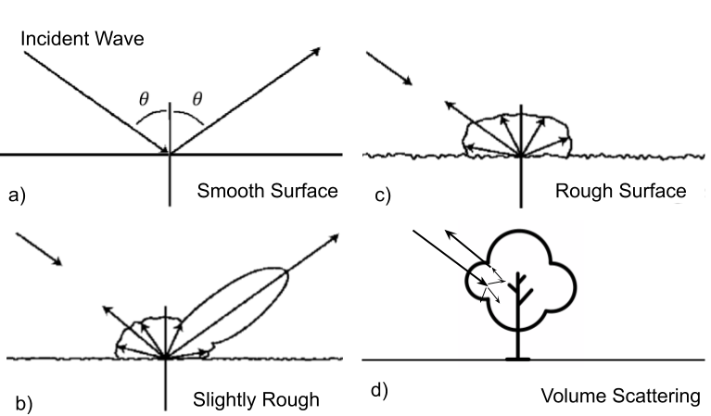
SAR Scattering

Slide 31
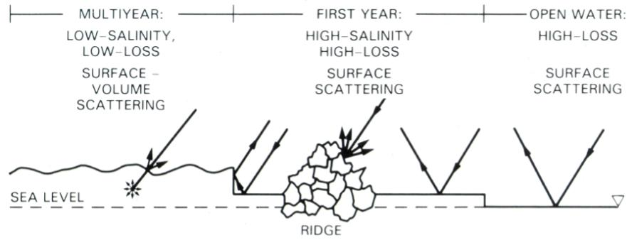
Ice Scattering

Slide 32
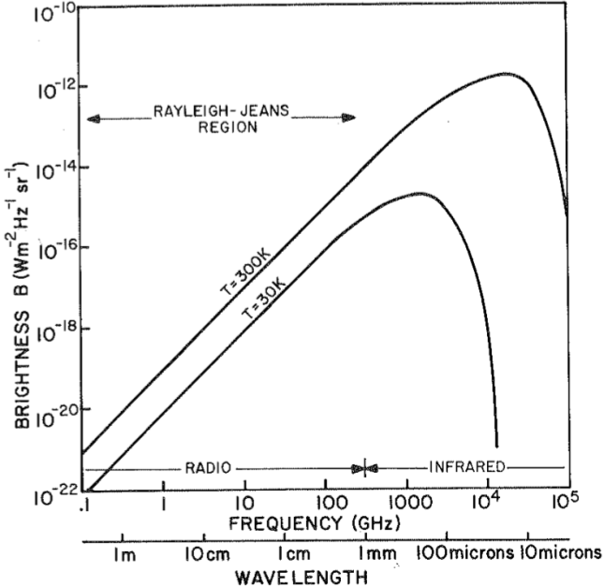
Planck’s Law of Radiation

Slide 33
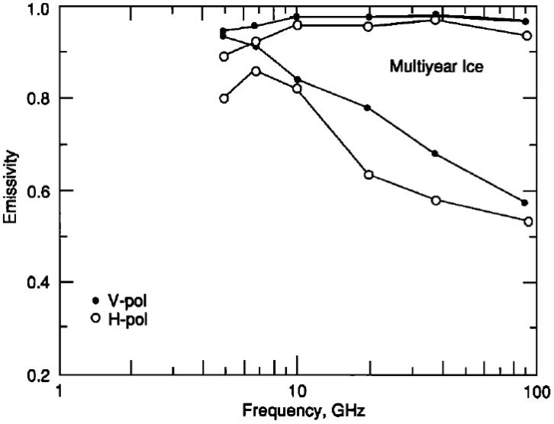
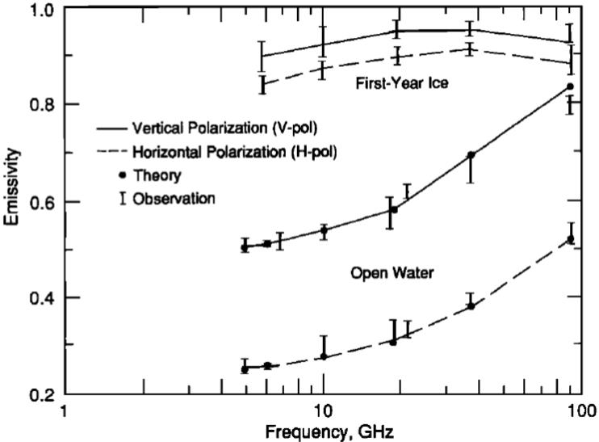
Sea Ice Emmisivity

Slide 34
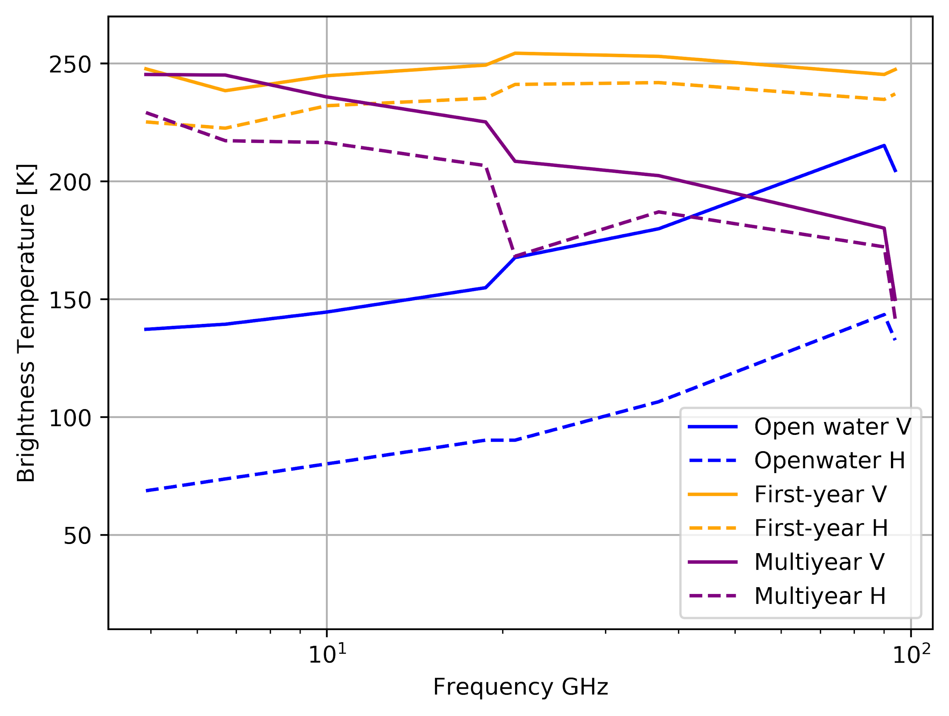
Sea Ice Brightness Temperatures

Slide 35


Month and Region Frequency

