Slide 1



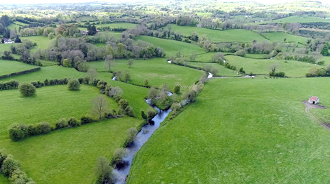
CatchmentCARE Week 2021
Modelling P Load Reductions in the Blackwater Catchment
Dr Russell Adams and Dr Donnacha Doody
May 2021

Slide 2
Diagram of sub-catchments in Blackwater (1460 km²)
Solid blue triangles are flow gauges, open
blue triangles are OPW (level only) gauges
Red rectangles are UK(NI) sub-catchments

Slide 3
Flow/ Load Pathways: CRAFT Simulation of Oona sub-catchment
Slow G/W = background flow + baseflow inc. point sources
Fast S/S = event subsurface flow inc. drainflow, interflow
SR = surface runoff, including near-surface flow in
the top layer of soil and overland flow from tracks etc.
SRP = soluble reactive P
SUP = soluble unreactive (i.e. “organic”) P
PP = particulate P
TP = SRP+SUP + PP
PP from soil erosion and entrainment from
P deposited on tracks and yards
SRP in SR mostly
from slurry
SUP mostly from slurry and other organic P
SRP in Fast S/S
from soil P (desorption), slurry P, and mineral fertilizer
P in slow G/W also from point sources
60% reactive (SRP)
This method is being used to couple SLAM and CRAFT
as shown in my main poster

Slide 4
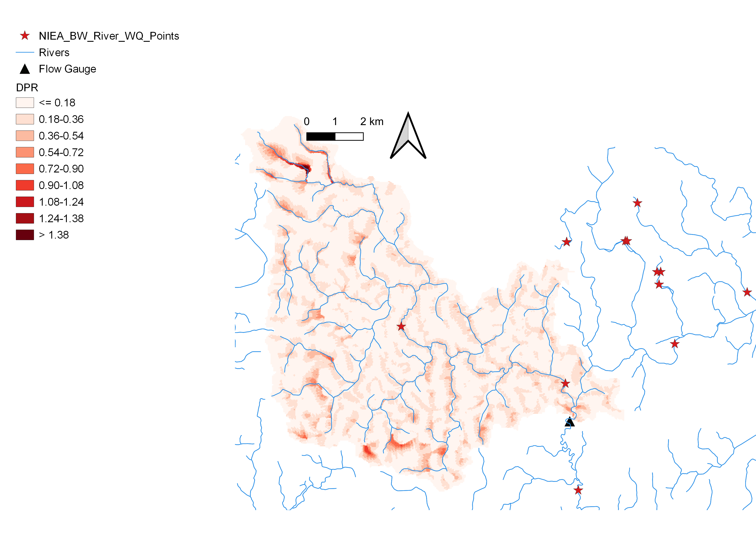
P export Risk Mapping in Oona subcatchment
Based on SAGA (Scimap) algorithm for DPR (Diffuse pollution riskiness)

Slide 5
P Load Reduction Modelling Using SLAM
SLAM Model Calculates Point and Diffuse Portions of TP Load
Pathway Factors Applied to Diffuse Load Sources

Slide 6
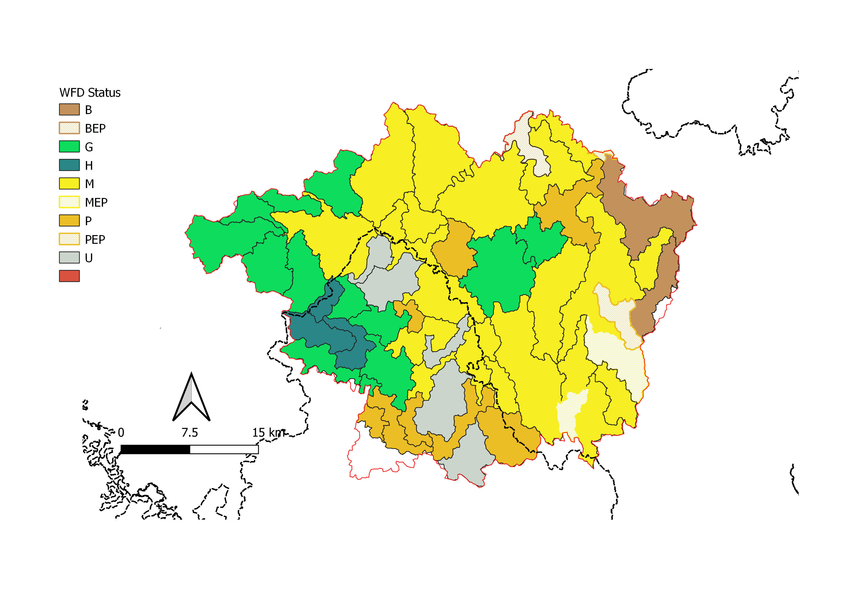
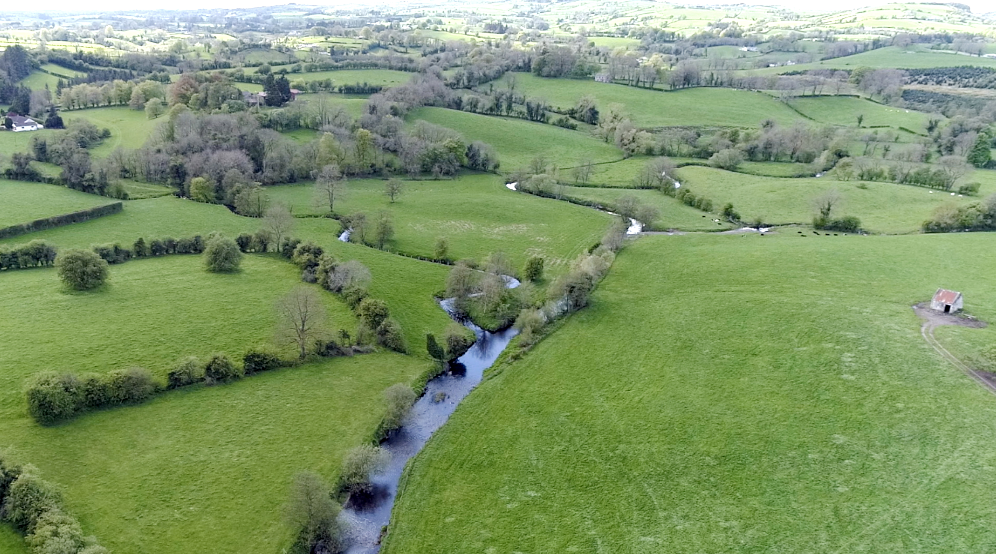
Recent WFD Status in Blackwater Catchment

Slide 7
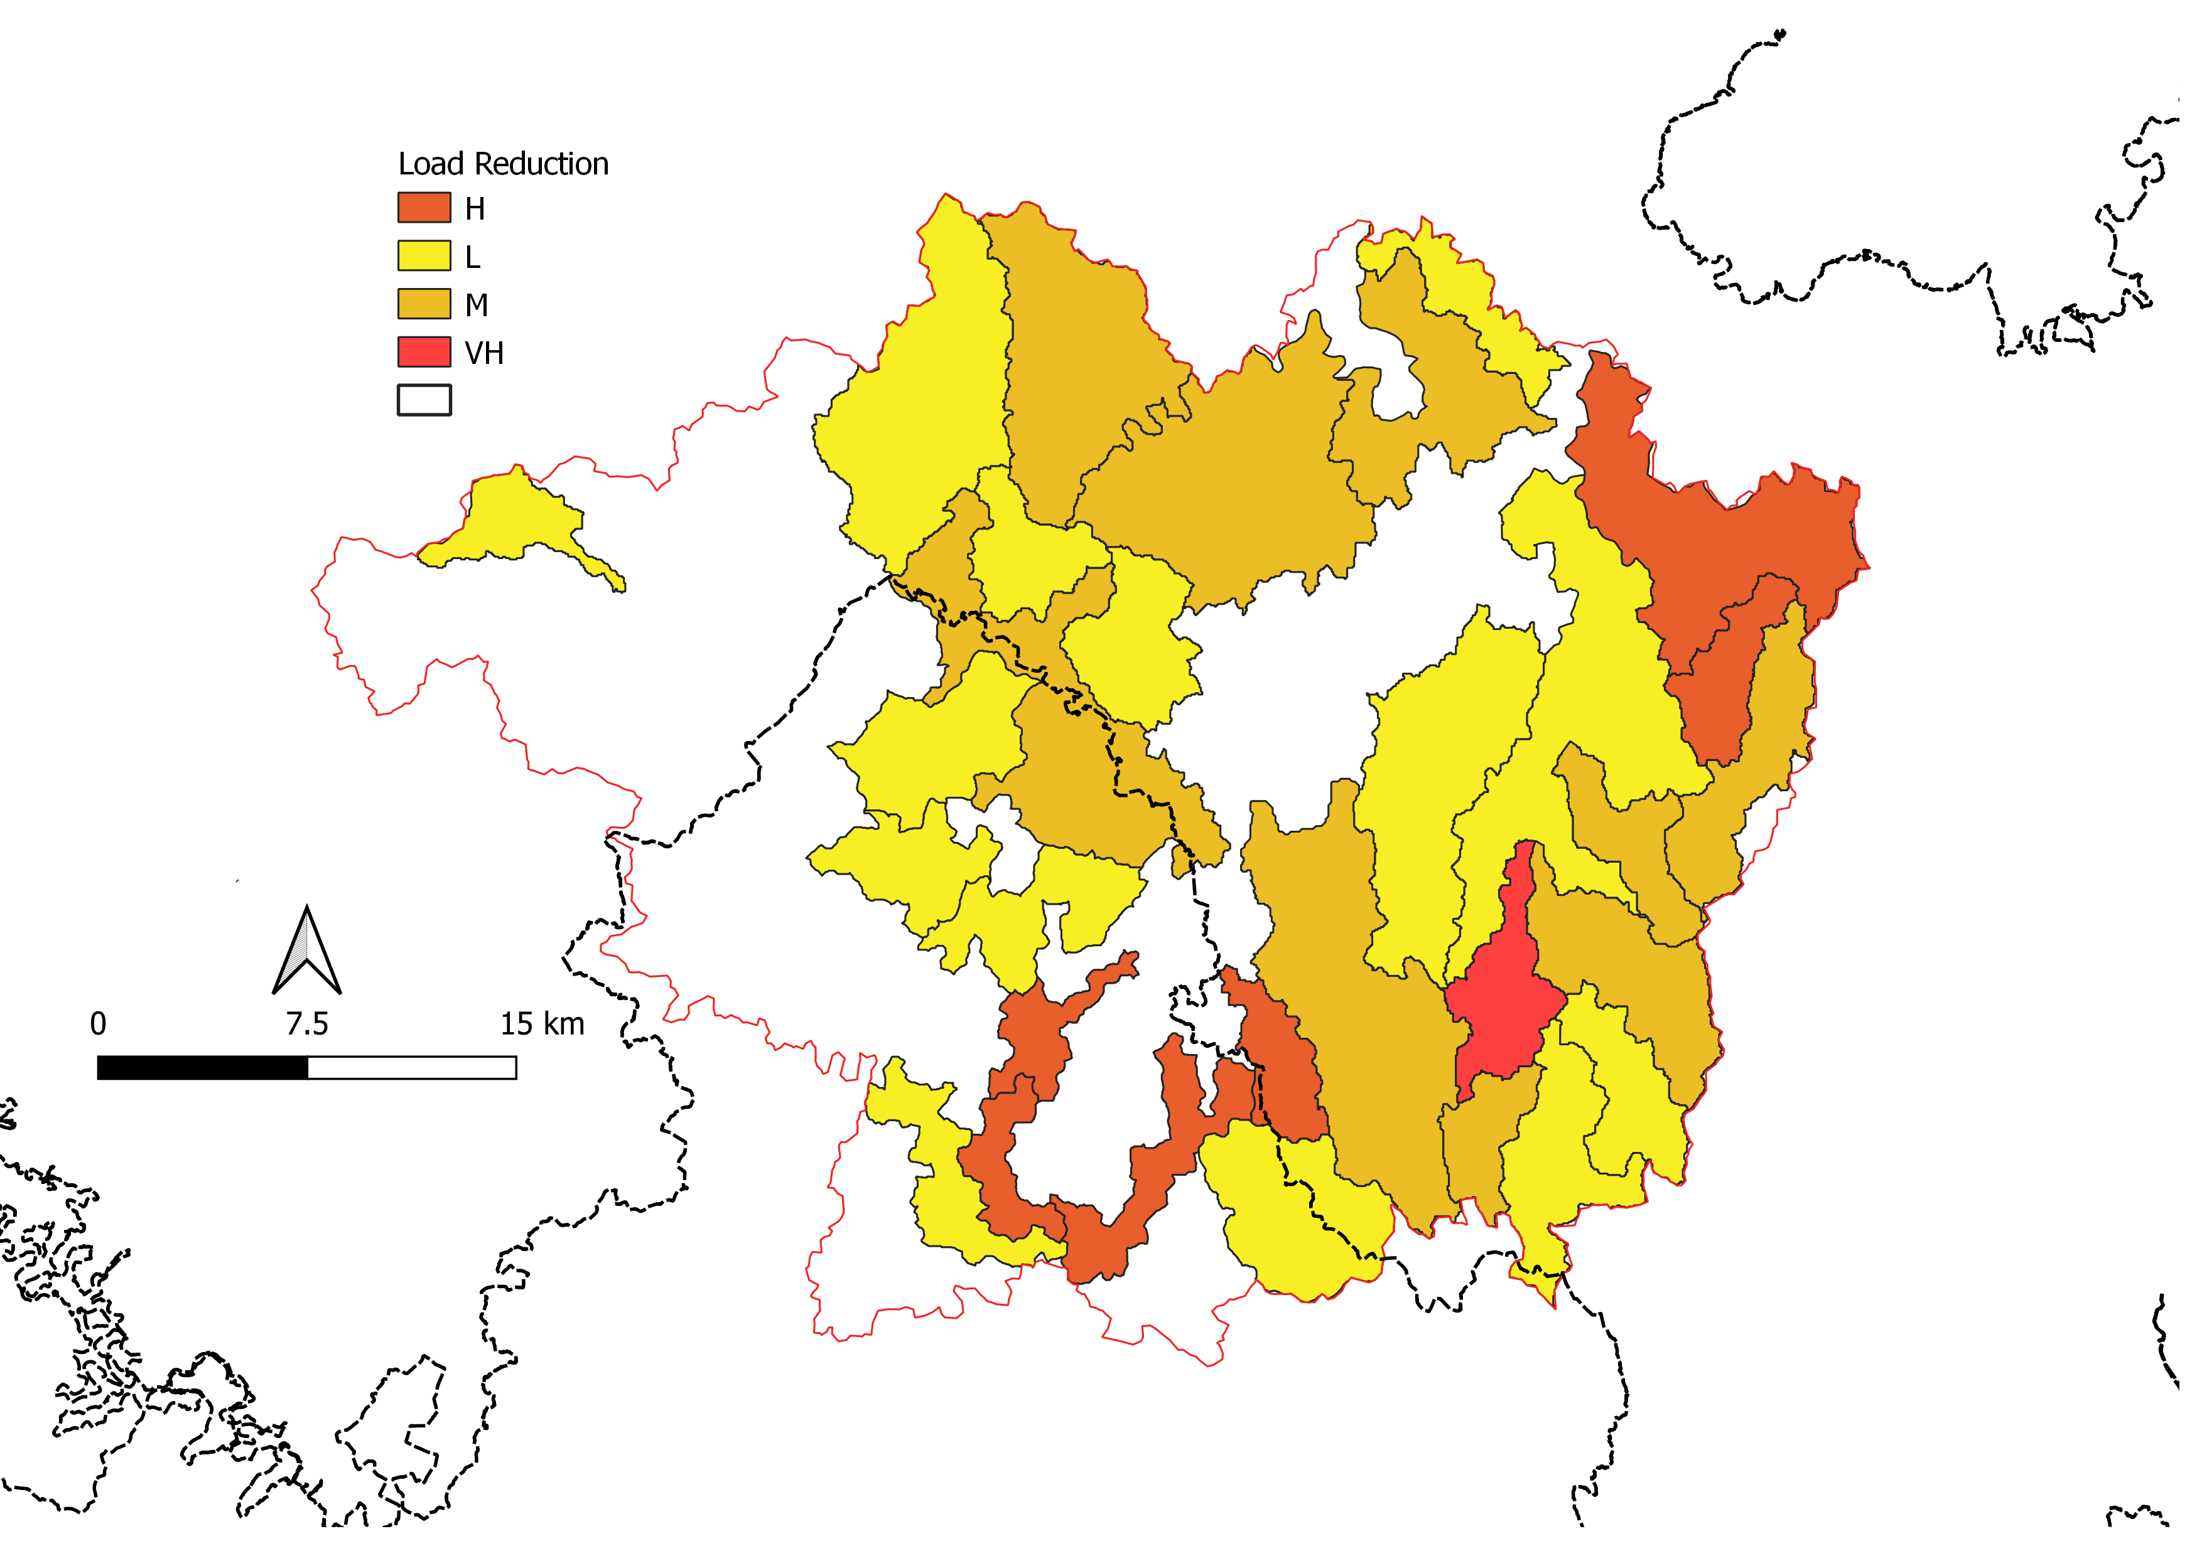
EPA Load Reduction Class
Based on Observed SRP Concentrations & Precipitation
White = No Reduction

Slide 8
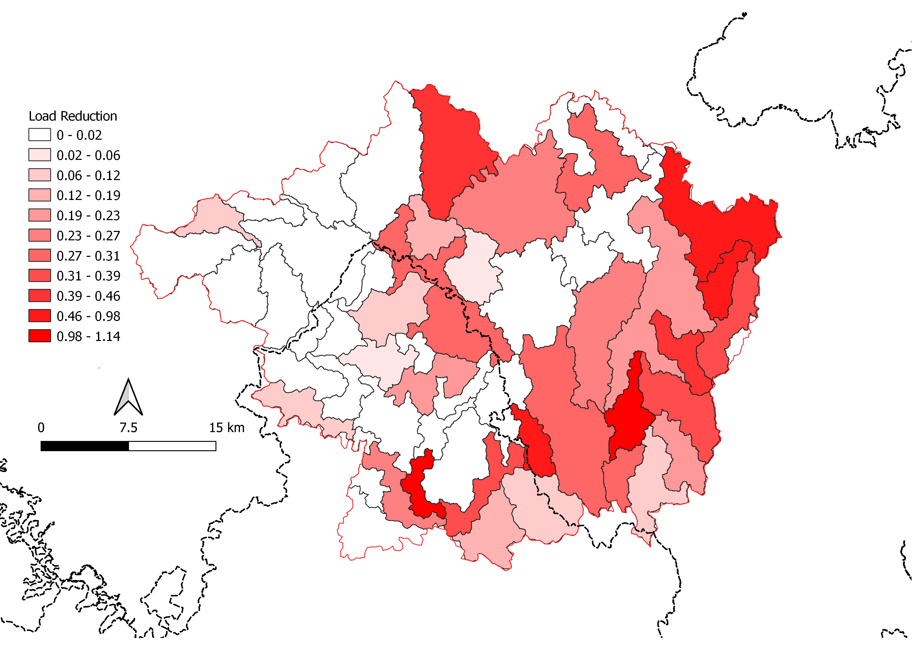
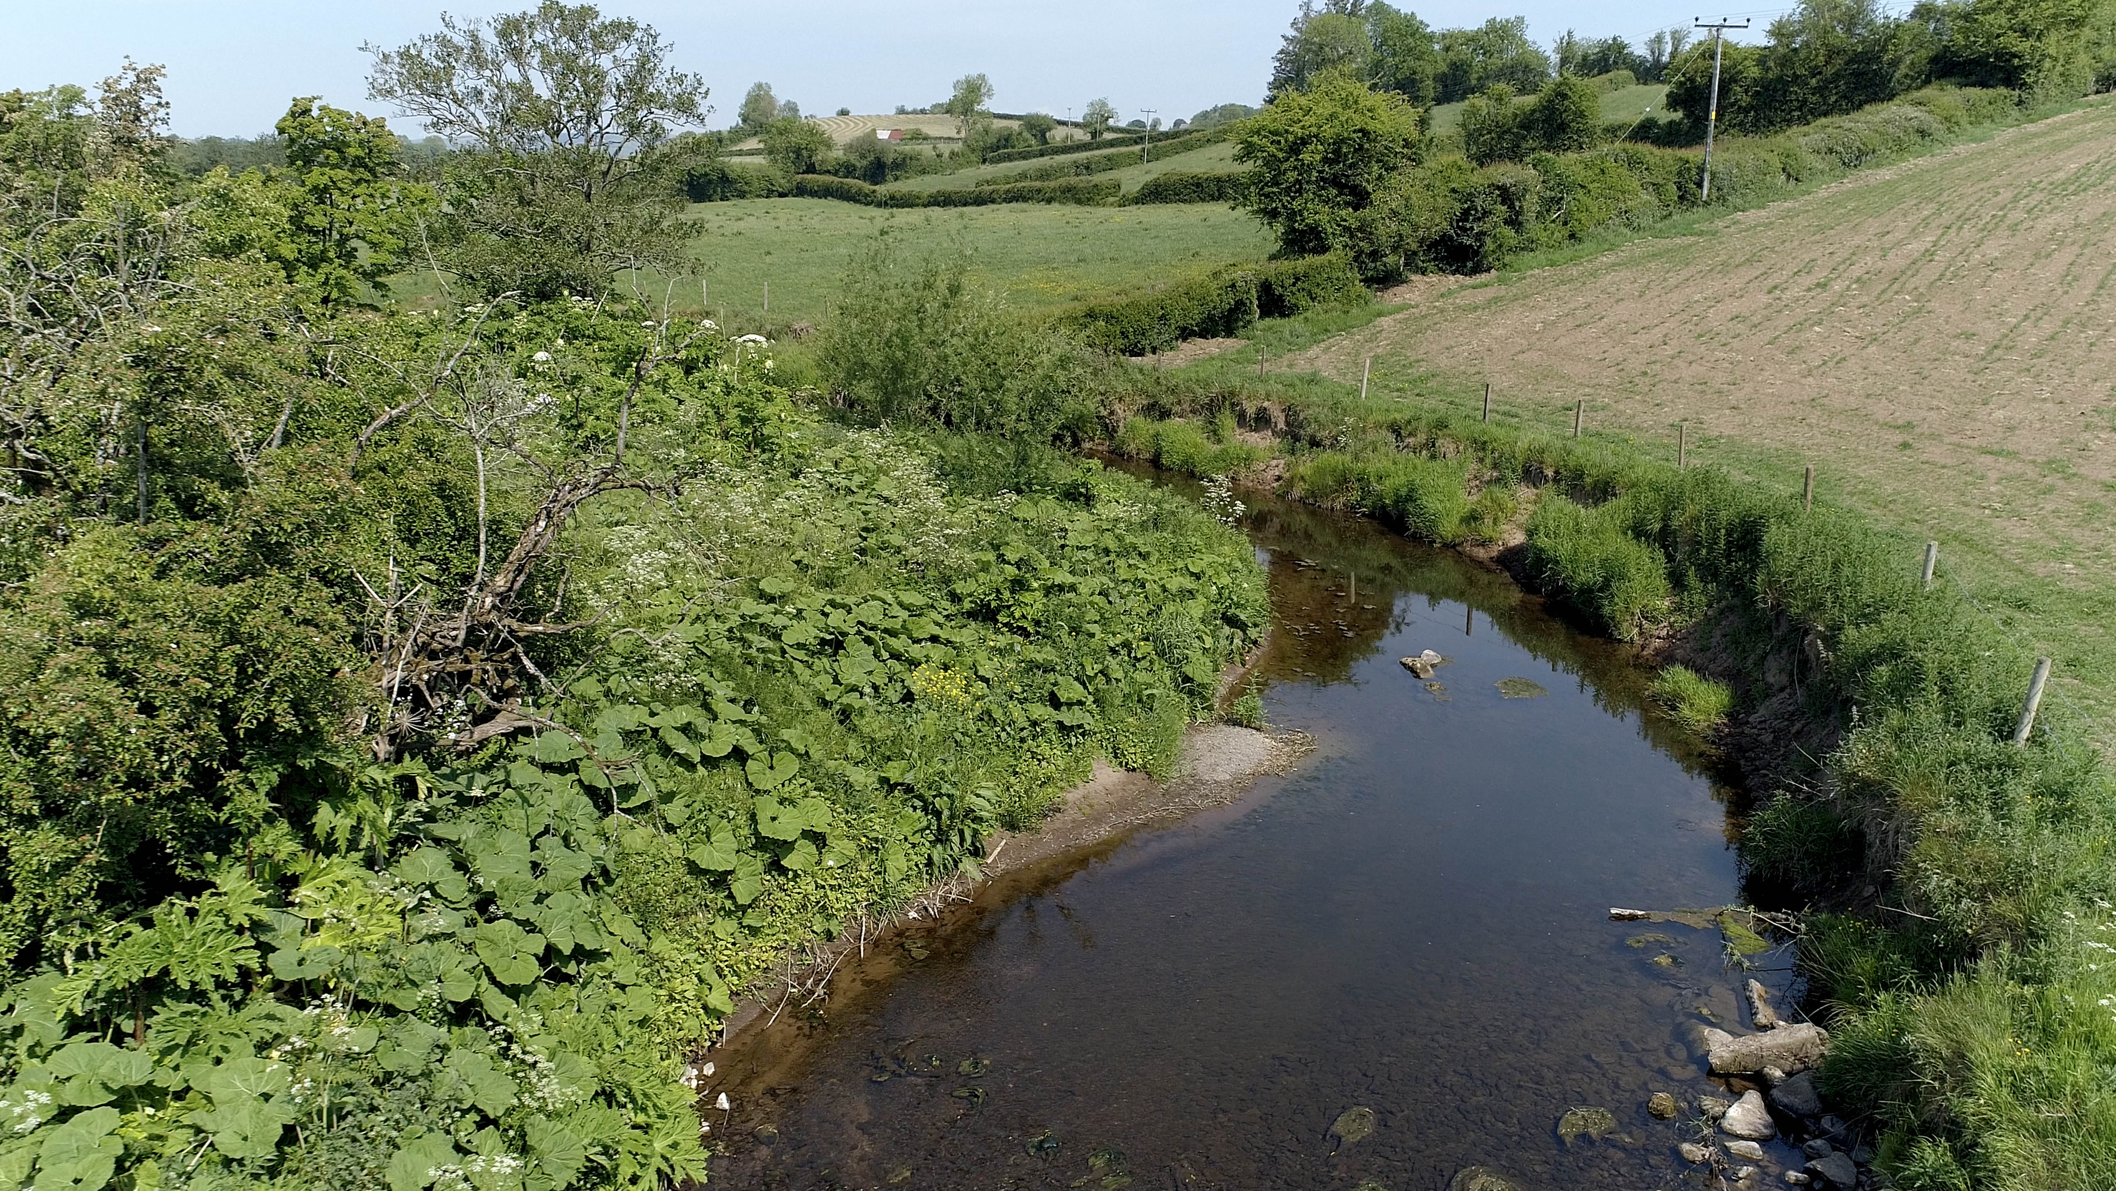
Load Reductions for Blackwater Subcatchments
Quantified in terms
of SRP export (loss)
in kg/ha/yr

Slide 9
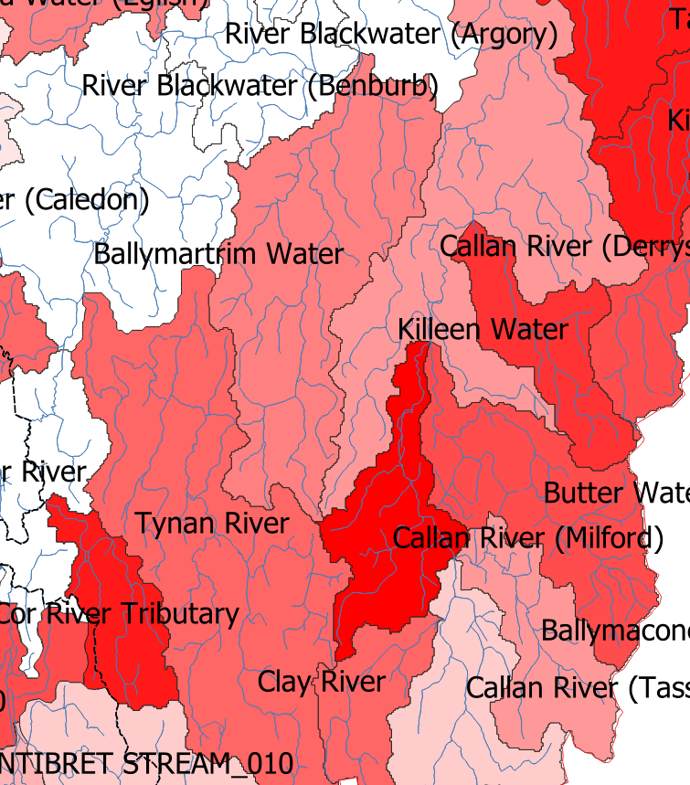
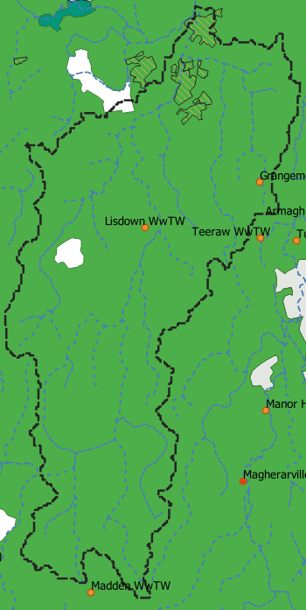
Ballymartrim Water - Mitigation Scenarios
Load Reduction Required
= 26% (0.4 kg P/ha/yr)
Explore Scenarios reducing
different diffuse P Sources
from Slurry, Soil and Fertiliser
P inputs
Point source Load only
71 kg/year (20 kg WwTWs)
Notes:
Green areas are pasture where load reductions can be applied. White areas arable or non-agricultural and were not considered

Slide 10
Ballymartrim Water – Mitigation Scenario 1
Baseline Reduced Load Scenario #1
Scenario #1
    the largest percentage reduction is from Soil P
Export is via Near Surface (NS) or Groundwater (GW) pathway
Export
Reduction
0.4 kg P/ha

Slide 11
Ballymartrim Water – Mitigation Scenario 2
Baseline Reduced Load Scenario #2
    Scenario # 2
Alternative Scenario reduces Slurry P instead….
Export
Reduction
0.4 kg P/ha

Slide 12
Conclusions
Modelling of different sources of P can be achieved using SLAM Model
Blackwater has a mixture of diffuse and point source pressures
Only 16 of the 55 WMUs achieve “Good” or better WFD status (29%)
Therefore 16 require at least “Moderate” load reductions (from 0.5 – 2.9
tonnes P /year, up to 7 tonnes P /year for a “VH” load reduction)
Sub-catchments (WMUs) with diffuse source pressures targeted for
further attention.
Bulk of (diffuse) load reductions could be achieved from slurry P and soil P management, typically 0.2 – 2.5 tonnes P/year

