Slide 1






First regional SMOS Sea Surface Salinity products over the Baltic Sea:
Quality assessment and oceanographic added-value
V. González-Gambau⁽¹⁾, E. Olmedo⁽¹⁾, C. González-Haro⁽¹⁾, A. Turiel⁽¹⁾, A. García⁽¹⁾, J. Martínez⁽¹⁾, C. Gabarró⁽¹⁾,P. Alenius⁽²⁾, L. Tuomi⁽²⁾,
P. Roiha⁽²⁾, M. Arias⁽³⁾, R. Catany⁽³⁾, D. Fernández⁽⁴⁾ and R. Sabia⁽⁴⁾
(1)
(2)
(3)
(4)
Notes:
1
1

Slide 2
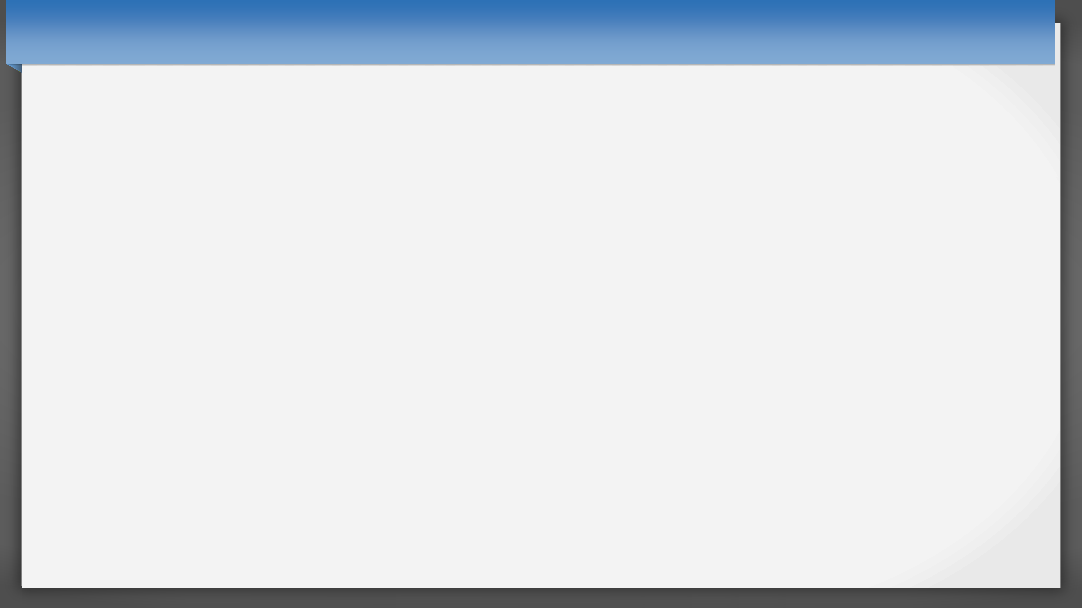
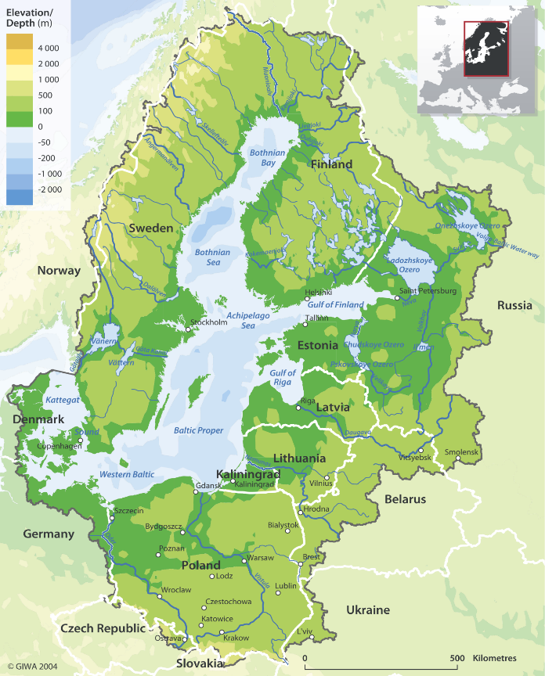

Understanding salinity dynamics through
satellite-based measurements
Potential scientific applications identified a‐priori, linked to the
needs described by the Baltic Earth group:
Monitorization of long-term SSS changes in the different sub-basins (determination of salinity annual trends).
Detection of frontal areas where SSS gradients are stronger (river run-offs, ice formation and melting processes, etc.).
Study of inflow and outflow dynamics through the determination of anomalous salinity periods.
Satellite-based SSS measurements can be used as initial fields and validation data to numerical models.
Analysis of the circulation patterns as derived from salinity in the basin.
Notes:
1

Slide 3
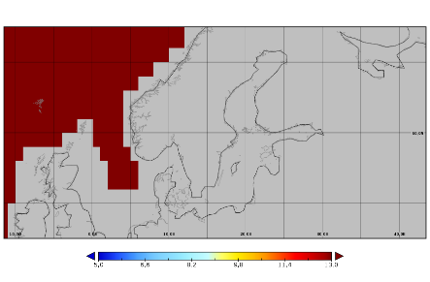
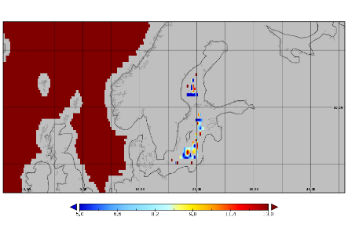
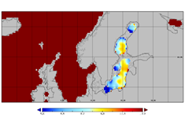
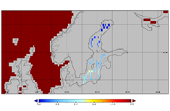
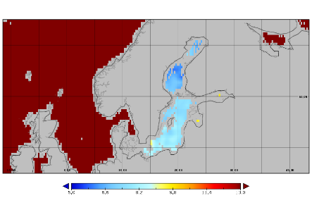
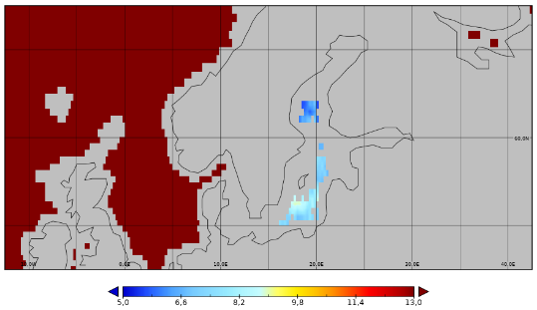
L-band satellite SSS before Baltic+ Salinity
Retrieving SSS over this region is a great challenge because of several technical issues
  L-band SSS global products provided by 3 missions: Aquarius, SMOS and SMAP
Aquarius
SMAP RSS
SMAP JPL
SMOS CATDS
SMOS BEC
CCI+SSS
There is a clear need for developing regional SSS products over Baltic Sea
Aquarius: version 4.0 CAP SMAP RSS: version 3.0, 40 km SMAP JPL: version 4.2 SMOS LOCEAN: L3 debiased version 3 SMOS BEC: L3 debiased non-Bayesian, version 1 CCI+ Salinity product: version 01.7
Notes:
1

Slide 4
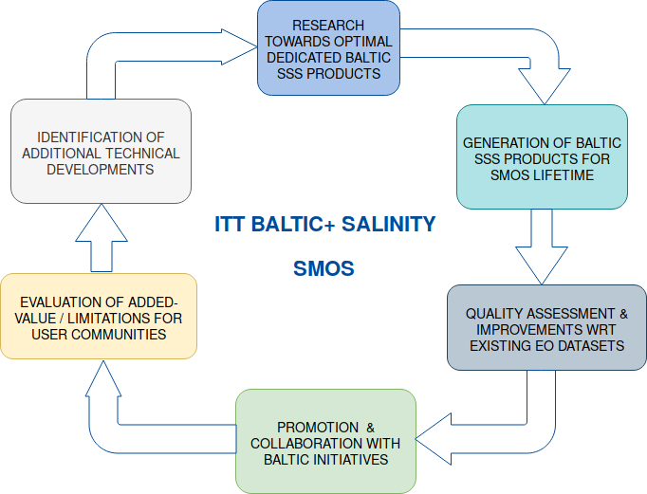


ITT Baltic+ Salinity Dynamics: Objectives
ESA funded project
https://balticsalinity.argans.co.uk
Partners:
Notes:
1

Slide 5
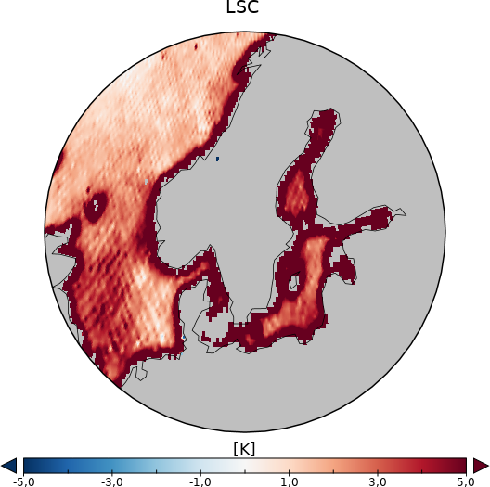
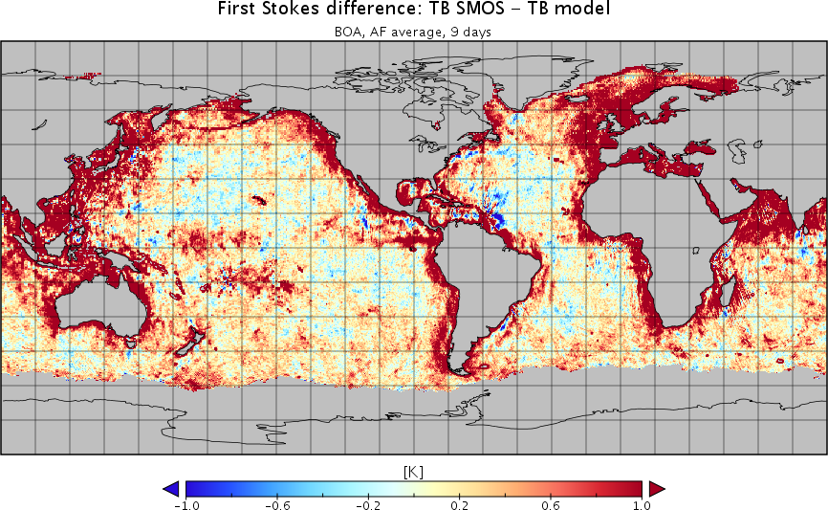
Challenges in retrieving SMOS SSS over Baltic (i)
  Systematic artificial increase of ocean TB close to land and ice edges, particularly crucial in semi-enclosed seas.
Land-sea and ice-sea contamination
mean(TB-TBmod)
[Martin-Neira et al. RSE 2016]
[Corbella et al. GRSL 2015]

Slide 6
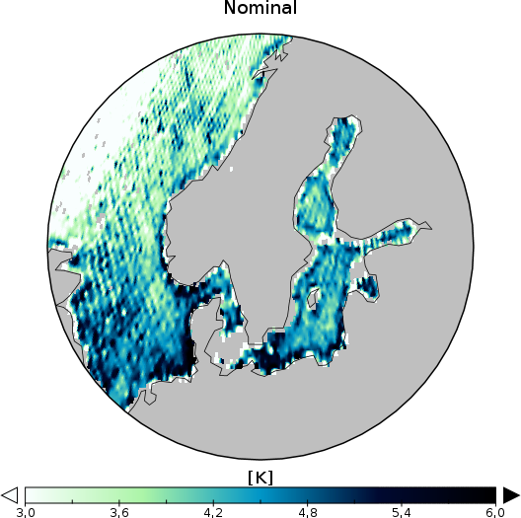
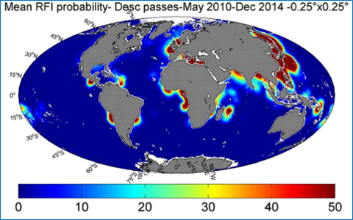
Challenges in retrieving SMOS SSS over Baltic (ii)
  Artefacts corrupt entire TB images when strong RFI sources or the Sun alias are present
Contamination by Radio-Frequency Interference sources
std(TB-TBmod)
Figure from [Oliva et al. RSE 2016]
[Martín-Neira et al. RSE 2016]
Map: June 2014
More intense RFI activity over Baltic: 2011-2013

Slide 7
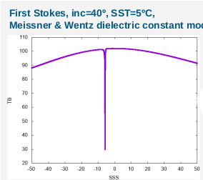
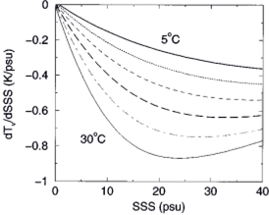
Challenges in retrieving SMOS SSS over Baltic (iii)
  Errors in the determination of SSS values are expected to be much more larger than at temperate oceans
Low sensitivity of L-band TB to SSS at low SSS and SST ranges
Assessment of available dielectric constant models for the low SSS & SST
Problems at low SSS, models have been extrapolated with polynomials
[Yueh et al. TGRS 2001]

Slide 8
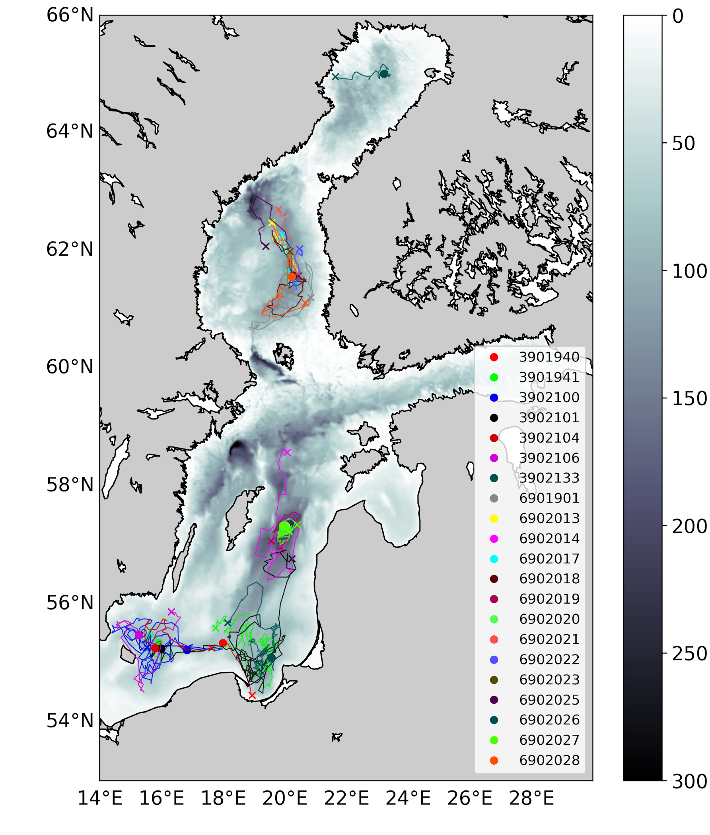
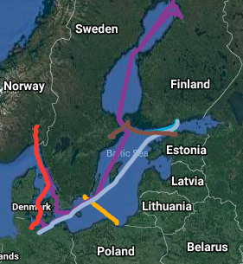
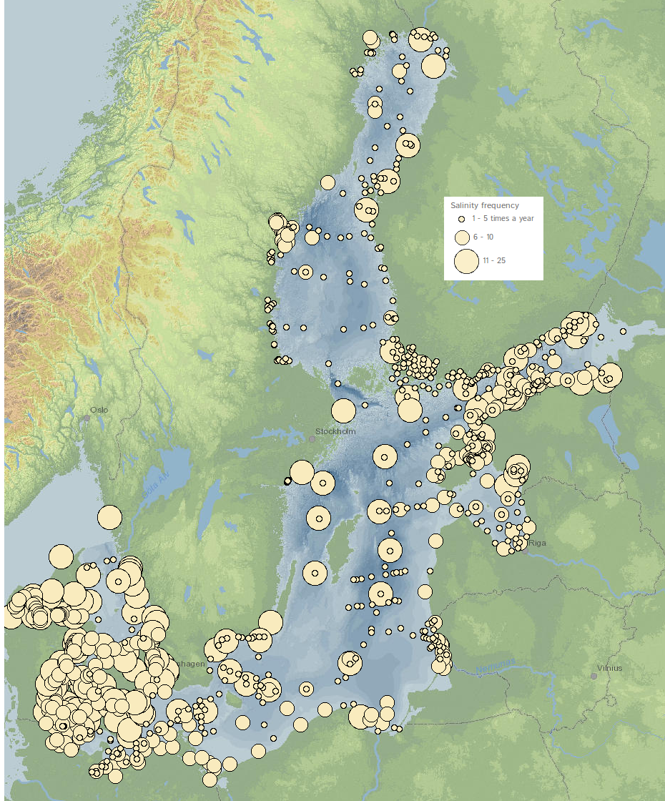
Challenges in validating SMOS SSS over Baltic
Scarcity of in-situ SSS measurements
Inhomogeneous spatial distribution and sampling of in-situ measurements
Representativeness of satellite SSS versus in-situ measurements
Significant differences between surface (satellite) and sub-surface (in situ) salinity (seasonal variations in the surface, strong horizontal gradients, etc.)
FerryBox lines
Monitoring stations Helcom
Argo floats

Slide 9
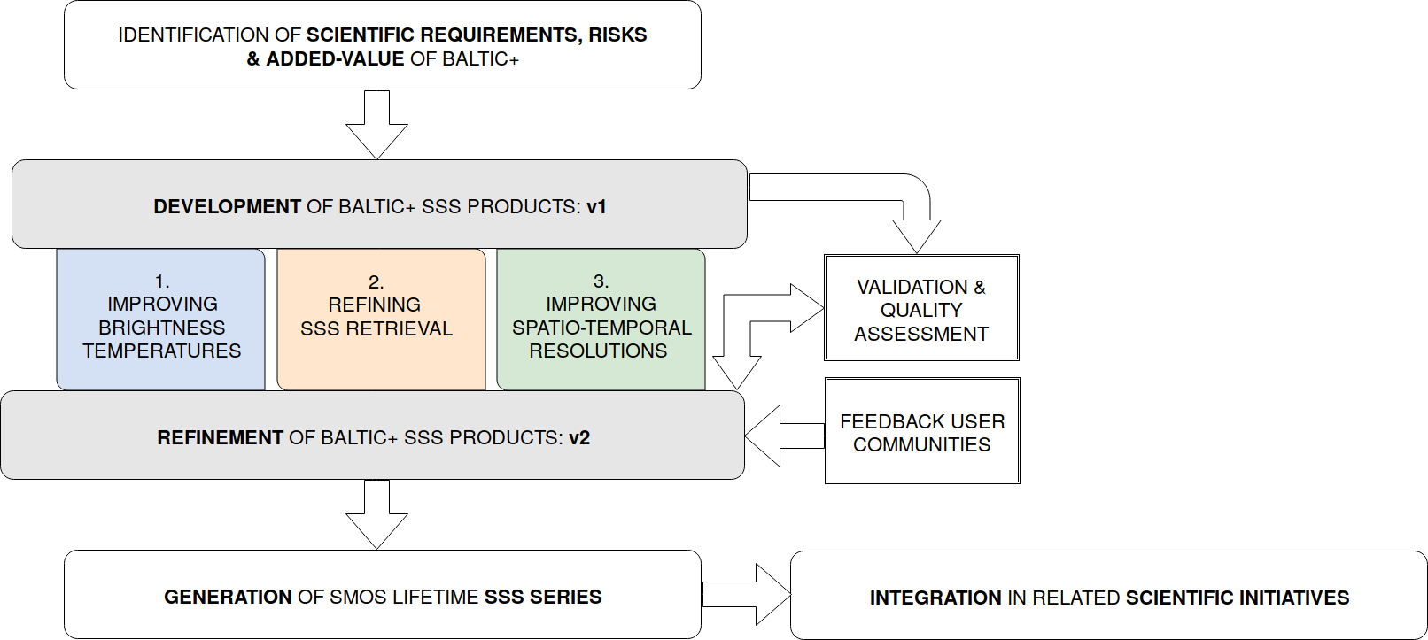

ITT Baltic+ Salinity Dynamics: Scientific approach
Collaboration with
9-year (2011-2019) L3 (9-day, 0.25 deg) and L4 (daily, 0.05 deg) SSS products

Slide 10
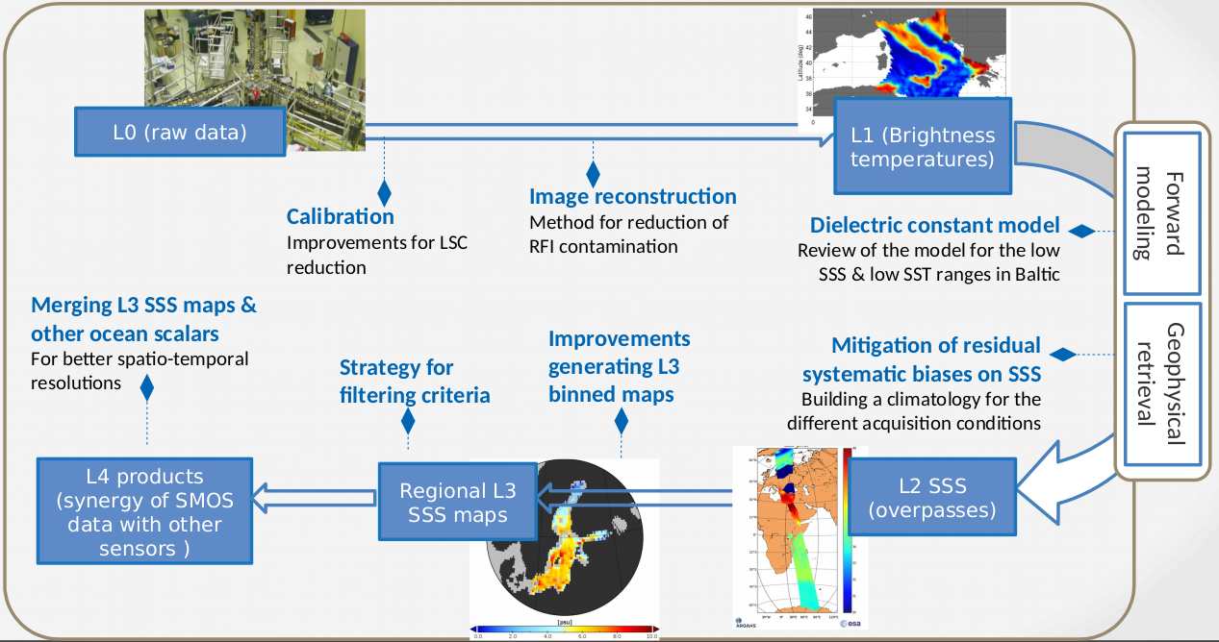
Exploratory research from L0 to L4

Slide 11
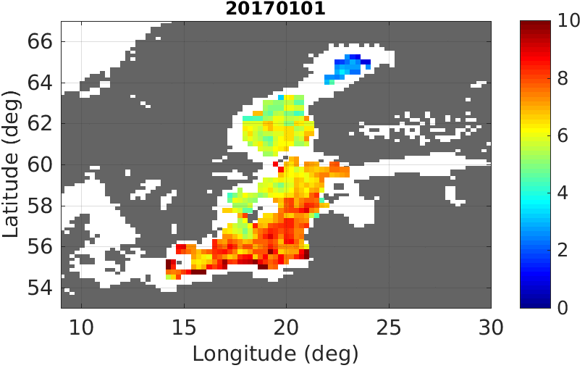
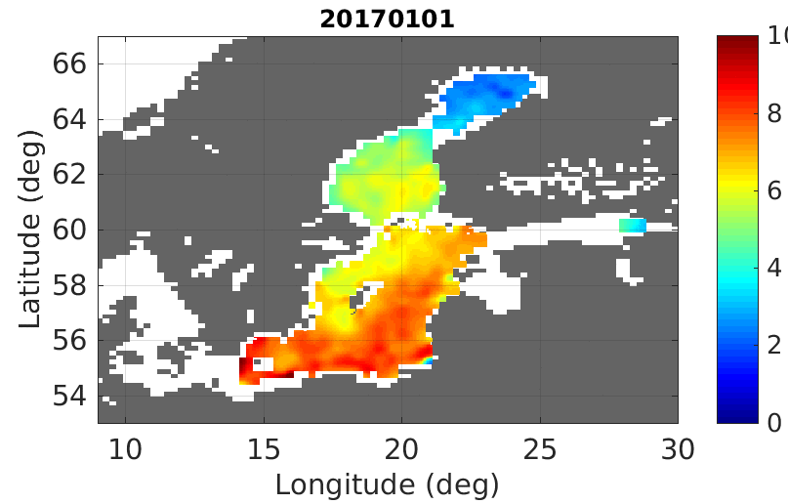
Baltic+ L3 and L4 SSS products
Baltic+ L3 SSS
Baltic+ L4 SSS

Slide 12
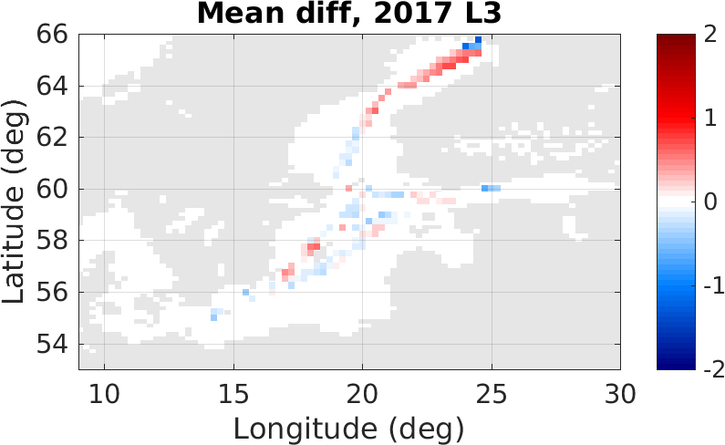
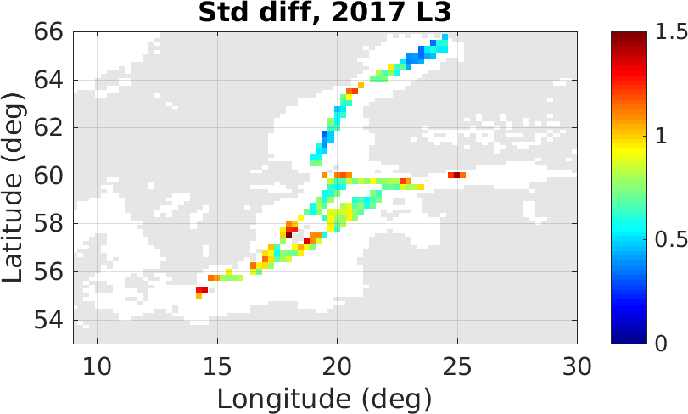
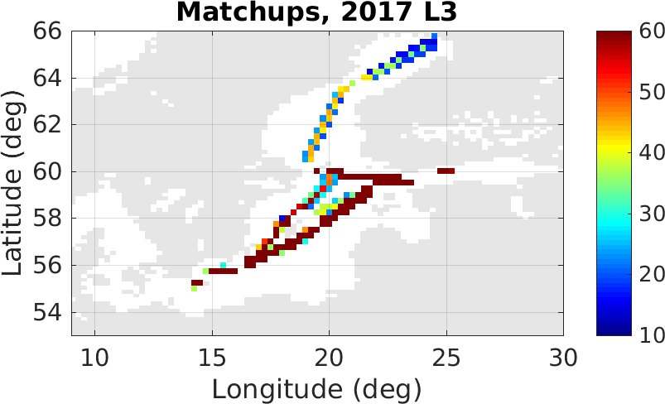
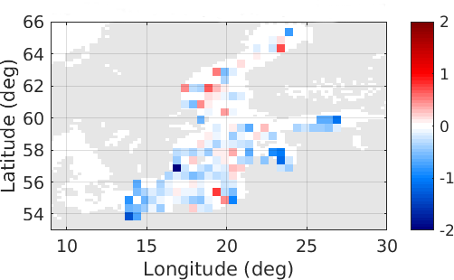
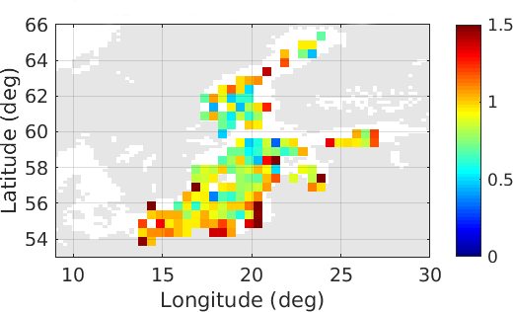
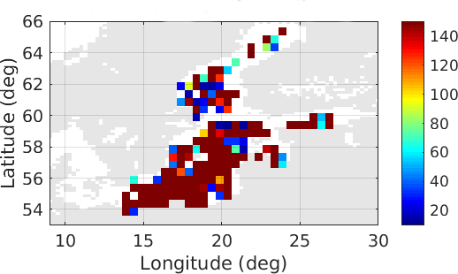
Quality assessment of Baltic+ L3 SSS
Ferrybox lines (stats per year, 0.25 deg. grid)
Mode: -0.15
Mode: 0.7
SeaDataNet (stats 9 years, 0.5 deg. grid)
Mode: -0.15
Mode: 0.9
Higher mean biases, reduced std, improved R in warm season than cold season.
Higher standard deviation values are located in cells closer to coast/ice edges, Arkona and Bornholm basins.

Slide 13

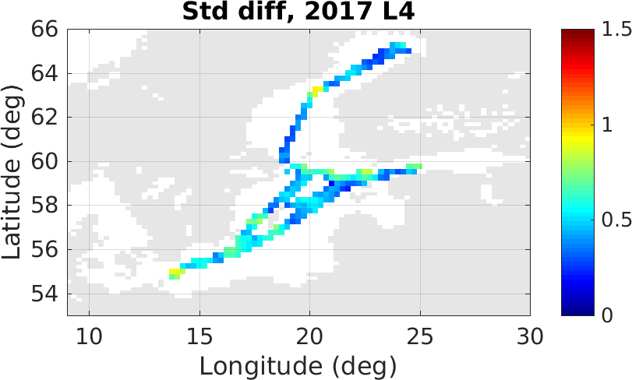
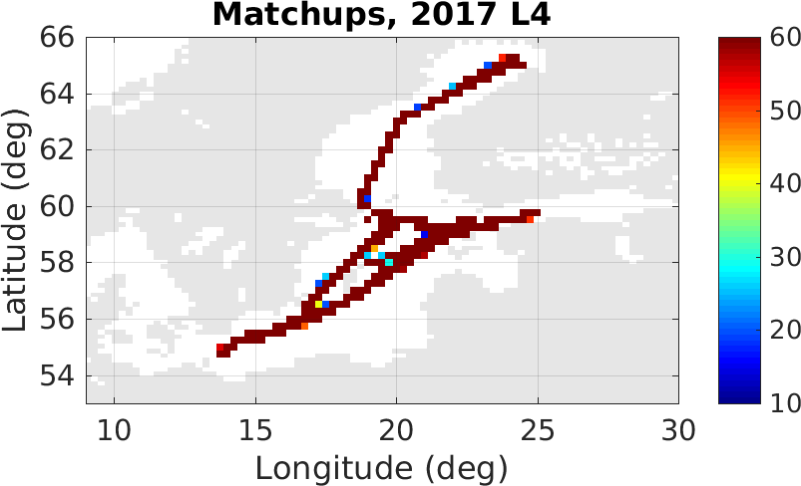
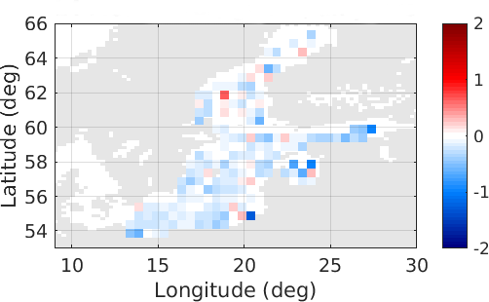
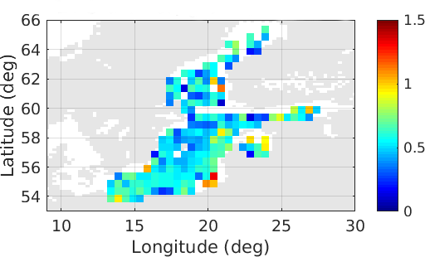
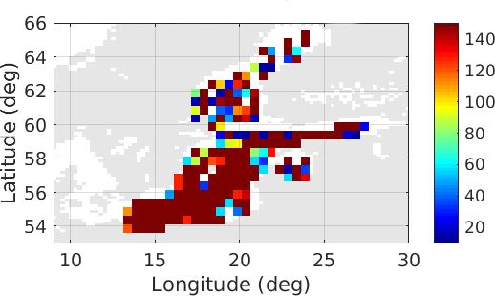
Quality assessment of Baltic+ L4 SSS product
Ferrybox lines (stats per year, 0.25 deg. grid)
Mode: -0.25
Mode: 0.38
SeaDataNet (stats 9 years, 0.5 deg. grid)
Mode: -0.25
Mode: 0.47
Standard deviations are very significantly reduced in all the basin with respect to the L3 product.
Similar biases in both L3 and L4 products (as expected).

Slide 14
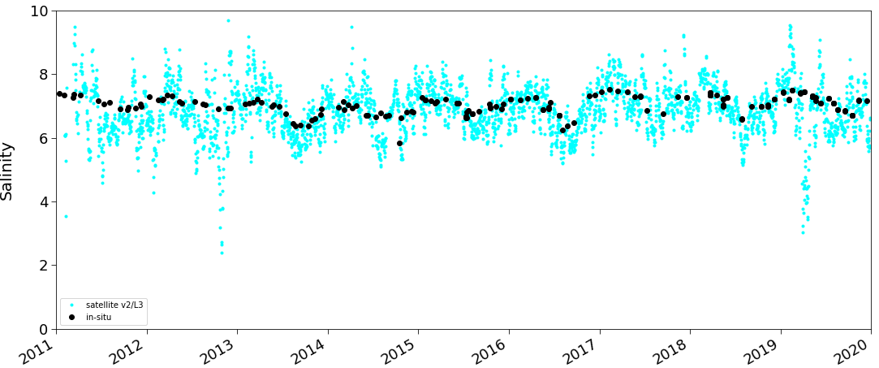
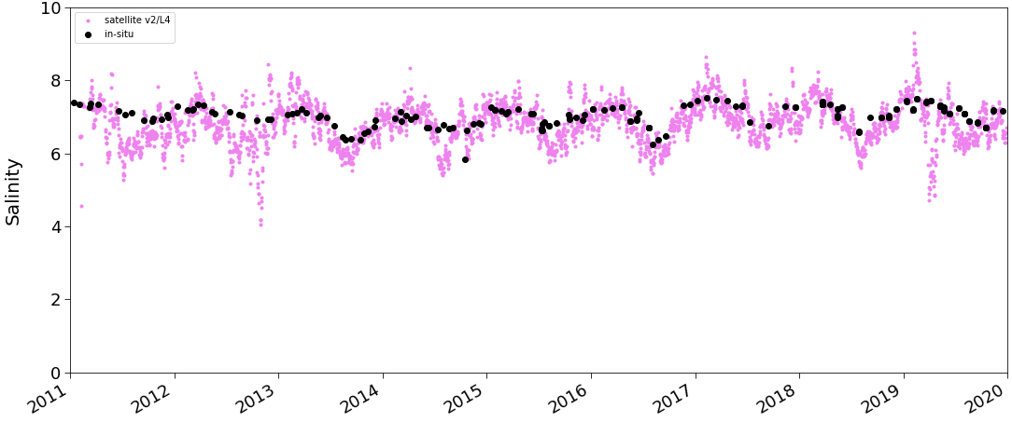
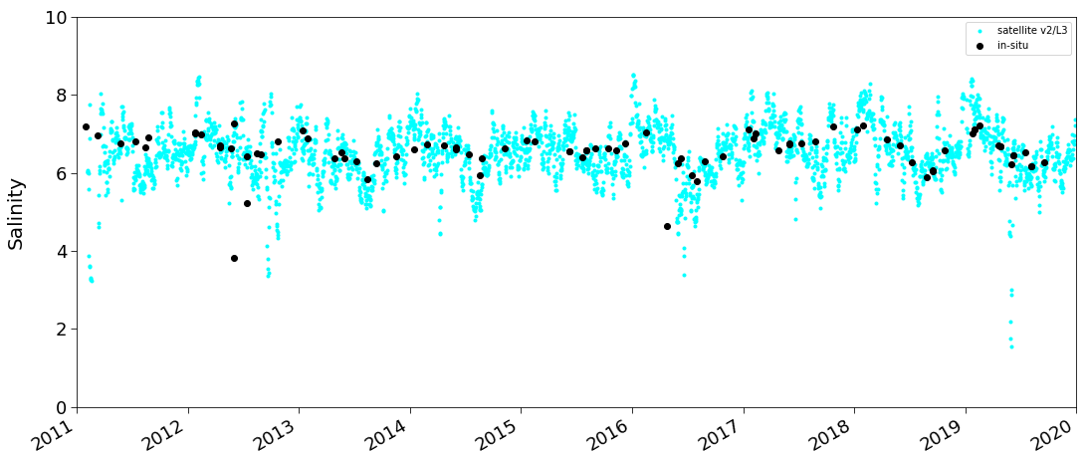
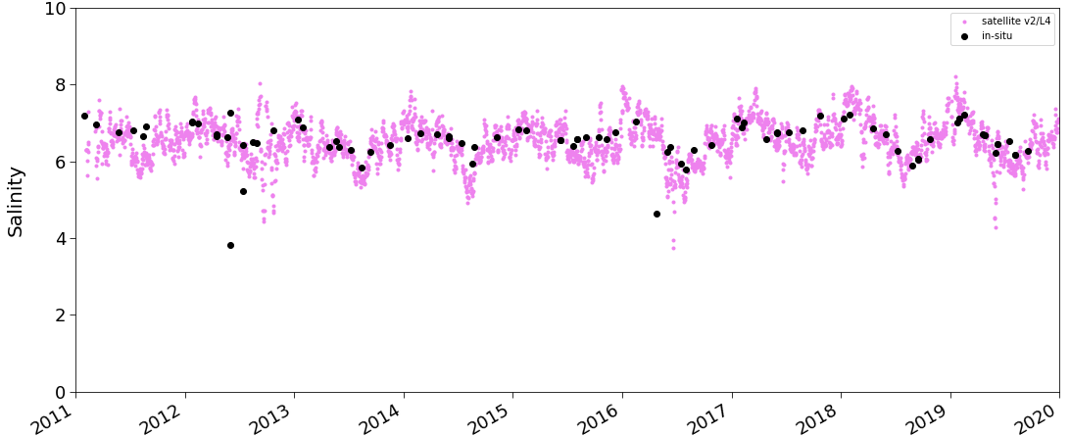
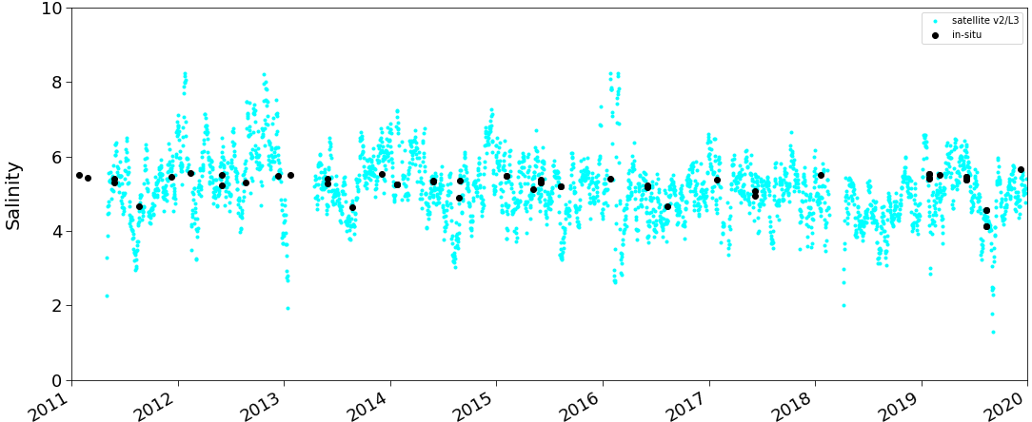
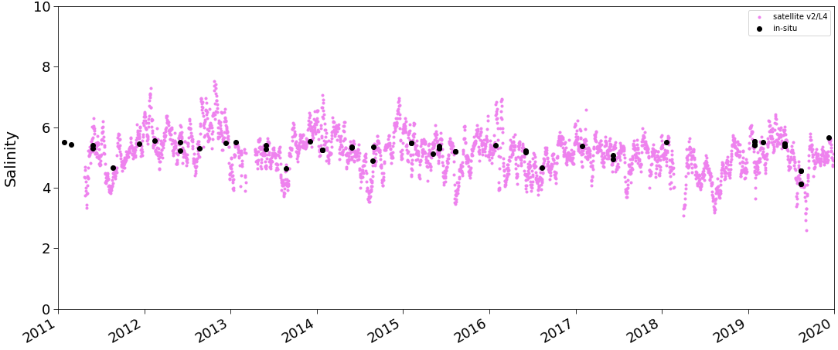
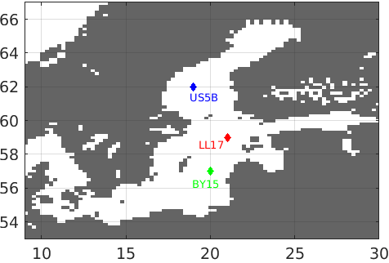
Baltic+ L3 and L4 SSS: Time-series vs in situ
BY15
BY15
LL17
LL17
BY15
US5B
US5B
US5B
insitu
L3
L3
L4
Ininsitu
L4
In situ
In situ

Slide 15
Baltic+ Salinity Dynamics: Outlook
Baltic+ L3 and L4 SSS products are available for the users under request
(contact: baltic@icm.csic.es).
Baltic+ SSS products are currently the best satellite-derived SSS between the available products, highlighting the improved spatial coverage and oceanographic resolution.
Errors in L3 SSS product are typically around 0.7-0.8 psu. The L4 product has an improved spatio-temporal resolution (daily, 0.05 deg.) wrt L3. Erros in L4 SSS product are typically around 0.4 psu.
L3 and L4 products show good performance in the detection of gradients and a good coherence in structures.
At this moment, the close collaboration with user communities will be very helpful for identifying added-values/limitations of the products with the objective of potential exploitation of Baltic+ SSS products by the communities involved in the study of Baltic processes.

Slide 16
First regional SMOS Sea Surface Salinity products over the Baltic Sea:
Quality assessment and oceanographic added-value
You can contact us at:
baltic@icm.csic.es
vgonzalez@icm.csic.es
Notes:
1
1

