Slide 1


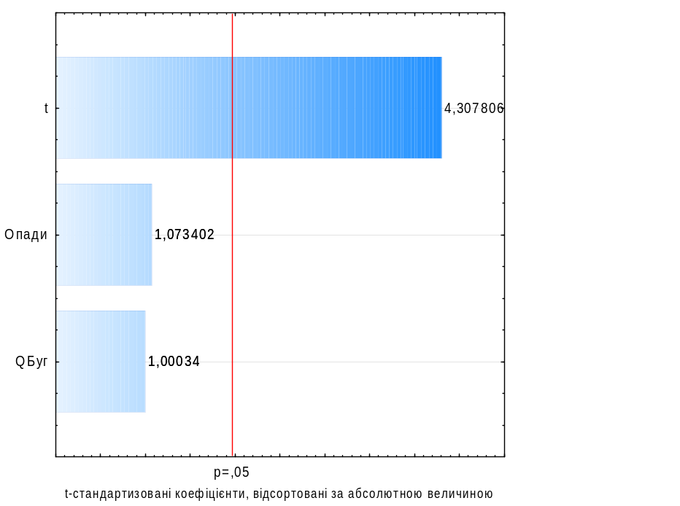
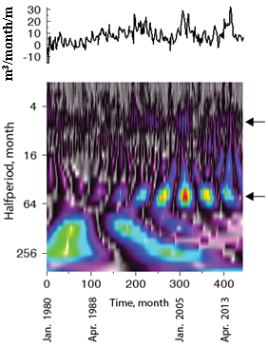
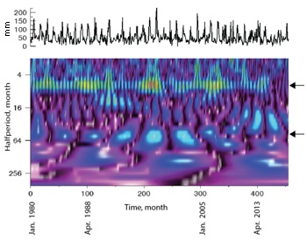
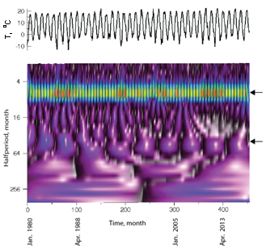
Formation features of river ungerground runoff under global warming conditions
Volodymyr Osadchyi, Oleksiy Shevchenko and Anastasia Krasovs’ka
Ukrainian Hydrometeorological Institute, Kyiv, Ukraine (shevch62@gmail.com)
Introduction
Results
Results
For the last 40 years, the temperature in the Forest-Steppe zone of Ukraine is steadily rising with an average intensity of 0.45-0.55 ^{о}С/10 years. Groundwater table (GWT) and sometimes interlayer water table have dropped significantly. This raises the question of whether the decline in GWT for the last 6-8 years is reversible or the changes in GWT regimes are more drastic and irreversible.
Objective
The work aims to identify patterns in seasonal and perennial changes in the components of groundwater supply, their runoff to rivers, as well as the degree of these changes dependence on temperature fluctuations and accumulated precipitation. To accomplish this purpose, we compare the changes in the groundwater infiltration supply in two sites with long-term average annual levels of 1.0-2.5 m and 3.0-4.5 m amid joint changes in temperature, precipitation, and river runoff.
Object
The Southern Bug river basin with an area of 63 700 km² was selected for research. The Southern Bug flows the Black sea and noticeably suffers from global warming.
Among other analyzed factors, the air temperature has the greatest influence on the amount of groundwater flow during the entire observation period. Herewith, the influence of temperature in 1980-1998 was less notable than in the second stage (Fig. 2). However, the increase in the long-term average annual winter temperature by 1.2 ^{о}С from 1988 to 1998 (Fig. 3d) led to an increase in groundwater infiltration supply (Fig. 3a) due to winter thaws and an increase in groundwater flow (Fig. 3b).
According to the ratio of seasonal groundwater flow (Fig. 8) and runoff from different sites, there are three stages: (1) 1980-1989 (1990) - the groundwater flow in both sites is characterized by minimal winter and autumn values, moderate summer values, and dominating spring values; the relative groundwater flow in site 2 with high GWT prevails; (2) 1990-1998 - groundwater flow in the site with low GWT continues increasing and prevailing, while groundwater flow in the site with high GWT (1.0-2.5 m) decreases to a long-term minimum; (3) 1999-2014 - a slow growth with low-amplitude fluctuations of groundwater flow in the site with GWT = 1.0-2.5 m; 2015-2019 - high-amplitude fluctuations of groundwater flow and GWT reaching long-term maxima in the site with GWT = 2.7-4.0 m and reduction of GWT and groundwater discharge.
Fig.1. Chronological graphs of the Specific groundwater yield to the Southern Bug river, m³/month/m (Khmilnyk -Vinnitsa region): 1 – GWT = 1,0-2,5; 2 – GWT = 3,0-4,5 m
Fig. 2. Diagram of values of standardized weights, sorted by absolute value, which reveals the dependence of groundwater flow on temperature, average monthly river discharge and monthly precipitation for the period: а-1980-1989; b - 1999-2016. Red vertical line - limit of significant coefficients (factors).
At the stage of 1999-2017, the weight coefficient of temperature influence on groundwater flow increased significantly, while the weight coefficient of the surface runoff (after the high-water season in the river) and precipitation influence fell drastically (Fig. 2b).
Fig. 8. Chronological graphs of seasonal changes in groundwater flow from 1980 to 2017 in the site with GWT = 1.0-2.5 m (a) and site with GWT = 2.5-4.5 m in Khmilnyk city: 1 - winter; 2 - spring; 3 - summer; 4 - autumn.
T
Since 1997, winter groundwater flow has mostly prevailed over spring one (12 of 21 years) (Fig. 9). Precipitation of the spring season is the main source for the formation of summer groundwater flow. In turn, the summer groundwater flow makes up one third of the total annual groundwater runoff into the river. With GWT = 3.0-4.0 m, summer groundwater flow was almost always significantly higher than autumn one. However, they have converged since 2009. Furthermore, autumn groundwater flow sometimes overrides summer one due to an increase of infiltration supply in autumn and its decrease in summer (Fig. 10).
Khmilnyk
a
b
c
d
Fig.3. Average annual values ​​per stage for GWT = 3.0-4.5 m (a,b,c) and comparison of groundwater flow to the river with precipitation (P) and t °C for the winter season (d).
The strengthening of the influence of temperature in the second stage (Fig. 2b) is expressed in both the periodic promotion of groundwater supply and its unloading. The effect of warming is not only direct - due to snow melting and evaporation, but also indirect - due to a decrease in accumulated precipitation (Fig. 3c), lowering the water levels in rivers and an increase in gradients of filtration flux, and an increase in the porosity of the dry soil. Therefore, the negative effect of temperature rise did not extend to GWT for a long time. Groundwater flow and river runoff have been changing in opposite directions until 2014 (Fig. 3b, 4), as the regime-forming factors (temperature and precipitation) affect them differently (Fig. 3b, 3c, 4): an increase in temperature during the cold season leads to an increase in groundwater flow and decrease in river runoff during winter and spring. It is obvious that the groundwater flow increases due to partial interception of the surface runoff, particularly thawed spring runoff. The decrease in precipitation and the sharper rise in temperature and evaporation after 1998 led to a decrease in groundwater infiltration supply (Fig. 3a). As a result, the general groundwater flow trend began decreasing (Fig. 3b). The role of groundwater flow in the formation of river runoff gradually increased, and their trends took the same direction (Fig. 3b).
Methods
As the main method for determining the groundwater flow to the river, we used the hydrodynamic method to analyze the underground and surface water regime according to stationary observations. To test the working hypothesis and determine the degree of connection between the GWT regime and climate change, we compared the cycles in the regime of groundwater levels and flows with the cycles of temperature and precipitation. As one of the perfect modern statistical methods, Wavelet analysis was chosen to identify the cyclicity in the data series of long-term observations of GWT and regime-forming factors (Grossmann & Morlet 1984). The method of Fourier transforms was used to compare and verify the results, and multiple correlation analysis was used to rank the degree of factors’ influence.
Fig. 9. The ratio of winter (1) and spring (2) groundwater flows with the corresponding logarithmic trends
Fig. 4. Multi-year dynamics of river runoff (the Southern Bug, stream gauge station Lelitka), annual accumulated precipitation, and average temperature from 1976 to 2017.
Fig. 10. Changes in seasonal infiltration groundwater supply (GWT = 3.0-4.5 m) by stages
The greatest impact of the temperature, among other factors, on groundwater flow (Fig. 2) is supplemented by the closest relationship of their cycles - about 8.0 years (Fig. 5-7), and since 1997 temperature and groundwater flow have been fully synchronized. In the Southern Bug runoff regime, which responds more quickly to changes in precipitation (Fig. 4), there are 11-year cycles traced back to 2004 and 5-year & 6-year cycles from 2008. At the same time, we observe 5-year & 6-year cycles for GWT of shallow (1.5-2.0 m) groundwater. 5-6-year cyclicity coincides with long low-water seasons and 7-8-year cyclicity - with high- and medium-water seasons. We track a 5-6-year cyclicity for groundwater infiltration supply with GWT = 3-4 m since 1997.
Conclusion
For the upper part of the catchment area of ​​the Southern Bug, we identified patterns of formation of groundwater flow into the river, which reflect the long-term growing impact of climate changes. Using two different methods, we proved a dominant influence of temperature on the amount of groundwater flow over other regime-forming factors. Since 1997, the cycles of temperature, infiltration supply, and groundwater flow have fully synchronized. After 1989, the temperature fluctuations include 10- and 11-year cycles, as well as non-typical 8-year cycles that correlate with solar cyclicity (11 and 5-6 years). It may be a signal of distinguishing the temperature as an independent factor that does not closely depend on solar activity but has an additional factor influencing it.
Infiltration supply is the main source of groundwater flow to rivers (correlation coefficient between them is 0.7-0.77). Over the last 30 years, winter infiltration groundwater supply at 3-4 m depths typical for the Forest-Steppe zone of Ukraine has gradually increased from negative values (1990-1998) to 32 mm on average in 2015-2017. Due to the "loss" of moisture in winter, low precipitation in spring (19 mm below normal), and an increase in temperature by 2.1 ^{о}С, spring season infiltration supply in 2015-2017 for the first time became negative. A reduction of summer groundwater flow is the main threat to groundwater and surface water resources. An unprecedented decrease in infiltration supply in the summer of 2015-2017 (to -61.5 mm) was not only due to a decrease in precipitation (153 mm below normal) but also a lack of moisture in the spring. As a result, the GWT values in 2015-2019 were abnormally low in the larger part of the basin, except for the riparian zones within the Ukrainian fissure water body, where there was an inversion supply of groundwater by confined water. In 1999-2014, groundwater infiltration supply at 3.5 m depth decreased by 66% compared to 1990-1998, while groundwater flow decreased only by 3% that is associated with unloading of confined fissure water in the soil.
Discussion of results
The analysis of the features of the groundwater flow to the Southern Bug River in Khmilnyk city includes two sites: the island area with flat relief and GWT = 1.0-2.5 m (site 1) and the left bank of the catchment with a slope towards the river and GWT = 2.7-4.5 m (site 2). Based on this analysis, we distinguish two major stages: (1) 1980-1998 - reduction of the groundwater flow in site 1 and its predominant growth in site 2 (Fig.1); (2) 1999-2017 - stabilization and a slight increase in groundwater flow in site 1 and high-amplitude fluctuations in groundwater flow with maxima in site 2. For both stages, we performed a multiple correlation analysis to find the dominant factors influencing the groundwater regime.
Fig. 5. Wavelet-periodogram, based on the results of the calculated data (1980-2016) of the underground runoff (m³/month/m) to the Southern Bug River. Distance between spots corresponds to a half of the cycle.
Fig. 6. Wavelet-periodogram of long-term (1980-2016) observations of precipitation (monthly amount, mm) at the Khmilnyk weather station.
Fig. 7. Wavelet -periodogram of long-term (1980-2016) observations of temperature cyclicity (monthly amount) at the Khmilnyk city.

