Slide 1





Impact of irrigation and soil compaction on salinization of soils in semiarid agricultural lands
Sina Maghami Nick¹, Seyedmehdi Emadian¹, Selen Deviren Saygın², Muhittin Onur Akça², Burak Demirel¹, Hasan Sabri Öztürk², Majid Sedighi⁴, Masoud Babaei³, and Nadim K. Copty¹
¹Environmental Sciences, Bogazici University, Istanbul, Turkey (sina.maghami@boun.edu.tr)
²Soil Science and Plant Nutrition, Ankara University, Ankara, Turkey
³Mechanical, Aerospace & Civil Engineering, The University of Manchester, Manchester, United Kingdom
⁴Chemical Engineering & Analytical Science, The University of Manchester, Manchester, United Kingdom
This work was supported by the Scientific and Technological Research Council of Turkey [Project number: TUBİTAK-118Y343] and British Council [Project number: 414693137]

Slide 2
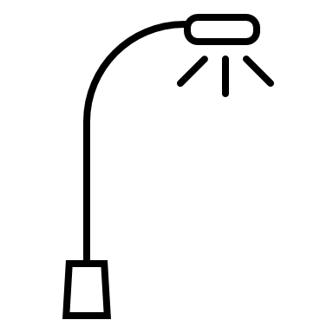
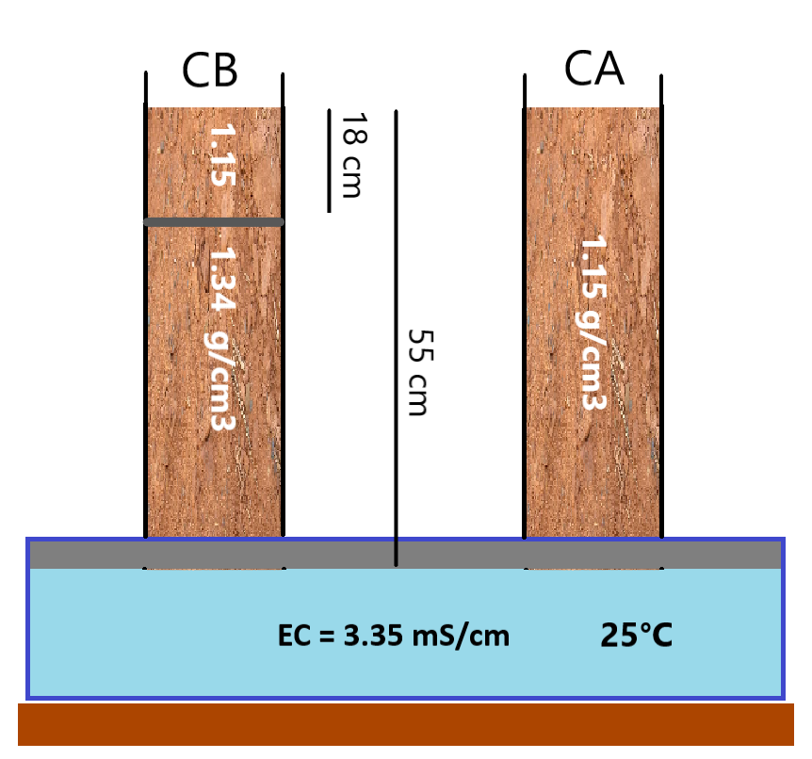
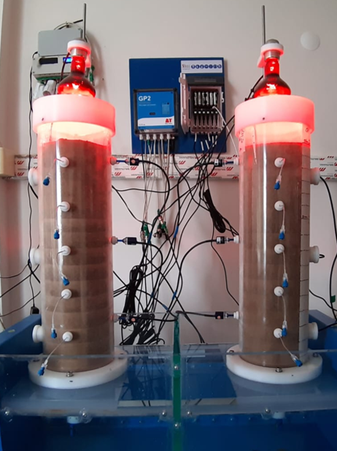
Columns
Constant 30°C at surface controlled
by infrared lamps

Slide 3
Experiments
Experiment A
Saline flood irrigation
Experiment B
Experiment C
Fresh water (DI) flood irrigation
Experiment D
Fresh water (DI) drip irrigation
Saline drip irrigation
Experiment E
Fresh water (DI) flood irrigation with free drainage

Slide 4
Flood irrigation cycles
1 litre of water (~5cm head) applied in one-go to the surface of the columns
Each phase consisted of 4-5 irrigations performed in 3-4 day gaps
Light was off during the irrigation
Soil water was extracted at 5 different heights before and after the irrigation
For the saline water phase, the water composition was same as the tank

Slide 5
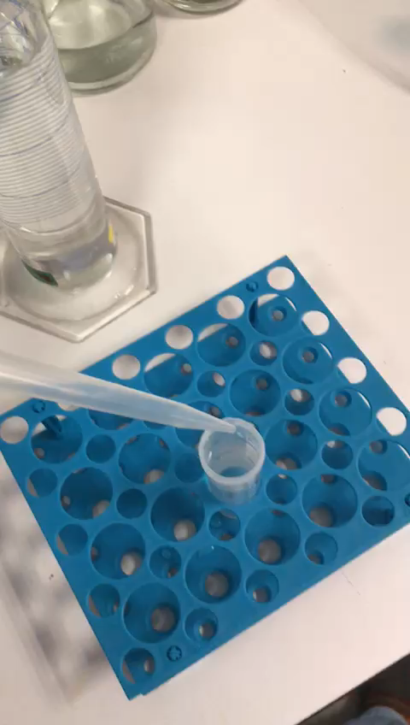
Drip irrigation cycles
250 ml of water (~1.25 cm head) is applied over 50 minutes ( 5 ml/min)
It was done for 4 consecutive days.
3 days rest
Soil water was extracted at 5 different heights before and after each 50 min cycle
For the saline water phase, the water composition was same as the tank

