Slide 1



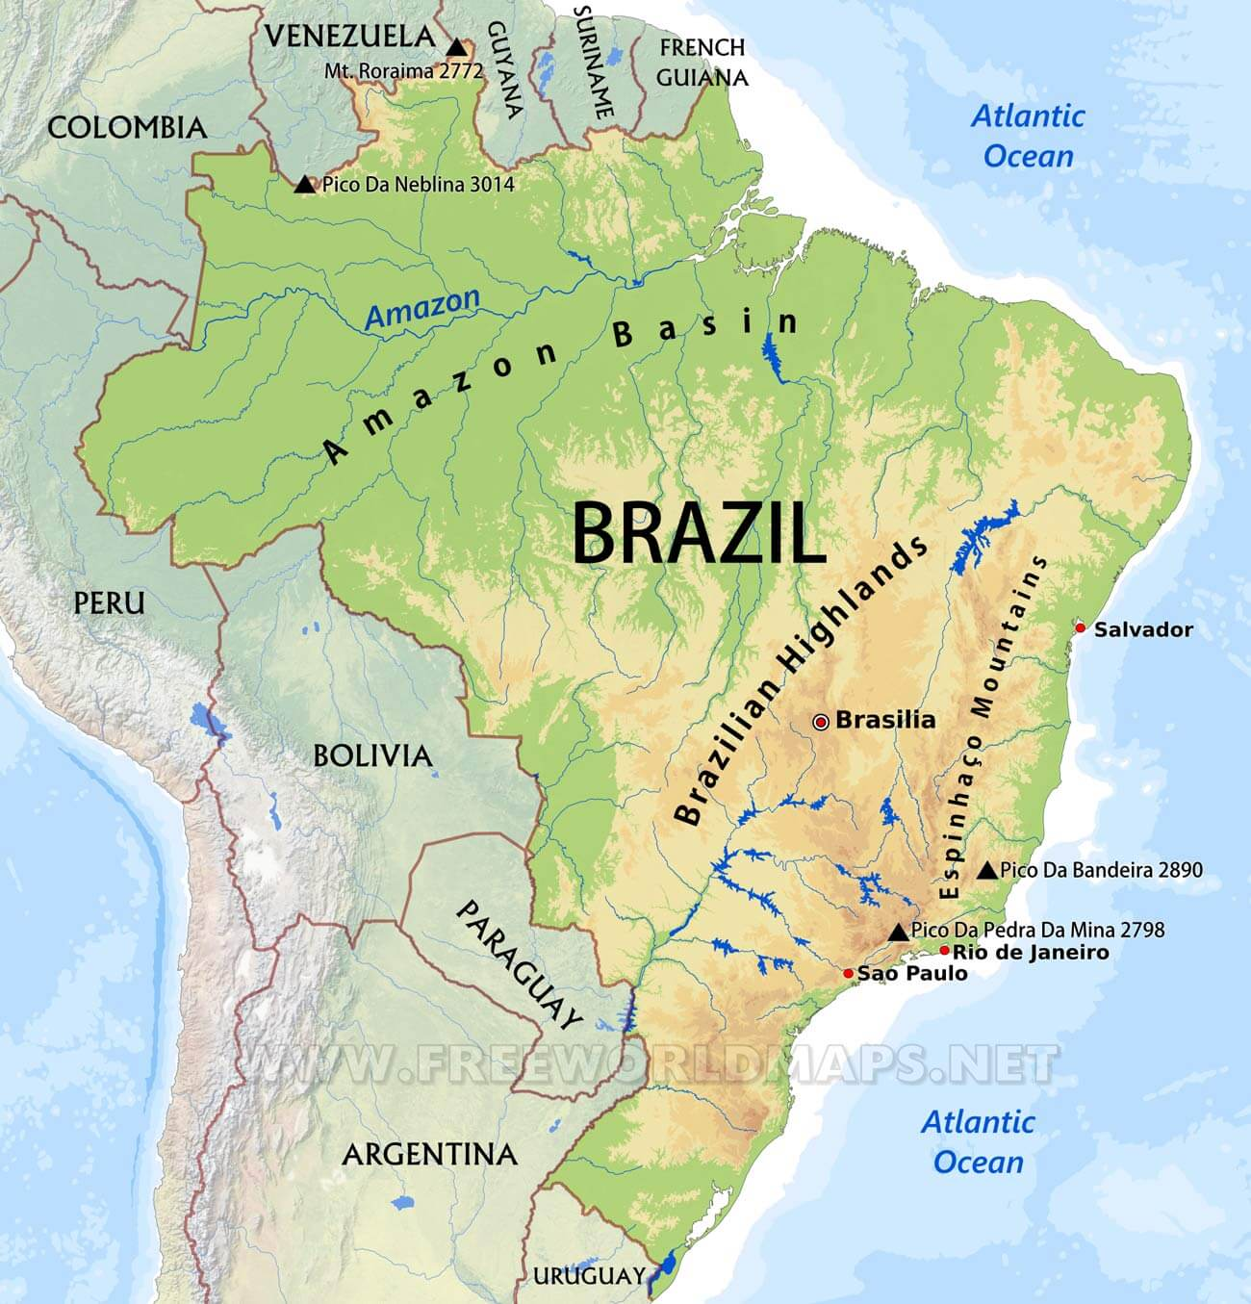
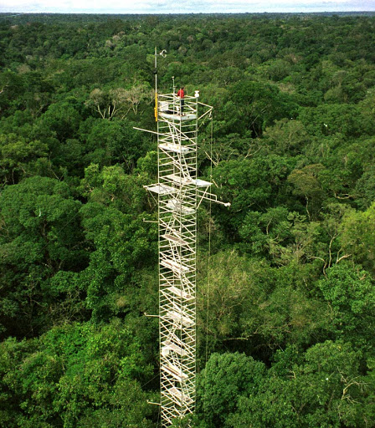


Evaluation of high-resolution meteorological global data products using flux tower observations across Brazil
Jamie Brown¹, Rafael Rosolem¹, Ross Woods¹, Humberto Rocha², and Debora Roberti³
¹University of Bristol, UK, ²Universidade de Sao Paulo, Brazil, ³Universidade Federal de Santa Maria, Brazil

Slide 2

Research Questions
What are the dominant sources of error?
How do these errors vary by location and time of year?
Which product is best for each variable?
Which product is best overall?

Slide 3
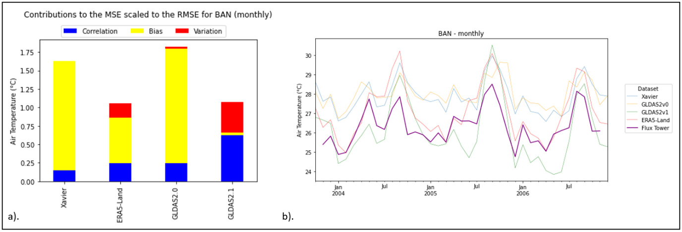
The Dominant Sources of Error
Contribution to MSE
Daily | Monthly
Correlation | Bias
Variation
Systematic Bias
Correlation

Slide 4
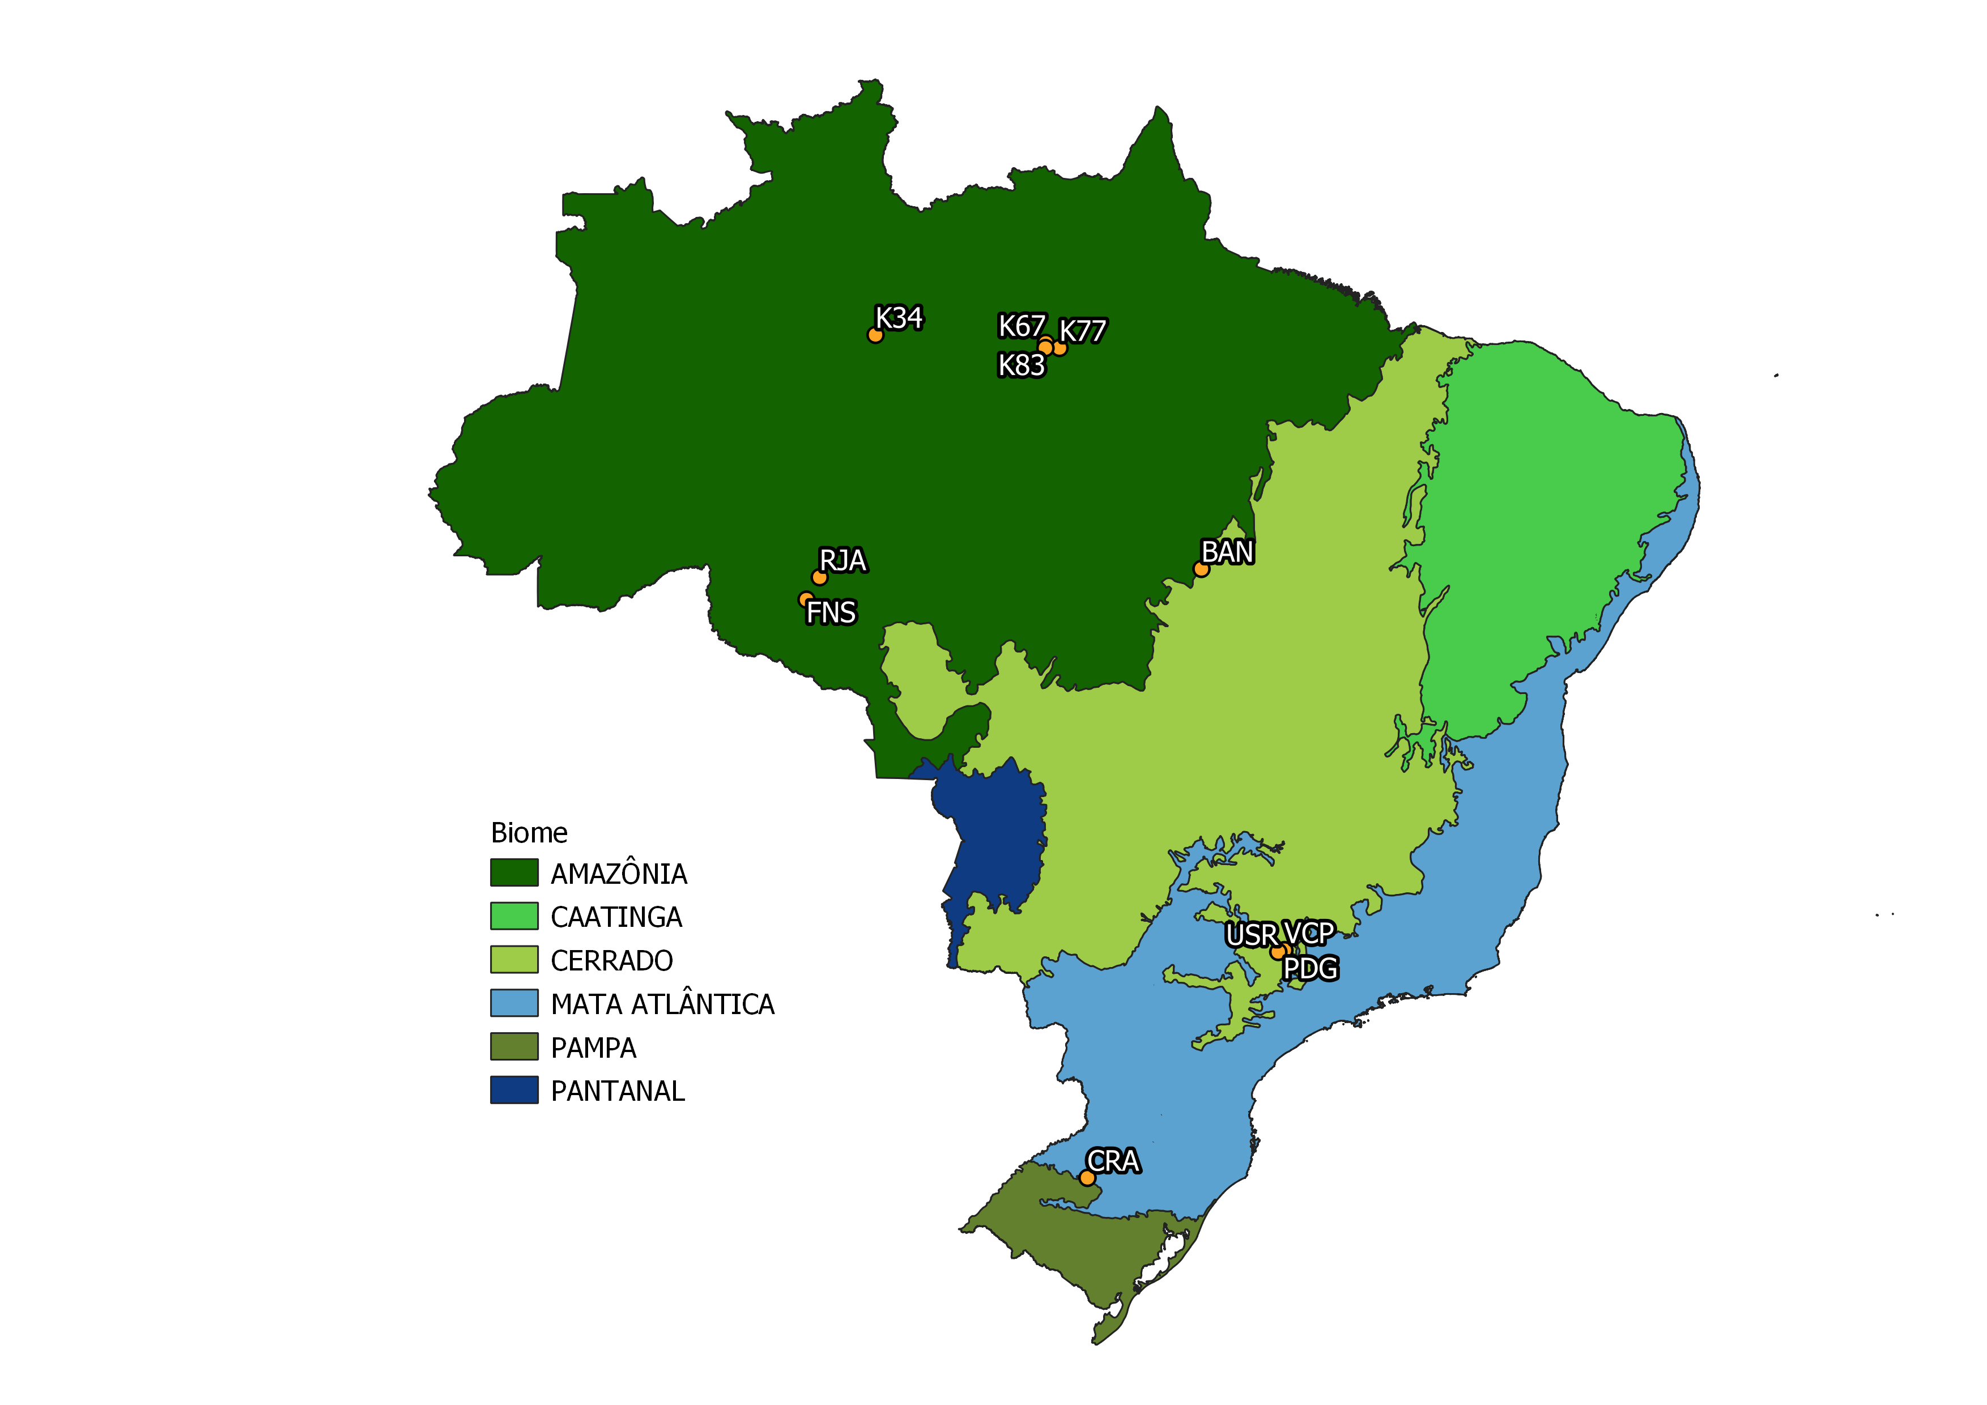
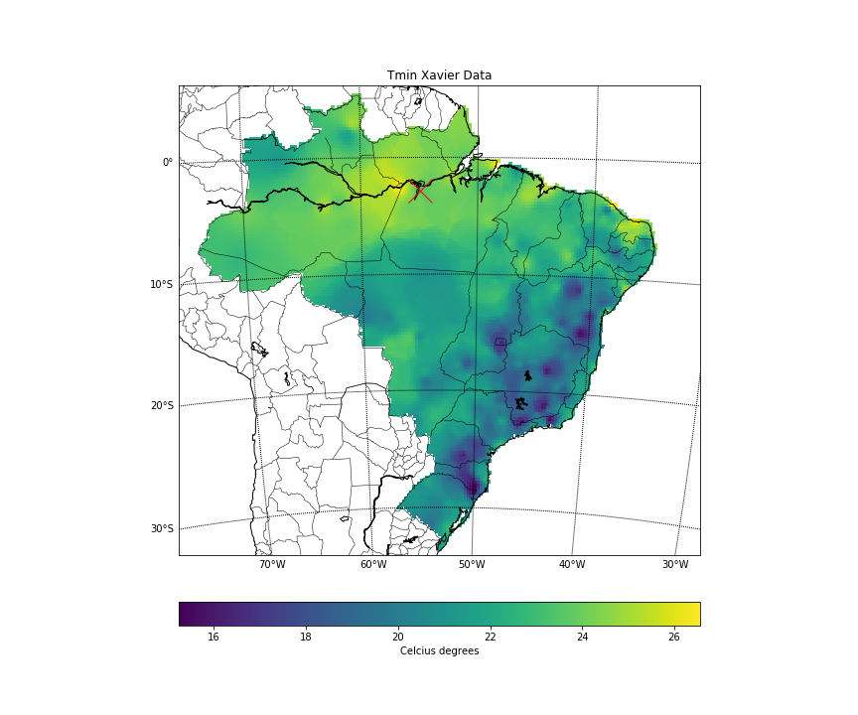
The Impact of Location and Season on Error

Slide 5
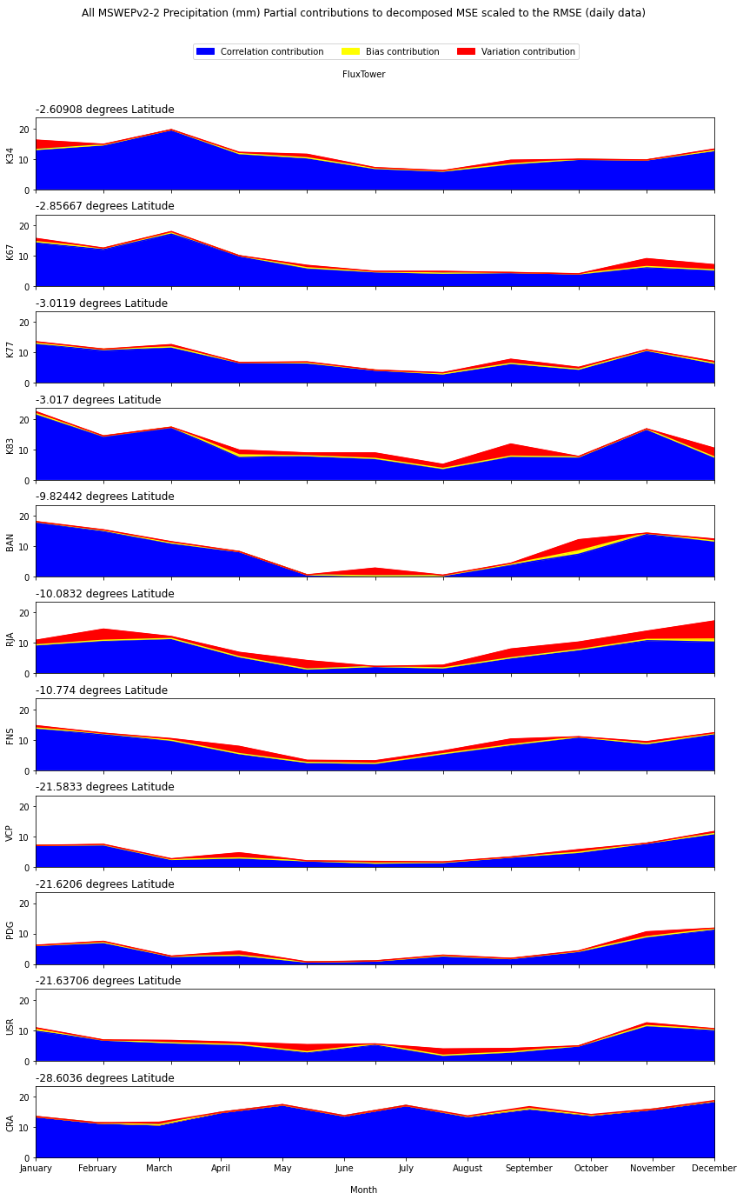
The Impact of Location and Season on Error

Slide 6







Best Product for each variable
 |  | Daily | Monthly
Precipitation |  | MSWEPv2.2 | Xavier
Air Temperature |  | ERA5-Land | ERA5-Land
Specific Humidity |  | ERA5-Land | ERA5-Land
Air Pressure |  | ERA5-Land | ERA5-Land
Shortwave Radiation |  | ERA5-Land | GLDAS2.0
Longwave Radiation |  | ERA5-Land | ERA5-Land
Wind Speed |  | ERA5-Land | Xavier

Slide 7
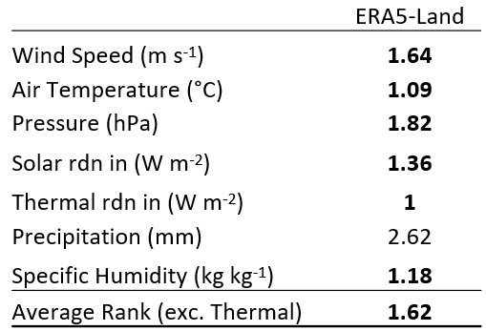
Best Overall Product
Daily
ERA5-Land

