Slide 1
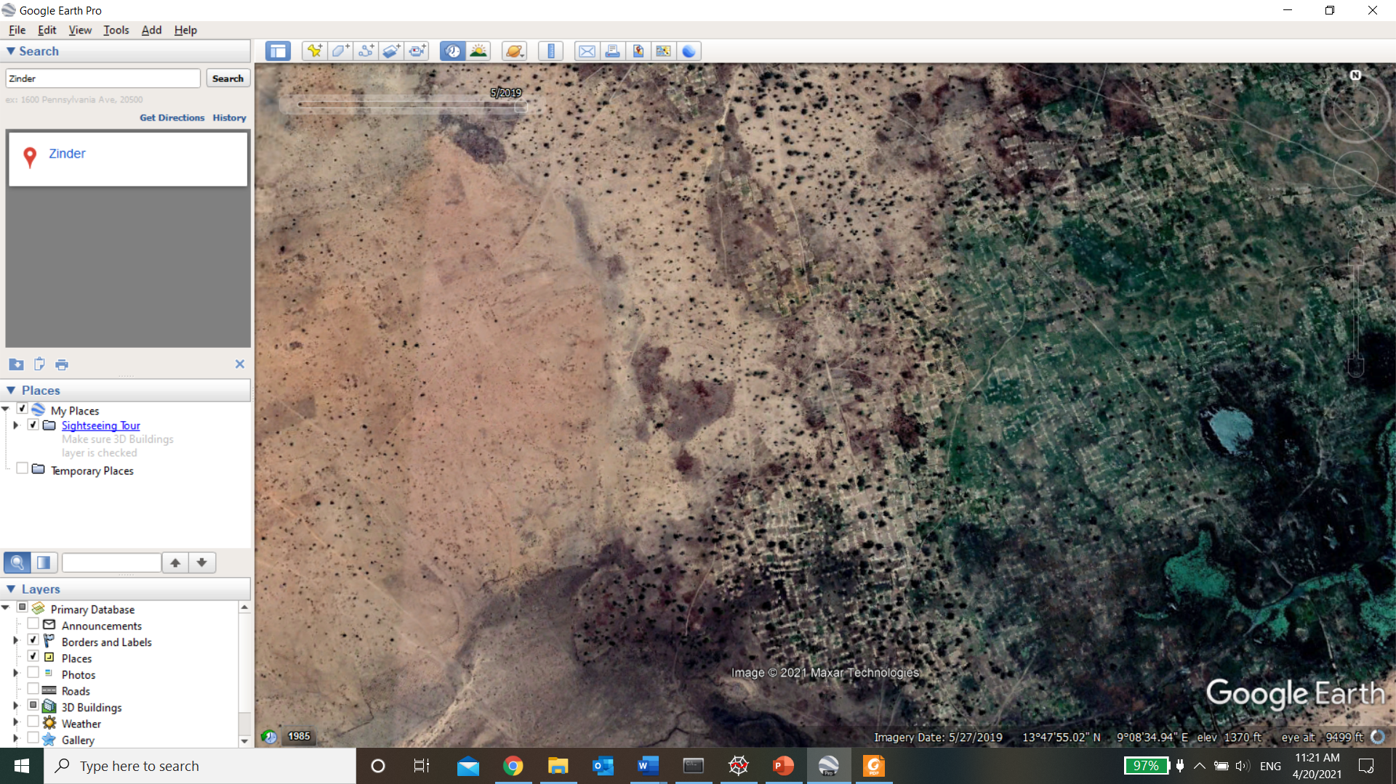
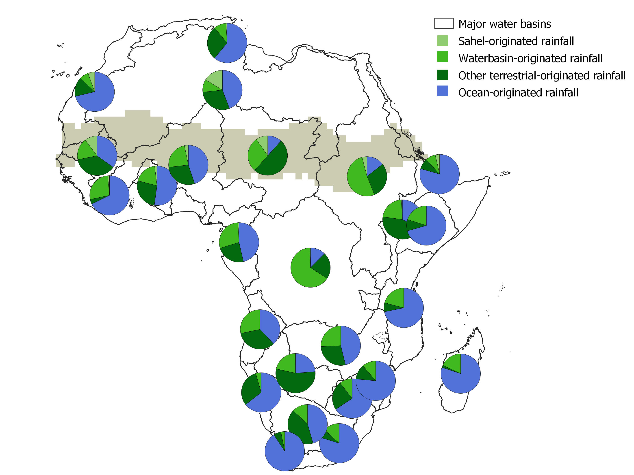
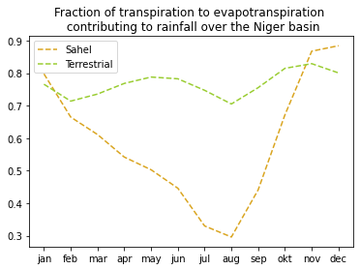
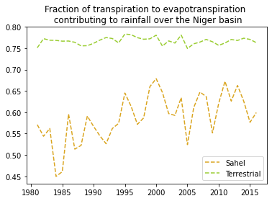
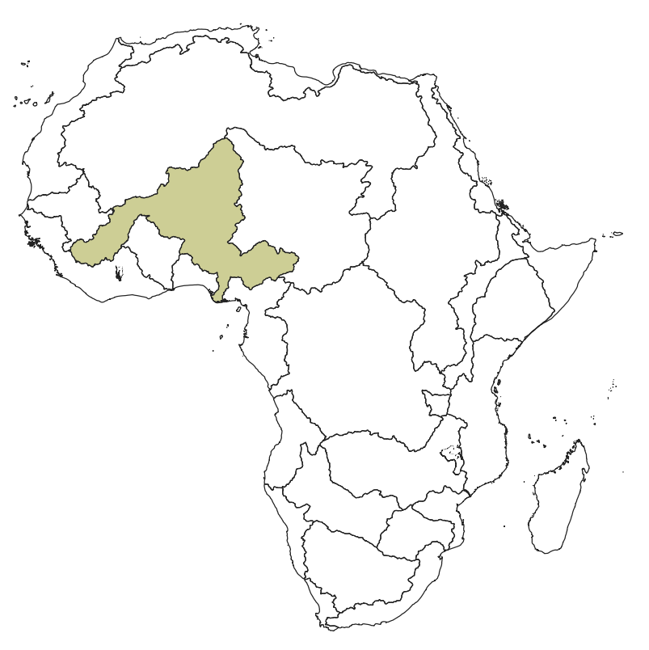
Contribution of the Sahel region to precipitation over the African continent
RESULTS
te Wierik, S.A.^{1.3,} Keune, J.^{2,} Miralles, D.G.^{2,} Cammeraat, L.H.^{1,} Artzy-Randrup, Y.A.¹ and Gupta, J.³
¹ Institute for Biodiversity and Ecosystem Dynamics, University of Amsterdam, Amsterdam
² Hydro-Climate Extremes Lab, Ghent University, Ghent, Belgium
³ Governance and Inclusive Development, University of Amsterdam, Amsterdam
vEGU 2021 - HS5.1.3 Impacts of land use and land cover changes on hydrological processes and water management - 26 April 2021
Contributions of different moisture sources over the African continent
Understand the magnitude and importance of moisture recycling in semi-arid regions
Evaluate the inter- and intra-annual role of vegetation for rainfall patterns
Rainfall over the Sahel:
23.9% of wet-season moisture recycling
54,7% of annual average P is vegetation regulated (transpiration)
METHODS & DATA
Atmospheric moisture tracking over Africa
Lagrangian moisture tracking model FLEXPART
  Driven by ECMWF reanalysis 1980-2016 (1°x1°)
  Bias-corrected precipitation (MSWEP) and evaporation (GLEAM & OAFLUX)
Output: monthly sources of rainfall for major African watersheds
Contribution of vegetation
GLEAM: monthly T/ET contribution to P
Fraction T/ET: Niger watershed

Slide 2
Contribution of the Sahel region to precipitation over the African continent
vEGU 2021 - HS5.1.3 Impacts of land use and land cover changes on hydrological processes and water management
26 April 2021
te Wierik, S.A.^{1.3,} Keune, J.^{2,} Miralles, D.G.^{2,} Cammeraat, L.H.^{1,} Artzy-Randrup, Y.A.¹ and Gupta, J.³
¹ Institute for Biodiversity and Ecosystem Dynamics, University of Amsterdam, Amsterdam
² Hydro-Climate Extremes Lab, Ghent University, Ghent, Belgium
³ Governance and Inclusive Development, University of Amsterdam, Amsterdam
Notes:
Abstract: Redistribution via atmospheric circulation of evaporated water from the land surface is an important Earth system process: globally, evaporation from the Earth surface contributes significantly to terrestrial rainfall, either locally or remotely. In wet, tropical regions (e.g. the Congo basin), moisture recycling is largely driven by transpiration and interception loss from the dense forest cover, and it plays a crucial role in preserving regional ecosystem functioning. However, for semi-arid and arid regions, the research on the extent and significance of evaporation for moisture recycling is limited. Here, we investigate the contribution of the Sahel region to precipitation in the African continent. Furthermore, we evaluate the importance of vegetation for precipitation by examining the fraction of transpiration and interception loss over the Sahel that contributes to precipitation, locally and downwind. Simulated atmospheric moisture flows — illustrating the flow of water from evaporation to precipitation — are derived using the Lagrangian model FLEXPART on a 1-degree resolution, driven by ECMWF reanalysis data over 1980–2016. Preliminary results show (1) the temporal variability in the contribution of the region to precipitation in African drylands, and (2) a significant contribution of local precipitation recycling. We conclude that the consideration of the naturally and anthropogenically-driven greening of the Sahel, as well as land use and land cover changes in the region, may have both local and far-reaching impacts via the transport of moisture through the atmosphere.
Image: Screenshot from Google Earth near Zinder, Niger (5/2019). 13°47’55 N, 09°08’34 E

Slide 3
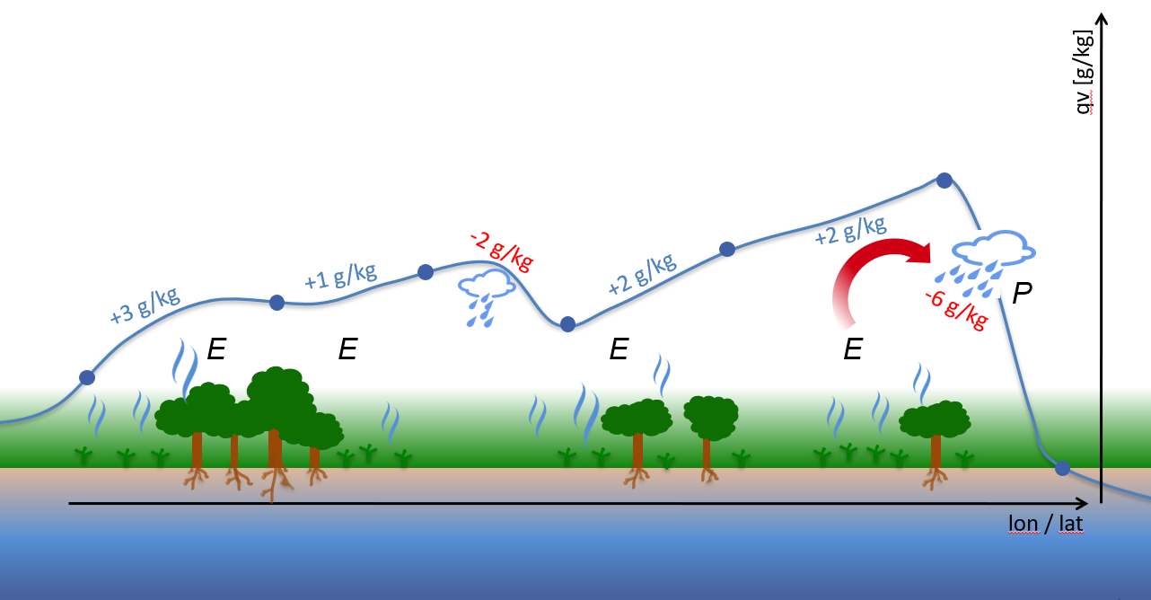
Methodology
Atmospheric moisture tracking over Africa
  Lagrangian moisture tracking model FLEXPART
    Driven by ECMWF reanalysis 1980-2016 (1°x1°)
    Bias-corrected precipitation (MSWEP) and evaporation (GLEAM & OAFLUX
  Output: monthly sources of rainfall for major African watersheds
Contribution of vegetation
  GLEAM: monthly T/ET contribution to P

Slide 4
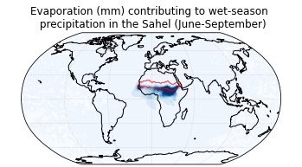
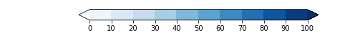
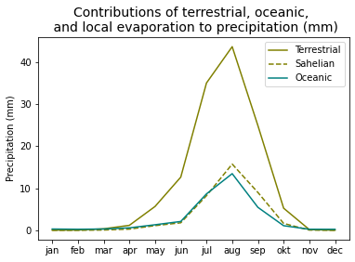
Origin of rainfall over the Sahel
Precipitationshed (wet-season)
Most of the precipitation in the wet-season originates from the terrestrial surface
Intra-annual contribution of different rainfall sources
Evaporation from Sahel during the wet-season = 23.9% of the total rainfall

Slide 5
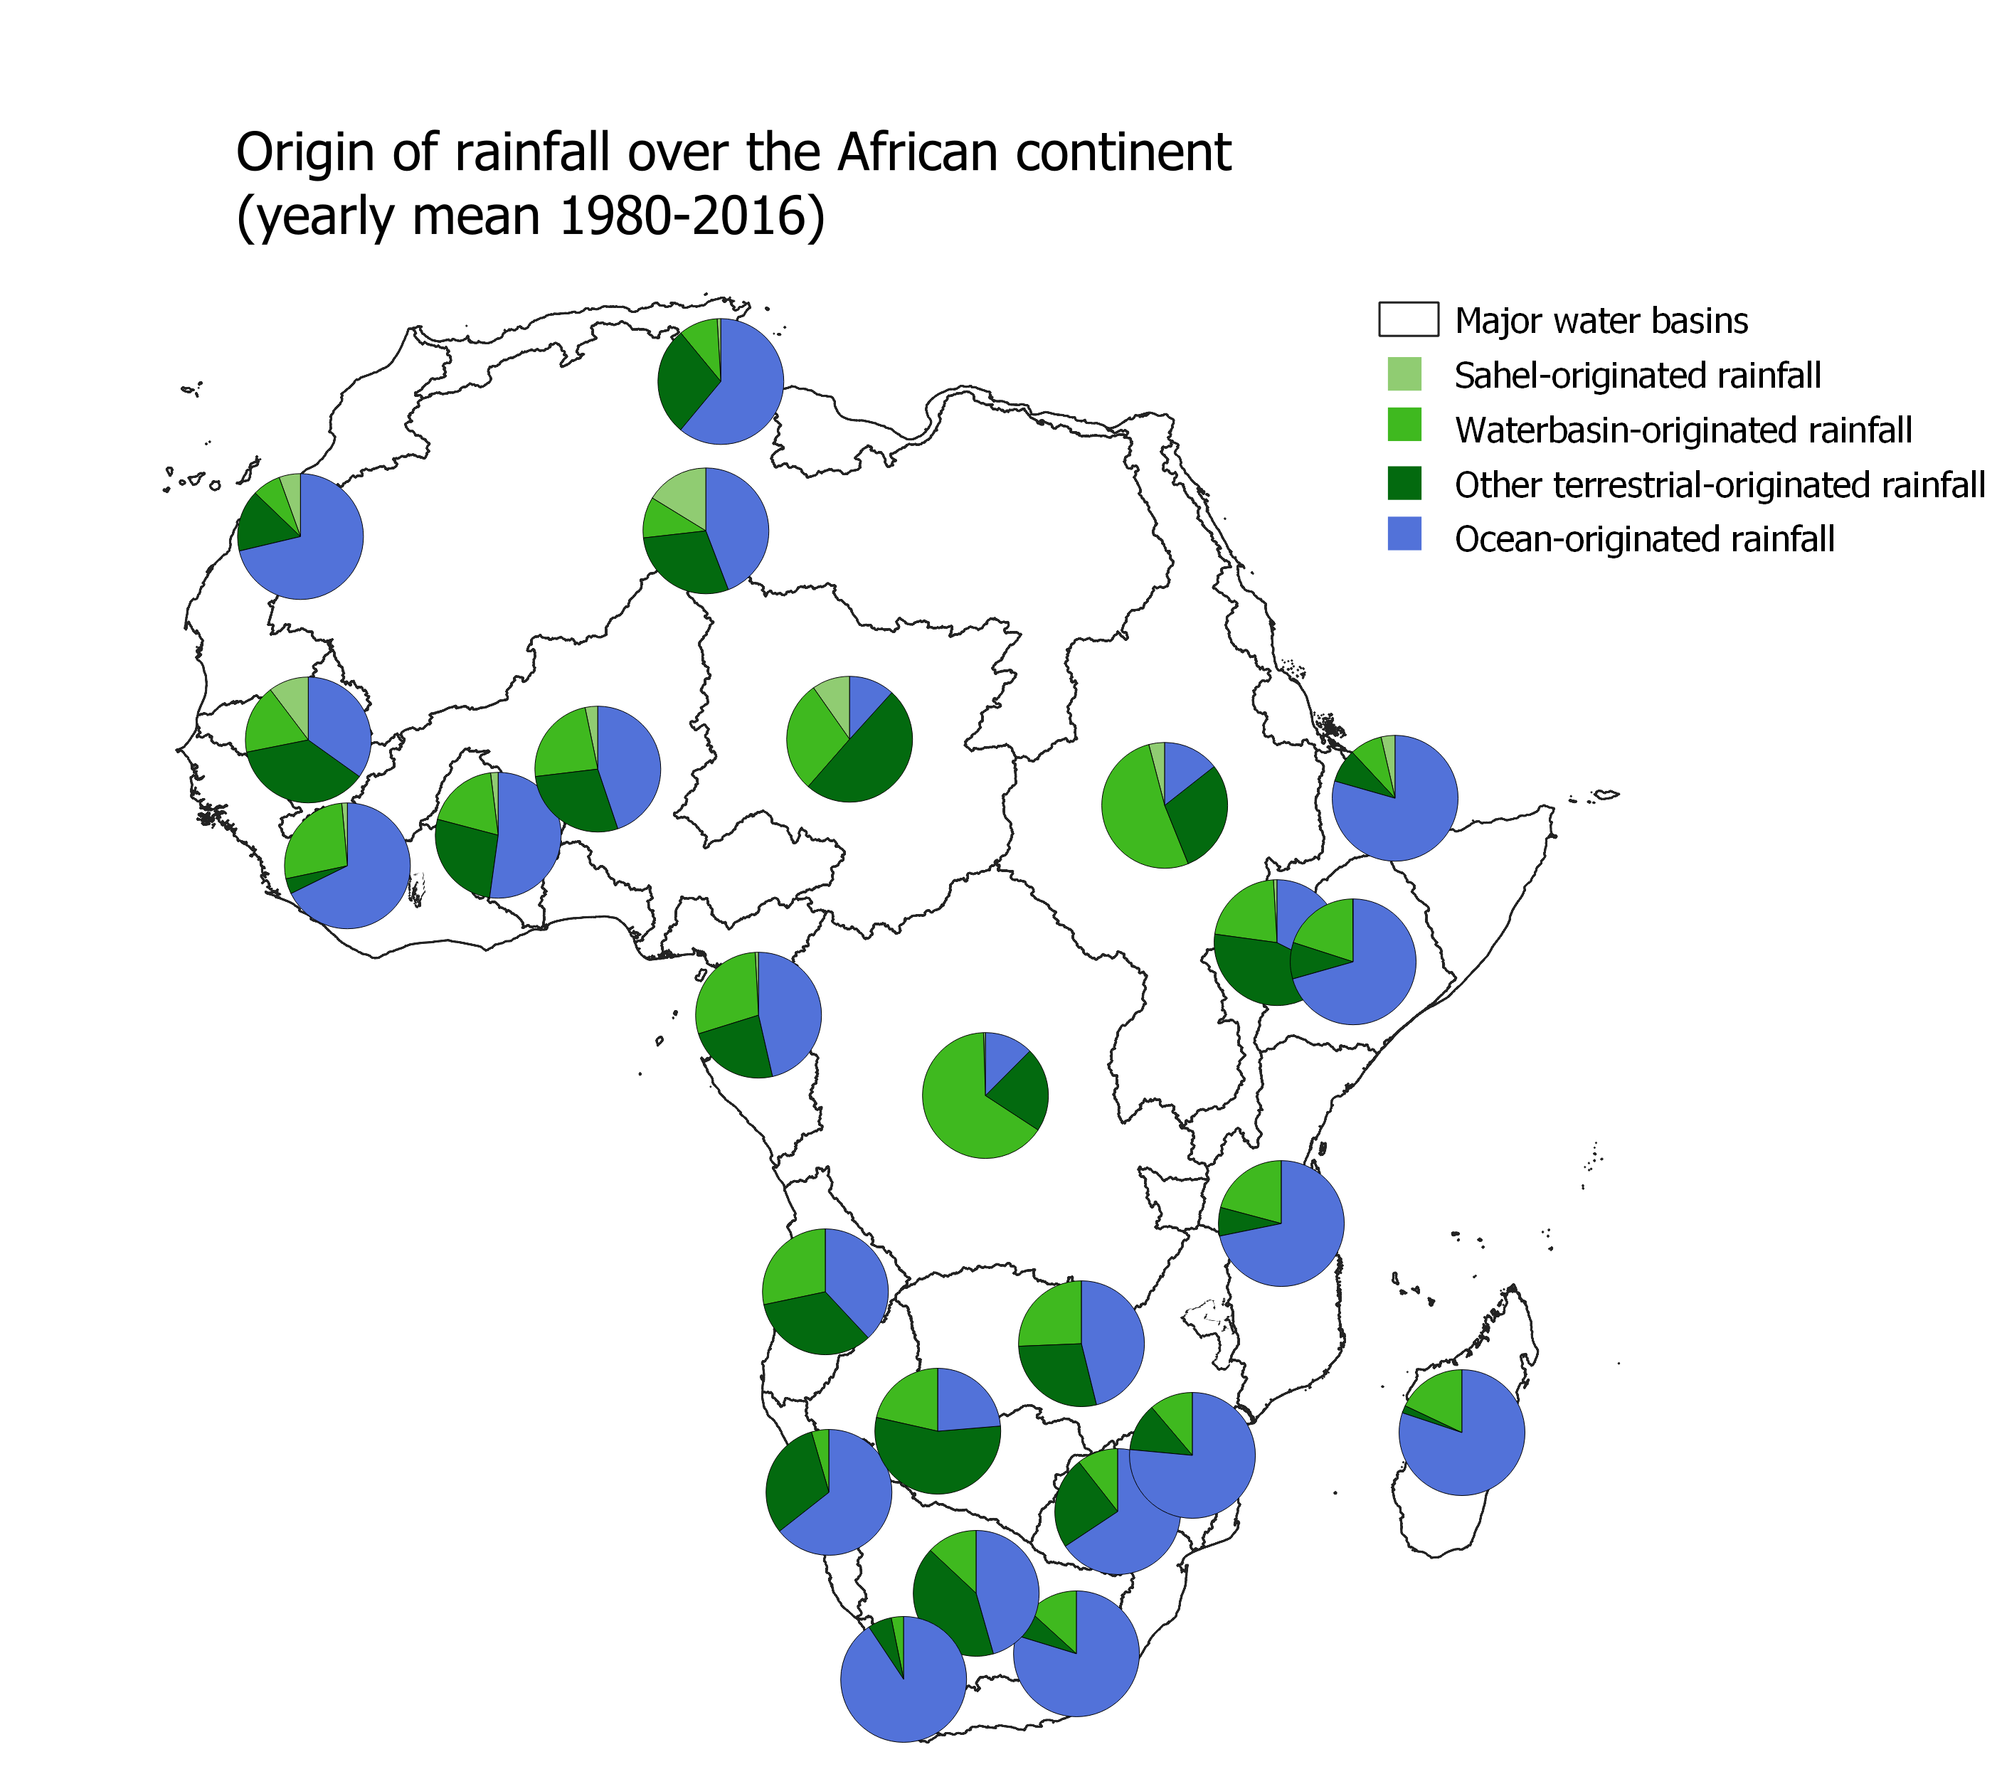
Origin of rainfall over Africa
Some regions are for more than 50% dependent on terrestrial moisture
Both very arid (Lake Chad) and very humid (Congo) regions
Some regions are depending on Sahelian evaporation (e.g. Niger in some months up to 10%)

Slide 6
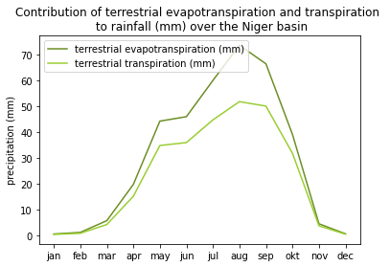
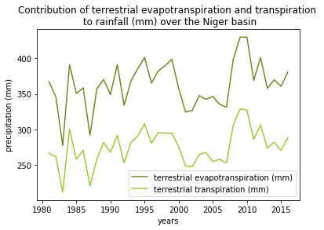
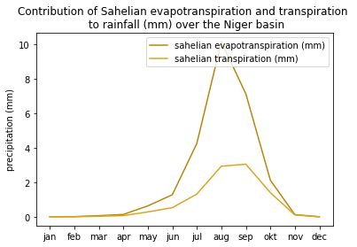
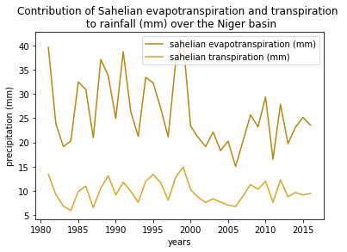
Contribution of vegetation to precipitation
Intra-annual
Interannual
Terrestrial (mm)
Sahel:
54,7% of annual average precipitation is vegetation regulated (transpiration)
Niger watershed:
40% of annual average precipitation is vegetation regulated (transpiration)
Increasing fraction of Sahelian transpiration contributing to precipitation (?)
Sahel (mm)
Fraction T/ET

Slide 7
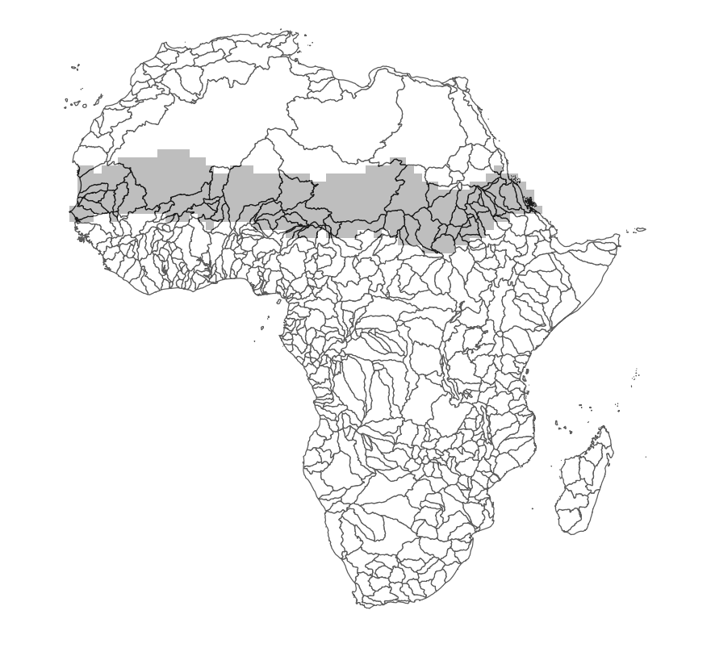
Conclusion & outlooks
Sahel is a sink rather than a source over Africa
  → How does it contribute to rainfall within the region?
A substantial part of the precipitation in the region is vegetation regulated
  How does vegetation and land cover change affect rainfall patterns?

