Slide 1
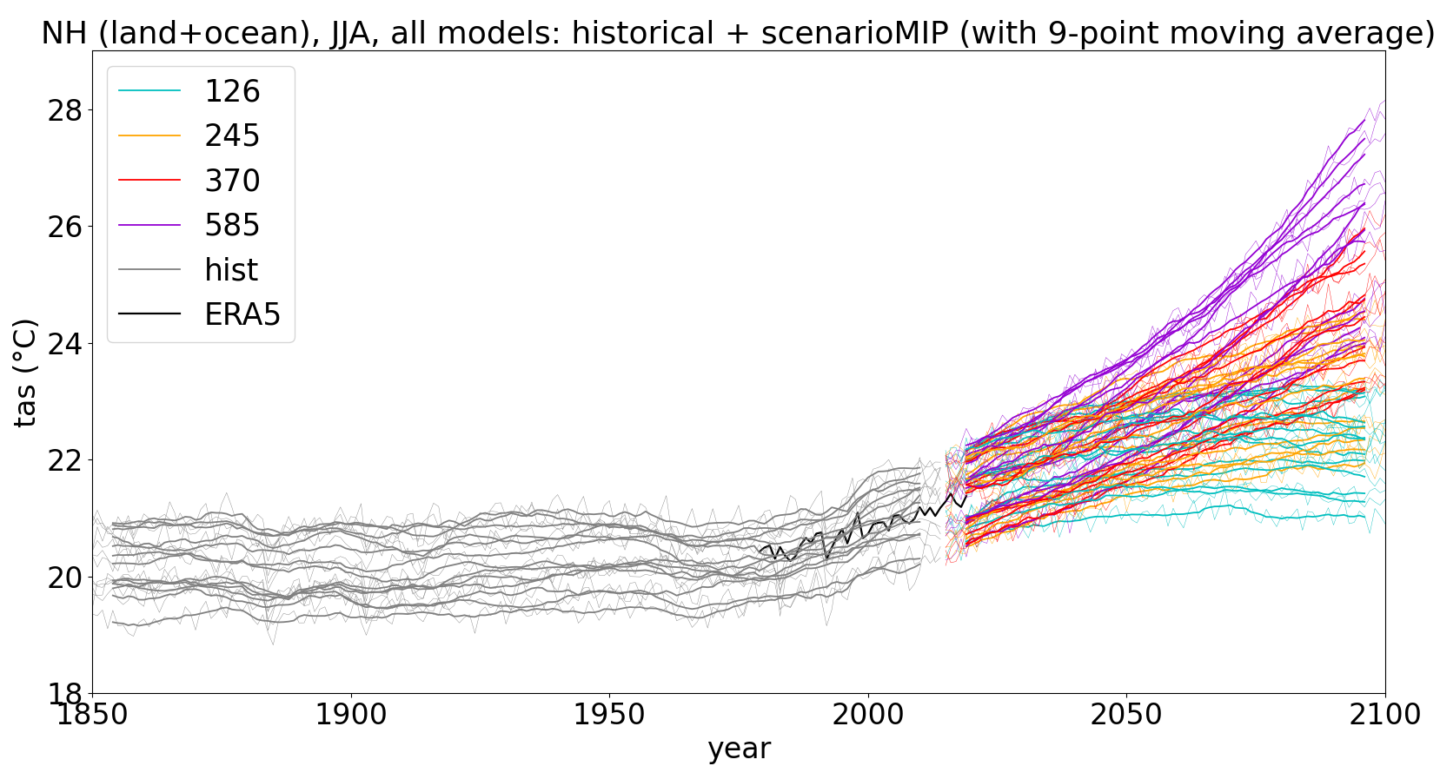
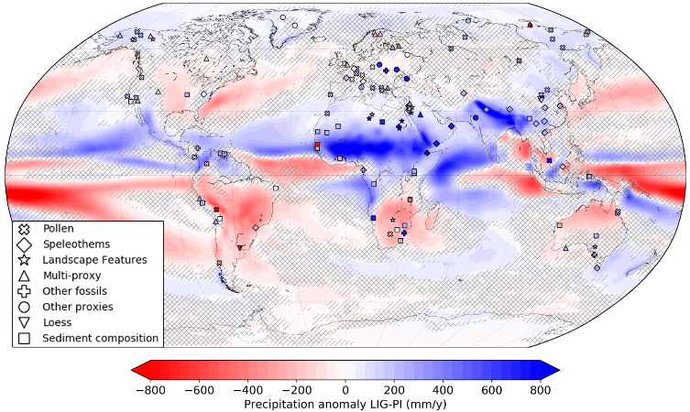
Global temperature and hydroclimate in warmer climates of the past and future: the Last Interglacial versus greenhouse scenarios
Paolo Scussolini and many colleagues
3) How well do these models perform?
1) A partial analog?
2) Let’s quantify
13 climate models performed both:
127k run (PMIP4)
ScenarioMIP runs (CMIP6):
ssp126; ssp245; ssp370; ssp585
Otto-Bliesner et al. 2013
4) When do futures meet the Last Interglacial?
JJA temperature 30-90°N
Scussolini et al. 2019

Slide 2
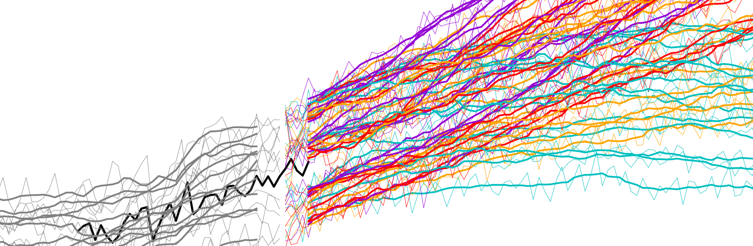
Global temperature and hydroclimate in warmer climates of the past and future: the Last Interglacial versus greenhouse scenarios
Paolo Scussolini, Pepijn Bakker, Paolo De Luca, Dim Coumou, Joyce H.C. Bosmans, Gerrit Lohmann, Zoë Thomas, Chris S.M. Turney, Laurie Menviel, Takashi Obase, Ayako Abe-Ouchi, Pascale Braconnot, Bette L. Otto-Bliesner, Qiuzhen Yin, Matthias Prange, Chronis Tzedakis, Emilie Capron, Hans Renssen, Philip J. Ward, Jeroen J.C.H. Aerts

Slide 3
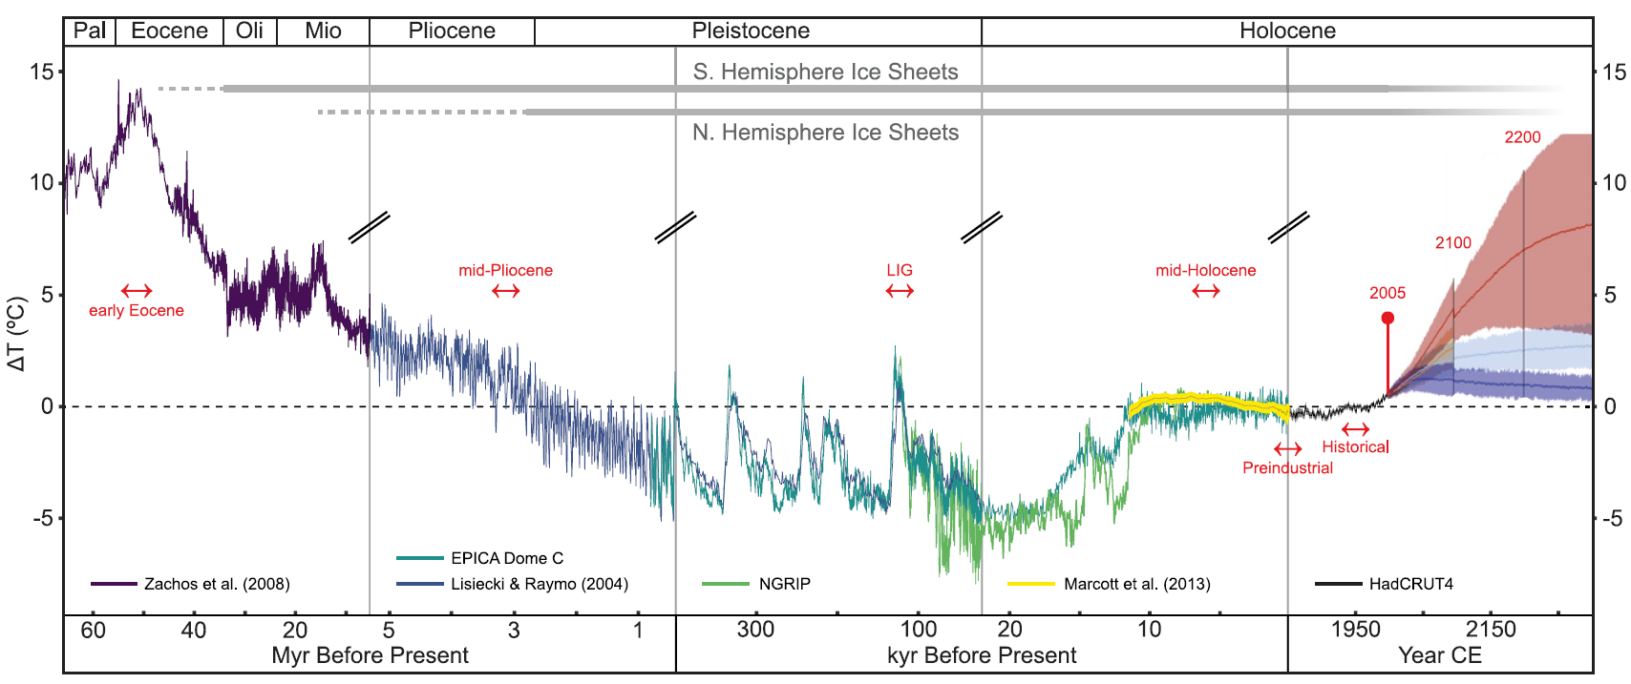
Motivation
Scouring the earth’s past
Searching for an analogue of the future
Burke et al. 2018, PNAS

Slide 4
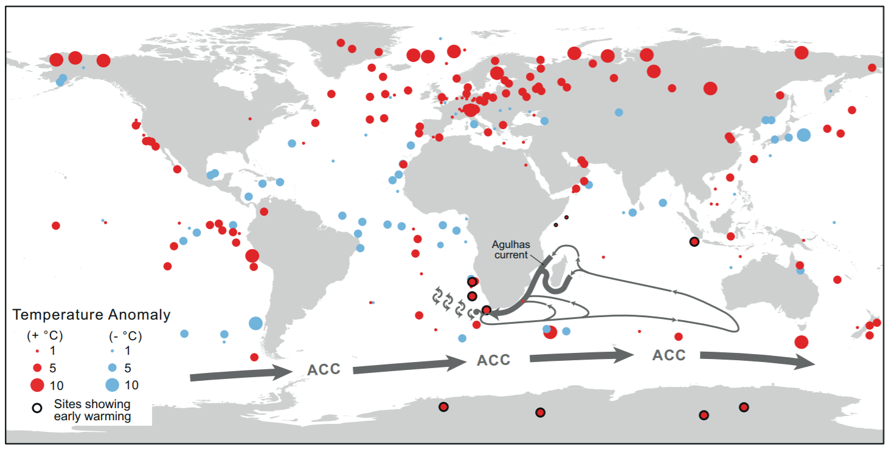
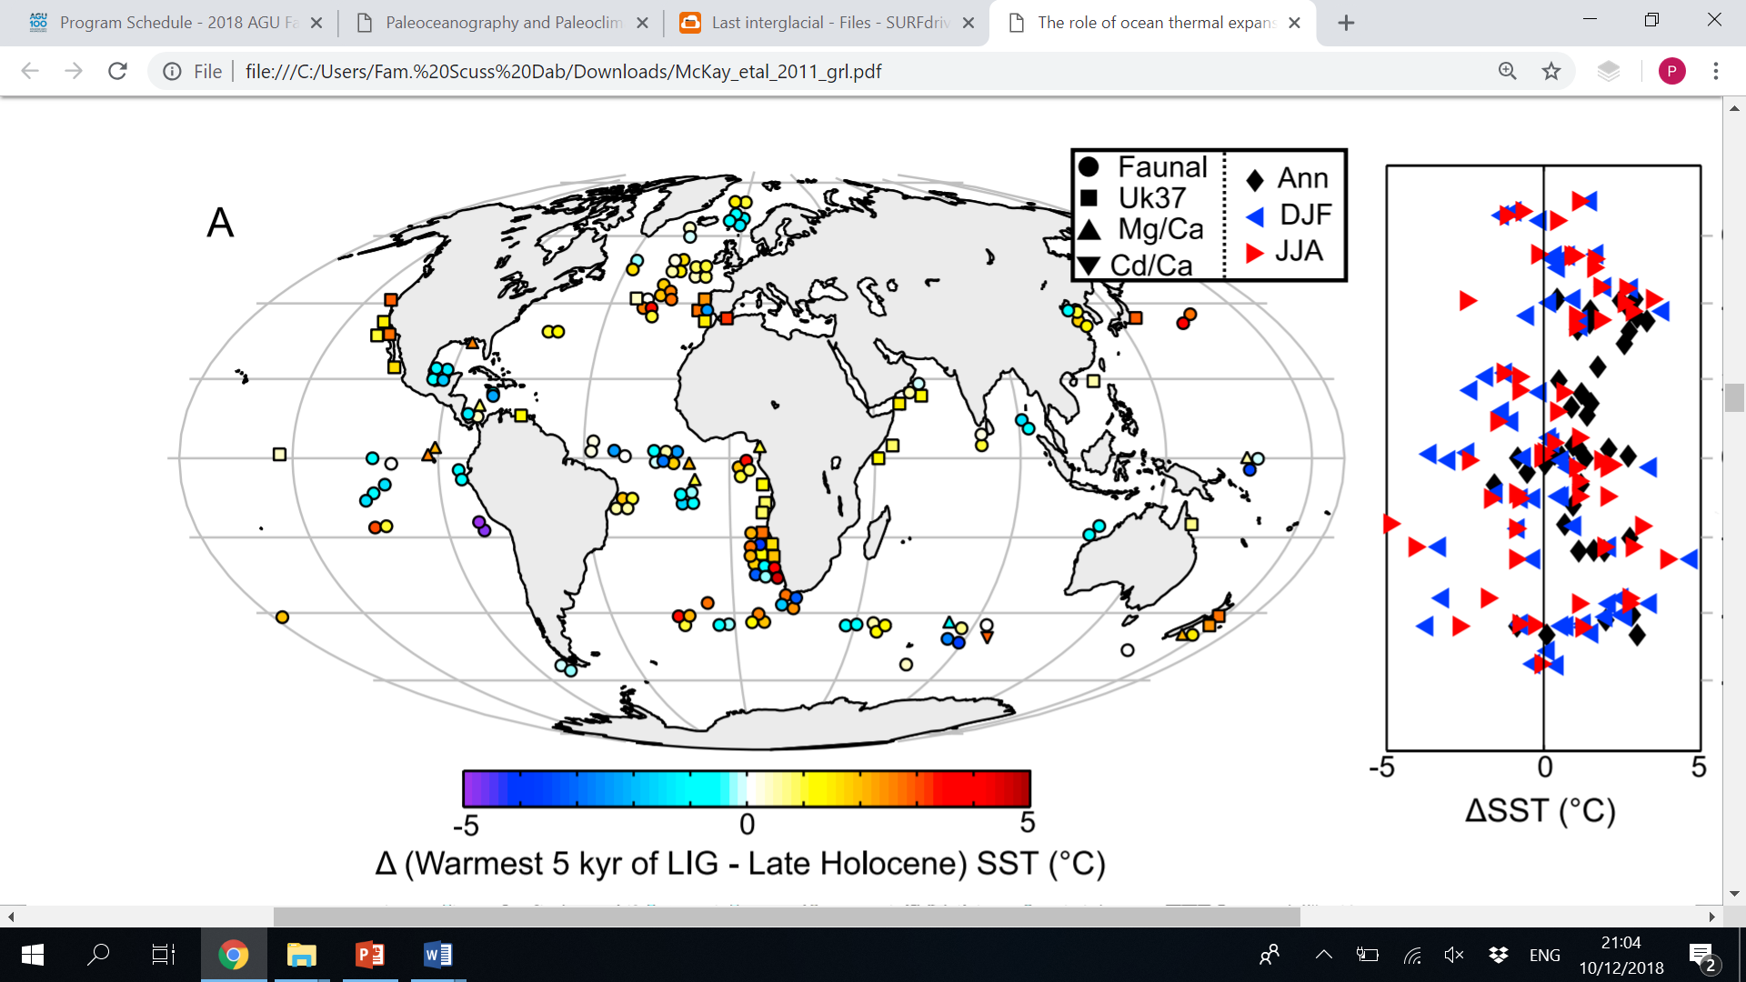
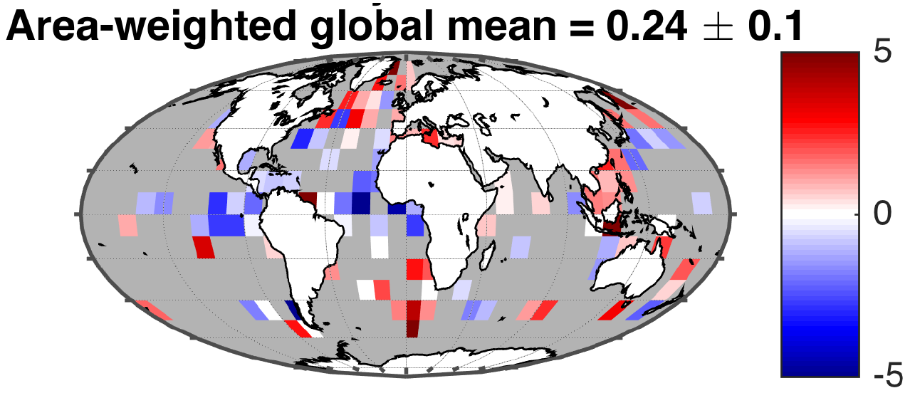
Motivation
The Last Interglacial (LIG; ~125 k years ago)
is interesting
Lunt et al. 2013, Cli Past
Extensive proxy records indicate temperatures were higher than now, at least in the Northern Hemisph.
Turney and Jones 2010, JQS
Otto-Bliesner et al. 2013, Philos Trans R Soc
ΔSST (°C)
McKay et al. 2011, GRL
Turney et al. 2020, ESSDD
Hoffman et al. 2017, Science

Slide 5
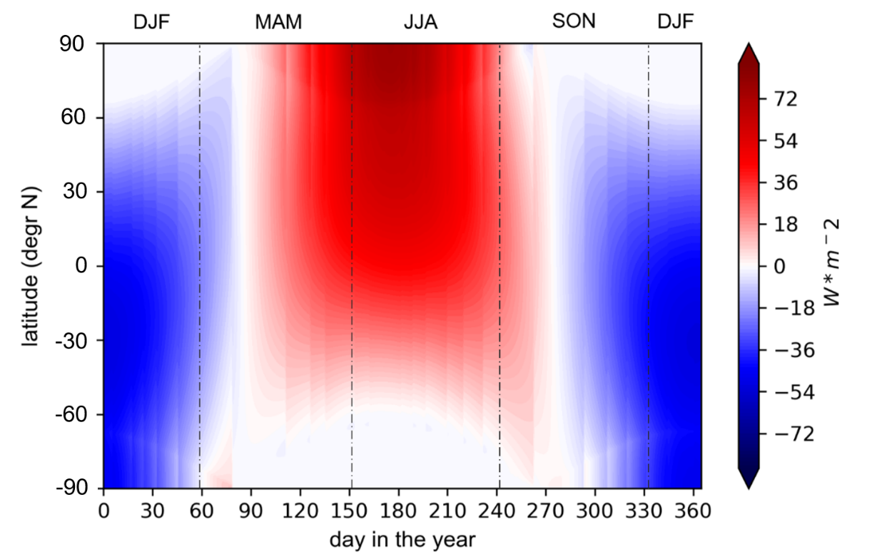
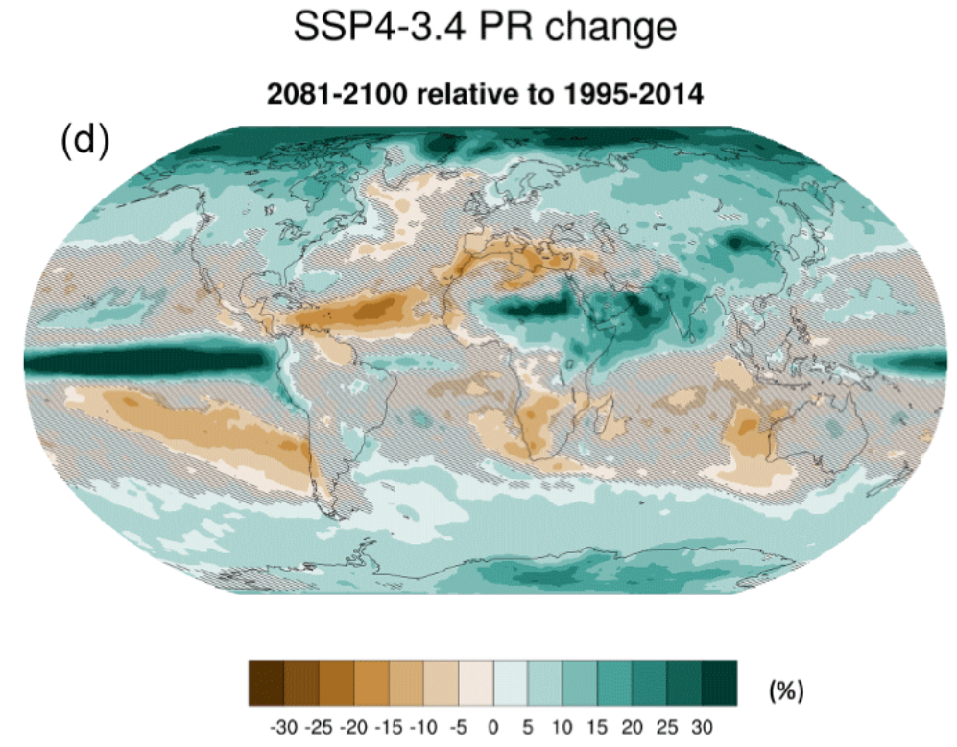
Motivation
Last Interglacial as partial analog
Analogies with futures
Northern Hemisphere temperature
Higher sea levels – reduced ice sheets
Weaker AMOC?
Stronger boreal monsoons
Boreal precipitation?
Differences with futures
Global temperature
Higher boreal summer insolation
[CO₂] at 290 ppm
LIG minus pre-industrial
Proxies (markers) and models (contours)
2081-2100 minus 1995-2014
Scussolini et al. 2019, Sci. Adv.
Burke et al. 2021, ESD

Slide 6
Motivation
Unique merit of LIG:
Compared to climates with higher temperatures and GHG (e.g., Eocene, Pliocene)
LIG is much more recent
→ amount and accuracy of information from proxies are much higher
LIG land-ocean configuration same as at present
→ ocean-atmosphere base dynamics not fundamentally altered
In fact, ~85% of LIG studies of the last two decades mention LIG’s merit as partial analog of the future (NB: non-rigorous review)
Even a circumscribed analogy could be valuable, as future is highly uncertain
But we need to better define the validity of the analogy

Slide 7
Set-up
We analyse results of CMIP6 models
Model | Atm. Resolution lon*lat
ACCESS-ESM1-5 | 0.94*1.24
CESM2 | 1.25*0.94
CNRM-CM6-1 | 1.41*1.41
FGOALS-f3-L | 1.25*1.00
FGOALS-g3 | 2.00*2.25
GISS-E2-1-G | 2.50*2.00
HadGEM3-GC31-LL | 1.88*1.25
INM-CM4-8 | 2.00*1.50
IPSL-CM6A-LR | 2.50*1.26
MIROC-ES2L | 2.81*2.81
MPI-ESM1-2-LR | 1.88*1.88
NESM3 | 1.88*1.88
NorESM2-LM | 2.5*1.88
Simulations
13 climate models performed both:
127k run (PMIP4)
Future scenarios runs (ScenarioMIP)
Shared Socioeconomic Pathways (SSP):
ssp126
ssp245
ssp370
ssp585

Slide 8
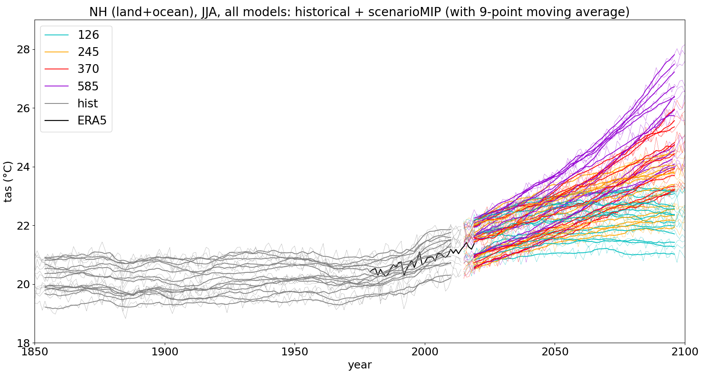
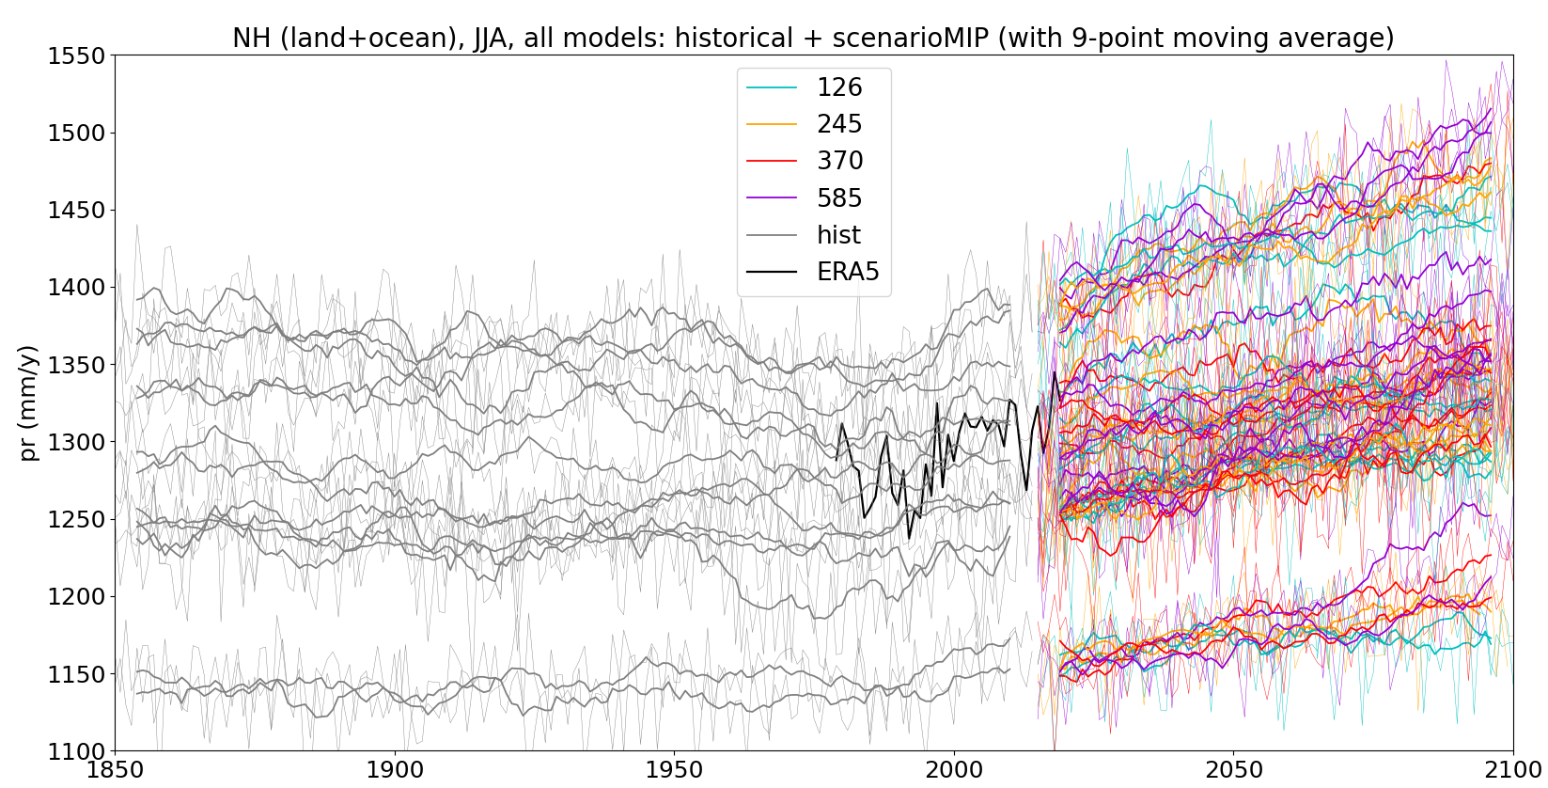
Temperature
Models performance
First:
How well do these models perform?
Validation vs ERA5 reanalysis
North Hemisphere - Summer
Precipitation

Slide 9
Models performance
Two strategies to assess models’ performance
Versus climate re-analysis
Versus proxies of the LIG
We want to see how rankings resulting from either strategy compare

Slide 10
Models performance
Ranking after performance vs re-analysis
TEMPERATURE
Euclidean distance between results of
historical simulation and ERA5 (1979-2014)
N Hem. JJA
IPSL-CM6A-LR
MPI-ESM1-2-LR
NorESM2-LM
NESM3
CNRM-CM6-1
FGOALS-g3
INM-CM4-8
HadGEM3-GC31-LL
CESM2
MIROC-ES2L
ACCESS-ESM1-5
FGOALS-f3-L
GISS-E2-1-G
N Hem. annual
MPI-ESM1-2-LR
FGOALS-g3
MIROC-ES2L
NorESM2-LM
IPSL-CM6A-LR
NESM3
ACCESS-ESM1-5
INM-CM4-8
HadGEM3-GC31-LL
CESM2
CNRM-CM6-1
GISS-E2-1-G
FGOALS-f3-L
Global JJA
INM-CM4-8
MPI-ESM1-2-LR
GISS-E2-1-G
NESM3
HadGEM3-GC31-LL
CESM2
IPSL-CM6A-LR
NorESM2-LM
FGOALS-f3-L
CNRM-CM6-1
FGOALS-g3
ACCESS-ESM1-5
MIROC-ES2L
Global annual
MPI-ESM1-2-LR
GISS-E2-1-G
NESM3
INM-CM4-8
HadGEM3-GC31-LL
CESM2
IPSL-CM6A-LR
FGOALS-g3
FGOALS-f3-L
CNRM-CM6-1
NorESM2-LM
ACCESS-ESM1-5
MIROC-ES2L
Only MPI-ESM1-2-LR ranks consistently high across the four comparisons
Consistency across comparisons is limited for most models, except e.g. NorESM2-LM

Slide 11
Models performance
Ranking after performance vs re-analysis
PRECIPITATION
Euclidean distance between results of
historical simulation and ERA5 (1979-2014)
N Hem. JJA
MPI-ESM1-2-LR
CNRM-CM6-1
MIROC-ES2L
CESM2
INM-CM4-8
IPSL-CM6A-LR
HadGEM3-GC31-LL
GISS-E2-1-G
NESM3
NorESM2-LM
ACCESS-ESM1-5
FGOALS-g3
FGOALS-f3-L
N Hem. annual
IPSL-CM6A-LR
CESM2
INM-CM4-8
HadGEM3-GC31-LL
CNRM-CM6-1
MIROC-ES2L
MPI-ESM1-2-LR
GISS-E2-1-G
FGOALS-f3-L
ACCESS-ESM1-5
FGOALS-g3
NESM3
NorESM2-LM
Global JJA
GISS-E2-1-G
CNRM-CM6-1
CESM2
NorESM2-LM
IPSL-CM6A-LR
MPI-ESM1-2-LR
NESM3
INM-CM4-8
FGOALS-f3-L
FGOALS-g3
HadGEM3-GC31-LL
MIROC-ES2L
ACCESS-ESM1-5
Global annual
CNRM-CM6-1
CESM2
FGOALS-f3-L
NorESM2-LM
NESM3
GISS-E2-1-G
MPI-ESM1-2-LR
FGOALS-g3
IPSL-CM6A-LR
INM-CM4-8
HadGEM3-GC31-LL
MIROC-ES2L
ACCESS-ESM1-5
CNRM-CM6-1 and CESM2 rank relatively high across the four comparisons
Some models emerge as high ranking after both temperature and precipitation: MPI-ESM1-2-LR and CNRM-CM6-1
For the rest, performances after temperature and after precipitation are different

Slide 12
Models performance
TO-DO: ranking vs proxies of LIG, and comparing the two ranking strategies
Preliminary ranking:
N Hem. Annual precipitation
HadGEM3-GC31-LL
NorESM2-LM
CESM2
NESM3
IPSL-CM6A-LR
MPI-ESM1-2-LR
…

Slide 13
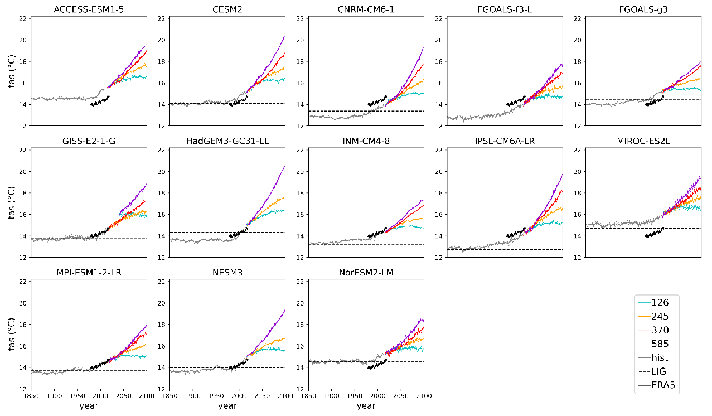
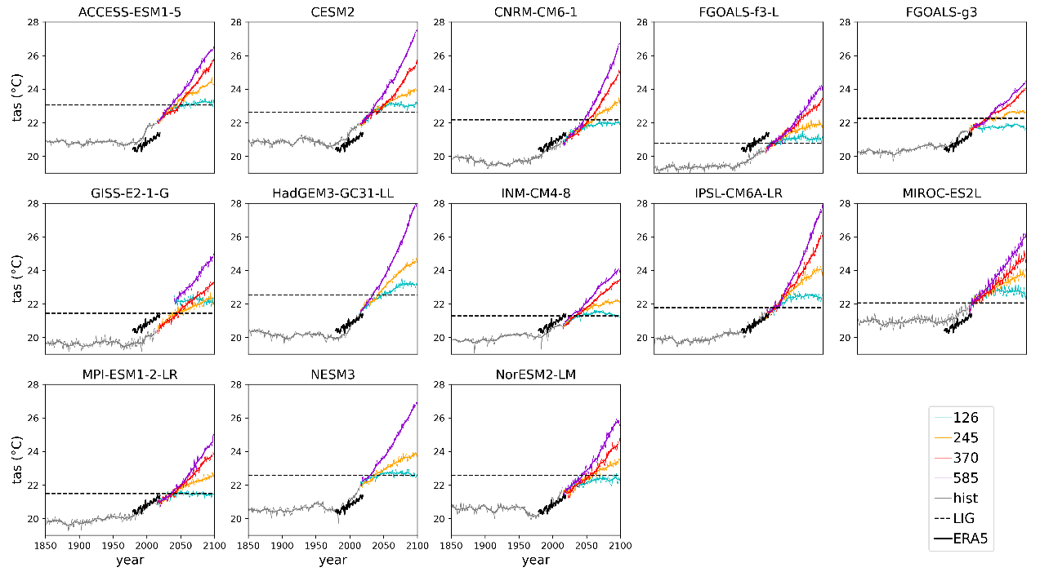
Global annual temp. → NOT AN ANALOGUE
Analogy analysis
Then:
Comparing LIG vs futures
Northern Hem. summer temp. → YES AN ANALOGUE
LIG temp already surpassed at global, annual scale
LIG N.H. summer (JJA) temp still relevant for future
Especially in N.H. extra-tropics

Slide 14
Seasonal temperature 30-90°N
Comparing values across 30-year climatologies, at 20-year steps (example: 2 models)
In MIROC-ES2L LIG temp resemble this decade
In IPSL-CM6-A-LR, LIG JJAS values are not not exceeded in scenario ssp126
Analogy analysis
IPSL-CM6-A-LR
MIROC-ES2L

Slide 15
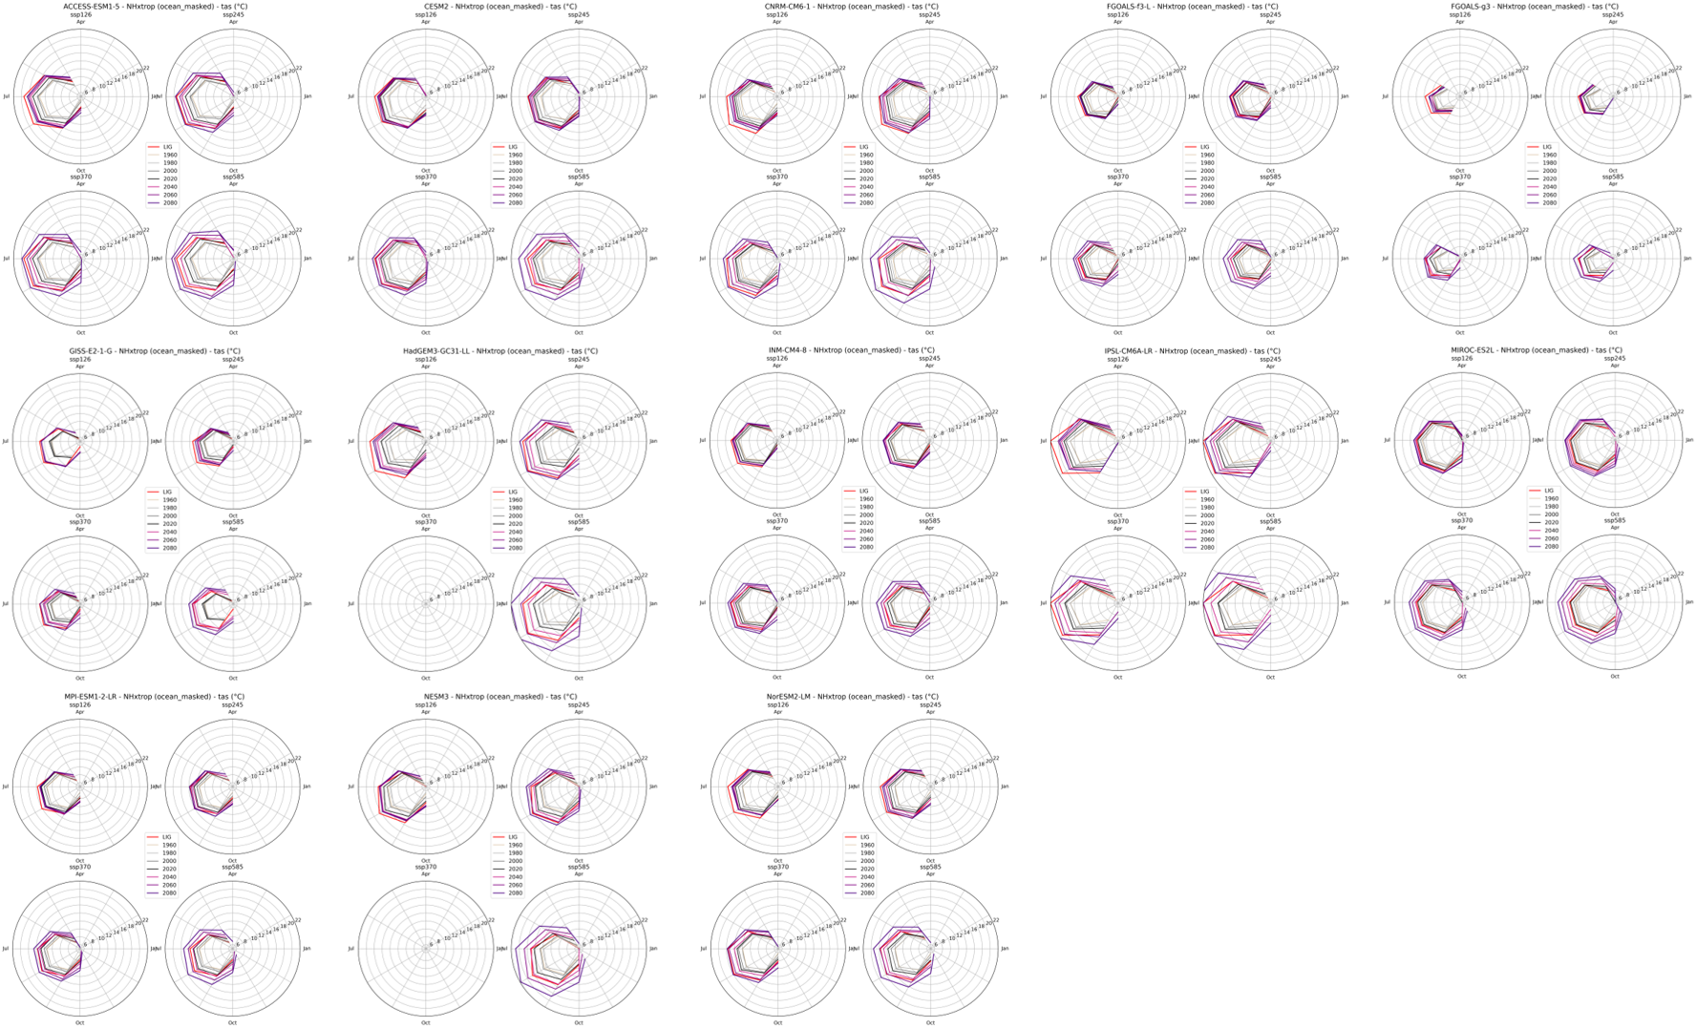
Analogy analysis
For consultation / curiosity
Temperature 30-90°N (over land only)
Much diversity across models!

Slide 16
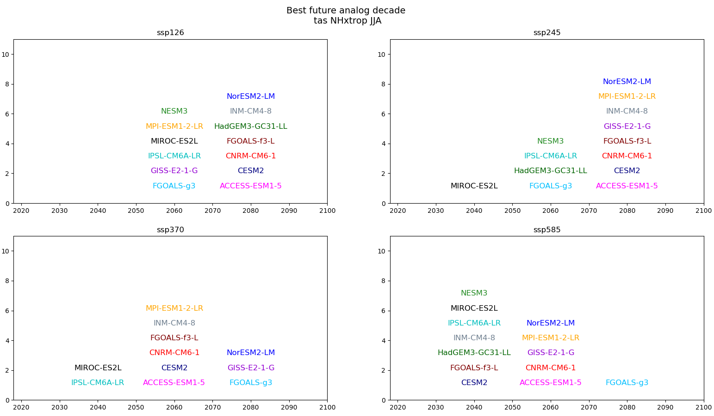
When do futures converge
with LIG?
Analogy analysis
JJA temperature 30-90°N
Best future analog decade

Slide 17
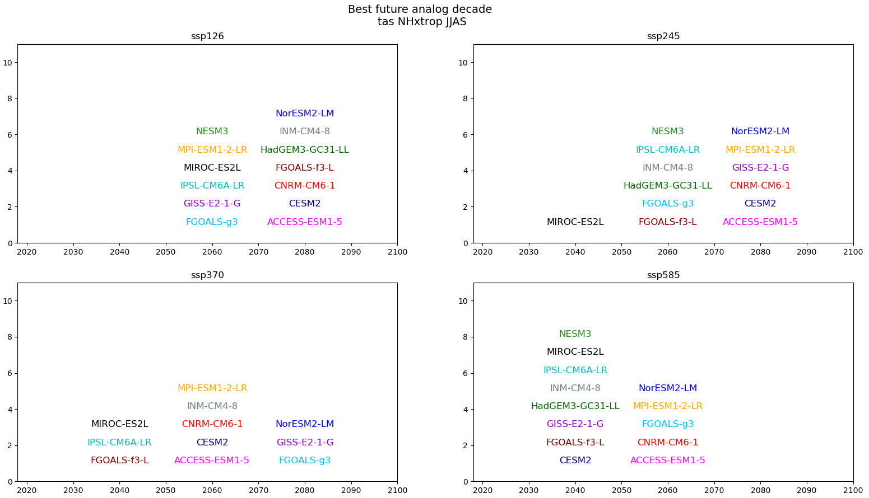
When do futures converge
with LIG?
Analogy analysis
JJAS temperature 30-90°N
Best future analog decade

Slide 18
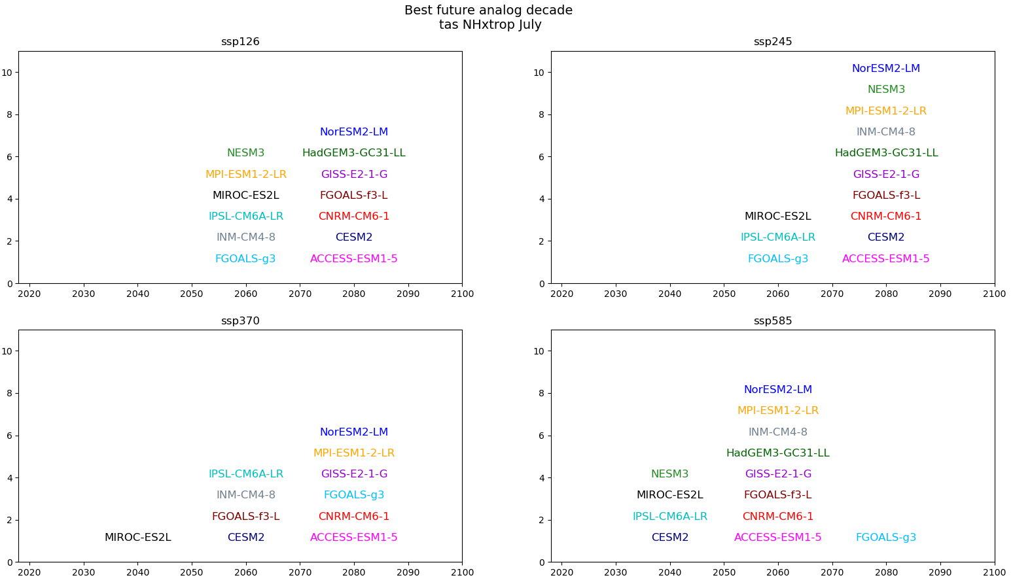
When do futures converge
with LIG?
Analogy analysis
July temperature 30-90°N
Best future analog decade

Slide 19
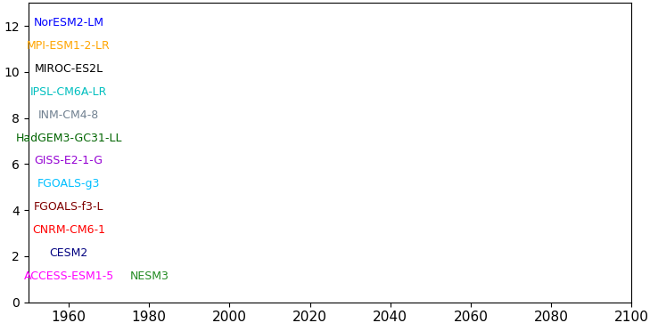
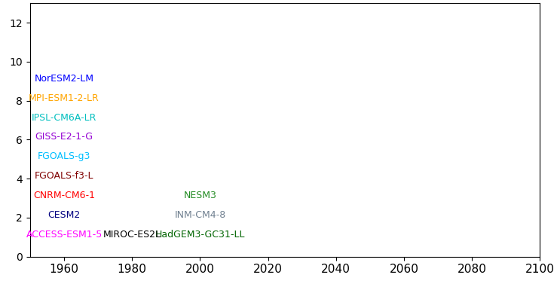
When do futures converge
with LIG?
Analogy analysis
30-90°N
JJA precipitation
Best future analog decade
0-90°N
JJA precipitation
Best future analog decade

Slide 20
To conclude…
Model ranking methods yield different results
LIG boreal summer temperature to be reached around 2080 (ssp126) or 2040 (ssp585)
USE?
E.g., if working on impacts ssp245 on boreal extratropical (eco/hydrological)systems in summer
it may be helpful to look at proxies of the LIG
TO DO:
Rank model after performance vs proxies of temp and precip – compare rankings
Thank you
paolo.scussolini@vu.nl

