Slide 1
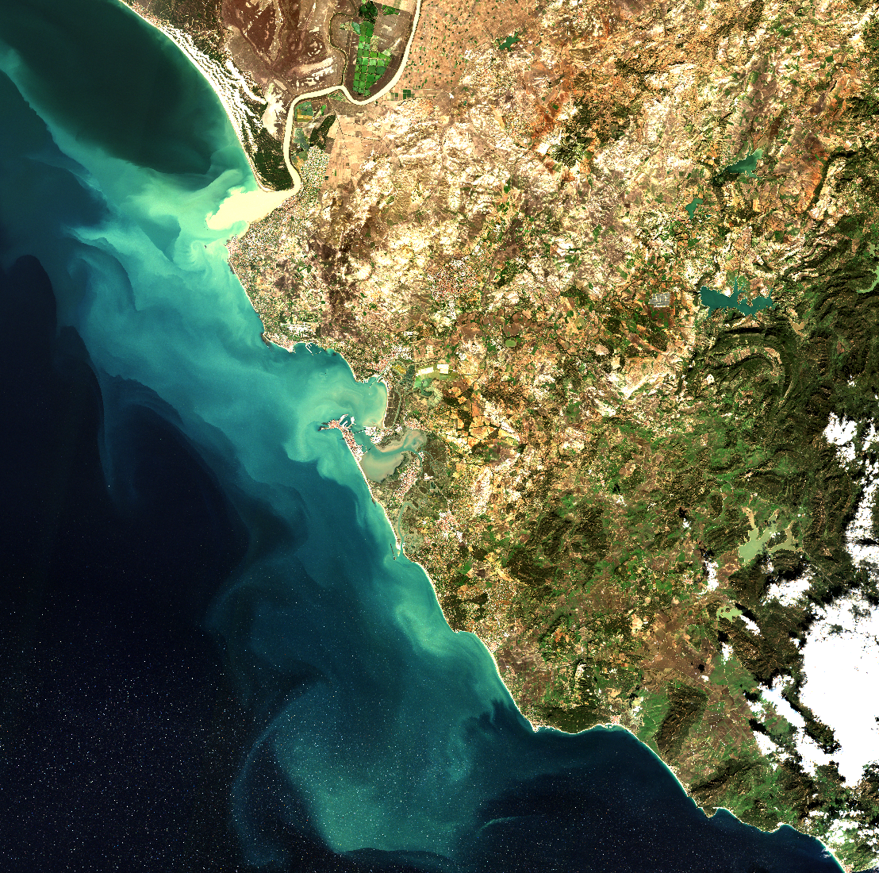
Application of Sentinel-2A/B satellites to retrieve turbidity in the Guadalquivir estuary (Southern Spain)
Masuma Chowdhury
Cesar Vilas
Stef VanBergeijk
Gabriel Navarro
Irene Laiz
Isabel Caballero de Frutos
Sentinel-2
Date: 28th December, 2019
CC BY 4.0 License

Slide 2
vEGU General Assembly 2021: Gather Online, 19-30 April 2021
A glance at the Guadalquivir River and Sentinel-2 satellites
In-situ Data and Sampling stations
ACOLITE atmospheric correction analysis
Spectral feature analysis from low to high turbidity levels
Turbidity models calibration & validation
Conclusions
Contact details
Acknowledgement
Table
of content

Slide 3
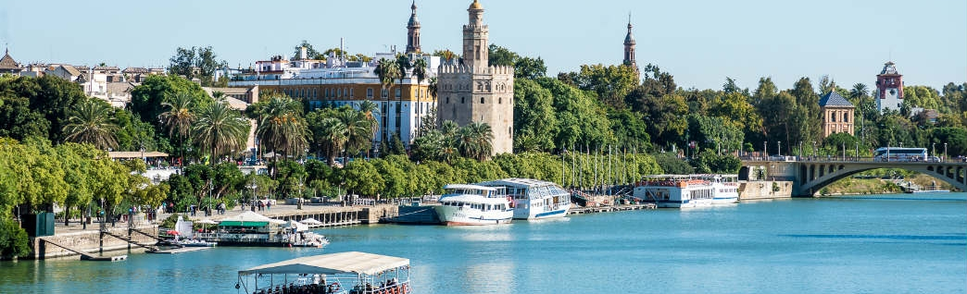
The Guadalquivir River at a glance.....
Source: Google
The major watercourse located in the Southwest Spain, crosses the whole region of Andalusia and ends into the Gulf of Cadiz, in the Atlantic Ocean.
Main source of freshwater inputs and nutrients to the estuary & the adjacent Gulf of Cadiz shelf, thereby regulating the high biological productivity of the basin.
Occasionally experiences high discharge episodes laden with high sediment concentrations, resulting in negative effects on water quality and clarity, productivity of the aquatic ecosystems, as well as human consumption, recreation and manufacturing.
Several prolonged turbid episodes originated hypoxia and inhibition of phytoplankton growth in the adjacent coastal region are endeavoring the policy-managers & stakeholders.
Therefore, examining the turbidity level is required to assist the challenging coastal management & water quality monitoring.
Source: Navarro et al., (2012); Losada et al., (2017); Caballero et al., (2018); & Denizli et al., (2018)

Slide 4
Copernicus Sentinel-2A/B at a glance.....
Two polar orbiting identical satellites
High spatial resolution at 10m, 20m & 60m.
High revist time (5 days at equator)
Highly prominsing for coastal and inland water quality monitoring
Source: Sentinel2_infographic

Slide 5
vEGU General Assembly 2021: Gather Online, 19-30 April 2021
Study period: Nov 2017 to Present time
Satellite data: Sentinel-2A/B
In-situ data: Instituto de Investigacion y Formacion Agraria y
Model calibration: Nov 2017 to Oct 2020
Model validation: Nov 2020 to present time
Data
Pesquera (IFAPA)
Sampling area: → Tarfia
→ Bonanza
→ Transit between Tarfia and Bonanza

Slide 6
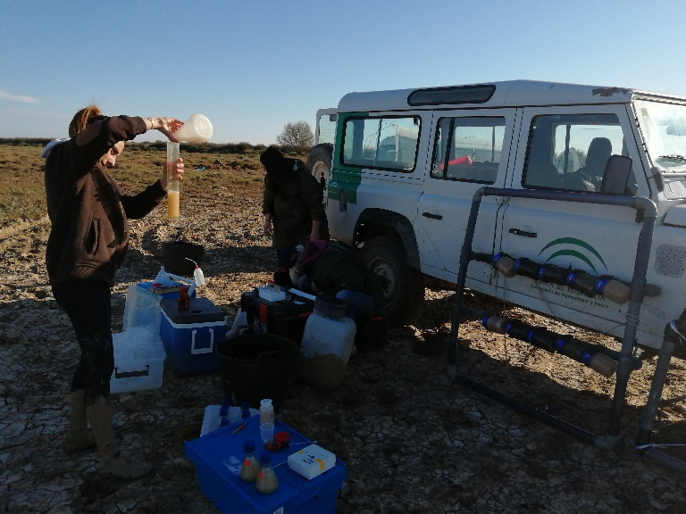
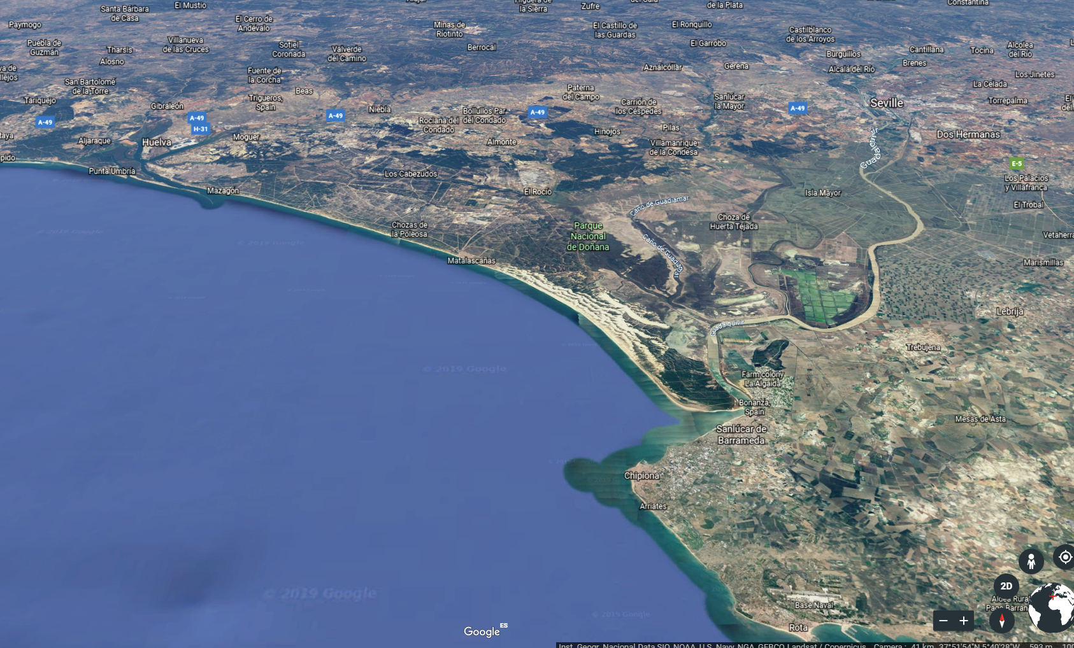
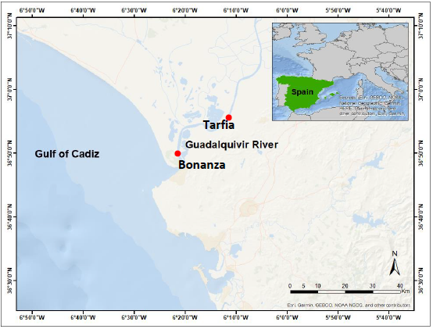
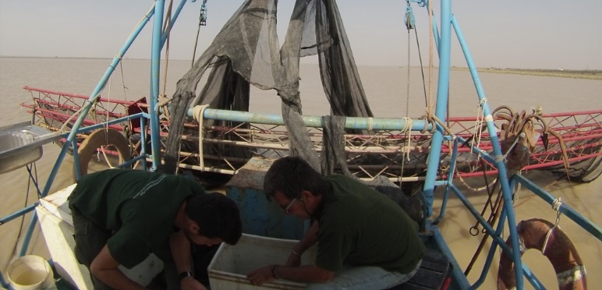
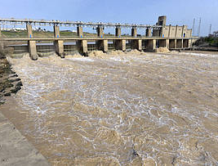
Field Survey & Sampling Stations
Tarfia
Bonanza

Slide 7
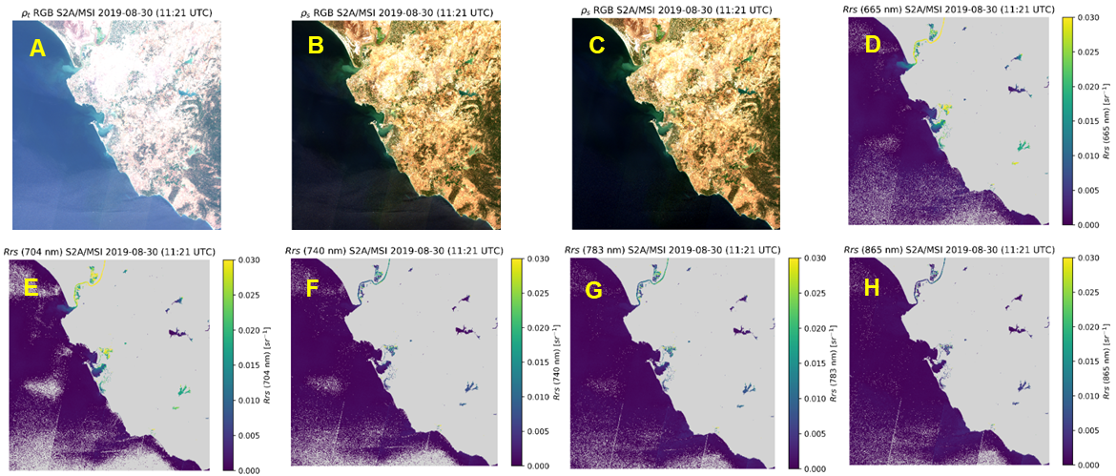
vEGU General Assembly 2021: Gather Online, 19-30 April 2021
ACOLITE atmospheric correction analysis
P1
RGB composites from Sentinel-2 image covering Guadalquivir River estuary (Spain) (Fig. A-C). Surface reflectance at TOA level (Fig. A), atmospheric correction using standard DSF without glint (Fig B) and with glint (Fig. C) correction. Fig. D-H represent the reflectance band at the wavelength of 665, 704, 740, 783 and 865 nm respectively with DSF + glint correction.
P2
P3
P4
Spectra extracted from the above Fig A-C. Fig I represents spectra before (TOA) and after (BOA with DSF + Glint) atmospheric correction. Fig. J & K represent a zoom in the atmospherically corrected spectra at the BOA level without glint and with glint correction respectively.
I
J
K

Slide 8
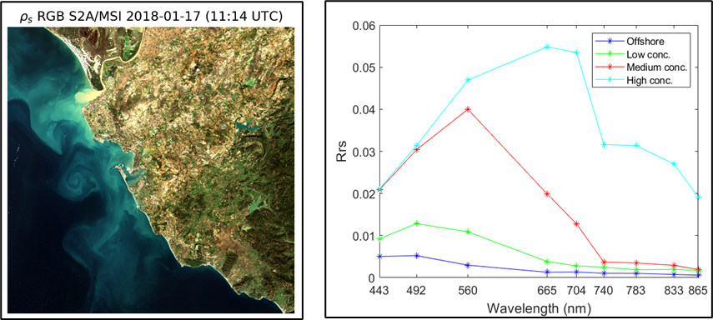
vEGU General Assembly 2021: Gather Online, 19-30 April 2021
Spectral
features
√ Offshore clear water region √ Low levels of turbidity
√ Medium levels of turbidity √ High levels of turbidity

Slide 9
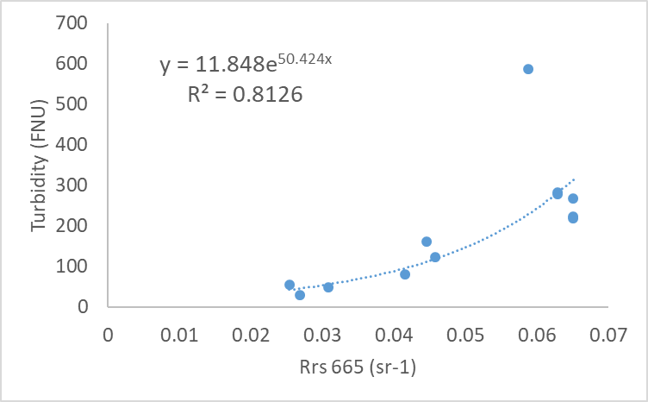
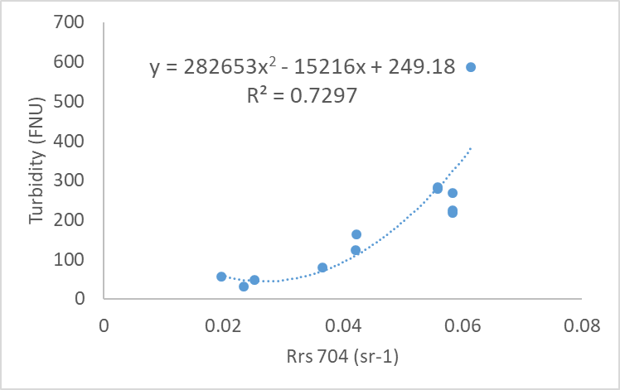
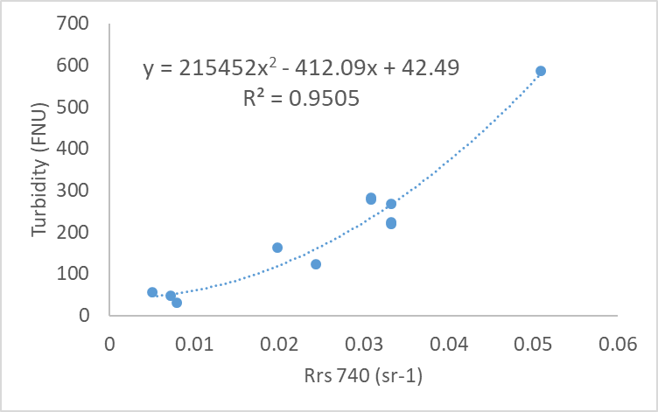
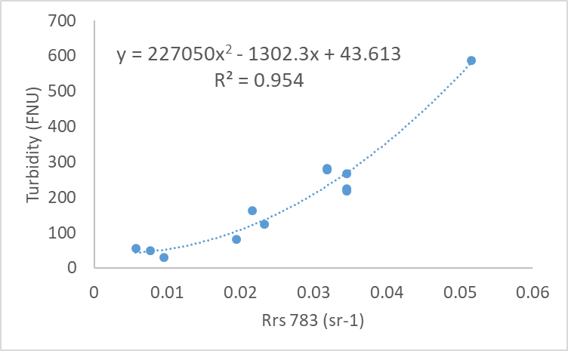
vEGU General Assembly 2021: Gather Online, 19-30 April 2021
Turbidity
models

Slide 10
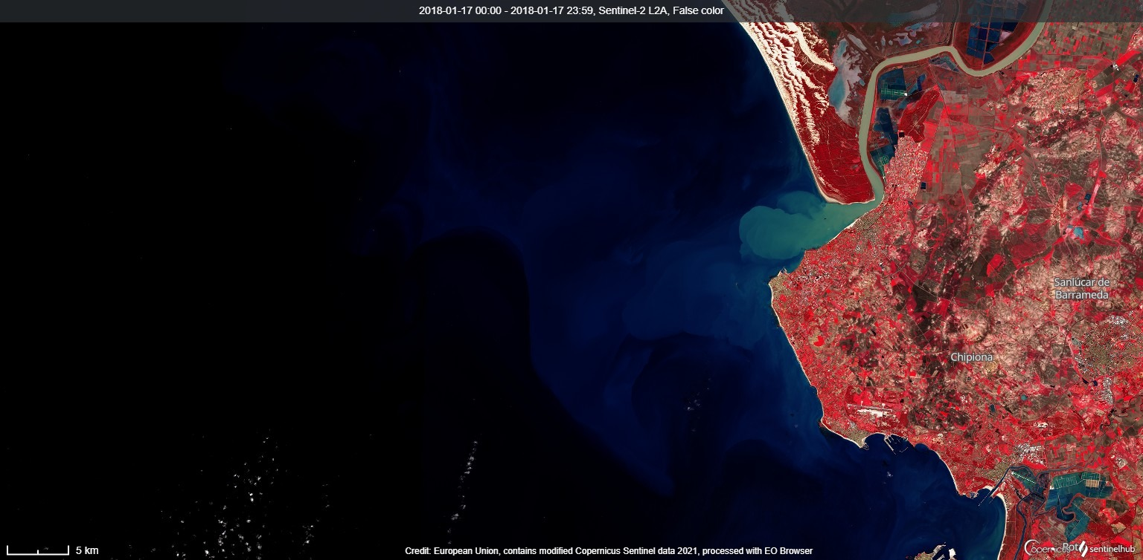
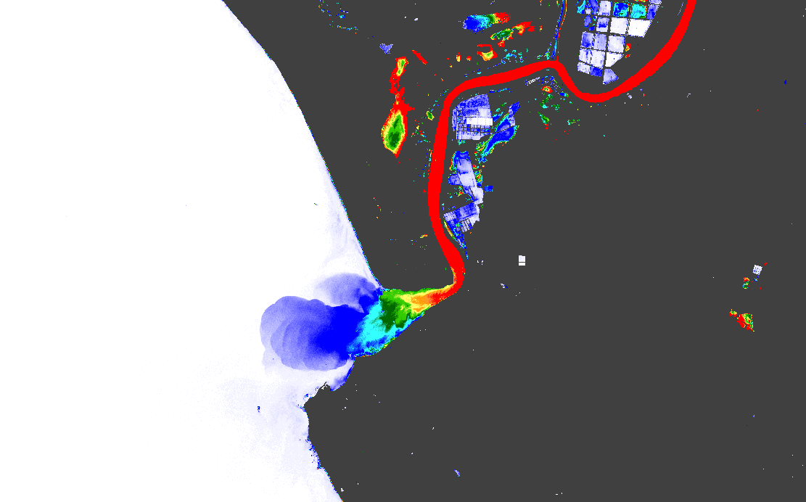
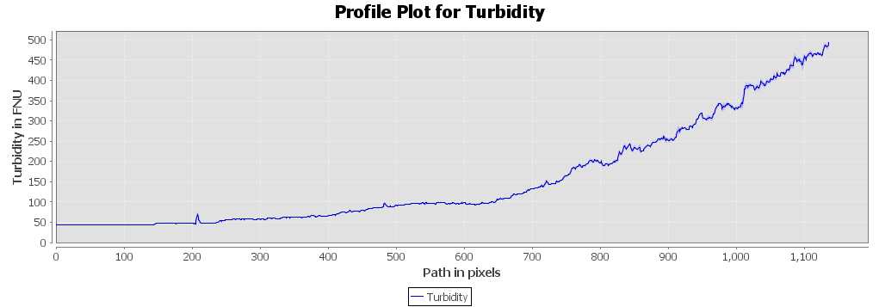
vEGU General Assembly 2021: Gather Online, 19-30 April 2021
Turbidity algorithm_Rrs_740
B

Slide 11
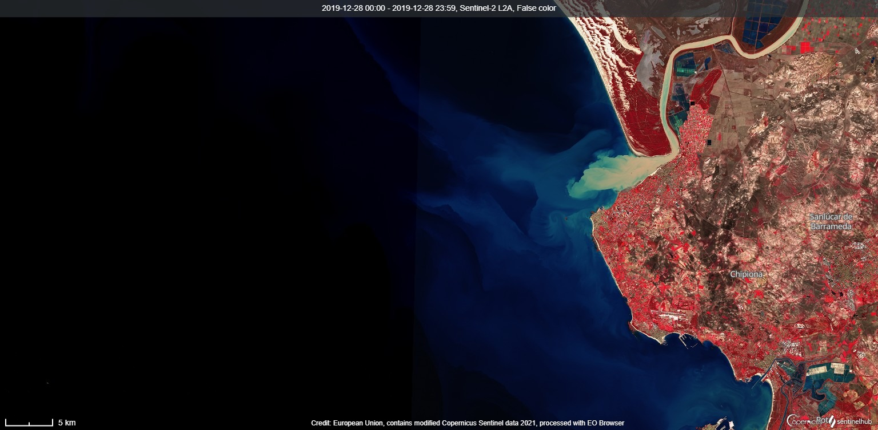
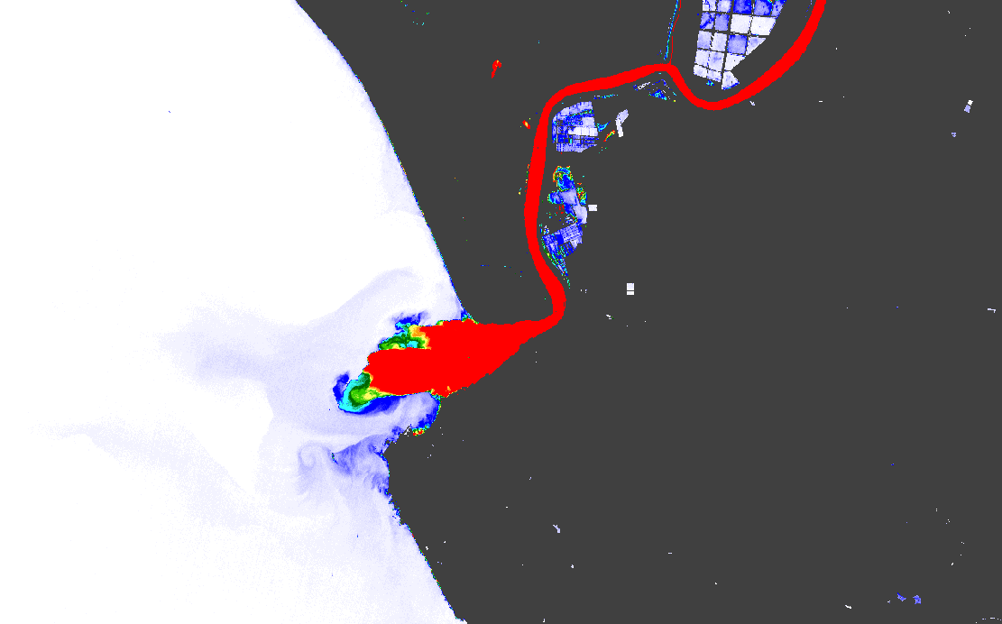
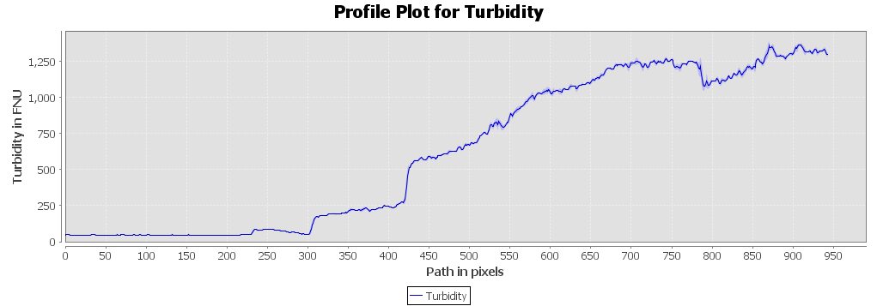
vEGU General Assembly 2021: Gather Online, 19-30 April 2021
Turbidity algorithm_Rrs_740
B

Slide 12
vEGU General Assembly 2021: Gather Online, 19-30 April 2021
Validation processing is ongoing..
Next validation field campaign will be carried out on mid May, 2021
Validation

Slide 13
vEGU General Assembly 2021: Gather Online, 19-30 April 2021
The atmospheric correction assessment of this study suggests that ACOLITE DSF along with ‘Glint’ correction is more reliable than without ‘Glint’ correction, especially for this study region where sun glint is a major problem during summertime, affecting most of the Sentinel-2 satellite scenes.
So far, among the four turbidity algorithms, the Rrs 740 nm algorithm is the best suited one, however, we need to wait until our next field campign in oder to validate this algorithm.
This algorithm will be a key to understand the turbidity level in the Guadalquivir river & therefore, will support the scientists, policy makers and the statkeholders for ensuring sustainable coastal management of the estuary, its adjacent coastal areas and its resources.
Conclusions

Slide 14
vEGU General Assembly 2021: Gather Online, 19-30 April 2021
Masuma Chowdhury - masuma.chowdhury@alum.uca.es
César Vilas - cesar.vilas@juntadeandalucia.es
Stef VanBergeijk - stefaniea@juntadeandalucia.es
Gabriel Navarro - gabriel.navarro@icman.csic.es
Irene Laiz - irene.laiz@uca.es
Isabel Caballero - isabel.caballero@icman.csic.es
Contact
Details

Slide 15
vEGU General Assembly 2021: Gather Online, 19-30 April 2021
This study has been done as an internship work for the Erasmus Mundus Joint Masters Degree on Water and Coastal Managemet (WACOMA Project586596-EPP-1-2017-1-IT-EPPKA1-JMD-MOB), in association with ICMAN-CSIC (Sen2Coast Project: RTI2018-098784-J-100) and IFAPA (Research Project PP.FEM.PPA201700.5) under the umbrella of ‘Blue Growth Associate Unit CSIC-IFAPA.
Acknowledgements

Slide 16
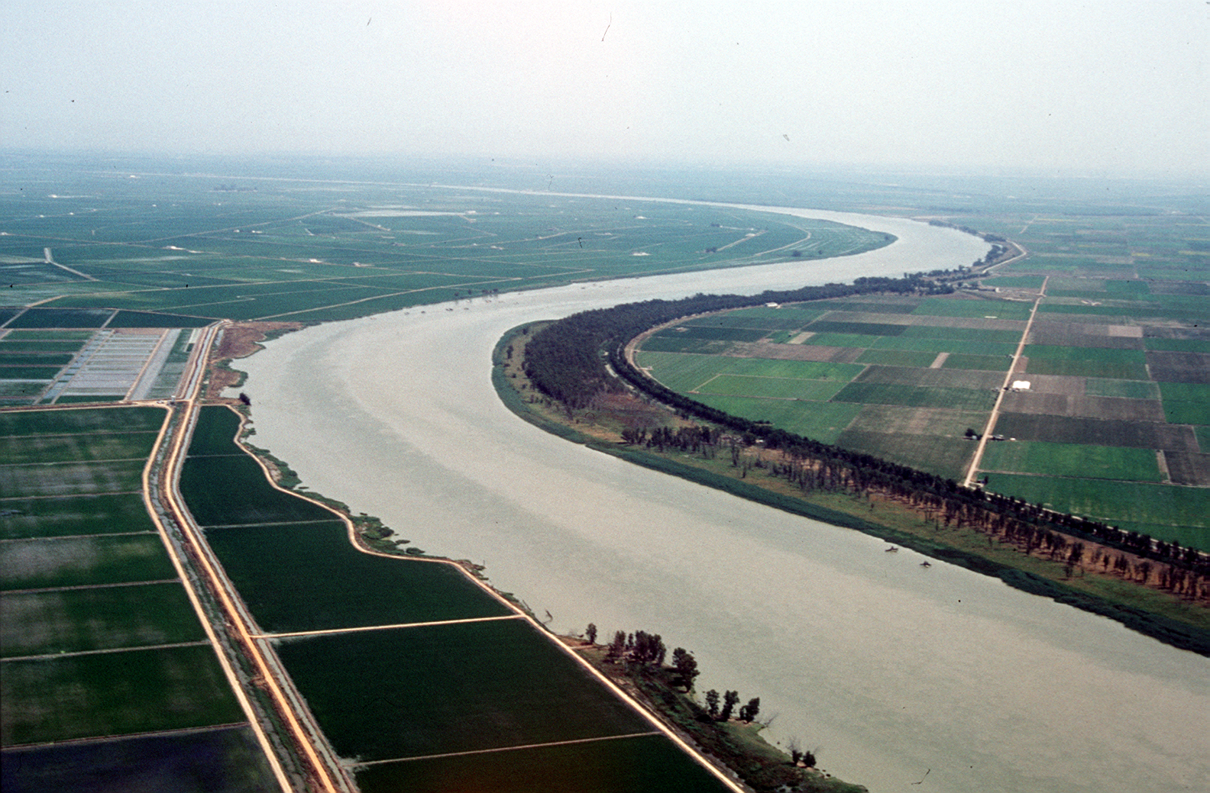
vEGU General Assembly 2021: Gather Online, 19-30 April 2021
Thank You

