Slide 1
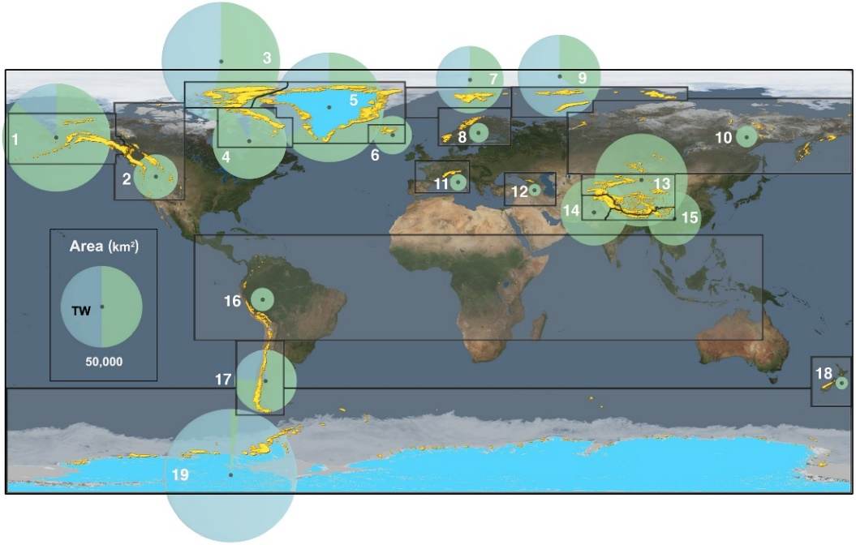
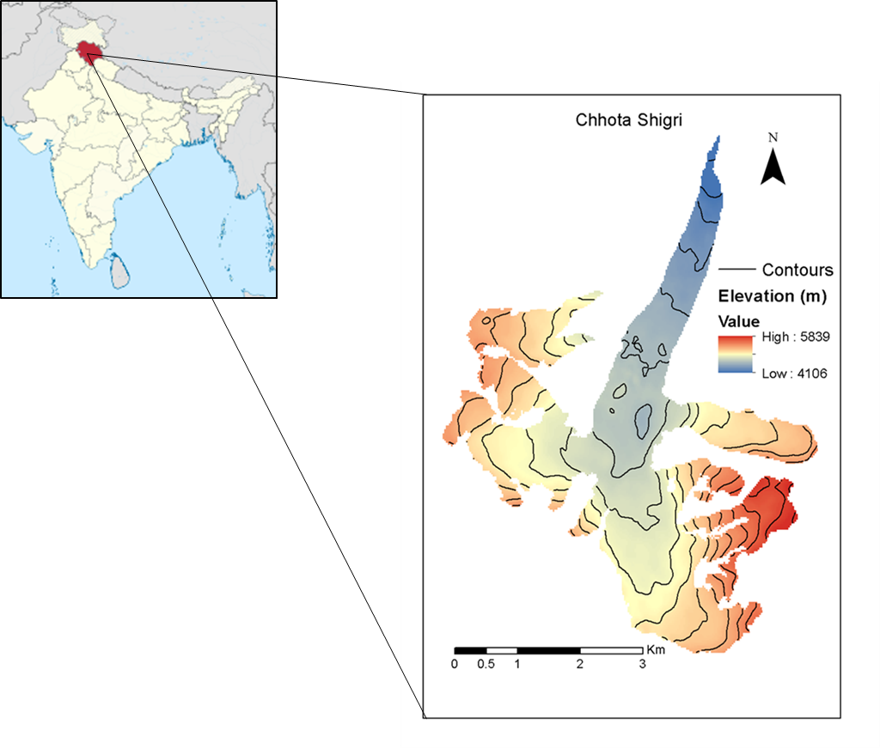
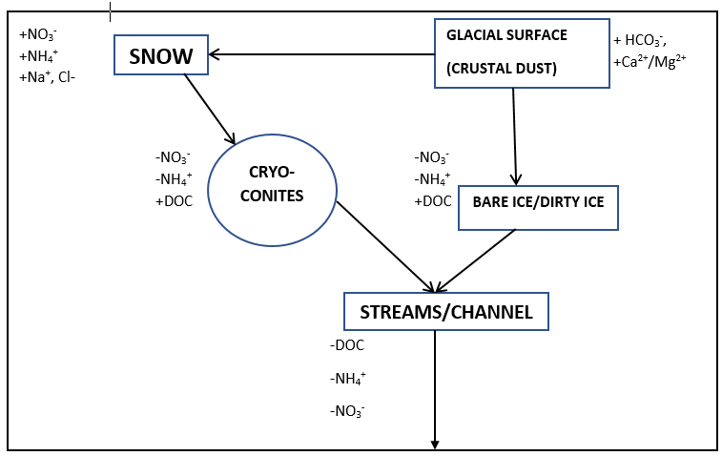
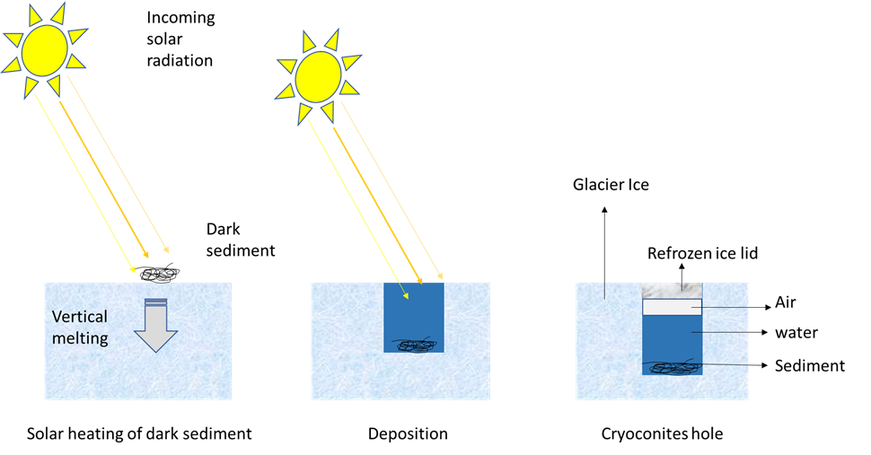
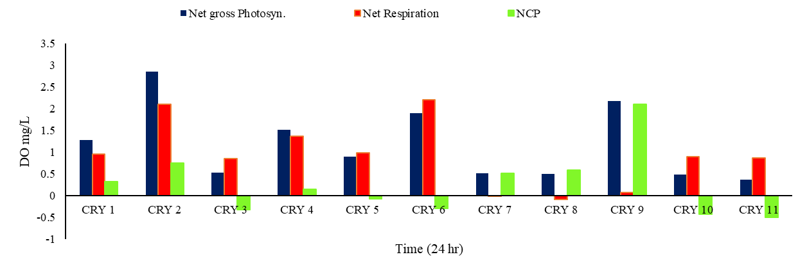
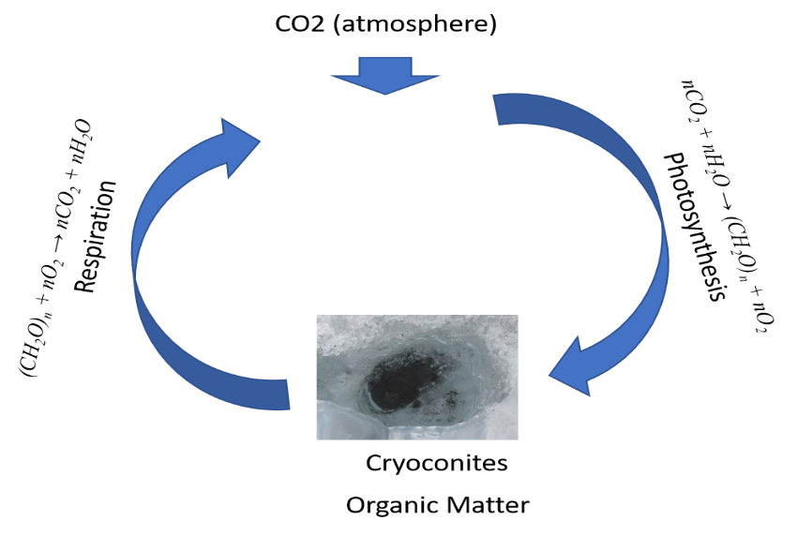
Role of Bio-albedo on the Glacier Health in the Chhota Shigri Glacier, Himachal Pradesh
Monica Sharma Shamurailatpam¹, Chris Yates², Jon Telling³, Jemma L Wadham² , AL Ramanathan¹
¹ School of Environmental Sciences, Jawaharlal Nehru University, India
² School of Geographical Sciences, University of Bristol, UK
³School of Natural and Environmental Sciences, Newcastle University
Introduction
Study Area
Figure. 1 Global glaciers (yellow) and their area (pie charts) (Bamber et al. 2018)
Figure 4. Map showing the location of Himachal Pradesh, Chhota Shigri Glacier (CSG), India.
Figure 6. Summary of the sources and sink of solute and nutrients in the Supraglacial environment (‘+’ indicates sources ‘-’ indicates sink).
Conclusion
Figure. 2 Formation of cryoconite hole in glacier surface
Results
Cryoconites may give an important bioavailable contribution of dissolved organic matter for proglacial and marine ecosystems, at least on an ecosystem scale.
Particulate organic carbon accumulation in cryoconites holes may ultimately contribute to further absorption of solar radiation and glacial melting.
Method
Figure.3 In-situ measurement of Dissolved Oxygen to measure the NEP of cryoconite holes.
Figure 5 In-situ measurement of DO to measure the Net Community Productivity in the cryoconites holes.

