Slide 1

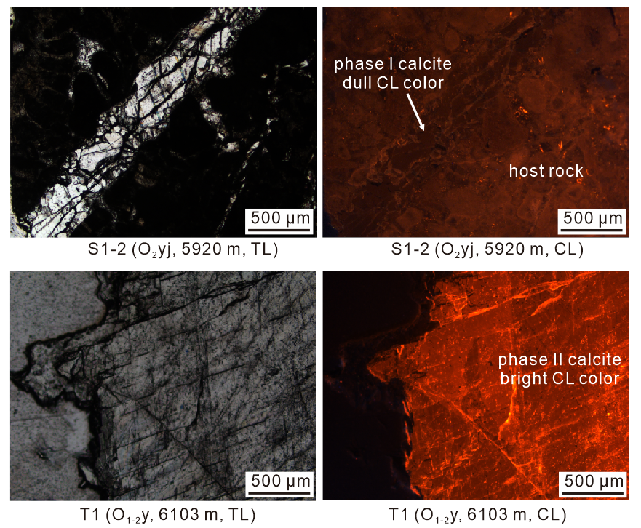
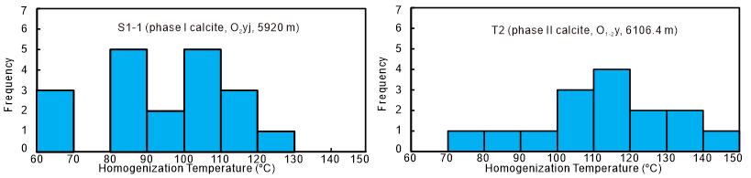
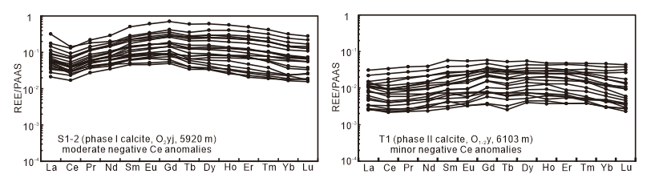
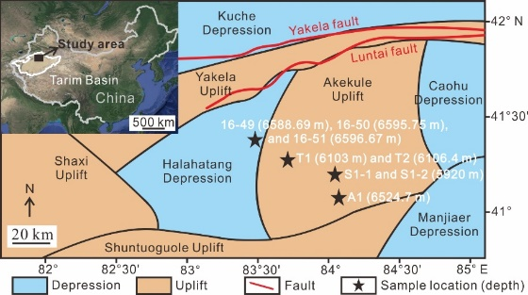
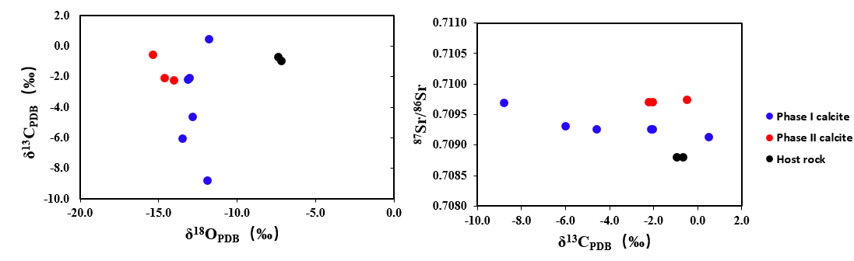
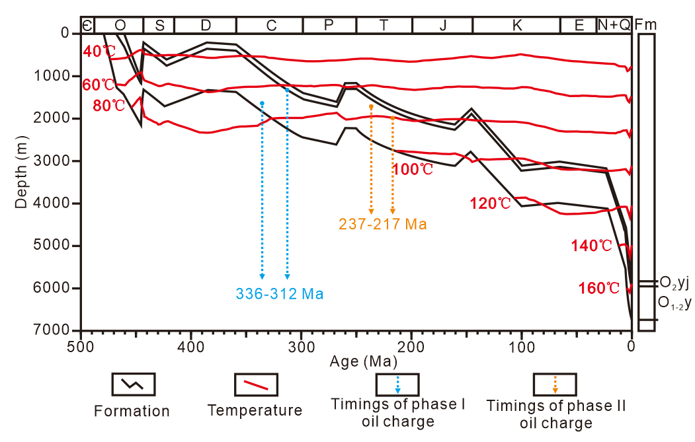
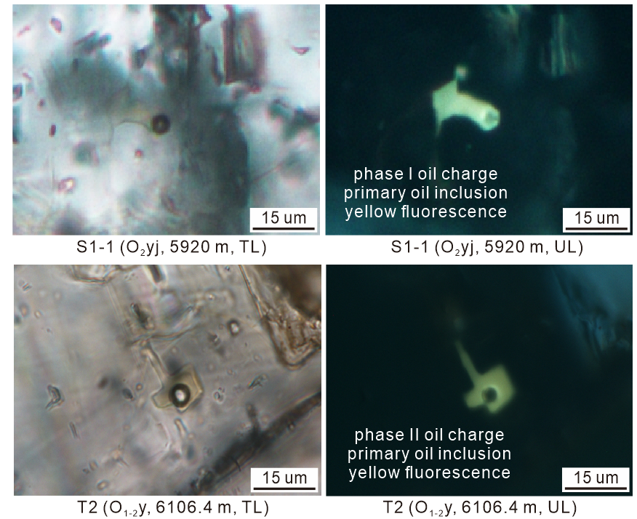
Determination of oil charge timing in the Ordovician carbonate reservoir of the Tahe Oilfield, Tarim Basin, NW China
Jiaxu Chen and Xiaowen Guo
Introduction
Phases of calcite veins
Homogenization temperatures of the aqueous inclusions, which coexisted with primary oil inclusions, ranged from 63.5 to 146.3 °C in phase I calcite and 75.1 to 148.5°C in phase II calcite, respectively (Fig. 6).
Determining the timings of oil charge in sedimentary basins are essential to understand the evolutionary histories of petroleum systems, especially in sedimentary basins with complicated tectonic evolution and thermal histories. The Ordovician carbonate reservoir in the Tahe Oilfield, which is located in the northern Tarim Basin, comprises the largest marine reservoirs in China with reserves up to 3.2×10⁸ t. Previous estimates for the ages of oil charge in the Ordovician reservoir of the Tahe Oilfield are still in dispute.
Phase I calcite shows uniform dull CL color (Fig. 2).
Phase II calcite shows uniform bright CL color.
Phase I calcite exhibits minor to moderate negative Ce anomalies (Fig. 3).
phase II calcite displays minor negative Ce anomalies.
Fig. 6 Histograms of homogenization temperatures for the aqueous inclusions that are coeval with primary oil inclusions in the calcite samples.
Objective
Fig. 2 Transmitted light (TL) and CL photomicrographs of the calcite veins.
Two phases of calcite veins containing primary oil inclusions indicated two phases of oil charge in the Ordovician reservoirs in the Tahe Oilfield. In our study, the smallest homogenization temperature of aqueous inclusions that were paragenetic with oil inclusions was used to identify timings of oil charge, combining the burial and geothermal histories. The timings of phase I oil charge could be inferred as 336–312 Ma, and the timings of phase II oil charge can be inferred as 237–217 Ma by the fluid inclusion method (Fig. 7).
This study aims to determine the timings of oil charge in the Ordovician carbonate reservoir in the Tahe Oilfield, Tarim Basin, which basin is subjected to multiple phases of tectonic deformations and oil charge.
Geological settings
The Tahe Oilfield, which covers an area of 2.4×10³ Km², is located in the northern Tarim Basin (Fig. 1). Crude oil has been discovered from the Ordovician carbonate reservoirs, Carboniferous sandstone reservoirs, and Triassic sandstone reservoirs, among which the Ordovician carbonate reservoir is the largest
Fig. 3 REE distribution patterns of calcite with two phases.
Fig. 4 The C, O, and Sr isotope composition of the calcite veins.
The C, O, and Sr isotope determinations revealed that phase I calcite exhibited wider ranges of δ¹³C, higher δ¹⁸O, and lower ⁸⁷Sr/⁸⁶Sr values compared to phase II calcite (Fig. 4).
Fig. 1 Sample locations used in the study from the Tahe Oilfield, Tarim Basin.
marine reservoirs in China with proved in-place reserves up to 3.2×10⁸ t. During the Caledonian and Hercynian periods, the Tahe Oilfield is subjected to multiple uplifts and denudations, which results in absence of upper Ordovician, Silurian, and Devonian strata.
Timings of oil charge
Fig. 7 Timings of oil charge determined by fluid inclusion analysis.
Most oil inclusions were comprised of two phases with a gas bubble at room temperature in the calcite samples from the Tahe Oilfield (Figs. 5). Oil inclusions with yellow fluorescence color were considered as primary oil inclusions, which were elongate in the direction of growth of the crystal.
Conclusions
Methods
The differences in CL color, Ce anomaly, δ¹⁸O, and ⁸⁷Sr/⁸⁶Sr values of calcite indicate two phases of calcite veins.
Primary oil inclusions with yellow fluorescence color occur in the two phases of calcite veins, indicating two phases of oil charge with yellow fluorescence.
The timings of phase I oil charge was 336–312 Ma, and the timings of phase II oil charge was 237–217 Ma.
The phases of calcite veins were systematically investigated by calcite cathodoluminescence (CL) observation, in situ rare earth elements (REE), and C, O, and Sr isotope analyses.
Fluid inclusion analysis on some samples was performed to identify oil charge history.
Fig. 5 TL and ultraviolet light photographs of two phases of oil charge.

