Slide 1





“Characterising the kinematics of the Joffre Peak landslides using a combined numerical modeling -remote sensing approach.”
Nicola Fullin¹, Monica Ghirotti¹, Davide Donati², and Doug Stead³
¹Dipartimento di Fisica e Scienze della Terra, Università di Ferrara, 44122, Ferrara, Italy. fllncl@unife.it
²Dipartimento di Ingegneria Civile, Chimica, Ambientale e dei Materiali - Università di Bologna, Viale del Risorgimento, 2, 40136 Bologna BO
³Department of Earth Sciences, Simon Fraser University, Burnaby, BC V5A 1S6, Canada.

Slide 2

OUTLINE
AIM OF THE WORK
SETTINGS
3D RECONSTRUCTION
SLOPE CHARACTERIZATION
NUMERICAL MODELING
CONCLUSIONS AND FUTURE WORKS
AIM OF THE WORK
SETTINGS
3D RECONSTRUCTION
SLOPE CHARACTERIZATION
NUMERICAL MODELING
CONCLUSIONS AND FUTURE WORKS
Characterising the kinematics of the Joffre Peak landslides using a combined numerical modeling -remote sensing approach
UNIFE
2

Slide 3
AIM OF THE WORK
AIM OF THE WORK
SETTINGS
3D RECONSTRUCTION
SLOPE CHARACTERIZATION
NUMERICAL MODELING
CONCLUSIONS AND FUTURE WORKS
IN THIS WORK IT WAS STUDIED THE EVOLUTION OF TWO LANDSLIDES HAPPENED ON 13th MAY AND ON 16th MAY 2019 FROM JOFFRE PEAK (B.C. CANADA) FOCUSING ON:
GEOMECHANICAL CHARACTERIZATION OF THE SLOPE
KINEMATIC ANALYSIS
ALL THESE ANALYSIS WERE PERFORMED USING REMOTE SENSING DATA AND POSSIBLE RESULTS WERE INVESTIGATED UTILIZING NUMERICAL MODELING.
Characterising the kinematics of the Joffre Peak landslides using a combined numerical modeling -remote sensing approach
UNIFE
3

Slide 4
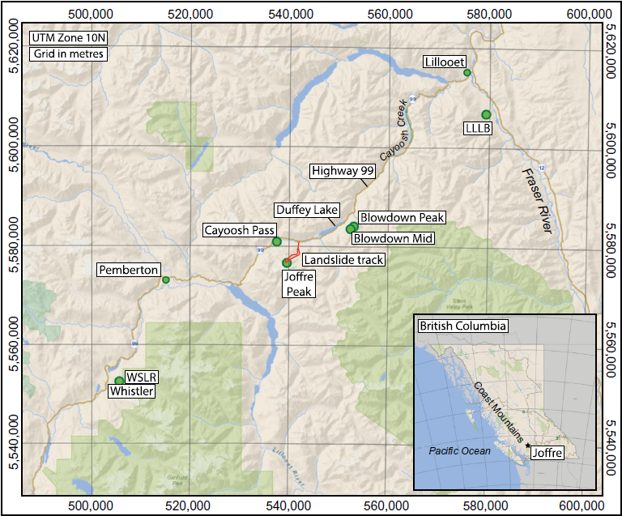
SETTINGS
AIM OF THE WORK
SETTINGS
3D RECONSTRUCTION
SLOPE CHARACTERIZATION
NUMERICAL MODELING
CONCLUSIONS AND FUTURE WORKS
Joffre Peak is located in southern British Columbia, along the Coast Mountain Belt (Canada)
Between the cities of Pemberton and Lillooet.
Friele et al. 2020
Characterising the kinematics of the Joffre Peak landslides using a combined numerical modeling -remote sensing approach
UNIFE
4

Slide 5
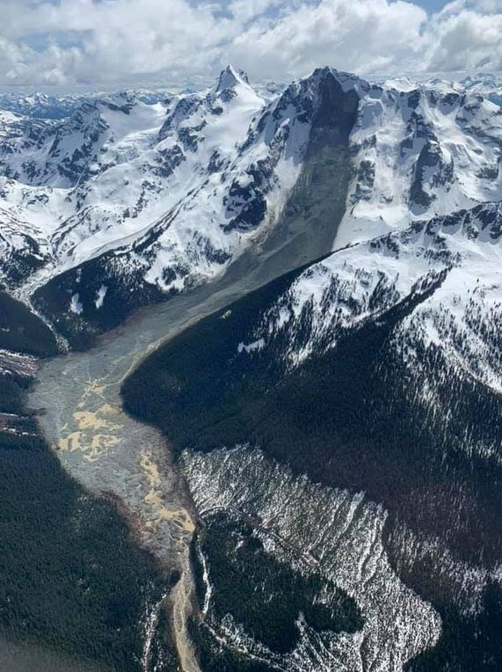
SETTINGS
300m
Both landslides after the detachment developed as rock avalanche and eventually they transformed in debris flow first and debris flood in the end. In toto both can be classified as complex movements.
Total volume involved
estimated is 5,3 Mm ³ .
AIM OF THE WORK
SETTINGS
3D RECONSTRUCTION
SLOPE CHARACTERIZATION
NUMERICAL MODELING
CONCLUSIONS AND FUTURE WORKS
moraine
Avalanche/Debris flow
transition
Friele et al.
2020
modified
Debris flow/Debris flood
transition
2,7 km from the crown
Characterising the kinematics of the Joffre Peak landslides using a combined numerical modeling -remote sensing approach
UNIFE
5

Slide 6
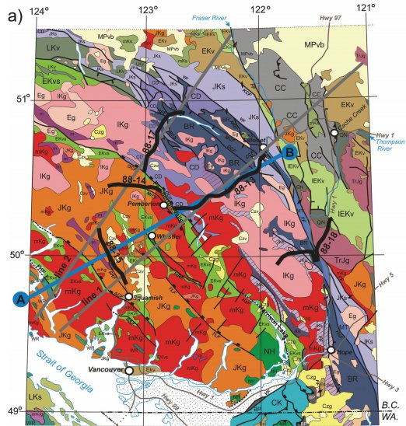
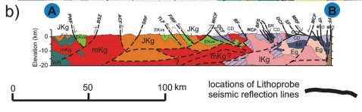
SETTINGS
Bustin et al. 2013
mKg= Plutonic rock (diorite) 110-90 Ma.
CD= Cadwallader Terrane;ophiolite + volcanic and sedimentary arc related rocks.
OCF=Owl Creek fault
BF= Birken fault
AIM OF THE WORK
SETTINGS
3D RECONSTRUCTION
SLOPE CHARACTERIZATION
NUMERICAL MODELING
CONCLUSIONS AND FUTURE WORKS
Characterising the kinematics of the Joffre Peak landslides using a combined numerical modeling -remote sensing approach
UNIFE
6

Slide 7
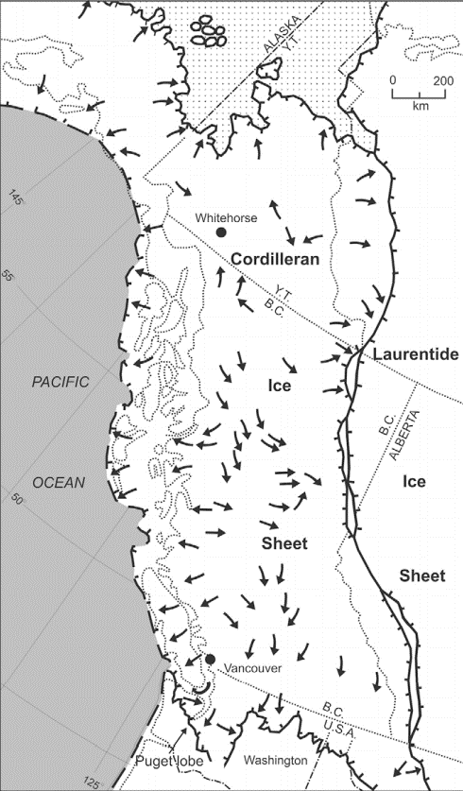
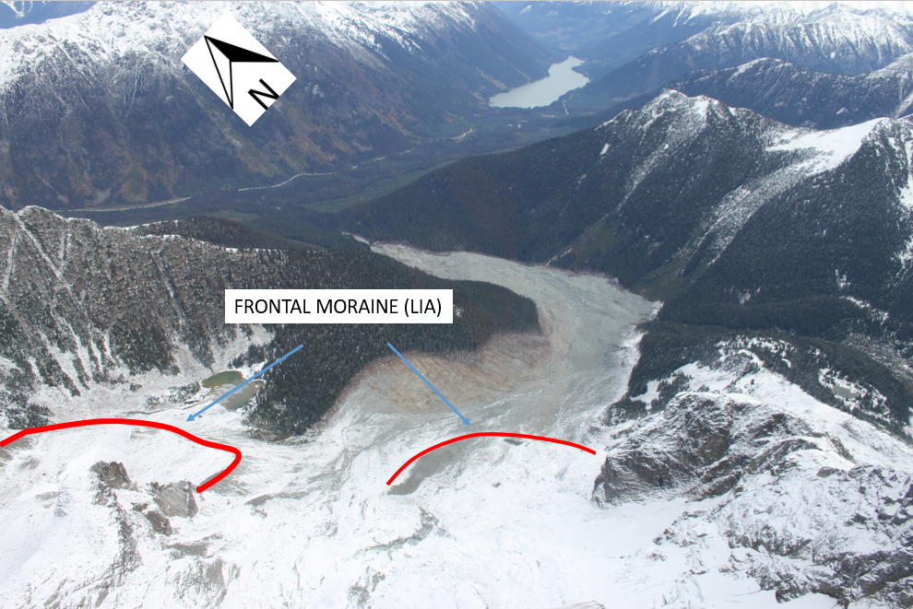
SETTINGS
Menounos
et al. 2009
AIM OF THE WORK
SETTINGS
3D RECONSTRUCTION
SLOPE CHARACTERIZATION
NUMERICAL MODELING
CONCLUSIONS AND FUTURE WORKS
The last glaciation, referred to as Fraser glaciation (Wurm in the Alps), reached its peak 18,000 year BP .The Cordilleran Ice Sheet reached a thickness of 2 km.
In the area object of this study are present many glacial morphologies .
Characterising the kinematics of the Joffre Peak landslides using a combined numerical modeling -remote sensing approach
UNIFE
7

Slide 8
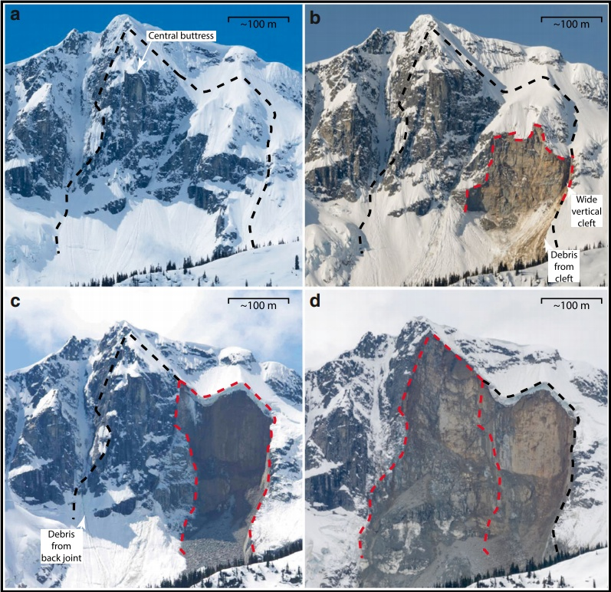
SETTINGS
Photograph of Joffre peak taken on May 1th 2017.
b) Photograph of Joffre Peak taken on May 6th2019 showing first signs of ongoing instability.
c) Delimited by red lines the first event on May 13th2019.
d) The following collapse of the adjacent part of the slope on May 16 th 2019
AIM OF THE WORK
SETTINGS
3D RECONSTRUCTION
SLOPE CHARACTERIZATION
NUMERICAL MODELING
CONCLUSIONS AND FUTURE WORKS
Friele
et al.
2020
Characterising the kinematics of the Joffre Peak landslides using a combined numerical modeling -remote sensing approach
UNIFE
8
Notes:
Guarda se mettere un’altra slide di frirele su permafrost melting fai un’altra slide triggering e altro
Distacco no crollo o cedimento

Slide 9
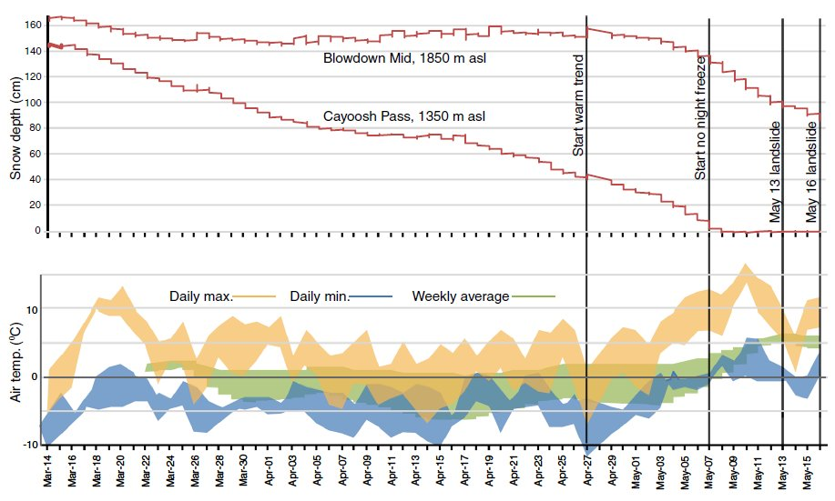
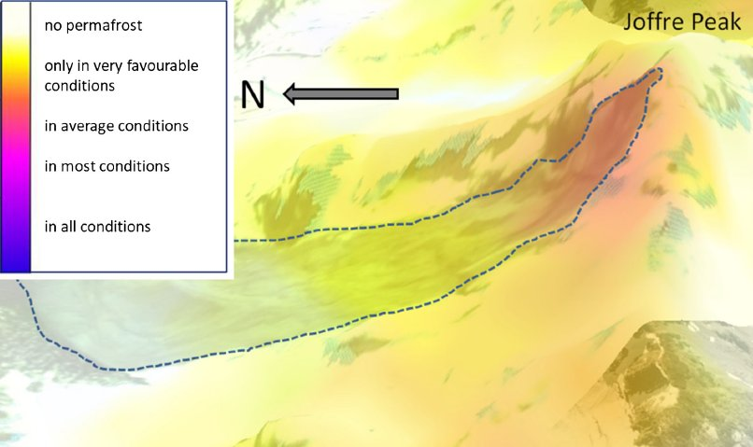
SETTINGS
AIM OF THE WORK
SETTINGS
3D RECONSTRUCTION
SLOPE CHARACTERIZATION
NUMERICAL MODELING
CONCLUSIONS AND FUTURE WORKS
IT WAS HYPOTIZED (FRIELE ET AL. 2020) THAT THE MAIN DRIVE WHOM CAUSED THE TRIGGERING OF THE LANDSLIDES WAS PORE PRESSURE DUE TO PERMAFROST MELTING FOR AN UNUSUAL WARM SPRING.
Friele et al. 2020
Characterising the kinematics of the Joffre Peak landslides using a combined numerical modeling -remote sensing approach
UNIFE
9
Notes:
Guarda se mettere un’altra slide di frirele su permafrost melting fai un’altra slide triggering e altro
Distacco no crollo o cedimento

Slide 10
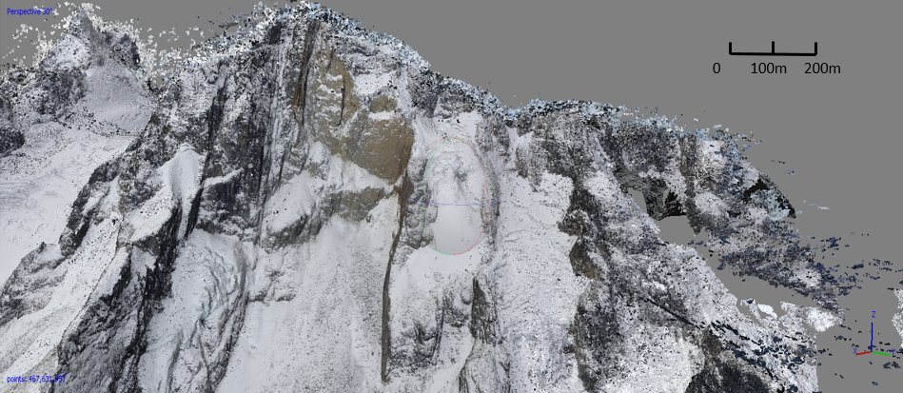
3D RECONSTRUCTION
3 DIFFERENT MODELS WERE RECREATED FOR DIFFERENT GOALS:
1 POST-LANDSLIDE:
USED FOR GEOMECHANICAL
CHARACTERIZATION
2 PRE-LANDSLIDE:
1 H.R. IN ORDER TO OBTAIN AN
ACCURATE SECTION
1 L.R. FOR USE IT AS BASE FOR NUMERICAL MODELING
POST-LANDSLIDE
AIM OF THE WORK
SETTINGS
3D RECONSTRUCTION
SLOPE CHARACTERIZATION
NUMERICAL MODELING
CONCLUSIONS AND FUTURE WORKS
Model obtained from photos collected during helicopter survey and subsequent SfM reconstruction on the software Metashape (Agisoft,2019)
Characterising the kinematics of the Joffre Peak landslides using a combined numerical modeling -remote sensing approach
UNIFE
10

Slide 11
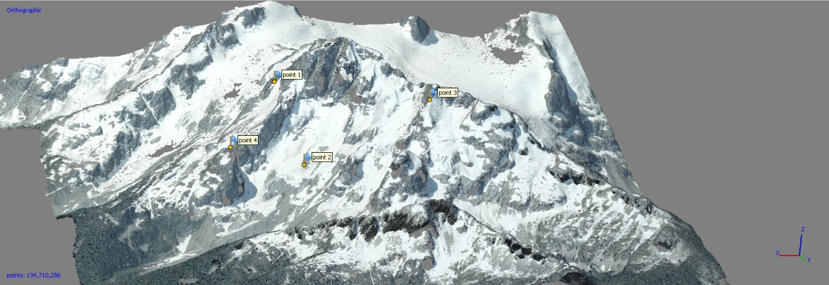
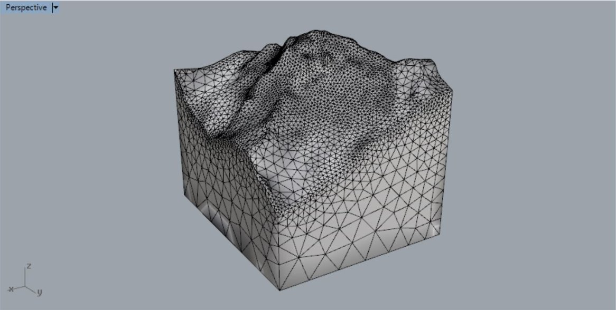
3D RECONSTRUCTION
PRE-LANDSLIDE
AIM OF THE WORK
SETTINGS
3D RECONSTRUCTION
SLOPE CHARACTERIZATION
NUMERICAL MODELING
CONCLUSIONS AND FUTURE WORKS
Model obtained with SfM methodology starting
from 4 aerial photographs
HIGH RESOLUTION
Model obtained from a DEM
LOW RESOLUTION
Characterising the kinematics of the Joffre Peak landslides using a combined numerical modeling -remote sensing approach
UNIFE
11

Slide 12
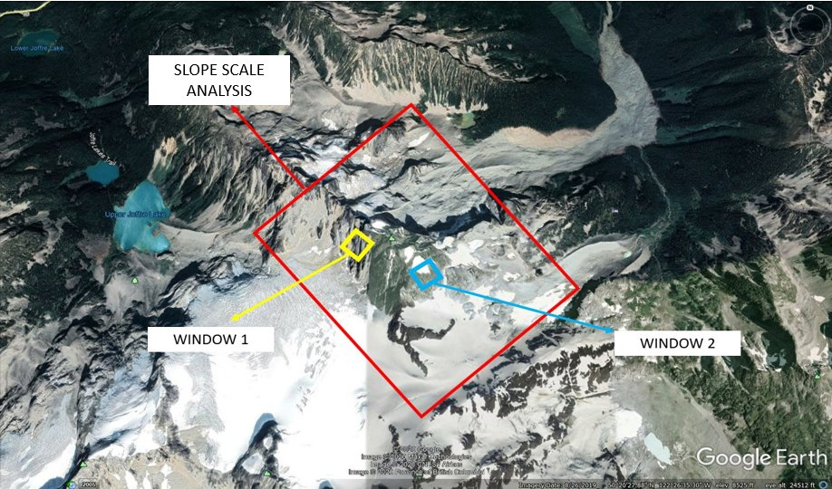
SLOPE CHARACTERIZATION
DISCONTINUITIES MAPPING
WAS PERFORMED AT 3
DIFFERENTS SCALE:
LINEAMENT ANALYSIS
SLOPE SCALE ANALYSIS
(RED RECTANGLE)
D>50m
3) SMALL SCALE ANALYSIS
(WINDOWS 1,2)
D<50m
AIM OF THE WORK
SETTINGS
3D RECONSTRUCTION
SLOPE CHARACTERIZATION
NUMERICAL MODELING
CONCLUSIONS AND FUTURE WORKS
Screenshot from Google Earth; every window misure almost 150x150m
Characterising the kinematics of the Joffre Peak landslides using a combined numerical modeling -remote sensing approach
UNIFE
12

Slide 13
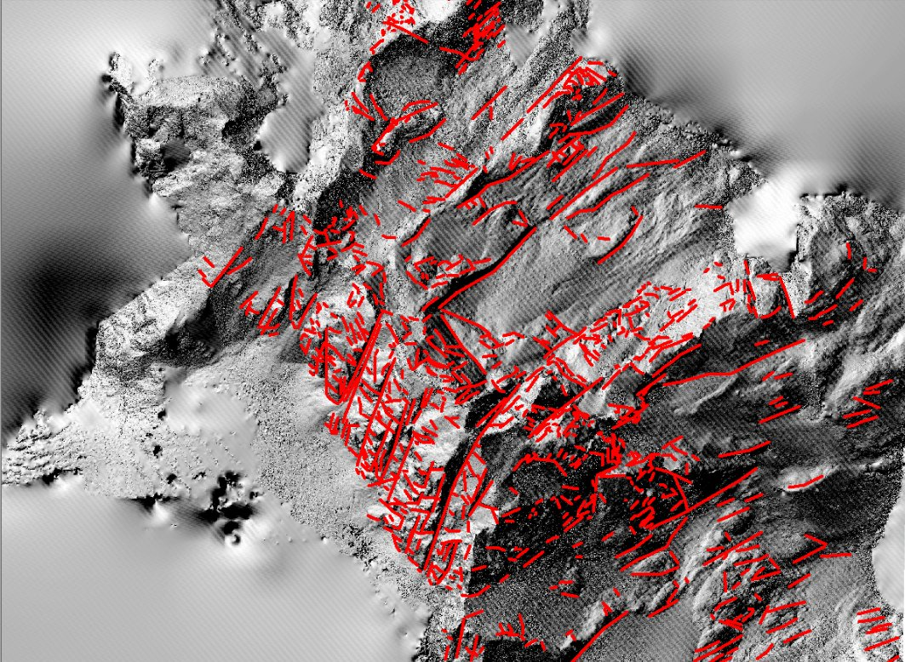
SLOPE CHARACTERIZATION
LINEAMENT ANALYSIS
AIM OF THE WORK
SETTINGS
3D RECONSTRUCTION
SLOPE CHARACTERIZATION
NUMERICAL MODELING
CONCLUSIONS AND FUTURE WORKS
THIS ANALYSIS WAS PERFORMED
IN ArcGIS (Esri,2014) ON A
HILLSHADE BASE OBTAINED FROM A DEM WITH A CELL SIZE OF 15,9 CM,
DRAWING ON ALL
THE VISIBLE LINEAMENTS
IN THE MAP.
Screenshot of the Hillshade on ArcGIS
Characterising the kinematics of the Joffre Peak landslides using a combined numerical modeling -remote sensing approach
UNIFE
13

Slide 14
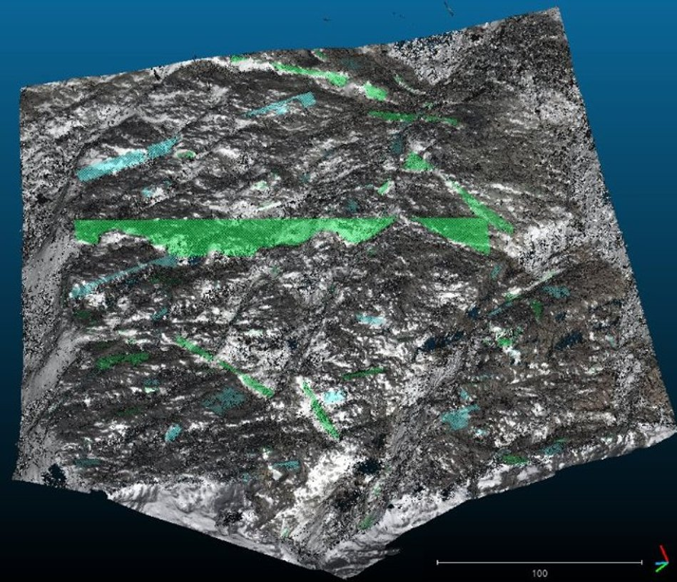
SLOPE CHARACTERIZATION
SLOPE AND SMALL SCALE ANALYSIS
AIM OF THE WORK
SETTINGS
3D RECONSTRUCTION
SLOPE CHARACTERIZATION
NUMERICAL MODELING
CONCLUSIONS AND FUTURE WORKS
THIS CHARACTERIZATION WAS CONDUCTED DRAWING MANY PLANES FOR EACH DISCONTINUITIES IN THE SOFTWARE CLOUDCOMPARE (2.10alpha (2016)),
USING AS BASE THE
POST-LANDSLIDE MODEL AND MANY CUTTINGS OF IT.
Screenshot from CloudCompare of window 1
Characterising the kinematics of the Joffre Peak landslides using a combined numerical modeling -remote sensing approach
UNIFE
14

Slide 15
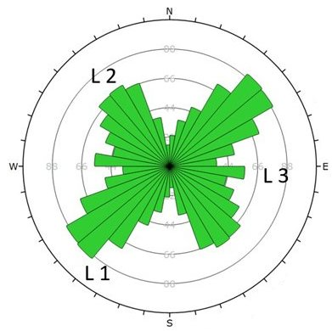
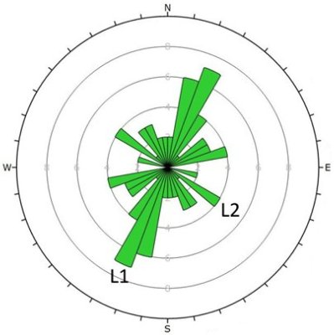
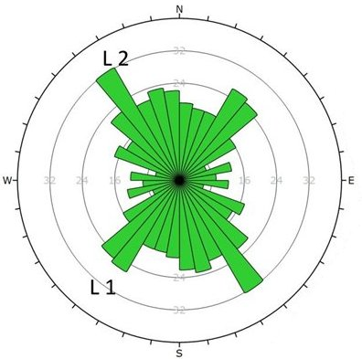
SLOPE CHARACTERIZATION
RESULTS OF ROSETTE PLOTS
FROM DIPS (Rocscience)
TWO MAIN LINEAMENTS: L1= strike N 30°/40° E
L2= strike N 130°/140° E
AIM OF THE WORK
SETTINGS
3D RECONSTRUCTION
SLOPE CHARACTERIZATION
NUMERICAL MODELING
CONCLUSIONS AND FUTURE WORKS
LARGE LINEAMENTS
SLOPE SCALE
SMALL SCALE
Characterising the kinematics of the Joffre Peak landslides using a combined numerical modeling -remote sensing approach
UNIFE
15

Slide 16
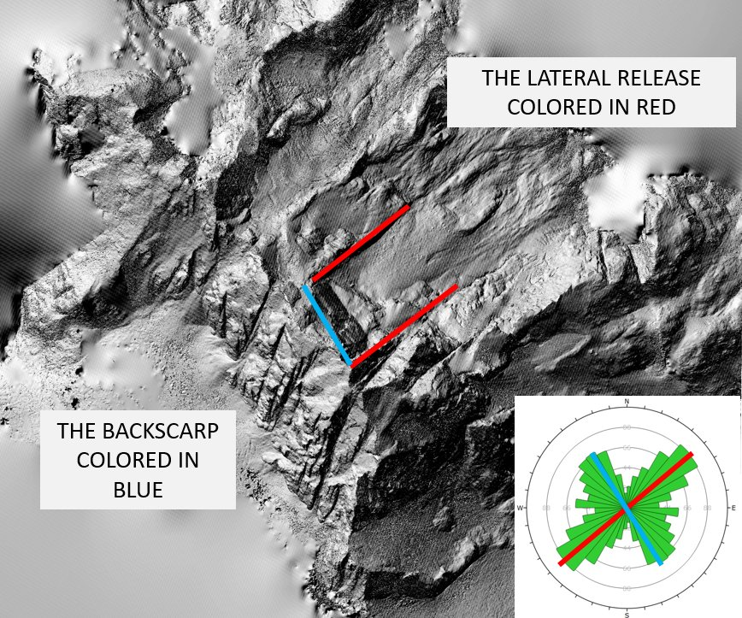
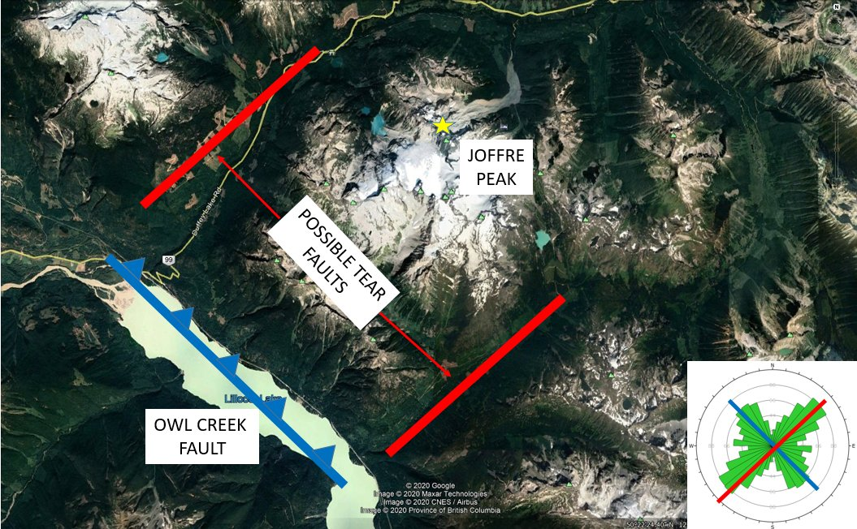
SLOPE CHARACTERIZATION
AIM OF THE WORK
SETTINGS
3D RECONSTRUCTION
SLOPE CHARACTERIZATION
NUMERICAL MODELING
CONCLUSIONS AND FUTURE WORKS
CORRELATION
BETWEEN RESULTS AND
EVIDENCE
MOST OF THE ROCK AVALANCHES
DETACH FROM HIGH PERSISTENCE
REGIONAL DISCONTINUITIES
Characterising the kinematics of the Joffre Peak landslides using a combined numerical modeling -remote sensing approach
UNIFE
16
Notes:
Rock avalanche, minimo un 1Mm3 necessitano pe rla mobilizzazione di svincoli cinematica ad elevata persistenza, nella maggior parte faglie

Slide 17
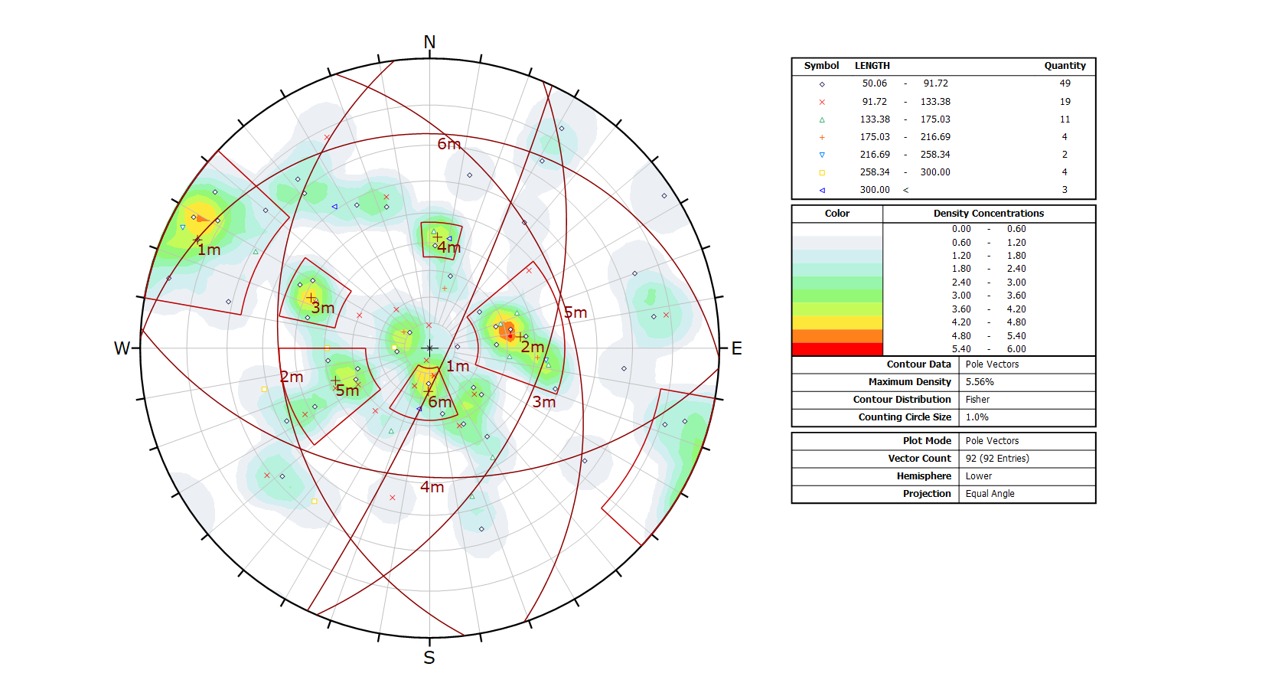
SLOPE CHARACTERIZATION
SLOPE SCALE RESULTS
FROM DIPS
AIM OF THE WORK
SETTINGS
3D RECONSTRUCTION
SLOPE CHARACTERIZATION
NUMERICAL MODELING
CONCLUSIONS AND FUTURE WORKS
SET NUMBER | DIP DIRECTION | DIP (°)
D1 | N 115° E | 83°
D2 | N 263° E | 35°
D3 | N 113° E | 48°
D4 | N 184° E | 42°
D5 | N 071° E | 38°
D6 | N 002° E | 17°
Characterising the kinematics of the Joffre Peak landslides using a combined numerical modeling -remote sensing approach
UNIFE
17

Slide 18
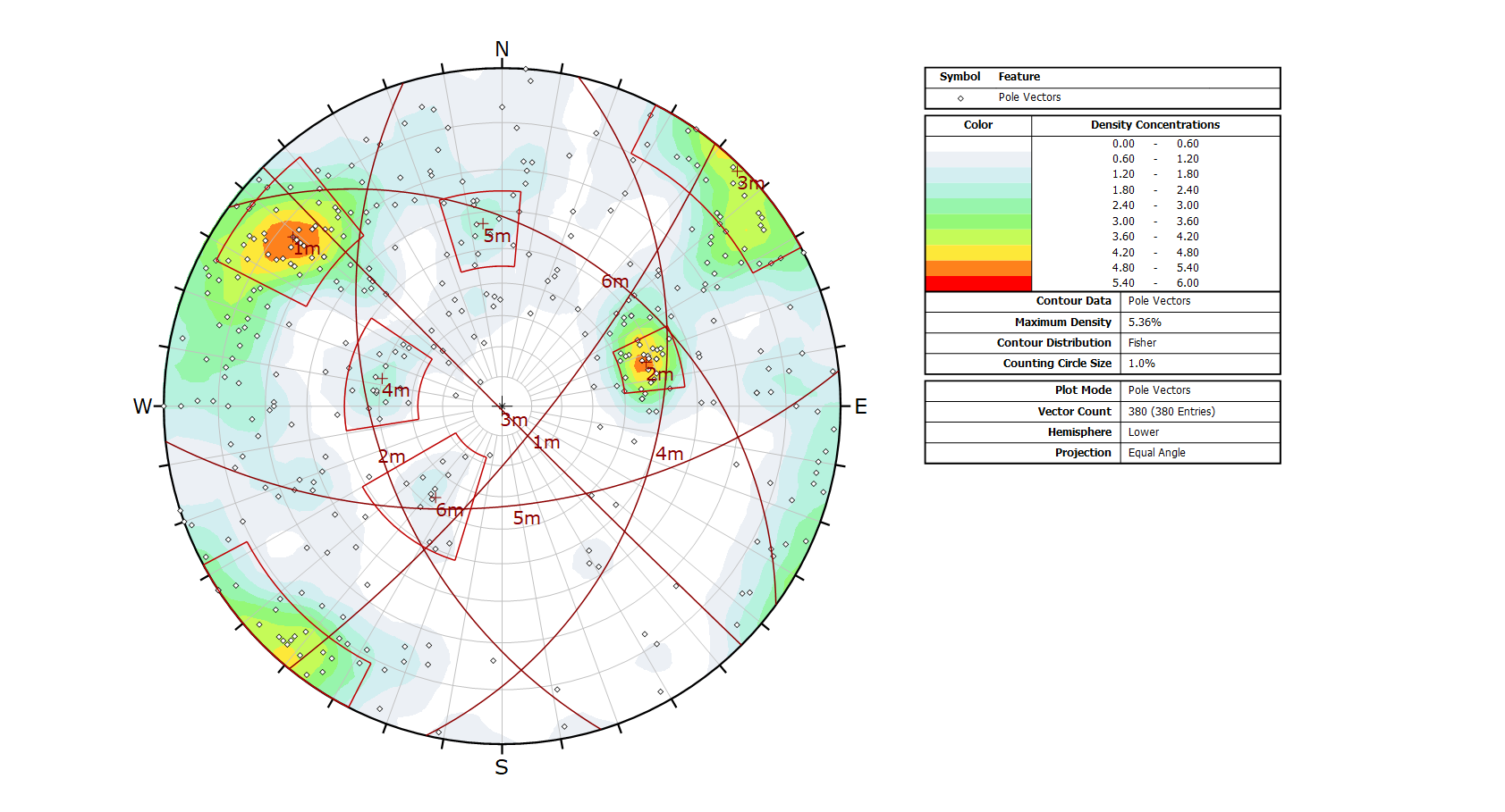
SLOPE CHARACTERIZATION
SMALL SCALE RESULTS
FROM DIPS
AIM OF THE WORK
SETTINGS
3D RECONSTRUCTION
SLOPE CHARACTERIZATION
NUMERICAL MODELING
CONCLUSIONS AND FUTURE WORKS
SET NUMBER | DIP DIRECTION | DIP (°)
D1 | N 129° E | 77°
D2 | N 253° E | 48°
D3 | N 225° E | 89°
D4 | N 103° E | 40°
D5 | N 174° E | 57°
D6 | N 036° E | 37°
Characterising the kinematics of the Joffre Peak landslides using a combined numerical modeling -remote sensing approach
UNIFE
18

Slide 19
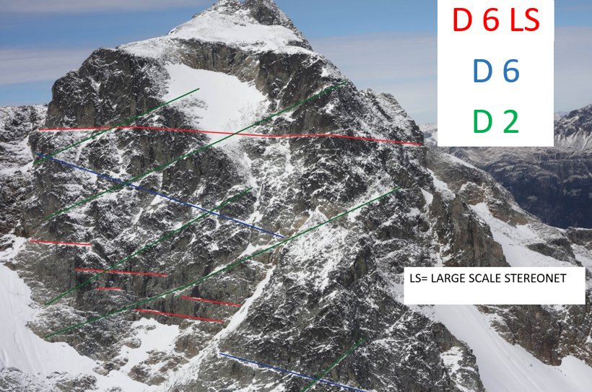
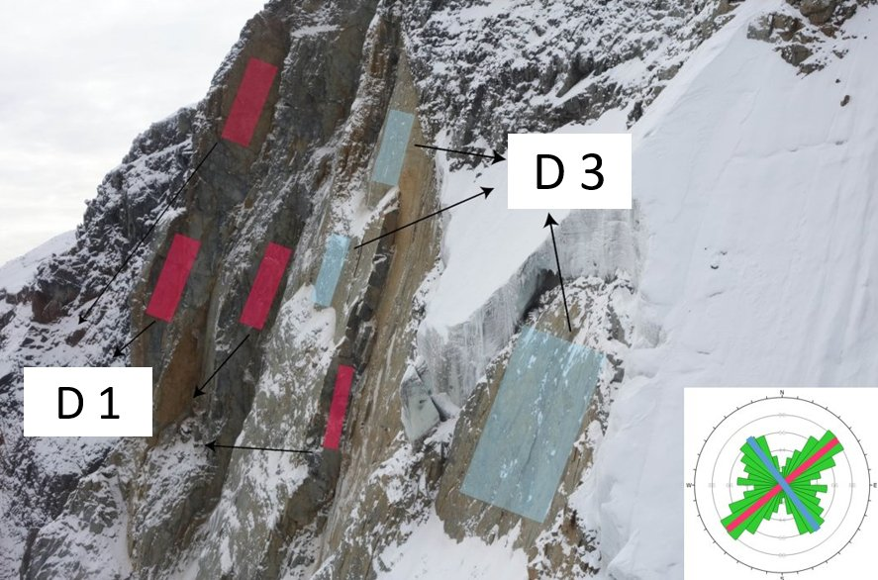
SLOPE CHARACTERIZATION
AIM OF THE WORK
SETTINGS
3D RECONSTRUCTION
SLOPE CHARACTERIZATION
NUMERICAL MODELING
CONCLUSIONS AND FUTURE WORKS
CORRELATION
BETWEEN RESULTS AND
EVIDENCE
Characterising the kinematics of the Joffre Peak landslides using a combined numerical modeling -remote sensing approach
UNIFE
19

Slide 20
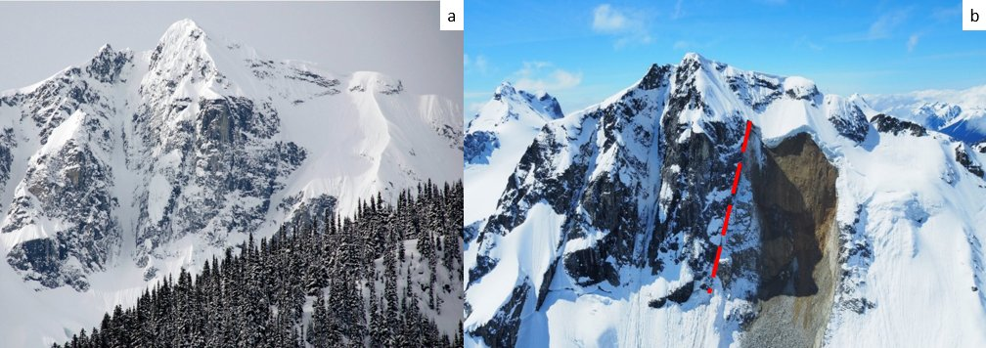
SLOPE CHARACTERIZATION
KINEMATIC ANALYSIS
AIM OF THE WORK
SETTINGS
3D RECONSTRUCTION
SLOPE CHARACTERIZATION
NUMERICAL MODELING
CONCLUSIONS AND FUTURE WORKS
THIS ANALYSIS WAS
PERFORMED CONSIDERING
TWO DIFFERENT SLOPE CONFIGURATION DUE TO THE EVOLUTION
OF THE LANDSLIDES
FOR EVERY KINEMATISM.
Joffre peak before the landslide (photo by Sharon Bader) b) The Joffe Peak landslide on May 13th 2019; it is possible to see how after the first event the configuration of the slope change dramatically (with the red line it is underline the limit between the two landslide), for this reason It was decided to undertake two different kinematics analysis (photograph from Geohazard report taken on May 13th 2019 by Pierre Friele).
Characterising the kinematics of the Joffre Peak landslides using a combined numerical modeling -remote sensing approach
UNIFE
20

Slide 21
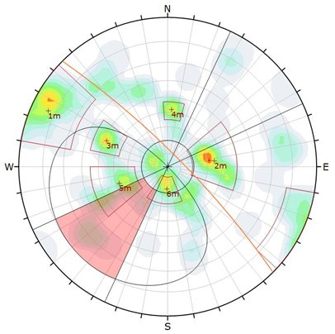
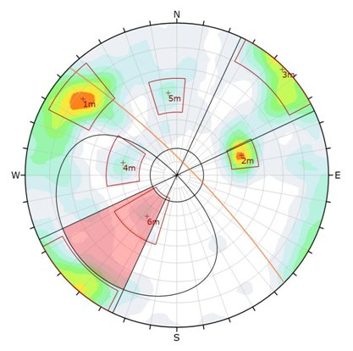
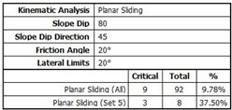
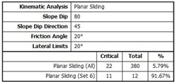
SLOPE CHARACTERIZATION
SLOPE SCALE
D >50M
SMALL SCALE
D <50M
AIM OF THE WORK
SETTINGS
3D RECONSTRUCTION
SLOPE CHARACTERIZATION
NUMERICAL MODELING
CONCLUSIONS AND FUTURE WORKS
FIRST EVENT:
PLANAR SLIDING
Characterising the kinematics of the Joffre Peak landslides using a combined numerical modeling -remote sensing approach
UNIFE
21

Slide 22
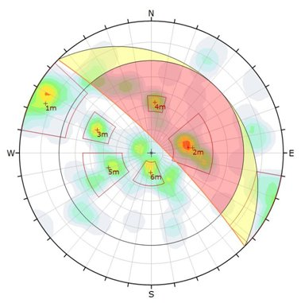
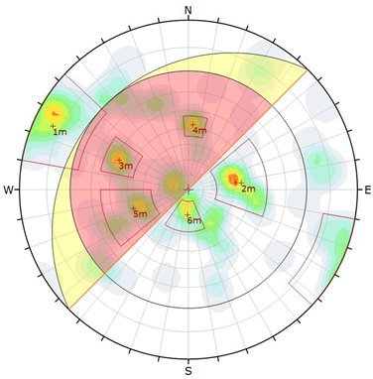
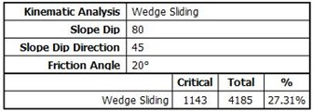
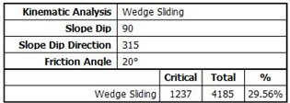
SLOPE CHARACTERIZATION
AIM OF THE WORK
SETTINGS
3D RECONSTRUCTION
SLOPE CHARACTERIZATION
NUMERICAL MODELING
CONCLUSIONS AND FUTURE WORKS
FIRST VS SECOND EVENT:
WEDGE SLIDING
Characterising the kinematics of the Joffre Peak landslides using a combined numerical modeling -remote sensing approach
UNIFE
22

Slide 23
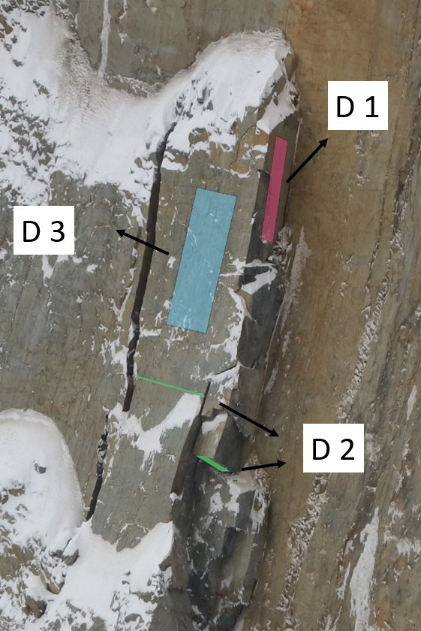
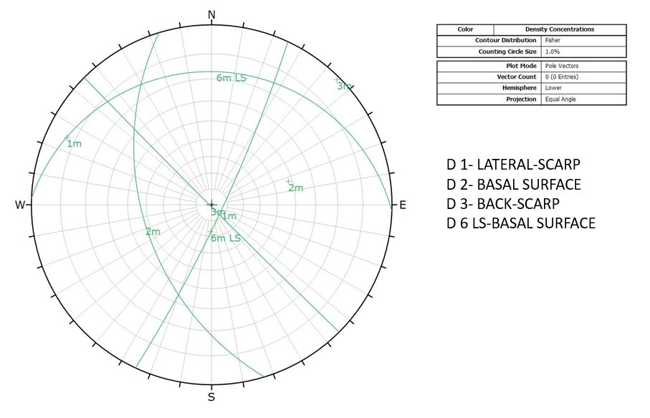
SLOPE CHARACTERIZATION
POSSIBLE RESULTS AND EVIDENCES
AIM OF THE WORK
SETTINGS
3D RECONSTRUCTION
SLOPE CHARACTERIZATION
NUMERICAL MODELING
CONCLUSIONS AND FUTURE WORKS
Characterising the kinematics of the Joffre Peak landslides using a combined numerical modeling -remote sensing approach
UNIFE
23

Slide 24
NUMERICAL MODELING
CONSIDERING THAT THESE LANDSLIDES DETACHED CLEARLY CONTROLLED BY DISCONTINUITIES , IT WAS DECIDED TO USE A DISTINCT ELEMENT CODE , 3DEC (ITASCA), TO STUDY BETTER THE EVOLUTION OF THE PROCESSES .
IN PARTICULAR IT WAS FOLLOWED THIS PATH:
RECONSTRUCTION OF THE GEOMETRY
VALIDATION OF THE GEOMETRY
DESCRIPTION OF THE RESULTS
AIM OF THE WORK
SETTINGS
3D RECONSTRUCTION
SLOPE CHARACTERIZATION
NUMERICAL MODELING
CONCLUSIONS AND FUTURE WORKS
Characterising the kinematics of the Joffre Peak landslides using a combined numerical modeling -remote sensing approach
UNIFE
24

Slide 25
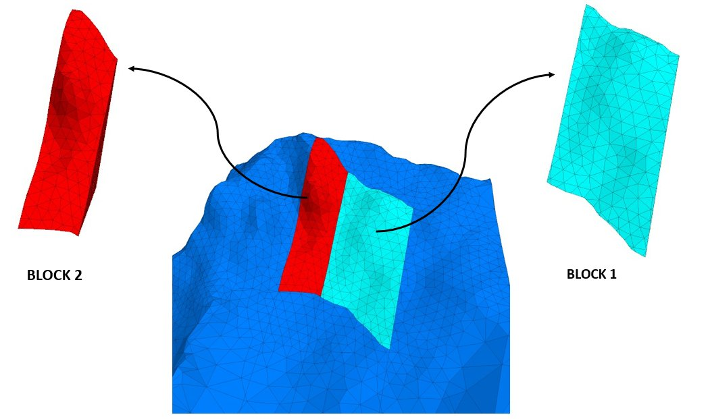
NUMERICAL MODELING
GEOMETRY RECONSTRUCTION
AIM OF THE WORK
SETTINGS
3D RECONSTRUCTION
SLOPE CHARACTERIZATION
NUMERICAL MODELING
CONCLUSIONS AND FUTURE WORKS
STARTING FROM THE LOW
RESOLUTION MODEL,
DISCONTINUITIES WERE ADDED
IMPLEMENTING COORDINATES
FROM CLOUDCOMPARE.
IN PARTICOLAR THESE DISCONTINUITIES WERE ADDED:
N 135°E/75° (lateral release)
N 50°E/ 71° (rear release)
N 2°E/ 23° (basal surface)
Screenshot from 3DEC where it is shown the nomenclature adopted
to classify the two different events
Characterising the kinematics of the Joffre Peak landslides using a combined numerical modeling -remote sensing approach
UNIFE
25

Slide 26
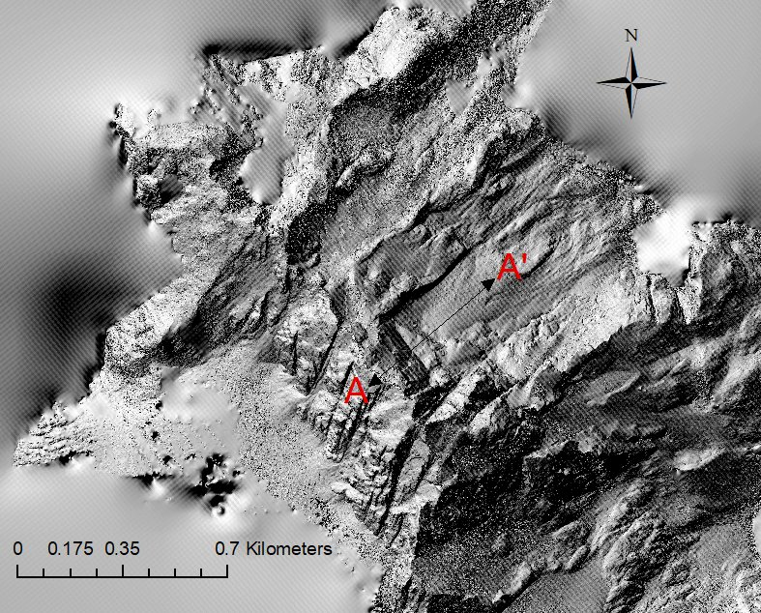
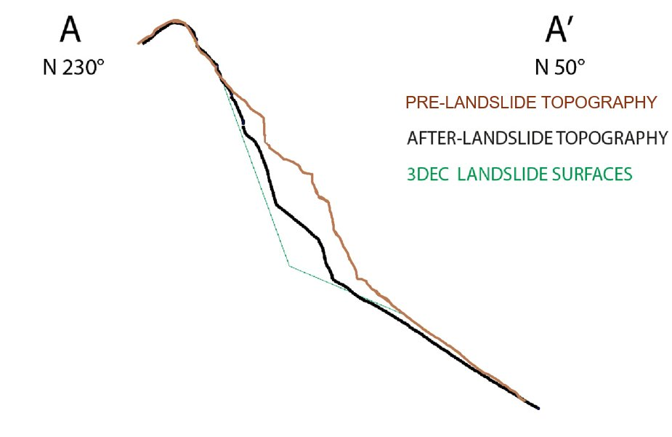
NUMERICAL MODELING
GEOMETRY VALIDATION
AIM OF THE WORK
SETTINGS
3D RECONSTRUCTION
SLOPE CHARACTERIZATION
NUMERICAL MODELING
CONCLUSIONS AND FUTURE WORKS
IN ORDER TO VALIDATE THE
GEOMETRY OBTAINED IT WAS
CALCOLATED ON 3DEC THE
SUMMA OF BLOCKS OF “BLOCK 1”AND “BLOCK 2” OBTAINING A
VALUE OF 6,3 Mm³,CONSIDERED
ACCEPTABLE IN CONFRONT OF
LITERATURE ( 5,3 Mm³ Friele et al.2020).
FURTHERMORE 3 DIFFERENT PROFILE WERE COMPARETED, OBTAINING GOOD SIMILARITY BETWEEN THEM.
Screenshot of the hillshade where it is shown the trace of profiles
Characterising the kinematics of the Joffre Peak landslides using a combined numerical modeling -remote sensing approach
UNIFE
26

Slide 27
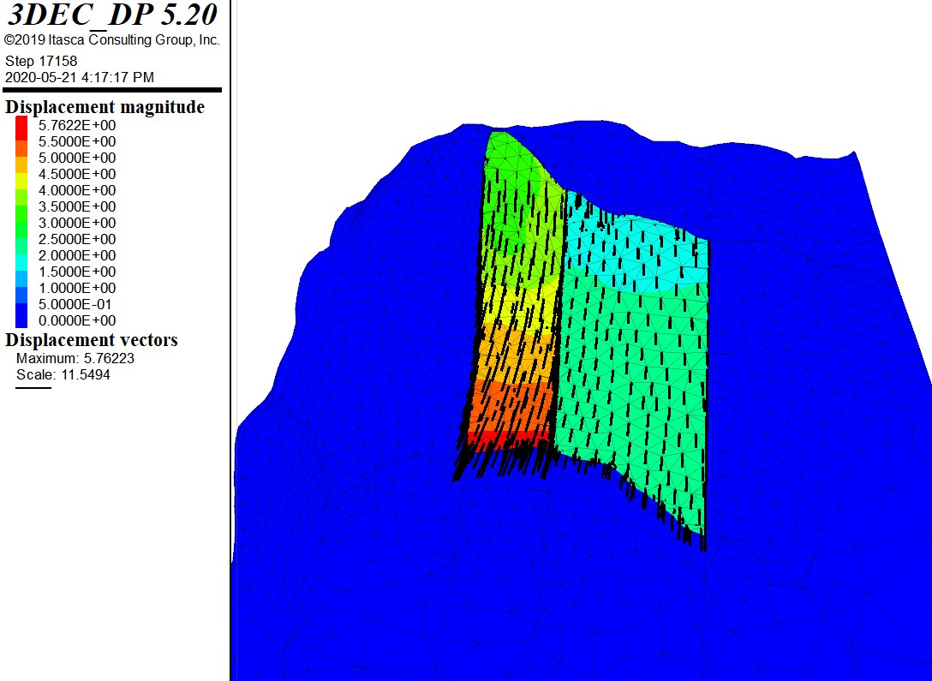
NUMERICAL MODELING
DESCRIPTION OF RESULTS
AIM OF THE WORK
SETTINGS
3D RECONSTRUCTION
SLOPE CHARACTERIZATION
NUMERICAL MODELING
CONCLUSIONS AND FUTURE WORKS
THE FIRST SIMULATION RESULT SHOWS
THAT THE FAILURE OCCURRED IN A SINGLE
EVENT, INSTEAD OF TWO STAGES AS IN REALITY, SO TWO DIFFERENT HYPHOTESIS WERE UNDERTAKEN:
SCENARIO 1 (DIFFERENT AMOUNT OF ROCK BRIDGES)
SCENARIO 2 (DIFFERENT GEOMETRY OF BASAL SURFACE)
Parameters | Basal surface “block 1” | Basal surface “block 2”
JKN | 1e8 Pa/m | 1e8 Pa/m
JKS | 1e7 Pa/m | 1e7 Pa/m
Φ | 12° | 12°
c | 0 | 0
Screenshot from 3DEC of the first simulation
Characterising the kinematics of the Joffre Peak landslides using a combined numerical modeling -remote sensing approach
UNIFE
27

Slide 28
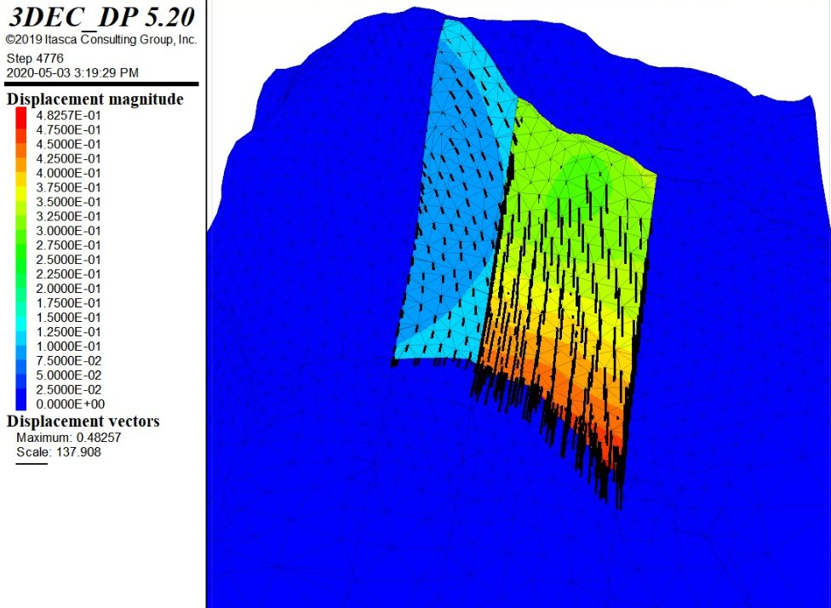
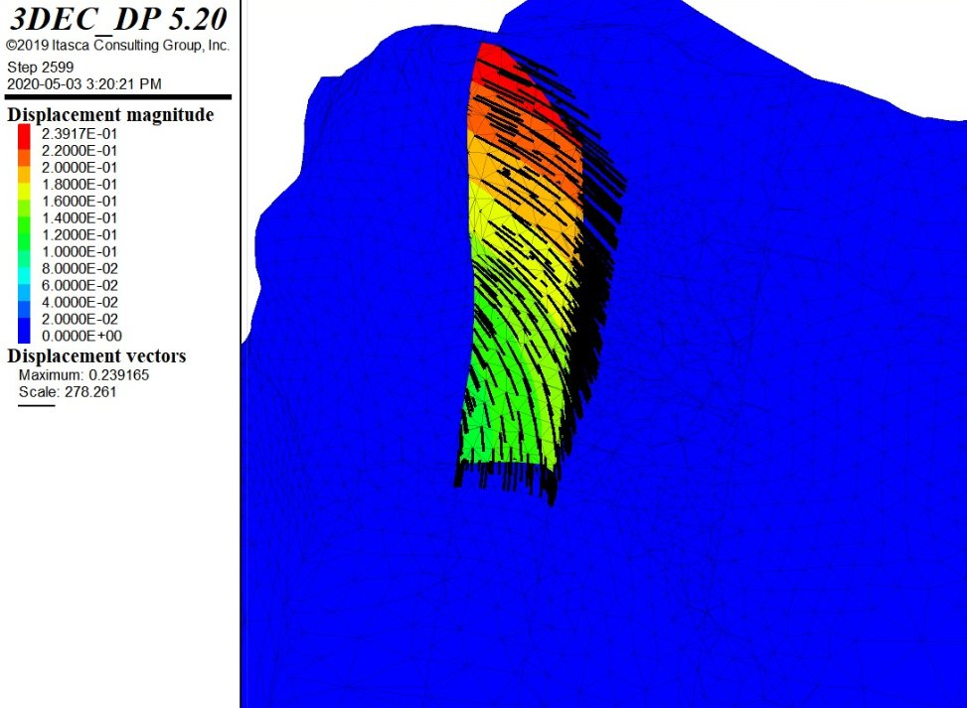
NUMERICAL MODELING
SCENARIO 1:
ROCK BRIDGES
UNDER BLOCK 2
Parameters | Basal surface “block 1” | Basal surface “block 2”
JKN | 1e8 Pa/m | 1e8 Pa/m
JKS | 1e7 Pa/m | 1e7 Pa/m
Φ (at failure) | 12° | 12°
c | 0 | 1e6 Pa
AIM OF THE WORK
SETTINGS
3D RECONSTRUCTION
SLOPE CHARACTERIZATION
NUMERICAL MODELING
CONCLUSIONS AND FUTURE WORKS
Characterising the kinematics of the Joffre Peak landslides using a combined numerical modeling -remote sensing approach
UNIFE
28

Slide 29
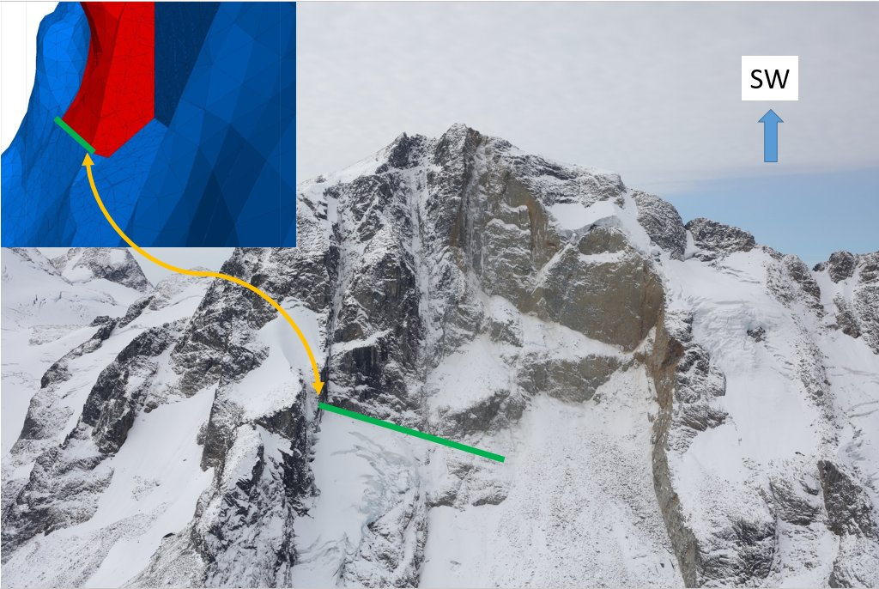
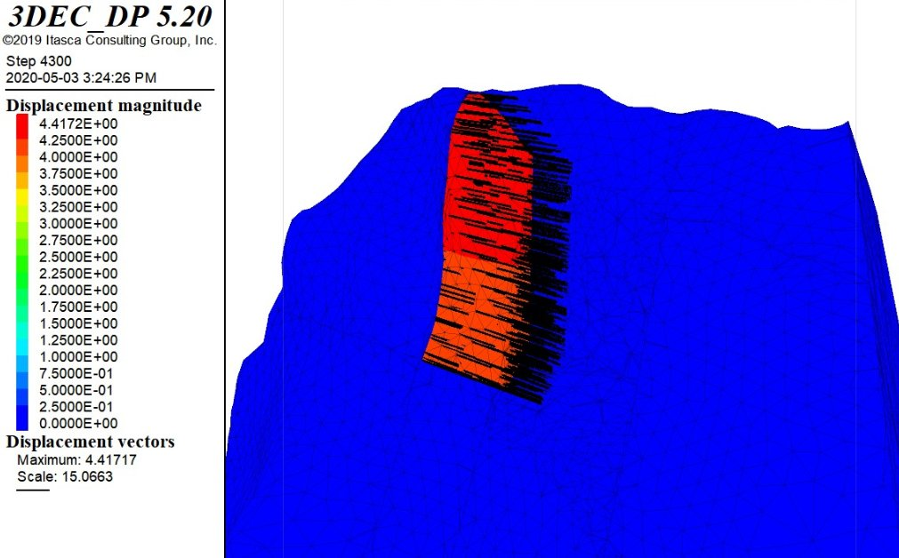
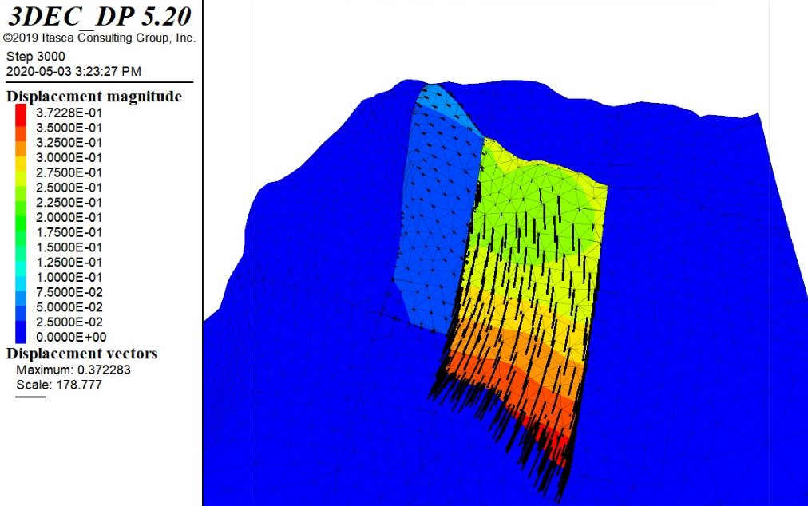
NUMERICAL MODELING
SCENARIO 2:
DIFFERENT BASAL GEOMETRY
Parameters | Basal surface “block 1” | Basal surface “block 2”
JKN | 1e8 Pa/m | 1e8 Pa/m
JKS | 1e7 Pa/m | 1e7 Pa/m
Φ | 12° | 12°
c | 0 | 0
AIM OF THE WORK
SETTINGS
3D RECONSTRUCTION
SLOPE CHARACTERIZATION
NUMERICAL MODELING
CONCLUSIONS AND FUTURE WORKS
BASAL SURFACE OBTAINED
COMBINED TOGETHER TWO
DIFFERENT SETS:
D 6 LS + D 2
Characterising the kinematics of the Joffre Peak landslides using a combined numerical modeling -remote sensing approach
UNIFE
29

Slide 30
CONCLUSIONS AND FUTURE WORKS
THE SETS THAT CONTROLLED THE INSTABILITY WERE RECOGNIZED .
USING NUMERICAL MODELING IT WAS POSSIBLE HYPOTIZE THAT THE FIRST EVENT COLLAPSED AS PLANAR SLIDING AND THE SECOND AS A WEDGE SLIDING.
THE BLOCK 1 PLAYED AS A KEY BLOCK FOR THE SECOND ONE.
AIM OF THE WORK
SETTINGS
3D RECONSTRUCTION
SLOPE CHARACTERIZATION
NUMERICAL MODELING
CONCLUSIONS AND FUTURE WORKS
NEXT STEPS IN FUTURE WORKS
CONSIDER PORE PRESSURE AND SLOPE WEAKENING IN MODELING STAGE.
DETERMINE THE KIND OF DISCONTINUITIES (JOINT/FAULT).
USING FEM/FDEM CODE TO GIVE AN APPROPRIATE VALUE OF COHESION IN
ORDER TO SIMULATE BETTER ROCK BRIDGES.
ADDITIONAL DATA COLLECTION UNDER BETTER CLIMATIC CONDITIONS.
Characterising the kinematics of the Joffre Peak landslides using a combined numerical modeling -remote sensing approach
UNIFE
30

