Slide 1
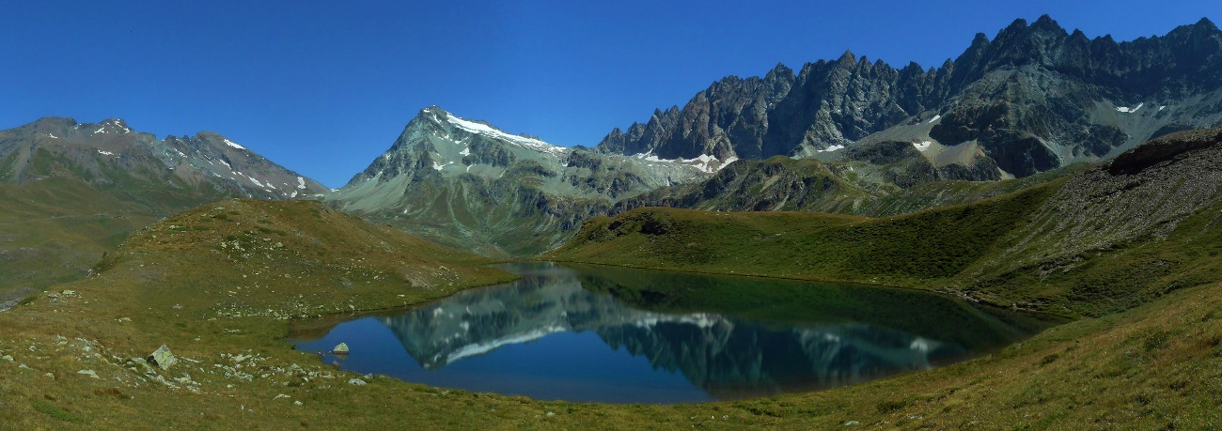
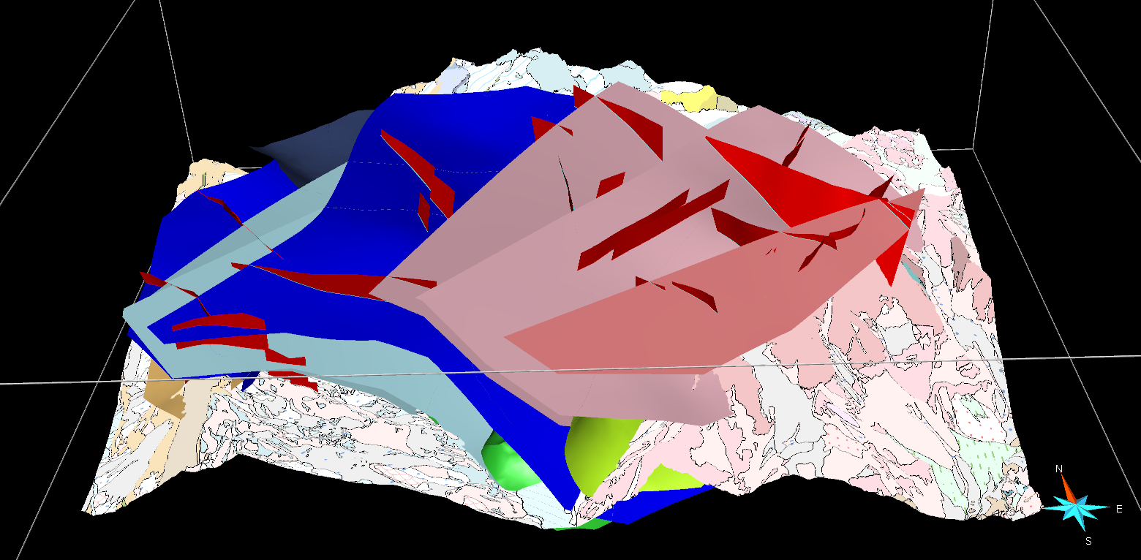









3D geomodelling in the complex metamorphic and poly-deformed units of the Italian Western Alps
(Conca di By, Aosta Valley, Italy)
NE
Mont Rion
SW
Mont Avril
Mont Gelé
Metagranitoids DB
Undifferentiated Granitoid Gneisses DB
Berio G.C. DB
Prasinites CO
DBBT
Calcschists s.l. CO
Lac Cormet
Gloria Arienti⁽¹⁾, Andrea Bistacchi⁽¹⁾, Bruno Monopoli⁽²⁾, Giorgio Vittorio Dal Piaz⁽³⁾, Giovanni Dal Piaz⁽²⁾, Davide Bertolo⁽⁴⁾
⁽¹⁾ Università degli Studi di Milano-Bicocca, Italy, ⁽²⁾ LTS-HT, Treviso, Italy, ⁽³⁾ Accademia delle Scienze di Torino, Italy, ⁽⁴⁾ Regione Autonoma Valle d’Aosta, Dipartimento Programmazione, Risorse Idriche e Territorio, Italy

Slide 2









Introduction
Collecting and analysing Data
3D geomodelling
Conclusions
Index
Introduction
Collecting and Analysing Data
Conclusions and References
- Fieldwork and Structural Data
- Fault Mapping
Panoramics and 3D model
3D Modelling
- Cross-sections interpretation
- Implicit modelling
Final 3D geological and structural Model

Slide 3

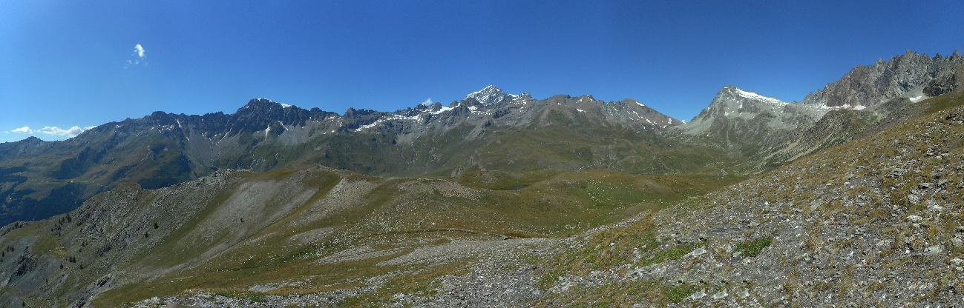


Introduction
Collecting and analysing Data
3D geomodelling
Conclusions
Modelling Workflow
Detailed (1:5.000 - 1:10.000) geological map
3D GEOLOGICAL AND STRUCTURAL MODEL BUILT WITH
THE IMPLICIT METHOD
Geological cross-sections
+
Structural field data
SW
NE
Gran Combin
Mont Gelé
Metagranitoids DB
Dents du Velan
Mont Avril
GSB
Pleureur Unit
Undifferentiated Granitoid Gneisses DB
CF
CF
DBBT
Calcschists s.l. CO
Col Cormet
1/3

Slide 4




Introduction
Collecting and analysing Data
3D geomodelling
Conclusions
Modelling Workflow
Detailed (1:5.000 - 1:10.000) geological map
Geomodelling problems
3D GEOLOGICAL AND STRUCTURAL MODEL BUILT WITH
THE IMPLICIT METHOD
Geological cross-sections
+
Structural field data
No out-of-the-box geomodelling in the present tectonic setting
Ductile structures developed under metamorphic conditions.
Isoclinal folds and large nappes bounded by
ductile shear zones.
Many normal faults has been mapped
Cheating on the geological meaning of the model entities to build a proper 3D model
Sparse input data
No subsurface data
High mountain environment in the Western Alps. Rugged topography for a better 3D visualisation. Panoramic photos and study
Very continuous outcrops
2/3

Slide 5
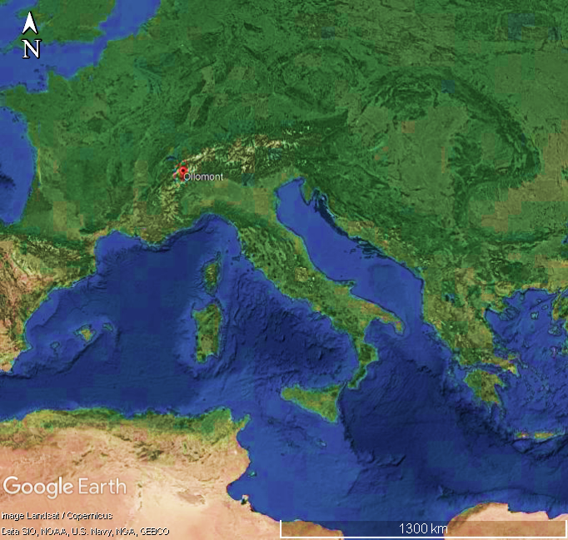

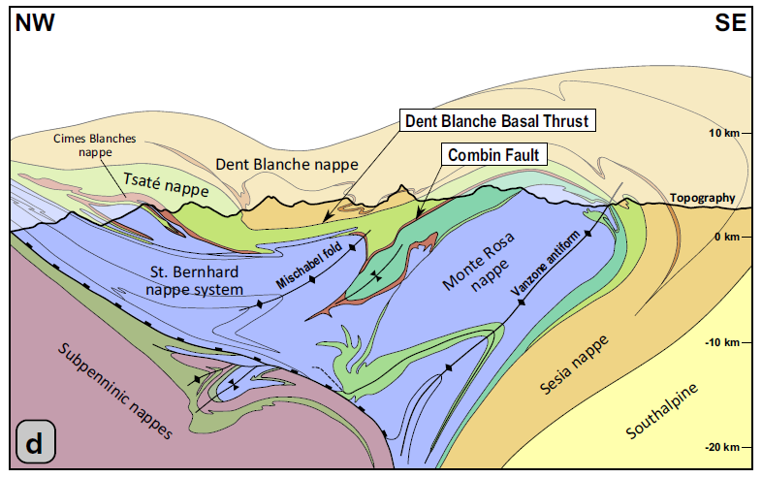
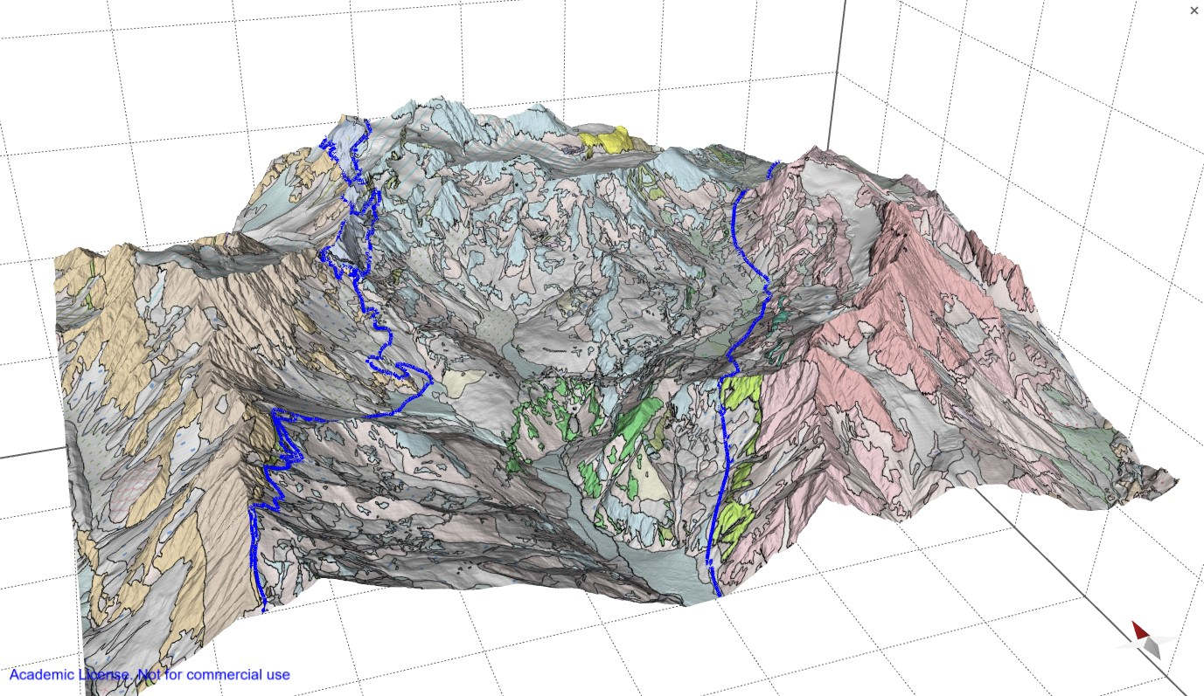

Introduction
Collecting and analysing Data
3D geomodelling
Conclusions
Geological Setting
Italy, Aosta Valley, By Valley.
Italian Western Alps, at the core of the Alpine arc.
High mountain environment, with elevations ranging from c. 1200 m to c. 3200 m a.s.l.
Combin Zone
Gran San Bernardo system
Dent Blanche nappe
Kirst & Leiss, 2017. Modified after Escher et al. (1993)
3/3

Slide 6
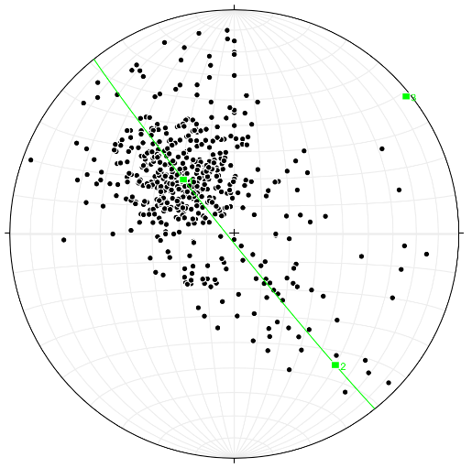
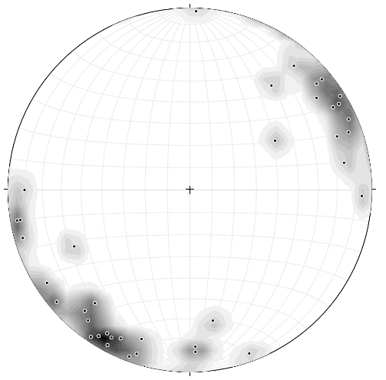

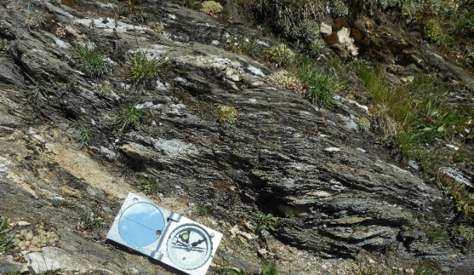
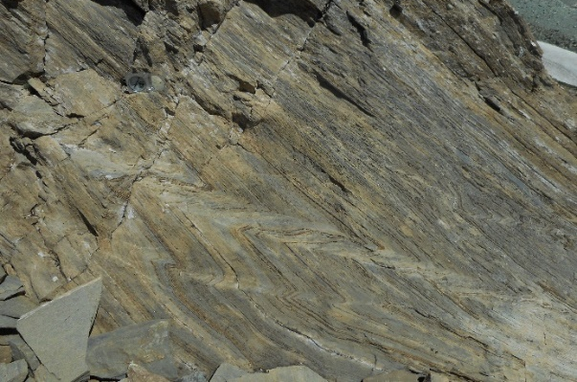

Introduction
Collecting and analysing Data
3D geomodelling
Conclusions
NW
SE
Gran San Bernardo
multi-nappe system
CF
DBBT
Dent Blanche nappe
Combin Zone
Dent Blanche Basal Thrust and Combin Fault, bounding major tectonic nappes, are reactivated as normal faults. Wust & Silverberg, 1989; Ballèvre, M., Merle, 1993.
Field structural data
S
137/25 k 9.3
A
More Structural Data
SCC’ structures
Simple shear asymmetric folding
NW
SE
NW
SE
NW
SE
NW
SE
C’
S
10cm
10cm
20cm
1/2

Slide 7
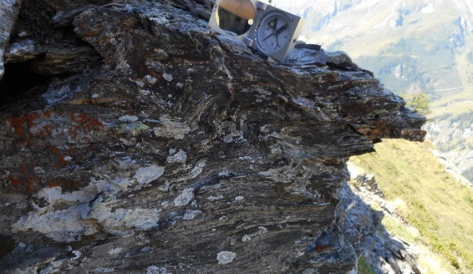
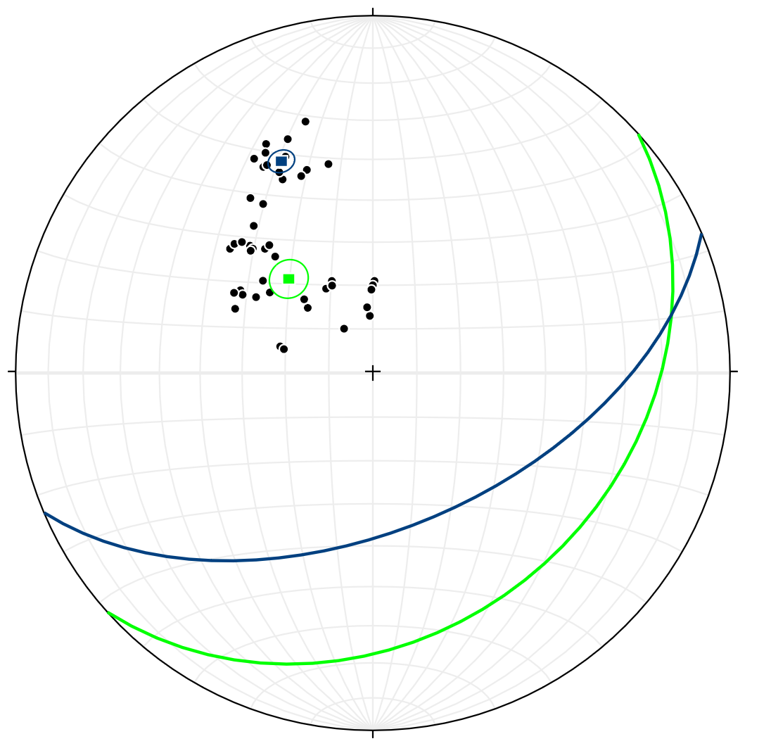


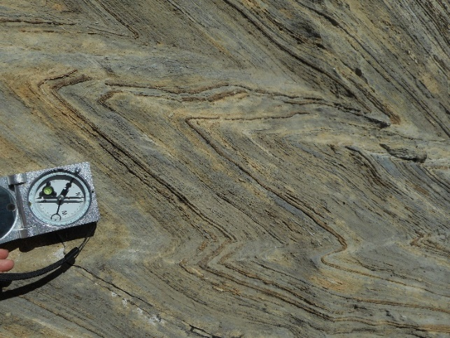
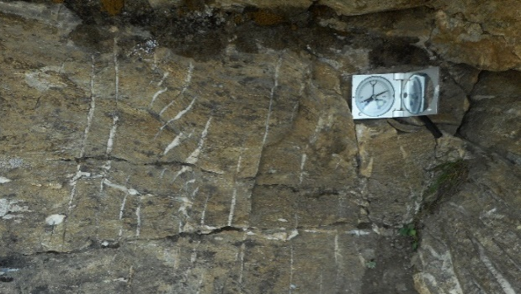
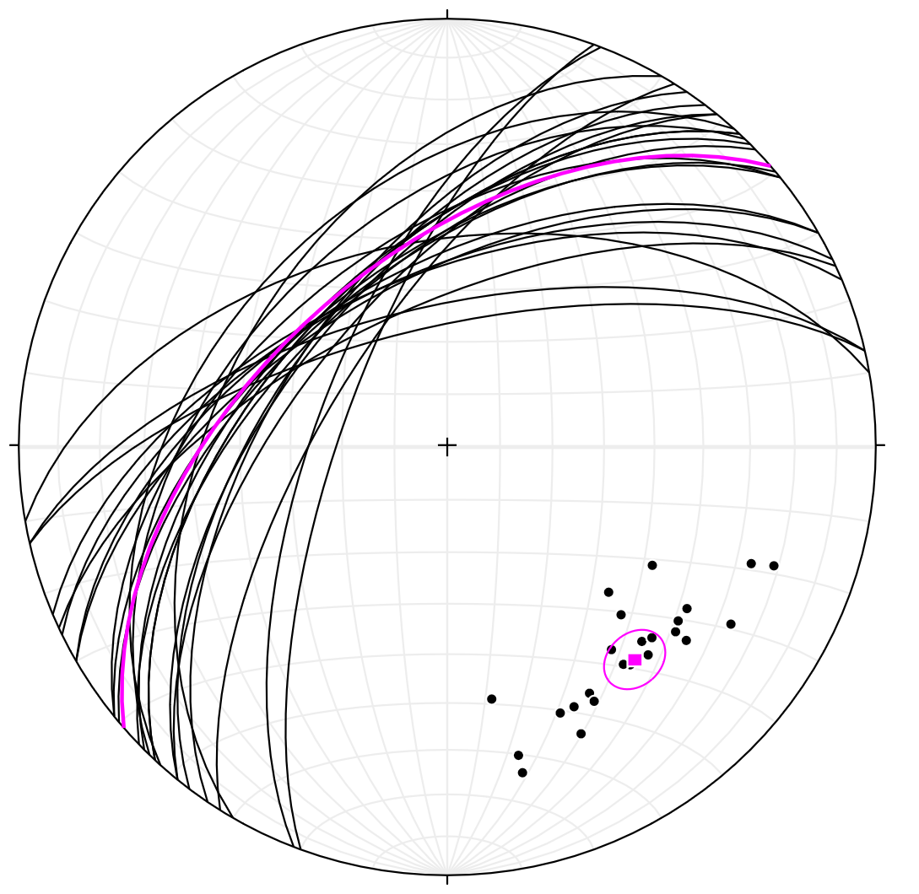
NW
SE
E
W
SCC’ Structures
Asymmetric Folds
A 200/11
10cm
10cm
NW
SE
NW
SE
A 060/15
C’
S
S 138/29 k 34.4
C’ 157/54 k 178.0
A
10cm
10cm
NW
SE
NW
SE
V 319/54 k 27.4
10cm
10cm
En-chelon Quartz Veins
1.1/2

Slide 8


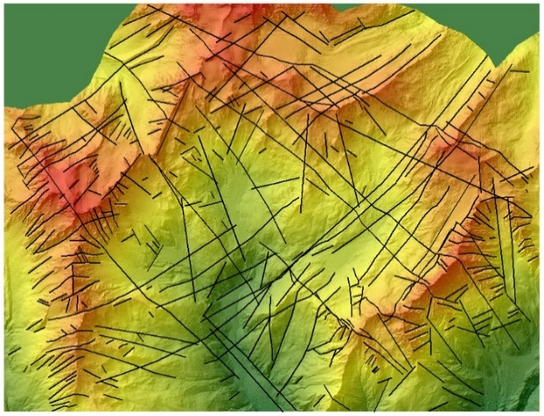

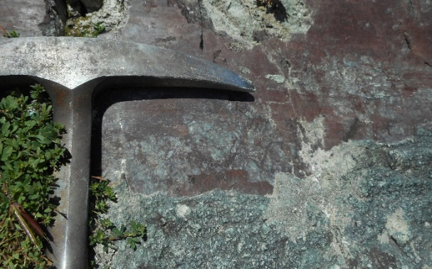
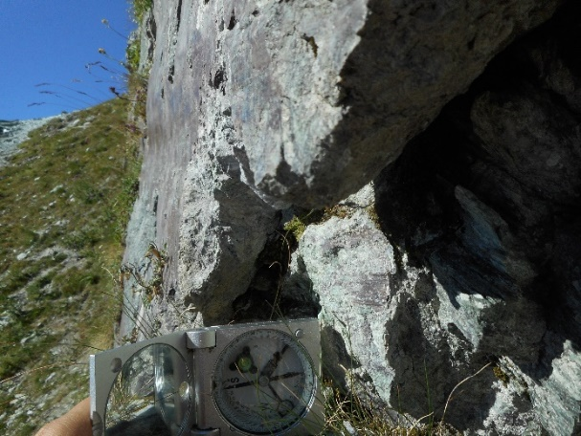
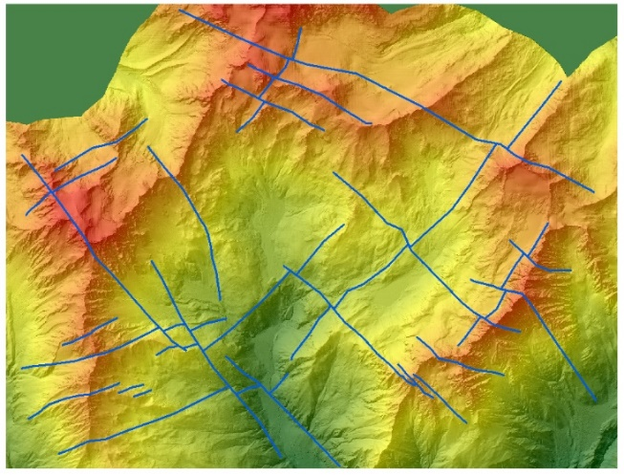
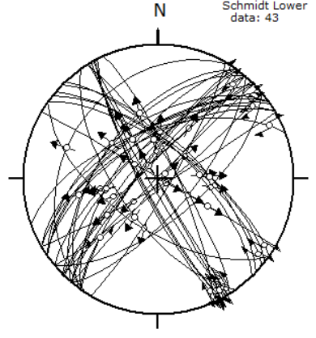
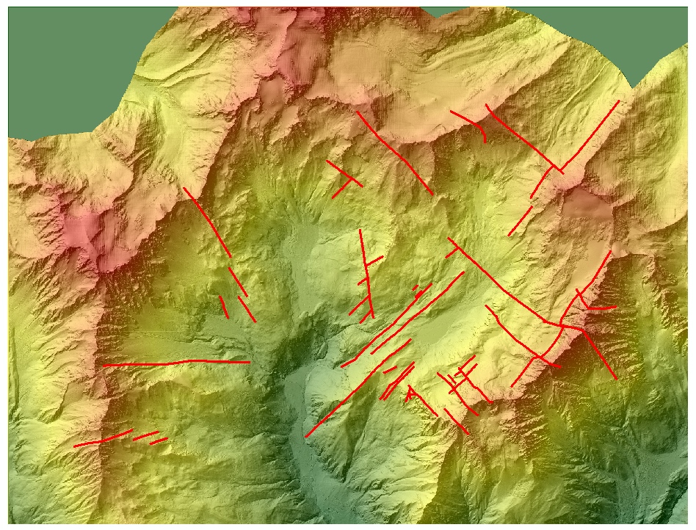
Introduction
Collecting and analysing Data
3D geomodelling
Conclusions
Remote Sensing Mapping
Ground truthing
More about Faults
NW
SE
SW
NE
10cm
10cm
Lineaments
Mapped Normal Faults
More about remote sensing
Hypothetic Faults
Drawn based on
morphological evidence
D1 (Oligocene) and D2 (Miocene) fault sets. Bistacchi & Massironi, 2000
2/2

Slide 9
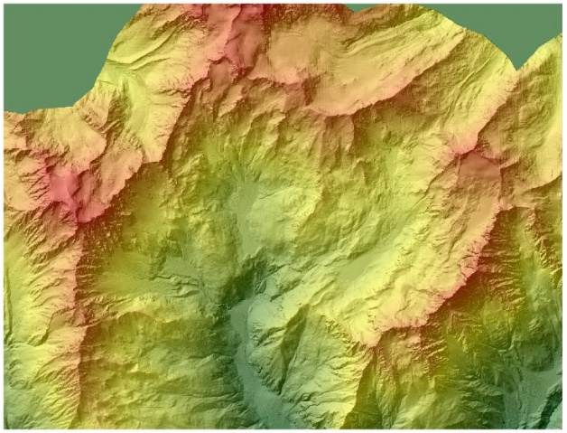
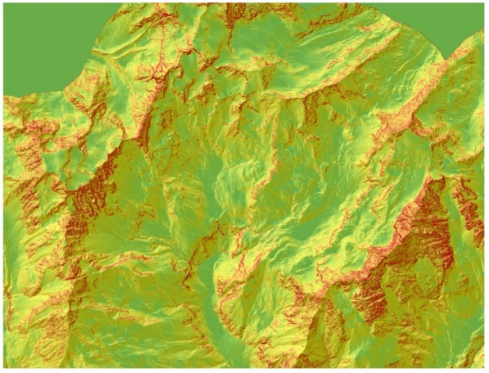
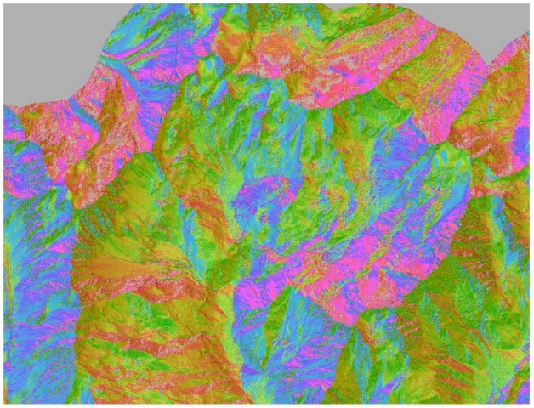


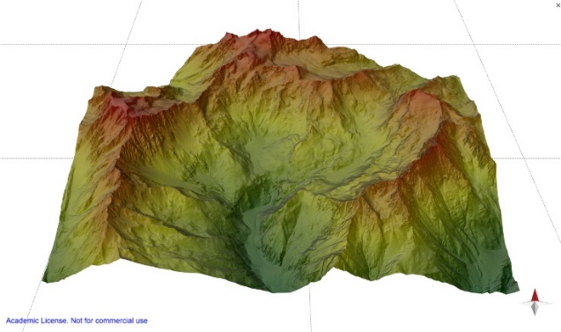
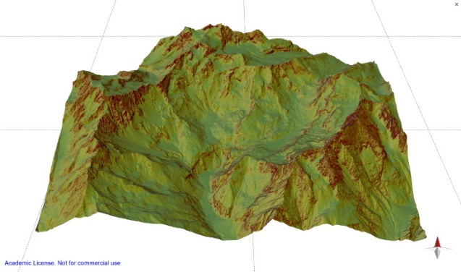
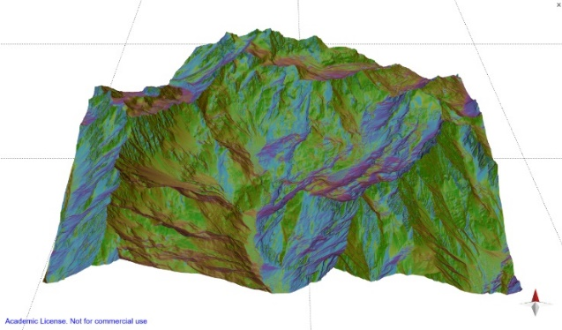
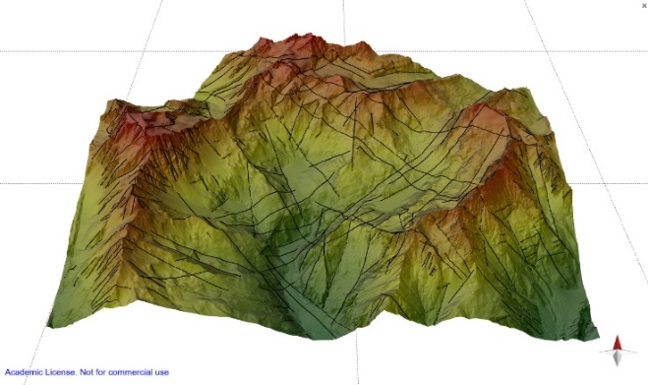
Introduction
Collecting and analysing Data
3D geomodelling
Conclusions
DEM
DEM + Slope
DEM + Hillshade
Lineaments
Remote sensing was carried on in 2D and 3D simultaneously with the goal of detecting persistent sets of brittle structures (= lineaments) at the macro scale. Lineaments have been ground-truthed in the field.
2.1/2

Slide 10
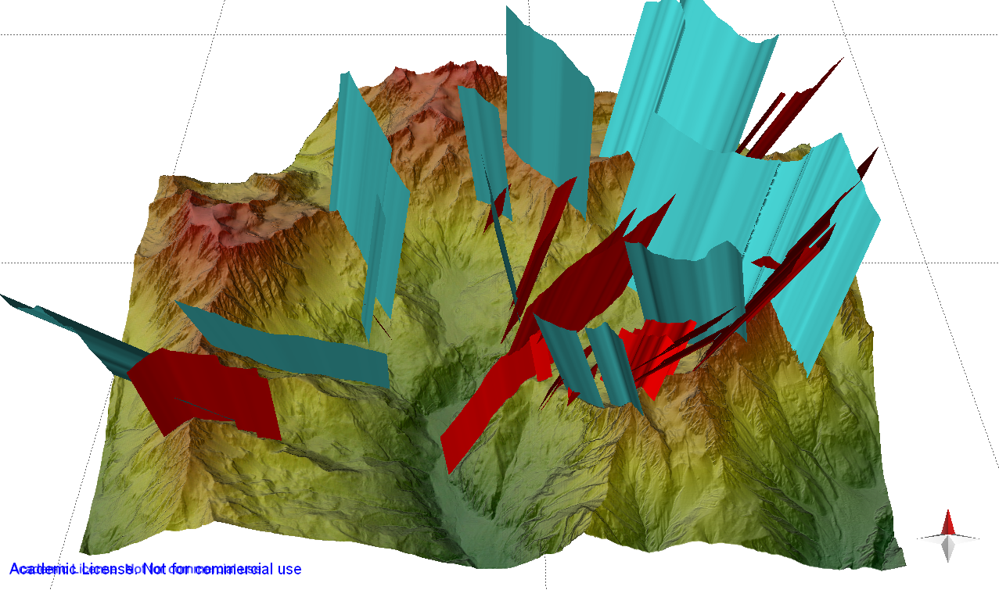
Introduction
Collecting and analysing Data
3D geomodelling
Conclusions
Normal Faults
Faults are first hypothesised with remote sensing, and later confirmed in the field.
Two phases of faulting are recognised, D1 and D2 according to literature (Bistacchi & Massironi, 2000), with a total of four conjugate fault sets.
MOVE
2.2/2

Slide 11
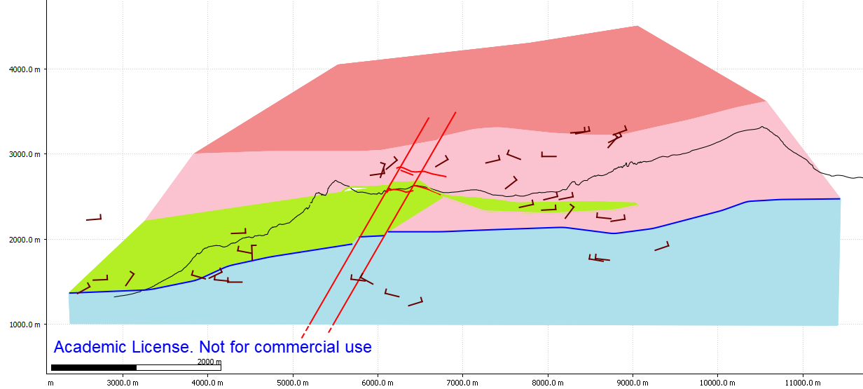
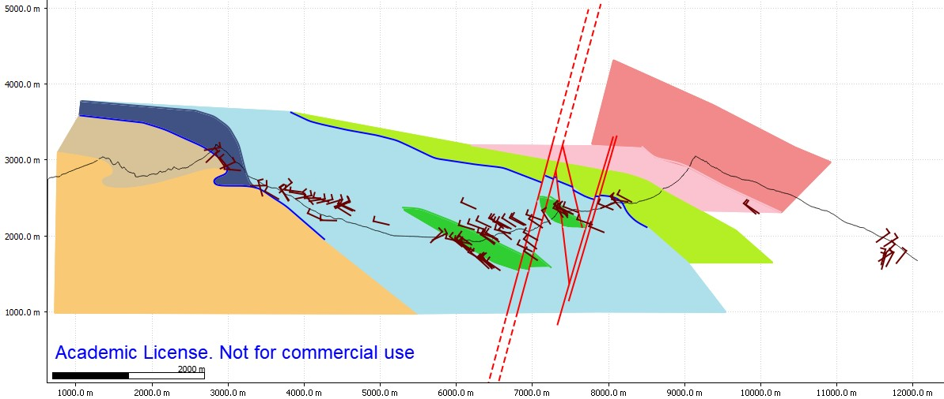
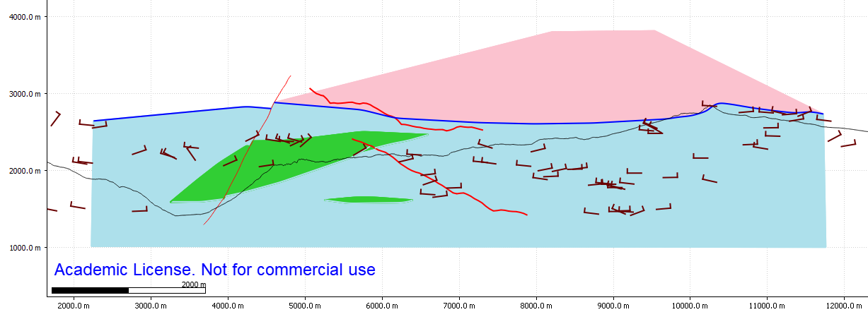

Introduction
Collecting and analysing Data
3D geomodelling
Conclusions
Structural interpretation in cross-sections – Move (https://www.petex.com/products/movesuite/)
Two sets of vertical cross-sections, chosen perpendicular to the main fault systems, to the fold axes and to the mean foliation.
More Cross-sections
NE – SW set
NE
SW
NW – SE set
Metagranitoids DB
NW
SE
Undifferentiated Granitoid Gneisses DB
Pleureur Unit
Metagranitoids DB
Berio G.C. DB
DBBT
Micaschists and Paragneisses GSB
DBBT
U.G. Gneisses DB
CF
Calcschists s.l. CO
Calcschists s.l. CO
Gneisses GSB
Berio G.C. DB
NE
SW
Undifferentiated Granitoid Gneisses DB
DBBT
Prasinites CO
BoundaryREPresentation method
Calcschists s.l. CO
1/5

Slide 12
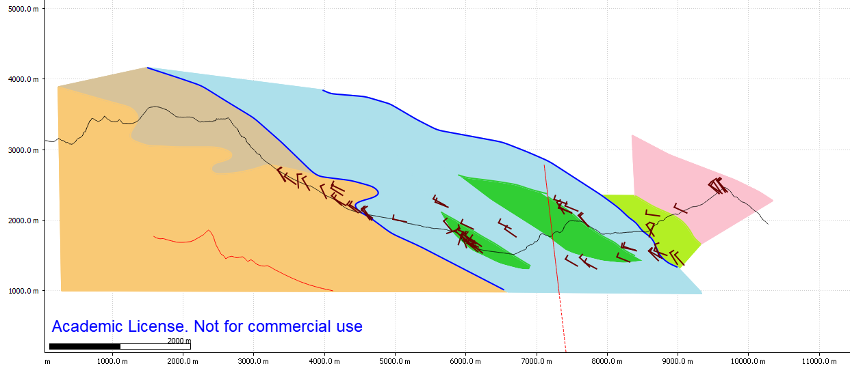
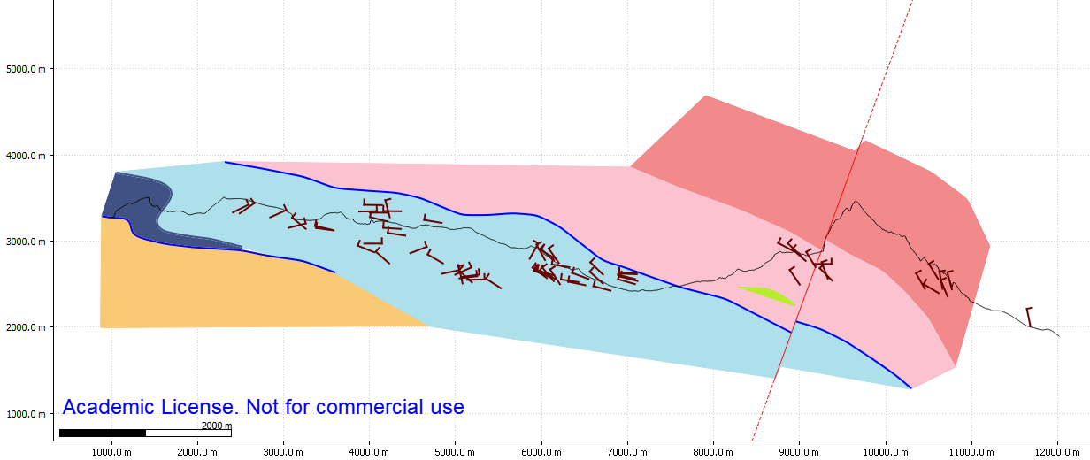
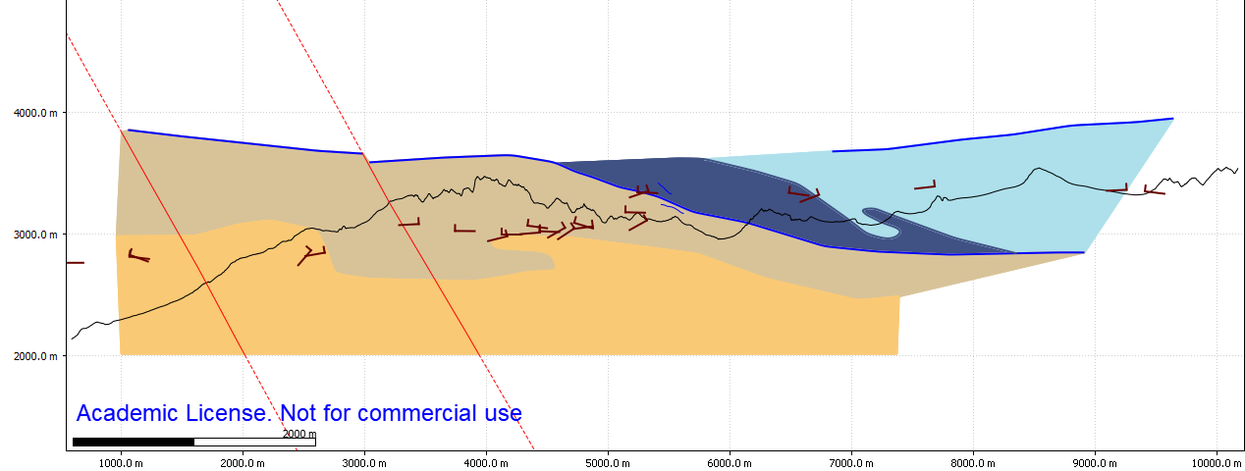
Introduction
Collecting and analysing Data
3D geomodelling
Conclusions
NW
SE
NE
SW
Metagranitoids DB
Pleureur Unit
Metagranitoids DB
Micaschists and Paragneisses GSB
DBBT
U.G. Gneisses DB
CF
Calcschists s.l. CO
Undifferentiated Granitoid Gneisses DB
Gneisses GSB
Berio G.C. DB
Berio G.C. DB
DBBT
Calcschists s.l. CO
Micaschists and Paragneisses GSB
CF
NE – SW vertical sections
NW – SE vertical sections
Calcschists s.l. CO
DBBT
Undifferentiated Granitoid Gneisses DB
U.G. Gneisses DB
DBBT
Gneisses GSB
Prasinites CO
Prasinites CO
Berio G.C. DB
Calcschists s.l. CO
Metagranitoids DB
CF
DBBT
Pleureur Unit
DBBT
Micaschists and Paragneisses GSB
Pleureur Unit
Calcschists s.l. CO
CF
U.G. Gneisses DB
Gneisses GSB
Calcschists s.l. CO
Gneisses GSB
1.1/5

Slide 13

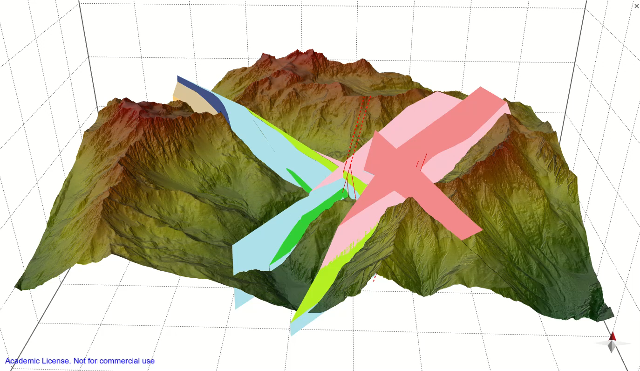
Introduction
Collecting and analysing Data
3D geomodelling
Conclusions
Structural interpretation in cross-sections - Move
VIDEO
2/5

Slide 14
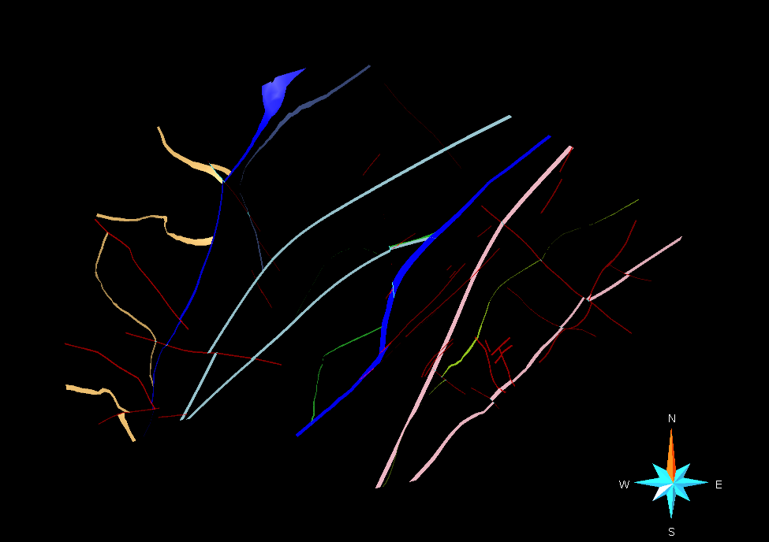

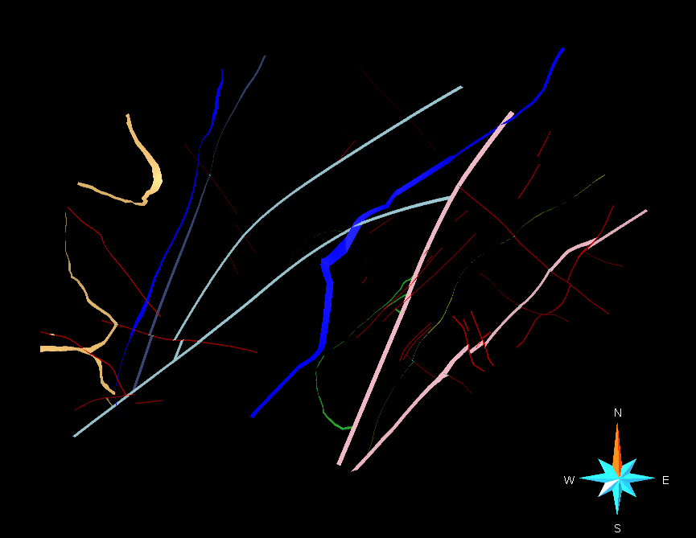

Introduction
Collecting and analysing Data
3D geomodelling
Conclusions
Implicit Modelling
SKUA/GOCAD (https://www.pdgm.com/products/skua-gocad/)
Originally implemented to represent gently deformed sedimentary sequences.
No out-of-the-box modelling. We chose to «cheat» on the geological meaning of some entities for a more realistic final model.
1) TECTONIC CONTACTS AS UNCONFORMITIES: Lithological Boundaries (different colors surfaces) stop at the intersection with the major Tectonic Contacts (blue surfaces). When TC were treated as fault surfaces, they did not act as boundaries for lithological units.
Tectonic Contacts as unconformities
Tectonic Contacts as faults surfaces
Horizontal section view
Horizontal section view
3/5

Slide 15
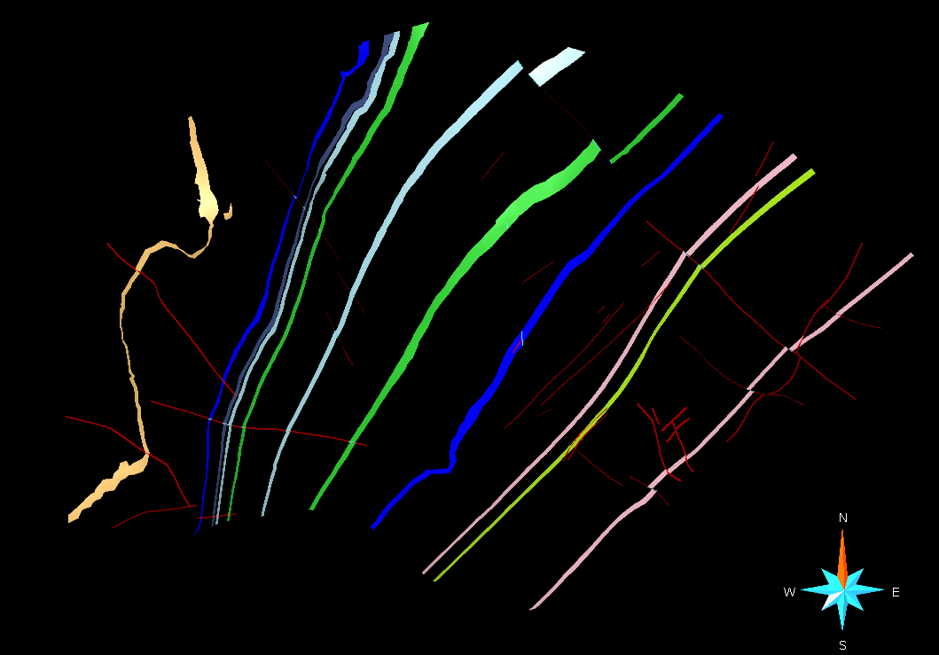
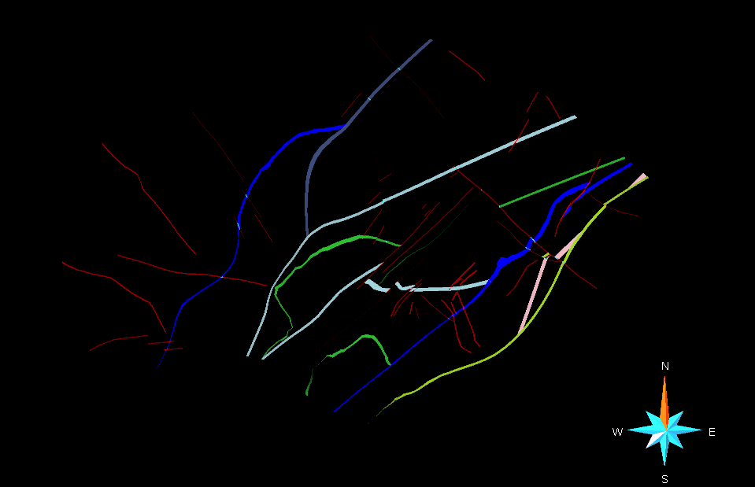
Introduction
Collecting and analysing Data
3D geomodelling
Conclusions
Implicit Modelling
2) LITHOLOGICAL BOUNDARIES AS UNCONFORMITIES: to model large thickness variations and lenticular bodies, also Lithological Boundaries need to be treated as unconformities.
Use of the Erosion Outline tool to impose the termination of one lithology.
Lithological Boudaries as Conformable surfaces
Lithological Boundaries as unconformities
Horizontal section view
Horizontal section view
4/5

Slide 16
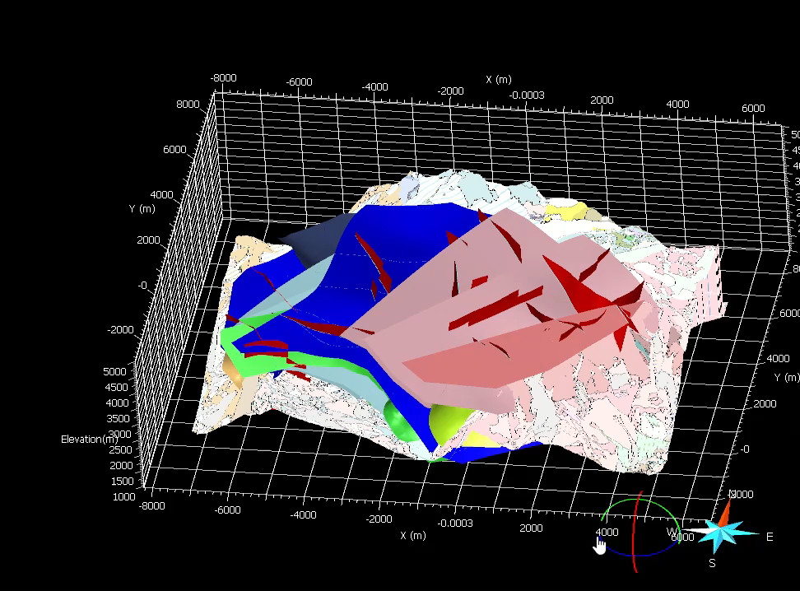
Introduction
Collecting and analysing Data
3D geomodelling
Conclusions
Final 3D geological and structural Model – SKUA/GOCAD
VIDEO
Panoramic and
3D model
5/5

Slide 17
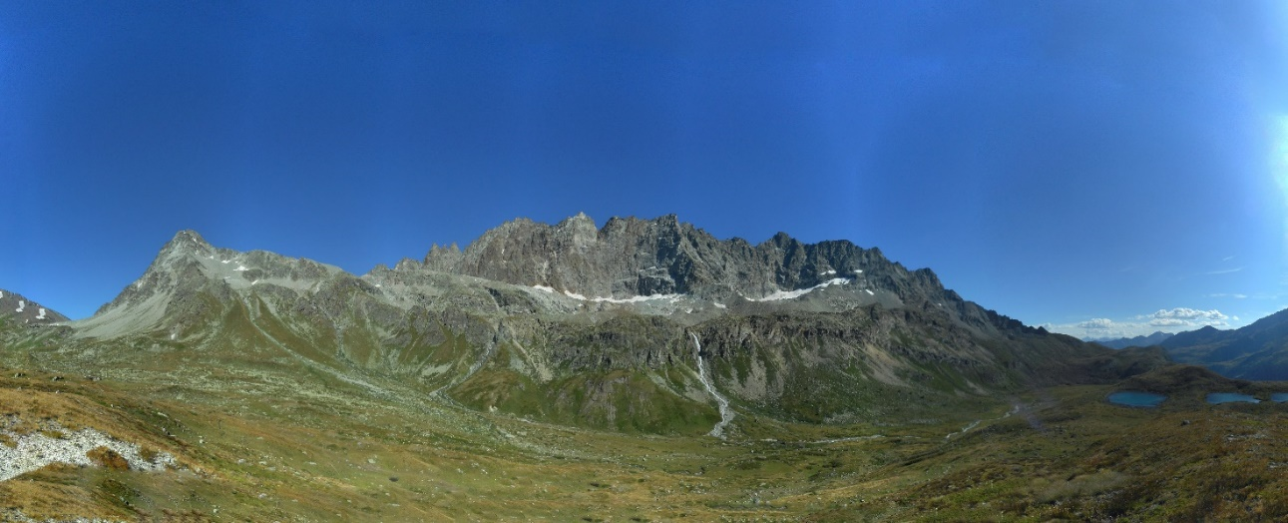
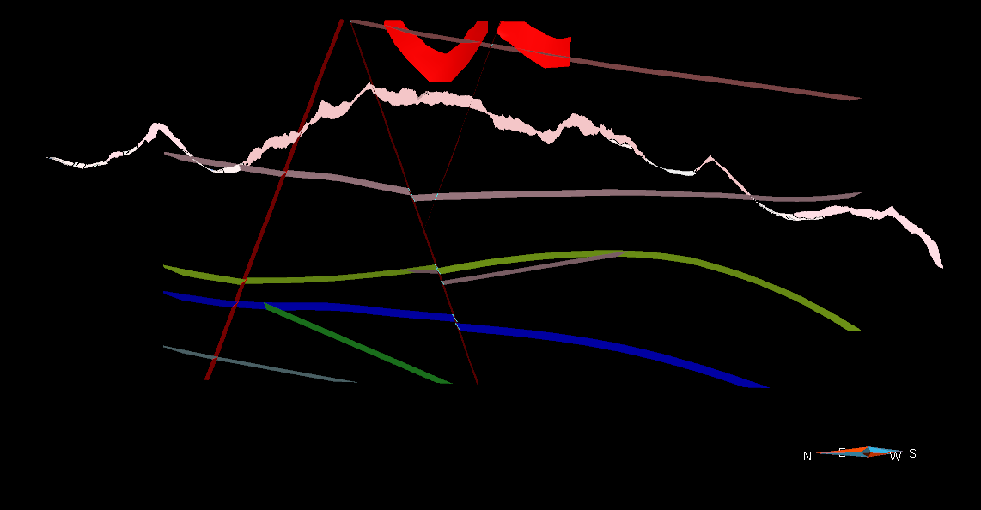
Introduction
Collecting and analysing Data
3D geomodelling
Conclusions
NE
SW
NE
SW
Mont Gelé
Mont Rion
Mont de Berrio
Metagranitoids DB
Fenêtre Durand
Undifferentiated Granitoid Gneisses DB
Col Cormet
CO
DBBT
Berio G.C. DB
CO
CO
Mont Gelè – Mont de Berrio ridge
Metagranitoids DB
Undifferentiated Granitoid Gneisses DB
DBBT
Berio G.C. DB
Prasinites CO
Calcschists s.l. CO
1/3

Slide 18
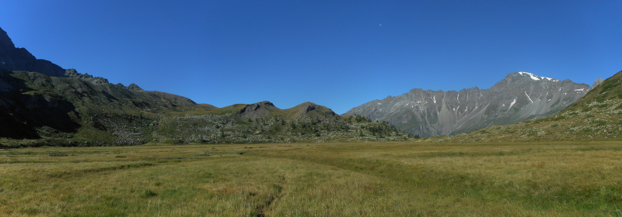
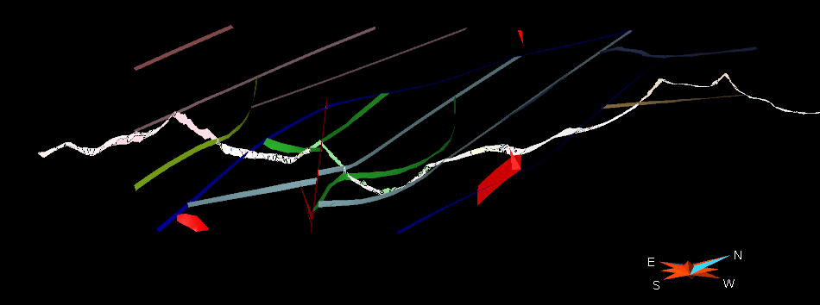
Introduction
Collecting and analysing Data
3D geomodelling
Conclusions
SE
NW
SE
NW
Dents du Velan
DB
Berio G.C. DB
Pleureur U.
Col Cormet
U.G. Gneisses DB
DBBT
CF
Micaschists and Paragneisses GSB
Calcschists s.l. CO
Prasinites CO
CF
GSB
Acque Bianche Valley
Acque Bianche Valley – By Valley
Pleureur Unit
Metagranitoids DB
Undifferentiated Granitoid Gneisses DB
DBBT
Calcschists s.l. CO
Micaschists and Paragneisses GSB
CF
Gneisses GSB
Prasinites CO
Berio G.C. DB
Prasinites CO
2/3

Slide 19
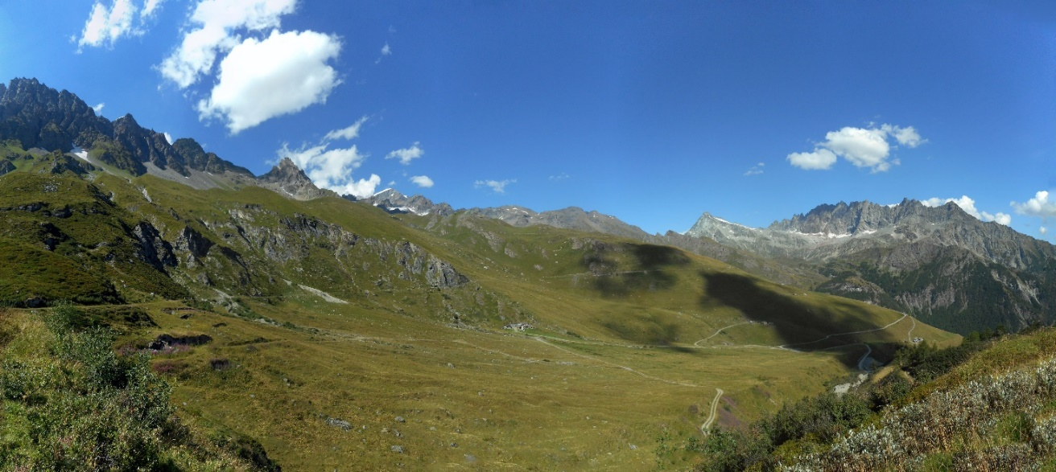
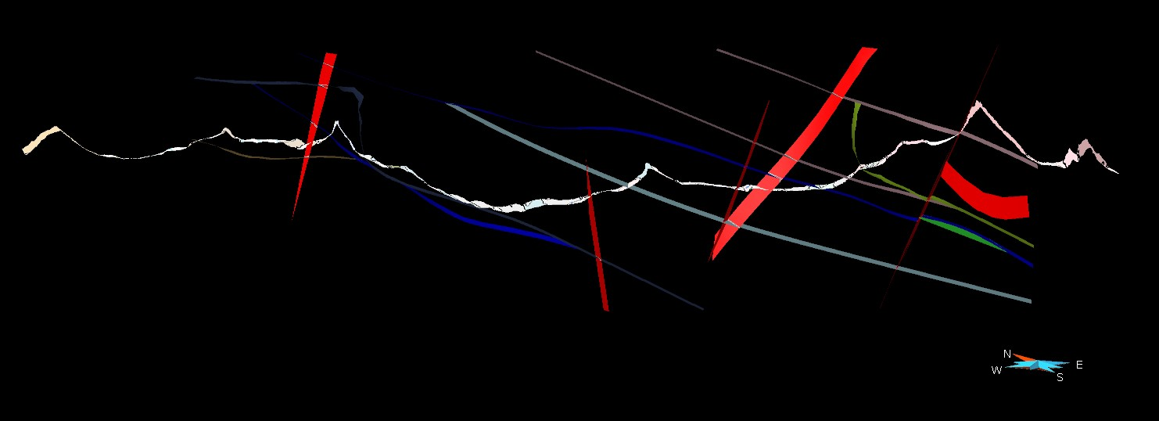
Introduction
Collecting and analysing Data
3D geomodelling
Conclusions
WNW
ESE
WNW
ESE
Les Molaires du Valsorey
Micaschists and Paragneisses GSB
Gran Combin
Mont Rion
Pleureur Unit
Mont Gelé
Metagranitoids DB
Gneisses GSB
Calcschists s.l. CO
U.G. Gneisses DB
Berio G.C. DB
CF
DBBT
CO
By Valley panorama
Metagranitoids DB
Micaschists and Paragneisses GSB
Pleureur Unit
DBBT
Undifferentiated Granitoid Gneisses DB
Gneisses GSB
CF
Berio G.C. DB
Prasinites CO
Calcschists s.l. CO
3/3

Slide 20
Introduction
Collecting and analysing Data
3D geomodelling
Conclusions
Conclusions
References
Ballèvre, M., Merle, O., 1993. The Combin Fault: compressional reactivation of a Late Cretaceous-Early Tertiary detachment fault in the Western Alps. Schweizerische Mineralogische und Petrographische Mitteilungen 73, 205-227. http://doi.org/10.5169/seals-55570
Bistacchi, A., Massironi, M., 2000. Post-nappe brittle tectonics and kinematic evolution of the north-western Alps: an integrated approach. Tectonophysics 327, 267-292. https://doi.org/10.1016/S0040-1951(00)00206-7
Escher, A., Masson, H., Steck, A., 1993. Nappe geometry in the Western Swiss Alps. Journal of Structural Geology 15, 501-509. https://doi.org/10.1016/0191-8141(93)90144-Y
Kirst, F., Leiss, B., 2017. Kinematics of syn- and post-exhumational shear zones at Lago di Cignana (Western Alps, Italy): constraints on the exhumation of Zermatt-Saas (ultra)high-pressure rocks and deformation along the Combin Fault and Dent Blanche Basal Thrust. International Journal of Earth Sciences 106, 215-236. DOI 10.1007/s00531-016-1316-1
Wust, G.H., Silverberg, D.,S., 1989. Northern Combin zone complex-Dent Blanche nappe contact: extension within the convergent Alpine belt. Schweizerische Mineralogische und Petrographische Mitteilungen 69, 251-259.
Remote sensing and validation through field work. Structural study.
3D Geomodelling:
High mountain environment with very continuous outcrops but sparse input data. No subsurface data.
Move. Great for modelling vertical cross-sections.
BREP method is not suitable for the complexity of the studied geological setting.
SKUA/GOCAD. Implements the implicit method.
As the algorithms were created to model gently deformed sedimentary sequences, SKUA must be «fooled» by changing the geological meaning of the modelled entities.
Tectonic contacts as unconformities.
Lithological boundaries as unconformities.
1/2

Slide 21

Introduction
Collecting and analysing Data
3D geomodelling
Conclusions
We will be happy to answer any question!
Gloria Arienti g.arienti5@campus.unimib.it
Acknowledgements
We warmly thank the RESERVAQUA project for the opportunity to work on the geomodelling of the Western Alps as part of a bigger Italian-Swiss project (https://interreg-italiasvizzera.eu/progetti/reservaqua/).
2/2

