Slide 1
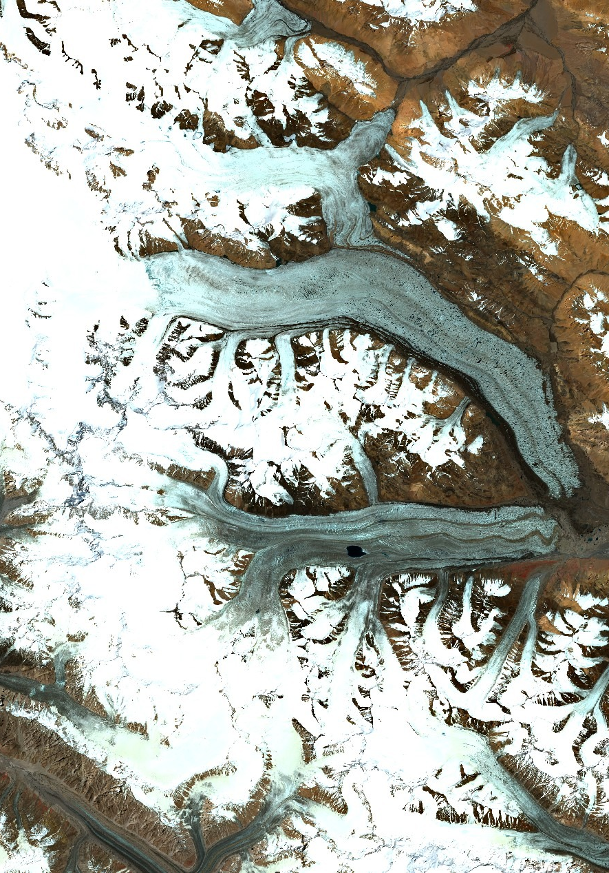




Recent Surge of the South Rimo Glacier, Karakoram:
Dynamics Characterization using SAR data
Shiyi Li¹, Philipp Bernhard¹, Irena Hajnsek^{1,2}, and Silvan Leinss¹
Earth Observation and Remote Sensing, Institute of Environmental Engineering, ETH Zurich
German Aerospace Center (DLR) E.V. Microwaves and Radar Institute, Wessling, Germany
Contact: shiyi.li@ifu.baug.ethz.ch
©Sentinelhub

Slide 2
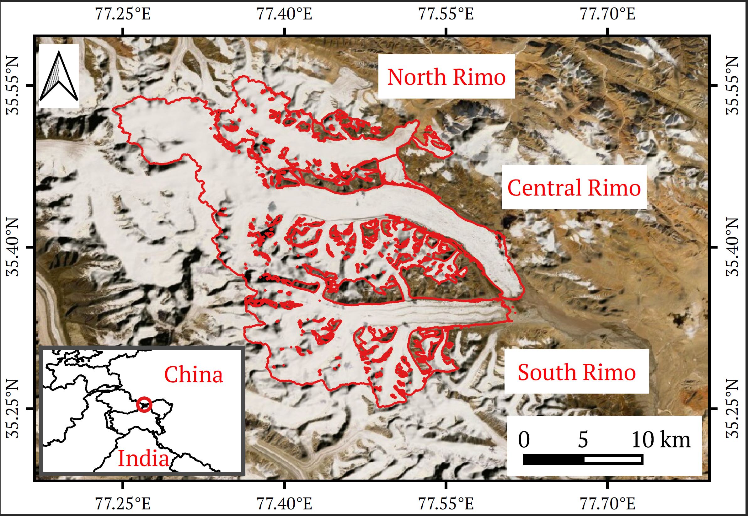
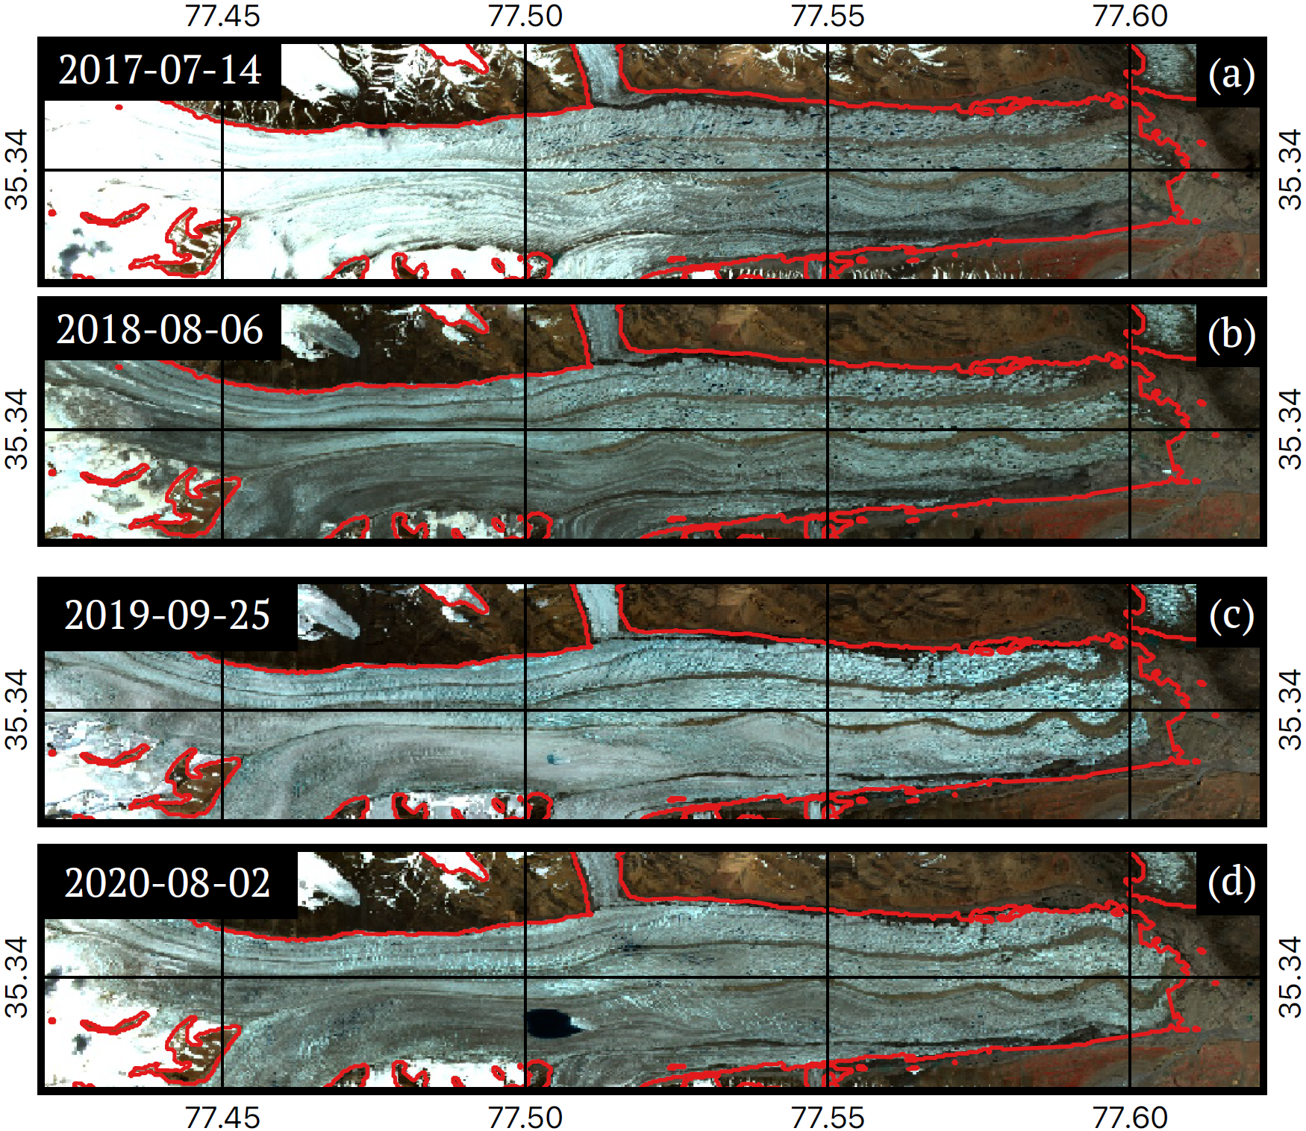
Introduction
Data & Methods
Results & Discussion
Conclusion
Objectives：
To characterize the surge dynamics of the South Rimo Glacier in the Karakoram range, including the topographic change and the velocity evolution of the glacier, using the Synthetic Aperture Radar data.
Glacier Surge: Abnormal glacier movements triggered by flow instabilities. Glacier flow oscillates quasi-periodically between long quiescent phases and abrupt active surge phases.
The surge of South Rimo started in mid 2018 and ended in early 2020. Typical morphological features of surging, such as looped moraines and terminus advancement, can be identified from the Sentinel-2 images. A glacier lake was formed before the surge termination and disappeared when the surge was stopped.
The Rimo Glacier Group is a large glacier system in the Karakoram, and is composed of three limbs. Recently, a surge event is observed for the South Rimo.

Slide 3
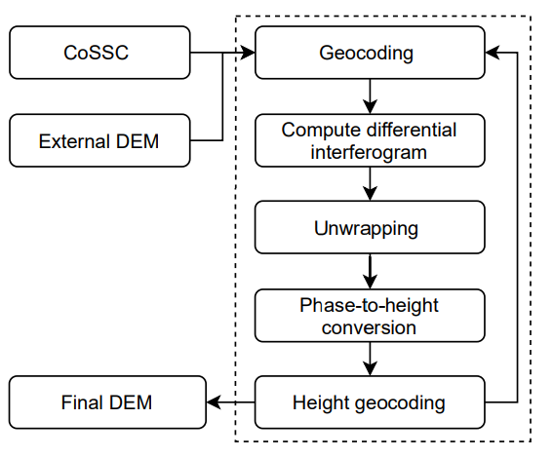
Introduction
Data & Methods
Results & Discussion
Conclusion
1. DEM generation and topographic change
We examined the topographic change of the South Rimo with digital elevation models (DEMs) generated from TanDEM-X CoSSC data acquired between 2011-07-15 and 2017-02-07. Acquisition parameters of the TanDEM-X data can be found in the appendix. The processing chain for the DEM generation is shown in the right. We used the GAMMA software in the data processing, and the ALOS 30m DEM as an external DEM.
2. Surface velocity evolution
To determine the surface velocity evolution of the South Rimo, we downloaded a time-series of 162 Sentinel-1 Interferometric Width Swath images (orbit 129, asc, VV, 10m resolution) using the Google Earth Engine and applied incoherent intensity offset tracking^{[1]} with a patch size of 128×128 pixels, a patch spacing of 32 × 32 pixels, and temporal intervals between 12 and 48 days. Offset tracking was applied on the backscatter intensity in dB with a high-pass filter of 96 × 96 pixels to avoid locking to topographic features.
[1] T. Strozzi, A. Luckman, T. Murray, U. Wegmuller, and C. L. ¨ Werner, “Glacier motion estimation using SAR offset-tracking procedures,” IEEE Trans. Geosci. Remote Sens., vol. 40, no. 11, pp. 2384–2391, 11 2002

Slide 4
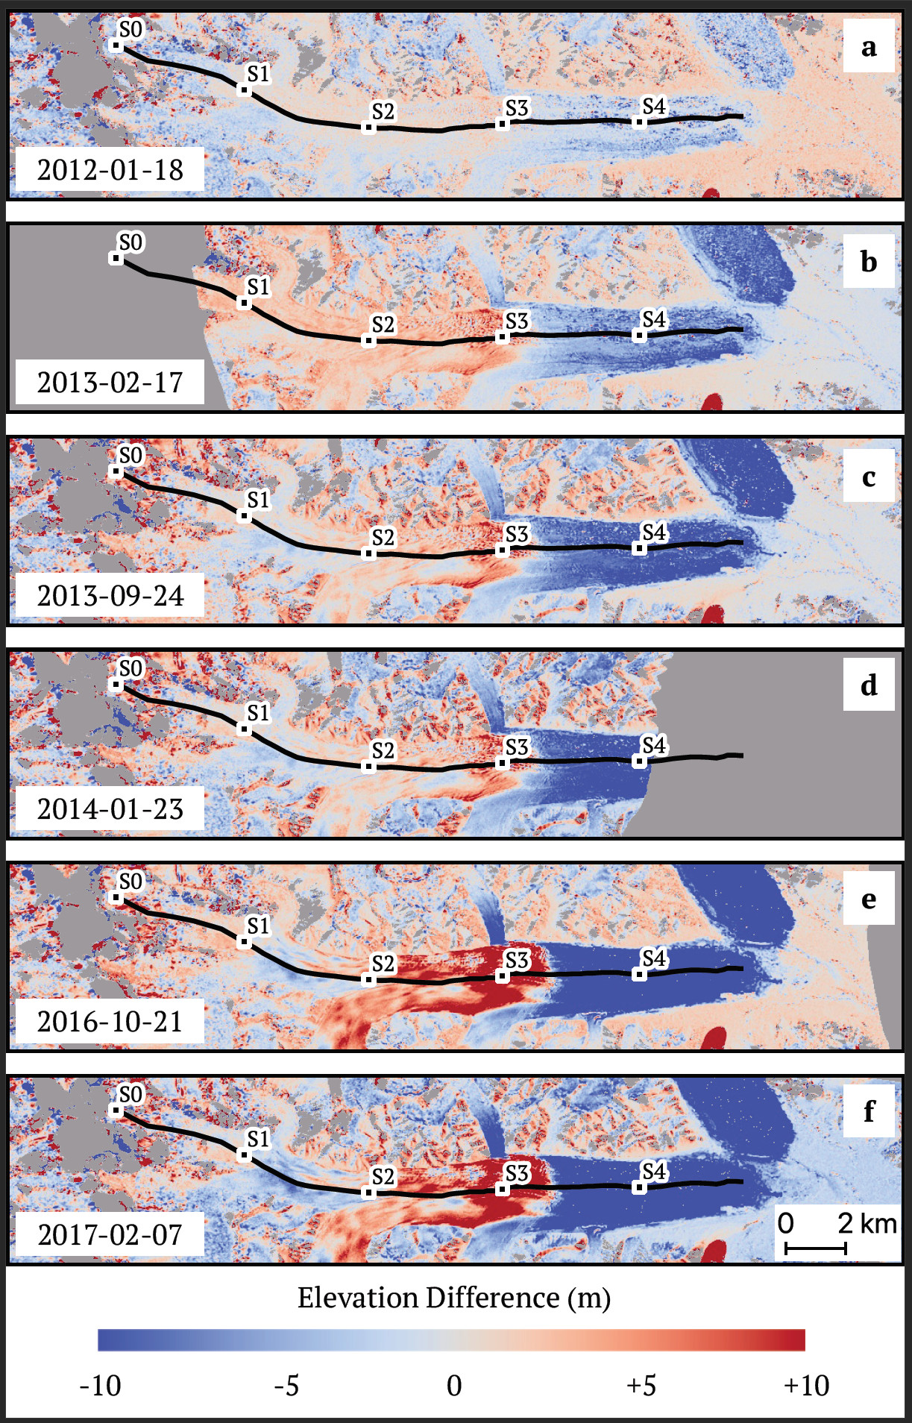
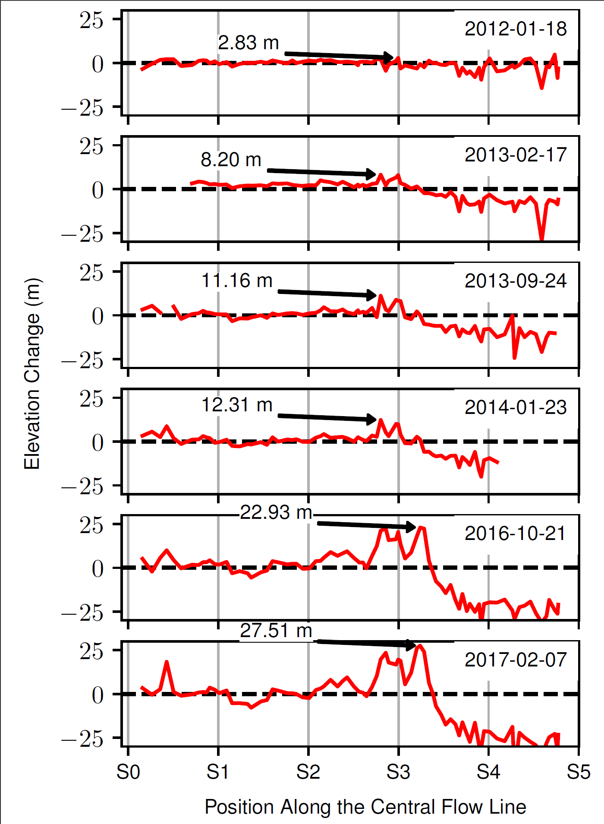
Introduction
Data & Methods
Results & Discussion
Conclusion
Topographic change
Using the DEM of 2011-07-15 as a reference, we obtained six elevation difference maps shown in the left. Transects of elevation change along the central flowline are shown in the right. Six reference points S0–S5 roughly divides the central flow line into five parts of equal length.
July 2011 - January 2012: the middle stream of the glacier (around S1 to S3) shows only limited elevation increase.
Since 2013, a bulge started to build aroundS3 and gained about 8.20 m in height. Elevation loss around S4 indicates a negative mass balance possibly due to insufficient ice supply from the upstream bulge. In 2013, the elevation decreased around S1 but the bulge (S3) grew about 3 meter higher.
In the winter of 2013 - 2014: the height of the bulge, and the drop height between the middle stream (S1 to S3) and downstream (around S4) was stable.
In the winter 2016/2017,the bulge developed a height of almost 30 meters relative to 2011, and spanned to a wider range along the flow line.
During 2013–2017, the average rate of elevation gain at the bulge peak is approximately 4.8 m/yr.
In general, the DEM differences clearly showed the thickening in a reservoir area and the thinning in a receiving area during the quiescent phase, which is a classical pattern for surge-type glaciers.

Slide 5
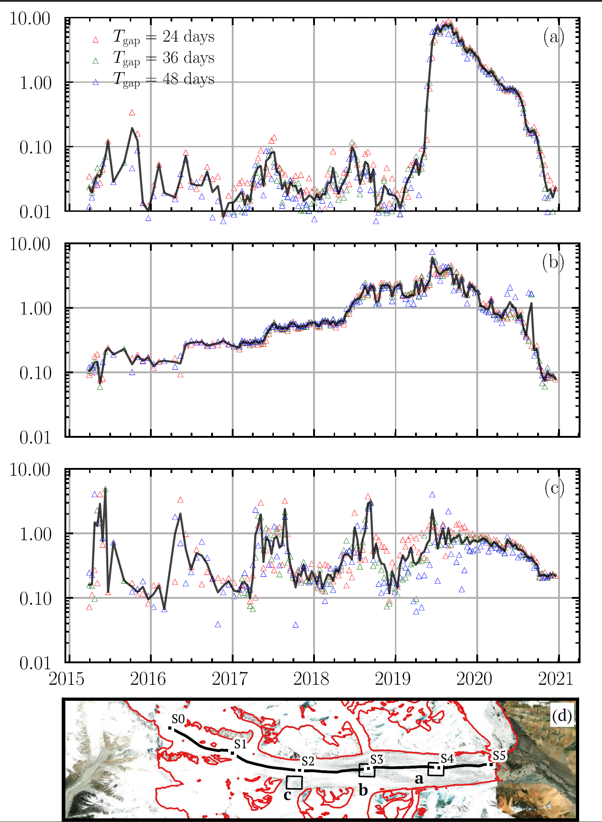
Introduction
Data & Methods
Results & Discussion
Conclusion
Surface velocity evolution
The evolution of surface velocities at three representative areas are shown in the right figure. The three areas are chosen to illustrate the velocity change close to the glacier tongue (a), at the bulge (b) and on the upstream tributary (c).
Glacier tongue: the surface velocity remained low during the quiescent phase until early 2019 when the surge was initiated and transported downstream. A peak velocity of about 10 m/day was reached in the mid of 2019 at the glacier tongue, which is three magnitudes higher than the velocity in quiescent phase.
At the bulge: the velocity profile behaved as a step function with three dramatic jumps in summer 2016, 2017, and 2018. After 2018, the velocity kept increasing and finally triggered the dynamic instability and the surge.
On the upstream tributary southwards to S2: the velocity was maintained in a range between 0.1 m/day and 1 m/day, and the fluctuations show obvious seasonal fluctuations. Sentinel-1 and -2 images showed formation of a super-glacial lake in late July 2019 and 2020 and its size extended to the maximum around August 2020. Lake formation was in parallel to maximum velocity in 2019, and to a little bump in the velocity profile in 2020. In September 2020, the lake quickly drained and velocities dropped to the pre-surge level, suggesting that the surge has stopped.

Slide 6
Introduction
Data & Methods
Results & Discussion
Conclusion
Trigger mechanism of the surge
Thermal Switch Theory
The change of basal thermal temperature drives the in-stability of the glacier, and the surge can initiate and terminate at varying times of the year
Hydrological Switch Theory
The flow instability is controlled by the basal drainage system and the pore water pressure. The surge usually initiates during winter and terminates in summer.
OR
Surge of South Rimo
The velocity time-series show clear seasonal trends, and the drop of surface velocity after the surge is coincident with the drainage of the super-glacial lake. Both suggest that the surge is hydrologically regulated rather than thermally regulated.

Slide 7
Introduction
Data & Methods
Results & Discussion
Conclusion
We characterized the dynamics of the recent surge of South Rimo in 2018–2020.
The glacier began accumulating height since 2013, which is 5 years before the surge.
The bulge that built up in the reservoir region grew with an approximate average rate of 4.8 m/yr. The increasing height of the bulge finally triggered dynamic instabilities and initiated the surge.
During the surge, the maximum velocity of the surge front is about 10 m/day. Velocity time-series show clear seasonal patterns with summer speed-up, and the terminate of the surge is coincident with the drainage of the super-glacial lake.
Our findings indicates that the surge is most likely triggered by the change of hydrological conditions.

Slide 8
Thank you!

Slide 9
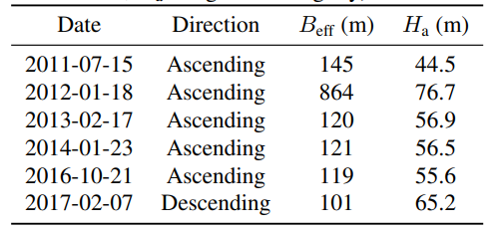
Appendix
Introduction
Data & Methods
Results & Discussion
Conclusion
Acquisition parameters of the TanDEM-X data is shown in the upper right ($B_{eff}$: effective baseline, $H_{a}$: height of ambiguity).

